Slide 1

Innovation in an infinite loop

Slide 2
DevOps Industry Stats (2025)
• 83% of IT decision-makers report faster software delivery with DevOps.
• High-performing DevOps teams deploy 208x more frequently.
• DevOps teams recover 24x faster from incidents.
• Organizations using DevOps have 3x fewer change failure rates.
• 74% of companies say DevOps has improved customer experience.
• 80% of enterprises have adopted DevOps in some form.
• DevOps increases developer productivity by up to 60%.

Slide 3
DevOps: Key Takeaways
• DevOps isn’t just a toolset—it’s a mindset focused on collaboration.
• It enhances speed, stability, and scalability.
• Success stories like Netflix show its massive real-world impact.
• The DevOps lifecycle is continuous—plan, develop, build, test, release, deploy, operate.
• Adoption continues to grow across industries.
• The future of innovation lies in loops, not lines.

Slide 4
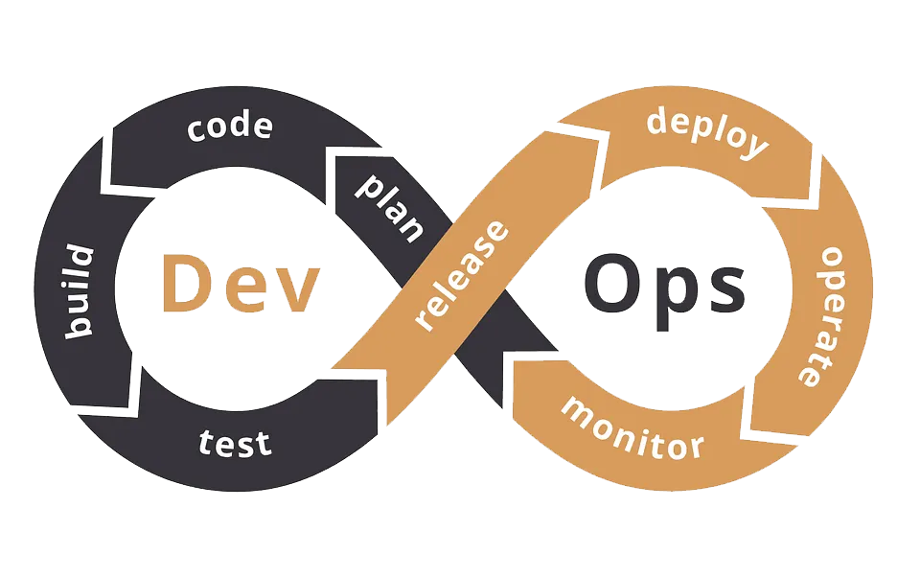
What is DevOps?
Infinite collaboration of Development and Operations.
Think of it as developers and operators sitting at the same table.

Slide 5



Why DevOps?
Faster
Delivery
Team release features quicker and more often
Better Collaboration
No more ‘us vs them’
Between Devs and Ops
Continuous
Improvement
The loop means we’re always optimizing, always learning

Slide 6
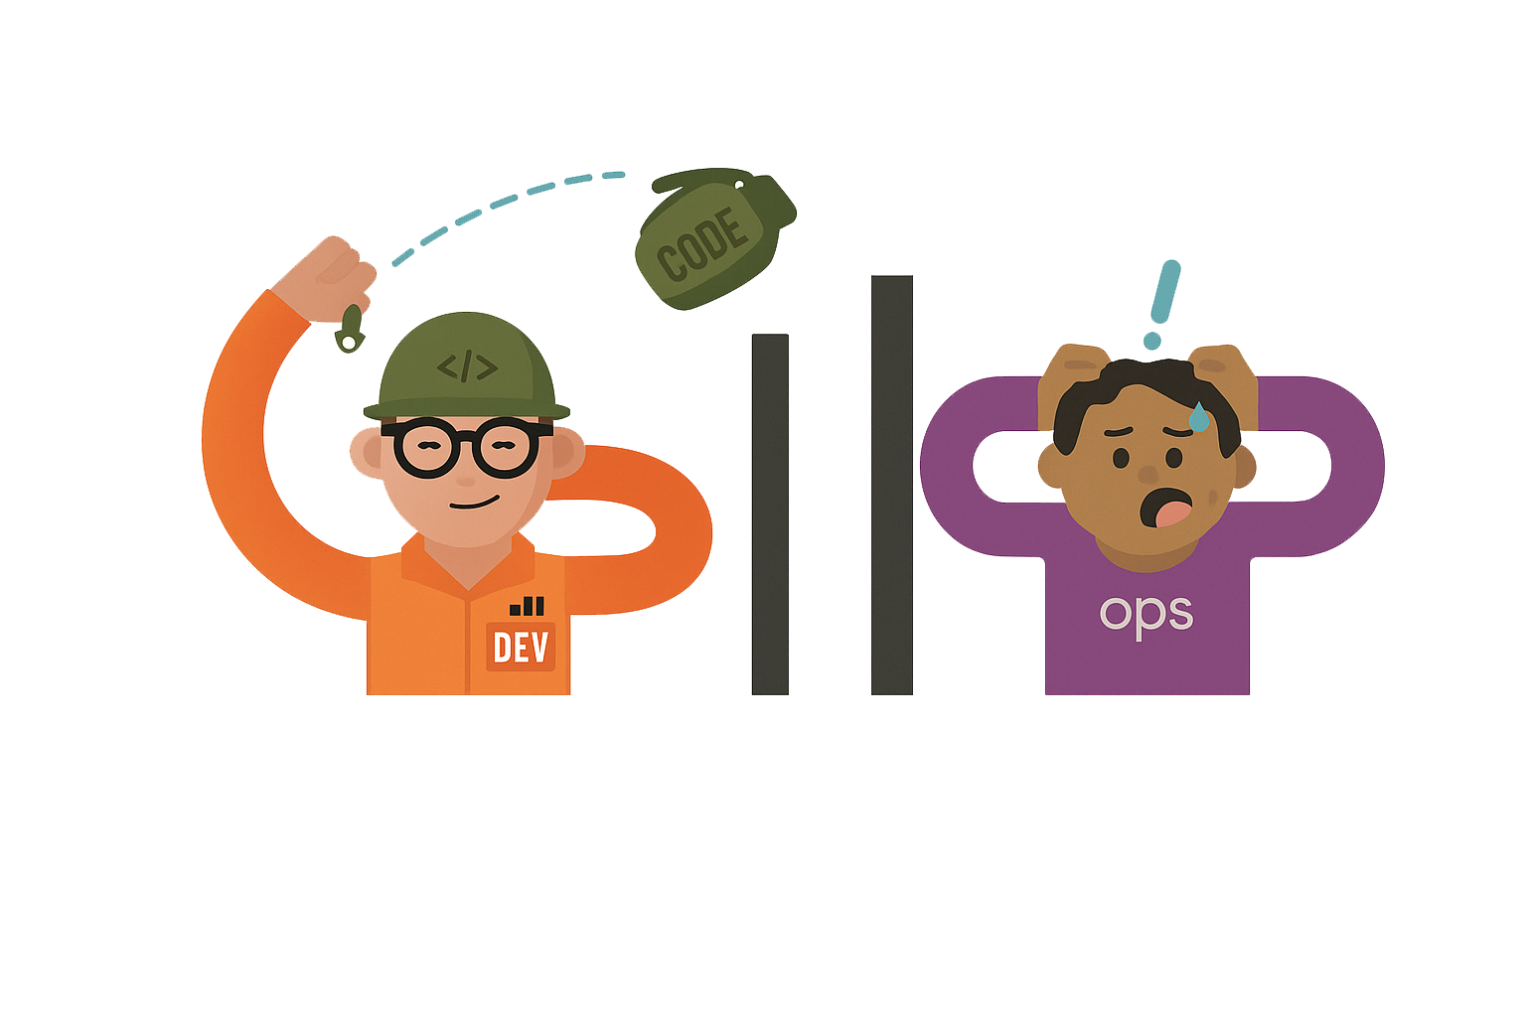
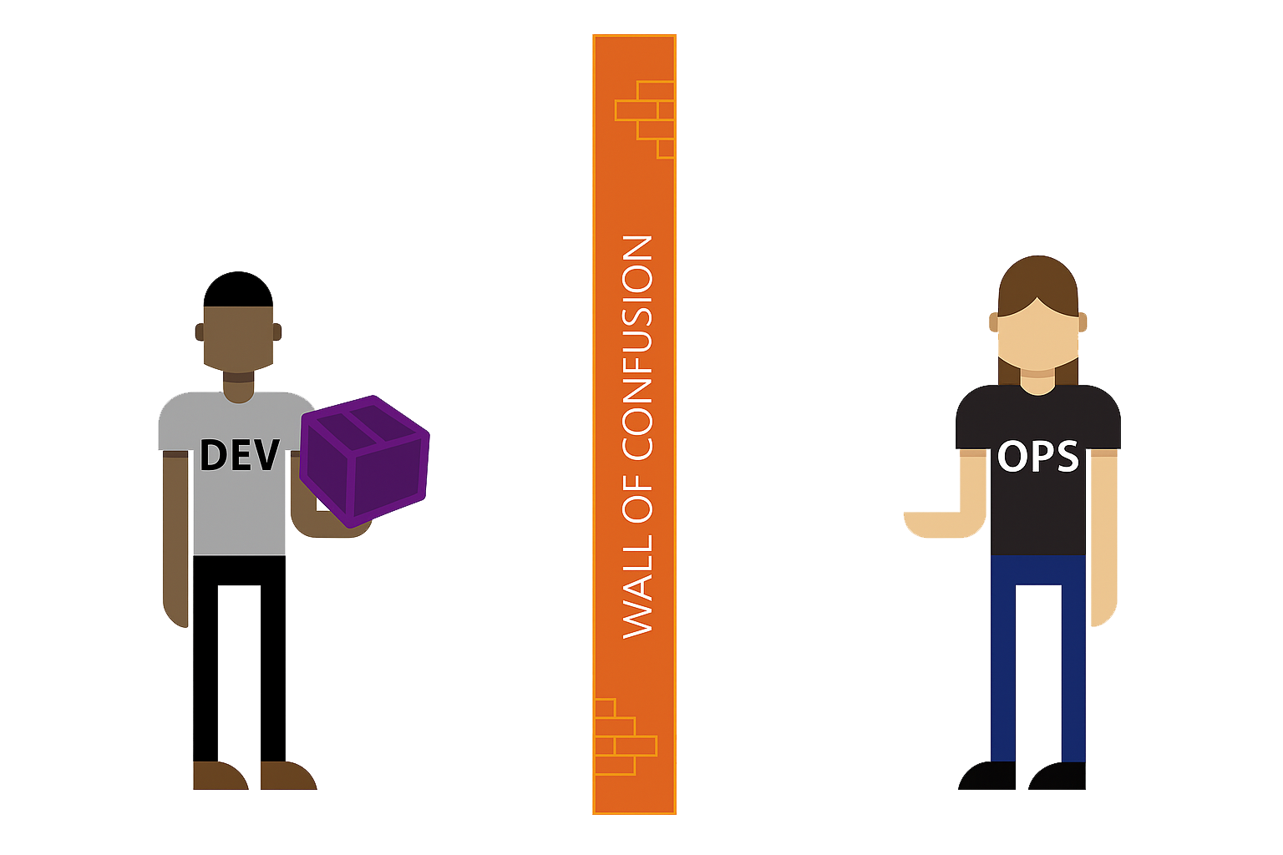
The problems before DevOps?

Slide 7
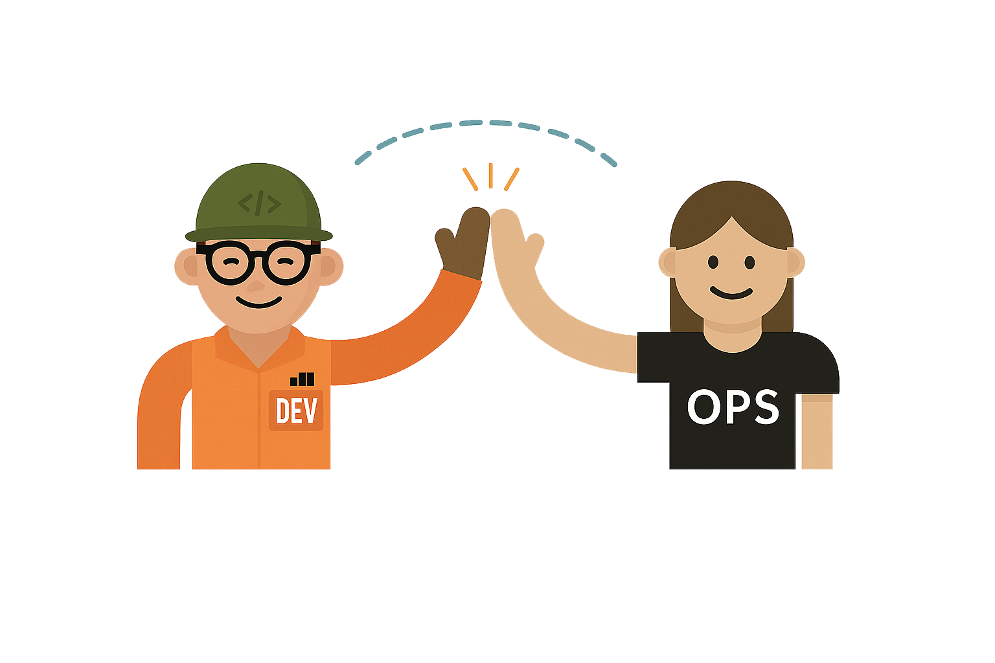
Enters DevOps?
DevOps bridge teams together by
uniting their focus on collaboration and efficiency

Slide 8




DevOps Lifecycle?
The lifecycle generally consists of three phases
Continuous
Integration
Continuous
Delivery
Continuous
Deployment

Slide 9
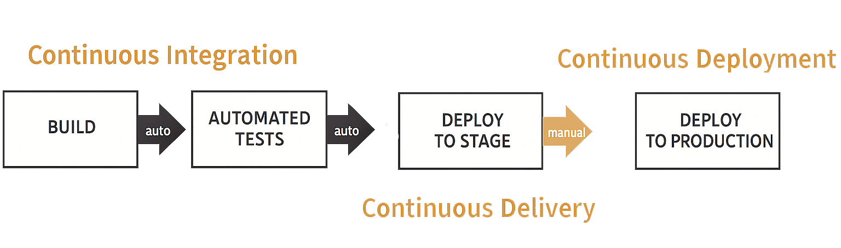
Life Cycle

Slide 10
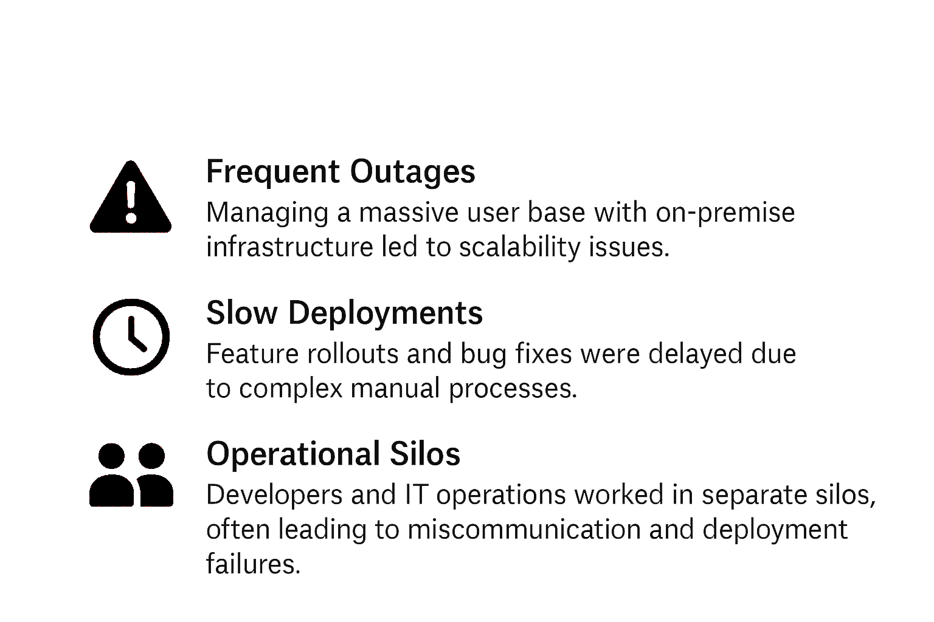
Netflix: Case Study
When Netflix got popular it started struggled to maintain high availability, rapid innovation, and top-tier user experience
Challenges faced by Netflix

Slide 11




After Implementing DevOps:
High Availability & Reliability- They're online 99.99% of the time
Faster Deployments - They fix 1000’s of bugs and launch updates everyday
Improved Scalability- Netflix can handle millions of users streaming at the
same time
Better User Experience- Users rarely face issues and if they do, Netflix fixes
them on the go using DevOps

Slide 12
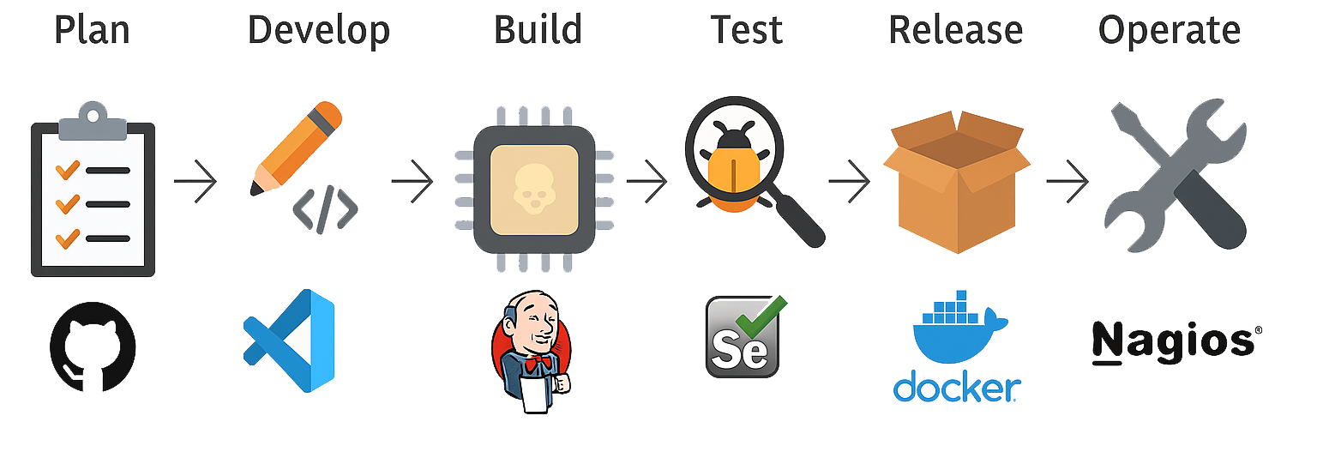
DevOps Tools?
GitHub
Vscode
Jenkins
Selenium
Docker
Nagios

Slide 13
DevOps Tools?
GitHub
Vscode
Jenkins
Selenium
Docker
Nagios

Slide 14
DevOps: Were innovation loops infinitely

