Slide 1
Investigation into Post Pandemic Education Emmett Lawlor 18238831 John Nelson
LM118: BEng in Electronic and Computer Engineering
Autumn semester 2021 Interim Presentation

Slide 2
Presentation overview
Web Scrapers
Used to extract webpage data.
Data
Timetables
UL Module Details
Qualifax
Web-App
Implementation of extracted data.
Text Processing
Best implementation to token and classify educational data
Preparation for clustering
Machine Learning
Recommendation software for courses.
Similar to Netflix, YouTube algorithm.
Analytical Report

Slide 3
Project overview (1)
The project will be an all around investigation into Third Level Education post-Covid19. It will be a re-evaluation into how we learn and how we will learn in the future. We will be investigating what we can learn from this new attraction to online learning, and wondering what we can build in order to adapt and streamline students into such a future of free, open-source, omnichannel learning experience.
The outcomes of this project
Web Scraping: Method of finding relevant data to course material.
Webapp: Streamline a semesters beginning.
Text-Processing: How to process Educational Data.
Machine Learning: Algorithm to pick/recommend the best courses.
Analytical report into Third Level Education in Ireland and reflection of findings.

Slide 4
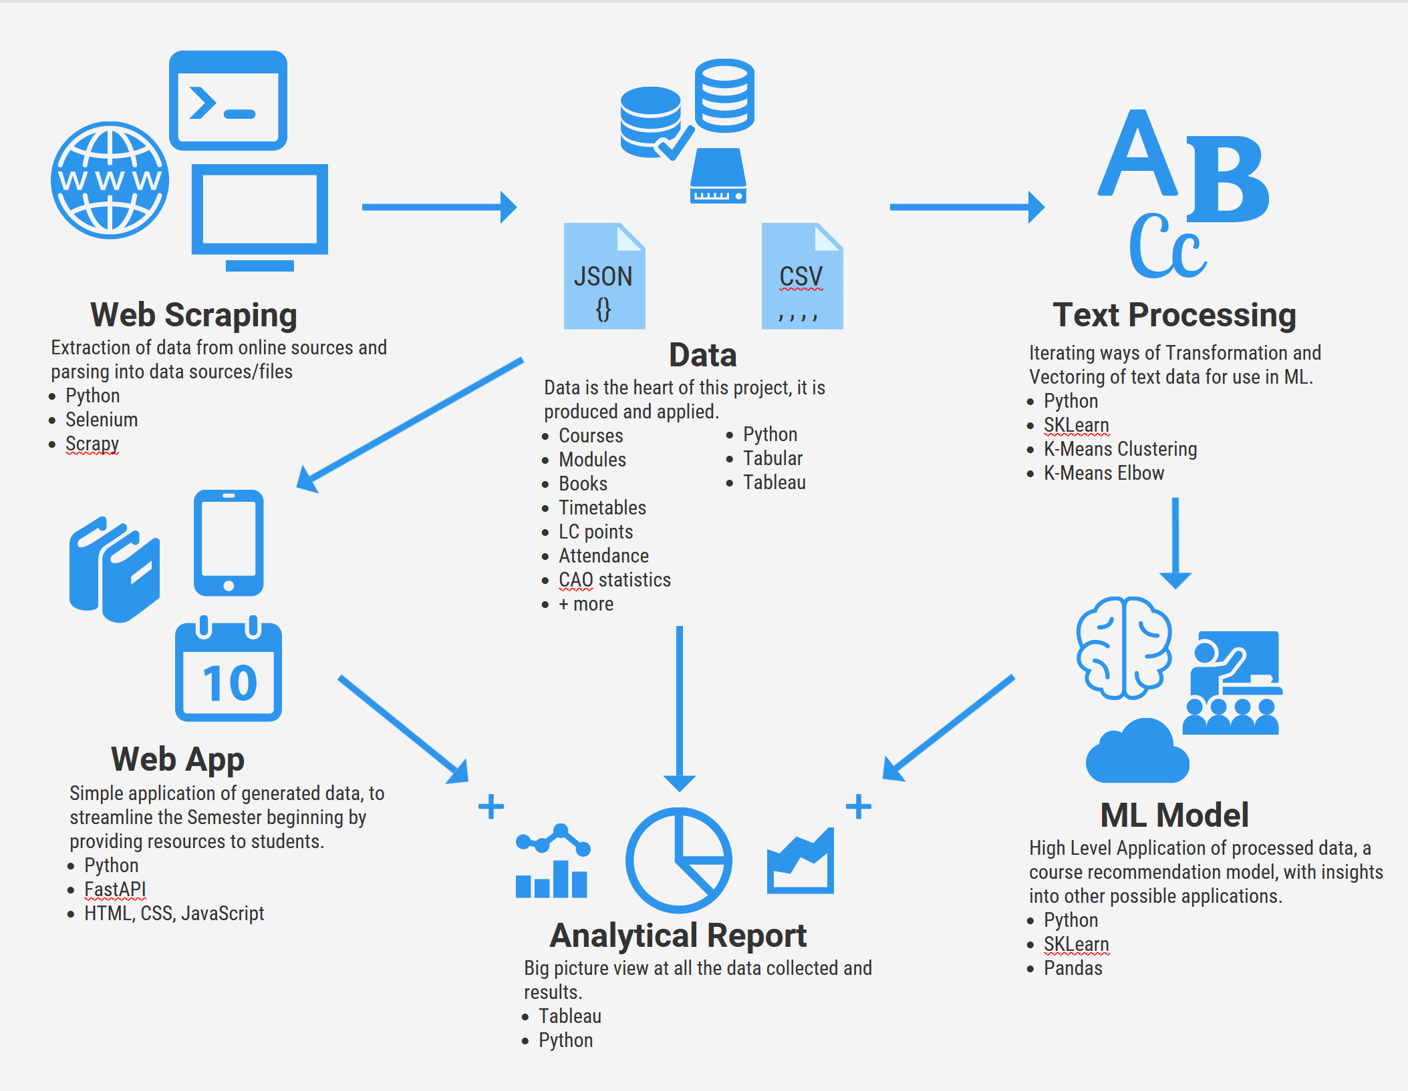
Project overview (2)

Slide 5
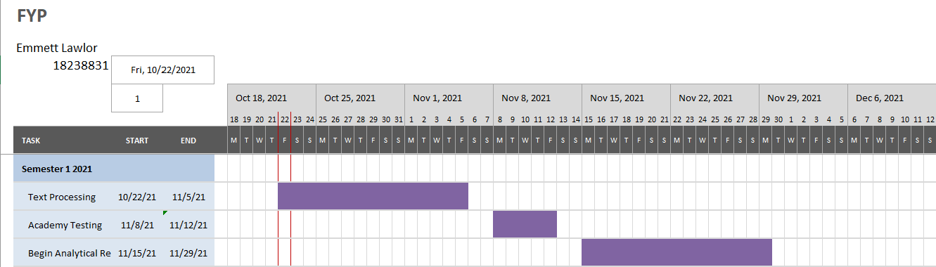
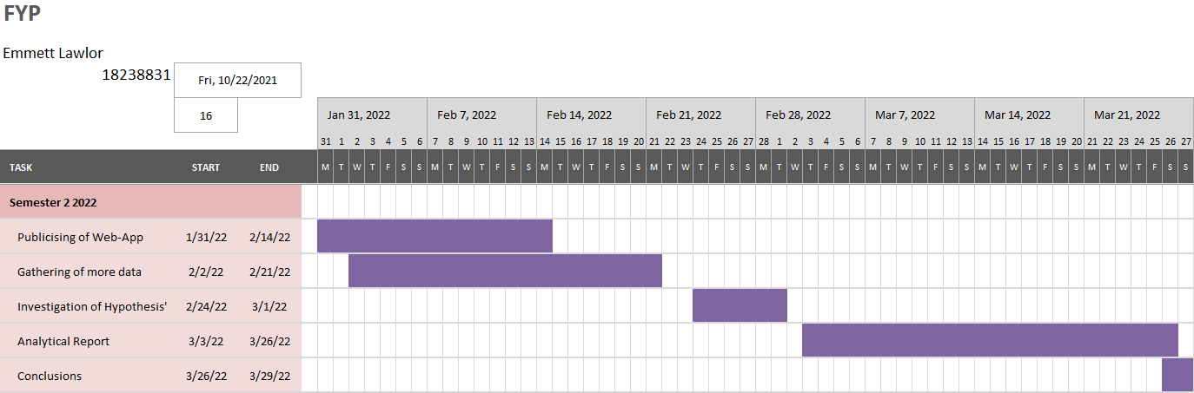
Project Gantt chart

Slide 6
Conclusions
Project summary:
The project is a large data gathering and implementation investigation, to intuitively develop and assist universities in the ever growing digital market of Digitisation and Omnichannel learning mediums.
Work completed to-date:
Web Scrapers
Web App
Analytical Report Data Gathering
Text-processing
Next steps:
Continuation of Text-Processing
Complete AI model
Complete Analytical Report

Slide 7
Thank you. Any questions?

