Slide 2
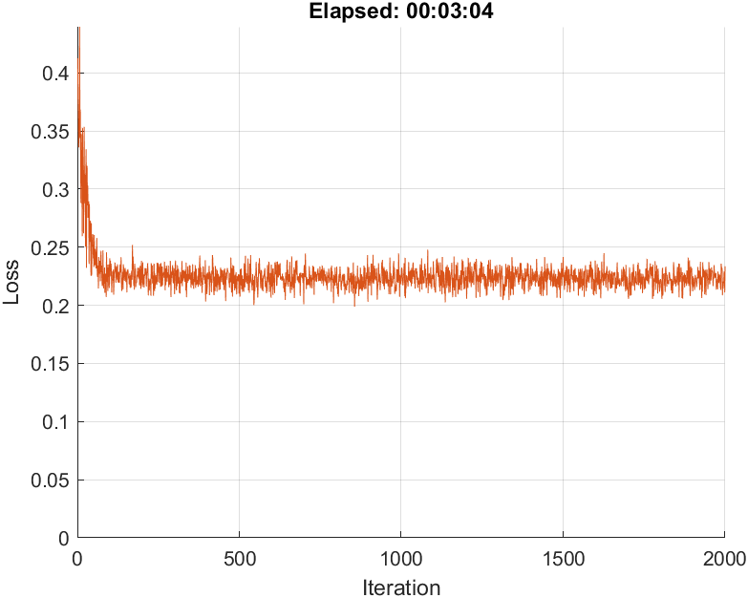
Step1: Train CNN with X1 and X2 input, and target Y1 and Y2.
Main problem is the input values being too many zeros ‘0’ and may be cross-entropy loss may not be good to use with y’(predicted) and Y(true value for log (Y1/Y2))
Training Loss is not dropping maybe of wrong architecture or wrong model loss calculation.
Predicted Abundance ratio value differs only in a very small range.

Slide 3
Y=log(Y1/Y2)
Training label
Sequence1, I1=X1, Y1
Training CNN
y1=net(X1)
Fully connected network shared weights & bias with CNN
y’=log(y1/y2)
Sequence2, I2 =X2, Y2
Training CNN
y2=net(X2)
Sigmoid
Backpropagation or gradient update per loss
Compare cross-entropy or mse Y with y’
loss= mse(Y-y’)

