Slide 1
Road Traffic Accident Severity Prediction CEN 380-Machine Learning Worked by-Megi Selimi, Anxhela Kullafi, Kledisa Çollaku, Frenki Zelo, Zejna Mema, Uarda Xhaferaj

Slide 2
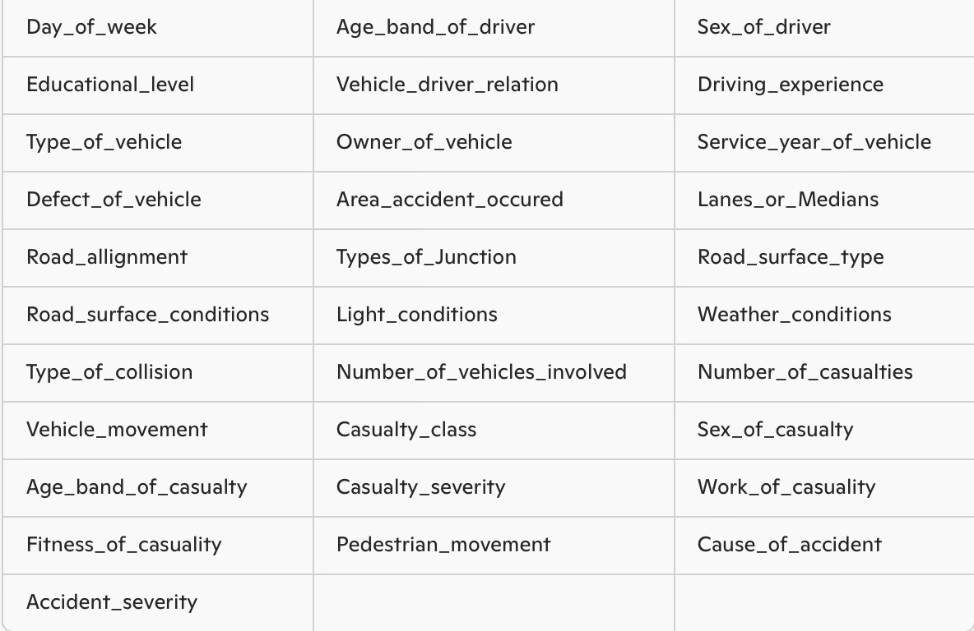
Dataset Description
Source: https://www.kaggle.com/datasets/saurabhshahane/road-traffic-accidents/data?select=cleaned.csv
Features:
Dataset name: RTA Dataset
Number of Samples: 12,316
Features: 32 attributes
Target Variable: Accident_severity (0 = Slight, 1 = Serious, 2 = Fatal)
Goal: Predict accident severity

Slide 3
Previous papers on our dataset :
“Analysis of Road Traffic Accidents Severity Using a Pruned Tree-Based Model.” Authors: Timothy T. Adeliyi, Deborah Oluwadele, Kevin Igwe, Oluwasegun J. Aroba. Published in: International Journal of Technology, Innovation and Education, June 2023 Main Model Used and its Accuracy: J48 Pruned Tree with accuracy of 85.47% Link:https://www.iieta.org/journals/ijtdi/paper/10.18280/ijtdi.070208 | “Preventing Traffic Accidents Through Machine Learning Predictive Models” Authors: Tewodros T. Bedane, Biniyam G. Assefa, S.K. Mohapatra Published in: 2021 International Conference on Information and Communication Technology for Development for Africa Model used - Random Forest with F1 score = 93,67 Link: https://ieeexplore.ieee.org/document/9672249/references#references

Slide 4
Road traffic accidents are a major concern globally. Predicting the severity of accidents helps in:
Better resource allocation
Safety policy design
Emergency response planning

Slide 5
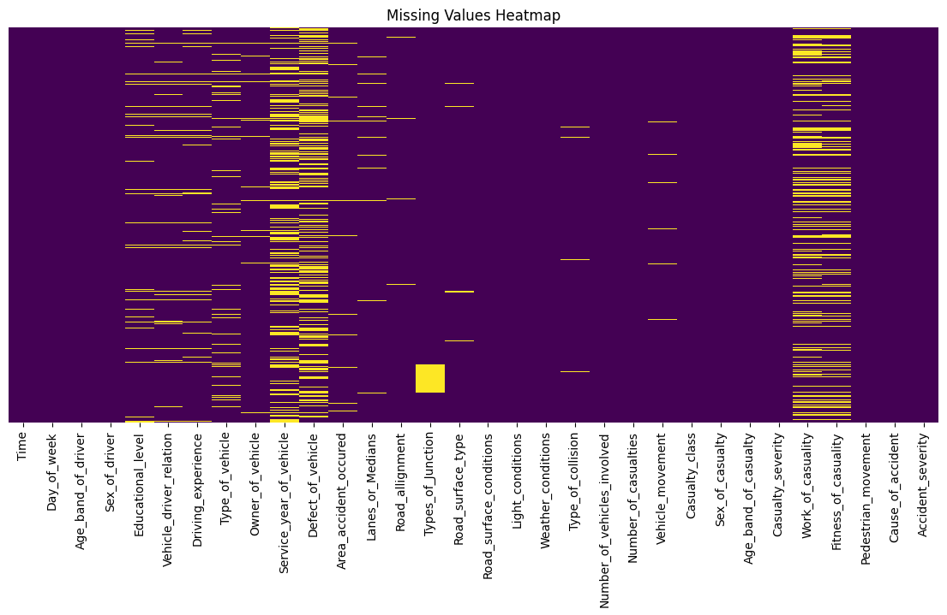
Data Preprocessing Steps
Initial Data Inspection
Checked dataset shape and structure
Identified missing values with a heatmap
Handling Missing Data
For categorical columns → filled missing values with the mode
For numerical columns → filled missing values with the mean

Slide 6
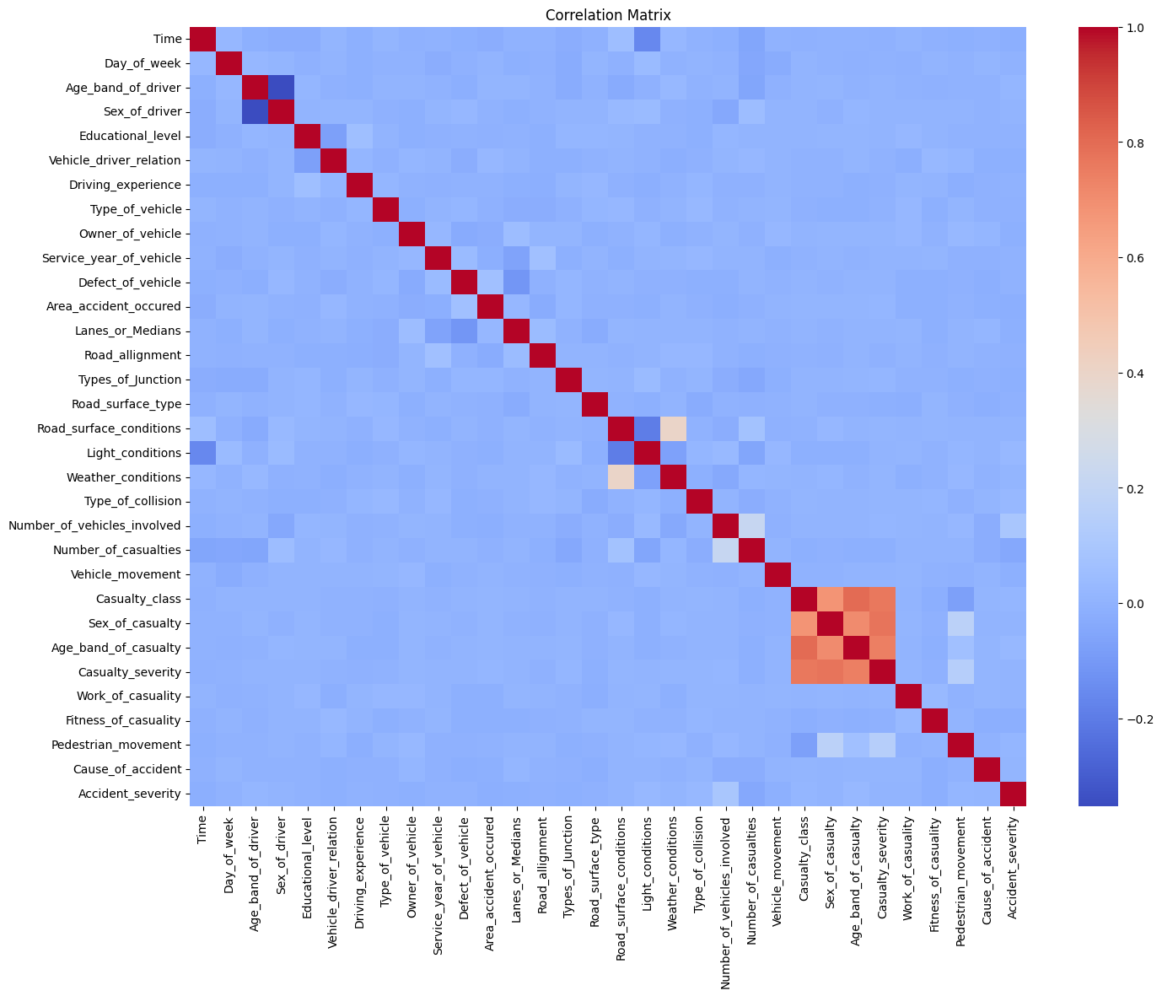
Data Preprocessing Steps
Encoding Categorical Variables
Used Label Encoding to convert string labels into numeric format.
Feature Scaling
Applied StandardScaler to normalize all input features (mean = 0, std = 1)
Feature & Target Separation
X = all features except Accident_severity
y = target column Accident_severity.
The correlation matrix shows the statistical relationship (linear correlation) between numerical features.

Slide 7
Machine Learning Models Used
KNN
SVM
Decision Tree
RandomForest
Hybrids: MLP + RF & Autoencoder+RF & Kmeans+DNN & PCA+NN
AdaBoost
XGBoost
LightGBM
TabNet
HistGB
Deep Neural Network using Keras

Slide 8
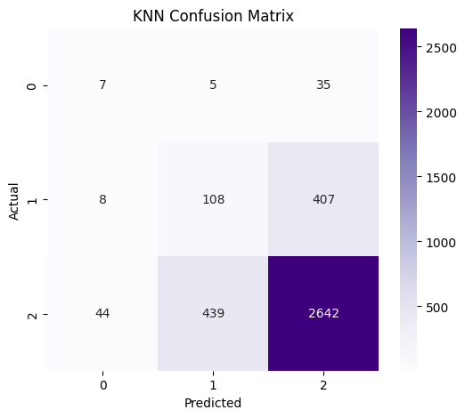
K-Nearest Neighbors (KNN) Model Results
Best Hyperparameters Found:
metric: Manhattann
neighbors: 1
weights: Uniform
Cross-Validation Accuracy: 93.37%
Test Accuracy: 74.6
Class | Precision | Recall | F1-Score | Support
0 | 0.12 | 0.15 | 0.13 | 47
1 | 0.20 | 0.21 | 0.20 | 523
2 | 0.86 | 0.85 | 0.85 | 3125
Model performs well on majority class (2) but poorly on minority classes (0 and 1).

Slide 9
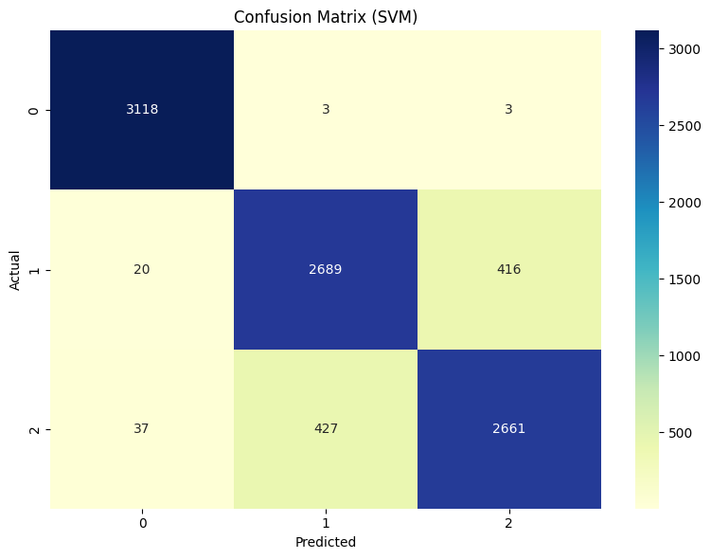
SVM MODEL RESULTS
Best Parameters: C=1 gamma=0.1 kernel='rbf’ CV Accuracy: 90.03% Test Accuracy: 90.34%
Class | Precision | Recall | F1-Score | Support
0 (Slight) | 0.982 | 0.998 | 0.990 | 3124
1 (Serious) | 0.862 | 0.860 | 0.861 | 3125
2 (Fatal) | 0.864 | 0.852 | 0.858 | 3125

Slide 10
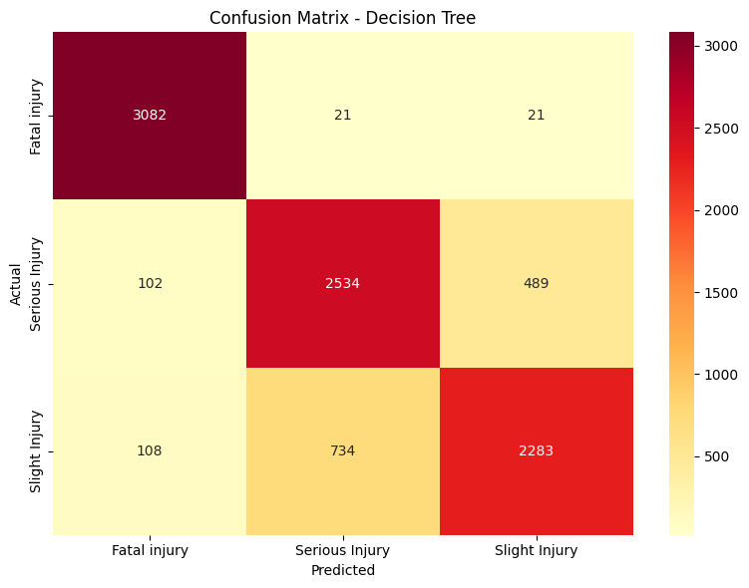
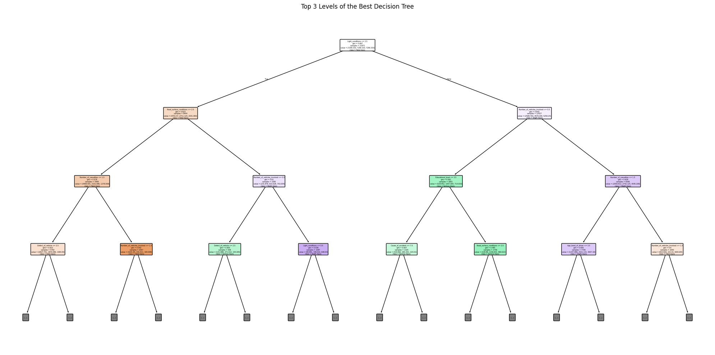
Decision Tree Results
Best Parameters Found:
Class | Precision | Recall | F1-Score
0 | 0.94 | 0.99 | 0.96
1 | 0.77 | 0.81 | 0.79
2 | 0.82 | 0.73 | 0.77
class_weight: 'balanced’
max_depth: 30
min_samples_split: 2
Best F1 Score: 0.8179
Best Mean Accuracy: 82%

Slide 11
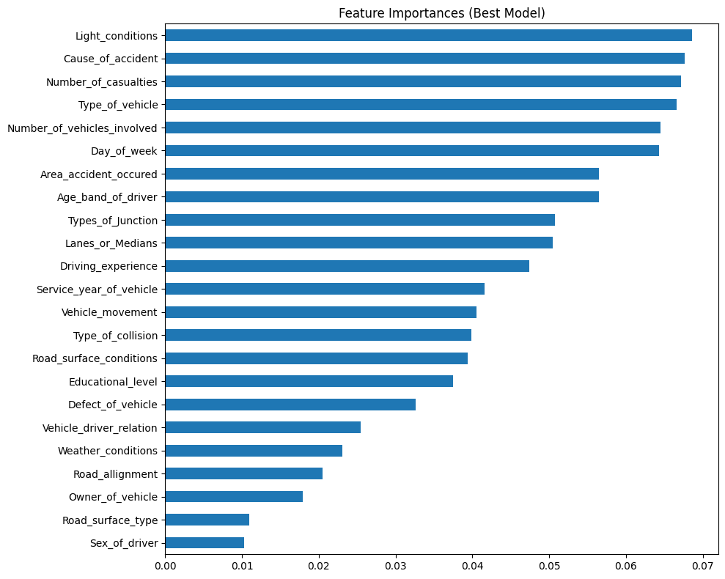
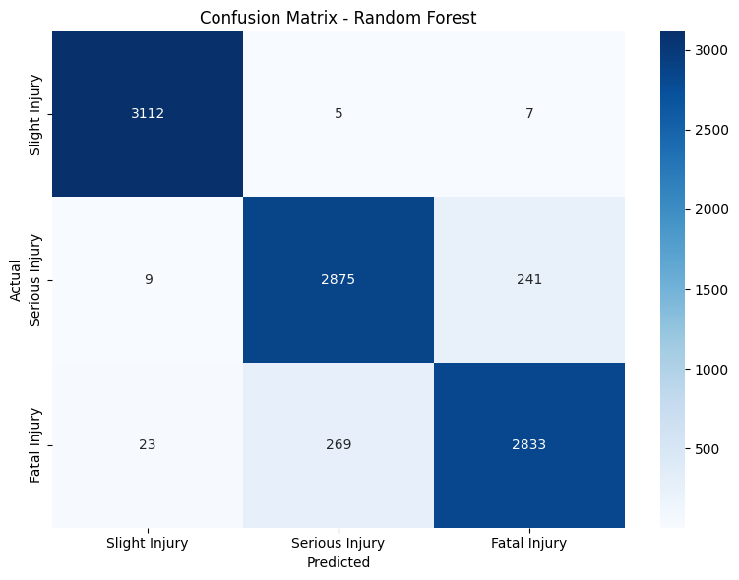
Random Forest Results
The following parameters provided the best results:
Best Parameters:
min_samples_split : 2
max_depth: 25
n_estimators: 200
Test Accuracy: 94.09%
Class | Precision | Recall | F1-Score | Support
0 | 0.98 | 1.00 | 0.99 | 3124
1 | 0.91 | 0.92 | 0.92 | 3125
2 | 0.92 | 0.91 | 0.91 | 3125

Slide 12
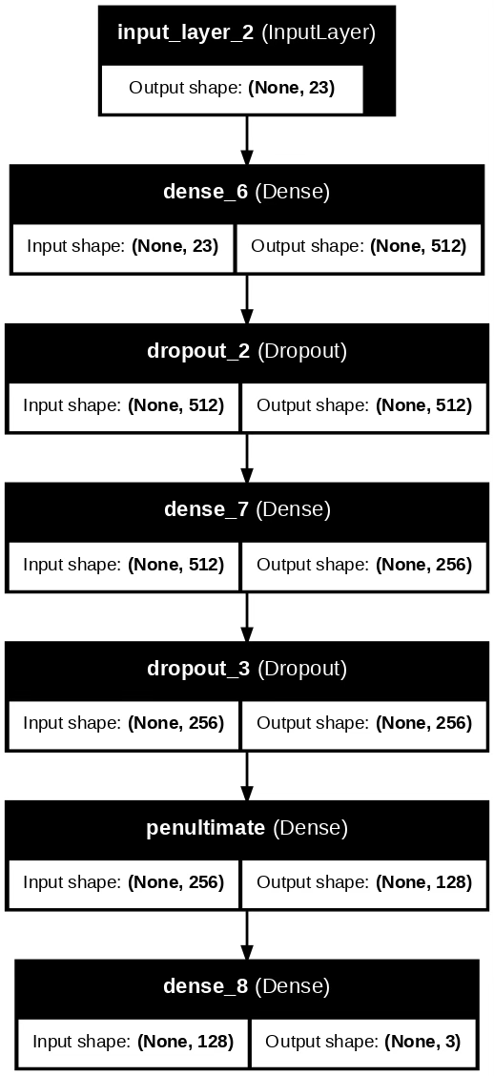
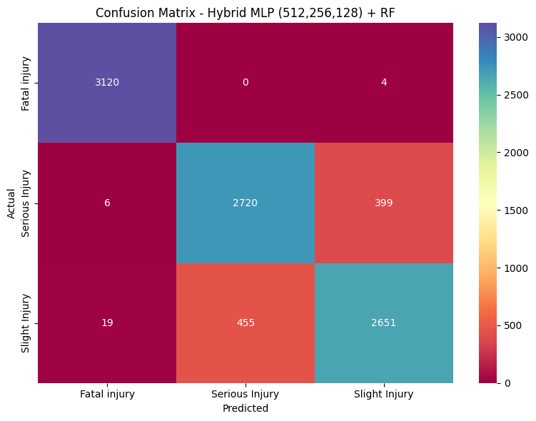
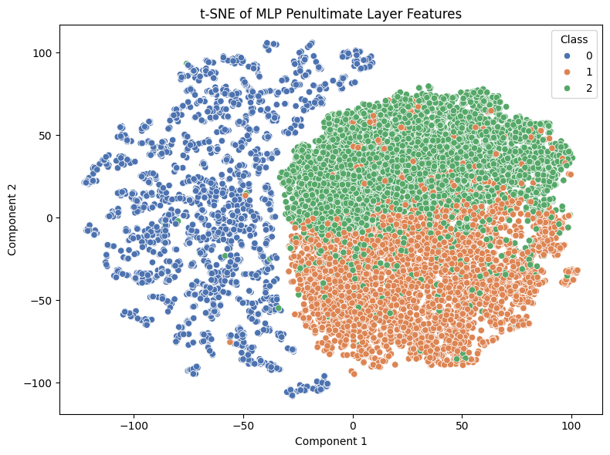
Hybrid MLP + RF Performance
Best Configuration of MLP+RF : MLP Hidden layers (512, 256, 128); RandomForest max_depth : 40, n_estimators : 400 Accuracy 91%
Trained for 50 epochs
Class | Precision | Recall | F1-Score | Support
0 | 0.99 | 1.00 | 0.99 | 3124
1 | 0.83 | 0.83 | 0.83 | 3125
2 | 0.83 | 0.82 | 0.82 | 3125

Slide 13
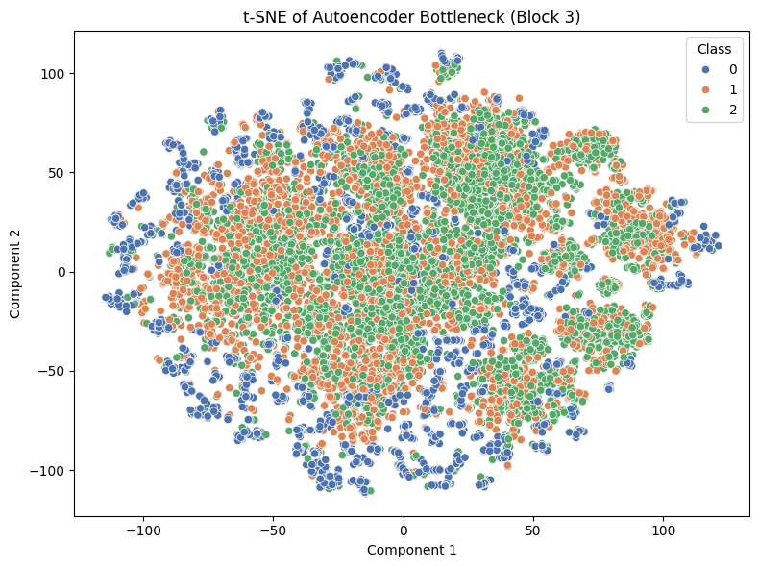
AE + RF Model Performance
Block | Autoencoder Architecture | Bottleneck Size | RF Parameters | Test Accuracy
Block 1 | 128 → 64 → 32 → 64 → 128 | 32 | n_estimators=300, max_depth=40 | 85%
Block 2 | 256 → 128 → 16 (Dropout) | 16 | n_estimators=400, max_depth=35 | 87%
Block 3 | 64 → 10 → 64 | 10 | n_estimators=150, max_depth=25 | 88%
Block 4 | 128 → 32 → 128 | 32 | n_estimators=400, max_depth=40 | 83%
Block 4++ | 160 → 56 → 160 | 56 | n_estimators=450, max_depth=42 | 88%

Slide 14
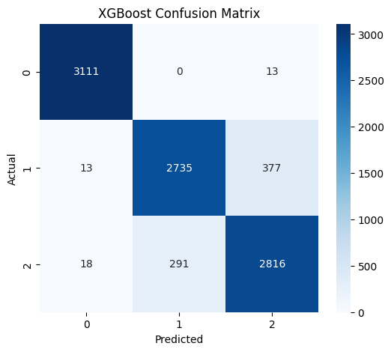
XGBoost Results
We used GridSearchCV for tuning the XGBoost model. The following parameters were tested:
Best Parameters:
learning_rate: 0.5
max_depth: 12
n_estimators: 400
Best CV Accuracy: 92.1%
Test Accuracy: 92.4%
Class (Label) | Precision | Recall | F1-Score | Support
0 (Slight) | 0.99 | 1.00 | 0.99 | 3124
1 (Serious) | 0.90 | 0.88 | 0.89 | 3125
2 (Fatal) | 0.88 | 0.90 | 0.89 | 3125

Slide 15
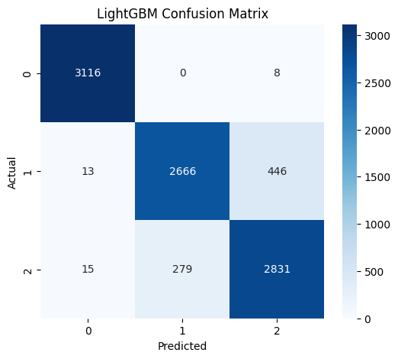
LightGBM Results
Best Parameters:
n_estimators= 300,
max_depth= 30,
learning_rate= 0.1
num_leaves = 63
Test Accuracy: 91.8%
Best CV Accuracy: 91.7%
Class (Label) | Precision | Recall | F1-Score | Support
0 (Slight) | 0.99 | 1.00 | 0.99 | 3124
1 (Serious) | 0.91 | 0.85 | 0.88 | 3125
2 (Fatal) | 0.86 | 0.91 | 0.88 | 3125

Slide 16
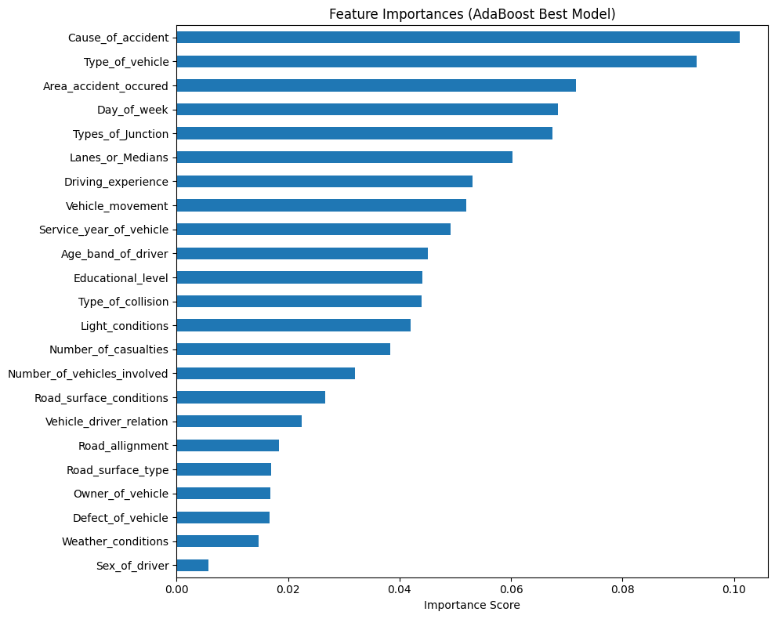
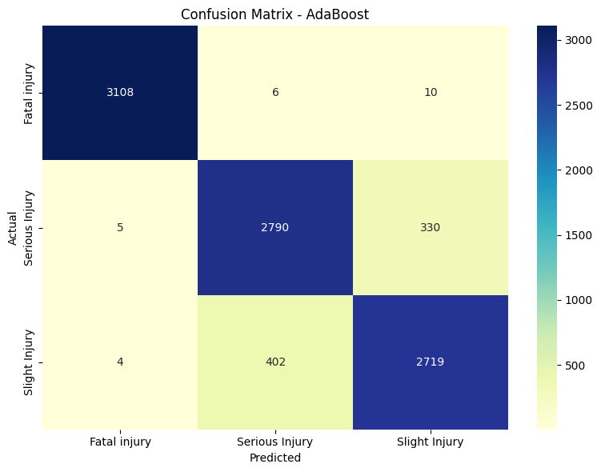
AdaBoost Results
Best Parameters:
max_depth = 8
learning_rate = 1.0
n_estimators = 300
Overall accuracy: 91.92%
Class | Precision | Recall | F1-score | Support
0 | 0.9971 | 0.9949 | 0.9960 | 3124
1 | 0.8724 | 0.8928 | 0.8825 | 3125
2 | 0.8889 | 0.8701 | 0.8794 | 3125

Slide 17
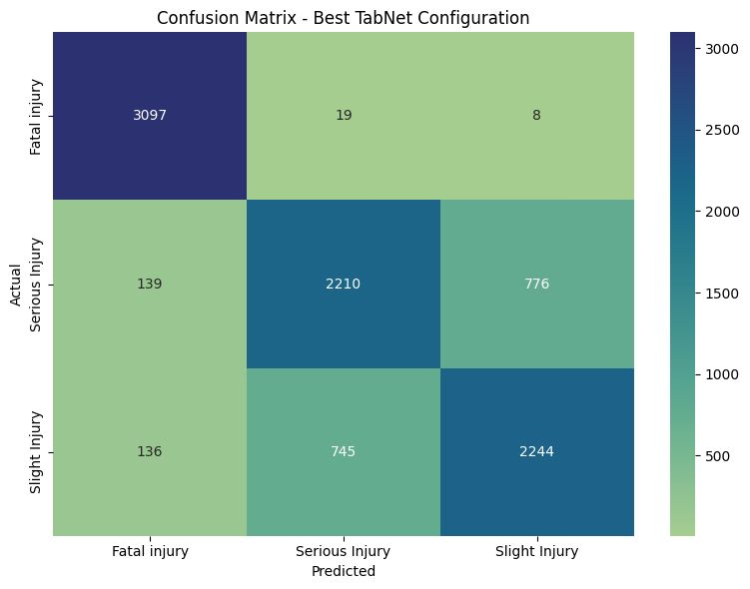
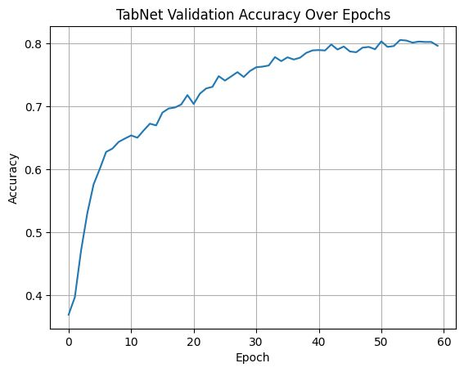
TabNet Results
Class | Precision | Recall | F1-Score | Support
0 | 0.93 | 0.99 | 0.96 | 3124
1 | 0.71 | 0.74 | 0.72 | 3125
2 | 0.74 | 0.67 | 0.70 | 3125
Accuracy |  |  | 0.81 | 9374
Best Parameters:
learning_rate = 0.005
batch_size = 512
virtual_batch_size = 64
max_epochs = 60
patience = 10
eval_metric = 'accuracy'
eval_name = 'valid'

Slide 18
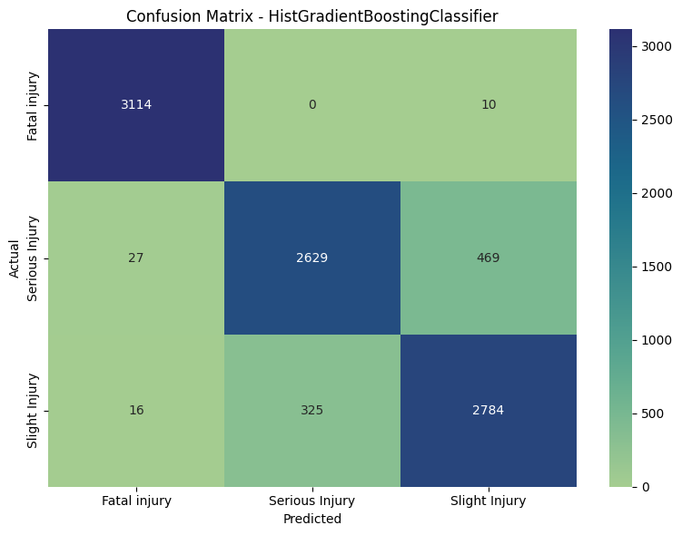
HistGB Model Results
Best model: Params:
learning_rate: 0.1
max_depth: None
max_iter: 200
Mean F1: 0.9056
Mean Accuracy: 0.9059
Class | Precision | Recall | F1-score | Support
0 | 0.99 | 1.00 | 0.99 | 3124
1 | 0.89 | 0.84 | 0.86 | 3125
2 | 0.85 | 0.89 | 0.87 | 3125
Overall Accuracy |  |  | 0.91 | 9374

Slide 19
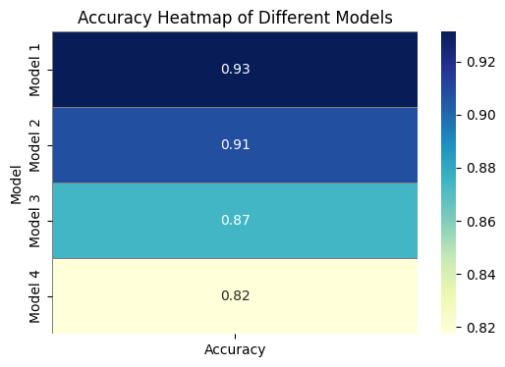
Deep Neural Network using Keras Sequential
Model | Learning Rate | Dropout1 | Dropout2 | Units1 | Units2 | Accuracy | F1 Macro
Model 1 | 0.0005 | 0.3 | 0.2 | 512 | 256 | 0.9312 | 0.9310
Model 2 | 0.001 | 0.3 | 0.2 | 256 | 128 | 0.9078 | 0.9077
Model 3 | 0.0005 | 0.4 | 0.3 | 256 | 128 | 0.8743 | 0.8738
Model 4 | 0.0001 | 0.2 | 0.1 | 128 | 64 | 0.8174 | 0.8153
Model 1 (LR=0.0005, Dropout1=0.3, Dropout2=0.2, Units1=512, Units2=256) achieved the best performance with an accuracy of 93.12% and F1 macro of 93.10%.

Slide 20
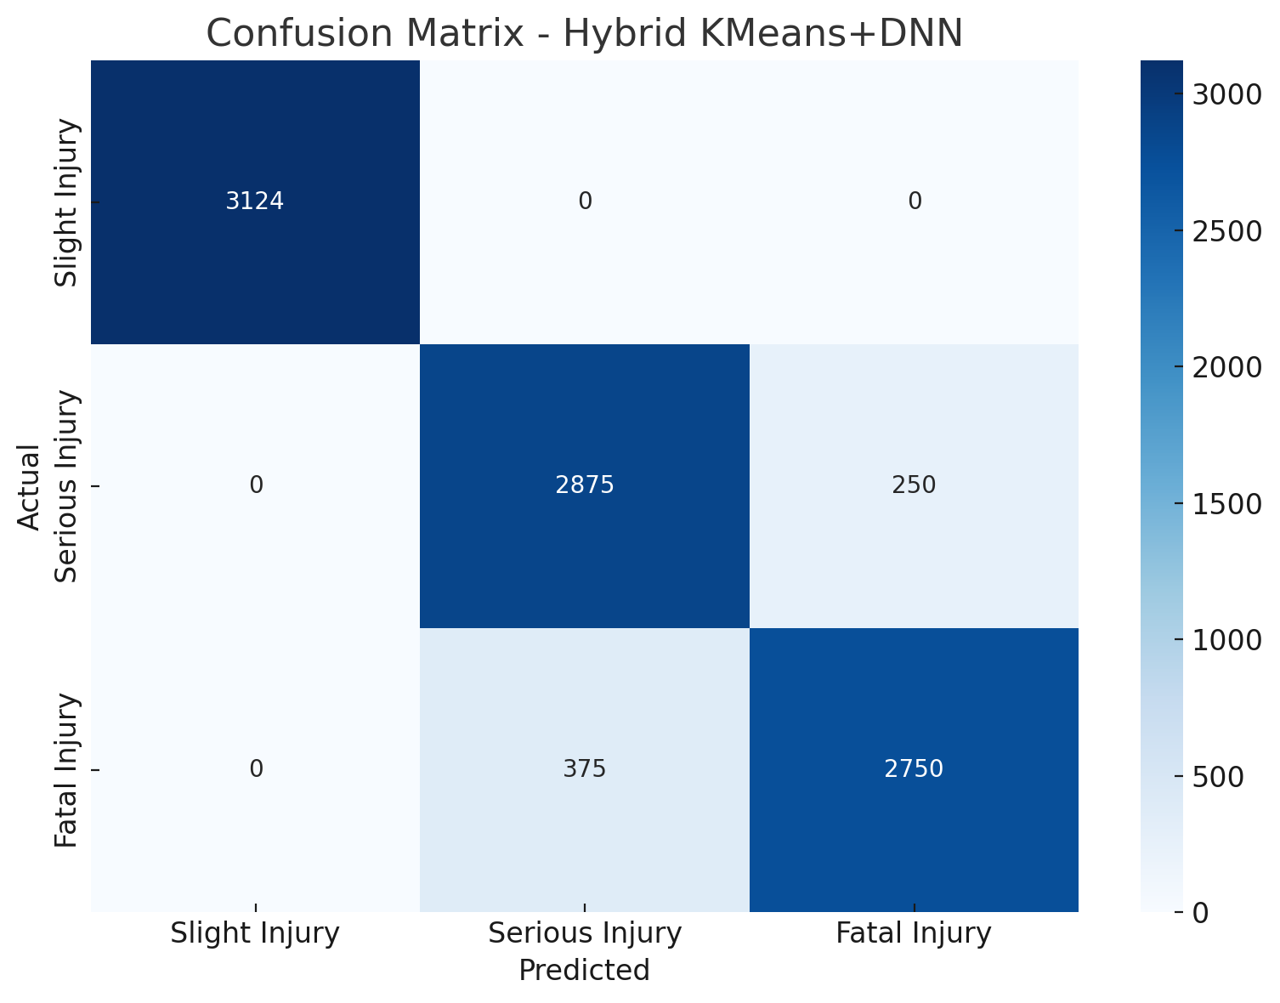
KMeans + DNN
The following parameters provided the best results:
Best-performing parameters for Kmeans + DNN : k=3 and a Deep Neural Network composed of two hidden layers: the first with 512 units and a dropout rate of 0.3, and the second with 256 units and a dropout rate of 0.2. The model was trained using a learning rate of 0.0005.
Accuracy:93.30%
Class | Precision | Recall | F1-Score | Support
0 | 0.99 | 1.00 | 1.00 | 3124
1 | 0.89 | 0.92 | 0.90 | 3125
2 | 0.92 | 0.88 | 0.90 | 3125

Slide 21
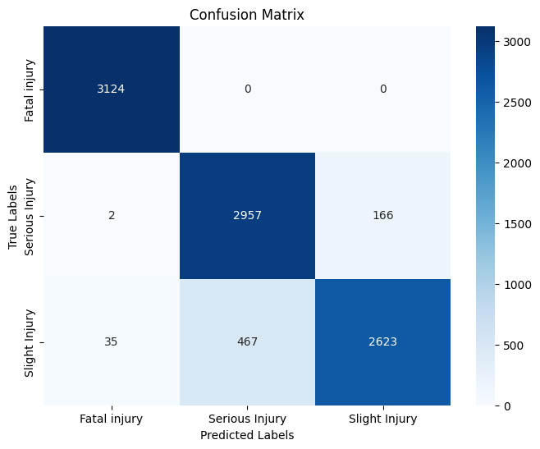
PCA + Neural Network
Accuracy : 92.85%
Parameter | Value
Hidden Layers | 4 (1024 → 512 → 256 → output)
Activation | ReLU (hidden), Softmax (output)
Dropout Rate | 0.05 per hidden layer
Optimizer | Adam
Learning Rate | 0.0007
Batch Size | 64
Epochs | Up to 100 with early stopping
Early Stopping | Patience = 15
Reduce LR on Plateau | Factor = 0.5, Patience = 3, Min LR = 1e-6
PCA Components | Enough to explain 95% variance (usually ~25)
SMOTE | Applied to full dataset before train-test split
Class | Precision | Recall | F1-score | Support
0 | 0.99 | 1.00 | 0.99 | 3124
1 | 0.86 | 0.95 | 0.90 | 3125
2 | 0.94 | 0.84 | 0.89 | 3125

Slide 22
Comparison of all models performance to identify the best performing:
Model | Test Accuracy | Notes
Random Forest | 90.84% | c_w': 'balanced', 'max_depth': 20, 'min_samples_split’: 2, 'n_estimators': 200
SVM | 90.34% | C=1, gamma=0.1, kernel='rbf'
Hybrid MLP + RF | 91% | Validation acc 91%
AE + RF | 88% | 64->10->64 10 N_estimators=150, max_depth=25
Decision Tree | 82% | Balanced weights, max_depth=30
KNN | 74.6% | Manhattan, neighbors=1, uniform
XGBoost | 92.4% | lr=0.5, depth=12, estimators=400
LightGBM | 91.8% | n_estimators=300, max_depth=30
AdaBoost | 91.92% | max_depth=8, lr=1.0, n_estimators=300
TabNet | 81% | lr=0.005, max_epochs=60, batch=512
HistGB | 91% | learning_rate: 0.1 max_depth: None max_iter: 200
Deep Neural Network (Keras) | 93.12% | LR=0.0005, Dropout1=0.3, Dropout2=0.2, Units1=512, Units2=256
KMeans + DNN | 93.30% | k=3, hidden layers: =512, dropout rate=0.3hidden layer= 256 dropout rate= 0.2, learning rate= 0.0005.
PCA + Neural Network | 92.85% | Hidden Layers1024 → 512 → 256,,Activation= ReLU (hidden), Softmax (output),Dropout = 0.05 , Adam, lr= 0.0007,epochs=100. ,
The KMeans + DNN outperforms all other models with Accuracy (93.12%) .
Deep Neural Network (Keras), PCA + Neural Network, XGBoost and AdaBoost are very close competitors and strong options for production deployment.
SVM and HistGradientBoosting offer a good balance of interpretability and performance.
Hybrid models (AE + RF, MLP + RF) show solid results but don’t exceed pure DNN or boosting methods.

Slide 23
Conclusion
This project explored various machine learning and deep learning models to predict accident severity using the RTA dataset. Among the models tested, the KMeans + Deep Neural Network achieved the highest accuracy at 93.30%, closely followed by the standalone DNN (Keras) at 93.12%. These results highlight the strong performance of deep learning approaches and show that combining clustering with neural networks can further improve classification accuracy.

