Slide 1
MINI_PROJECT - 2 : Developing Alexa Skills
PREPARED BY:-
Name: Darshan k. Darji
Roll no:16BCE023
Guide: Dr . Priyank Thakkar.

Slide 2
Understand Alexa key_word
Intents
Sample utterances : my name is {name} and my favorite color is {color}
Custom slot types : AMAZON.DATE,NUMBER,FOUR_DIGIT_NUMBER,TIME
Dialog model

Slide 3
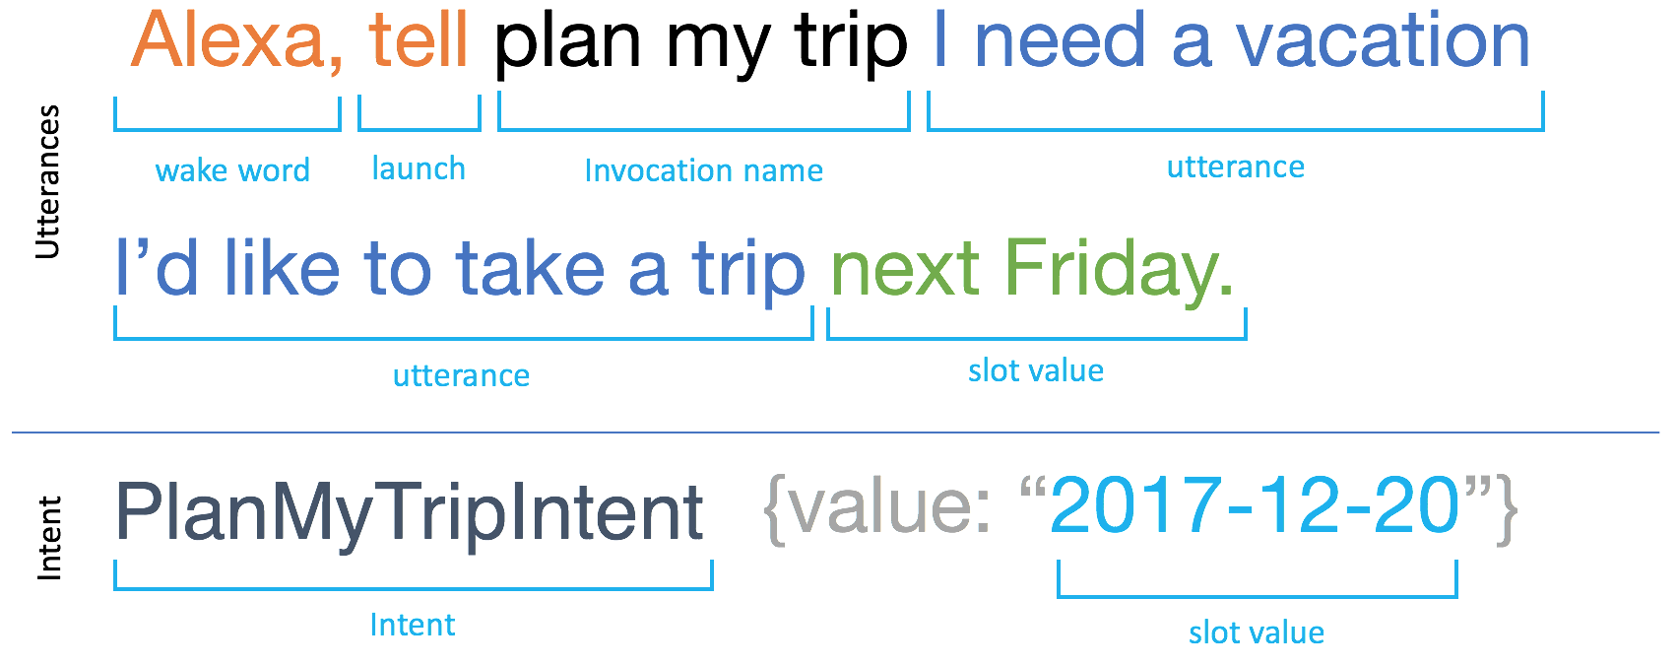

Slide 4
Type of Interaction Models
Interact with a Custom Skill
Interact with the Smart Home Skill API
Interact with the Video Skill API
Interact with the Flash Briefing Skill API

Slide 5
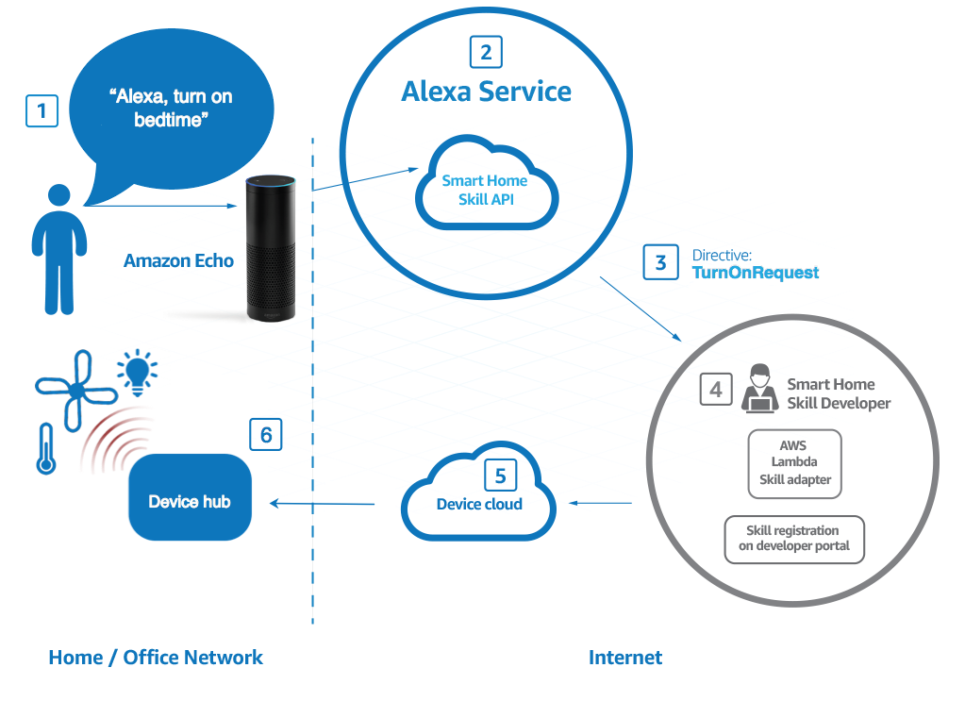

Slide 6
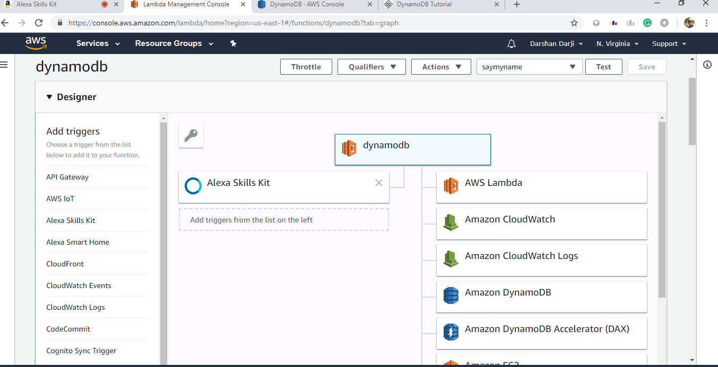
Alexa_skill: Say my name skill

Slide 7
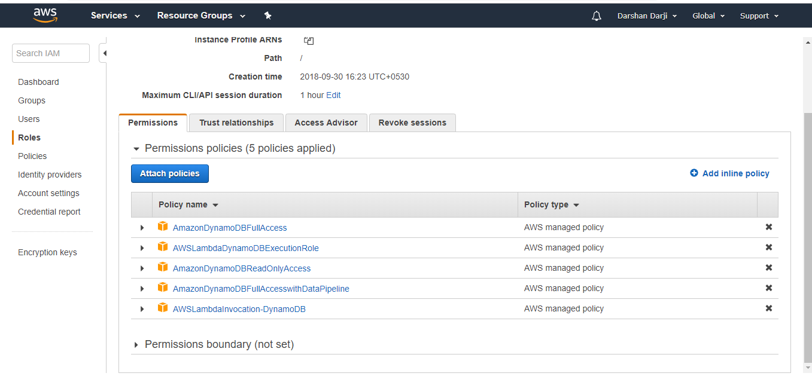
Step to create and use DynamoDb
The AWSLambda DynamoDBExecution Role has the permissions that the function needs to read items from DynamoDB and write logs to CloudWatch Logs.

Slide 8
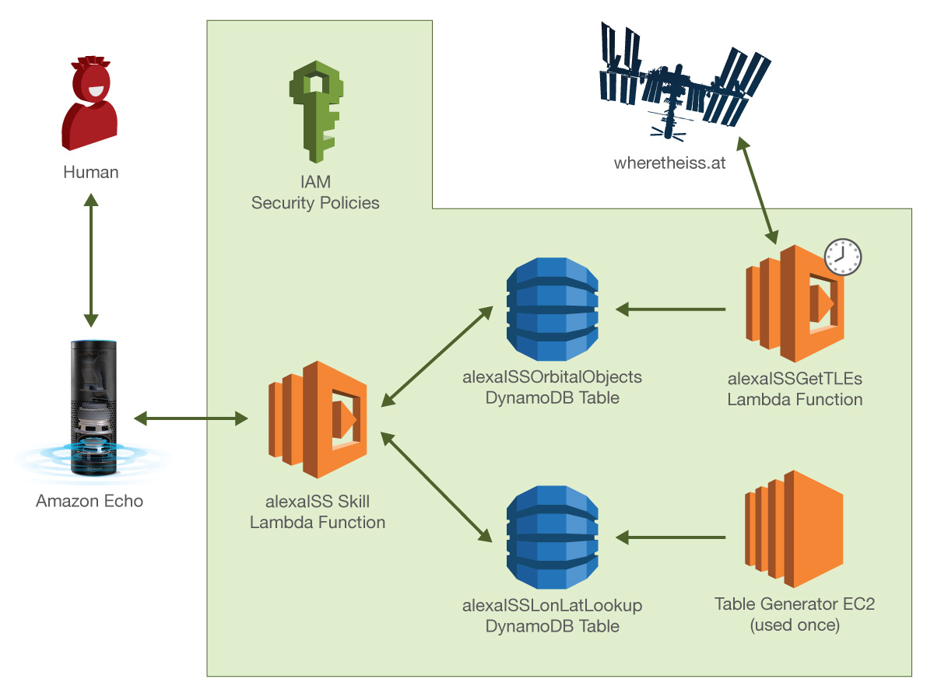

Slide 9
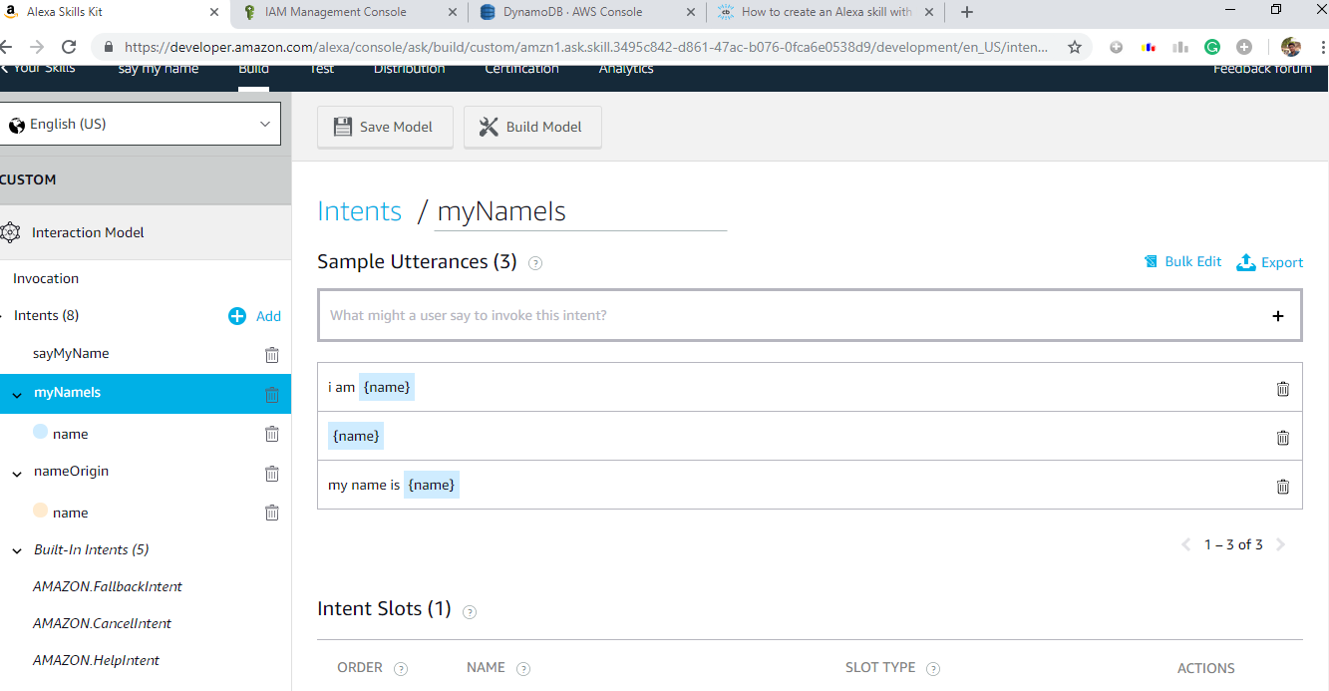

Slide 10
Tool required
Developer Console Account
Aws (amazon web services) lamda functions
Java script
nodejs

Slide 11
Working on Quiz game
Objective: create a multiple statement conversation between user and Alexa.
The game having three level.
Each level have multiple choice questions and a user has to answer the questions

Slide 12
REFERENCES
https://developer.amazon.com/alexa-skills-kit/tutorials/fact-skill-1
https://developer.amazon.com/alexa-skills-kit/tutorials
https://www.codecademy.com/pro-trial-expired
https://www.today.com/home/best-amazon-alexa-skills-echo-dot-show-t115489

Slide 13
THANK YOU

