Slide 1
UNIVERSITY OF MISSOURI
Equine Lameness
A Two-Phase AI Pipeline
From Socratic discharge-summary generation to multi-modal lameness-location prediction —
one clinical workflow, one anonymized data spine, two complementary models.
PHASE 1
PHASE 2
Discharge Summary AI
Lameness Location Prediction
Socratic interview · structured drafts · anonymized case archive
Two-stage LightGBM · 209 features · 92.6% test accuracy
Phase 1 — Arwa Mashagbeh · Phase 2 — Ajay Kumar · University of Missouri
2024–2026

Slide 2
UNIVERSITY OF MISSOURI
EQUINE LAMENESS · TWO-PHASE AI PIPELINE
ONE PROJECT, TWO PHASES
A unified pipeline for equine lameness diagnosis
Phase 1 captures structured, anonymized clinical data through a Socratic AI interview. Phase 2 consumes that same anonymized record format — together with inertial sensor data — and predicts lameness location. The two phases share one data spine and one mission.
PHASE 1
DATA COLLECTION
PHASE 2
PREDICTIONS
Discharge Summary AI
Lameness Location Prediction
Socratic interview walks the student through nine structured sections, pushing back on vague answers.
Measurement file upload ingests Lameness Locator PDFs, CSV, Excel — extracts metrics directly.
Quality assessment auto-grades each draft for completeness and surfaces clinical-reasoning shifts.
Anonymized output becomes training data for Phase 2.
Multi-modal fusion of inertial sensor data, EHR text, anatomical flags, and clinical metadata.
Two-stage classifier isolates non-limb cases (binary) before three-class limb localization.
Bayesian HPO + stacking with LightGBM, XGBoost, and ExtraTrees lifts accuracy to 92.6%.
Decision support at IMU upload — feeds back into the clinician review view.
Streamlit · Python 3.12 · Claude Sonnet 4.5
LightGBM + XGBoost + ExtraTrees · Optuna · Stacking
MIZZOU · Project Overview
2 / 23

Slide 3
UNIVERSITY OF MISSOURI
EQUINE LAMENESS · TWO-PHASE AI PIPELINE
CLINICAL MOTIVATION
Why automated lameness localization matters
1 in 3
$800M+
6–12 hrs
~30%
horses experience
significant lameness annually
estimated US economic
impact per year
typical workup time
per lameness case
inter-observer disagreement
on location diagnosis
THE GOAL
Automate location classification from wearable IMU data + EHR records. Reduce diagnostic time, eliminate observer bias, and provide objective decision support at the point of care — fed by anonymized case data captured upstream by the discharge-summary AI.
Phase 1 informs Phase 2: anonymized cases captured during discharge become structured training rows for the predictive model.
MIZZOU · Clinical Motivation
3 / 23

Slide 4
PHASE 1
The Generator
Equine Discharge Summary AI Assistant
A Socratic AI agent that helps veterinary students generate polished discharge
summary drafts — and produces the anonymized case data Phase 2 trains on.
01 / 02

Slide 5
UNIVERSITY OF MISSOURI
EQUINE LAMENESS · TWO-PHASE AI PIPELINE
PHASE 1 · THE PROBLEM
Discharge summaries are broken — for both students and clinicians
1
Errors and gaps
2
Clinician time sink
Student-written drafts frequently contain errors, miss key clinical points, or include excessive history.
Clinicians spend more time editing student drafts than it would take to write the summary from scratch.
3
No standard
4
Busywork, not learning
Students don't know what a good discharge summary looks like, or which elements are clinically essential.
The task becomes mechanical — no real teaching value remains for the student.
MIZZOU · Phase 1 · The Problem
5 / 23

Slide 6
UNIVERSITY OF MISSOURI
EQUINE LAMENESS · TWO-PHASE AI PIPELINE
PHASE 1 · THE SOLUTION
Flip the model: AI interviews the student, then drafts the summary
Instead of asking the student to write (poorly), the AI asks Socratic questions to make them think — then generates a polished first draft for clinician review.
1
2
3
4
5
Interview
Push back
Synthesize
Quality check
Clinician review
AI walks the student through 9 sections, one at a time
Socratic follow-ups when answers are vague — like a teaching clinician
AI drafts a structured summary using only what the student provided
Auto-graded for completeness; inconsistencies flagged for the clinician
Attending edits and approves before anything reaches the owner
Safety guardrails: all identifying veterinary information is anonymized. The AI never invents clinical content.
MIZZOU · Phase 1 · The Solution
6 / 23

Slide 7
UNIVERSITY OF MISSOURI
EQUINE LAMENESS · TWO-PHASE AI PIPELINE
PHASE 1 · HACKATHON DELIVERABLES
Five new features built on top of the MVP
11
5
3
2
issues found
& documented
new features
shipped
anonymized
case references
prompt
rewrites
Measurement file upload
Quality assessment
Lameness-aware questioning
Students drop in Lameness Locator PDFs (or CSV/Excel/PDF). The AI reads the data and writes precise metrics into the summary.
Every draft is auto-graded with a completeness % and an A–F quality grade — a learning signal for students, a triage tool for clinicians.
On lameness cases, the AI asks the right questions (Diff Max Head, Vector Sum, Q Score, impact vs. pushoff) using the clinic's vocabulary.
Items for Clinician Review
DOCX & TXT export
AI surfaces clinical-reasoning shifts (rDVM diagnosis vs. localization vs. imaging) so the attending doesn't miss them buried in prose.
Both download formats available after the summary generates — Word for the medical record, plain text for VetView paste.
MIZZOU · Phase 1 · Features
7 / 23

Slide 8
UNIVERSITY OF MISSOURI
EQUINE LAMENESS · TWO-PHASE AI PIPELINE
PHASE 1 · EVIDENCE OF IMPROVEMENT
v1 baseline vs. v3 with new prompts and features
BEFORE · v1 BASELINE
AFTER · v3 REWRITES + NEW FEATURES
Real names leaked. Buried contradictions. Mechanical interview.
Anonymized end-to-end. Reasoning shifts surfaced. Faster cadence.
Real referring vet name (Dr. Marcotte) leaked into case-summary narrative
Real dates leaked.
Clinical-reasoning contradictions buried inline, never surfaced
Three turns to advance one section (over-confirmation)
AI rejected out-of-section content as 'wrong section'
AI invited speculation when student said 'I don't know'
Output style didn't match real clinic discharge format
All veterinary names anonymized — including in narrative prose
Dr. Keegan-confirmed: horse names + dates retained per his policy
New 'Items for Clinician Review' section surfaces case contradictions
Single-turn advance — write recap, mark complete, move on
Out-of-section input acknowledged, captured, and continued cleanly
AI accepts 'I don't know' gracefully → marks for clinician completion
Quality assessment block: completeness % + A–F grade with rationale
MIZZOU · Phase 1 · Evidence
8 / 23

Slide 9
UNIVERSITY OF MISSOURI
EQUINE LAMENESS · TWO-PHASE AI PIPELINE
PHASE 1 · HOW IT WORKS
Architecture — simple by design
FRONTEND
LOGIC
REASONING
Streamlit
Python application
Anthropic Claude API
Web-based chat interface. Sidebar progress tracker. File-upload widget for measurement data. Two-format download (TXT + DOCX).
Manages conversation flow, section tracking, file extraction (pypdf, pandas), prompt assembly, and DOCX rendering (python-docx).
Claude Sonnet powers the Socratic interview, clinical-reasoning consistency checks, quality grading, and the final draft generation.
Streamlit · Python 3.12 · Browser-based
Agent orchestration · Prompt assembly · File parsing
Claude Sonnet 4.5 · Two-prompt design · Few-shot grounding
Built on top of the existing MVP shared by Dr. Keegan. Same Streamlit + Claude foundation, with rewritten prompts, new modules (file_processor, docx_export), and a polished UI.
MIZZOU · Phase 1 · Architecture
9 / 23

Slide 10
PHASE 2
The Predictor
Equine Lameness Location Prediction
A multi-modal machine-learning approach that fuses inertial sensor data with
electronic health records to predict where the lameness is — automatically.
02 / 02

Slide 11
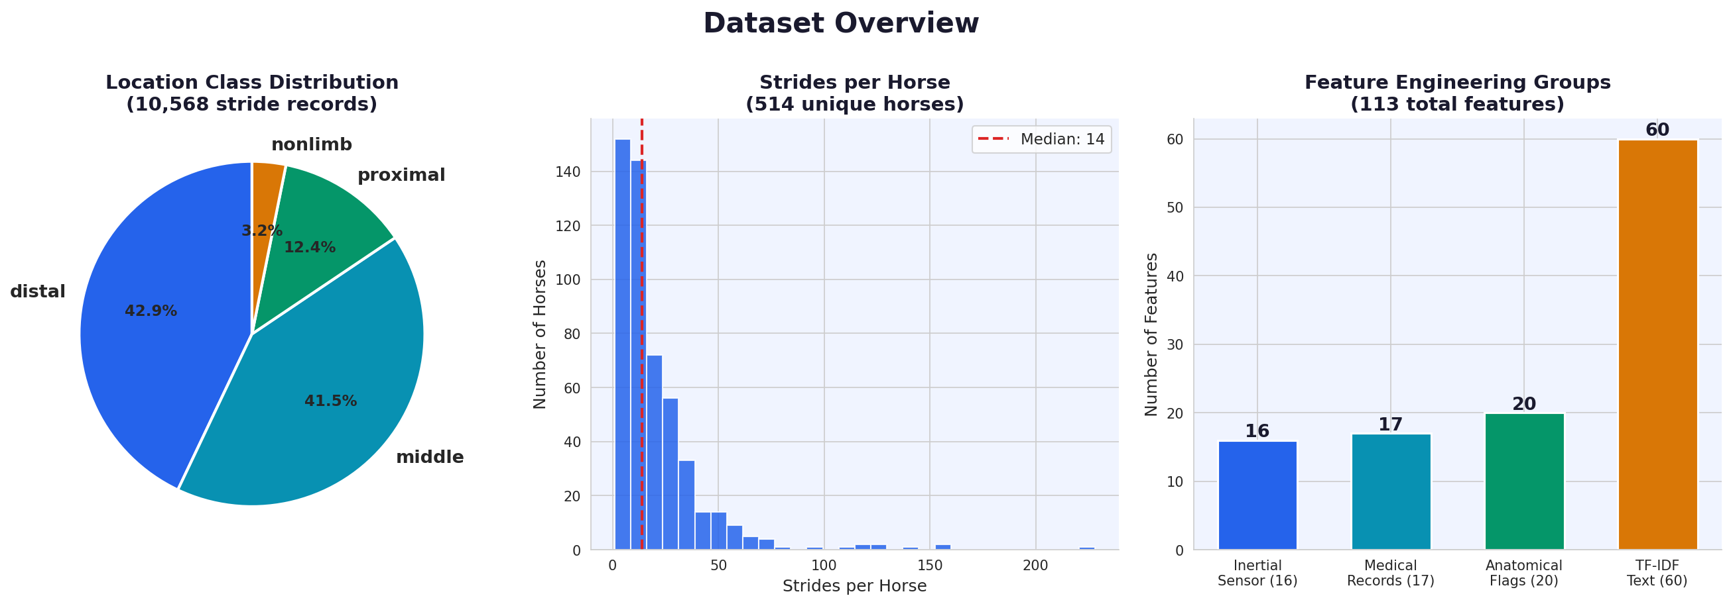
UNIVERSITY OF MISSOURI
EQUINE LAMENESS · TWO-PHASE AI PIPELINE
PHASE 2 · DATASET OVERVIEW
514 horses, 10,568 strides, 557 cases
514
10,568
557
4
horses
stride records
clinical cases
location classes
MIZZOU · Phase 2 · Dataset
11 / 23

Slide 12
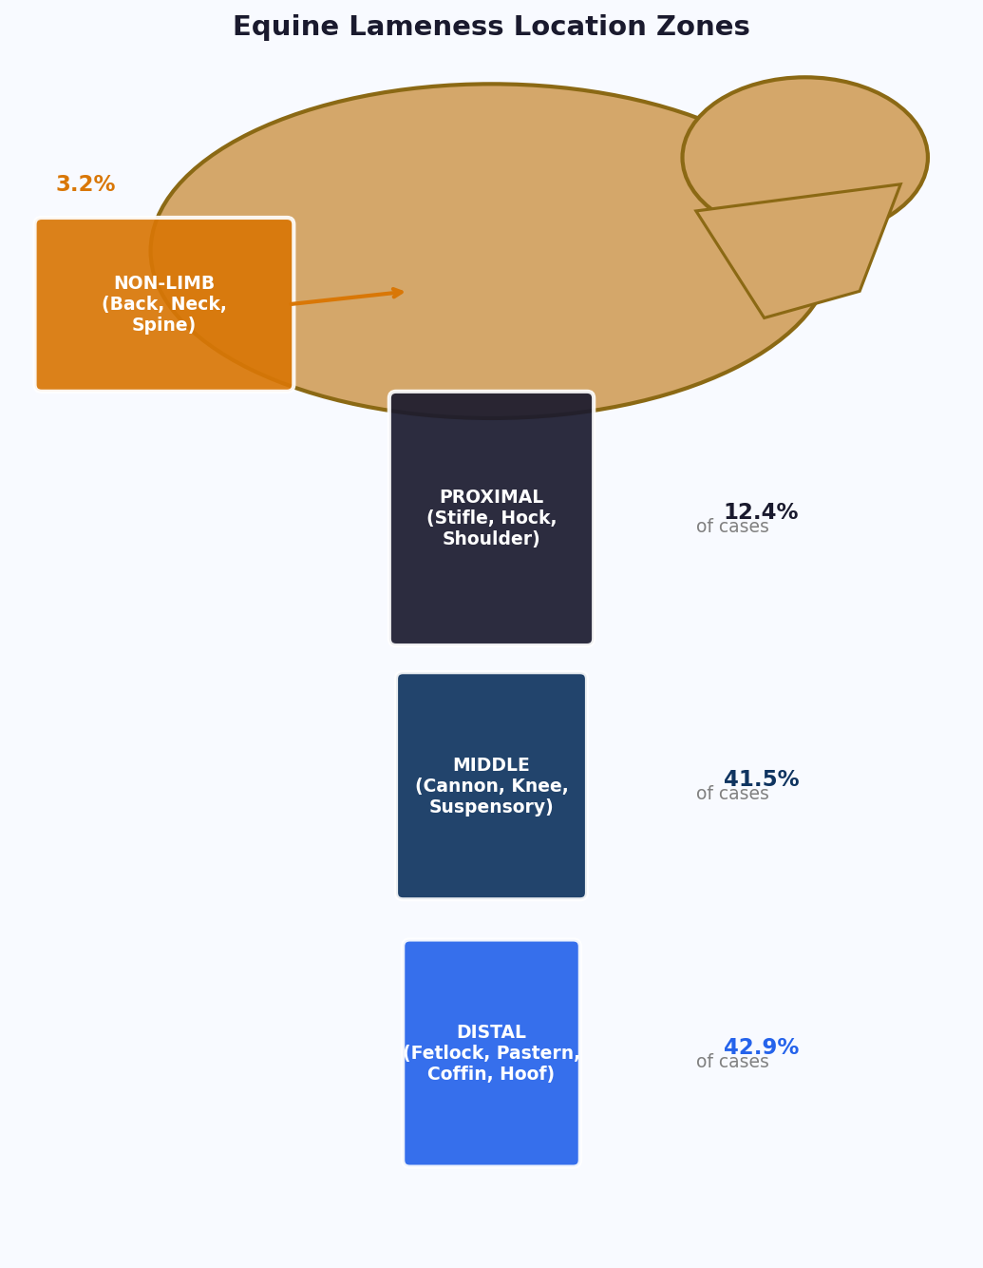
UNIVERSITY OF MISSOURI
EQUINE LAMENESS · TWO-PHASE AI PIPELINE
PHASE 2 · LAMENESS LOCATION ZONES
Four anatomical prediction targets — each with distinct sensor & clinical signatures
DISTAL
MIDDLE
42.9% of cases
41.5% of cases
Below the fetlock: pastern, coffin joint, navicular bone, hoof, sole & heel. Most common site. Clear sensor signature: high forelimb asymmetry on hard surfaces.
Cannon-bone region through knee/hock: suspensory ligament, check ligaments, digital flexor tendons, carpus. Second most common; often bilateral.
PROXIMAL
NON-LIMB
12.4% of cases
3.2% of cases
Above knee/hock: stifle, hip, shoulder, sacroiliac joint, upper limb muscles. Highest diagnostic complexity — improved by two-stage architecture.
Axial skeleton: back, neck, cervical, thoracic & lumbar spine, sacrum. Rarest class. Misclassified as proximal without dedicated Stage 1 filter.
MIZZOU · Phase 2 · Location Zones
12 / 23

Slide 13
UNIVERSITY OF MISSOURI
EQUINE LAMENESS · TWO-PHASE AI PIPELINE
PHASE 2 · FEATURE ENGINEERING PIPELINE
Five feature groups → 209 total features
16
17
20
60
features
features
features
features
INERTIAL SENSOR
MEDICAL RECORDS
ANATOMICAL FLAGS
TF-IDF TEXT
Forelimb & hindlimb diff max/min means & SDs · Vector sums, ratio means, stride rates · Fore & hind trot stride counts · Captured at 100 Hz, single-stride resolution.
Use of horse (sport / pleasure / racing) · Prior surgeries, shoeing status · Physical exam: nervous, imaging, integumentary · Last hoof care & dental care (days elapsed).
Binary flags regex-matched from History + Reason text · Fetlock, pastern, stifle, hock, back/spine · Fires if term present in either text field · Clinical vocab → location zones.
History of Current Problem + Reason combined · Domain stop-words removed (horse names, dates) · Unigrams & bigrams · Sublinear TF scaling · 'lameness' = #4 most important feature.
96
CASE-LEVEL GAIT STATS · NEW
μ, σ, skew, IQR, min, max per sensor feature — summarises all strides per horse into a distribution.
features
16 sensor features × 6 statistics = 96 new features. Within-case CV = 1.7 → rich distributional signal; biggest single accuracy gain in the entire pipeline: +6.9 percentage points.
MIZZOU · Phase 2 · Features
13 / 23

Slide 14
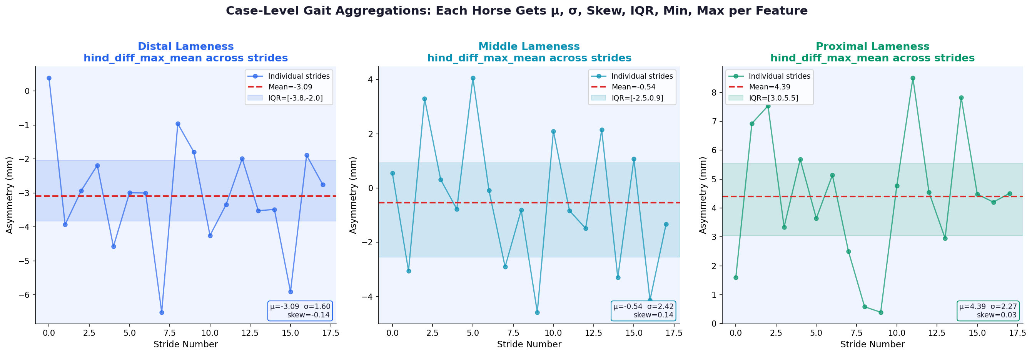
UNIVERSITY OF MISSOURI
EQUINE LAMENESS · TWO-PHASE AI PIPELINE
PHASE 2 · CASE-LEVEL GAIT AGGREGATIONS
Why stride-level features alone are insufficient
THE PROBLEM
Each horse has up to 228 strides — all tagged with the same label. A single stride is noisy. The model needs distributional context.
THE SOLUTION
KEY INSIGHT
Per-horse statistics across all strides: mean, SD (central tendency & spread), skew (distribution asymmetry), IQR (robust spread), min, max (extremes).
High within-case coefficient of variation (CV = 1.7) means stride distributions differ meaningfully between location classes. Aggregation captures what single strides cannot.
THE IMPACT
16 sensor features × 6 statistics = 96 new features. Single biggest accuracy gain in the pipeline: +6.9 pp.
+6.9 pp
MIZZOU · Phase 2 · Aggregations
14 / 23

Slide 15
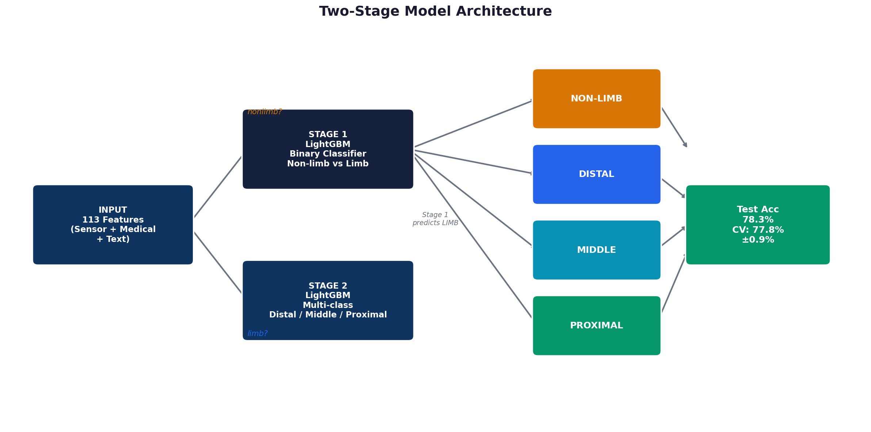
UNIVERSITY OF MISSOURI
EQUINE LAMENESS · TWO-PHASE AI PIPELINE
PHASE 2 · TWO-STAGE MODEL ARCHITECTURE
Structurally solving the non-limb minority class problem
WHY SEPARATE?
Non-limb cases (3.2%) have different feature signatures — back/spine flags, low sensor asymmetry. A single model creates conflicting gradient signals.
STAGE 1 — BINARY
Non-limb vs Limb | LightGBM
Optuna-tuned: lr=0.0163, n=300
Binary accuracy: 98.1%
Non-limb recall: 100%
STAGE 2 — 3-CLASS
Distal / Middle / Proximal
Trained on limb-only rows; lr=0.0111, n=300
Proximal recall: 99% (was 84%)
MIZZOU · Phase 2 · Architecture
15 / 23

Slide 16
UNIVERSITY OF MISSOURI
EQUINE LAMENESS · TWO-PHASE AI PIPELINE
PHASE 2 · OPTIMISATION
Optuna Bayesian search + stacking ensemble
OPTUNA HYPERPARAMETER SEARCH
STACKING ENSEMBLE — STAGE 2
40 trials per stage · 9 parameters · 5-fold CV objective
Three diverse base learners → logistic-regression meta-model
Parameter | Range
n_estimators | 300 – 1,200
learning_rate | 0.01 – 0.10
max_depth | 5 – 12
num_leaves | 31 – 127
min_child_samples | 5 – 30
subsample | 0.7 – 1.0
colsample_bytree | 0.7 – 1.0
reg_alpha / reg_lambda | 1e-4 – 10.0
1
LightGBM (Optuna-tuned)
Gradient boosting with optimised hyperparameters. Best single-model accuracy.
2
XGBoost (lr=0.03, n=600)
Different regularisation paradigm; complementary signal to LightGBM.
3
ExtraTrees (n=600)
Random-split trees, high variance, low correlation with boosting models.
BEST PARAMS FOUND
META-LEARNER · LOGISTIC REGRESSION
Stage 1: lr = 0.0163 · n = 300 · leaves = 33
Stage 2: lr = 0.0111 · n = 300 · leaves = 31
Insight: Very low LR + shallow trees → reduces overfitting on small N.
Trains on out-of-fold (5-fold) probabilities
Stage 2 accuracy: 92.6% · Proximal recall: 99% · +7.4 pp from stacking
MIZZOU · Phase 2 · Optimisation
16 / 23

Slide 17
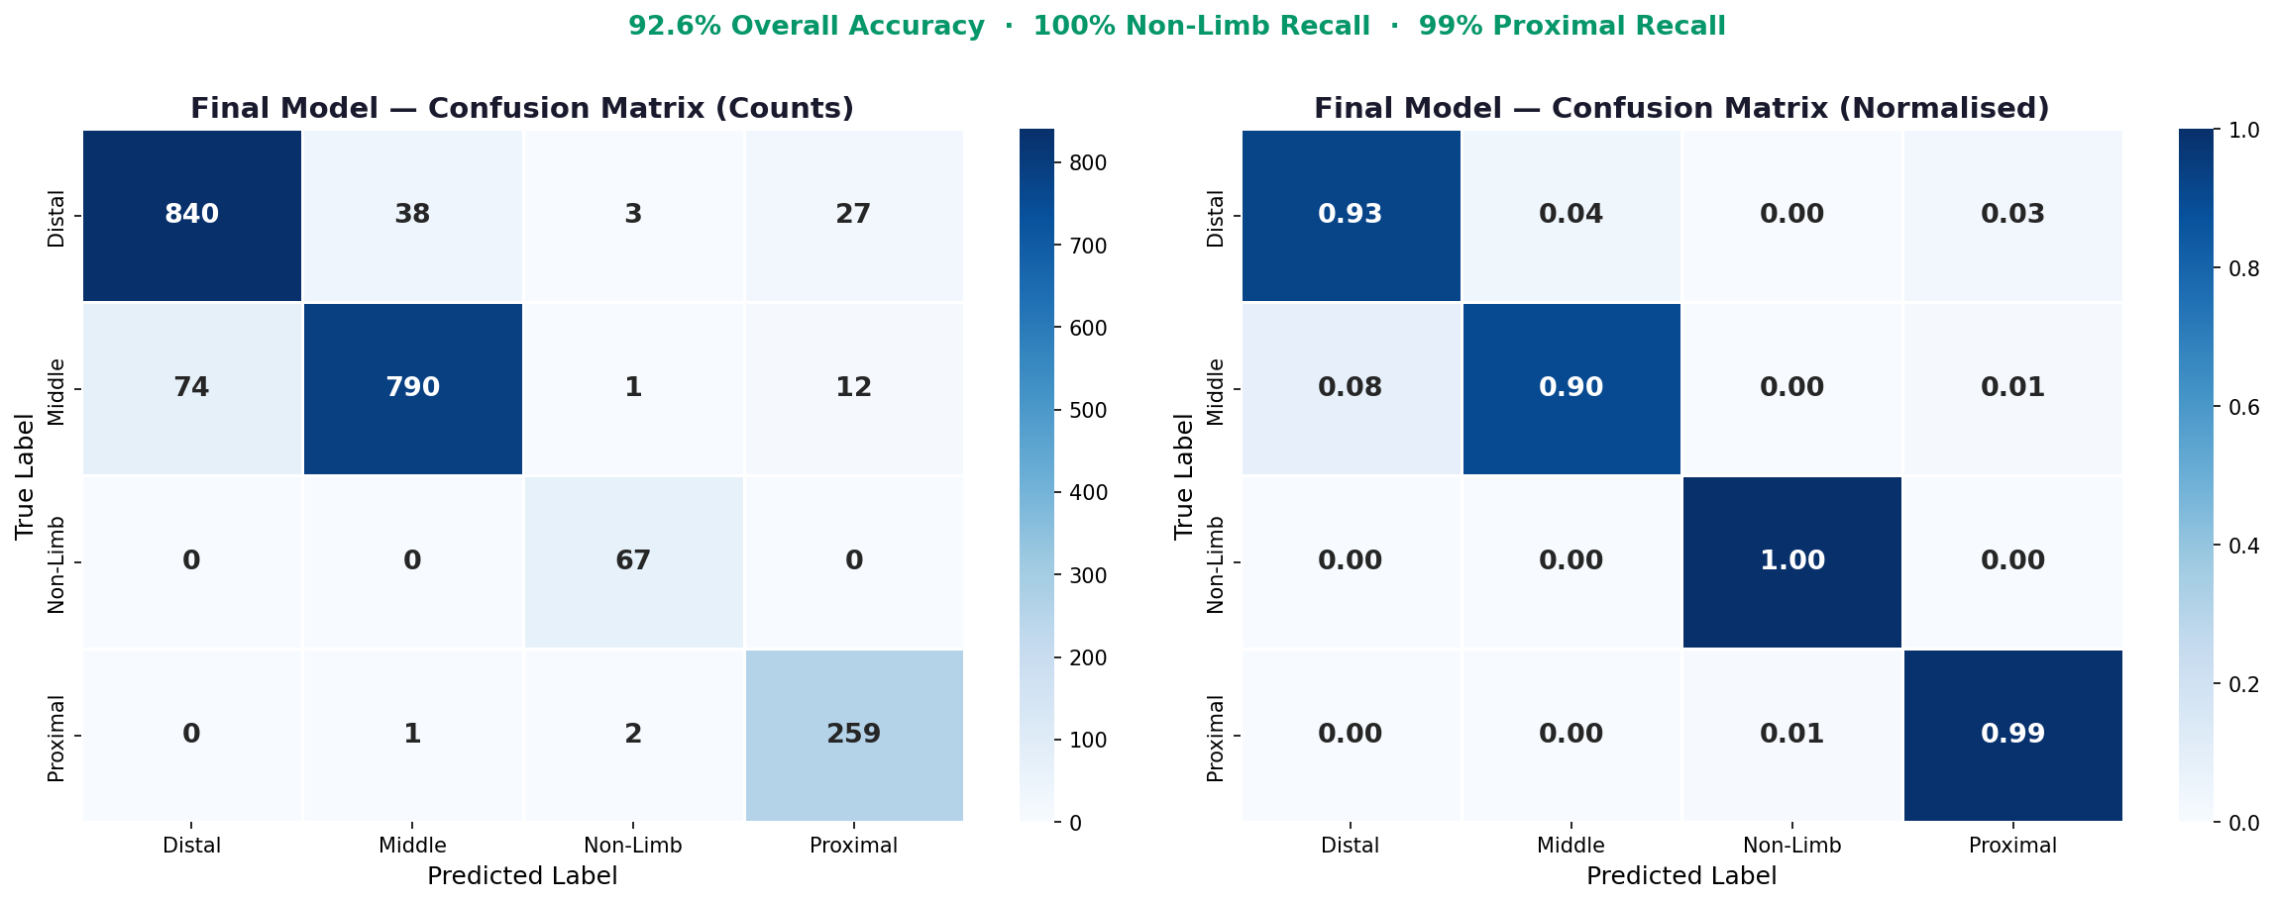
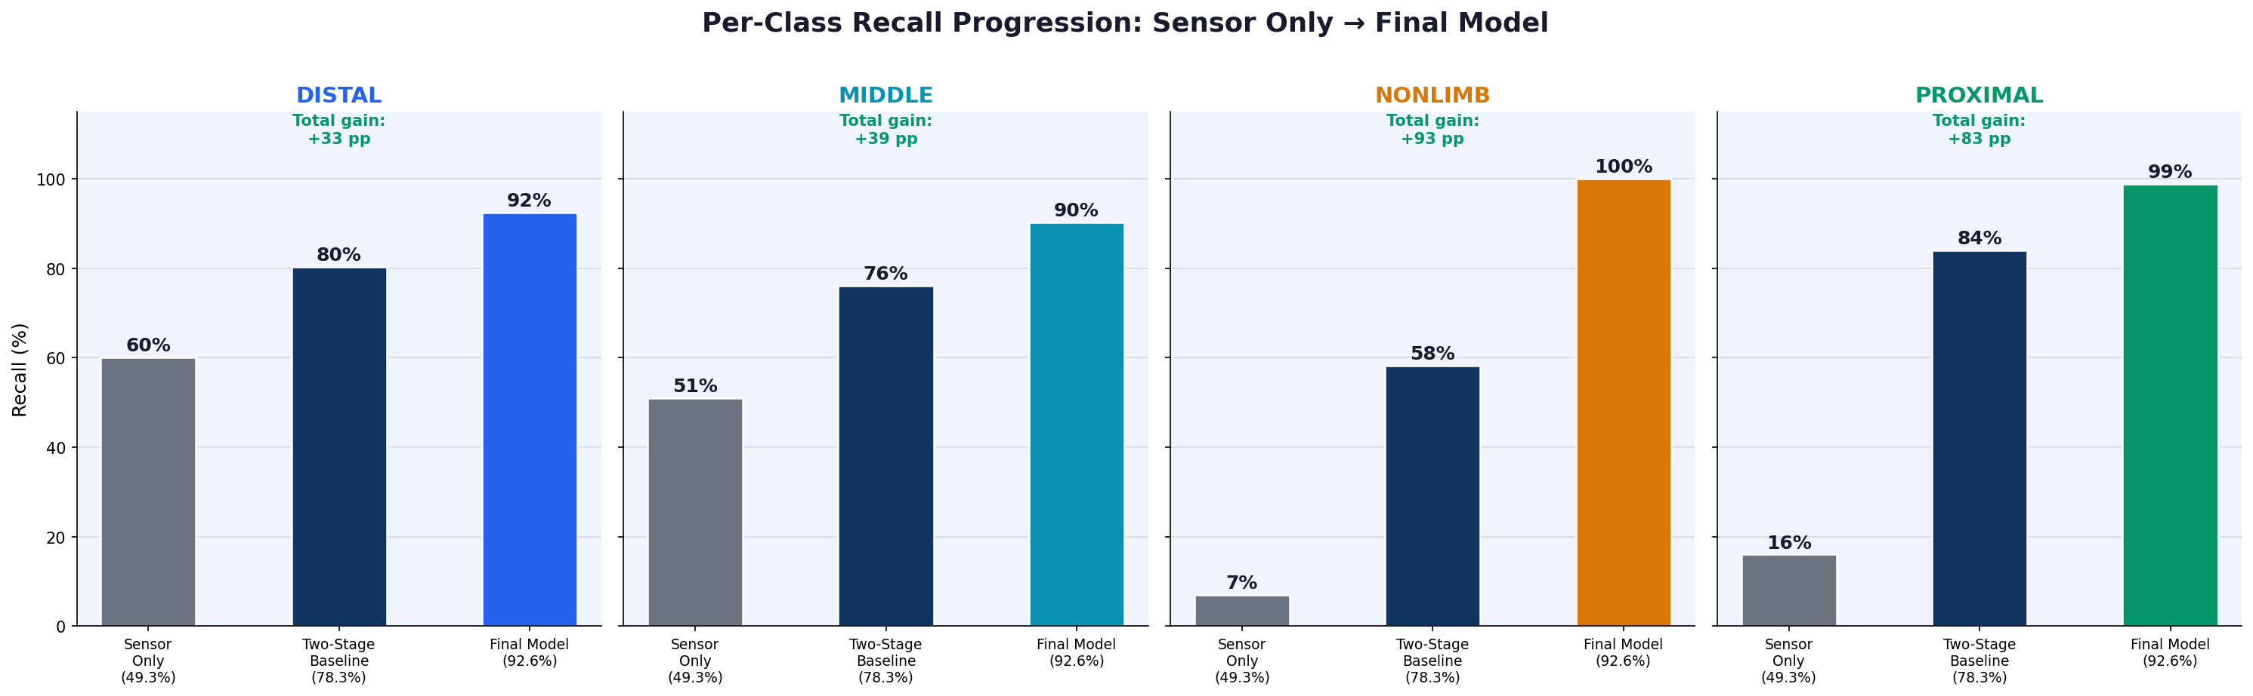
UNIVERSITY OF MISSOURI
EQUINE LAMENESS · TWO-PHASE AI PIPELINE
PHASE 2 · CONFUSION MATRIX
92.6% accuracy · 100% non-limb recall · n=2,114 strides
Per-class recall progression
From sensor-only baseline (49.3%) to final model (92.6%)
PROXIMAL RECALL JOURNEY
16% (sensor only) → 84% (two-stage) → 99% (final stacked model)
MIZZOU · Phase 2 · Results
17 / 23

Slide 18
UNIVERSITY OF MISSOURI
EQUINE LAMENESS · TWO-PHASE AI PIPELINE
PHASE 2 · FINAL CLASSIFICATION REPORT
Two-Stage + Gait Agg + Optuna + Stacking · n=2,114
Class | Precision | Recall | F1-Score | Support | Key observation
Distal | 97% | 93% | 95% | 908 | Highest precision. Clear sensor signal. Slight confusion with Middle.
Middle | 96% | 90% | 93% | 877 | Improved most from stacking ensemble (+15% vs baseline).
Non-Limb | 63% | 100% | 77% | 67 | 100% recall via dedicated Stage 1 binary classifier — clinically safer to over-detect.
Proximal | 82% | 99% | 90% | 262 | Recall 16% (sensor only) → 84% (two-stage) → 99% (final).
FINAL RESULT
92.6%
77.8% ± 0.9%
95.4%
93%
Test Accuracy
5-Fold CV
Macro Recall
Weighted F1
Feature set: 209 (Sensor 16 + Medical 17 + Flags 20 + TF-IDF 60 + Case Agg 96) · Model: Two-Stage + Optuna + Stacking
MIZZOU · Phase 2 · Classification Report
18 / 23

Slide 19
UNIVERSITY OF MISSOURI
EQUINE LAMENESS · TWO-PHASE AI PIPELINE
PHASE 2 · COMPLETE EXPERIMENT SUMMARY
Eight experiments — systematic ablation
# | Model / Experiment | Accuracy | Features | Key observation
1 | Sensor-only baseline | 49.3% | 16 | No class balancing. Establishes lower bound.
2 | + class_weight=balanced | 48.3% | 16 | Balancing alone insufficient for sensor features.
3 | + Medical records | 75.5% | 33 | Largest single gain: +26.1 pp. USE_OF_HORSE most important.
4 | + TF-IDF text (n=200) | 76.6% | 93 | History + Reason text. tfidf_lameness = top-4 feature.
5 | + Anatomical flags, LR=0.03 | 77.3% | 113 | Regex flags + cleaned stop-words + lower LR.
6 | Two-stage architecture | 78.3% | 113 | Stage 1 binary + Stage 2 limb-only. +14 pp proximal recall.
7 | + Case-level gait agg + Optuna | 85.2% | 209 | 96 new features + Bayesian HPO. Stage 1 = 100% non-limb recall.
8 | + Stacking ensemble (FINAL) | 92.6% | 209 | LGBM + XGB + ET → LR meta. All classes >90% recall.
Best model (Exp 8): 92.6% accuracy · 100% non-limb recall · 99% proximal recall · +43.3 pp gain from baseline
MIZZOU · Phase 2 · Experiments
19 / 23

Slide 20
UNIVERSITY OF MISSOURI
EQUINE LAMENESS · TWO-PHASE AI PIPELINE
PHASE 2 · DELIVERABLES
What you can use today
DELIVERABLE 01
DELIVERABLE 02
DELIVERABLE 03
Mizzou Prediction Tool
Two-Stage Multi-Modal Architecture
Open-Source Repository
LIVE WEB APP
GITHUB · MIT-LICENSED
A Streamlit-deployed inference UI that runs the full two-stage pipeline on uploaded inertial-sensor + clinical data and returns a predicted lameness location with class probabilities.
MODEL PIPELINE
Full source code, training pipeline, feature-engineering scripts, hyperparameter-search configs, and inference notebooks. Reproduce the 92.6% result end-to-end.
Stage 1 binary (non-limb vs. limb) feeds Stage 2 three-class limb localization. Trained on multi-modality features: inertial sensor signals, EHR text, anatomical flags, TF-IDF, and case-level gait aggregations.
OPEN THE LIVE APP ↗
92.6% test accuracy · 100% non-limb recall
CLONE THE REPO ↗
mizzou-lameness-predictor.streamlit.app
github.com/xenificity/equine-lameness-predictor
Try the live tool, inspect the architecture, fork the code — all three deliverables are public and accessible right now.
MIZZOU · Phase 2 · Deliverables
20 / 23

Slide 21
UNIVERSITY OF MISSOURI
EQUINE LAMENESS · TWO-PHASE AI PIPELINE
CONVERGENCE
How Phase 1 and Phase 2 close the loop
Two complementary work streams. Same project. Convergence after the hackathon.
PHASE 1
ARCHIVE
PHASE 2
Discharge Summary AI
Anonymized Case Data
Lameness Prediction Model
Captures structured case data through Socratic interview. Extracts measurement files (Lameness Locator metrics). Outputs anonymized summaries the predictive model can train on. Surfaces clinical-reasoning contradictions.
Structured discharge records with location-relevant metrics, anatomical flags, and clinical narrative — all de-identified and conformed to a single schema. The data spine.
Consumes structured lameness data (sensor metrics + EHR taxonomy). Predicts location, anatomy, type, primary vs. compensatory. Trained on the anonymized case archive built upstream.
Closing the loop: data collection → prediction → clinical decision support → better data collection.
MIZZOU · Convergence
21 / 23

Slide 22
UNIVERSITY OF MISSOURI
EQUINE LAMENESS · TWO-PHASE AI PIPELINE
WHERE WE GO FROM HERE
Next steps — beyond the hackathon
PHASE 1
NEXT FOR THE GENERATOR
PHASE 2
NEXT FOR THE PREDICTOR
1
Native VetView integration
1
Scale type & anatomy prediction
Embed the Socratic interview directly inside MU's VetView clinical system. Students complete the form in the same EHR where the case lives — the generator runs natively, no context-switch, no copy-paste, drafts land straight into the medical record.
Extend beyond location to predict lameness type (impact vs. pushoff, primary vs. compensatory) and exact anatomical structure — turning a 4-class location model into a richer multi-label diagnostic system.
2
Clinician review dashboard
2
Deploy on Mizzou Vet servers
A login-protected page where attendings see all pending student drafts, edit inline, and approve in one click.
Move the inference stack out of Streamlit Cloud and into MU's veterinary infrastructure so clinicians and students can rely on it as a sanctioned point-of-care tool.
3
Show-Me AI / Azure migration
3
Submit for publication
Per Dr. Keegan's IT Compliance request — move the LLM backend into MU's walled-garden infrastructure.
Package the methodology, ablation study, and results into a peer-reviewed manuscript for a relevant veterinary-informatics or applied-ML venue.
MIZZOU · Future Work
22 / 23

Slide 23
UNIVERSITY OF MISSOURI
Thank you.
Questions and feedback welcome.
PHASE 1
PHASE 2
Arwa Mashagbeh
Ajay Kumar
Discharge Summary AI Assistant
ajay.kumar@missouri.edu
MIZ — ZOU

