Slide 1
iBank: Delivery 3
Project of SOEN 6611 - Software Measurement
DESIGNER | EVALUATOR
WEI HUANG | 40109362
YICHEN HUANG | 40167688
QIANG XUE | 40300671
ANALYST | REVIEWER
TEAM C
LEAD | CODER | WRITER
July 2026

Slide 2
Agenda
1. Problem 7: Cyclomatic Complexity
• Method-level CC1, the onOk hotspot, and one targeted refactoring
2. Problem 8: Object-Oriented Metrics
• WMC roll-up, CF/LCOM* hotspots, and design actions
3. Problem 9: Use Case Points
• UAW/UUCW, adjustment factors, and effort calibration
4. Problem 10: Correlation Analysis
• Scatter plot, Spearman coefficient, and interpretation
5. Final GQM Synthesis & Appendix
• Return to the revised goal, then appendix and Q&A

Slide 3
Problems 7-10: Measurement Baseline
Every result is recomputed on the latest repository commit. (Kamthan, 2026d)
VERSION-CONTROL BASELINE
Commit e616e59 · July 20, 2026;
25 Java types · 23 classes + 2 interfaces
1,929 Logical SLOC
46 / 46 JUnit tests pass
REPRODUCIBLE PIPELINE
UCC-J → LSLOC + method CC1
Compiler AST → WMC, CF, LCOM*
Merge → class-level CSV
Average ranks → Spearman ρ
Scope: production code only; interfaces remain in the CF universe.
REPRODUCIBLE OUTPUTS
class_metrics.csv · metrics_summary.json · correlation_data.csv · D3MetricsAnalyzer.java
Baseline: GitHub commit e616e59 (full URL in speaker notes).
Source-driven calculations; no D2 metric snapshot reused.

Slide 4
Problem 7: Cyclomatic Complexity
Cyclomatic complexity counts independent control-flow paths. (Kamthan, 2026a)
DEFINITION
V(G) = E - N + 2P ≡ number of decisions + 1 (per method)
iBank: ΣV(G) = 474 | 239 methods | mean = 1.98
📏 Counting Scheme
UCC-J 2020.01 CC1 is used consistently for every Java method and constructor.
File/class WMC is the unnormalized sum of method complexities. Project total is the sum over the 23 classes.
🎯 Lecture Thresholds
1-10: low; 11-20: moderate; 21-50: high; >50: very high.
A value of 10 or more is cause for concern. These are method-level indicators, not a verdict on the whole product.

Slide 5
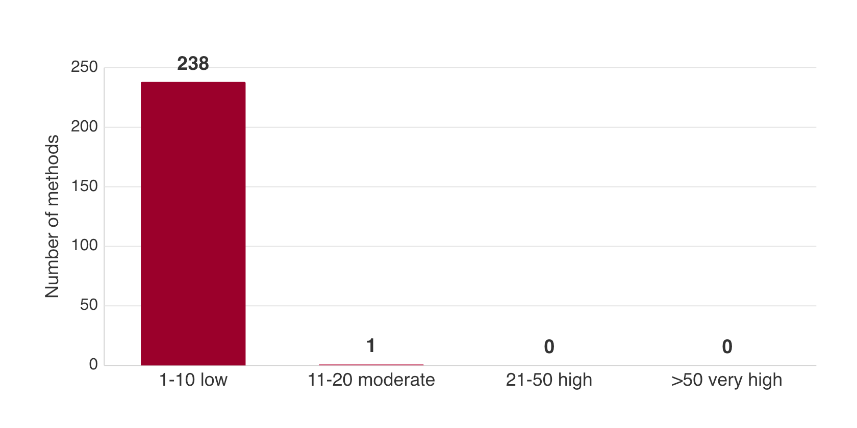
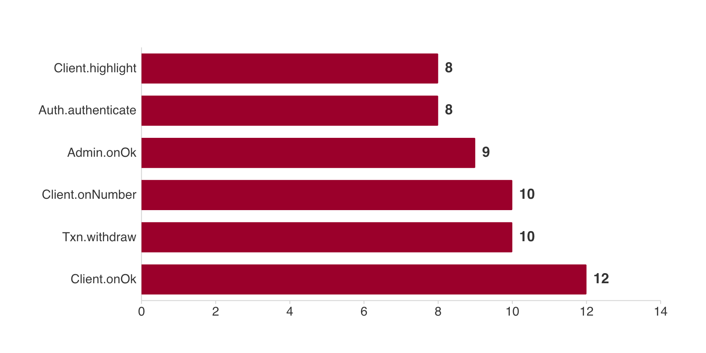
Problem 7: Complexity Results
Only onOk is moderate; overall, method complexity is not a major concern. (Kamthan, 2026a)
📊 Cyclomatic Summary
Methods measured | 239
Total V(G) | 474
Mean / maximum | 1.98 / 12
V(G) 1-9 | 236
V(G) = 10 | 2
V(G) = 12 | 1
V(G) >20 | 0
Method-level evidence

Slide 6
Problem 7: Qualitative Conclusion
The only moderate method combines four UI states and three transaction paths. (Kamthan, 2026a)
RESULT
ClientDashboardPanel.onOk = 12; every other method ≤ 10
2 methods = 10 | 1 method = 12 | 0 methods above 20
✅ Project-Specific Conclusion
The mean of 1.98 and absence of high or very-high methods indicate generally simple control flow.
The total 474 is not one complex unit: it is the sum of 239 method-level CC1 values.
🔧 Why onOk Is High and What to Do
onOk switches among acc_select, dest_select, amount, and confirm; then dispatches withdraw, deposit, or transfer and handles two exceptions.
Extract one handler per state; separately review the two CC1 = 10 methods.

Slide 7
P7 Method CC Rolls Up into P8 Class WMC
Unnormalized WMC uses each method’s CC1 as its weight. (Kamthan, 2026e)
The same UCC-J method results support both problems: P7 reports CC1 per method; P8 groups those methods by class and sums their CC1 values. Therefore ΣWMC = Σmethod CC1 = 474.
Measure | Level | Computation | Concrete example
CC1 | Method | decisions + 1 | Account.withdraw = 2
WMC | Class | Σ CC1(method) | ClientDashboardPanel: 23 methods → 99
CF | Project / type | 71 / (25² - 25) | System CF = 0.1183
LCOM* | Class | field-use cohesion | 8 classes ≥ 0.80

Slide 8
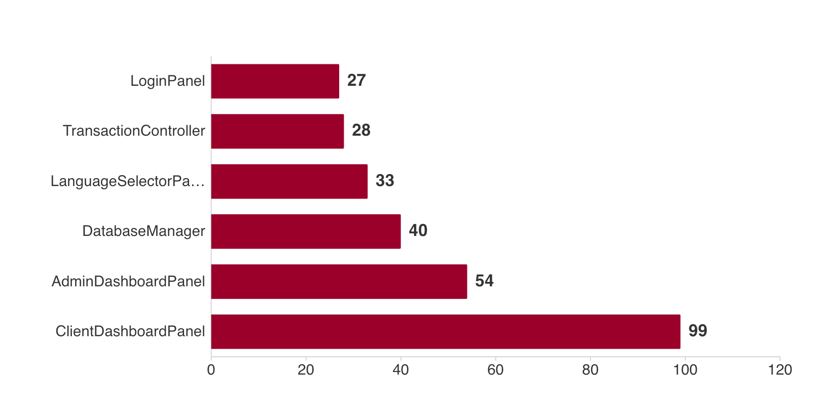
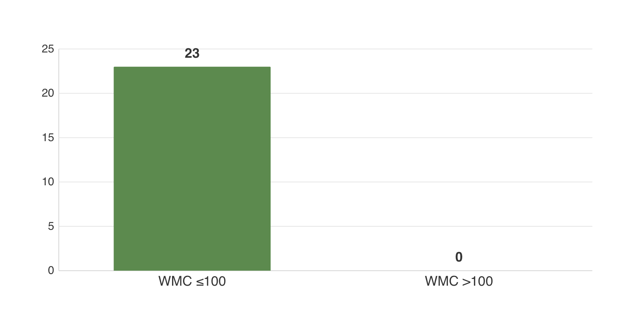
Problem 8: WMC Results
ClientDashboardPanel’s 23 method weights sum to 99; no class exceeds 100. (Kamthan, 2026e)
📊 WMC Summary
Classes | 23
Total WMC | 474
Mean per class | 20.61
WMC >100 | 0 classes
Hotspot calculation | 23 methods → ΣCC1 = 99
Second highest | AdminDashboard 54
Interpretation | 99 is near the lecture limit
Class-level evidence

Slide 9
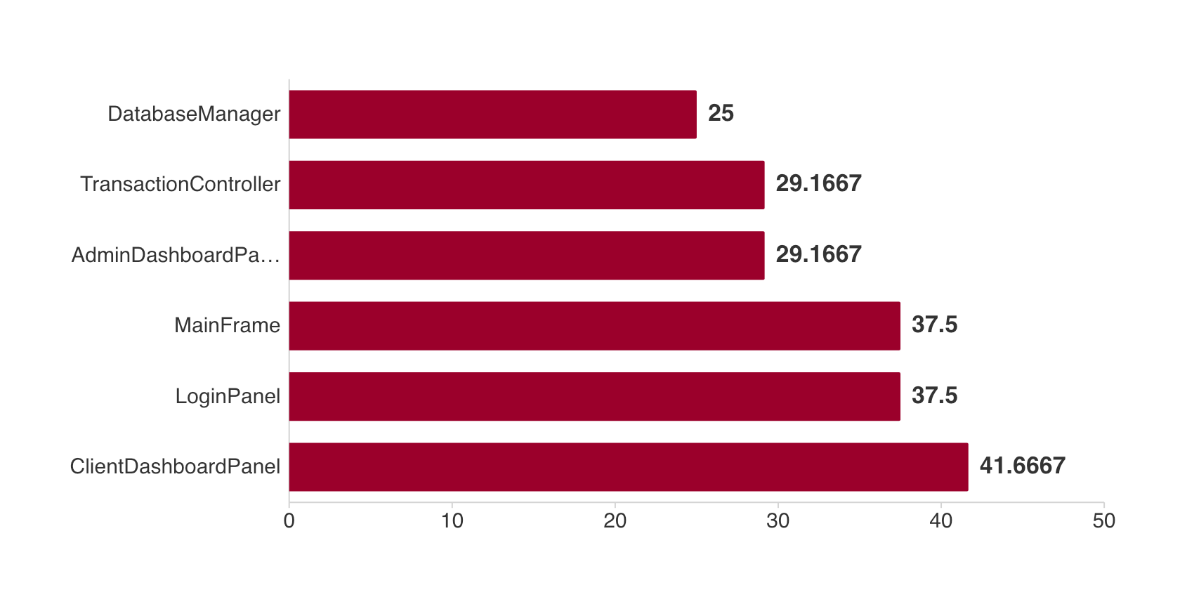
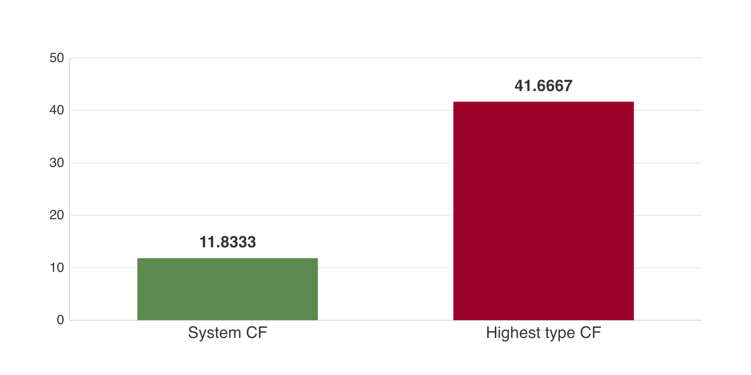
Problem 8: Coupling Factor
71 of 600 possible directed dependencies give system CF = 0.1183. (Kamthan, 2026e)
🔗 CF Summary
Type universe | 25
Possible directed pairs | 600 = 25 × 24
Observed couplings | 71
System calculation | 71 ÷ 600 = .1183
Highest contribution | ClientDashboard .4167
Interpretation | Low overall
Action | Extract UI flow
Directed dependencies

Slide 10
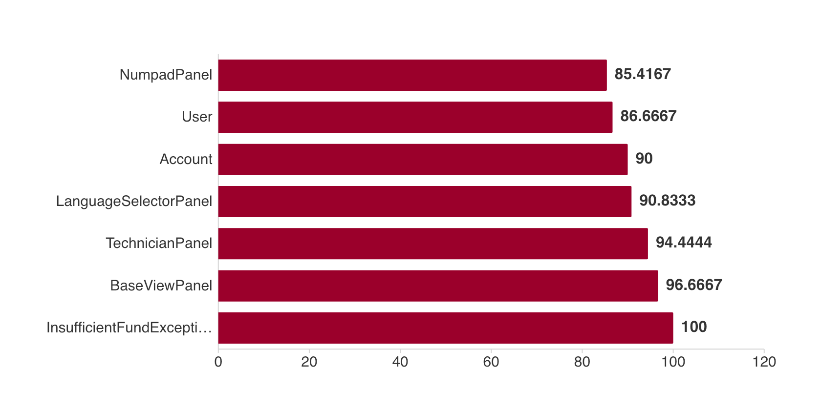
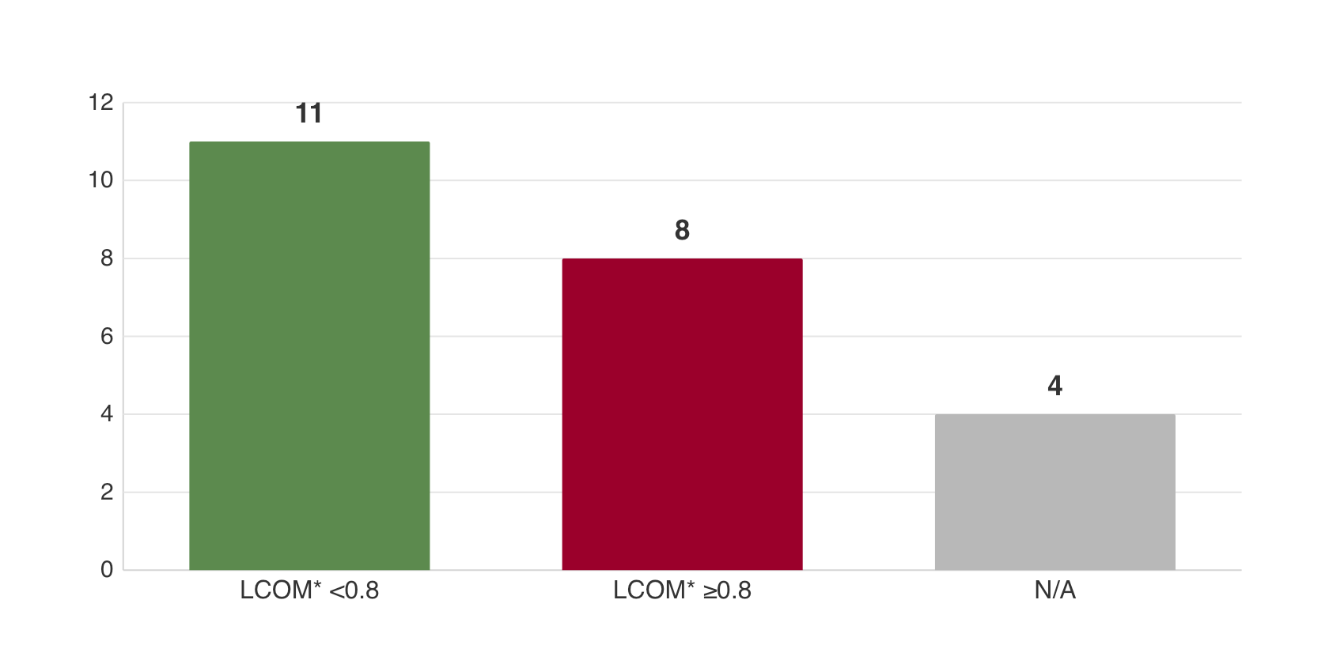
Problem 8: LCOM* Results
Eight classes reach the lecture concern level; several are UI/state containers. (Kamthan, 2026e)
🧩 LCOM* Summary
Applicable classes | 19 / 23
Below 0.8 | 11
At/above 0.8 | 8
N/A | 4
Highest | Insufficient 1.00
UI examples | Base 0.97; Tech 0.94
Action | Extract panel/state roles
Instance-field usage

Slide 11
Problem 8: Project-Specific Conclusions
The values point to a concentrated UI-design risk, not a system-wide failure. (Kamthan, 2026e)
SO WHAT?
WMC 99 + CF 0.4167 + localized LCOM* hotspots
The main maintainability risk is UI orchestration concentrated in a few classes.
🔎 Why These Classes Stand Out
ClientDashboardPanel owns 23 instance methods and directly references 10 project types.
BaseViewPanel, TechnicianPanel, and MainFrame contain fields used by separate UI method groups.
🔧 Targeted Design Response
Extract transaction-state handlers from ClientDashboardPanel; move orchestration into controllers/services; split large UI containers into focused panels or state holders.
N/A LCOM* cases are not failures.

Slide 12
Problem 8: Complete Class Matrix (1/2)
Native table view — first 12 classes. (Kamthan, 2026e)
Class | WMC | CF | LCOM*
Account | 9 | 0.00 | 0.90
AccountLockedException | 3 | 0.00 | —
AdminDashboardPanel | 54 | 0.29 | 0.68
AuthenticationController | 17 | 0.17 | 0.67
BankClient | 7 | 0.04 | 0.33
BaseViewPanel | 14 | 0.13 | 0.97
CashBox | 15 | 0.00 | 0.63
ClientDashboardPanel | 99 | 0.42 | 0.70
DatabaseManager | 40 | 0.25 | 0.00
ExchangeRateManager | 16 | 0.04 | 0.67
I18nController | 19 | 0.00 | 0.71
InsufficientFundException | 3 | 0.00 | 1.00
KEY CHECK — No class exceeds WMC > 100; ClientDashboardPanel is the near-limit hotspot at 99.
Full precision and coupled-type details: d3/eval/class_metrics.csv

Slide 13
Problem 8: Complete Class Matrix (2/2)
Native table view — remaining 11 classes. (Kamthan, 2026e)
Class | WMC | CF | LCOM*
InvalidAmountException | 3 | 0.00 | —
LanguageSelectorPanel | 33 | 0.17 | 0.91
LoginPanel | 27 | 0.38 | 0.70
MainFrame | 14 | 0.38 | 0.83
NumpadPanel | 22 | 0.08 | 0.85
SystemAdmin | 5 | 0.00 | —
Technician | 3 | 0.00 | —
TechnicianPanel | 21 | 0.21 | 0.94
TransactionController | 28 | 0.29 | 0.17
TransactionRecord | 10 | 0.00 | 0.13
User | 12 | 0.00 | 0.87
KEY CHECK — Highest CF contribution: 0.42 • LCOM* ≥ 0.80: 8 classes • N/A is not a failure.
Full precision and coupled-type details: d3/eval/class_metrics.csv

Slide 14
Problem 9: Why UAW = 9 and UUCW = 125
Lecture categories are applied to three GUI actors and eleven counted use cases. (Kamthan, 2026b)
WHY EACH ACTOR WEIGHS 3
Lecture rule: a person interacting through a GUI is a complex actor, weighted 3.
Bank Client · System Administrator · Technician
UAW = 3 actors × 3 = 9
WHY UUCW EQUALS 125
Count main-success actor–system transactions.
Simple: Check Balance (2) → 1 × 5 = 5
Average: 6 use cases (4–7) → 6 × 10 = 60
Complex: Withdraw 10 · Deposit 10 · Transfer 12 · Exchange Rate 8 → 4 × 15 = 60
UUCW = 125; UUCP = 9 + 125 = 134
Traceability: all 11 counted use cases and transaction counts are retained in ucp_use_cases.csv; included sub-use cases are counted once.
Details: d3/eval/ucp_actors.csv and ucp_use_cases.csv
Lecture weights: simple 5 · average 10 · complex 15.

Slide 15
Problem 9: UCP Adjustment Factors
TCF and ECF adjust 134 UUCP. (Kamthan, 2026b)
Ratings follow the lecture definitions and are auditable in CSV. Examples: T1 Distributed system = 0 (standalone); T3 End-user efficiency = 5; E2 Part-time workers = 5; E8 Stable requirements = 4.
Component | Weighted sum | Formula | Result
Unadjusted | UAW 9 + UUCW 125 | UUCP | 134
Technical | Σ(Ti × weight) = 39.5 | 0.6 + 0.01T | TCF = 0.995
Environment | Σ(Ei × weight) = 18.5 | 1.4 - 0.03E | ECF = 0.845
Adjusted | 134 × .995 × .845 | UCP | 112.66

Slide 16
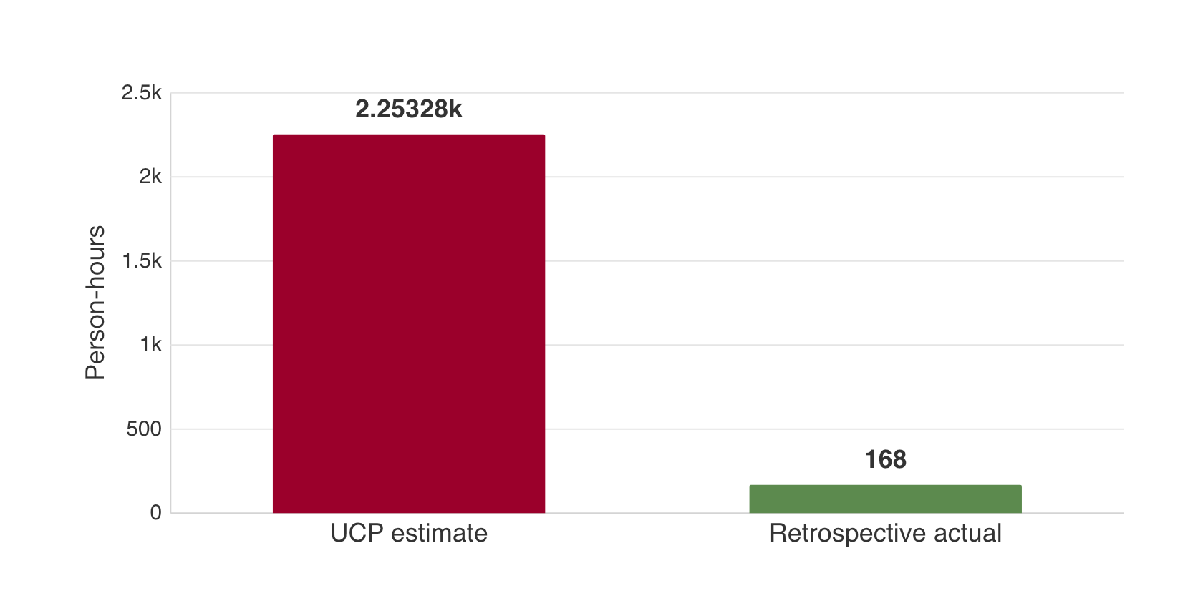
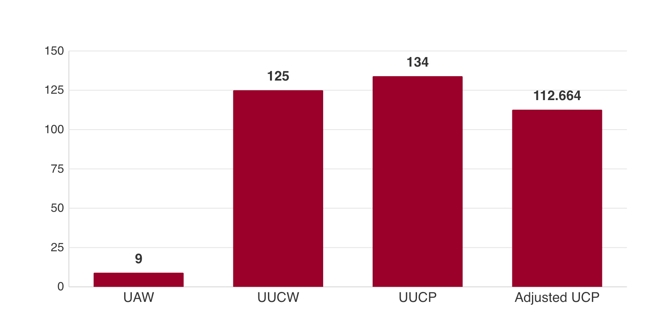
Problem 9: Effort Comparison
3 members × 56 h = 168 h; the default factor predicts 2,253 h. (Kamthan, 2026b)
⏱ Effort Summary
Adjusted UCP | 112.66
Productivity factor | 20 h/UCP
Estimated effort | 2,253 h
Actual baseline | 168 h retrospective
Observed factor | 168 ÷ 112.66 = 1.49 h/UCP
Estimate / actual | 13.41×
Actual formula | 3 × 56 h
Estimate vs. retrospective

Slide 17
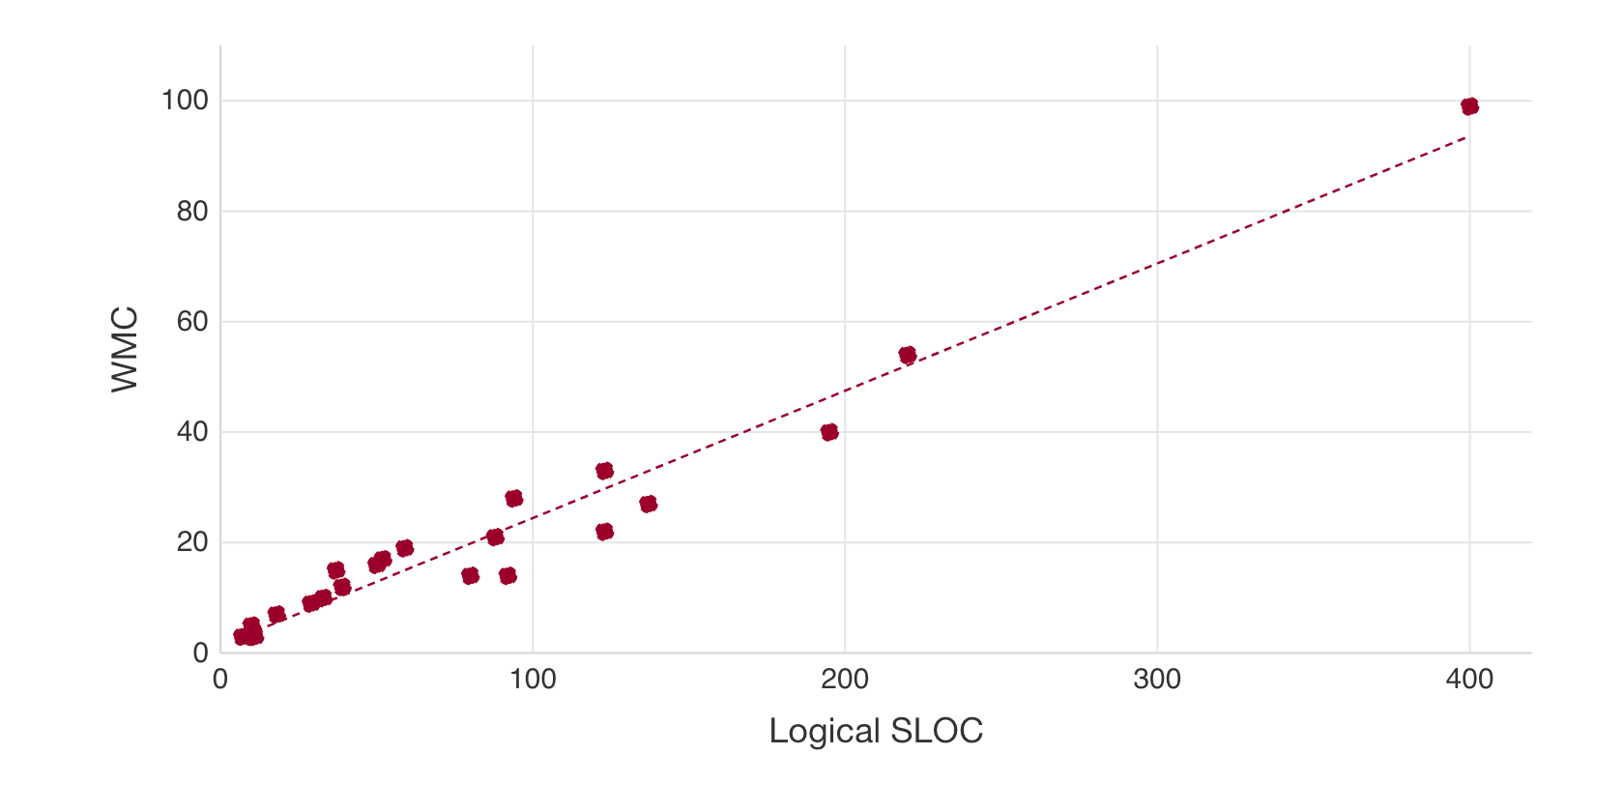
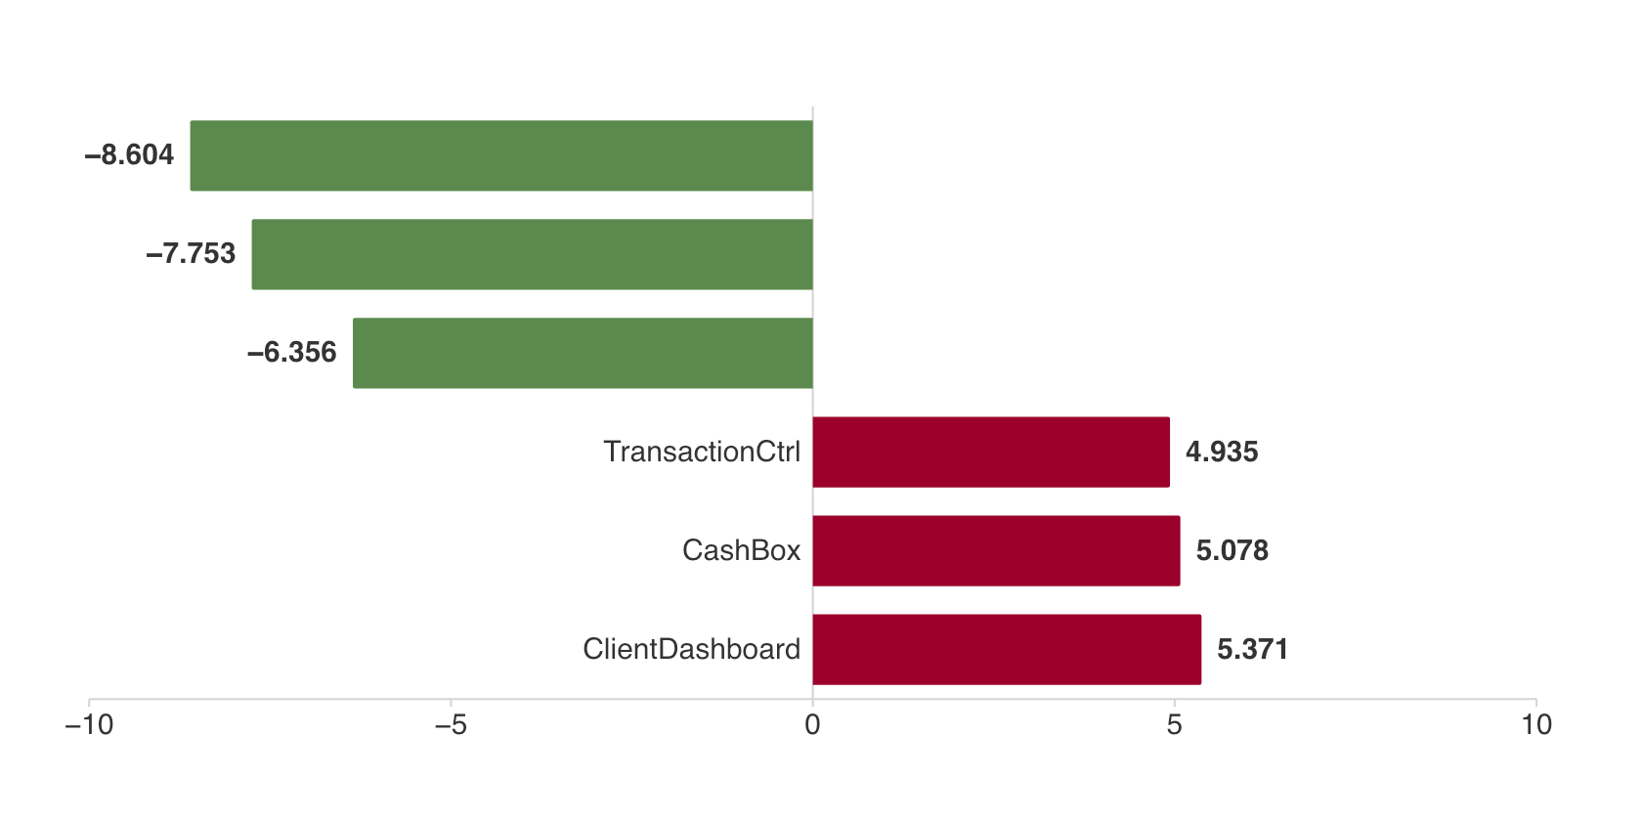
Problem 10: Scatter Plot
Scatter → skewness check → Spearman: larger classes tend to be more complex. (Kamthan, 2026c, 2026d)
📈 Correlation Summary
Observations | 23 classes
Spearman ρ | 0.9549
Lecture label | Almost perfect
Pearson sensitivity | 0.9805
Regression | y=.2306x+1.389
Skewness | LSLOC 2.06; WMC 2.37
Direction | Positive monotonic
23 class observations

Slide 18
Problem 10: Correlation Conclusion
The association is almost perfect, not causal. (Kamthan, 2026c)
SPEARMAN
ρ = corr(rank(LSLOC), rank(WMC)); ties use average ranks
ρ = 0.9549 | Pearson sensitivity r = 0.9805 | n = 23
✅ Sensible Conclusion
Both distributions are strongly right-skewed, so Spearman is selected under the lecture rule for non-normal data.
Its value confirms an almost-perfect positive monotonic relationship.
⚠️ Limitation & Action
The result is codebase-specific and size-confounded; it does not prove that adding lines causes complexity.
Prioritize classes that are both large and above the fitted line—especially ClientDashboardPanel.

Slide 19
Final Synthesis: Did We Achieve the Goal?
D1 GQM revised to match the evidence collected in D2–D3.
REVISED GQM GOAL
Evaluate and improve iBank’s maintainability and evolvability by keeping the Java code readable, logically simple, loosely coupled, cohesive, and predictably sized—measured by D3.
STRENGTHS & IMPROVEMENT OPPORTUNITIES
✓ Readability — BLR 15.11%, within the 15–25% target.
✓ Simplicity — 238/239 methods are low-band; no WMC > 100.
✓ Low coupling — system CF = 0.1183.
⚠ UI design — WMC 99 and 8 LCOM* hotspots need focused refactoring.
◇ Planning baseline — 1,929 LSLOC and 112.66 UCP.
◇ Size signal — Spearman ρ = 0.9549; monitor large classes.
OVERALL — GOAL ACHIEVED AT SYSTEM LEVEL
Readable, loosely coupled, and generally simple. Next: refactor onOk and high-LCOM* UI classes; calibrate UCP productivity.
Repository (commit e616e59): https://github.com/xenobinary/6611-project/tree/master

Slide 20
Appendix: GAI CASTROFF Prompts
PROBLEM 7 — COMPLEXITY
C e616e59 · UCC-J CC1
A Instructor + classmates
S Formula → metric → threshold
T Concise · evidence-based
R Measurement analyst
O Reproducible CSV + slides
F Separate aggregation levels
F Reject unsupported values
PROBLEM 8 — OO METRICS
C Raw WMC · CF excludes inheritance
A Technical evaluator
S Conventions → metrics → hotspots
T Academic · cautious
R Static-analysis reviewer
O CSV + qualitative summary
F Explain N/A · no invented cutoffs
F Validate with compiler AST
PROBLEMS 9–10 — UCP & CORRELATION
C Transactions · 20 h/UCP · 23 classes
A Course marker
S Inputs → result → limitations
T Transparent · evidence-based
R Estimation/statistics analyst
O UCP tables + scatter + Spearman
F Distribution-aware · no causality
F Verify all CSV results
Full CASTROFF prompt: GitHub repository — d3/prompts/delivery3_castroff_prompt.md (see References).

Slide 21
References (1/3)
[1] Concordia University. (2026). SOEN 6611 Project Description, pp. 7–8.
[2] Kamthan, P. (2026a). Control Flow Structure of Source Code [Lecture slides]. SOEN 6611, Concordia University, pp. 13–20.
[3] Kamthan, P. (2026b). The Estimation of Effort Based on Use Cases [Lecture slides]. SOEN 6611, Concordia University, pp. 5–17.
[4] Kamthan, P. (2026c). Introduction to Analysis of Software Measurement Data [Lecture slides]. SOEN 6611, Concordia University, pp. 42, 46–53.
[5] Kamthan, P. (2026d). Length of Source Code [Lecture slides]. SOEN 6611, Concordia University, pp. 16–20.

Slide 22
References (2/3)
[6] Kamthan, P. (2026e). Metrics for Classes in Object-Oriented Design [Lecture slides]. SOEN 6611, Concordia University, pp. 11–16, 32, 36–42.
[7] USC CSSE. (2020). Unified Code Counter—Java (UCC-J), Version 2020.01, U.S. Government Edition.
[8] Group C. (2026). iBank Project, commit e616e59.
https://github.com/xenobinary/6611-project/tree/master.
[9] McCabe, T. J. (1976). A complexity measure. IEEE Transactions on Software Engineering, SE-2(4), 308–320. https://doi.org/10.1109/TSE.1976.233837.
[10] Chidamber, S. R., & Kemerer, C. F. (1994). A metrics suite for object-oriented design. IEEE Transactions on Software Engineering, 20(6), 476–493. https://doi.org/10.1109/32.295895.

Slide 23
References (3/3)
[11] Brito e Abreu, F., & Carapuça, R. (1994). Object-oriented software engineering: Measuring and controlling the development process. In Proceedings of the 4th International Conference on Software Quality. https://zenodo.org/record/1217609.
[12] Henderson-Sellers, B. (1996). Object-oriented metrics: Measures of complexity. Prentice Hall.
[13] Anda, B., Dreiem, H., Sjøberg, D. I. K., & Jørgensen, M. (2001). Estimating software development effort based on use cases—Experiences from industry. In UML 2001: The Unified Modeling Language (LNCS 2185, pp. 487–502). Springer. https://doi.org/10.1007/3-540-45441-1_35.
[14] Cohn, M. (2005). Estimating with use case points. Methods & Tools. https://www.methodsandtools.com/archive/archive.php?id=25.
[15] Tavakoli, H. (2026). The CASTROFF framework: A professional standard for prompt engineering. In Prompt Engineering for Everyone (pp. 95–116). Apress. https://doi.org/10.1007/979-8-8688-2338-1_6.

Slide 24
Questions & Answers
Thank you for reviewing our iBank Delivery 3 Presentation

