Slide 1
iBank: Delivery 1
Project of SOEN 6611 - Software Measurement
DESIGNER | EVALUATOR
WEI HUANG | 40109362
YICHEN HUANG | 40167688
QIANG XUE | 40300671
ANALYST | REVIEWER
GROUP C
LEAD | CODER | WRITER
June 4, 2026

Slide 2
Agenda
1. Introduction & Overview
• The iBank Concept and Scope
2. Problem 1: ABM Selection
• Canadian Context and Project Assumptions
3. Problem 2: GQM Goal & Metrics
• SMART Goal, Candidate Questions, and Measurement Strategy
4. Problem 3: Use Case Architecture
• User Stories, Use Case Diagram and Text Description
5. Q&A

Slide 3
Project Overview
💻 The iBank Concept
A simulated, software-only Automated Banking Machine (ABM) implemented as a Java desktop GUI application. It represents a standard retail ABM found across Canada without requiring specialized hardware.
🇨🇦 Canadian Alignment
Regulatory Context: Represents retail ABMs governed by the Bank Act (S.C. 1991, c. 46) and the FCAC. [3]
Accessibility: GUI design respects principles derived from the Accessible Canada Act. [4]
PIPEDA: Personal Information Protection and Electronic Documents from the PIPEDA Act. [5]
🛡️ Deliberately Simple Scope
NO real card-reader hardware or biometrics.
NO live Interac/payment networks.
NO real customer data or interbank transfers.

Slide 4
Generative AI Strategy
Structured prompting using the CASTROFF framework. [1]
🤖 LLM Tool Usage
Constraints: Follow D1 scope.
Audience: Course instructor & evaluators.
Structure: Organized by problem.
Tone: Academic and presentation-ready.
Role: Software measurement analyst.
Output: Markdown tables and presentation outline.
Focus: ABM selection and SMART GQM.
Function: Draft brainstorming, not final content.
You are assisting a student team in Software Measurement with Delivery 1 for a project named iBank. Act as both a software measurement analyst and a requirements analyst.
Context:
- iBank is an Automated Banking Machine (ABM) product.
- An ABM is an automated self-service machine that enables bank clients to carry out transactions.
- The project process includes elements of agile methodologies and DevOps.
- Every problem must use one or more publicly available GAI tools that rely on LLMs.
- The prompt must be based on the CASTROFF prompt engineering framework: Constraints, Audience, Structure, Tone, Role, Output format, Focus, and Function.
- All non-original work must be cited and referenced appropriately.
- Claims must be evidence-based. Do not copy external text verbatim.
… [Full version]
claude
chatgpt
gpt 5.5
deepseek
qwen
gemini
✍️ Attribution & Originality
No Verbatim Copying: All six GAI output was manually reviewed, synthesized, and rephrased into the team's original wording.
Verification: All Canadian regulatory claims and academic frameworks generated by the LLM were independently verified against primary source literature.
Citing: All external ideas are formally cited using IEEE style.

Slide 5
Problem 1: ABM Concept
Defining the machine, currency, and primary users.
🏧 The iBank Concept
A standard retail cash-and-account ABM, commonly found in Canadian bank branches and convenience locations.
Format: Software-only Java GUI prototype.
Supported Currency: Default Canadian Dollars (CAD) -- no foreign exchange features are included to keep scope manageable.
Transactions: Cash withdrawal, balance inquiry, internal fund transfers, and replenish cash inventory.
👤 Bank Client
Everyday retail banking customers who hold chequing and/or savings accounts. They use the ABM for financial self-service.
🔧 ABM Technician
Bank maintenance staff who access the machine via a secure supervisor mode to update internal physical cash inventories.

Slide 6
Problem 1: 21st Century Canadian Context
Aligning the prototype with federal, provincial, and municipal realities.
⚖️ Federal Banking Regulations (Bank Act & FCAC)
Standard ABMs operate under frameworks overseen by the Financial Consumer Agency of Canada (FCAC). By building a simulated, non-networked prototype, we legally avoid live payment-network compliance requirements. [3]
♿ Accessibility & Language (Accessible Canada Act)
Modern Canadian ABMs must comply with the Accessible Canada Act (S.C. 2019, c. 10). Our GUI design assumes accessible UI patterns (high contrast, clear fonts) and conceptual support for English/French bilingualism. [4]
🔒 Privacy & Data Protection (PIPEDA)
Under PIPEDA (S.C. 2000, c. 5), handling real financial data requires strict encryption. iBank legally bypasses this by utilizing 100% fictional test data, ensuring zero risk of PII (Personally Identifiable Information) exposure. [5]

Slide 7
Problem 1: Explicit Project Assumptions
Setting boundaries to ensure the project is achievable in D2 and D3.
💻 1. Hardware Simulation
No real card-reader hardware. Card reading is simulated by manual entry or a GUI dropdown of pre-defined sample cards.
🌐 2. Network Isolation
No live connection to Interac, Visa, or Mastercard. The system is a standalone, single-bank simulation.
💾 3. Data Persistence
Account balances and PINs are initialized at application start from hard-coded/in-memory data. No complex enterprise database is used.
🛑 4. Out of Scope Features
No biometric authentication, no cryptocurrency, no live interbank wire transfers, and no fraud-scoring engines.

Slide 8
Problem 2: GQM Goal Statement [2]
Defining the Goal, Question, Metric approach for iBank.
🎯 Full Goal Statement
Evaluate the transaction reliability and usability of the iBank ABM simulation, in order to improve it, from the viewpoint of the development team, in the context of a three-student, one-semester Java GUI project following an agile and DevOps process.
📍 Purpose & Perspective
Purpose: To evaluate the iBank ABM simulation in order to improve it.
Perspective: Examine transaction reliability and usability from the viewpoint of the development team.
🏢 Environment
In the context of a three-student, one-semester Java GUI project following an agile and DevOps process.

Slide 9
Problem 2: SMART Check
Ensuring our measurement goal is specific, measurable, attainable, realistic, and timely.
S - Specific
Targets transaction reliability and usability of a named system (iBank), for a named stakeholder (development team).
M - Measurable
Both reliability (e.g., transaction success rate) and usability (e.g., task completion time) map to quantifiable metrics.
A - Attainable
The scope is deliberately restricted to a Java GUI simulation; the team can instrument and test it within a semester.
R - Realistic
The system is small enough (few classes, few use cases) that full coverage measurement is practical.
T - Timely
Framed within a one-semester project; D3 is the explicit measurement deadline for evaluation.

Slide 10
Problem 2: GQM Questions & Metrics (1/2)
Deriving specific size and complexity questions from the GQM goal.
Q1: Does the planned scope of core ABM features (e.g., PIN authentication, cash withdrawals, and inventory maintenance) represent a manageable workload for the team?
Candidate Metric: Use Case Points (UCP)
Collection: Manual calculation; bridges requirements to codebase size.
Q2: How large will the simulated ABM codebase be when implementing the required self-service banking transactions?
Candidate Metric: Logical SLOC
Collection: Static analysis tools on Java source; objective count of non-comment, non-blank lines.
Q3: How complex is the control flow required to validate simulated banking rules (e.g., verifying PINs and checking sufficient funds for a withdrawal)?
Candidate Metrics: Cyclomatic Complexity (CC), Weighted Methods per Class (WMC)
Collection: Static analysis tools; measures branch logic and overall class weight.

Slide 11
Problem 2: GQM Questions & Metrics (2/2)
Design structure, coupling, and defect correlations.
Q4: Will the components handling financial logic (like processing deposits) maintain strict separation from the ABM's graphical user interface?
Candidate Metric: LCOM (Lack of Cohesion of Methods)
Collection: Static analysis tool; objective score closer to 1 indicates lower cohesion.
Q5: How tightly coupled is the simulated card-reading and authentication system to the underlying customer account data?
Candidate Metric: Coupling Factor (CF)
Collection: Static analysis tool; measures how many classes rely on other classes.
Q6: Do the most complex ABM transaction features (such as transferring funds between accounts) result in higher defect rates during prototype testing?
Candidate Metrics: WMC vs Defect count
Collection: Defect log from testing paired with static analysis; satisfies D3 requirement.

Slide 12
Problem 2: Metrics Discussion
Interpreting measures, indicators, and evaluation strategy.
📊 Metric vs. Measure vs. Indicator
Measure: raw count (e.g. 7 branches). Metric: assigned to attribute (e.g. CC is 7). Indicator: metric + threshold to support decisions (e.g. flag CC > 10).
⚙️ 100% Automated Measurement Strategy
By targeting UCP, SLOC, CC, WMC, LCOM, and CF, all metrics can be calculated objectively via static analysis tools in D3. No subjective human testing is required.
🚫 Metric Misuse Warning
No single metric from this set should be used in isolation to judge overall iBank quality.
CC, WMC, and SLOC must be interpreted together in context.

Slide 13

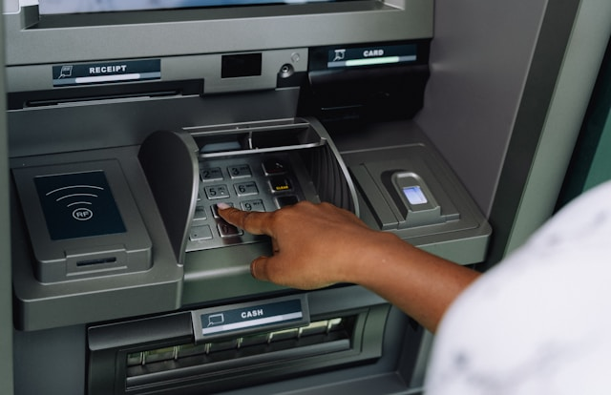
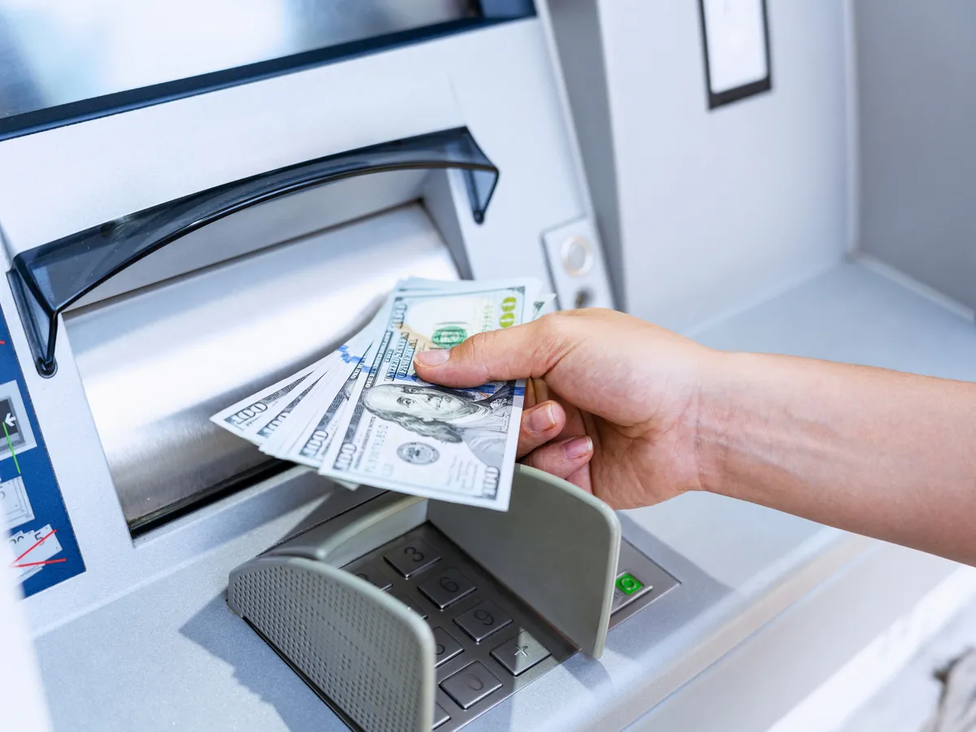
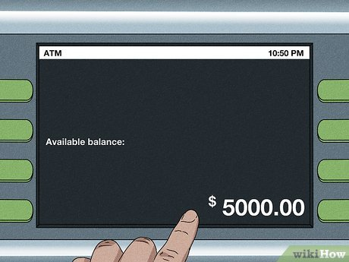
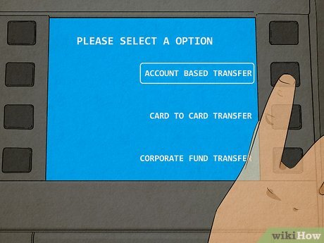
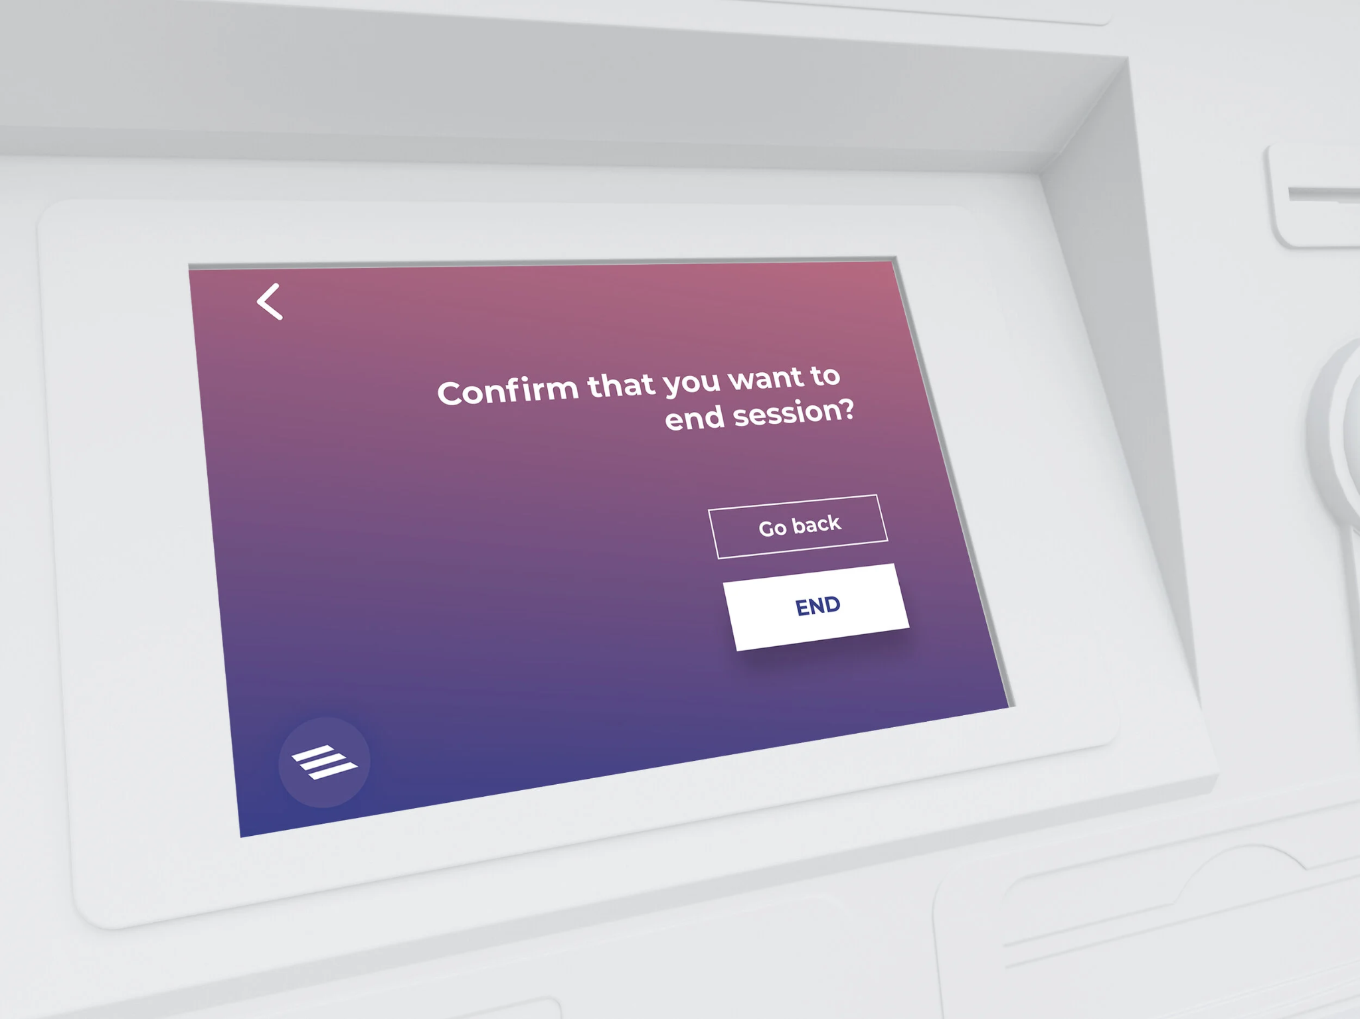
Problem 3: User Story Board – Client
Client: Everyday retail banking customers who hold chequing and/or savings accounts. They use the ABM for financial self-service.
As a Client, I want to select my card and enter my PIN to access accounts securely.
As a Client, I want to withdraw a specified amount from my accounts to obtain cash.
As a Client, I want to view current balances to monitor my finances.
Image Source: Public access via Google Images. Used for educational purposes.
As a Client, I want to move money between my own accounts to manage funds.
As a Client, I want to end my session so my account is protected after I am done.

Slide 14
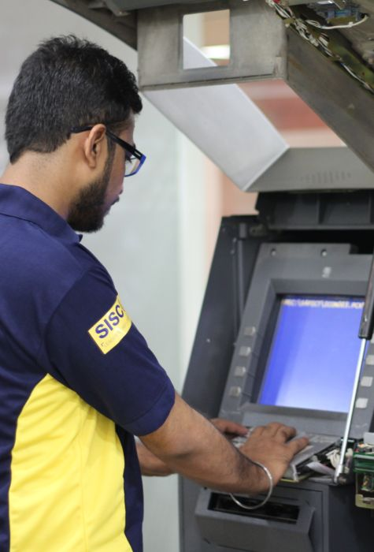
Problem 3: User Story Board – Technician
ABM Technician: Bank maintenance staff who access the machine via a secure supervisor mode to update internal physical cash inventories.
As a Technician, I want to enter my Tech-ID and PIN so that I can access the maintenance menu securely.
As a Technician, I want to input the amount of physical cash I loaded into the machine so the internal inventory is accurate for customers.
As a Technician, I want to end my session securely so that no unauthorized person can access the supervisor menu after I walk away.
iBank System: The software-only ABM simulation that authenticates users, processes transactions, maintains account state in memory, and triggers internal sub-behaviors such as PIN validation and balance updates.
Image Source: Public access via Google Images. Used for educational purposes.

Slide 15
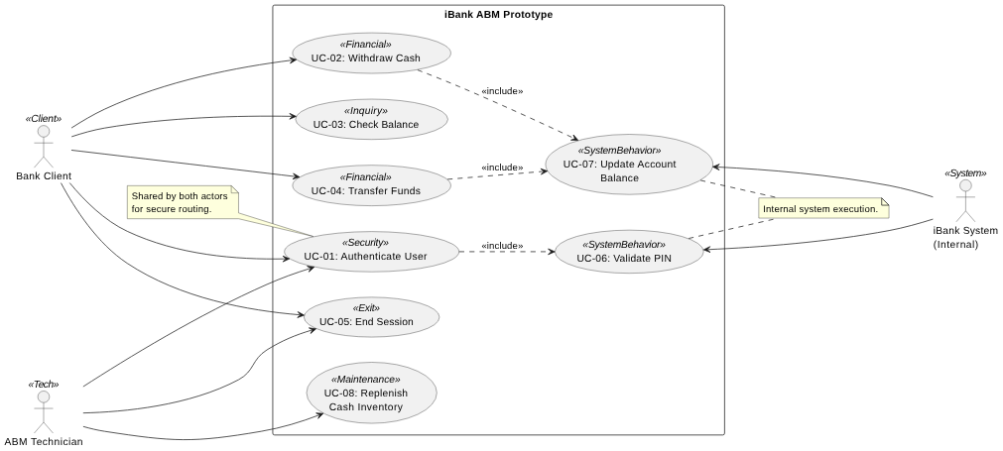
Problem 3: Use Case Diagram
UML Diagram Generation: The Use Case diagrams presented in this deck were programmatically rendered using the open-source PlantUML syntax via the PlantUML extension for Visual Studio Code.

Slide 16
UC-01: User Authentication
👤 Primary Actor
Bank Client OR ABM Technician
⚙️ Supporting Actor
iBank System
📋 Preconditions
Application is running; initial card-selection screen is displayed.
✅ Main Success Scenario
User provides identifier (Client inputs Card; Tech inputs Tech-ID).
System prompts for PIN.
User enters PIN.
System triggers UC-06 (Validate PIN).
System routes user: Clients see Main Menu; Technicians see Maintenance Menu.
⚠️ Exceptions
E1: PIN is incorrect -- system displays error and increments attempt counter. After 3 failures, system displays lockout message and resets.
E2: No card number selected -- system prompts again.
🏁 Postconditions
User is securely authenticated and routed to their respective role-based menu.

Slide 17
UC-02: Withdraw Cash
👤 Primary Actor
Bank Client
⚙️ Supporting Actor
iBank System
📋 Preconditions
UC-01 has been completed successfully (Logged in as Client)
✅ Main Success Scenario
Client selects 'Withdraw' from the menu.
Client selects account type (chequing or savings).
Client enters desired withdrawal amount.
System verifies amount is a positive multiple of 20 and <= balance.
System deducts amount from account in memory.
System displays simulated receipt with updated balance.
⚠️ Exceptions
E1: Amount not a multiple of 20 -- error, request re-entry.
E2: Amount exceeds balance -- insufficient-funds message, return to menu.
E3: Client cancels -- return to main menu without modifying balance.
🏁 Postconditions
Account balance is reduced by the withdrawn amount (in memory). A transaction summary is displayed.

Slide 18
UC-03: Check Balance
👤 Primary Actor
Bank Client
⚙️ Supporting Actor
iBank System
📋 Preconditions
UC-01 has been completed successfully (Logged in as Client)
✅ Main Success Scenario
Client selects 'Balance Inquiry' from the menu.
System retrieves and displays the current balance of both the chequing and savings accounts.
⚠️ Exceptions
E1: No accounts found for the client -- system displays an error (should not occur if sample data is correctly initialized).
🏁 Postconditions
No account state is changed. Client has seen the current balances.

Slide 19
UC-04: Transfer Funds
👤 Primary Actor
Bank Client
⚙️ Supporting Actor
iBank System
📋 Preconditions
UC-01 completed (Logged in as Client).
Client has at least two accounts (chequing & savings).
✅ Main Success Scenario
Client selects 'Transfer' from the menu.
Client selects the source account.
Client selects the destination account.
Client enters the transfer amount.
System verifies source account has sufficient funds.
System deducts from source and adds to destination in memory.
System displays a transfer summary.
⚠️ Exceptions
E1: Source and destination are the same -- displays error, returns to screen.
E2: Insufficient funds in source -- displays error message.
E3: Client cancels -- returns to main menu without modification.
🏁 Postconditions
Source account balance is reduced; destination account balance is increased by the same amount (in memory).

Slide 20
UC-05: End Session
👤 Primary Actor
Bank Client OR ABM Technician
⚙️ Supporting Actor
iBank System
📋 Preconditions
A session is active (UC-01 completed).
✅ Main Success Scenario
Client selects 'Exit' OR the session timer expires.
System displays a farewell message.
System clears session state and returns to the initial card-selection screen.
⚠️ Exceptions
None significant beyond the timer-triggered path, which is handled as a normal scenario variant.
🏁 Postconditions
No client is authenticated. The application is ready for the next client.

Slide 21
UC-06: Validate PIN (Sub-Behavior)
👤 Primary Actor
iBank System (Internal Trigger)
⚙️ Supporting Actor
None
📋 Preconditions
System has captured card number and PIN input.
✅ Main Success Scenario
System queries in-memory test data for the provided User ID.
System extracts the stored PIN for that specific user.
System compares the entered PIN string with the stored PIN string.
System returns 'Success' boolean and Role type (Client/Tech) to the base use case.
⚠️ Exceptions
E1: PIN does not match -- System returns 'Failure' boolean.
E2: Card number not found in test data -- System returns 'Failure'.
🏁 Postconditions
Authentication validity is resolved and passed back to UC-01.

Slide 22
UC-07: Update Account Balance (Sub)
👤 Primary Actor
iBank System (Internal Trigger)
⚙️ Supporting Actor
None
📋 Preconditions
A valid transaction amount is approved by the calling use case.
✅ Main Success Scenario
System identifies target account object.
System adds or subtracts the approved amount.
System saves the new balance in memory.
System returns updated balance to calling use case.
⚠️ Exceptions
E1: Account object not found in memory -- System throws internal exception.
🏁 Postconditions
In-memory balance is updated. State is consistent.

Slide 23
UC-08: Replenish Cash Inventory
👤 Primary Actor
ABM Technician
⚙️ Supporting Actor
iBank System
📋 Preconditions
Application is at the idle/start screen.
✅ Main Success Scenario
System displays the current internal ABM physical cash inventory total.
Technician inputs the amount of physical cash they just added to the hardware cassettes.
System adds the newly inputted amount to the internal cash inventory variable.
System logs the replenishment event.
System displays 'Inventory Updated' confirmation.
⚠️ Exceptions
E1: Invalid Technician ID/PIN — System denies access and returns to idle screen.
E2: Technician enters negative cash amount — System rejects input.
🏁 Postconditions
ABM internal cash inventory is updated and ready to dispense to customers.

Slide 24
References
[1] H. Tavakoli, "The CASTROFF Framework: A Professional Standard for Prompt Engineering," in Prompt Engineering for Everyone, Apress, 2026. https://doi.org/10.1007/979-8-8688-2338-1_6
[2] V. R. Basili and D. M. Weiss, "A Methodology for Collecting Valid Software Engineering Data," IEEE Transactions on Software Engineering, vol. SE-10, no. 6, pp. 728-738, 1984.
[3] Bank Act, S.C. 1991, c. 46. [Online]. Available: Justice Laws Website, Government of Canada.
[4] Accessible Canada Act, S.C. 2019, c. 10. [Online]. Available: Justice Laws Website, Government of Canada.
[5] Personal Information Protection and Electronic Documents Act, S.C. 2000, c. 5. [Online]. Available: Justice Laws Website, Government of Canada.

Slide 25
Questions & Answers
Thank you for reviewing our iBank Delivery 1 Presentation

