Slide 1
Chapter 1
Getting to Know InDesign

Slide 2
Exploring the InDesign Workspace
The arrangement of windows and panels that you see on your monitor is called the workspace.

Slide 3
Exploring the InDesign Workspace
The InDesign workspace features the following areas:
the document window
the pasteboard
the Menu bar
the Control panel
the Tools panel
a stack of collapsed panels along the right side of the pasteboard

Slide 4
Exploring the InDesign Workspace
InDesign offers a number of pre-defined workspaces that are customized for different types of tasks.
Each workspace is designed so that panels with similar functions are grouped together.

Slide 5
Exploring the InDesign Workspace
You can customize the workspace, including predefined workspaces, to suit your working preferences.

Slide 6
Exploring the InDesign Workspace
The pasteboard is the area surrounding the document.
The pasteboard provides space for extending objects past the edge of the page (known as “creating a bleed”), and it also provides space for storing objects that you may or may not use in the document.

Slide 7

Exploring the InDesign Workspace
Object that “bleeds” into the pasteboard on two sides
Using the pasteboard

Slide 8
Exploring the InDesign Workspace
The Tools panel houses all the tools that you will work with in InDesign.
The first thing that you should note about the Tools panel is that not all tools are visible; many are hidden.
Look closely and you will see that some tools have small black triangles beside them.
These triangles indicate that other tools are hidden behind them.

Slide 9
Exploring the InDesign Workspace
Small black triangles indicate hidden tools
The Ellipse tool and the Polygon tool revealed behind the Rectangle tool
Hidden tools on the Tools panel

Slide 10
Exploring the InDesign Workspace
You can view the Tools panel as a single column, a double column, or even a horizontal row of tools.
Horizontal lines divide the Tools panel into eight sections.

Slide 11
Exploring the InDesign Workspace
The eight sections include:
The top section which contains the selection tools.
The section beneath which contains item creation tools, such as the drawing, shape, and type tools.
The next section contains transform tools, such as the Rotate and Scale tools

Slide 12
Exploring the InDesign Workspace
The eight sections include:
The next section contains navigation tools.
The bottom-most sections of the Tools panel contain functions for applying colors and gradients to objects and choosing different modes for viewing documents, such as the commonly used Preview mode

Slide 13
Exploring the InDesign Workspace
Many InDesign functions are grouped into panels.
All panels can be accessed from the Window menu.
Some panels are placed within categories on the Window menu.
When you choose a panel from the Window menu, the panel appears in its expanded view.

Slide 14
Exploring the InDesign Workspace
The following figure shows three panels grouped together.
The Paragraph panel is the active panel—it is in front of the others in the group and available for use.
To better manage available workspace, it’s a good idea to minimize or “collapse” panels to make them smaller but still available in the workspace.

Slide 15
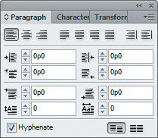
Exploring the InDesign Workspace
Paragraph panel
Character panel name tab
Transform panel name tab
Three grouped panels

Slide 16
Exploring the InDesign Workspace
When you have expanded a panel, the other panels grouped with it appear as tabs on the panel.
You can activate these other panels by clicking their tabs.
You can ungroup panels by dragging a panel’s name tab away from the other panels in the group.

Slide 17
Exploring the InDesign Workspace
Docking panels is when you connect the bottom edge of one panel to the top edge of another panel, so that both move together.

Slide 18
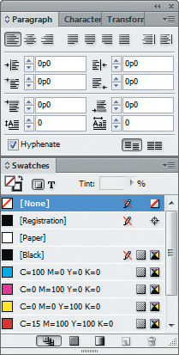
Exploring the InDesign Workspace
Swatches panel docked beneath Paragraph, Character and Transform panels
Docked panels

Slide 19
Viewing and Modifying Page Elements
Using the Zoom tool, you can reduce or enlarge the view of the document from 5% to 4000%.

Slide 20
Viewing and Modifying Page Elements
When you click the Zoom tool and move the pointer over the document window, the pointer becomes the Zoom pointer with a plus sign; when you click the document with the Zoom pointer, the document area you clicked is enlarged.

Slide 21
Viewing and Modifying Page Elements
To reduce the view of the document, press and hold [Alt] (Win) or [option] (Mac).
When the plus sign changes to a minus sign, click the document with this Zoom pointer, and the document size is reduced.

Slide 22
Viewing and Modifying Page Elements
Current magnification
A reduced view of the document

Slide 23
Viewing and Modifying Page Elements
When you zoom in on a document—when you make it appear larger—eventually the document will be too large to fit in the window.
Therefore, you will need to scroll to see other areas of it.
You can use the scroll bars along the bottom and the right sides of the document window or you can use the Hand tool to scroll through the document.

Slide 24

Viewing and Modifying Page Elements
Scrolling with the Hand tool
Scrolling through a document

Slide 25
Viewing and Modifying Page Elements
The best way to understand the concept of the Hand tool is to think of it as your own hand.
Imagine that you could put your hand up to the document on your monitor, then move the document left, right, up, or down, like a paper on a table or against a wall.

Slide 26
Viewing and Modifying Page Elements
Designing and working with page layouts involves using measurements to position and align elements in your documents.
InDesign is well-equipped with a number of features that help you with these tasks.

Slide 27
Viewing and Modifying Page Elements
Rulers are positioned at the top and left side of the pasteboard to help you align objects.
Ruler guides are horizontal and vertical rules that you can position anywhere in a layout as a reference for positioning elements.
Margin guides are guides that you specify to appear at a given distance within the page, usually to maintain visual consistency from page to page.

Slide 28
Viewing and Modifying Page Elements
Document grids provide precise alignment.
With the “snap” options on, objects that you move around on the page automatically align themselves with guides or with the grid quickly and easily.

Slide 29
Viewing and Modifying Page Elements
Frames are rectangular, oval, or polygonal shapes that you use for a variety of purposes, such as creating a colored area on the document or placing text and graphics.
All frames have visible frame edges, and when a frame is selected, those edges automatically highlight.

Slide 30
Viewing and Modifying Page Elements
Screen Modes are options for viewing your documents. The two basic screen modes in InDesign are:
Normal
Preview
You’ll work in Normal mode most of the time.
In Normal mode, you can see any and all page elements, including margin guides, ruler guides, frame edges, and the pasteboard.

Slide 31
Viewing and Modifying Page Elements
Preview mode shows you what your page would look like with all non-printing elements removed.
The View menu offers commands for switching between Normal and Preview modes, but it’s much faster and easier to press the [W] key on your keypad to toggle between the two modes.

Slide 32
Viewing and Modifying Page Elements
Presentation mode presents a view of your document as though it were being showcased on your computer monitor.

Slide 33
Viewing and Modifying Page Elements
All Adobe products come loaded with preferences.
Preferences are options you have for specifying how certain features of the application behave.
The Preferences dialog box houses the multitude of InDesign preferences available.

Slide 34
Viewing and Modifying Page Elements
Other preferences
Select to open documents as tabs
Interface Preferences dialog box

Slide 35
Viewing and Modifying Page Elements
InDesign offers a preference for having multiple open documents available as tabs in the document window.
With this preference selected, a tab will appear for each open document showing the name of the document.

Slide 36
Navigating through a Document
When you create a layout for a magazine, book, or brochure, you create a document that has multiple pages.
Spreads are two pages that face each other—a left page and a right page in a multi-page document.

Slide 37
Navigating through a Document
The Pages panel is a comprehensive solution for moving from page to page in your document.
The Pages panel shows icons for all of the pages in the document.
Double-clicking a single page icon brings that page into view.
The icon representing the currently visible page is highlighted on the panel.

Slide 38
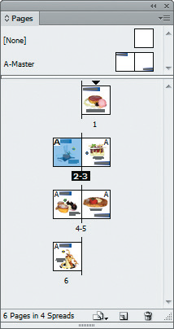
Navigating through a Document
Click to view Panel options menu
Targeted page
Pages panel

Slide 39
Navigating through a Document
You can apply one of fifteen color labels to a page thumbnail in the Pages panel.
Color labels can be useful for organizing your own work or for working with others on a document.
To apply color labels, simply click the Pages panel options button, point to Page Attributes, point to Color Label, then choose a color.

Slide 40
Working with Objects and Smart Guides
Objects are text or graphic elements, such as images, blocks of color, and even simple lines, that are placed in an InDesign document.
All objects in InDesign are in frames.
When you select an object’s frame, its handles become highlighted.

Slide 41
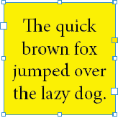
Working with Objects and Smart Guides
Viewing frame handles on a text frame

Slide 42
Working with Objects and Smart Guides
You can click and drag the handles to change the shape and size of the frame.
InDesign offers three basic keyboard combinations that you can use when dragging frame handles to affect how the frame and its contents are affected.

Slide 43
Working with Objects and Smart Guides
You can resize multiple objects just as easily.
Simply select multiple objects and handles will appear around all the selected objects.

Slide 44
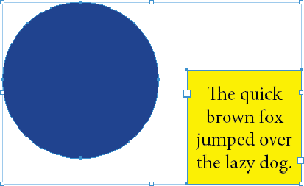
Working with Objects and Smart Guides
Viewing frame handles around two objects

Slide 45
Working with Objects and Smart Guides
At any time, you can copy and paste an object.
You can also copy objects while dragging them.

Slide 46
Working with Objects and Smart Guides
The Hide, Lock, Group, and Ungroup commands on the Object menu are essential for working effectively with layouts, especially complex layouts with many objects.
Hide objects to get them out of your way. They won’t print, and nothing you do changes the location of them as long as they are hidden.
Lock an object to make it immovable—you will not even be able to select it.

Slide 47
Working with Objects and Smart Guides
You group multiple objects with the Group command on the Object menu.
Grouping objects is a smart and important strategy for protecting the relationships between multiple objects.

Slide 48
Working with Objects and Smart Guides
When the Smart Guides feature is activated, Smart Guides appear automatically when you move objects in the document.
Smart Guides give you visual information for positioning objects precisely—in relation to the page or in relation to other objects.

Slide 49

Working with Objects and Smart Guides
Smart Guide aligning top edges
Smart Guides aligning the top edge of two objects

