Slide 1
Chapter 2
Working with Text

Slide 2
Formatting Text
In InDesign, when you create text, you do so by first creating a text frame.
All InDesign text is in a text frame. You use the Character and Paragraph panels to format the text in the frame.

Slide 3
Formatting Text
The Character panel is the command center for modifying text.
The Character panel works hand-in-hand with the Paragraph panel, which is why it’s wise to keep them grouped together.

Slide 4
Formatting Text
The Paragraph panel focuses on manipulating paragraphs or blocks of text.
The Character panel focuses on more specific modifications, such as font, font style, and font size.

Slide 5
Formatting Text
Leading is the term used to describe the vertical space between lines of text.
This space is measured from the baseline of one line of text to the baseline of the next line of text.
The baseline is the invisible line on which text sits.
Leading, like font size, is measured in points.

Slide 6
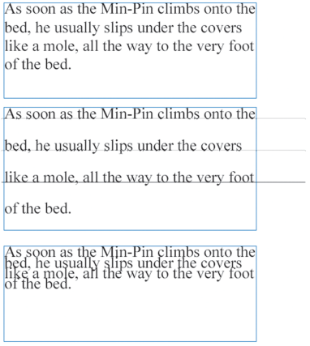
Formatting Text
12pt text with 14 pt leading
12 pt text with 24 pt leading
12 pt text with 8 pt leading
Examples of leading

Slide 7
Formatting Text
When you format text, your most basic choice is which font you want to use and at what size you want to use it.
Once you’ve chosen a font and a font size, you can further manipulate the appearance of the text with a horizontal or vertical scale.
By default, text is generated at a 100% horizontal and 100% vertical scale, meaning that the text is not scaled at all.

Slide 8
Formatting Text
Decreasing the horizontal scale only, for example, maintains the height of the characters but decreases the width—on the horizontal axis.
Conversely, increasing the horizontal scale again maintains the height but increases the width of the characters on the horizontal axis.

Slide 9
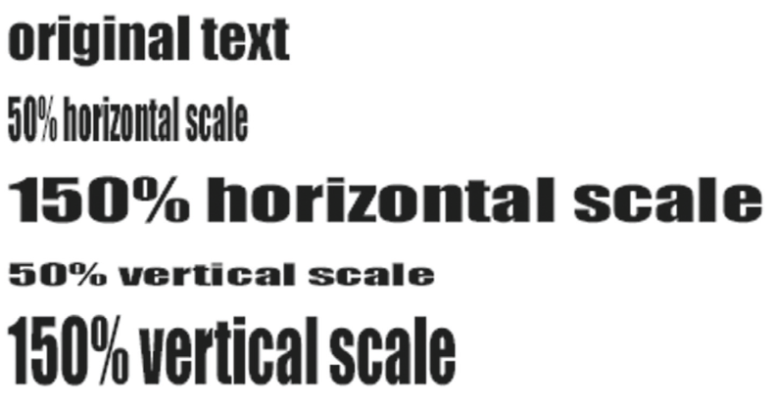
Formatting Text
Scaling text horizontally and vertically

Slide 10
Formatting Text
Kerning is a longstanding process of increasing or decreasing space between a pair of characters.

Slide 11
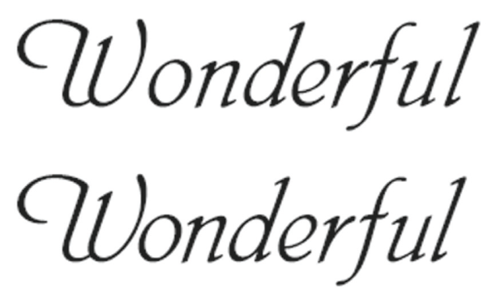
Formatting Text
No kerning
With kerning
Kerning text

Slide 12
Formatting Text
Tracking is more global. Like kerning, tracking affects the spaces between letters, but it is applied globally to an entire word or paragraph.

Slide 13
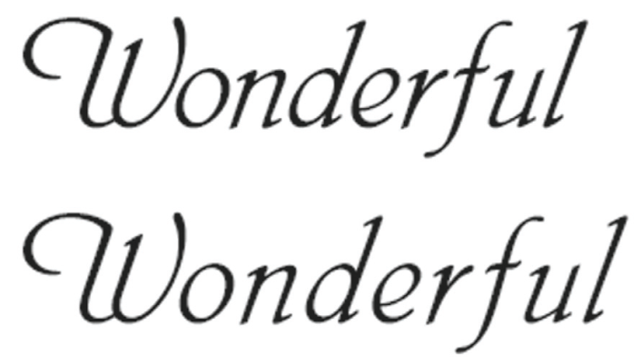
Formatting Text
Tracked text with greater space between characters
Kerned text with no tracking
Tracking text

Slide 14
Formatting Text
InDesign measures both kerning and tracking in increments of 1/1000 em—a unit of measure that is determined by the current type size.

Slide 15
Formatting Text
You are already familiar with superscript characters, even if you don’t know them by that term.
When you see a footnote in a book or document, the superscripted character is the footnote itself, the small number positioned to the upper-right of a word.

Slide 16

Formatting Text
Superscripted character
Identifying a superscript character

Slide 17
Formatting Text
Subscript is the opposite of Superscript.
Instead of raising the baseline of the selected text, the Subscript command positions the text below its original baseline.
As with Superscript, the Subscript command makes the selected text appear smaller.

Slide 18
Formatting Text
InDesign offers different methods for underlining text and for creating rules, which are horizontal, vertical, or diagonal lines.
The weight of the underline is determined by the point size of the selected text.
The greater the point size, the greater the weight of the line.

Slide 19
Formatting Text
Font search enhancements in Creative Cloud make working with fonts and finding the font you want to use quick and easy.
The traditional paradigm of clicking the Font family menu and choosing a font is still in place—nothing’s changed there—but Creative Cloud lets you experiment with and search for fonts in powerful new ways.

Slide 20
Formatting Text
As shown in the following figure, the top field in the Character panel contains a magnifying glass icon on the left side.
Think of this field as both the font search and current font field, because you can use this field to search through the available fonts on your system.

Slide 21
Formatting Text
Superscript command
Search feature on the Character panel

Slide 22
Formatting Text
As shown in the following figure, when you click the magnifying glass, you can choose between Search Entire Font Name or Search First Word only.
Search First Word only is a helpful setting if you are unsure of the complete font name that you need.

Slide 23
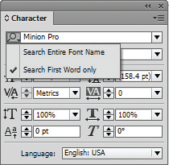
Formatting Text
Click magnifying glass to choose search options
Search options on the Character panel

Slide 24
Formatting Text
As shown in the following figure, if you select the contents of the field, a small x appears at the right. Click it to delete any current font listed in the field as the current search item.

Slide 25
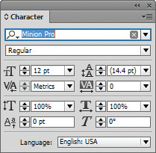
Formatting Text
Click the x to remove the current font from your search
Removing a font from a search

Slide 26
Formatting Text
If you click the Font family list arrow, you’ll see the most recently used fonts at the top of the menu.
In addition to searching through the available fonts on your system, you can also search for and download fonts from Adobe Typekit; an enormous repository of fonts that is available to Creative Cloud subscribers.

Slide 27
Formatting Text
Once you download a font family from Typekit, shown in the following figure, it is available in all of your other Adobe and non-Adobe applications.

Slide 28
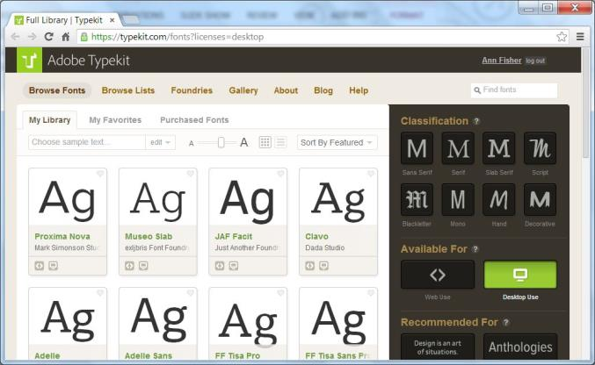
Formatting Text
Adobe Typekit

Slide 29
Formatting Text
Font preview is also a powerful feature. With text selected, click the Font family list arrow on Character panel, then use the up and down arrows on your keypad to preview how different typefaces will affect the selected text.

Slide 30
Formatting Text
You can categorize fonts as favorites by clicking the star icon beside the font’s name.
Then, when you click the Apply Favorite Filter button at the top of the menu, only your favorite fonts will appear in the list.

Slide 31
Formatting Paragraphs
The Paragraph panel is the command center for modifying paragraphs or blocks of text also known as body copy.
The Paragraph panel is divided into three main sections.
The top section controls alignment. The first four—Align left, Align center, Align right, and Justify with last line aligned left —are the most common.

Slide 32
Formatting Paragraphs
The next section offers controls for indents.
Use an indent when you want the first line of each paragraph to start further to the right than the other lines of text.
Pull quotes are a typographical design solution in which text is used at a larger point size and positioned prominently on the page.

Slide 33
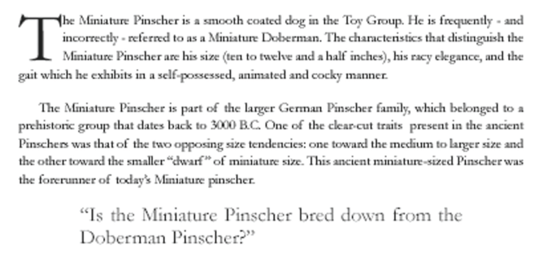
Formatting Paragraphs
First line indent
Left indent
Right indent
First line indent and left and right indents

Slide 34
Formatting Paragraphs
The third section of the Paragraph panel controls vertical spacing between paragraphs and applying drop caps.
For large blocks of text, it is often most pleasing to the eye to create either a subtle or distinct space after every paragraph.

Slide 35
Formatting Paragraphs
In InDesign, you create these by entering values in the Space After or the Space Before text boxes on the Paragraph panel.
Of the two, the Space After text box is more commonly used.
The Space Before text box, when it is used, is often used in conjunction with the Space After text box to offset special page elements, such as a pull quote.

Slide 36
Formatting Paragraphs
A drop cap is a design element in which the first letter or letters of a paragraph are increased in size to create a visual effect.

Slide 37
Formatting Paragraphs
Widows and orphans are words or single lines of text that become separated from the other lines in a paragraph.
Orphans are left alone at the bottom of a page and widows at the top.
The Paragraph panel options menu has a number of commands that allow you to control how text appears and flows, specifically at the end of a column or page, avoiding unsightly widows and orphans.

Slide 38
Formatting Paragraphs
Most people think of a paragraph as a block of text, but, in design language, a paragraph can be a block of text, a line of text, or even a single word, followed by a paragraph return.
A paragraph return, also called a hard return, is inserted into the text formatting by pressing [Enter] (Win) or [return] (Mac).

Slide 39
Formatting Paragraphs
When typing body copy, designers will often want a space after each paragraph because it is visually pleasing and helps to keep paragraphs distinct.
The mistake many designers make is pressing [Enter] (Win) or [return] (Mac) twice to create space after a paragraph. Wrong! What they’ve done is created two paragraphs.

Slide 40
Formatting Paragraphs
The correct way to insert space between paragraphs is to enter a value in the Space After text box on the Paragraph panel.
As you edit text, you may encounter a “bad line break” at the end of a line, such as an oddly hyphenated word or a phrase that is split from one line to the next.

Slide 41
Formatting Paragraphs
In many of these cases, you will want to move a word or phrase to the next line.
You can do this by entering a soft return. A soft return moves words down to the next baseline but does not create a new paragraph.
You enter a soft return by pressing and holding [Shift ], while pressing [Enter] (Win) or [return] (Mac).

Slide 42
Formatting Paragraphs
You can avoid untold numbers of formatting problems by using correct typesetting behaviors, especially those regarding Space After and First Line Indent.

Slide 43
Creating and Applying Styles
A style is a group of formatting attributes, such as font, font size, color, and tracking, that is applied to text throughout a document or multiple documents.
Using styles saves you time and it keeps your work consistent.
Styles are given descriptive names for the type of text to which they are applied.

Slide 44
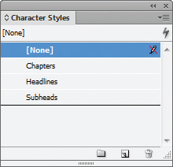
Creating and Applying Styles
Three styles
Character Styles panel

Slide 45
Creating and Applying Styles
You use the Character Styles panel to create styles for individual words or characters, such as a footnote, which you would want in a smaller, superscript font.
You use the Paragraph Styles panel to apply a style to an entire paragraph.
Paragraph styles include formatting options such as indents and drop caps.

Slide 46
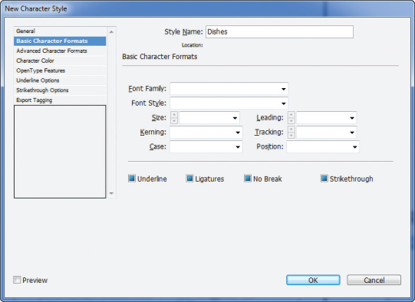
Creating and Applying Styles
New Character Style dialog box

Slide 47
Creating and Applying Styles
Another important feature about styles is that they are useful when you change your mind and want to modify text.
Simply modify the style, and all the text that is assigned to that style will be automatically updated—throughout the document!

Slide 48
Creating and Applying Styles
Once you have more than one paragraph style saved in the Paragraph Styles panel, you can program which style will come next when you are currently in one style and create a new paragraph.

Slide 49
Creating and Applying Styles
A quick way to apply a character or paragraph style is to use Quick Apply.
The Quick Apply button is available on the Control panel, Character Styles panel, and Paragraph Styles panel.
You can use the Quick Apply access menu commands and run scripts.

Slide 50
Editing Text
The Find/Change dialog box is a powerful tool for editing a document.
With this command, you can search for any word in the document, then change that word to another word or delete it altogether with a click of your mouse.

Slide 51
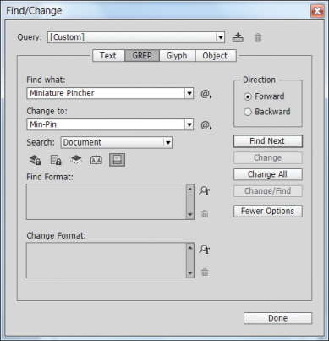
Editing Text
Find/Change dialog box

Slide 52
Editing Text
The spell checker continues to be one of the most powerful features of word processing.
InDesign’s Check Spelling dialog box, is a comprehensive utility for locating and correcting typos and other misspellings in a document.

Slide 53
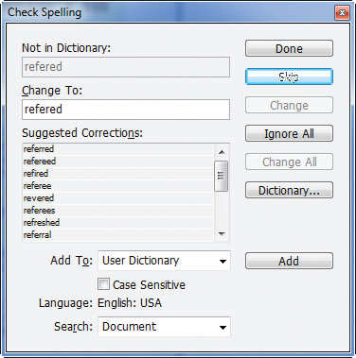
Editing Text
Check Spelling dialog box

Slide 54
Editing Text
You can create your own user dictionary in the Dictionary section of the Preferences dialog box.
Another spell check feature is Dynamic Spelling.
As you type, the program places a squiggly red line under words that its spell checker thinks are misspelled.
To prevent the program from flagging a proper name, you can add that name to your customized dictionary.

Slide 55
Editing Text
Autocorrect takes dynamic spell checking one step farther.
Instead of flagging a misspelled word, the Autocorrect feature actually corrects the misspelled word.
So if you type the word “refered” and press [Spacebar], Autocorrect will change it to “referred.”

Slide 56
Creating Bulleted and Numbered Lists
The best way to create a numbered or bulleted list is to type the list first, without formatting.
Point to the Bulleted & Numbered Lists command in the Type menu and then choose whether you want to apply bullets or numbers to the selected text.

Slide 57
Creating Bulleted and Numbered Lists
Bullets and numbers are like any other type of paragraph formatting.
InDesign applies them to each paragraph of the selected text.
At any time, you can select the text and change the marks from bullets to numbers or vice versa.
You also use the same Bulleted & Numbered Lists command to remove bullets or numbers from selected text.

Slide 58
Creating Bulleted and Numbered Lists
You can think of bullets and numbers as being applied “virtually” to a paragraph.
Let’s use numbers as an example. When you apply numbers, you can see the numbers, but you can’t select them.
If you select the entire paragraph of text, the numbers won’t appear to be selected.
This is because the numbers are applied as a format to the paragraph.

Slide 59
Creating Bulleted and Numbered Lists
Once you’ve finished a list, you might find that you want to modify the numbers by changing the type face, color, or size of the numbers.
To do so, you must first convert the list to text so that the numbers can be selected and modified.
Click the Bulleted & Numbered Lists command, then click the Convert Bullets and Numbering to Text command, shown in the following figure.

Slide 60
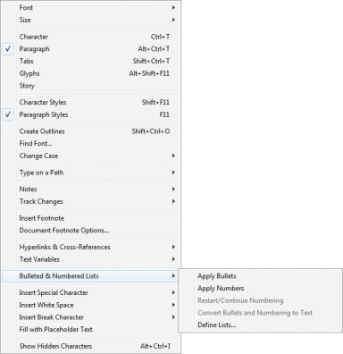
Creating Bulleted and Numbered Lists
Convert Bullets to Text command

Slide 61
Creating Bulleted and Numbered Lists
When you do this, the numbers (or bullets) will be converted to regular text.
The list will still appear to be numbered, but it will have lost the functionality of the list formatting.
If you insert or remove any component of the list, the numbers won’t be updated.
InDesign will see it only as a block of text.

