Slide 1
Chapter 4
Working with Frames

Slide 2
Aligning and Distributing Objects on a Page
A fill is a color you apply to the inside of an object.
A stroke is a color that you apply to the outline of an object.
The following figure shows an object with a blue fill and a yellow stroke.

Slide 3

Aligning and Distributing Objects on a Page
Fill
Stroke
An object with a fill and stroke

Slide 4
Aligning and Distributing Objects on a Page
InDesign offers you a number of options for filling and stroking objects.
The simplest and most direct method for doing so is to select an object and then pick a color from the Swatches panel.

Slide 5
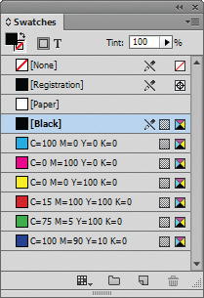
Aligning and Distributing Objects on a Page
Swatches panel

Slide 6
Aligning and Distributing Objects on a Page
Once a stroke is applied, you can modify the stroke weight—how heavy the outline appears—using the Stroke panel.
The Stroke panel is command central for all the modifications you can apply to a stroke, including making dotted and dashed strokes and varying stroke styles.

Slide 7
Aligning and Distributing Objects on a Page
The Align Stroke section of the Stroke panel is critical for determining where on the object the stroke is applied.
By default, a stroke is aligned to the center of the object’s perimeter.
This means that it’s centered on the edge, halfway inside and halfway outside the object.

Slide 8
Aligning and Distributing Objects on a Page
The Stroke panel offers three Align Stroke options:
Align Stroke to Center
Align Stroke to Inside
Align Stroke to Outside

Slide 9
Aligning and Distributing Objects on a Page
A 10 pt stroke with three different alignments
Align Stroke to Center
Align Stroke to Inside
Align Stroke to Outside

Slide 10
Aligning and Distributing Objects on a Page
Many times, when laying out a page, you will want to create multiple objects that are evenly spaced in lines or in grids.
InDesign CC offers many great utilities for accomplishing this, one of which is the Step and Repeat dialog box.
You also specify the offset value for each successive copy. The offset is the horizontal and vertical distance the copy will be from the original.

Slide 11
Aligning and Distributing Objects on a Page
The Align panel offers quick and simple solutions for aligning and distributing multiple objects on a page.
To align objects is to position them by their tops, bottoms, left sides, right sides or centers.
To distribute objects is to space them equally on a page horizontally, vertically, or both.

Slide 12
Aligning and Distributing Objects on a Page
Using the top section of the Align panel, you can choose from six alignment buttons:
Align top edges
Align bottom edges
Align right edges
Align left edges
Align horizontal centers
Align vertical centers

Slide 13
Aligning and Distributing Objects on a Page
You use the Distribute Objects section of the Align panel to distribute objects.
As stated earlier, to distribute objects is to space them equally on a page, horizontally, vertically, or both.
The following figure shows three objects that are not distributed evenly on either the horizontal or vertical axis.

Slide 14
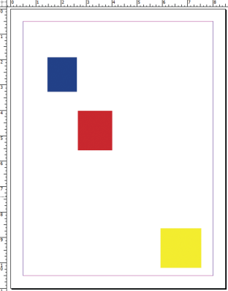
Aligning and Distributing Objects on a Page
Three objects, positioned randomly

Slide 15
Aligning and Distributing Objects on a Page
The following figure shows the same three objects after clicking the Distribute horizontal centers button.
Clicking this button means that—on the horizontal axis—the distance between the center point of the first object and the center point of the second object is the same as the distance between the center point of the second object and the center point of the third object.

Slide 16
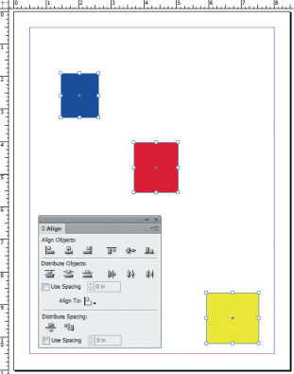
Aligning and Distributing Objects on a Page
Distribute horizontal centers button
Objects distributed by their horizontal centers

Slide 17
Aligning and Distributing Objects on a Page
The following figure shows the same three objects after clicking the Distribute vertical centers button.
Clicking this button means that—on the vertical axis—the distance between the center points of the first two objects is the same as the distance between the center points of the second and third objects.

Slide 18
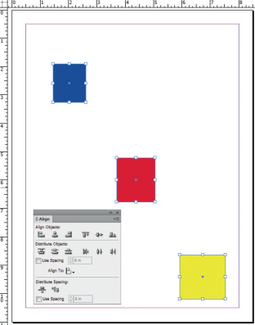
Aligning and Distributing Objects on a Page
Distribute vertical centers button
Objects distributed by their horizontal centers

Slide 19
Aligning and Distributing Objects on a Page
When you select multiple objects, a bounding box appears around the objects; you can drag the handles of that bounding box to transform all the selected objects.
The Live Distribute option offers a different behavior; instead of resizing the objects, you can use the Live Distribute option to proportionally resize the space between the objects.

Slide 20
Aligning and Distributing Objects on a Page
When you’re working with multiple objects, the Gap tool offers a quick way to:
adjust the size of the gaps between them
resize several items that have commonly aligned edges at once, while maintaining the size of the gaps between them
The following figure shows the result of dragging the Gap tool positioned over the center gap.

Slide 21

Aligning and Distributing Objects on a Page
Gap tool positioned over a grid of frames
Gray area identifies frames that will be affected

Slide 22
Aligning and Distributing Objects on a Page
The following figure shows the result of dragging the Gap tool to the left.
*Note that only the gap moved; the size of the gap didn’t change. The width of the associated frames changed.

Slide 23

Aligning and Distributing Objects on a Page
Result of dragging the Gap tool to the left

Slide 24
Stacking and Layering Objects
The stacking order refers to how objects are arranged in hierarchical order.
When you create multiple objects, it is important for you to remember that every object is on its own level.

Slide 25
Stacking and Layering Objects
You control the stacking order with the four commands on the Arrange menu.
The Bring to Front command moves a selected object to the front of the stacking order
The Send to Back command moves a selected object to the back of the stacking order
The Bring Forward command moves a selected object one level forward in the stacking order
The Send Backward command moves a selected object one level backward in the stacking order

Slide 26
Stacking and Layering Objects
The Layers panel is a smart solution for organizing and managing elements of a layout.
It includes options for locking and hiding individual objects on a layer.
By default, every document you create in InDesign has one layer.

Slide 27
Stacking and Layering Objects
You can create as many layers on the Layers panel as you need to organize your work.
Think of layers on the Layers panel as being three-dimensional:
the topmost layer is the front layer
the bottommost layer is the back layer
Therefore, it follows logically that objects on the topmost layer are in front of objects on any other layer.

Slide 28
Stacking and Layering Objects
Layers themselves are transparent.
If you have a layer with no objects on it, you can see through the layer to the objects on the layers behind it.
One great organizational aspect of layers is that you can assign a selection color to a layer.

Slide 29
Stacking and Layering Objects
Clicking a layer on the Layers panel to select it is called targeting a layer.
The layer that you click is called the target layer.
When you create a new object, the object will be added to whichever layer is targeted on the Layers panel.

Slide 30
Stacking and Layering Objects
The pen tool icon next to a layer’s name on the Layers panel is called the Current drawing layer icon.
This icon will help remind you that anything placed or drawn will become part of that layer.

Slide 31
Stacking and Layering Objects
You can select any object on the page, regardless of which layer is targeted.
When you select the object, the layer that the object is on is automatically targeted on the Layers panel.
You can also change the order of layers on the Layers panel by dragging a layer up or down on the panel.

Slide 32
Stacking and Layering Objects
When you have multiple overlapping objects on a page, objects behind other objects can sometimes be difficult to select.
Pressing and holding [Ctrl] (Win) or [Command] (Mac) allows you to “click through the stacking order” to select objects behind other objects.

Slide 33
Working with Graphics Frames
In its most basic definition, a graphic is an element on the page that is not text.
When you are talking about placing graphics in an InDesign document, the term “graphic” usually refers to bitmap images or vector graphics.

Slide 34
Working with Graphics Frames
Bitmap images are images that consist of pixels. They are either:
created in a program like Adobe Photoshop
scanned
or downloaded from the Internet or a digital camera

Slide 35
Working with Graphics Frames
Vector graphics are artwork comprised of geometrically defined paths and curves, usually illustrations created and imported from drawing programs like Adobe Illustrator.

Slide 36
Working with Graphics Frames
There are two essential methods for placing a graphic in a document.
The first is to create a graphics placeholder frame using any of the InDesign’s shape tools
Locate the graphic you want to import into the document
The graphic will appear in the graphics frame

Slide 37
Working with Graphics Frames
There are two essential methods for placing a graphic in a document.
The second method is to place a graphic without first creating a graphics frame
If you click the Place command and then locate the graphic you want to import, you will see the loaded graphics icon when you position the pointer over the page

Slide 38
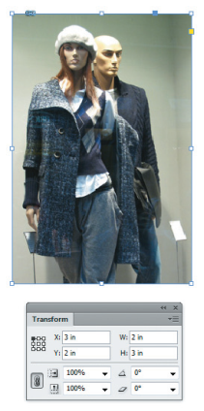
Working with Graphics Frames
A graphics frame selected with the Selection tool
Selected frame

Slide 39
Working with Graphics Frames
One of the essential concepts in InDesign is the distinction between the graphics frame and the graphic itself.
Think of the graphics frame as a window through which you see the placed graphic

Slide 40
Working with Graphics Frames
The bounding box—always rectangular—is the frame that defines the horizontal and vertical dimensions of the graphic itself—not the graphics frame.

Slide 41
Working with Graphics Frames
The quickest way for selecting graphics and frames is to double-click the image.
Double-clicking the image toggles between the frame and the graphic being selected.
The content indicator is the donut-shaped circle shown in the following figure.

Slide 42

Working with Graphics Frames
Content indicator
The content indicator

Slide 43
Working with Graphics Frames
You’ll just need to make sure that when you intend to select a frame, you don’t accidentally select the content indicator and, thus, the graphic.

Slide 44
Working with Graphics Frames
When you want to move a graphic within a frame, select the graphic by any method you prefer, then click and drag it.
You can also move the selected graphic using the arrow keys on the keypad.
When you click and drag the graphic to move it, you see a ghosted image of the areas that are outside the graphics frame.

Slide 45
Working with Graphics Frames
The ghosted image is referred to as a dynamic preview.

Slide 46
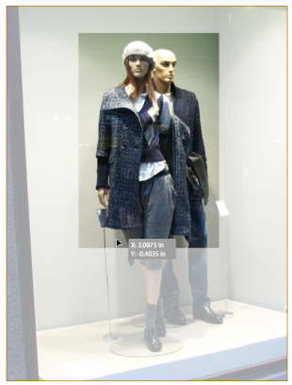
Working with Graphics Frames
Dynamic preview

Slide 47
Working with Graphics Frames
When designing layouts, you’ll often find that you want to copy and paste a graphic from one frame to another. This is easy to do;
First, select the graphic (not the frame)
Copy it
Select the frame where you want to paste the copy
Choose the Paste Into command on the Edit menu

Slide 48
Working with Graphics Frames
When you select a graphic with the Direct Selection tool, you can then resize the graphic within the frame.
Changes that you make to the size of the graphic do not affect the size of the graphics frame.
You can scale a selected graphic by dragging its handles or changing values in the Scale X Percentage and the Scale Y Percentage text boxes on the Transform or Control panels.

Slide 49
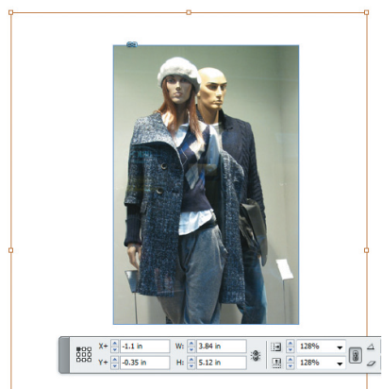
Working with Graphics Frames
The Scale X Percentage and Scale Y Percentage text boxes
Using the Control panel to scale the graphics

Slide 50
Working with Graphics Frames
You can also use the Transform/Scale command on the Object menu to scale the graphic.
*Remember, when the graphic is selected with the Direct Selection tool, only the graphic will be scaled when you use this command.

Slide 51
Working with Graphics Frames
While it’s not difficult to select a graphic with the Direct Selection tool and then scale it using the Transform panel, there are a lot of steps in the process.
For a quick solution, you can use the Fitting commands, located on the Object menu.
The Fitting commands offer different options for positioning the graphic in the frame.

Slide 52
Working with Graphics Frames
These commands are smart and useful but beware—they’re easy to confuse with one another.
It’s important that you keep each command straight in your head, because one of the commands distorts the image to fit the frame.

Slide 53
Working with Graphics Frames
Of all the fitting commands, the Fill Frame Proportionally command is the one you’re likely to use most often.
It resizes the placed graphic to a size that is guaranteed to fit the frame, with no negative space in the frame.
Some of the graphic may not be visible if it exceeds the size of the frame, but it will not be distorted to fit the frame.

Slide 54
Working with Graphics Frames
A clipping path is a graphic that you draw in Photoshop that outlines the areas of the image you want to show when the file is placed in a layout program like InDesign.

Slide 55

Working with Graphics Frames
Clipping path created in Photoshop
A Photoshop image with a clipping path

Slide 56
Working with Text Frames
Semi-autoflowing text is a method for manually threading text through multiple frames.
You can also autoflow text, which is a powerful option for quickly adding text to your document.
A column break is a typographic command that forces text to the next column.

Slide 57
Working with Text Frames
When threading text manually or autoflowing text, you will get to a point where text has filled all the text frames on the page and continues to another page.
Usually, the text continues onto the very next page—but not always.
You can insert a “Continued on page...” notation to let the reader know where to go to continue reading.

Slide 58
Working with Text Frames
There’s one important point you need to note when creating a “Continued on page...” notation.
Below the text frame on the page of the text you are flowing, you will need to create another text frame to contain the “Continued on page...” notation.

Slide 59
Working with Text Frames
In order for the notation to work—for it to list the page where the text continues—the top edge of the text frame that contains the notation must be touching the frame that contains the body copy that is to be continued.

Slide 60
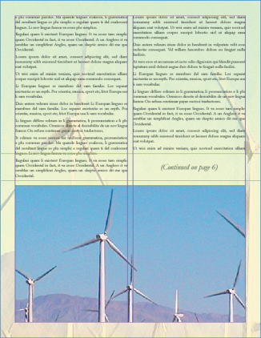
Working with Text Frames
Text frame
Guides
Creating a text frame for the page continuation notation

