Slide 1
Chapter 5
Working with Color

Slide 2
Working with Process Colors
Process colors are colors that you create (and eventually print) by mixing varying percentages of cyan, magenta, yellow, and black (CMYK) inks.
CMYK inks are called process inks.
Lighter colors are produced with smaller percentages of ink, and darker colors with higher percentages.

Slide 3
Working with Process Colors
By mixing CMYK inks, you can produce a large variety of colors, and you can even reproduce color photographs.
Most, if not all the color photographs you see, are created using only four colors!

Slide 4
Working with Process Colors
In InDesign, you create process colors by creating a new swatch on the Swatches panel or in the New Color Swatch dialog box.
You then mix percentages of CMYK to create the color.

Slide 5
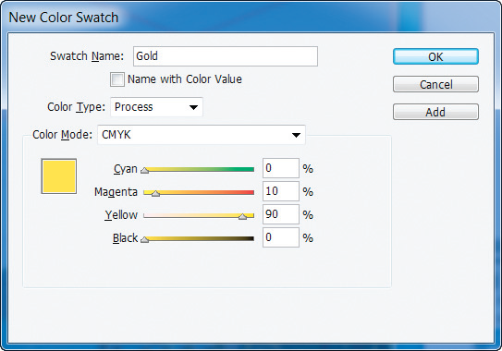
Working with Process Colors
Color Type: Defines whether the color is Process or Spot
New Color Swatch dialog box

Slide 6
Working with Process Colors
Any color that you create in this manner is called a named color and is added to the Swatches panel.
You can choose to have the color’s name defined by CMYK percentages or you can give it another name that you prefer.

Slide 7
Working with Process Colors
In the print world, the term “tint” is used to refer to many things.
For example, some print professionals refer to all process colors as tints.
In InDesign, however, the term tint refers specifically to a lighter version of a color.

Slide 8
Working with Process Colors
In the example on the next slide, the four swatches are all filled with the same cyan ink.
The only difference is that, in the lighter objects, there’s less white space covered with cyan, thus creating the illusion that the object is filled with a lighter cyan.

Slide 9
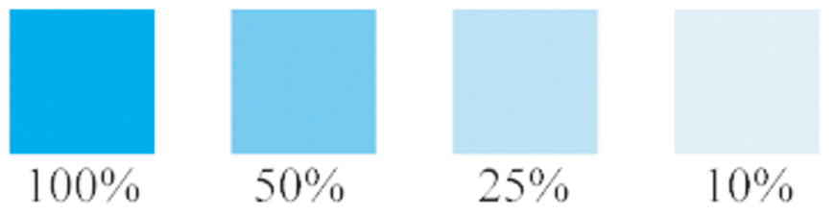
Working with Process Colors
Four objects filled with cyan

Slide 10
Working with Process Colors
Like process colors, you use the Swatches panel to create tint swatches.
If you modify the original swatch, any tint swatch that is based on the original will automatically updated to reflect that modification.
It is not a requirement that you create named swatches for every color that you want to use in your layout. Many designers prefer to use the Color panel.

Slide 11
Working with Process Colors
Using the Color panel, you can apply a color to an object by selecting it, then dragging the sliders on the Color panel until you are happy with the new color.
As you drag the sliders, the color is continually updated in the selected object.

Slide 12
Working with Process Colors
When you create colors using the Color panel, those colors are not saved anywhere.
Any colors you create that aren’t saved to the Swatches panel are called unnamed colors.

Slide 13
Working with Process Colors
Once you’ve decided on a color, simply save it to the Swatches panel.
The swatch will instantly be added to the Swatches panel as a process color and its CMYK values will be used as its name, as shown in the following figure.

Slide 14
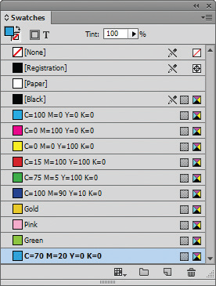
Working with Process Colors
Color dragged into Swatches panel
Viewing a formerly unnamed color dragged into the Swatches panel

Slide 15
Applying Color
InDesign offers a number of options for applying fills and strokes to objects.
The most basic method is to:
select an object
activate either the Fill or the Stroke button on the Tools panel
then click a color on the Swatches panel or mix a color on the Color panel

Slide 16
Applying Color
Keyboard shortcuts also offer useful options.
Pressing [X] toggles between Fill and Stroke.
In other words, if the Stroke button is activated and you press [X], the Fill button will be activated.

Slide 17
Applying Color
Dragging and dropping is also useful. You can drag a swatch from the Swatches panel onto an object and apply the swatch as a fill or a stroke.
Drag a swatch over the interior of an object and the swatch will be applied as a fill, as shown in the following figure.

Slide 18
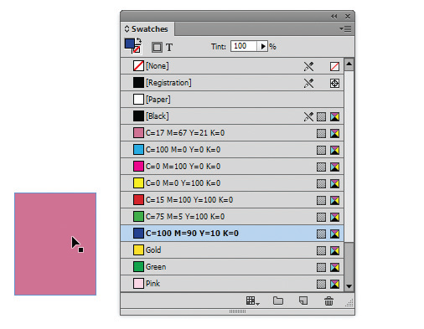
Applying Color
When pointer is released square will be filled with the blue swatch color
Dragging and dropping a swatch to fill an object

Slide 19
Applying Color
The Default Fill and Stroke button reverts the Fill and Stroke buttons to their default colors—no fill and a black stroke.
Clicking this button will apply a black stroke and no fill to a selected object.
The Swap Fill and Stroke button swaps the fill color with the stroke color.

Slide 20
Applying Color
The three “Apply” buttons on the Tools panel are useful for speeding up your work.
The Apply Color and Apply Gradient buttons display the last color and gradient that you’ve used.
This makes for quick and easy access when you are using the same color or gradient repeatedly.

Slide 21
Applying Color
The Apply None button is available for removing the fill or stroke from a selected object, depending on which button (Fill or Stroke) is active on the Tools panel.

Slide 22
Applying Color
Use the Paper swatch whenever you want an object to have a white fill or stroke.
Don’t confuse a Paper fill with a None fill. When you fill a frame with Paper, it is filled with white. When you fill it with None, it has no fill—its fill is transparent.
The following figure illustrates this distinction.

Slide 23


Applying Color
Understanding a Paper fill
Text frame with None fill
Frames with yellow fill
Text frame with Paper fill

Slide 24
Applying Color
There are two different methods for applying color to text:
the Type tool
the Selection tool

Slide 25
Applying Color
When you position text against a background color or against a photographic image, sometimes it’s not easy to see the text, as shown in the following figure.

Slide 26

Applying Color
Text positioned against an image

Slide 27
Applying Color
To remedy this, many designers use the classic technique of placing a black copy of the text behind the original text, as shown in the following figure.
This trick adds much-needed contrast between the text and the image behind it.

Slide 28

Applying Color
Black text placed behind purple text
Text with a black copy behind it

Slide 29
Applying Color
Once you’ve created a swatch or added a swatch to the Swatches panel, it is a named color and will be saved with the document.

Slide 30
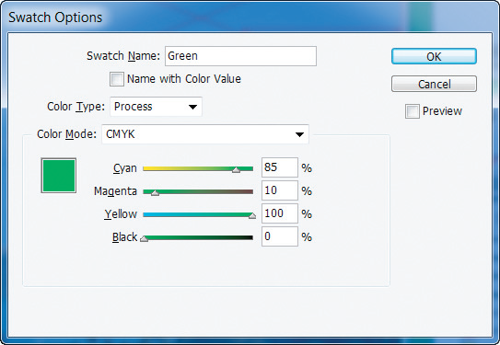
Applying Color
Swatch Options dialog box

Slide 31
Applying Color
You can also delete a swatch from the Swatches panel.
You use the Delete Swatch dialog box to choose a color to replace the deleted swatch.

Slide 32
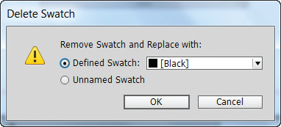
Applying Color
Delete Swatch dialog box

Slide 33
Working with Spot Colors
Spot colors are non-process inks that are manufactured by companies.
Though printing is based on the four process colors, CMYK, it is not limited to them.

Slide 34
Working with Spot Colors
It is important to understand that though combinations of CMYK inks can produce a wide variety of colors—enough to reproduce any color photograph quite well—they can’t produce every color.
For this reason, and others, designers often turn to spot colors.

Slide 35
Working with Spot Colors
The design and print worlds refer to spot colors by a number of names:
Non-process inks: Refers to the fact that spot colors are not created using the process inks—CMYK
Fifth color: Refers to the fact that the spot color is often printed in addition to the four process inks. Note, however, that a spot color is not necessarily the “fifth” color

Slide 36
Working with Spot Colors
The design and print worlds refer to spot colors by a number of names:
PANTONE color: PANTONE is a manufacturer of non-process inks. PANTONE is simply a brand name.
PMS color: An acronym for PANTONE Matching System.

Slide 37
Working with Spot Colors
You create spot color swatches in InDesign using the New Color Swatch dialog box.
When you create graphics in Adobe Illustrator or Adobe Photoshop, you can create and apply spot colors in those applications as well.
Because InDesign, Illustrator, and Photoshop are all made by Adobe, InDesign recognizes the spot colors applied to graphics created in those applications.

Slide 38
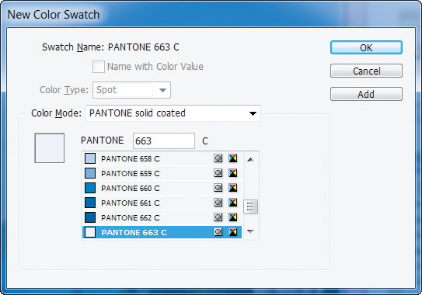
Working with Spot Colors
Choosing a spot color in the New Color Swatch dialog box

Slide 39
Working with Gradients
A gradient is a graduated blend of two or more colors.
Every gradient must have at least two colors (the starting and ending colors).
Colors that come between the starting and ending colors are called color stops.

Slide 40
Working with Gradients
Radial gradient – is like a series of concentric circles. The starting color appears at the center of the gradient, then radiates out to the ending color.

Slide 41
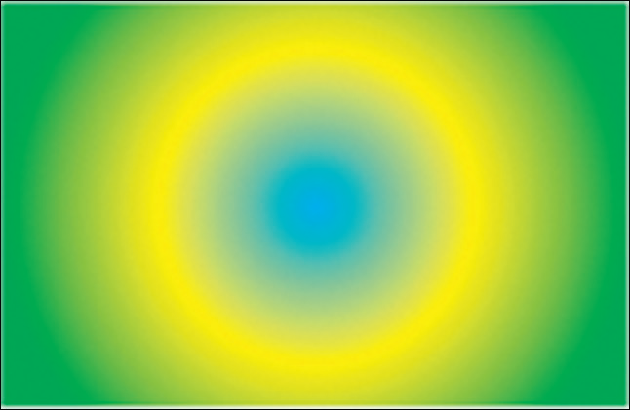
Working with Gradients
Radial gradient

Slide 42
Working with Gradients
Linear gradient – is a series of straight lines fading to the edge.

Slide 43
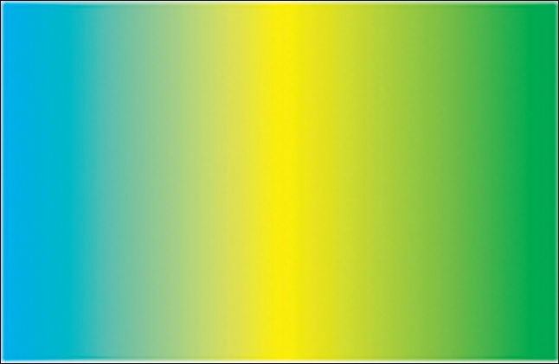
Working with Gradients
Linear gradient

Slide 44
Working with Gradients
You apply a gradient to an object the same way you apply a color to an object.
Simply select the object, then click the gradient on the Swatches panel.
A gradient swatch can be applied as a fill or as a stroke.

Slide 45
Working with Gradients
If you use a gradient to fill an object, you can further control how the gradient fills the object using the Gradient Swatch tool or the Gradient Feather tool.
The Gradient Swatch tool allows you to change the length and/or direction of a linear or radial gradient.
You can also use it to change the angle of a linear gradient and the center point of a radial gradient.

Slide 46
Working with Gradients
For linear gradients, the direction in which you drag the Gradient Swatch tool determines the angle of the blend that fills the object.

Slide 47
Working with Gradients
The following figure shows six rows of six square frames filled with rainbow gradients.
The Gradient Swatch tool was dragged in varying lengths and directions across each row—represented by the black lines you see in the example—to create different effects.

Slide 48
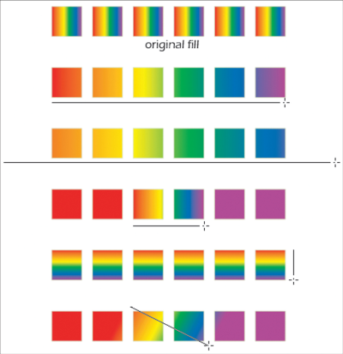
Working with Gradients
Using the Gradient Swatch tool

Slide 49
Working with Gradients
Like color swatches, gradients can be modified.
When you modify a gradient, all instances of the gradient used in the document will be automatically updated.

