Slide 1
Chapter 6
Working with Placed Images

Slide 2
Placing Multiple Graphics
The Place command on the File menu is the basic command used for placing graphics into an InDesign layout.

Slide 3
Placing Multiple Graphics
When you place an image, you always have two options for how it’s placed.
If you click the place gun in an already existing frame, the image will be placed into the frame.
If you click the place gun on the page, InDesign will create a frame for the placed image.
By default, the frame will be sized to display the entire image at 100%.

Slide 4
Placing Multiple Graphics
When placing graphics into frames, be aware at what size the graphic is being placed.
When you create a new frame and then place a graphic into that frame, by default the graphic will be placed at 100%—even if the graphic is larger than the frame itself.
However, if you place a graphic into a “used” frame, the rules can change.

Slide 5
Placing Multiple Graphics
The Fitting menu lists a number of commands that affect how a graphic fits into its frame.
The Fill Frame Proportionally fitting command scales the graphic so that it fills the entire frame—without distorting the graphic.
The Fit Content Proportionally fitting command scales a placed graphic so that the entire graphic is visible when placed into any size frame.

Slide 6
Placing Multiple Graphics
When you’re placing many graphics into a layout, you will find it tiring to be choosing the same fitting command over and over again.
To alleviate this, you can set up options in the Frame Fitting Options dialog box.

Slide 7
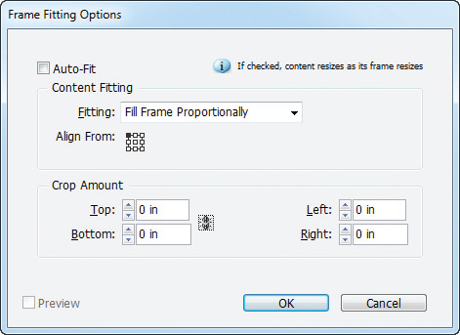
Placing Multiple Graphics
Frame Fitting Options dialog box

Slide 8
Placing Multiple Graphics
This dialog box allows you a specific fitting option for all placed graphics.
If you want the options applied to all frames you create in all future documents, set the frame fitting options with no documents open.
By doing so, the frame fitting options you choose will be applied to all frames you create when you open a document.

Slide 9
Placing Multiple Graphics
If you apply settings in the Frame Fitting Options dialog box with a document open and no frames selected, the options will apply to all frames you create in that document only.
If you apply frame fitting options to a selected frame, the options affect only that frame.

Slide 10
Placing Multiple Graphics
Adobe Bridge is a free-standing content management application.
If you view content in a folder using Adobe Bridge as the interface, Bridge will show you a thumbnail of each file.
You can choose the size of the thumbnail, allowing you to sample and preview each image quickly.

Slide 11
Placing Multiple Graphics
Adobe Bridge also allows you to apply color labels and text data to images to help you categorize them.

Slide 12
Placing Multiple Graphics
Mini Bridge is a panel that allows you to access the power of Adobe Bridge without leaving InDesign, by incorporating Adobe Bridge into InDesign as a panel.
The Mini Bridge panel provides you with a thumbnail preview and other useful information about the files in the target folder.

Slide 13
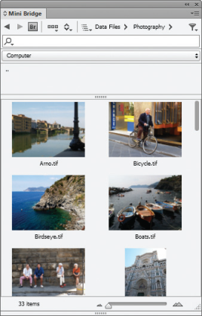
Placing Multiple Graphics
Thumbnail previews
Mini Bridge panel

Slide 14
Placing Multiple Graphics
Mini Bridge is great for previewing and a great resource for placing graphics.
When you place an image, the Link Badge appears at the upper-left corner of the frame.

Slide 15
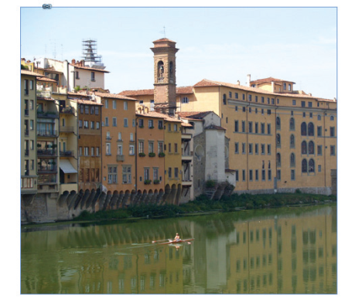
Placing Multiple Graphics
Link Badge

Slide 16
Placing Multiple Graphics
If you mouse over the Link Badge, the name of the placed file appears.

Slide 17
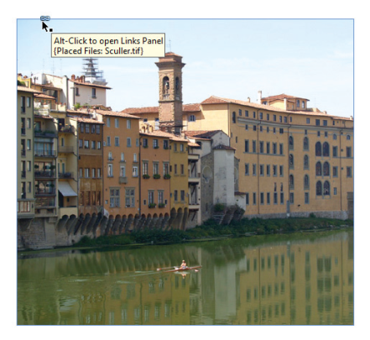
Placing Multiple Graphics
File name of placed file listed with Link Badge

Slide 18
Using the Links Panel
When you use the Place command to place a graphic file, the image that you see in the graphics frame in InDesign is a preview file; it is not the graphic itself.
The preview is a low-resolution version of the placed graphic file.

Slide 19
Using the Links Panel
As such, its file size is substantially smaller than the average graphics file.
The role of the preview file in the layout is ingenious. As a proxy for the actual graphic, it allows you to see a representation of the graphic in your layout without having to carry the burden of the graphic’s full file size.

Slide 20
Using the Links Panel
You can think of the Links panel as command central for managing the links to placed graphics.
The Links panel lists all of the graphics files that you place into an InDesign document.
By default, text that you place in InDesign is not linked to the original text file and therefore not listed in the Links panel.

Slide 21
Using the Links Panel
By default, graphics files are listed with a thumbnail of the graphic.
You can use the Links panel to locate a placed file in your document quickly.
Double-clicking a filename on the Links panel displays the Link Info section of the Links panel.

Slide 22
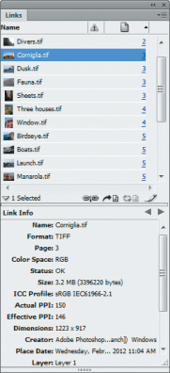
Using the Links Panel
Show/Hide Link info
The Link info section of the Links panel

Slide 23
Using the Links Panel
The Link Info section displays important information about the placed file, including its file size, resolution, the date it was last modified, the application that created it, and its file format.
The file format identifies what type of file it is, such as a Photoshop or an Illustrator file.

Slide 24
Using the Links Panel
When you place text in InDesign, the text is usually from a Word processing program like Microsoft Word or Word Perfect.
By default, when you place text in InDesign, the text is not linked to the original text file and the placed text does not appear in the Links panel.

Slide 25
Using the Links Panel
The formatting changes you apply in InDesign don’t affect the original text file and, more importantly, any changes that you might make to the original text file don’t affect the formatting of the text in InDesign.

Slide 26
Using the Links Panel
You can override the default and link text you place in InDesign to the original text document.
If you select the Create Links When Placing Text And Spreadsheet Files option in the File Handling Preferences dialog box before you place a file, the name of the text file appears in the Links panel.

Slide 27
Using the Links Panel
When text is linked to its original file in this manner, you can use the Links panel to update and manage the file.

Slide 28
Using the Links Panel
When you place a graphics file, InDesign establishes a link between the graphics frame and the placed file.
That link is based on the location of the file.
InDesign remembers that navigation path as the method for establishing the location of the placed file.

Slide 29
Using the Links Panel
The Links panel uses icons to alert you to the status of a placed file.
The Missing icon appears beside the file’s name when the established link no longer points to the file. (if you move the file or delete it after you place it in InDesign.)
The Missing icon is a white question mark inside a red circle.

Slide 30
Using the Links Panel
The Modified icon is a black exclamation point in a yellow triangle.
A placed file’s status is noted as Modified when the original file has been edited and saved after being placed in InDesign.

Slide 31
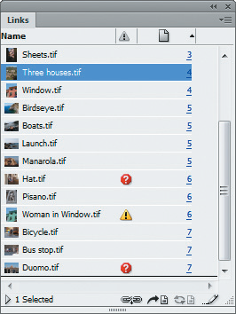
Using the Links Panel
Missing indicator
Modified indicator
Placed graphics with Missing and Modified status

Slide 32
Using the Links Panel
The OK status does not have an icon.
The OK status means that the established link still points to the location of the placed graphic, and the graphic itself has not been modified since being placed.

Slide 33
Using the Links Panel
When the Links panel displays modified and missing icons, those links need to be updated, meaning you need to reestablish the connection between the preview file and the graphic file that has been moved or edited.

Slide 34
Using the Links Panel
InDesign allows you to embed a placed file into the InDesign document.
When you embed a placed file, the file literally becomes part of the InDesign document; it no longer links to a source file.
In fact, if you edit the source file, you cannot update the embedded file; the link is literally broken.

Slide 35
Using the Links Panel
You would do this for one reason: to have a self-contained InDesign document without the need for supporting files.
Rather than having to package an InDesign document with all its supporting files, an InDesign document with embedded graphics offers you the simplicity of having to work with only a single document.

Slide 36
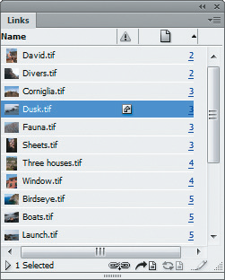
Using the Links Panel
Embedded link icon
Embedding a placed file

Slide 37
Exploring Image Resolution Issues
Photographic images are created on computers using a rectangular grid of colored squares called pixels.
Because pixels (a contraction of “picture elements”) can render subtle gradations of tone, they are the most common medium for continuous tone images—what you perceive as a photograph on your computer.

Slide 38
Exploring Image Resolution Issues
Graphics created from pixels are called bitmap graphics.
All scanned images and digital “photos” are composed of pixels.
The following figure shows an example of a bitmap image.
The enlarged section shows you the pixels that compose the image.

Slide 39
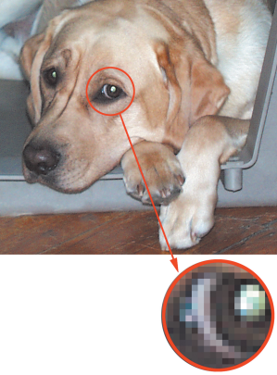
Exploring Image Resolution Issues
Enlarged view of eye shows pixels
Bitmap graphic

Slide 40
Exploring Image Resolution Issues
The number of pixels in a given inch is referred to as the image’s resolution.
To be effective, pixels must be small enough to create an image with the illusion of continuous tone.
The standard resolution for images for the web is 72 pixels per inch (ppi).
For images that will be professionally printed, the standard resolution is 300 pixels per inch (ppi).

Slide 41
Exploring Image Resolution Issues
The term effective resolution refers to the resolution of a placed image based on its size in the layout.
The important thing to remember about bitmap images in relation to InDesign is that the size of the image placed in the InDesign layout has a direct effect on the image’s resolution.

Slide 42
Exploring Image Resolution Issues
This is why enlarging an image in InDesign usually creates a problem with effective resolution: the greater the enlargement, the lower the effective resolution of the image.

Slide 43
Exploring Image Resolution Issues
Photoshop is the best-selling pixel-based image manipulation software application by Adobe Systems, the same company that produces InDesign.
It’s important that you understand that scaling a graphic in Photoshop is different from scaling a graphic in InDesign.

Slide 44
Exploring Image Resolution Issues
When you scale a graphic in InDesign, it either spreads the existing pixels over a larger area (enlargement) or squeezes them into a smaller area (reduction).
Photoshop allows you to actually change the number of pixels when you scale a graphic.

Slide 45
Exploring Image Resolution Issues
When enlarging a graphic in Photoshop, Photoshop creates the new pixels necessary to maintain an image’s resolution by a process called interpolation.
The color of the new pixels is based on the color information of the original pixels in the image.

Slide 46
Exploring Image Resolution Issues
Enlarging a bitmap graphic always results in a loss of quality—even if you do it in Photoshop.
That’s because interpolated data is only duplicated data—inferior to the original data that you get from a scan or a digital image that you download from a digital camera.

Slide 47
Exploring Image Resolution Issues
If you find that you need to enlarge the graphic substantially (more than 10%), remember that all resizing of bitmap graphics should be done in Photoshop, not in InDesign.
Use InDesign simply to place the graphics in a layout, create text wraps, and perform other layout related tasks.

Slide 48
Placing Vector Graphics
Graphics that you create in computer drawing programs, such as Adobe Illustrator, are called vector graphics.
Vector graphics consist of anchor points and line segments, together referred to as paths.
Paths can be curved or straight; they are defined by geometrical characteristics called vectors.

Slide 49
Placing Vector Graphics
The following figure shows an example of vector graphics used to draw a cartoon boy.
The graphic on the left is filled with colors, and the graphic on the right shows the vector shapes used to create the graphic.

Slide 50


Placing Vector Graphics
Examples of vector graphics

Slide 51
Placing Vector Graphics
As geometric objects, vector graphics can be scaled to any size with no loss in quality.
This means that a graphic that you create in an application like Adobe Illustrator can be output to fit on a postage stamp . . . or on a billboard!
Computer graphics rely on vectors to render bold graphics that must retain clean, crisp lines when scaled to various sizes.

Slide 52
Placing Vector Graphics
When you place vector graphics in InDesign, you can enlarge or reduce them to any size because scaling a vector graphic does not have any impact on its visual quality.
When you place a vector graphic from Illustrator, only the objects that compose the graphic are placed.

Slide 53
Placing Vector Graphics
When you create a graphic in Illustrator, Illustrator draws an imaginary bounding box that defines the perimeter of the graphic.
The technique used, in the following figure, allows you to create interesting text wraps around a complex Illustrator graphic.

Slide 54
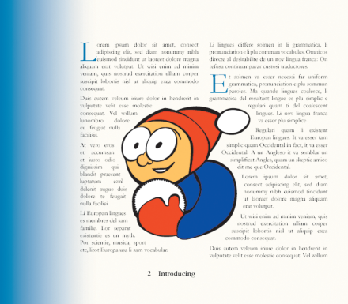
Placing Vector Graphics
Placed Illustrator graphic with a text wrap

Slide 55
Placing Vector Graphics
When you place a graphic file in InDesign, a low-resolution preview file appears in the graphics frame.
The appearance of the preview file—the quality at which it is displayed—is determined by default in the Display Performance section of the Preferences dialog box.

Slide 56
Placing Vector Graphics
You can choose between Fast, Typical, or High Quality views of placed graphics.
The Fast Display view shows no preview file. Instead, it shows a gray box within the graphics frame.
Most up-to-date computers have enough memory that you won’t need to resort to this option.

Slide 57
Placing Vector Graphics
The Typical Display view displays a low resolution preview.
This is an adequate display for identifying and positioning an image within the layout.

Slide 58
Placing Vector Graphics
The High Quality Display view displays the preview file at high resolution.
This option provides the highest quality, but requires the most memory.

Slide 59
Placing Vector Graphics
The setting that you choose in the Display Performance section of the Preferences dialog box will determine the default display for every graphic that you place in InDesign.
In addition, there are two sets of Display Performance commands on the Menu bar.

Slide 60
Placing Vector Graphics
There is one set on the Object menu and another set on the View menu.
Use the View menu commands when you want to change the display performance of all of the placed graphics in an open document.
Use the Object menu commands when you want to change the display performance for graphics on an individual basis.

Slide 61
Placing Vector Graphics
There are two different ways you can put your Illustrator graphics into an InDesign document.
If you know you won’t need to modify the graphic at all in InDesign, just place it using the Place command on the File menu.
If you want to retain the option of editing the file from within InDesign, copy and paste the Illustrator graphic.

Slide 62

Placing Vector Graphics
Illustrator graphic placed in InDesign and selected with Direct Selection tool

Slide 63
Interfacing InDesign with Photoshop
Adobe makes a number of software products.
InDesign is a layout application.
Illustrator is a drawing application.
Photoshop is a photo manipulation application.
Because they are all Adobe products, they have been engineered to work together, in most cases, seamlessly.

Slide 64
Interfacing InDesign with Photoshop
In many cases, bitmap graphics that you place in InDesign will have a white background.
One useful overlap between InDesign and Photoshop is the ability to remove a white background from a placed graphic in InDesign.

Slide 65
Interfacing InDesign with Photoshop
Using the Detect Edges function in the Clipping Path dialog box, as shown in the following figure, InDesign identifies pixels in the graphic based on their values— from light to dark—and makes specific pixels transparent.

Slide 66
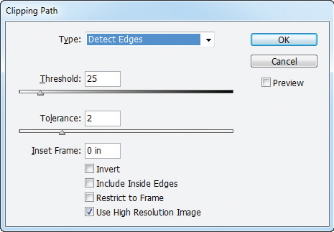
Interfacing InDesign with Photoshop
Detect Edges function in the Clipping Path dialog box

Slide 67
Interfacing InDesign with Photoshop
The Threshold value determines the pixel values that will be made transparent.
For example, if the Threshold value is set to 10, the 10 lightest pixel values (out of a total of 256 values from light to dark) would be made transparent.
Your best method for using this feature is to start with a Threshold value of 0—no pixels will be transparent.

Slide 68
Interfacing InDesign with Photoshop
The Tolerance value determines how smooth the edge of the image will be once pixels are made transparent.
A Tolerance value of 1 or 2 is usually acceptable.
The following figures show a placed graphic, first with a white background, then with the white background removed using the Detect Edges section of the Clipping Path dialog box.

Slide 69
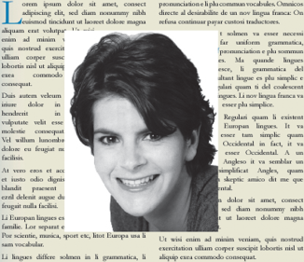
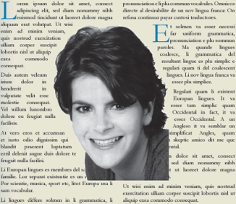
Interfacing InDesign with Photoshop
A placed graphic with a white background and with the white
background made transparent
White background
White background made transparent

Slide 70
Interfacing InDesign with Photoshop
The Detect Edges feature works most effectively with darker foreground images against a white background.
One drawback to using the Detect Edges feature is that it affects all white pixels, whether they are in the background or foreground.

Slide 71
Interfacing InDesign with Photoshop
In other words, if you have an image of a man with a white beard against a white background, there’s no way to make the white background transparent without making the white beard transparent as well.

Slide 72
Interfacing InDesign with Photoshop
Many times, when working with bitmap graphics, you’ll find that you want to select only a specific area of the graphic.
For example, you may want to isolate an image of a person from its background.

Slide 73
Interfacing InDesign with Photoshop
Using selection tools in Photoshop, you can do just that.
The selection, known as a silhouette, can be saved with the Photoshop file for use in another Photoshop document or in another program, such as InDesign.

Slide 74
Interfacing InDesign with Photoshop
Alpha channels are selections created and saved in Photoshop.
InDesign has the ability to load alpha channels that have been saved with a Photoshop file.

Slide 75
Interfacing InDesign with Photoshop
Alpha channels are rendered in terms of black and white, with the white areas representing the selected pixels and the black areas representing the non-selected areas.

Slide 76
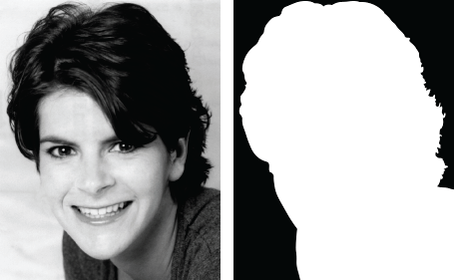
Interfacing InDesign with Photoshop
Black areas can be made transparent in InDesign
White represents selected areas of image
A Photoshop file and an alpha channel

Slide 77
Interfacing InDesign with Photoshop
When you place the Photoshop graphic in InDesign, the alpha channel saved with it is not automatically loaded.
The graphic will be placed by default as a square-up—the entire image, including the background.
You can then use the Clipping Path command to load the alpha channel, thereby creating a silhouette in your layout.

Slide 78
Interfacing InDesign with Photoshop
Like alpha channels, clipping paths are another type of selection you can create in Photoshop.
Paths are created with the Pen tool, which is a sophisticated selection tool in Photoshop that allows you to make very specific selections.
Once created, one or more paths can be saved or exported with a Photoshop file.

Slide 79
Interfacing InDesign with Photoshop
If a path is exported with the Photoshop file, the path will be loaded automatically when you place the graphic in InDesign.
If you save, rather than export, a path with a Photoshop file, it won’t automatically load when you bring it into InDesign, though you can use the Clipping Path command in InDesign to load it.

Slide 80
Interfacing InDesign with Photoshop
When placing a bitmap graphic with a feathered edge against a colored background in InDesign, the best solution is to save the graphic against a transparent background in Photoshop.
If you save the graphic in Photoshop with this configuration in the Photoshop Layers panel, when you place the graphic in InDesign, only the visible layer—the graphic with the feathered edge—appears.

Slide 81
Using Libraries
Libraries (also called Object Libraries) are files you create that appear as a panel in your InDesign document.
You can use this library panel to organize and store graphics that you use most often.
You can also store other page elements, such as text, ruler guides, and grids.

Slide 82
Using Libraries
Library files exist as named files on your computer’s hard drive, just like any other files.
When you create a library file, you specify where it will be stored.
You can open and close a library file just as you would any other file.
Libraries exist independently of whatever InDesign document is open and you can open multiple libraries, as needed.

Slide 83
Using Libraries
When you use a file from a library in a document, you can edit the file any way you like.
The edits that you make to the file in the document do not affect the original file in the library in any way.

Slide 84
Using Libraries
InDesign has two great commands that allow you to add all the objects on a page to a library as one single object or as separate objects.
Both commands are found on the Library panel menu.
You don’t need to select any objects on the page before choosing either of these two commands.

Slide 85
Using Libraries
The following figure shows the results of adding all objects on the page as separate objects.

Slide 86
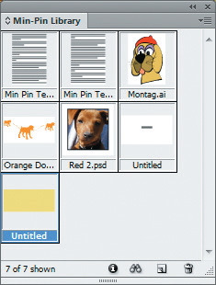
Using Libraries
All items on page added to library as separate objects

