Slide 1
Chapter 7
Creating Graphics

Slide 2
Using the Pen Tool
The Pen tool creates straight or curved line segments called paths.
Clicking the Pen tool on the page creates an anchor point.
Line segments are automatically placed between every two anchor points.

Slide 3
Using the Pen Tool
An open path is a path whose end points are not connected.
A closed path is a path consisting of continuous lines that do not contain end points.

Slide 4

Using the Pen Tool
Closed paths with fills
Open and curved path
Closed path with a stroke
Examples of open and closed paths

Slide 5
Using the Pen Tool
Straight segments are connected by corner points—anchor points that create a corner between the two segments.
Whenever you need to reconnect to a path, simply position the Pen tool over the path’s end point until a diagonal line appears beside the Pen tool.

Slide 6
Using the Pen Tool
You can use the Direct Selection tool to perfect, or tweak, the points and paths.
“Tweaking” a finished object is making small, specific improvements to it, and is always part of the drawing process.

Slide 7
Using the Pen Tool
When you delete an anchor point, the two segments on both sides of it are joined as one new segment.
The Delete Anchor Point tool will delete a point from the path without breaking the path into two paths.

Slide 8
Using the Pen Tool
Anchor points that connect curved segments are called smooth points.
A smooth point has two direction lines attached to it.
Direction lines determine the arc of the curved path, depending on their direction and length.

Slide 9
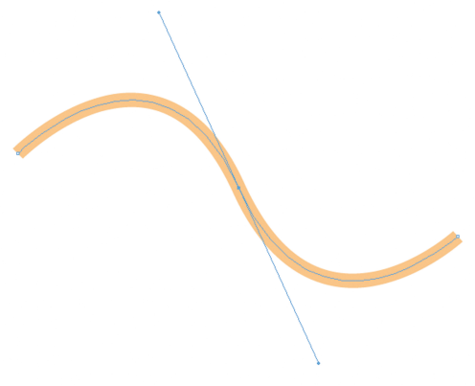
Using the Pen Tool
Direction lines
Smooth point
A smooth point and direction lines

Slide 10
Using the Pen Tool
Using the Direct Selection tool, you can manipulate the direction lines of a smooth point.
When you do this, you alter the arc of both segments attached to the point, always maintaining a smooth transition through the anchor point.
Simply click the point that you want to modify, then drag the direction handle—the round blue circle at the top of the direction line—in a new direction to shorten or elongate it.

Slide 11
Using the Pen Tool
When two segments are joined at a corner point, the two segments can be manipulated independently.
A corner point can join two straight segments, one straight segment and one curved segment, or two curved segments, having zero, one, and two direction lines, respectively.

Slide 12
Using the Pen Tool
Direction lines work in tandem. When you move one, the other one also moves. This is often very useful when making curved paths.
However, in some cases, you will want to move one direction line independently of the other, especially when creating or tracing a path that abruptly changes direction.

Slide 13
Using the Pen Tool
The Convert Direction Point tool “breaks” a smooth point’s direction lines and allows you to move one independently of the other.
When you do so, the smooth point is converted to a corner point that now joins two unrelated curved paths.
Once the direction lines are broken, they remain broken. You can manipulate them independently with the Direct Selection tool; you no longer need the Convert Direction Point tool to do so.

Slide 14
Using the Pen Tool
The Convert Direction Point tool can also be used to change corner points to smooth points and smooth points to corner points.

Slide 15
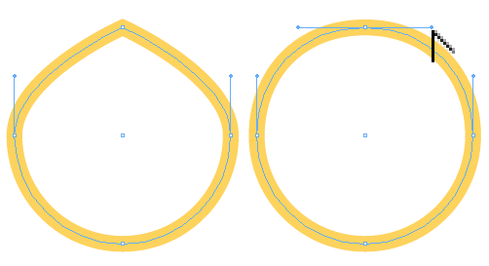
Using the Pen Tool
Convert Direction Point tool being used to create new direction lines
Corner point
Corner point converted to a smooth point
Converting a corner point to a smooth point

Slide 16
Using the Pen Tool
To convert a smooth point to a corner point, simply click the Convert Direction Point tool on the smooth point.
The direction lines disappear and the two attached paths become straight paths.

Slide 17
Using the Pen Tool
If you drag a direction line with the Convert Direction Point tool, the point is automatically converted from a smooth point to a corner point.
Therefore, the direction line you are dragging moves independently from the other direction line.

Slide 18
Reshaping Frames and Applying Stroke Effects
The Tools panel offers a number of tools for creating basic shapes.
The graphics frame tools include:
Rectangle
Polygon
Ellipse
You can also use the regular Rectangle, Polygon, and Ellipse tools.

Slide 19
Reshaping Frames and Applying Stroke Effects
The objects that you create with any of these tools can be modified using the Direct Selection tool or the Pen tool.
When you select an object, the appearance of the object will differ depending on which of the two selection tools is selected on the Tools panel.

Slide 20
Reshaping Frames and Applying Stroke Effects
When the Selection tool is selected, you’ll see the object’s bounding box.
The bounding box includes eight handles, which you can manipulate to change the object’s size.

Slide 21
Reshaping Frames and Applying Stroke Effects
When you click the Direct Selection tool, the object’s bounding box disappears and is replaced by its path.
You can select and move anchor points or path segments along the path.

Slide 22
Reshaping Frames and Applying Stroke Effects
The Pen tool is active on the Tools panel, any selected object is essentially a path, composed of anchor points and path segments, which you can manipulate like any other path.
This means that, using the Direct Selection tool or the Pen tool, you can reshape any of the basic objects you create with the shape tools—rectangles, ellipses, and polygons.

Slide 23
Reshaping Frames and Applying Stroke Effects
Color that you apply to a path is called a stroke.
Once you’ve applied a stroke to a path, you can manipulate characteristics of the stroke using the Stroke panel, such as the weight or thickness of the stroke.

Slide 24
Reshaping Frames and Applying Stroke Effects
You have options for changing the design of the stroke, such as making it a dotted line instead of a solid line.
You can format the stroke as a dashed stroke, and you can apply end shapes to the stroke, such as arrowheads and tail feathers.

Slide 25
Reshaping Frames and Applying Stroke Effects
Joins define the appearance of a corner point when a path has a stroke applied to it.
There are three types of joins;
The miter join produces pointed corners and is the default.
The round join produces rounded corners.
The bevel join produces squared corners.

Slide 26

Reshaping Frames and Applying Stroke Effects
Miter point
Round point
Bevel point
Three types of joins

Slide 27
Reshaping Frames and Applying Stroke Effects
Caps define the appearance of end points when a stroke is added to a path.
The Stroke panel offers three types of caps;
The butt cap produces squared ends.
The round cap produces rounded ends.
The projecting cap applies a squared edge that extends the anchor point at a distance one-half the weight of the stroke.

Slide 28
Reshaping Frames and Applying Stroke Effects
With a projecting cap, the weight of the stroke is equal in all directions around the line.
The projecting cap is useful when you align two anchor points at a right angle.

Slide 29
Reshaping Frames and Applying Stroke Effects
The miter limit determines when a miter join will be squared off to a beveled edge.
The miter is the length of the point, from the inside to the outside, as shown in the following figure.

Slide 30

Reshaping Frames and Applying Stroke Effects
Measurement of miter
Point reduced to a beveled edge
Understanding miters and miter limits

Slide 31
Reshaping Frames and Applying Stroke Effects
The length of the miter is not the same as the stroke weight.
When two stroked paths are at an acute angle, the length of the miter will greatly exceed the weight of the stroke, which results in an extreme point that can be very distracting.

Slide 32
Reshaping Frames and Applying Stroke Effects
The default miter limit is 4, which means that when the length of the miter reaches 4 times the stroke weight, it will automatically be squared off to a beveled edge.

Slide 33
Reshaping Frames and Applying Stroke Effects
Dashed strokes, which are created and formatted using the Stroke panel, are strokes that consist of a series of dashes and gaps.
You define the dash sequence for a dashed stroke by entering the lengths of the dashes and the gaps between them in the dash and gap text boxes on the Stroke panel.

Slide 34
Reshaping Frames and Applying Stroke Effects
You can create a maximum of three different sized dashes separated by three different sized gaps.
The pattern you establish will be repeated across the length of the stroke.

Slide 35
Working with Polygons and Compound Paths
The Tools panel offers the Polygon tool and the Polygon Frame tool for creating multi-sided objects, such as triangles, pentagons, and hexagons.
You can place graphics into objects you create with either tool.

Slide 36
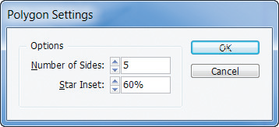
Working with Polygons and Compound Paths
Polygon Settings dialog box

Slide 37
Working with Polygons and Compound Paths
The Star Inset setting allows you to use the Polygon tool or the Polygon Frame tool to create star shapes.
The greater the star inset percentage, the more acute and longer the points of the star will be, as shown in the following figure.

Slide 38

Working with Polygons and Compound Paths
70% star inset
40% star inset
Comparing different star inset percentages

Slide 39
Working with Polygons and Compound Paths
Imagine you were going to use the Pen tool to trace the outline of a doughnut.
You would draw an outer circle for the doughnut itself, then an inner circle to define the doughnut hole.
Then, you would want to format the two paths so that the inner circle “cuts a hole” in the outer circle.

Slide 40
Working with Polygons and Compound Paths
You create compound paths when you want to use one object to cut a hole in another object.

Slide 41
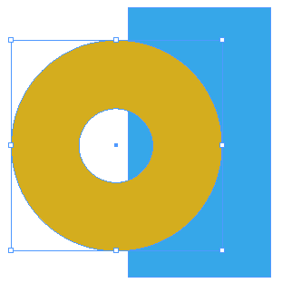
Working with Polygons and Compound Paths
“Hole” in the circle
Two paths that make
up a compound path
Identifying two paths compounded as a single path

Slide 42
Working with Polygons and Compound Paths
Once compounded, the two paths create one object.
Compound paths are not only used for the practical purpose of creating a hole.
When you work with odd or overlapping shapes, the Make Compound Path command can produce results that are visually interesting and can be used as design elements.

Slide 43

Working with Polygons and Compound Paths
Using compound paths to design interesting graphics
A “hole” is created where the letter overlaps the circle

Slide 44
Working with Polygons and Compound Paths
Anchored objects are objects that you create and use as text characters within a block of text.

Slide 45
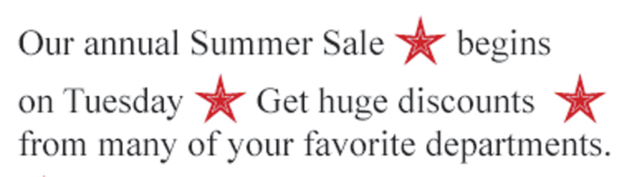
Working with Polygons and Compound Paths
Viewing anchored objects

Slide 46
Working with Advanced Text Features
Anchored objects are placed or pasted into text blocks at the insertion point.
Any modifications you make to the text after they are placed, such as rotating the text box, will also affect the anchored objects.

Slide 47
Working with Advanced Text Features
The default position for anchored objects is Inline.
In the Inline position, the anchored object is aligned with the baseline.
You can adjust the Y Offset value of the anchored object to raise or lower it.
The other possible positions are referred to as Above Line and Custom.

Slide 48
Working with Advanced Text Features
Once you’ve created an object, like a line or a polygon, the Type on a Path tool allows you to position text on the outline of the object.
Simply float the Type on a Path tool pointer over the path until a plus sign appears beside the pointer, and then click the path.
A blinking cursor appears, allowing you to begin typing.

Slide 49
Working with Advanced Text Features
Whenever you position text on a path, a default start, end, and center bracket are created, as well as an in port and an out port used for threading text.
Drag the start bracket with either of the selection tools to move the text along the path.
If you drag the center bracket across the path, the text will flow in the opposite direction.

Slide 50
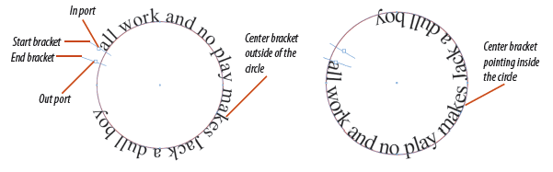
Working with Advanced Text Features
Text positioned on a path
Reversing the direction of the text

Slide 51
Working with Advanced Text Features
One key design technique that many designers use in conjunction with text on a line is a baseline shift.
You can use the Baseline Shift text box on the Character panel to make the text float above or below the path.

Slide 52
Working with Advanced Text Features
After you create text in InDesign, you can convert the text to outlines.
When text is converted to outlines, each character is converted to a closed path and shares the same characteristics of all paths.

Slide 53

Working with Advanced Text Features
Placing a graphic in outlined text
Blue stroke applied to paths

