Slide 1
Chapter 8
Exploring Effects and
Advanced Techniques

Slide 2
Using the Pathfinder Panel
The Pathfinder panel is essentially a drawing tool and is divided into four sections:
Paths
Pathfinder
Convert Shape
Convert Point

Slide 3
Using the Pathfinder Panel
The Path section is useful when creating paths with the Pen tool. You can:
Join
Open
Close
or Reverse a path using the four buttons in this section
The Convert Point section also applies to paths and points, allowing you to manipulate points to create different corners and arcs with a path.

Slide 4
Using the Pathfinder Panel
The Pathfinder section in the Pathfinder panel helps you easily create new complex shapes by overlapping simple objects.
The panel does this by offering five buttons that work as follows:
Add
Subtract
Intersect
Exclude Overlap
Minus Back

Slide 5
Using the Pathfinder Panel
Add: Combines two or more overlapping objects into one object.
The resulting object assumes the color properties of the frontmost object.

Slide 6
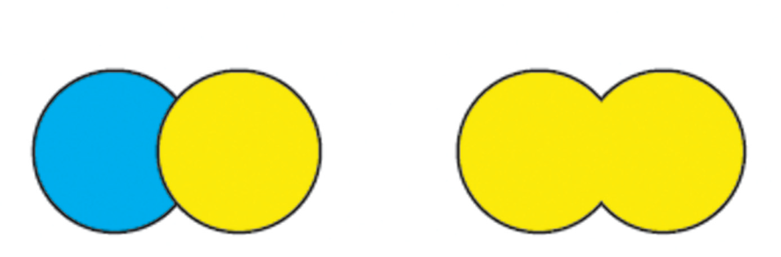
Using the Pathfinder Panel
Original
Add
Add pathfinder

Slide 7
Using the Pathfinder Panel
Subtract: The frontmost object(s) “punch a hole” in the backmost object.
The resulting object retains the color properties of the backmost object.

Slide 8

Using the Pathfinder Panel
Original
Subtract
Subtract pathfinder

Slide 9
Using the Pathfinder Panel
Intersect: The resulting shape is the intersection of the overlapping object(s) and assumes the color properties of the frontmost object.

Slide 10
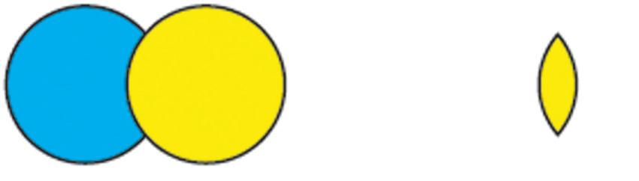
Using the Pathfinder Panel
Original
Intersect
Intersect pathfinder

Slide 11
Using the Pathfinder Panel
Exclude Overlap: A hole is created where the two objects overlap.
The resulting object assumes the color properties of the frontmost object.

Slide 12
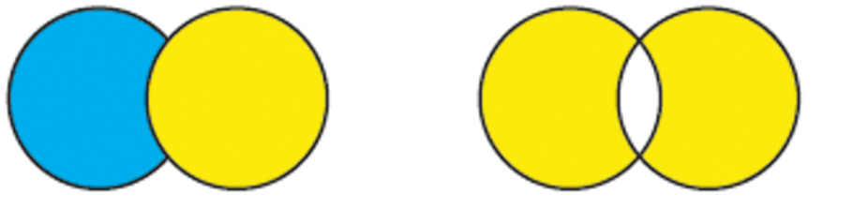
Using the Pathfinder Panel
Original
Exclude Overlap
Negative space
Exclude Overlap pathfinder

Slide 13
Using the Pathfinder Panel
Minus Back: The backmost object “punches a hole” in the object(s) in front.
You can think of the Minus Back pathfinder as the opposite of the Subtract pathfinder.
The resulting object assumes the color properties of the frontmost object.

Slide 14
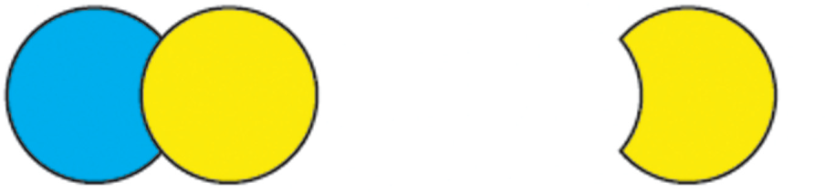
Using the Pathfinder Panel
Original
Minus Back
Minus Back pathfinder

Slide 15
Using the Pathfinder Panel
The Convert Shape section of the Pathfinder panel offers practical solutions and is easy to use.
You can create a frame of any shape and size, then click any of the buttons in the Convert Shape section of the panel, such as the ellipse, triangle, polygon, or line.
The selected frame will then change to that shape.

Slide 16
Creating New Stroke Styles
The Stroke panel offers a number of stroke styles that you can apply to objects.
You can also create and customize your own stroke styles and make them available for use on the Stroke panel.

Slide 17
Creating New Stroke Styles
InDesign allows you to create and customize three types of stroke styles:
Dash
Dotted
Stripe

Slide 18
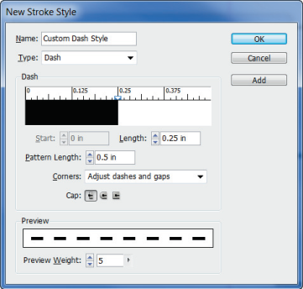
Creating New Stroke Styles
Type list arrow
Length text box
Pattern Length text box
New Stroke Style dialog box

Slide 19
Creating New Stroke Styles
You can add additional dashes to the pattern.
You can change the length of the new dash by dragging the two white triangles (Win) or black triangles (Mac) above the dash.
As you modify the new dash stroke style, you can see what it looks like in the preview window at the bottom of the dialog box.
Using this dialog box, you can create dash stroke styles that are complex and visually interesting.

Slide 20
Creating New Stroke Styles
As with dash strokes, you can add additional dots to the stroke pattern.
By default, a stripe stroke style begins with two stripes.
You can specify additional stripes as having different widths, thus creating a style that is unique and visually interesting.

Slide 21
Incorporating Gridify Behavior
Gridifying is positioning frames into a grid pattern in just one move.
You can make several different types of these moves using a combination of tools and keypad inputs.
Adobe refers to these various moves as gridify behaviors.

Slide 22
Incorporating Gridify Behavior
You can use any of the frame creation tools, such as Rectangle, Polygon, and Type, to create a grid of frames in one move.

Slide 23
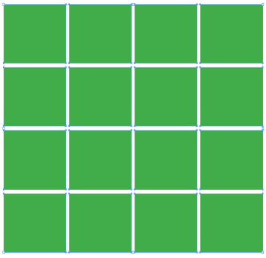
Incorporating Gridify Behavior
Frames in a grid

Slide 24
Incorporating Gridify Behavior
If you set up your document with column guides, InDesign will automatically use the gutter width specified for the column guides as the width for the columns of the grid you create.
Having the grid align to the columns is especially useful when creating text frames.
As an added bonus, the text frames you create with gridify behavior will automatically be threaded.

Slide 25
Incorporating Gridify Behavior
Gridify behaviors are powerful in conjunction with the place gun.
When you’ve loaded multiple images into the place gun, you can use the same keyboard inputs to place all the loaded images in a grid layout.

Slide 26
Incorporating Gridify Behavior
Earlier in this book, you learned that you can “drag and drop” a copy of a frame.
You also learned to use the Step and Repeat command.
Gridify behavior merges the two.

Slide 27
Working with Nested Styles
Nested styles are paragraph styles that contain two or more character styles.
Without nested styles, you would need to apply character styles one at a time.
With nested styles, you can format the entire block of text with a single paragraph style.

Slide 28
Working with Nested Styles
Nested styles are useful in specific situations, especially for blocks of text that contain repeating formatting at the beginning of each paragraph.

Slide 29
Working with Nested Styles
Implementing nested styles requires a bit of forethought when formatting paragraphs.
You must have characters that you can use to identify where a nested style ends.
Periods, colons, and em or en spaces can be entered in the paragraph style to mark where a nested style should end.

Slide 30
Working with Nested Styles
If your layout doesn’t call for periods, colons, or em spaces, then you can insert a special character using the End Nested Style Here command.

Slide 31
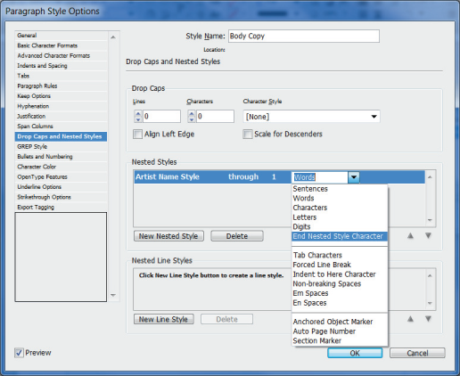
Working with Nested Styles
Specifies where Artist Name Style will end
Formatting a nested style using the End Nested Style Character command

Slide 32
Applying Live Corner Effects
Live Corner Effects offer an interactive interface to apply different corner styles to a frame.

Slide 33

Applying Live Corner Effects
Original (no corner effect applied)
Fancy
Bevel
Inset
Inverse Rounded
Rounded

Slide 34
Applying Live Corner Effects
The Live Corner Effects utility allows you to click and drag to specify the extent of an effect.
You can apply an effect to a single corner, and you can apply multiple effects to a single frame.
The ability to apply different effects to different corners offers the opportunity to create interesting frame shapes.

Slide 35
Working with Effects and Object Styles
The Effects dialog box offers a number of effects that you can apply to objects to make your layouts more visually interesting.
All of the available effects are listed on the left side of the dialog box, and settings for each effect become available on the right side of the dialog box when you click the name of the effect on the left.
You can apply multiple effects to a single object.

Slide 36
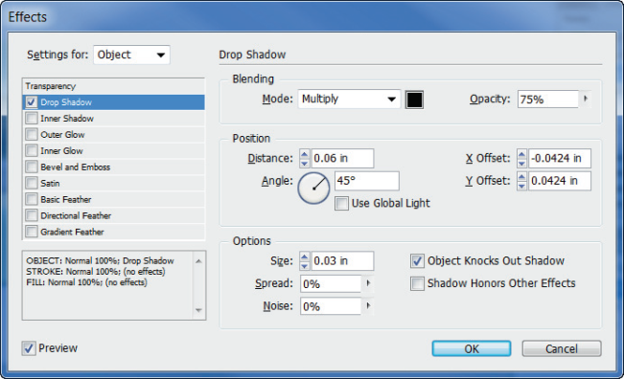
Working with Effects and Object Styles
List
of effects
Effects dialog box

Slide 37
Working with Effects and Object Styles
InDesign effects, such as glows, shadows, bevels, embosses, and feathers, are all nondestructive, which means that they are not necessarily permanent.
At any time, you can apply, remove, or modify them.
In other words, they don’t permanently alter or “destroy” the object to which they’re applied.

Slide 38
Working with Effects and Object Styles
When you select a frame, the Effects panel lists information about any effects applied to the frame or to contents of the frame.
When you have applied effects, the fx icon appears beside the word Object in the panel.

Slide 39
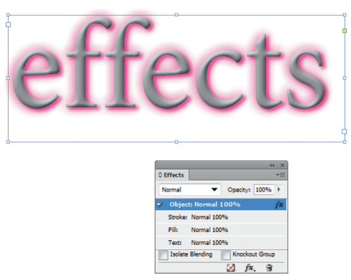
Working with Effects and Object Styles
Indicates effects applied
Effects panel

Slide 40
Working with Effects and Object Styles
Once you have applied effects, you can double-click the fx icon on the Effects panel to reopen the Effects dialog box if you want to modify or remove effects.

Slide 41
Working with Effects and Object Styles
Use the fx icon on the Effects panel to copy effects between objects.
Select any object that has an effect applied to it, then drag the fx icon to another object in the document.
The effects applied to the first object will be applied to the second.

Slide 42
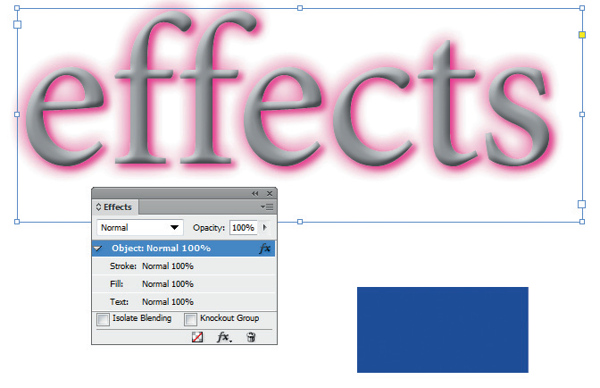
Working with Effects and Object Styles
Dragging the fx icon

Slide 43
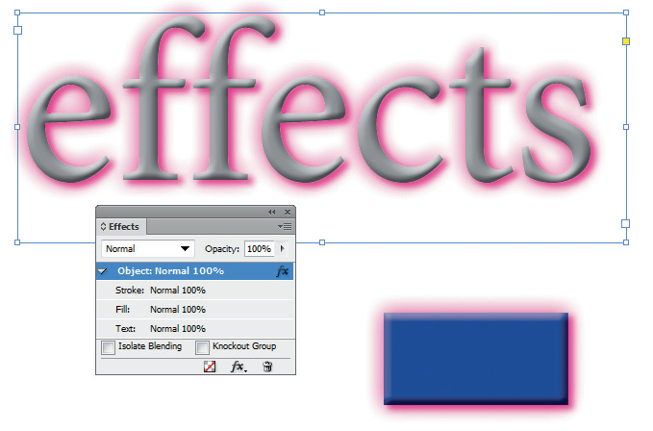
Working with Effects and Object Styles
Effects copied to the blue-filled frame

Slide 44
Working with Effects and Object Styles
Note that when you copy effects from one object to another, no relationship is created between the objects.
If you modify the effects on one object, the other object won’t be affected by the change.

Slide 45
Working with Effects and Object Styles
The New Object Style dialog box allows you to specify a variety of formatting choices for graphics frames and text frames.
Any modification you make to the object style will update automatically for any object that uses the object style.

Slide 46
Working with Effects and Object Styles
Once you’ve created an object style, the named style is listed on the Object Styles panel, as shown in the following figure.

Slide 47
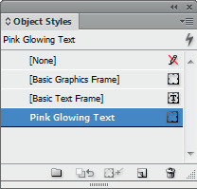
Working with Effects and Object Styles
Object Styles panel

Slide 48
Working with Multiple Page Sizes
InDesign allows you to work with multiple page sizes in a single document.
Working in this manner, you can change the size of any and every page in the Pages panel.
The new multiple page size feature also works with master pages.

Slide 49
Working with Multiple Page Sizes
For example, you could create a single document with three master pages—one for a letterhead, one for business cards, and one for envelopes.
You could then apply the master to any page in the document.

Slide 50
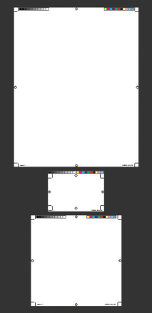
Working with Multiple Page Sizes
Three different page sizes output with crop marks
Three page sizes output to PDF

Slide 51
Designing with Multiple Documents
The Content Collector panel is a shuttle for moving objects between documents.
The panel has two tools:
the Content Collector tool
the Content Placer tool

Slide 52
Designing with Multiple Documents
The Content Collector tool takes objects—frames, text and placed images—from a document and puts them into the Content Collector panel.
The Content Placer tool places those objects into another document.
The Content Collector tool and the Content Placer tool are also available on the Tools panel.

Slide 53
Designing with Multiple Documents
The panel is more than just a glorified cut and paste utility, because it allows you to create links between the objects.
This offers you significant time savings and is a method you can rely on to maintain consistency between multiple documents.

Slide 54
Designing with Multiple Documents
Rather than creating and saving multiple documents, you can work with multiple layouts within a single document using the Create Alternate Layout command.

Slide 55
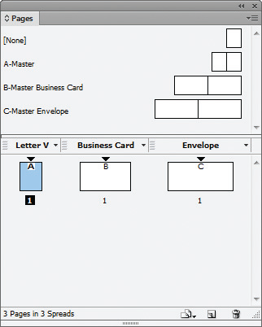
Designing with Multiple Documents
Alternate layout thumbnails in the Pages panel

Slide 56
Designing with Multiple Documents
When you create an alternate layout, all of the objects from the original layout are automatically copied to the alternate layout, and you will have the option to link all the text from the parent to the child.

