Slide 1
Chapter 10
Making Books, Tables of Contents, and Indexes

Slide 2
Creating a Book File
In InDesign, a book is a collection of two or more InDesign documents, which are paginated as a single book.
Creating a book is similar to creating a document—you use the New command on the File menu; however, you choose Book instead of Document.
A book is an individual InDesign file, like a library file.

Slide 3
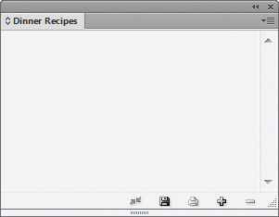
Creating a Book File
Name of book
Open book file

Slide 4
Creating a Book File
To create a book, you add InDesign documents to the Book panel.
When you do so, the documents are paginated as though they were one book.
When you add documents to a Book panel, the page numbering of those documents is also changed on the Pages panel, when the document is opened from the Book panel.

Slide 5
Creating a Book File
Page numbering changes that occur in your book file affect the original documents.
Always save backup copies of your original documents before adding them to a Book panel.

Slide 6
Organizing a Book File
When you add documents to a book file, the documents are repaginated as you add them.
However, you can reorder the documents by dragging them up or down in the Book panel.
When you reorder documents in the Book panel, the documents are repaginated accordingly—in both the panel and the documents themselves.

Slide 7
Organizing a Book File
Pagination is reordered

Slide 8
Organizing a Book File
Documents are repaginated when added to a book file.
This can create left-hand page/right-hand page issues.

Slide 9
Organizing a Book File
Typically, the documents that you add to a Book panel will start on page 1 in their original incarnation.
In other words, if you add five documents, each would have originally been numbered starting with page 1.
By default, page 1 is always a right-hand page.

Slide 10
Organizing a Book File
The Book Page Numbering Options dialog box, from the Book panel menu allows you to manipulate how documents are paginated as they are added to the book file.

Slide 11
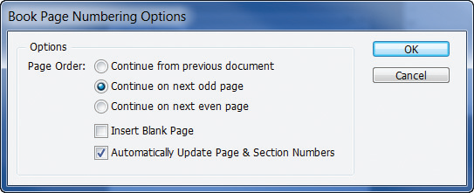
Organizing a Book File
Book Page Numbering Options dialog box
Continuing pagination on the next odd page

Slide 12
Creating a Table of Contents
When you create a table of contents (TOC) for a book, it is generated from information contained within the documents that make up the book.
Specifically, the entries in the TOC are text items from the documents formatted with specific paragraph styles.

Slide 13
Creating a Table of Contents
If you’ve created four documents of recipes that you want to collate into a book and you want the title of every recipe from every document to be listed in the TOC, then you must format the title of each recipe with the same paragraph style.
The best method for assuring consistent paragraph styles is to load them between documents.

Slide 14
Creating a Table of Contents
In the following figure, note the Style Source icon to the left of Entrees.
This means that InDesign regards the paragraph styles in the Entrees document as the master paragraph styles.
In other words, the paragraph styles in the three other documents should be consistent with those in the Entrees document.

Slide 15
Creating a Table of Contents
Identifying the master paragraph style
Style Source icon

Slide 16
Creating a Table of Contents
You can select two or more documents on the Book panel and then use the Synchronize Selected Documents command on the panel menu to synchronize styles.
When you do so, InDesign automatically searches all the paragraph styles in the selected files and compares them to those in the style source document.

Slide 17
Creating a Table of Contents
If InDesign finds paragraph styles in any of the selected documents that are not consistent with the style source document, it will modify those styles so that they match, thus insuring consistency throughout the book.

Slide 18
Creating a Table of Contents
A table of contents is an individual InDesign document that you add to the Book panel to become part of the book.
When creating the TOC document, it is critical that you carefully choose the same document-setup specifications that were used to create the other documents in the book, such as page size and orientation.
After creating the TOC document, add it to the Book panel.

Slide 19
Creating a Table of Contents
TOC on page 1
TOC document on the Book panel

Slide 20
Creating a Table of Contents
Once you’ve added the TOC document to the Book panel, you must then load the paragraph styles used in the other documents in the book.
The only way that the TOC document can access the paragraph styles necessary to create the TOC is to have those paragraph styles loaded into the TOC document itself.
Simply use the Load Paragraph Styles command on the Paragraph Styles panel.

Slide 21
Creating a Table of Contents
The Table of Contents dialog box is command central for creating a TOC.
Once you have loaded the paragraph styles, they will be available in the Other Styles box.
Choose which styles you want the TOC to use by adding them to the Include Paragraph Styles box.

Slide 22
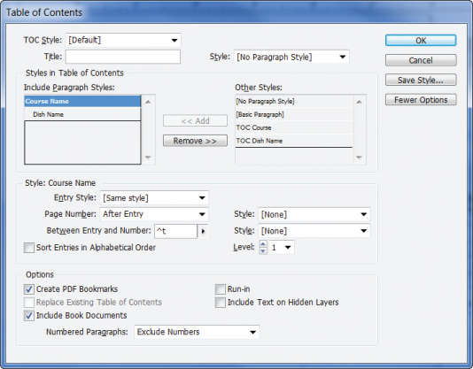
Creating a Table of Contents
Check to include documents in open book file
Table of Contents dialog box

Slide 23
Creating a Table of Contents
Be sure to check the Include Book Document check box in the dialog box.
This tells InDesign to use the documents on the Book panel as the basis for the TOC.

Slide 24
Creating a Table of Contents
In most cases, the paragraph styles from which you generate your TOC will not be appropriate for the TOC layout.
Once you generate the TOC, you can reformat the text any way you see fit, or you can modify the paragraph styles in the TOC document only.

Slide 25
Creating a Table of Contents
For another solution, you can create new paragraph styles in the TOC document that are more appropriate for the layout.
Any new paragraph styles that you create will be listed in the Table of Contents dialog box.
In the Style section of the Table of Contents dialog box, you can use the new paragraph styles to modify the appearance of the loaded paragraph styles.

Slide 26
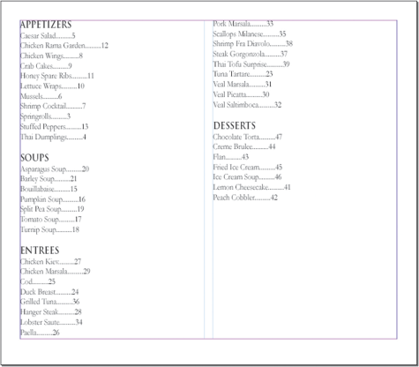
Creating a Table of Contents
TOC with reformatted paragraph styles

Slide 27
Creating an Index
Index entries are specified within the documents that make up the book and are saved with the documents.
You can specify index entries by selecting the text that you want to use as an index entry, click the Create a new index entry button on the Index panel, then click OK in the New Page Reference dialog box.
The selected text will be added to the Index panel.

Slide 28
Creating an Index
An index is an individual InDesign document that you add to the Book panel to become part of the book.
It is critical that you carefully choose the same document setup specifications that were used to create the other documents in the book.
Once you have created the index document, add it to the Book panel.

Slide 29
Creating an Index
After you’ve added the index document to the Book panel, click the Generate index button on the Index panel, shown in the following figure.
This command generates the index based on the index entries saved with the documents that compose the book.

Slide 30
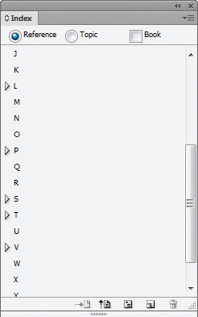
Creating an Index
Generate index button
Index panel

Slide 31
Creating an Index
One of your greatest challenges, when creating an index, will be to anticipate the way a reader will search the index for specific topics.
You could create an index entry and include a cross-reference, as seen in the following figure.

Slide 32
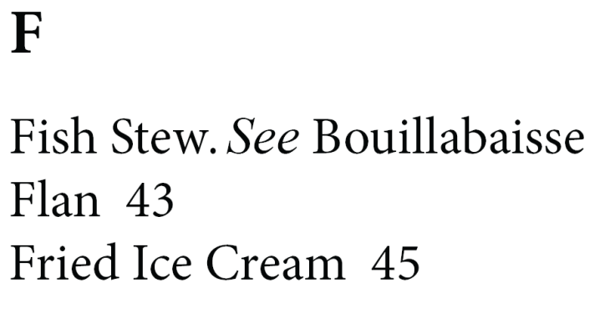
Creating an Index
Cross-referenced index entry
Cross-reference

Slide 33
Creating an Index
You create this cross-reference entry in the document itself, when you create the other index entries.
Once you’ve created individual index entries for specific topics in your document, you may want to sort specific entries together under a new topic.

Slide 34
Creating an Index
To do this, you must create a new index entry.
Go to the desired page, then click to place the pointer in the headline.
Click the Create a new index entry button on the Index panel, which opens the New Page Reference dialog box.

Slide 35
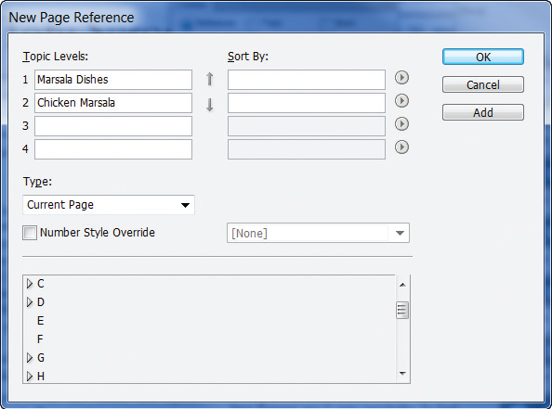
Creating an Index
New Page Reference dialog box

