Slide 1
Chapter 11
Preparing, Packaging, and Exporting Documents for Print

Slide 2
Creating Bleeds, Slugs, and Printer's Marks
Trim size is the size to which a printed document will be cut, or trimmed, when it clears the printing press.
Bleeds are areas of the layout that extend to the trim size.

Slide 3

Creating Bleeds, Slugs, and Printer's Marks
Green extends to the trim size on all four sides
Yellow extends to the trim size on two sides
Identifying areas that will bleed

Slide 4
Creating Bleeds, Slugs, and Printer's Marks
Areas of the layout that extend to the trim—areas that are meant to bleed—must actually go beyond the trim size when the document is prepared for printing.

Slide 5
Creating Bleeds, Slugs, and Printer's Marks
To accommodate for this margin of error, any item that bleeds—any item that extends to the trim size—must actually extend beyond the trim size in your final layout.
The standard measurement that a bleed item must extend beyond the trim size is .125".

Slide 6
Creating Bleeds, Slugs, and Printer's Marks
You define a bleed area for a document in the Bleed and Slug section of the New Document dialog box when you’re creating a document.
Or, if you want to define a bleed area after the document has been created, you can do this in the Document Setup dialog box.

Slide 7
Creating Bleeds, Slugs, and Printer's Marks
When you output a document, often you’ll want to include a note on the output.
Printers refer to that note as a slug.
Slugs are often notes to the printer, phone numbers to call if there are any problems, or other information related to the file.

Slide 8
Creating Bleeds, Slugs, and Printer's Marks
Slugs are not meant to be part of the final trimmed document. They must be positioned outside the trim size and outside the bleed area so that they will be discarded when the document is trimmed.
InDesign allows you to create a slug area in the Bleed and Slug section of the Document Setup dialog box or the New Document dialog box.

Slide 9
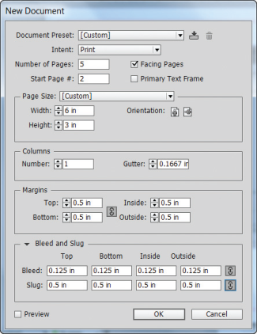
Creating Bleeds, Slugs, and Printer's Marks
Slug area
Define the slug area

Slide 10
Creating Bleeds, Slugs, and Printer's Marks
When you create a slug, use the Registration swatch on the Swatches panel as the fill color for the text.
When the document is color separated, anything filled with Registration appears on all printing plates.

Slide 11
Creating Bleeds, Slugs, and Printer's Marks
The bleed and slug areas are not visible in Preview mode.
If you want to see a preview of the page with those areas visible, press and hold the Preview button at the bottom of the Tools panel to reveal the Bleed and Slug buttons.

Slide 12
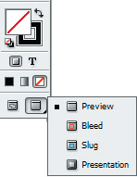
Creating Bleeds, Slugs, and Printer's Marks
View mode buttons on the Tools panel

Slide 13
Creating Bleeds, Slugs, and Printer's Marks
Printer’s marks include crop marks, which are guide lines that define the trim size.
Bleed marks define the bleed size.
Printers use registration marks to align the color-separated output.
Color bars are used to maintain consistent color on press, and page information includes the title of the InDesign document.

Slide 14
Using the Ink Manager and Preview Color Separations
The Ink Manager dialog box gives you control over the inks that you create on the Swatches panel.
One important function that the Ink Manager provides is the ability to convert spot colors easily to process inks if you should want to do so.

Slide 15
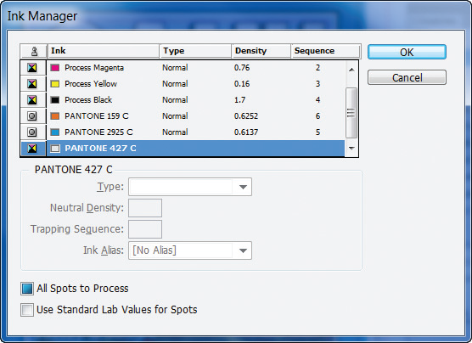
Using the Ink Manager and Preview Color Separations
Identifies process ink
Identifies spot ink
Ink Manager dialog box

Slide 16
Using the Ink Manager and Preview Color Separations
The Ink Manager makes it easy to specify how the document will color separate.
It is important to remember that using the Ink Manager is something you do at the output phase of your work with a document.
The changes that you make to inks in the Ink Manager only affect the output of the document, not the inks in the document.

Slide 17
Using the Ink Manager and Preview Color Separations
The Separations Preview panel is another panel that allows you to see at a glance the number of inks available for printing the document.
The Separations Preview panel lists only the four process inks and any swatches that are defined as spot inks.

Slide 18
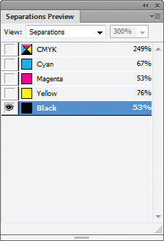
Using the Ink Manager and Preview Color Separations
Separations Preview panel

Slide 19
Using the Ink Manager and Preview Color Separations
The Separations Preview panel is interactive.
Click on an ink, and the areas of the document that use that ink will appear black.
The areas that don’t use that ink will disappear.

Slide 20
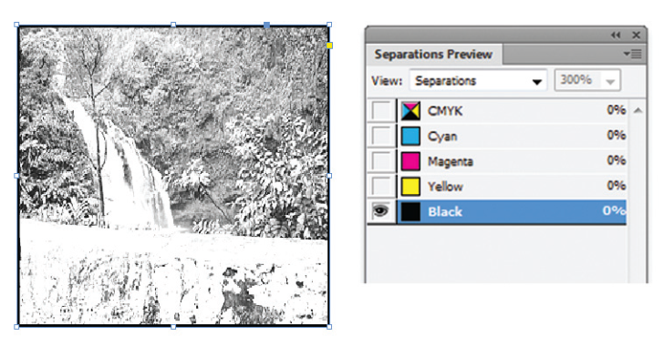
Using the Ink Manager and Preview Color Separations
Viewing the Black ink in the document

Slide 21
Using the Ink Manager and Preview Color Separations
The Separations Preview panel comes into play in the output stages, not in the design stages.
It is a great resource for the print professional to see at a glance how a document will color separate and to inspect each plate quickly.

Slide 22
Preflighting and Packaging a Document
In the print world, designers and printers have coined the term “preflight” to refer to checking out a document before it’s released from the designer to the printer or service bureau, or before it’s actually downloaded to an output device.

Slide 23
Preflighting and Packaging a Document
The Preflight feature is an InDesign utility that you can use to check an open document for errors such as missing fonts, missing or modified links, and overset text.
Any errors that are found are listed on the Preflight panel; you can use this list to fix any problems by substituting fonts, fixing overset text issues and/or updating missing and modified files.

Slide 24
Preflighting and Packaging a Document
A green circle on the left side of the status bar, also known as Live Preflight, indicates that there are no preflight errors in a document; when the circle is red, there are errors.

Slide 25
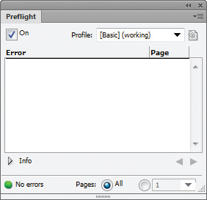
Preflighting and Packaging a Document
Live Preflight is on
All pages are checked for errors
Preflight panel

Slide 26
Preflighting and Packaging a Document
The On check box is checked because Preflight is on.
The [Basic] Preflight profile, which, by default, checks for missing fonts, missing or modified links, and overset text, is selected.
The Preflight all pages option button indicates that all pages in the document have been checked.

Slide 27
Preflighting and Packaging a Document
You can click the Preflight specified pages option button to choose a page range to be checked.
You can create customized preflight profiles in which you indicate what you would like the Preflight panel to flag as errors to be fixed.

Slide 28
Preflighting and Packaging a Document
Once a document has been preflighted, it’s ready to be packaged.
Packaging a document means getting it ready to send to a printer, a composition house, or a client for printing or archiving.

Slide 29
Preflighting and Packaging a Document
When you use the Package command, InDesign automatically creates a folder and packages a copy of the InDesign document, copies of all the placed graphics, and copies of all the fonts used.
It also offers the Printing Instructions dialog box.

Slide 30
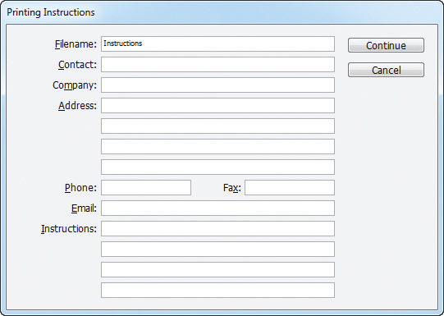
Preflighting and Packaging a Document
Printing Instructions dialog box

Slide 31
Exporting a Document
When you export a document, the document that you create is your InDesign file saved in a different file format.

Slide 32
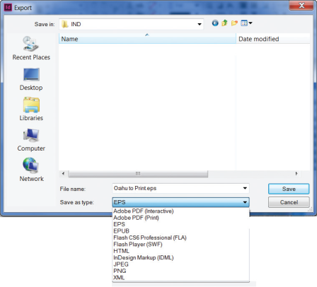
Exporting a Document
Export dialog box

Slide 33
Exporting a Document
The Export command is used most often to translate a document into another format so that it can be used in another application or uploaded to the web.

Slide 34
Exporting a Document
Common exports of InDesign documents include:
EPS An EPS or encapsulated PostScript file can be placed as a bitmap graphic in Adobe Photoshop or Adobe Illustrator.
PDF Portable document format, or PDF, is the file format used in Adobe Reader, a free software program that allows you to view documents created from other software programs without having to have those programs installed on your computer.

Slide 35
Exporting a Document
Common exports of InDesign documents include:
JPEG A JPEG is a compressed graphic file format which has a smaller file size than other graphic formats and is ideal for use on the web.
SWF (Shockwave Flash) SWF is an acronym for Shockwave Flash. For interactive InDesign documents that are destined for the web.

Slide 36
Exporting a Document
PDF is one of the most common export formats for InDesign documents.
The key to the relationship between InDesign and PDF is that, as a PDF, the InDesign document is complete and self-contained.

Slide 37
Exporting a Document
With PDFs, issues with imported graphics and fonts become non-issues.
The PDF file includes all imported graphics and fonts. The recipient of the file does not need to have the document fonts loaded to view the file correctly.

Slide 38
Exporting a Document
When emailing a layout as a PDF, you will export the document with compression utilities activated to reduce the file size for email.
These compression utilities will compress the file size of placed images.

Slide 39
Exporting a Document
When sending a layout to a printer for professional printing, you won’t want the placed graphics to be compressed. In this case, you’ll export the PDF with compression utilities turned off.
The resulting PDF will likely be too large to email, but it will remain high quality for printing.

Slide 40
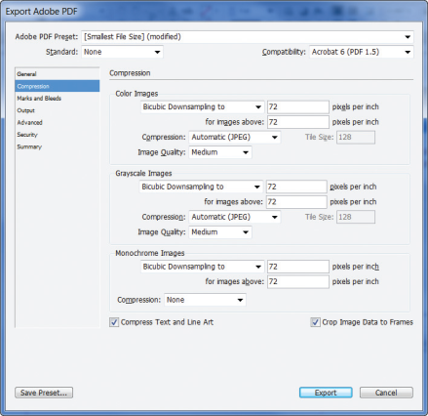
Exporting a Document
Compression settings for the PDF

