Slide 1
Chapter 9
Working with Tabs and Tables

Slide 2
Working with Tabs
You use tabs to position text at specific horizontal locations within a text frame.
The left edge of the white ruler in the Tabs dialog box is aligned with the left edge of the text frame.
This alignment occurs by default when you select a text frame and open the Tabs dialog box.
The alignment of the text frame with the Tabs dialog box makes it easier to note the horizontal position of text within a frame.

Slide 3
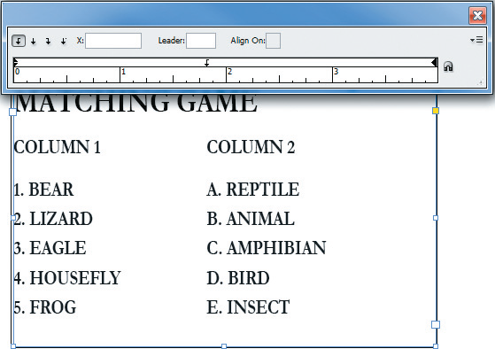
Working with Tabs
Tab ruler
Left-Justified tab
Position Panel above Text Frame button
Left edge of tab ruler aligns with left edge of text frame
Left-aligned text positioned to the right of the tab
Tabs dialog box

Slide 4
Working with Tabs
If you scroll up or down, or resize the page or the text frame, the text frame will no longer be aligned with the Tabs dialog box.
Once text has been aligned on a tab, moving the tab moves the text as well.
The text does not need to be selected to be moved. Simply moving the tab moves the text.
To delete a tab from the tab ruler, simply drag it off the tab ruler.

Slide 5
Working with Tabs
The Tabs dialog box offers four types of tab buttons for aligning text:
Left-Justified Tab
Center-Justified Tab
Right-Justified Tab
Align to Decimal Tab

Slide 6
Working with Tabs
When you use the align-to-decimal tab, you can align text with characters other than a decimal point, such as an asterisk or a dollar sign.

Slide 7
Working with Tabs
When you enter text in a text frame, text insets determine how far from the edge of the frame the text is positioned, or inset, into the frame.
Text insets can be entered for all four sides of a text frame:
Top
Bottom
Left
Right

Slide 8
Working with Tabs
Text inset values are entered in the Text Frame Options dialog box.

Slide 9
Working with Tabs
Many times, you will want to add a horizontal rule above or below a line of text.
InDesign regards rules above and below text as paragraph attributes—in other words, they are part of the text formatting.

Slide 10
Working with Tabs
If you resize the text—let’s say you make it larger—the rule increases however much is necessary to continue underlining the text.
If you move the text, the rule moves with it.
Rules for text are defined in the Paragraph Rules dialog box.
This dialog box allows you to specify a number of attributes for the rule, including its color and its weight.

Slide 11
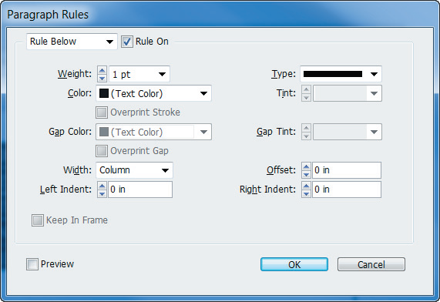
Working with Tabs
Click to activate a rule
Paragraph Rules dialog box

Slide 12
Working with Tabs
This is where you also specify whether the rule is positioned above or below the text.
When you apply a rule below text, the rule is positioned by default at the baseline of the text.
Generally speaking, a rule below looks best when it is slightly below the baseline.
Use the Offset text box in the Paragraph Rules dialog box to accomplish this.

Slide 13
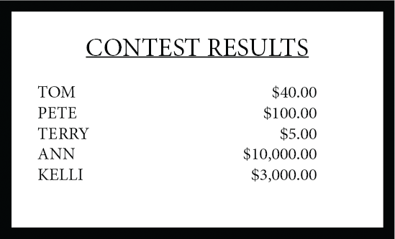
Working with Tabs
Rule positioned with a zero offset value
Rule below, at the baseline

Slide 14
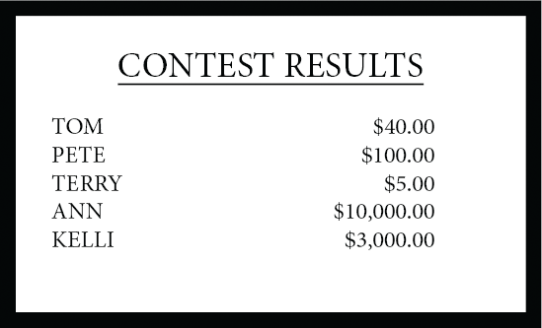
Working with Tabs
Rule below, with a 3 point offset

Slide 15
Working with Tabs
Rule offsets are best specified in points.
A point is 1/72 of an inch.
This small increment allows you to be very specific when positioning a rule.
For a rule below, a two- or three-point offset value is usually best.

Slide 16
Creating and Formatting a Table
As with tabs, tables are an efficient method for communicating information and an important component to any layout application.
Tables consist of rectangles in horizontal rows and vertical columns.
Each rectangle is called a cell.

Slide 17

Creating and Formatting a Table
An example of an InDesign table

Slide 18
Creating and Formatting a Table
The first important thing to note about tables is that InDesign regards them as text.
Tables can only be created within a text frame.
When you edit a table, you do so with the Type tool.
If you select a table with the Selection tool, you can only modify the text frame, not the text or the formatting of the cells in the text frame.

Slide 19
Creating and Formatting a Table
The first step in creating a table is to create a text frame.
Once you’ve created the text frame, you can specify the number of rows and columns for the table in the Insert Table dialog box.

Slide 20
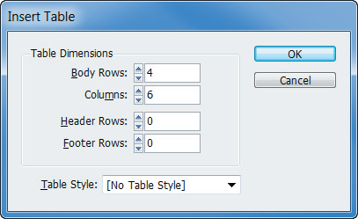
Creating and Formatting a Table
Insert Table dialog box

Slide 21
Creating and Formatting a Table
When you create the table, it always appears in a default layout.

Slide 22
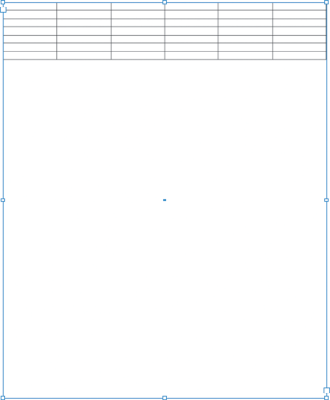
Creating and Formatting a Table
Default table layout

Slide 23
Creating and Formatting a Table
Note that the default width of the cells is determined by the number of columns and the width of the text frame.
In other words, the default width of the cells is the width of the text frame divided by the number of columns.

Slide 24
Creating and Formatting a Table
The Table panel is command central for manipulating a table.
Even after you create the table, you can modify the number of rows and columns using the Table panel.
After you create the table, you determine the width of the columns and the height of the rows.

Slide 25
Creating and Formatting a Table
Individual columns and rows in a table can have varying widths and heights.
Column widths and row heights determine the size of any given cell in the table.

Slide 26
Creating and Formatting a Table
You can set the size of all the cells in a table simultaneously by selecting them all and entering values on the Table panel.
You can also select a single column or row and specify a width just for that particular column or row.

Slide 27
Creating and Formatting a Table
Headers and footers can be specified in the Insert Table dialog box at the time that you create the table.
Or you can convert existing rows to header or footer rows using the Convert Rows To Header or Footer commands on the Table menu.

Slide 28
Creating and Formatting a Table
Adding color to a table can do wonders for its visual interest and improve the impact of the information it contains.
You can apply strokes to the cells of the table to modify the color and the weight of the lines that make up the table grid.

Slide 29
Creating and Formatting a Table
You apply strokes and fills to a table just as you would to other InDesign objects.
You can select a single cell, multiple cells, or an entire row or column.
*Remember, you use the Type tool to select elements of a table.
You can then use the Swatches panel to add a fill color or to apply a stroke color, and the Stroke panel to modify the weight of the strokes.

Slide 30
Creating and Formatting a Table
You can the Table menu to apply fills and strokes.
In addition, the Table menu provides options for alternating fills and strokes by row or column.
Alternating fills is a technique that is often used to improve readability and enhance the look of a table.

Slide 31
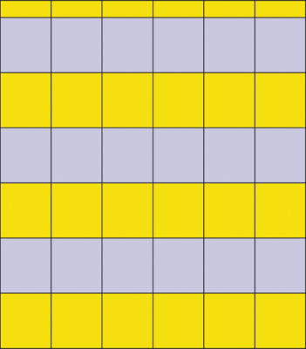
Creating and Formatting a Table
A table with an alternating fill

Slide 32
Formatting Text in a Table
Because tables are always in text frames and, as such, are regarding as text, entering text in them is simple and straightforward.
With the Type tool selected, simply click in a cell and begin typing.
Press [Tab] to move from column to column.

Slide 33
Formatting Text in a Table
You can also use the arrow keys to move from cell to cell in any direction.
To modify selected text in a cell, use the features on the Character panel, just as you would in a regular text frame.

Slide 34
Formatting Text in a Table
When you enter text in a cell, by default, it is aligned to the left edge of the cell.
You can select the text and change its alignment just as you would for any other text, using buttons such as Align Right or Align Center, in the Paragraph panel.

Slide 35
Formatting Text in a Table
By default, text that you enter in a cell is also aligned vertically to the top of the cell.
To modify this, use the vertical alignment buttons on the Table panel.

Slide 36
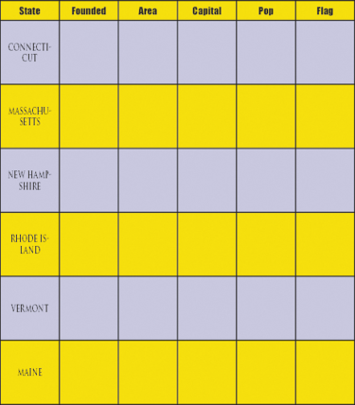
Formatting Text in a Table
Text centered horizontally and vertically

Slide 37
Formatting Text in a Table
Once you have entered text into a table, you will often find that you need to modify the table to better fit the text.
Sometimes the rows will not be tall enough to contain all the text, and sometimes the columns won’t be wide enough.

Slide 38
Formatting Text in a Table
Fortunately, InDesign makes it easy to modify the height of a row or the width of a column.
One way to do this is to select the row or column and change the height or width value on the Table panel.
Another option is simply to drag a cell border left or right to decrease or increase the width.
Similarly, you can drag a cell border up or down to modify the height of a row.

Slide 39
Formatting Text in a Table
The cell inset text boxes on the Table panel allow you to control the text inset for all four sides of the cell.
With the default inset of .0556 inch, a block of text would appear.

Slide 40
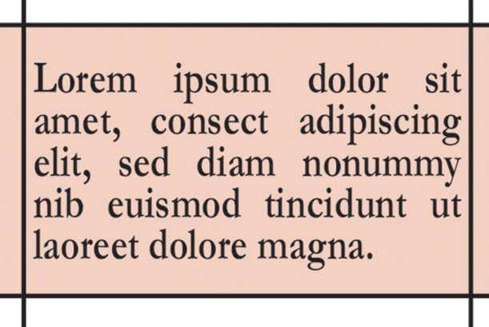
Formatting Text in a Table
Text with a default cell inset

Slide 41
Formatting Text in a Table
The following figure shows the same block of text with the left and right inset values increased to .1875 in.
Note the improvement in appearance.

Slide 42
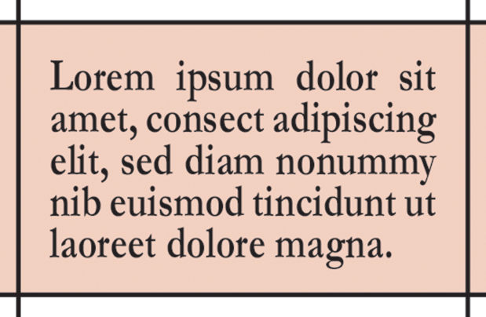
Formatting Text in a Table
Text with increased right and left cell inset values

Slide 43
Placing Graphics in a Table
InDesign makes it easy to place a graphic into a cell in a table.
One simple method is to simply click in the cell and then use the Place command to choose and place the graphic.
Graphics that are placed in cells are treated like any other placed graphics.
They appear in the Links panel and can be updated or edited, if necessary.

Slide 44
Placing Graphics in a Table
If the graphic you place is too large to fit in the cell, a red circle will appear in the bottom-right corner of the cell.
Your only options are to increase the size of the cell or decrease the size of the graphic.
The following figure shows a table with six graphics placed in the rightmost column.

Slide 45

Placing Graphics in a Table
Placing graphics in a table

Slide 46
Placing Graphics in a Table
If you’ve entered text into a table, you have the option of replacing text with graphics.
Remember, InDesign regards tables as text.
Thus, graphics in tables function as anchored objects, just like any other text element.

Slide 47
Placing Graphics in a Table
You replace text in a cell with a graphic the same way you add anchored objects to a block of text.
The graphic will flow with any other text that is in the cell.
This is a powerful option; it allows you to place both text and graphics in a single cell!

Slide 48
Placing Graphics in a Table
There may be times when you would like to convert one or more table cells into one large cell, a process known as merging.
Merging cells allows you to accommodate more text or larger graphics in one cell.

Slide 49
Placing Graphics in a Table
Conversely, you can select one or more cells and split them horizontally or vertically.
Click Table on the Menu bar and choose Split Cells Vertically or Split Cells Horizontally.

Slide 50
Placing Graphics in a Table
Rows and columns can be moved by dragging them to a new location in the table.
Simply select a row or column and drag it to a new location in the table.
To copy a row or column, press and hold [Alt] (Win) or [option] (Mac) while dragging the row or column to a new location.

