Slide 1
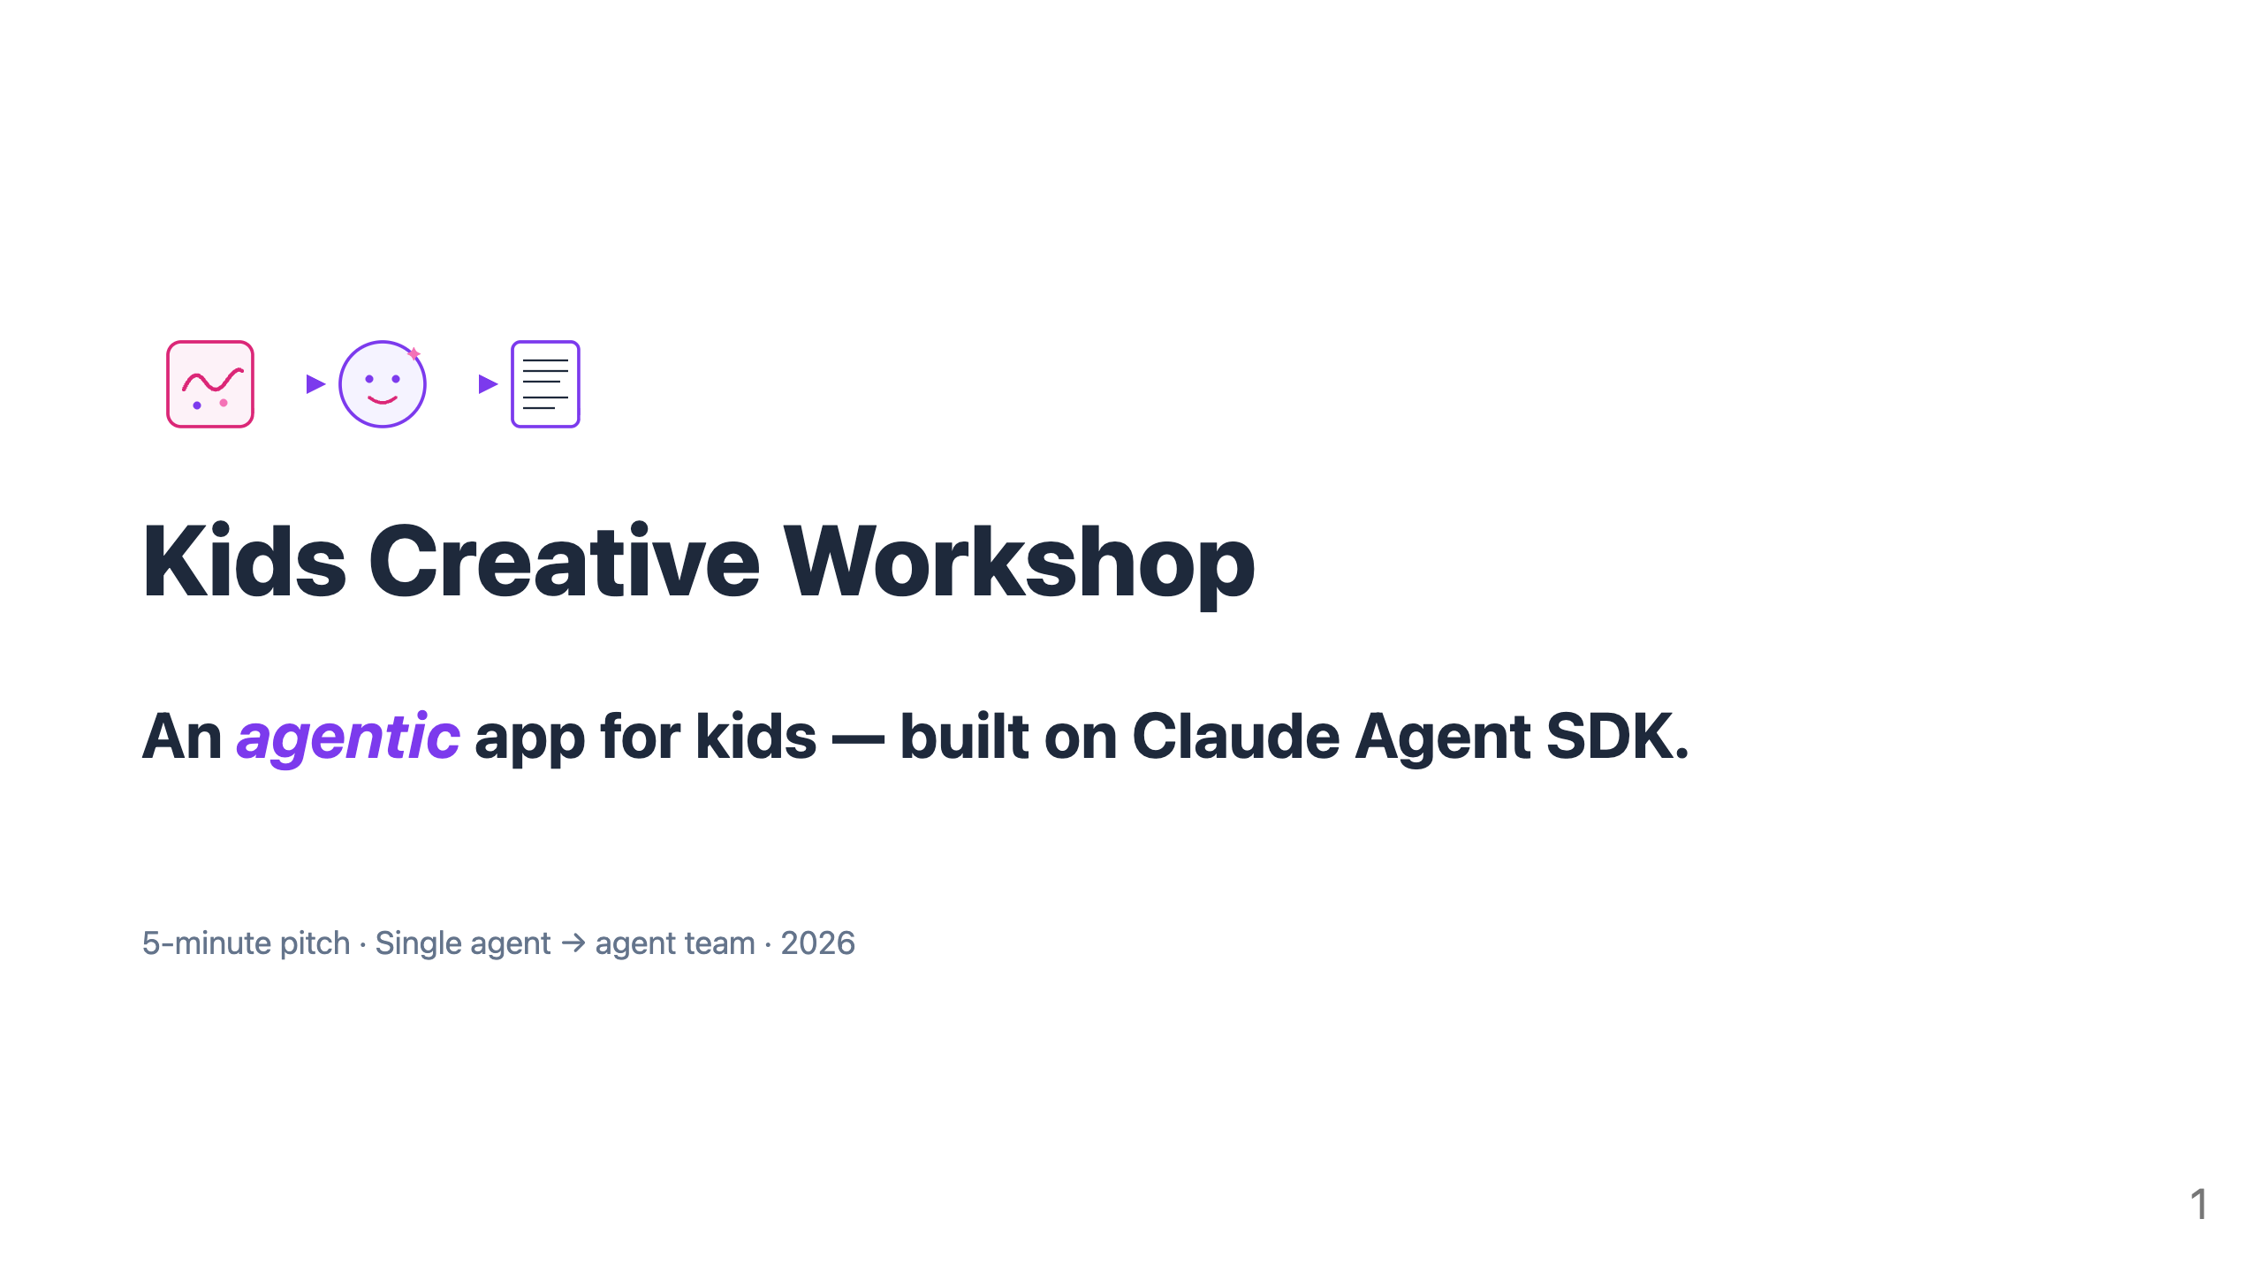
Notes:
🎤 SCRIPT · Slide 1 · Title ⏱ ~8 seconds · 5-min cut: KEEP "Good [morning/afternoon]. Kids Creative Workshop — an agentic app for kids, built on Claude Agent SDK. Let me start with a moment." 🎬 Delivery: Warm and slow. Don't rush the subtitle. Pause, then click. ➡ Transition: pivot directly to the emotional anchor on slide 2.

Slide 2
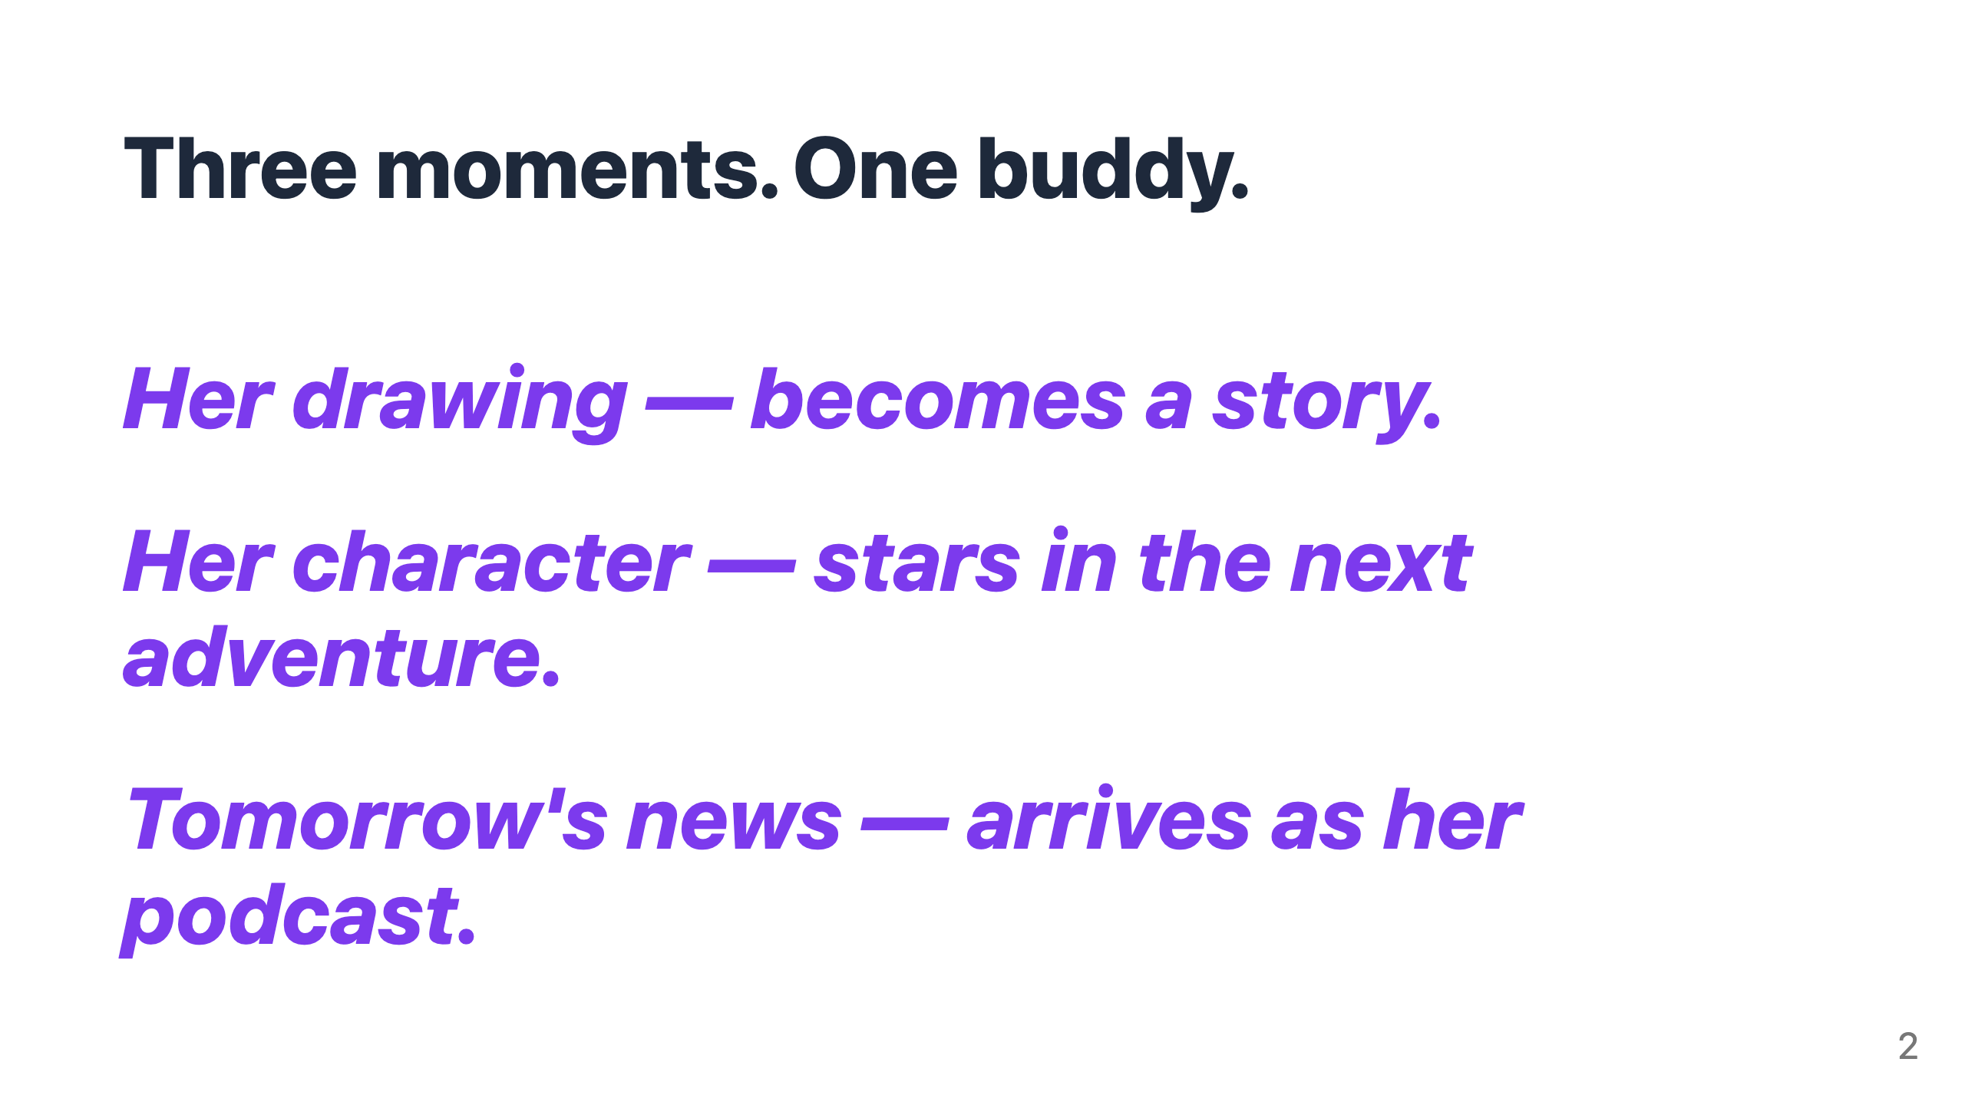
Notes:
🎤 SCRIPT · Slide 2 · Three moments ⏱ ~28 seconds · 5-min cut: KEEP "Three moments — one buddy. [2-second pause] A five-year-old hands her drawing to her buddy. It becomes a story — in her character, her voice. [2-second pause] The same character stars in the next adventure — her choices, her ending. [2-second pause] Tomorrow's news arrives as her podcast — kid-safe, in her buddy's voice. [3-second pause] One buddy. Three kinds of moments. Her world, every time." 🎬 Delivery: SLOW. Three product moments, three deliberate pauses. The cadence is the slide. ➡ Transition: "But today's AI fails her on every one of those moments. Here's how."

Slide 3
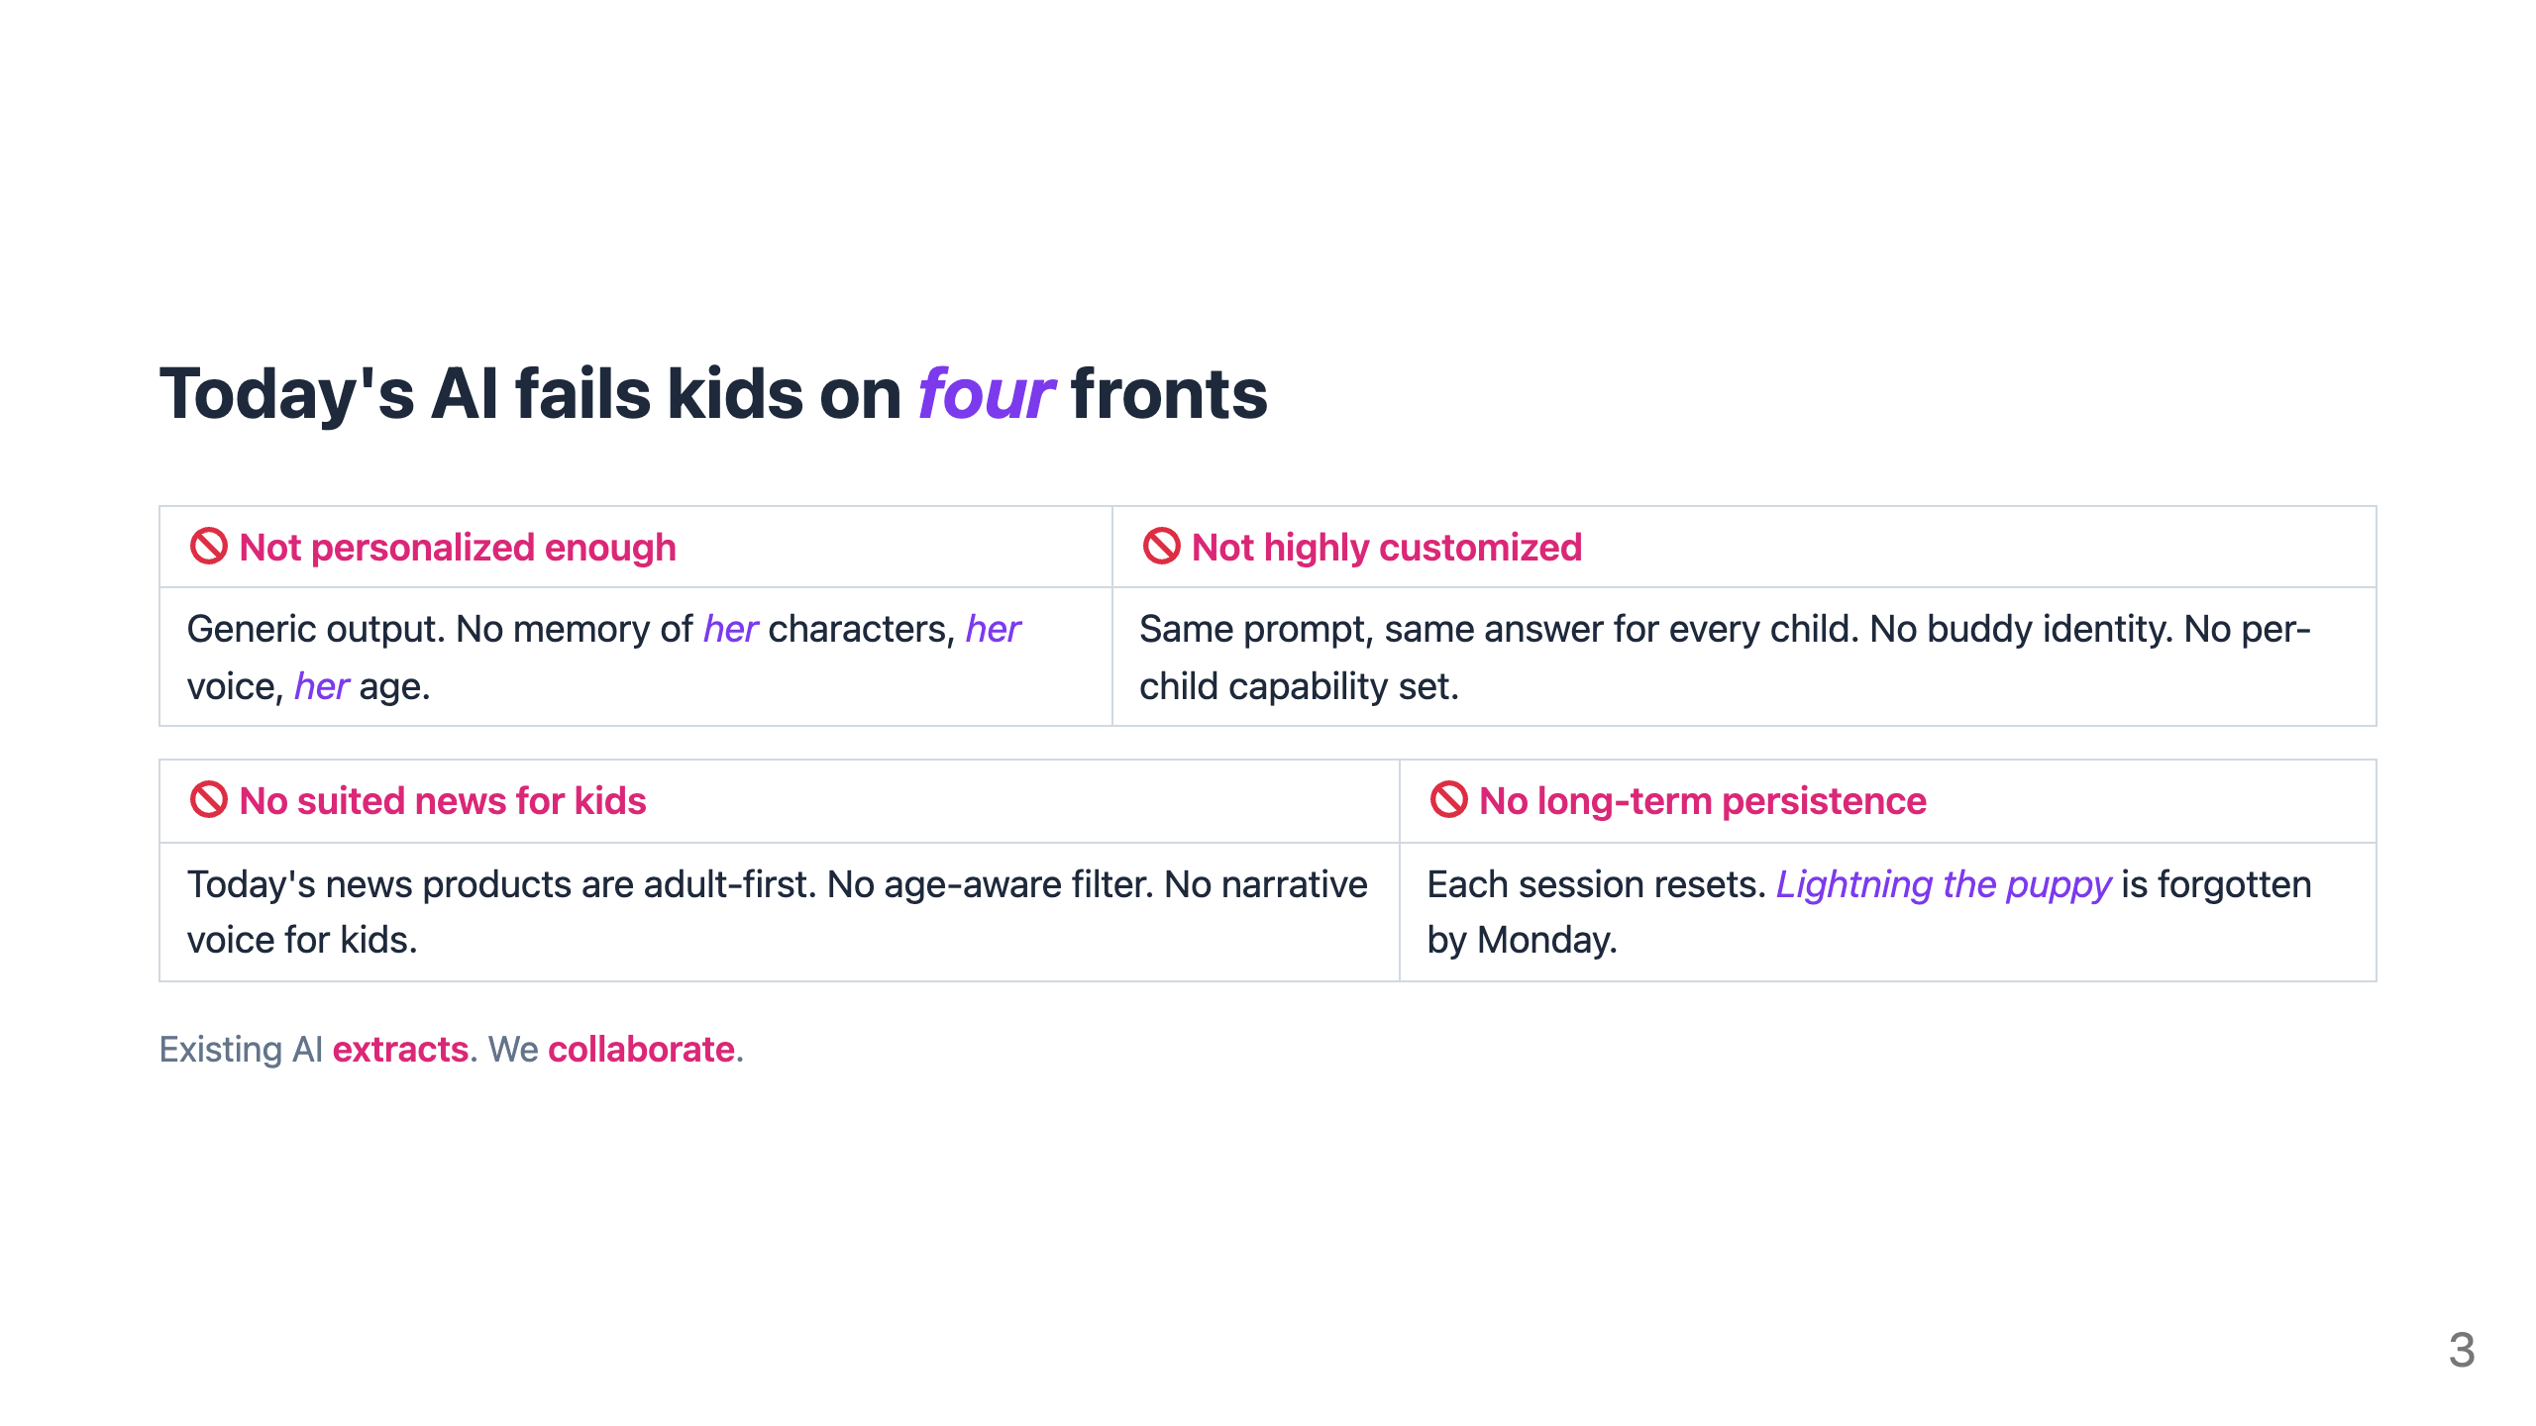
Notes:
🎤 SCRIPT · Slide 3 · Four problems ⏱ ~28 seconds · 5-min cut: KEEP "Today's AI fails kids on four fronts. NOT PERSONALIZED ENOUGH — generic outputs. No memory of her characters, her voice, her age. NOT HIGHLY CUSTOMIZED — every child gets the same prompt and same answer. No buddy identity. No per-child capability set. NO SUITED NEWS FOR KIDS — today's news products are adult-first. No age-aware filter, no narrative voice for kids. NO LONG-TERM PERSISTENCE — each session resets. Lightning the puppy is forgotten by Monday. [brief pause] Existing AI extracts. We collaborate." 🎬 Delivery: Read each problem deliberately. The 4-card grid does the work; don't editorialize. ➡ Transition: "Here's how our agent's abilities solve each one."

Slide 4
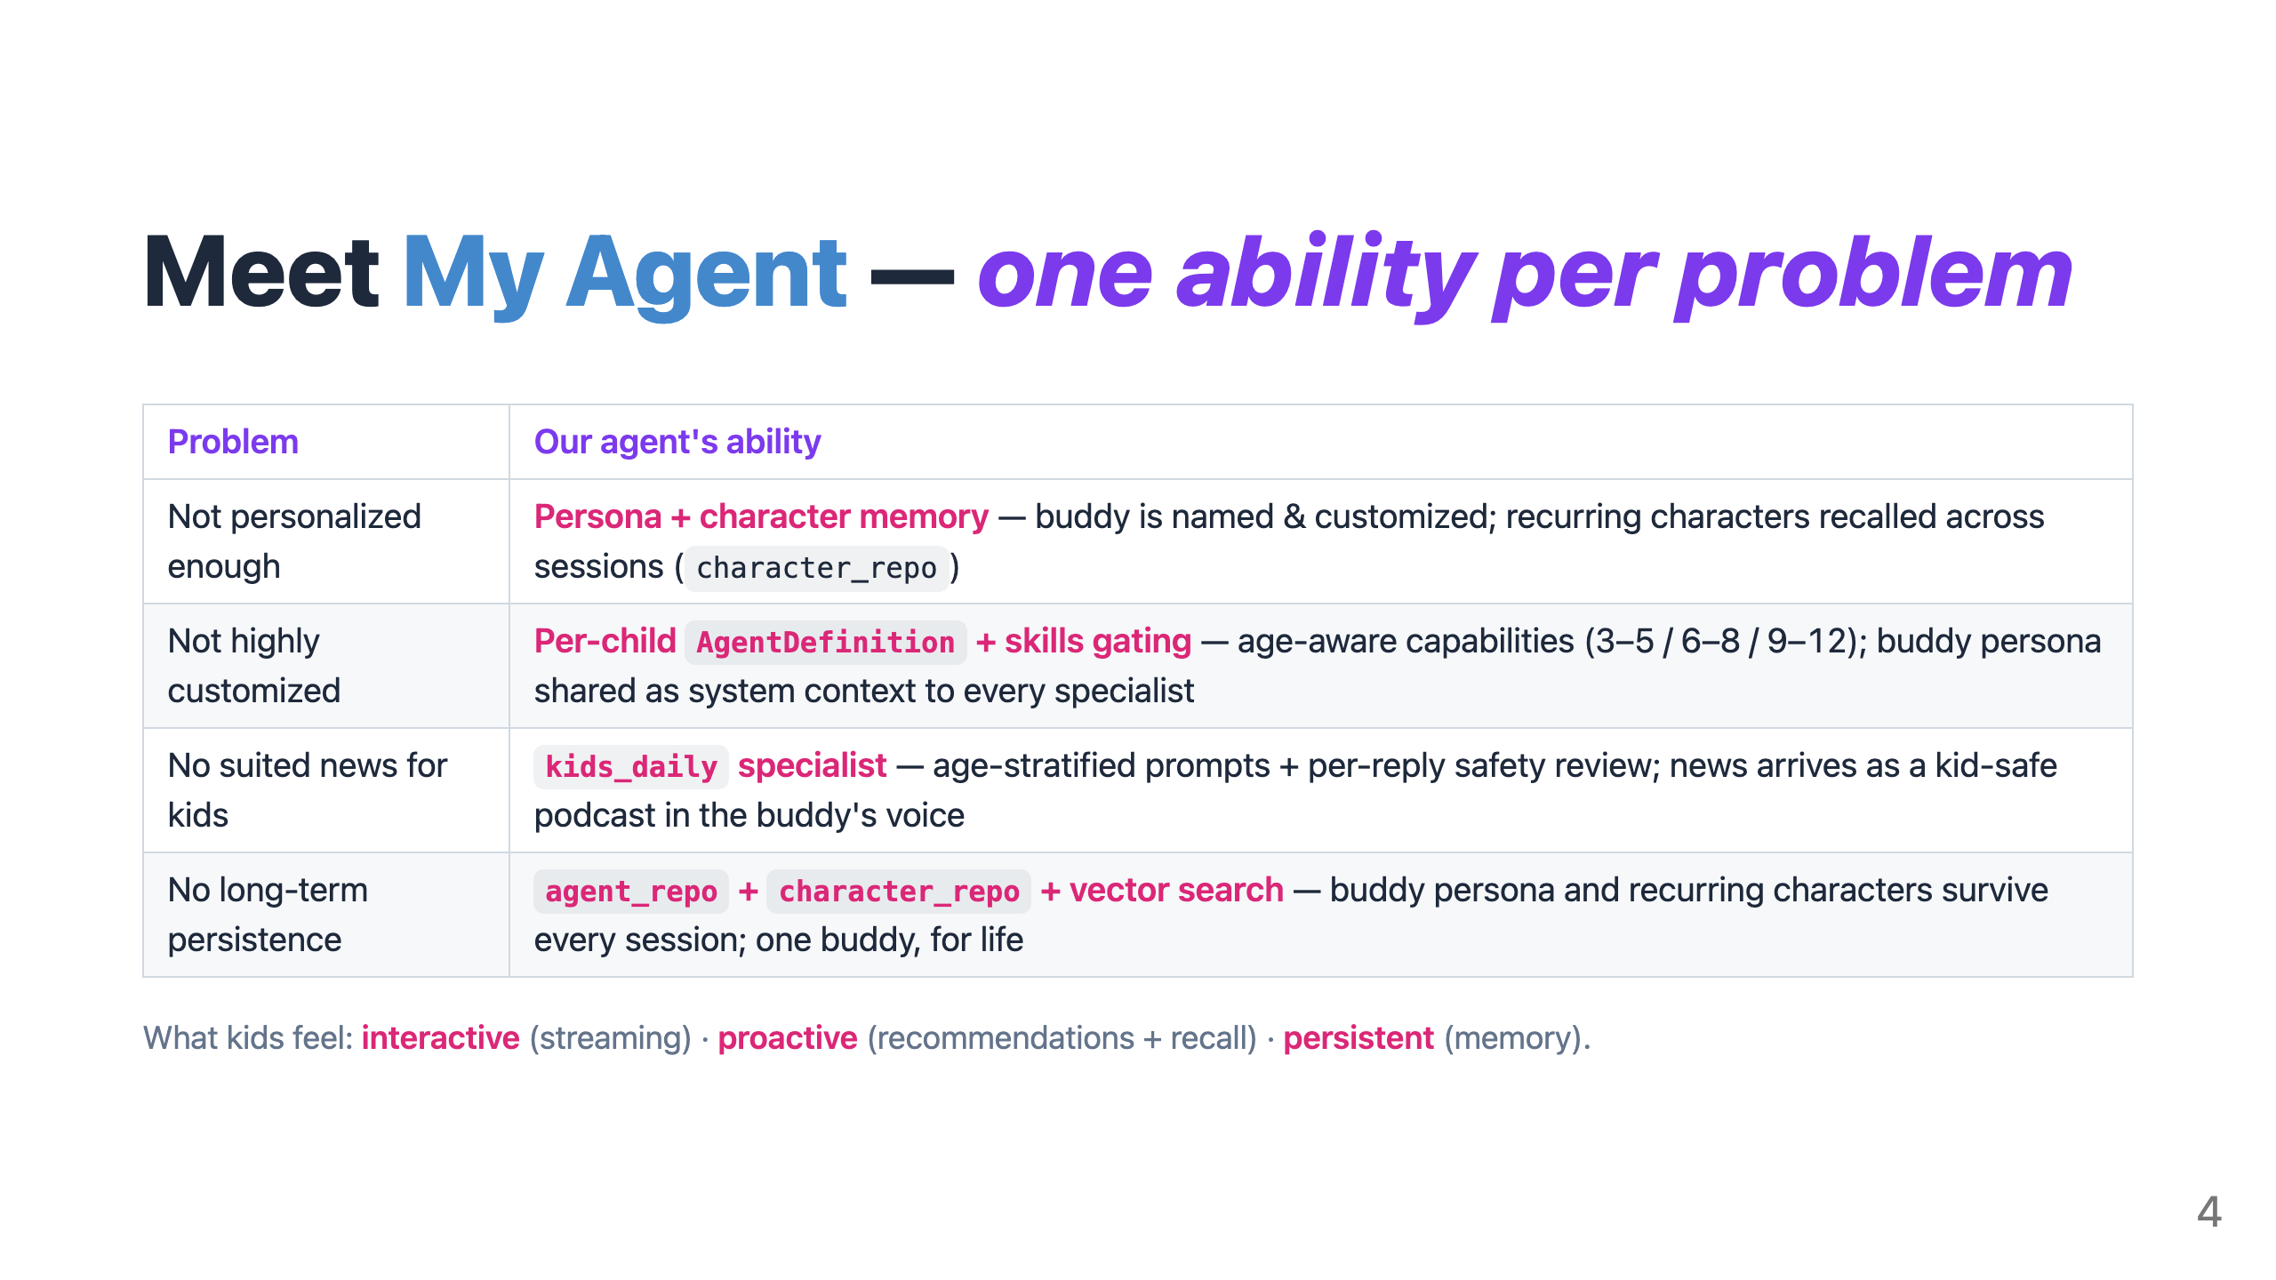
Notes:
🎤 SCRIPT · Slide 4 · Our agent's abilities ⏱ ~35 seconds · 5-min cut: KEEP "Four problems. Four agent abilities — one for each. NOT PERSONALIZED → PERSONA + CHARACTER MEMORY. The buddy is named and customized. Recurring characters — Lightning the puppy — are recalled across sessions through character_repo. NOT HIGHLY CUSTOMIZED → PER-CHILD AGENT DEFINITION WITH SKILLS GATING. Age-aware capabilities for three to five, six to eight, nine to twelve. The buddy persona is shared as system context to every specialist. NO KID-NEWS → THE KIDS_DAILY SPECIALIST. Age-stratified prompts plus per-reply safety review. News arrives as a kid-safe podcast in the buddy's voice. NO PERSISTENCE → AGENT_REPO + CHARACTER_REPO + VECTOR SEARCH. The buddy survives every session. One buddy. For life. And kids feel three things immediately: interactive — the story streams as it writes itself. Proactive — the buddy suggests and recalls. Persistent — same buddy persona, every time." 🎬 Delivery: Read each row tightly — problem then ability. The 1-to-1 mapping does the work. ➡ Transition: "These abilities are built on four SDK primitives."

Slide 5
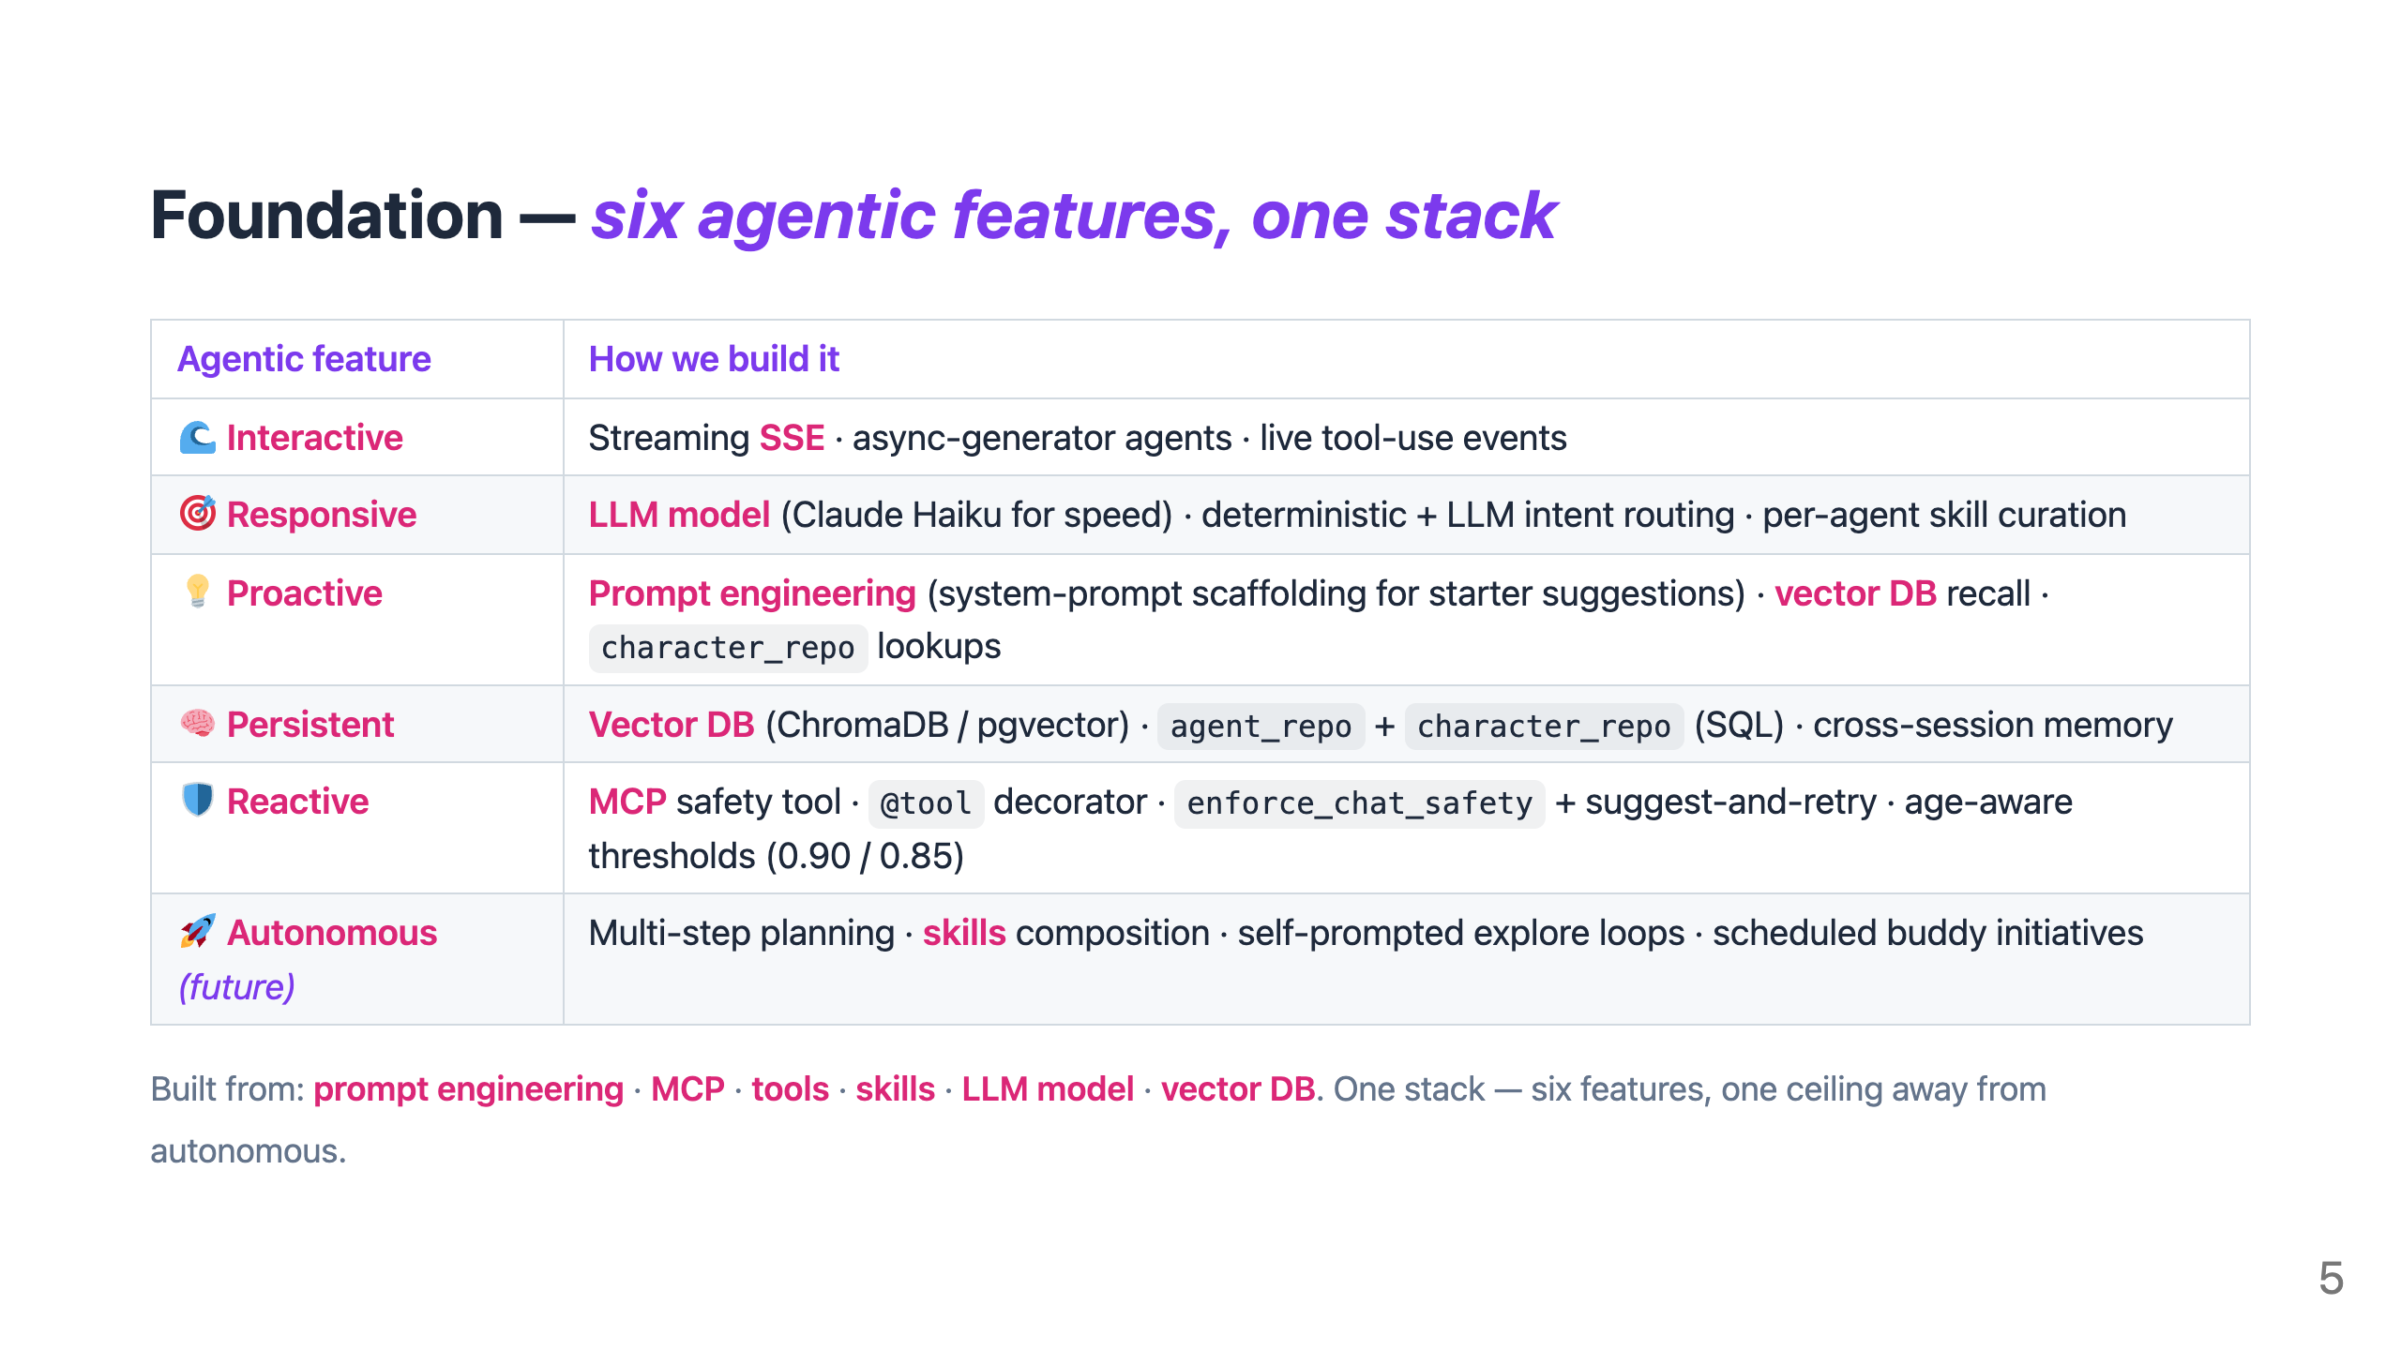
Notes:
🎤 SCRIPT · Slide 5 · Six agentic features ⏱ ~40 seconds · 5-min cut: KEEP "Six agentic features. One stack. INTERACTIVE — streaming SSE plus async-generator agents. The story writes itself token by token. RESPONSIVE — Claude Haiku for speed, deterministic plus LLM-disambiguating intent routing, per-agent skill curation. PROACTIVE — prompt engineering shapes the buddy's starter suggestions; vector DB recall surfaces recurring characters; character_repo proposes next moves. PERSISTENT — vector DB plus SQL repos hold the buddy across sessions. ChromaDB locally, pgvector in production. REACTIVE — every reply runs through the safety MCP tool. Age-aware thresholds: 0.90 for three to five, 0.85 for six to twelve. Suggest-and-retry on fail. AUTONOMOUS — this one's the next frontier. Multi-step planning, self-prompted explore loops, scheduled buddy initiatives. One ceiling away." 🎬 Delivery: Walk row-by-row. Linger on REACTIVE (the safety story). Mark AUTONOMOUS as future explicitly so judges don't think you're claiming it. ➡ Transition: "One agent hit a ceiling. So we extended to a team."

Slide 6
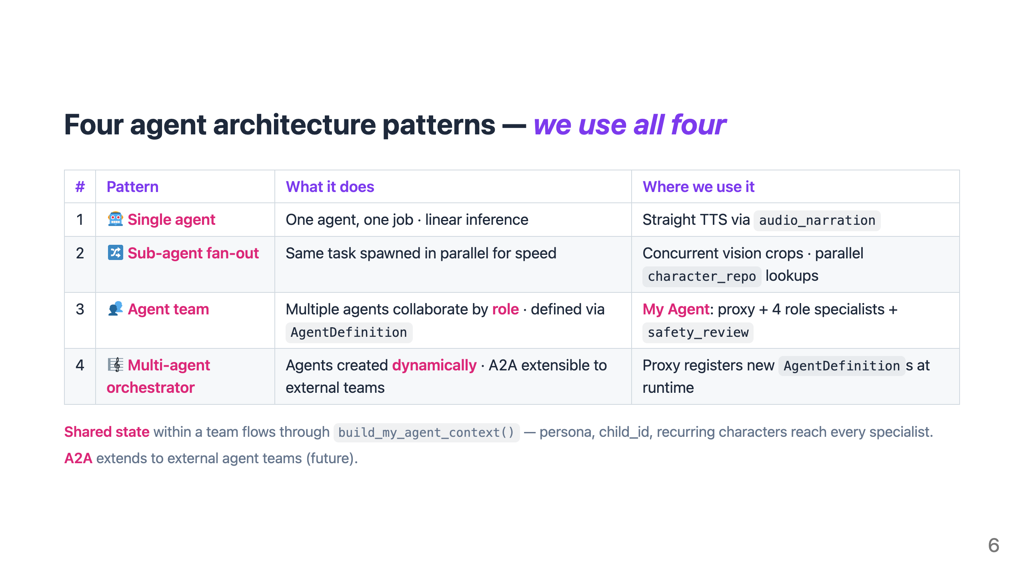
Notes:
🎤 SCRIPT · Slide 6 · Four architecture patterns ⏱ ~30 seconds · 5-min cut: KEEP "Four agent architecture patterns. We use all four. PATTERN ONE — single agent. One agent, one job, linear inference. We use it for straight TTS via audio_narration. PATTERN TWO — sub-agent fan-out. The same task spawned in parallel for speed. Concurrent vision crops, parallel character_repo lookups. PATTERN THREE — agent team. Multiple agents collaborate by ROLE, defined via AgentDefinition. This is our My Agent: proxy plus four role specialists plus safety_review. PATTERN FOUR — multi-agent orchestrator. Agents are created DYNAMICALLY. A2A extensible. The proxy can register new AgentDefinitions at runtime. Shared state within a team flows through build_my_agent_context. A2A extends to external teams as future work." 🎬 Delivery: Read each pattern with its example. The "we use all four" claim is the punchline — most teams build one pattern and force-fit everything. ➡ Transition: "Each agent in the team is wired to six memory layers."

Slide 7
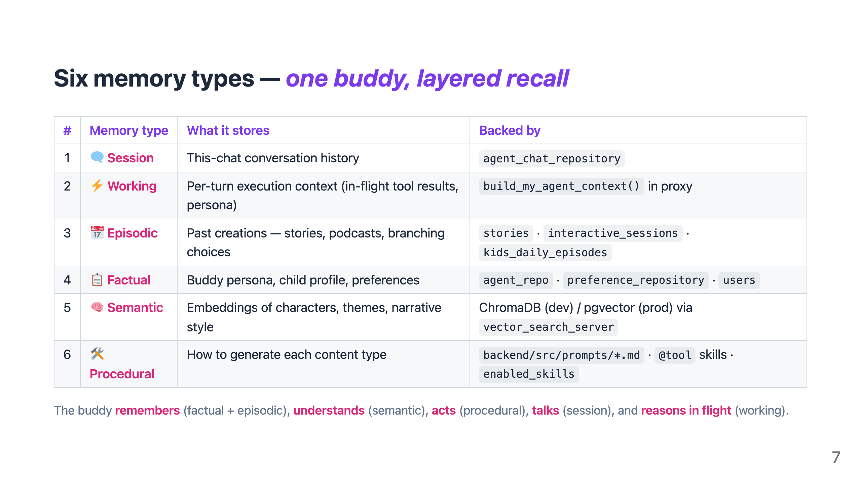
Notes:
🎤 SCRIPT · Slide 7 · Six memory types ⏱ ~32 seconds · 5-min cut: KEEP "Six memory types. One buddy. Layered recall. SESSION memory — this-chat conversation history, stored in agent_chat_repository. WORKING memory — per-turn execution context. In-flight tool results, persona, recurring characters, passed to every specialist via build_my_agent_context. EPISODIC memory — past creations. Stories, interactive sessions, kids_daily episodes. Three tables. FACTUAL memory — buddy persona, child profile, preferences. Agent repo, preference repo, users table. SEMANTIC memory — embeddings of characters, themes, narrative style. ChromaDB locally, pgvector in production, via the vector search MCP. PROCEDURAL memory — how to generate each content type. Versioned markdown prompts, at-tool skills, and enabled_skills gating per agent. The buddy remembers, understands, acts, talks, and reasons in flight." 🎬 Delivery: Walk each row briskly. Pause briefly on PROCEDURAL — that's the one most teams don't have. Land the closing line slowly. ➡ Transition: "Here's how those memory layers and patterns compose in our team."

Slide 8
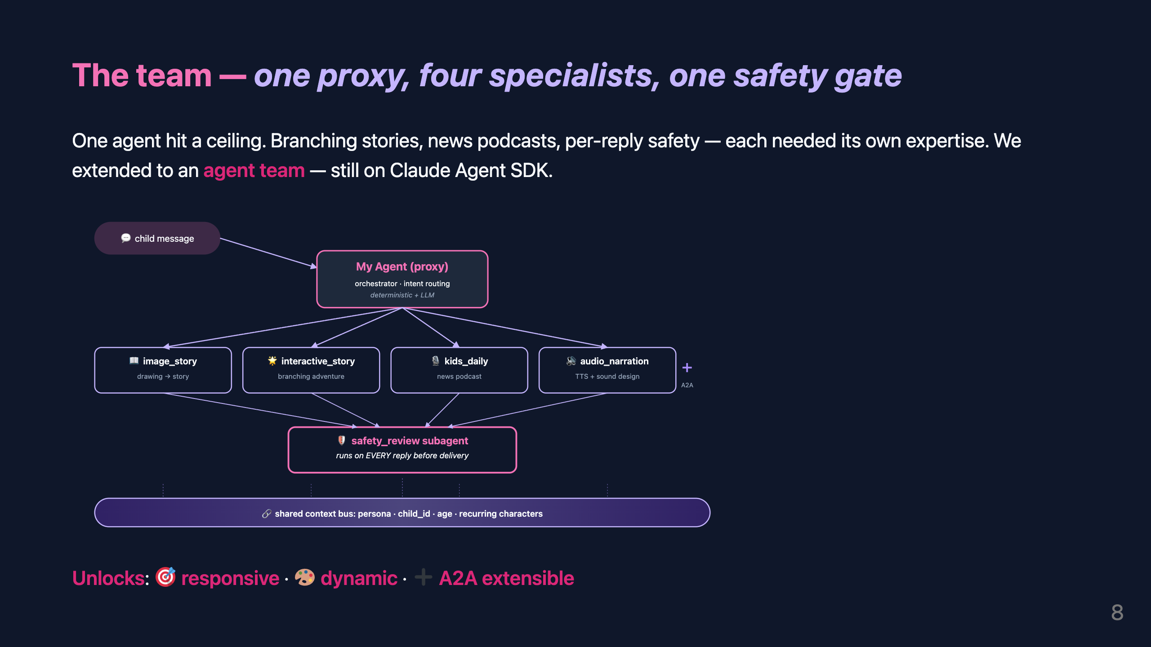
Notes:
🎤 SCRIPT · Slide 8 · The team (CENTERPIECE) ⏱ ~50 seconds · 5-min cut: KEEP "Branching adventures, daily podcasts, per-reply safety — each needed its own expertise. So we extended to an agent team. Still on Claude Agent SDK. [point at proxy node — top of diagram] The child's message comes in. The proxy ORCHESTRATES — routes the intent with deterministic rules plus LLM disambiguation. [point at the four specialists] Four specialists. Image story, interactive story, kids daily, audio narration. Each has its own prompt, tools, and skill set. [point at safety_review — pause for emphasis] Every reply passes through safety_review. That subagent is the non-negotiable gate before anything reaches the child. [point at the shared context bus] And underneath everything — SHARED CONTEXT. Persona, child ID, recurring characters — flows to every agent. So Lightning the puppy is the same dog in the story AS in the podcast. This unlocks responsive — right specialist in milliseconds. Dynamic — different experience per turn. And A2A extensible — new specialists plug in by registering one AgentDefinition." 🎬 Delivery: This is the CENTERPIECE. Walk top-to-bottom. PAUSE after "before anything reaches the child" — let it land. ➡ Transition: "These weren't accidents — every primitive earned its place."

Slide 9
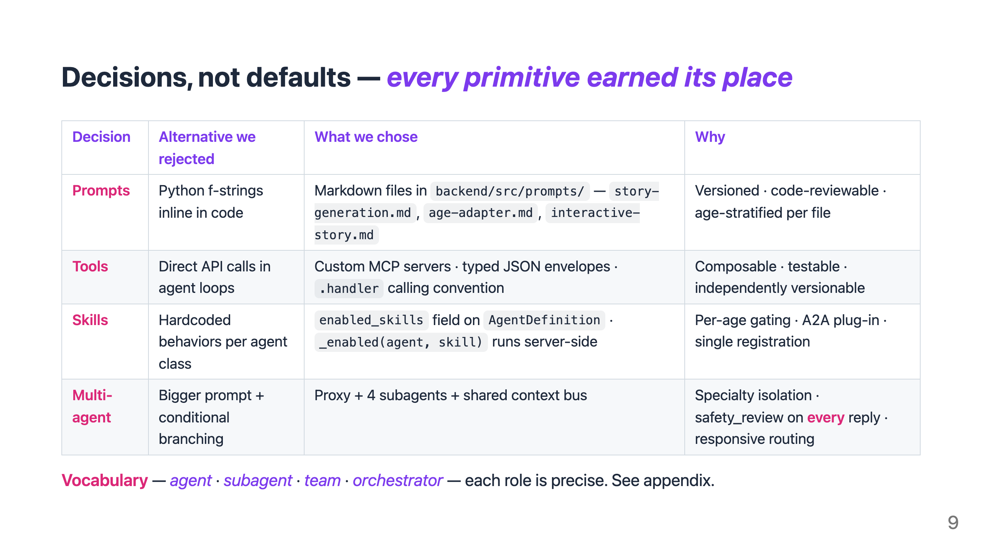
Notes:
🎤 SCRIPT · Slide 9 · Why this shape (rationale) ⏱ ~30 seconds · 5-min cut: DEFAULT-CUT (keep for 6-min slot) "Every primitive on the previous slides was a decision. PROMPTS — we could have inlined them as Python f-strings. We chose markdown files in git. Versioned. Code-reviewable. Age-stratified per file. TOOLS — we could have called the API directly inside agent code. We chose custom MCP servers with typed envelopes. Composable. Testable. SKILLS — we could have hardcoded behaviors per agent. We chose enabled_skills as a field on AgentDefinition — per-age gating, A2A extensible, server-side gate. MULTI-AGENT — we could have written a bigger prompt with branching. We chose a proxy plus four subagents. Each specialty isolated. Safety subagent on EVERY reply. We didn't adopt defaults." 🎬 Delivery: Walk row by row, ~7 seconds each. Land hard on "We didn't adopt defaults." ➡ Transition: "Three layers, six bets — here's where we innovate."

Slide 10
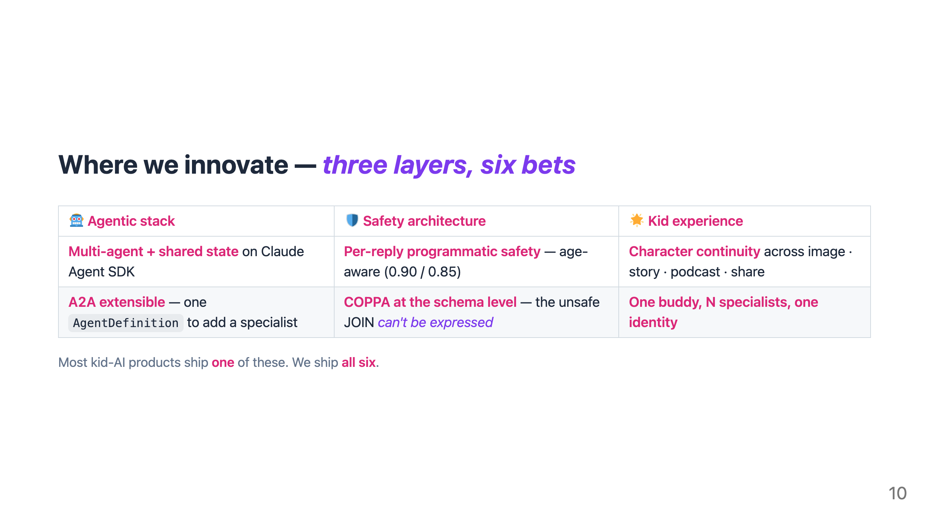
Notes:
🎤 SCRIPT · Slide 10 · What's good about it (moats) ⏱ ~30 seconds · 5-min cut: KEEP "Three layers. Six specific bets. AGENTIC STACK — multi-agent with shared state on Claude Agent SDK. A2A extensible — new specialists plug in by registering one AgentDefinition. SAFETY ARCHITECTURE — per-reply programmatic safety, age-aware thresholds. And COPPA enforced AT THE SCHEMA LEVEL. The unsafe JOIN can't even be expressed. KID EXPERIENCE — character continuity across image, story, podcast, and community. One buddy, many specialists, one identity. [brief pause] Most kid-AI products ship ONE of these. We ship ALL SIX." 🎬 Delivery: Read each cell as a defensible CLAIM, not a feature list. PAUSE before the closing line. Land hard on "all six." ➡ Transition: "Here's what kids actually do."

Slide 11
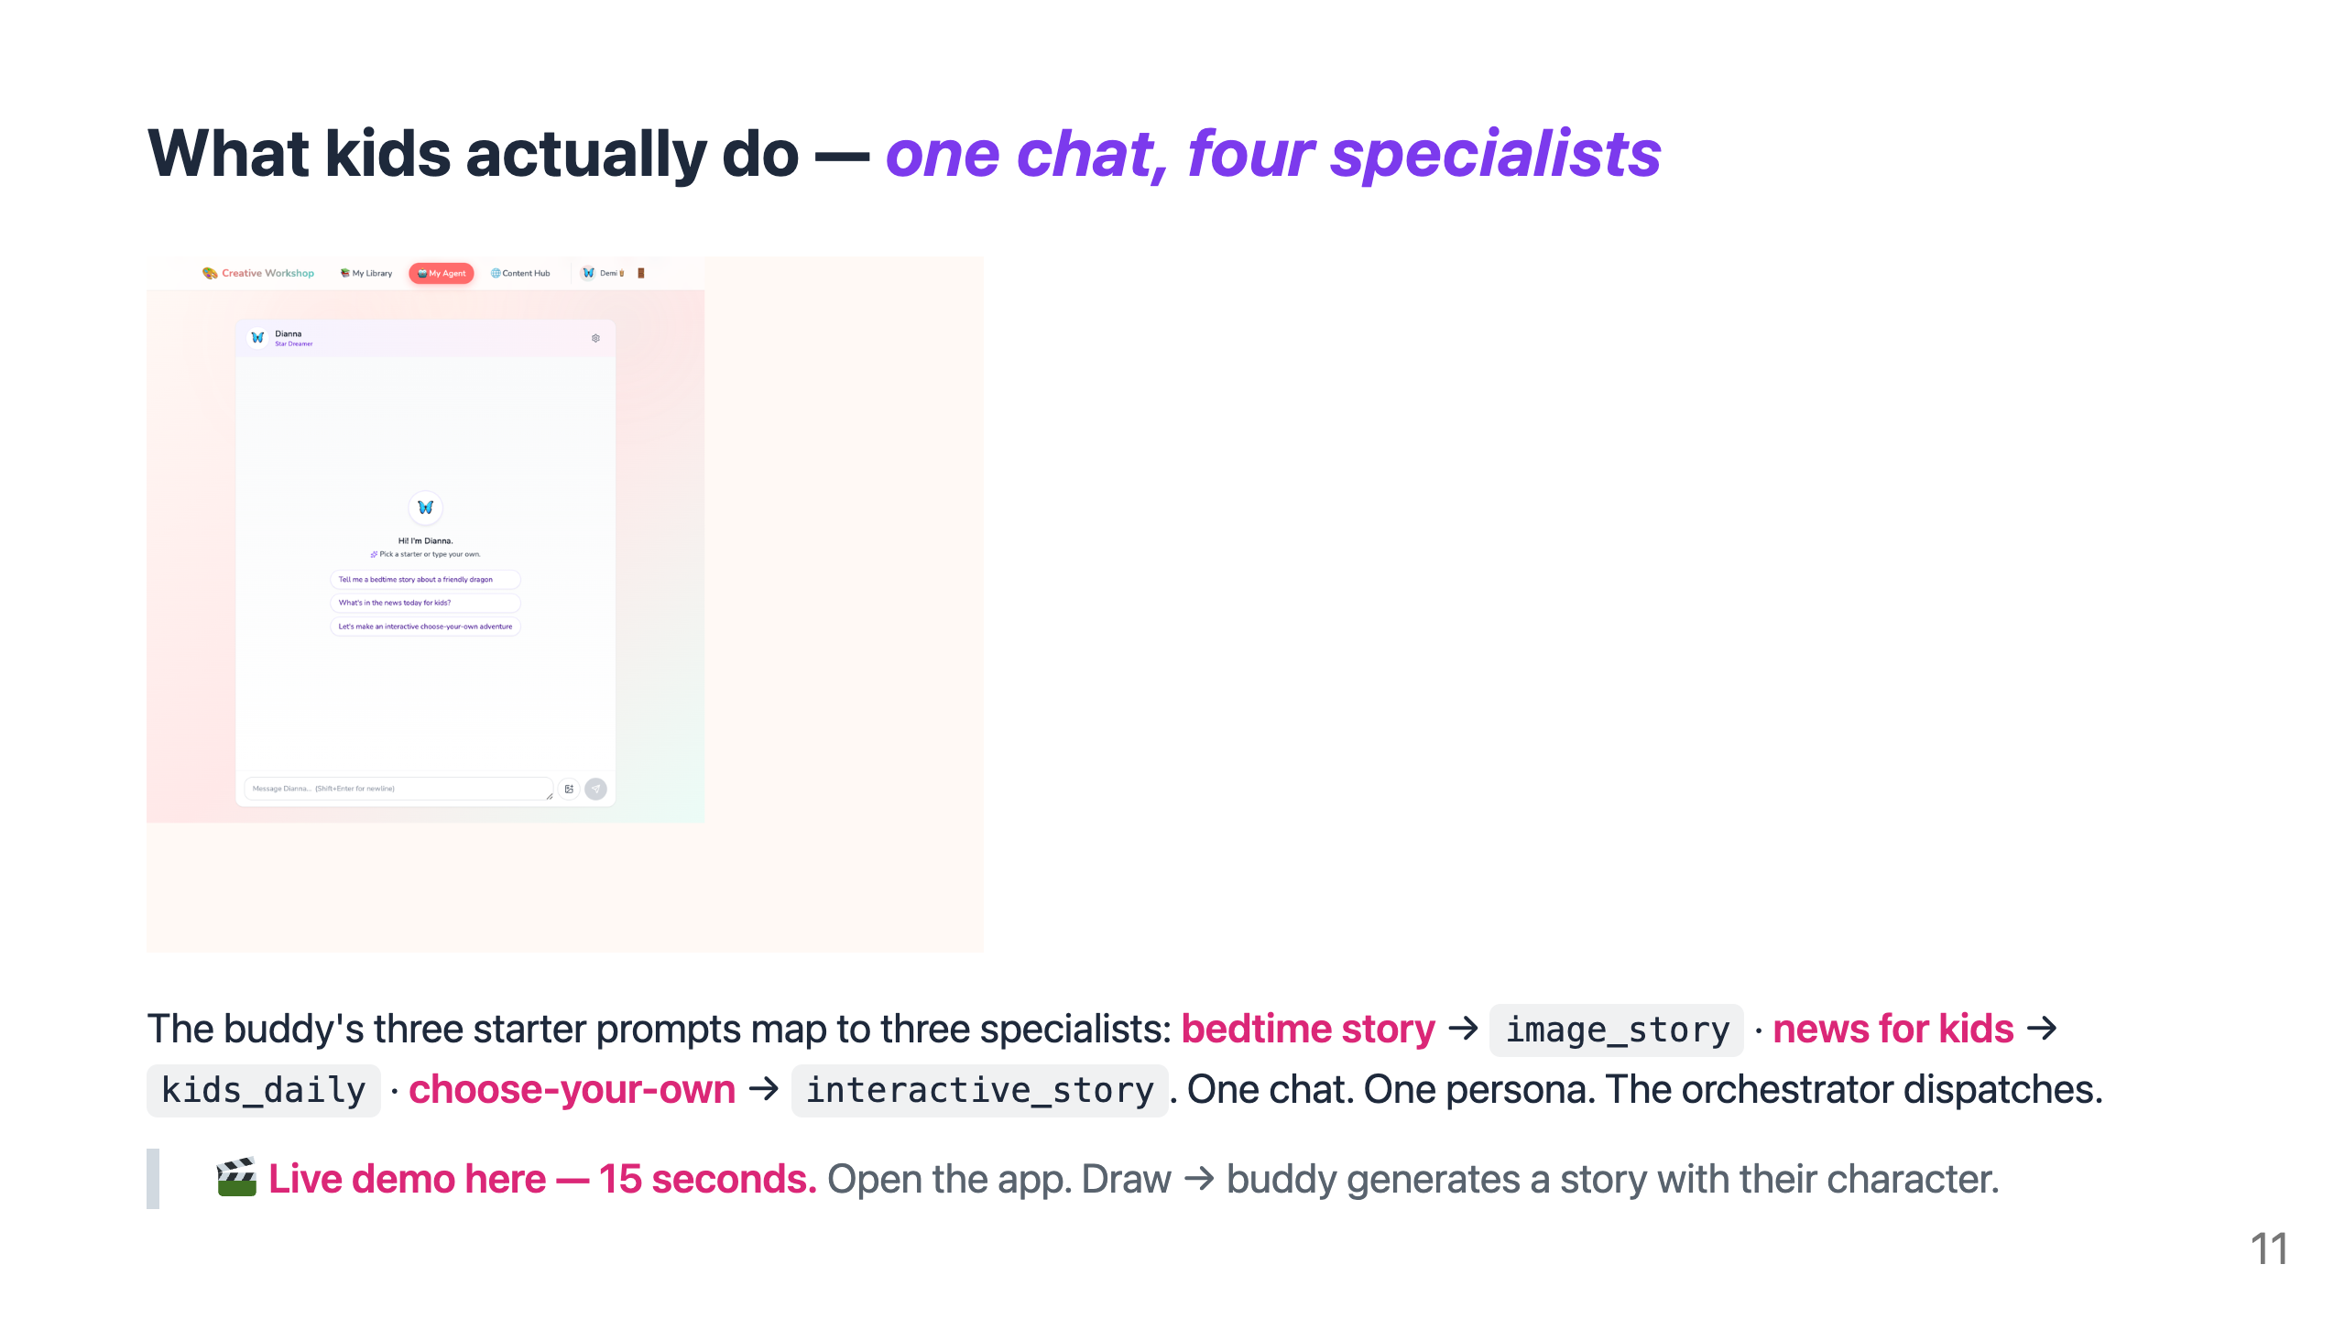
Notes:
🎤 SCRIPT · Slide 11 · Product proof + demo beat ⏱ ~35 seconds · 5-min cut: KEEP "You can see the buddy here — Dianna in this case — offering three starter prompts. Each one routes to a different specialist underneath. 'Tell me a bedtime story' goes to image_story. 'What's in the news for kids' goes to kids_daily. 'Choose your own adventure' goes to interactive_story. One chat surface. The multi-agent team behind it. [OPTIONAL — 15-second live demo here. Open the app. Draw → buddy generates a story with their character. Pick ONE flow, not all four. Let it land.]" 🎬 Delivery: Point at the hero screenshot. Read the 3 prompts. Make the mapping to specialists EXPLICIT — it's the proof of the slide-7 architecture. ➡ Transition: "Here's where we are in shipping this."

Slide 12
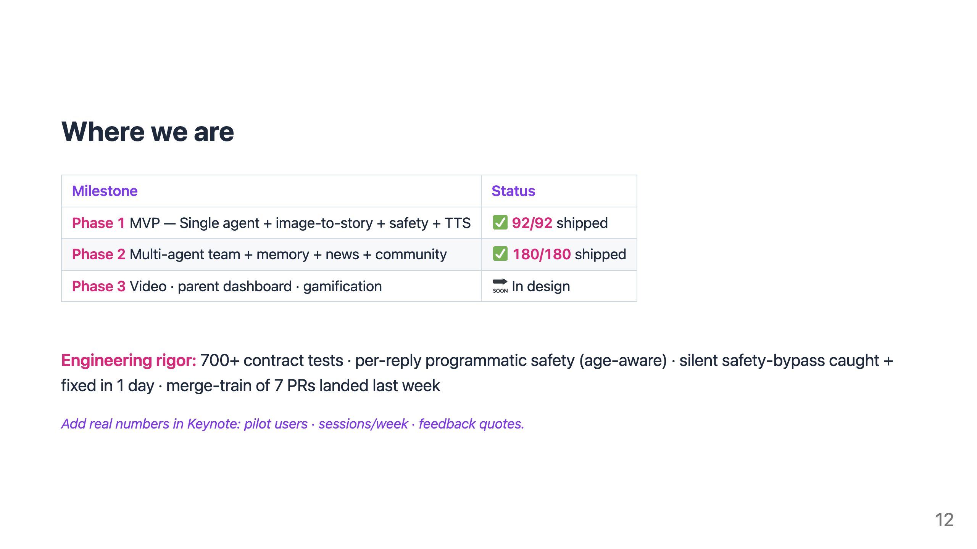
Notes:
🎤 SCRIPT · Slide 12 · Where we are ⏱ ~25 seconds · 5-min cut: KEEP "Two hundred seventy-two stories shipped across three milestones. Phase 1 — MVP, single agent — done. Phase 2 — multi-agent team plus community — done. Phase 3 — video and parent dashboard — in design. Engineering rigor matters as much as features. Seven hundred contract tests. Per-reply programmatic safety. A silent safety-bypass we caught and fixed in twenty-four hours. A merge train of seven PRs landed last week. We don't pitch features — we ship them." 🎬 Delivery: Speak the numbers slowly. "Two hundred seventy-two" beats "272/272" by a long way out loud. If you have real pilot numbers, replace the placeholder. ➡ Transition: "And we own our bugs too."

Slide 13
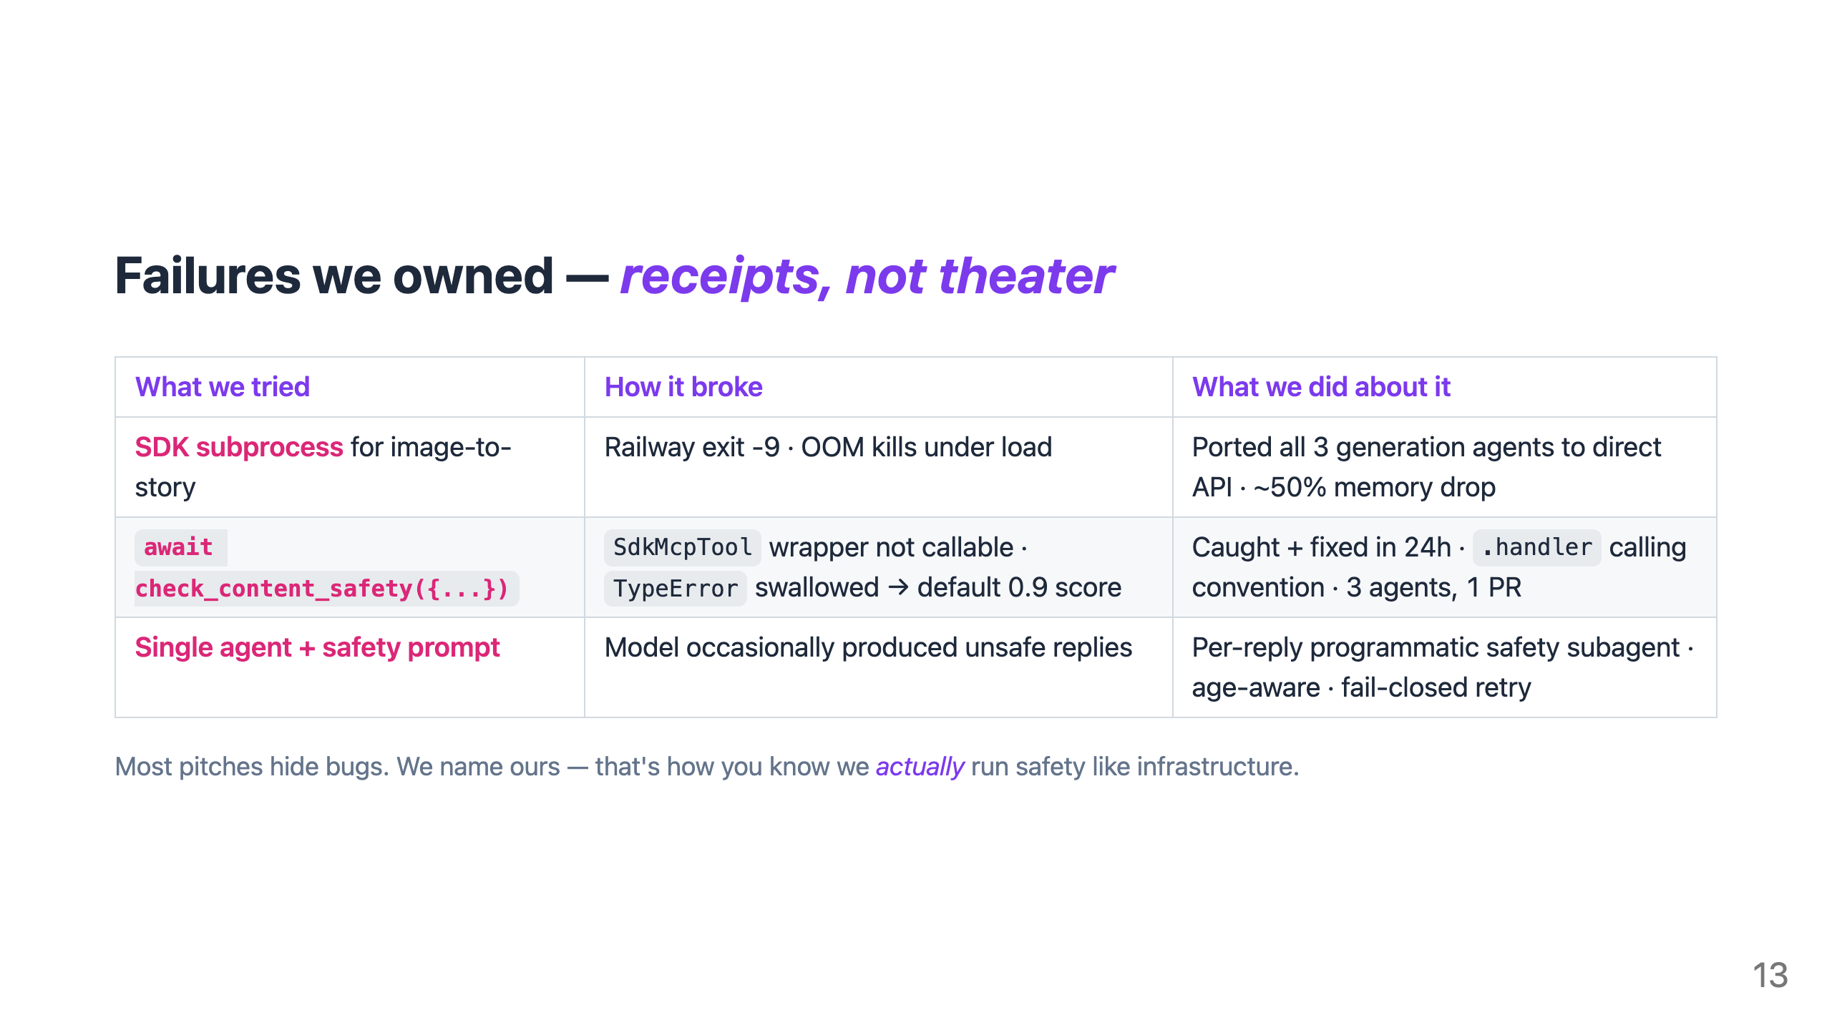
Notes:
🎤 SCRIPT · Slide 13 · Failures we owned ⏱ ~30 seconds · 5-min cut: DEFAULT-CUT (keep for 6-min slot) "And we own our bugs. We tried the SDK subprocess for image-to-story. Railway killed it — out-of-memory under load. So we ported all three generation agents to direct API. Got half the memory back. We tried calling check_content_safety directly. The wrapper isn't callable. The TypeError got swallowed. Every story shipped with a default 0.9 score. We caught it ourselves and fixed it in twenty-four hours. We tried single agent plus a safety prompt. The model occasionally produced unsafe replies. So we built per-reply programmatic safety with suggest-and-retry. Most pitches hide bugs. We name ours." 🎬 Delivery: Counter-intuitive slide. Speak each row in ~9 seconds. The 24-hour bypass story is the receipt — speak it slowly. ➡ Transition: "Here's why this matters."

Slide 14
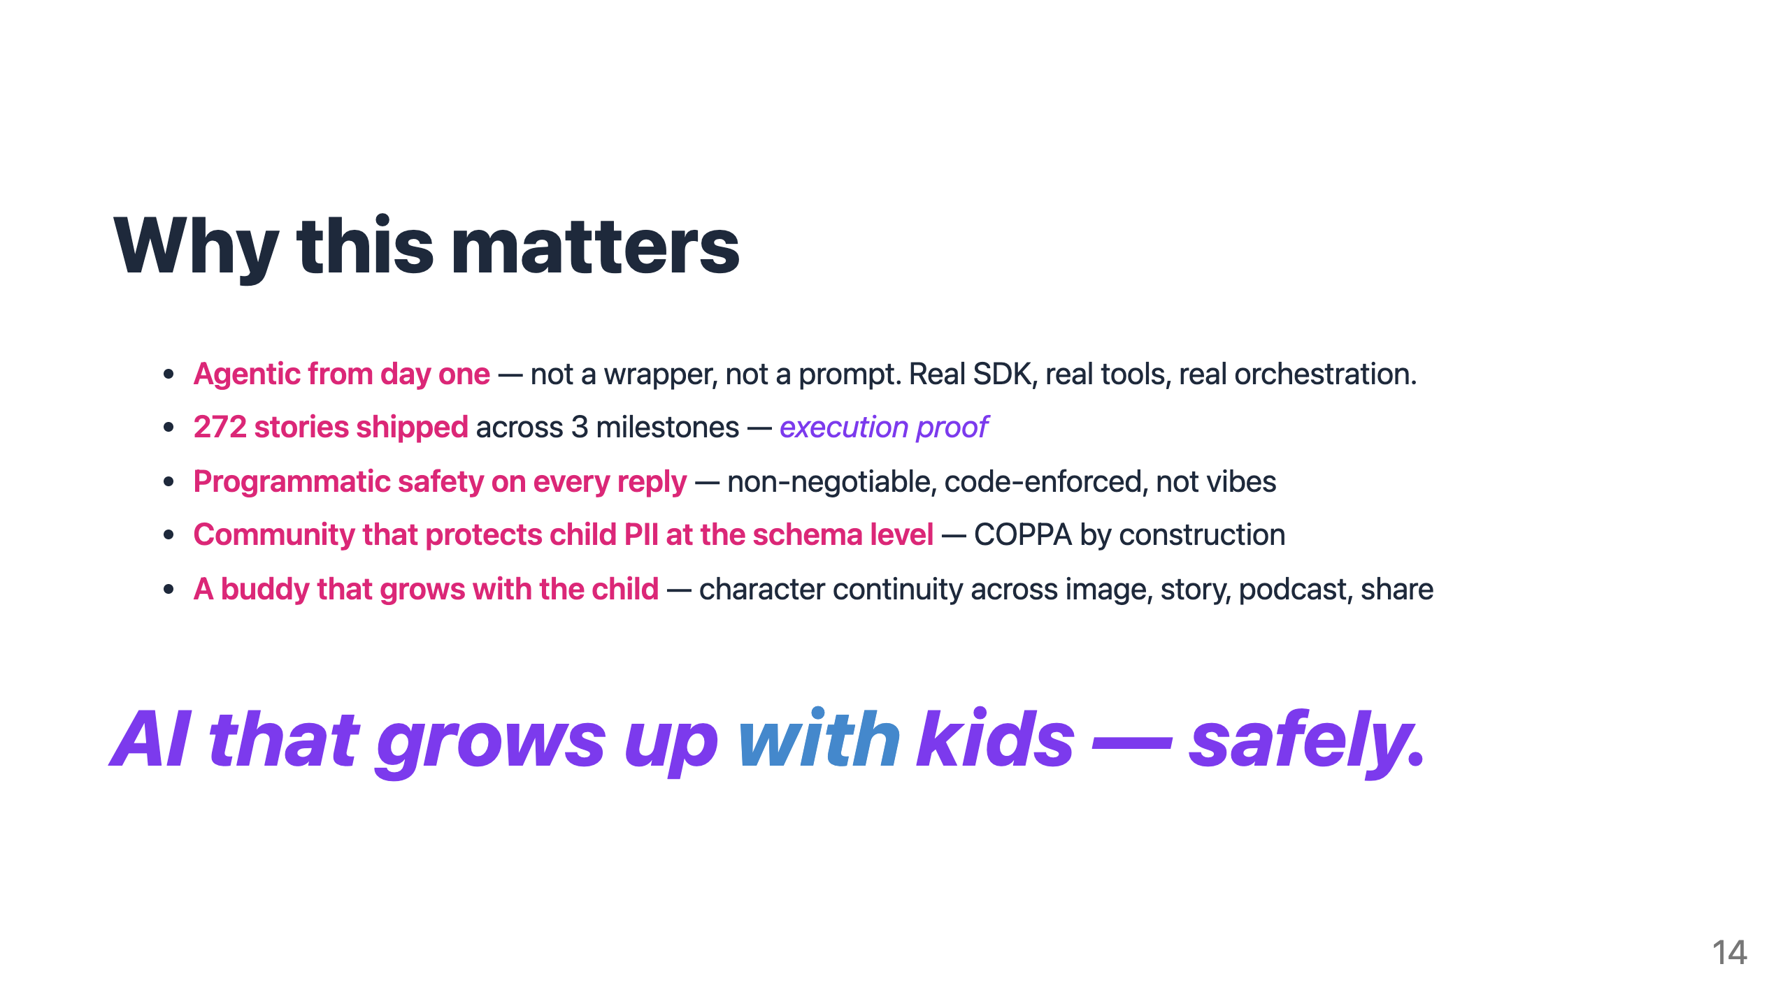
Notes:
🎤 SCRIPT · Slide 14 · Why this matters (CLOSING BOOKEND) ⏱ ~25 seconds · 5-min cut: KEEP "Why this matters. Agentic from day one — not a wrapper, not a prompt. Real SDK. Real tools. Real orchestration. 272 stories shipped across three milestones — execution proof. Programmatic safety on every reply — non-negotiable, code-enforced, not vibes. A community that protects child PII at the schema level — COPPA by construction. A buddy that grows with the child — character continuity across image, story, podcast, and share. [PAUSE] AI that grows up WITH kids — safely. [PAUSE — hold eye contact, don't fill the silence] Happy to take questions." 🎬 Delivery: Read the achievements briskly. PAUSE before the closing line. Deliver it SLOWLY, holding eye contact. Don't smile until you've said "happy to take questions." ➡ End of pitch.

Slide 15
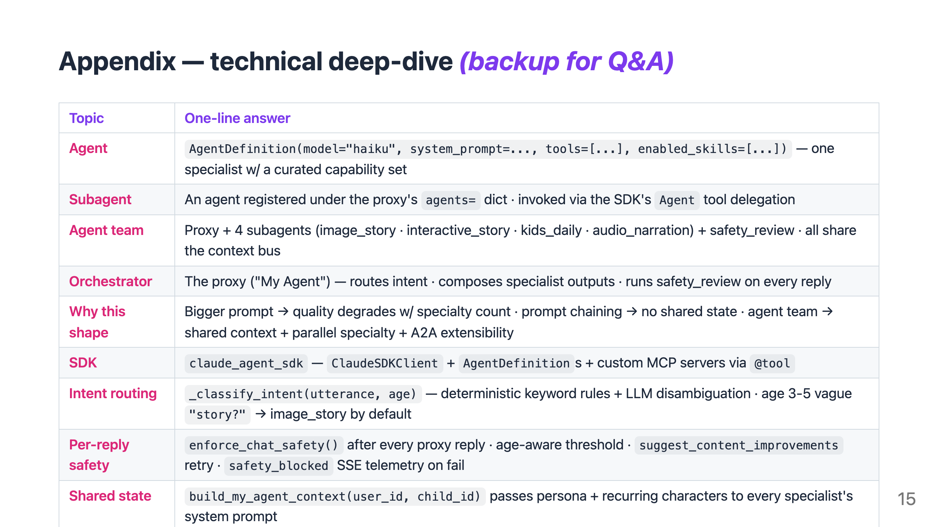
Notes:
🎤 SCRIPT · Slide 15 · Appendix (Q&A backup, HIDDEN BY DEFAULT) ⏱ Variable · Only reveal during Q&A This slide should be HIDDEN during the main presentation: Keynote → right-click slide thumbnail → Skip Slide REVEAL only if a judge asks a deep technical question. Then jump straight to the relevant row. Example responses you might say: If asked "what's the difference between agent and subagent?": "An agent is an AgentDefinition — model, system prompt, tools, and skills. A subagent is one of those registered under our proxy's agents dictionary. The SDK's Agent tool lets the proxy delegate to a subagent based on intent." If asked "why not just a bigger prompt?": "Quality degrades as specialty count grows in one prompt. And we'd lose per-reply safety as a separate subagent — which is the non-negotiable gate." If asked "how is your COPPA pattern different?": "Most teams enforce kid-PII rules in code review. We enforce them in the schema. The hub_posts table has agent_name, agent_avatar, agent_title as immutable snapshot columns. There's no read path that JOINs users. The unsafe query can't be expressed." 🎬 Don't read the whole table out loud — jump to the row that answers the question.

