Slide 1
Kids Creative Workshop
An agentic app for kids — built on Claude Agent SDK.
6-minute pitch · Single agent → agent team · 2026
Notes:
⏱ ~7 seconds · 5-min cut: KEEP
"Good morning. This is Kids Creative Workshop — an agentic app for kids, built on the Claude Agent SDK. Let me start with a moment."
🎬 Warm and slow. Pause before "Let me start with a moment."

Slide 2
Three moments. One buddy.
Her drawing — becomes a story.
Her character — stars in the next adventure.
Tomorrow's news — arrives as her podcast.
Notes:
⏱ ~22 seconds · 5-min cut: KEEP
"Three moments in a kid's day.
She hands her drawing to her buddy — and it becomes a story, in her character.
[pause]
That same character stars in the next adventure — her choices, her ending.
[pause]
And tomorrow's news arrives as her own podcast — kid-safe.
One buddy. Three moments. Her world, every time."
🎬 Slow down. The pauses are the slide.
➡ Next: "But today's AI fails her on every one of these."

Slide 3
Today's AI fails kids on four fronts
🚫 Not personalized enough | 🚫 Not highly customized
Generic output. No memory of her characters, her voice, her age. | Same prompt, same answer for every child. No buddy identity. No per-child capability set.
🚫 No suited news for kids | 🚫 No long-term persistence
Today's news products are adult-first. No age-aware filter. No narrative voice for kids. | Each session resets. Lightning the puppy is forgotten by Monday.
Existing AI extracts. We collaborate.
Notes:
⏱ ~24 seconds · 5-min cut: KEEP
"Today's AI fails kids on four fronts.
One — it's not personalized. Generic output, no memory of her characters or her age.
Two — it's not customized. Every child gets the same prompt, the same answer.
Three — no kid-suited news. Today's news products are adult-first.
Four — no persistence. Every session resets — last week's character is forgotten.
Existing AI extracts from kids. We collaborate with them."
🎬 Number each problem — "one, two, three, four" — to match the grid on screen.
➡ Next: "Here's how our agent fixes each one."

Slide 4
Meet My Agent — one ability per problem
Problem | Our agent's ability
Not personalized enough | Persona + character memory — buddy is named & customized; recurring characters recalled across sessions (character_repo)
Not highly customized | Per-child `AgentDefinition` + skills gating — age-aware capabilities (3–5 / 6–8 / 9–12); persona shared as system context to every specialist
No suited news for kids | `kids_daily` specialist — age-stratified prompts + per-reply safety review; news arrives as a kid-safe podcast in the buddy's voice
No long-term persistence | `agent_repo` + `character_repo` + vector search — buddy persona and recurring characters survive every session; one buddy, for life
What kids feel: interactive (streaming) · proactive (recommendations + recall) · persistent (memory).
Notes:
⏱ ~28 seconds · 5-min cut: KEEP
"Four problems, four abilities — one for each.
Not personalized — persona and character memory. Recurring characters recalled across every session.
Not customized — per-child agent definitions, with skills gated by age.
No kid-news — a dedicated kids-daily specialist: age-stratified, safety-reviewed, in the buddy's voice.
No persistence — agent and character repositories, plus vector search. One buddy, for life.
And kids feel three things: interactive, proactive, persistent."
🎬 Walk problem-to-ability, tight. End on the three feelings.
➡ Next: "These abilities run on a small set of SDK primitives."

Slide 5
Foundation — six agentic features, one stack
Agentic feature | How we build it
🌊 Interactive | Streaming SSE · async-generator agents · live tool-use events
🎯 Responsive | LLM model (Claude Haiku for speed) · deterministic + LLM intent routing · per-agent skill curation
💡 Proactive | Prompt engineering (system-prompt scaffolding) · vector DB recall · character_repo lookups
🧠 Persistent | Vector DB (ChromaDB / pgvector) · agent_repo + character_repo (SQL) · cross-session memory
🛡️ Reactive | MCP safety tool · @tool decorator · enforce_chat_safety + suggest-and-retry · age-aware thresholds (0.90 / 0.85)
🚀 Autonomous (future) | Multi-step planning · skills composition · self-prompted explore loops · scheduled buddy initiatives
Built from: prompt engineering · MCP · tools · skills · LLM model · vector DB.
Notes:
⏱ ~32 seconds · 5-min cut: KEEP
"Six agentic features, one stack.
Interactive — streaming SSE, so the story writes itself token by token.
Responsive — Claude Haiku for speed, plus deterministic and LLM intent routing.
Proactive — vector recall surfaces recurring characters and suggests next moves.
Persistent — vector DB plus SQL repositories hold the buddy across sessions.
Reactive — every reply runs through our safety tool, with age-aware thresholds.
And autonomous — that's next: multi-step planning, scheduled buddy initiatives."
🎬 Walk row by row. Slow down on reactive — that's the safety moat. Mark autonomous as future, not shipped.
➡ Next: "One agent hit a ceiling. So we extended to a team."

Slide 6
Four agent architecture patterns — we use all four
# | Pattern | What it does | Where we use it
1 | 🤖 Single agent | One agent, one job · linear inference | Straight TTS via audio_narration
2 | 🔀 Sub-agent fan-out | Same task spawned in parallel for speed | Concurrent vision crops · parallel character_repo lookups
3 | 👥 Agent team | Multiple agents collaborate by role · via AgentDefinition | My Agent: proxy + 4 role specialists + safety_review
4 | 🎼 Multi-agent orchestrator | Agents created dynamically · A2A extensible | Proxy registers new AgentDefinitions at runtime
Shared state flows through build_my_agent_context(). A2A extends to external teams (future).
Notes:
⏱ ~26 seconds · 5-min cut: KEEP
"Four agent architecture patterns — and we use all four.
Single agent — one job, linear inference. We use it for text-to-speech.
Sub-agent fan-out — the same task in parallel, for speed.
Agent team — multiple agents collaborating by role, each an AgentDefinition. That's our My Agent.
Multi-agent orchestrator — agents created dynamically at runtime. That's what makes us extensible.
Shared state flows to every specialist through the agent context. A2A to external teams is future work."
🎬 Walk pattern by pattern. "We use all four" is the punchline.
➡ Next: "And every agent is wired to six memory layers."

Slide 7
Six memory types — one buddy, layered recall
# | Memory type | What it stores | Backed by
1 | 🗨️ Session | This-chat conversation history | agent_chat_repository
2 | ⚡ Working | Per-turn execution context (tool results, persona) | build_my_agent_context()
3 | 📅 Episodic | Past creations — stories, podcasts, choices | stories · interactive_sessions · kids_daily_episodes
4 | 📋 Factual | Buddy persona, child profile, preferences | agent_repo · preference_repository · users
5 | 🧠 Semantic | Embeddings of characters, themes, style | ChromaDB / pgvector via vector_search_server
6 | 🛠️ Procedural | How to generate each content type | prompts/*.md · @tool skills · enabled_skills
The buddy remembers, understands, acts, talks, and reasons in flight.
Notes:
⏱ ~28 seconds · 5-min cut: KEEP
"Memory is what makes a buddy feel like a buddy. Six layers.
Session — this conversation's history.
Working — the per-turn execution context.
Episodic — past creations: stories, podcasts, choices.
Factual — persona, child profile, preferences.
Semantic — embeddings of characters and themes, in our vector store.
Procedural — how the buddy generates each kind of content.
Put it together: the buddy remembers, understands, acts, talks, and reasons in flight."
🎬 Brisk through the six. Slow down on procedural — most teams don't have it. Land the closing line.
➡ Next: "Here's how the layers and patterns compose in our team."

Slide 8
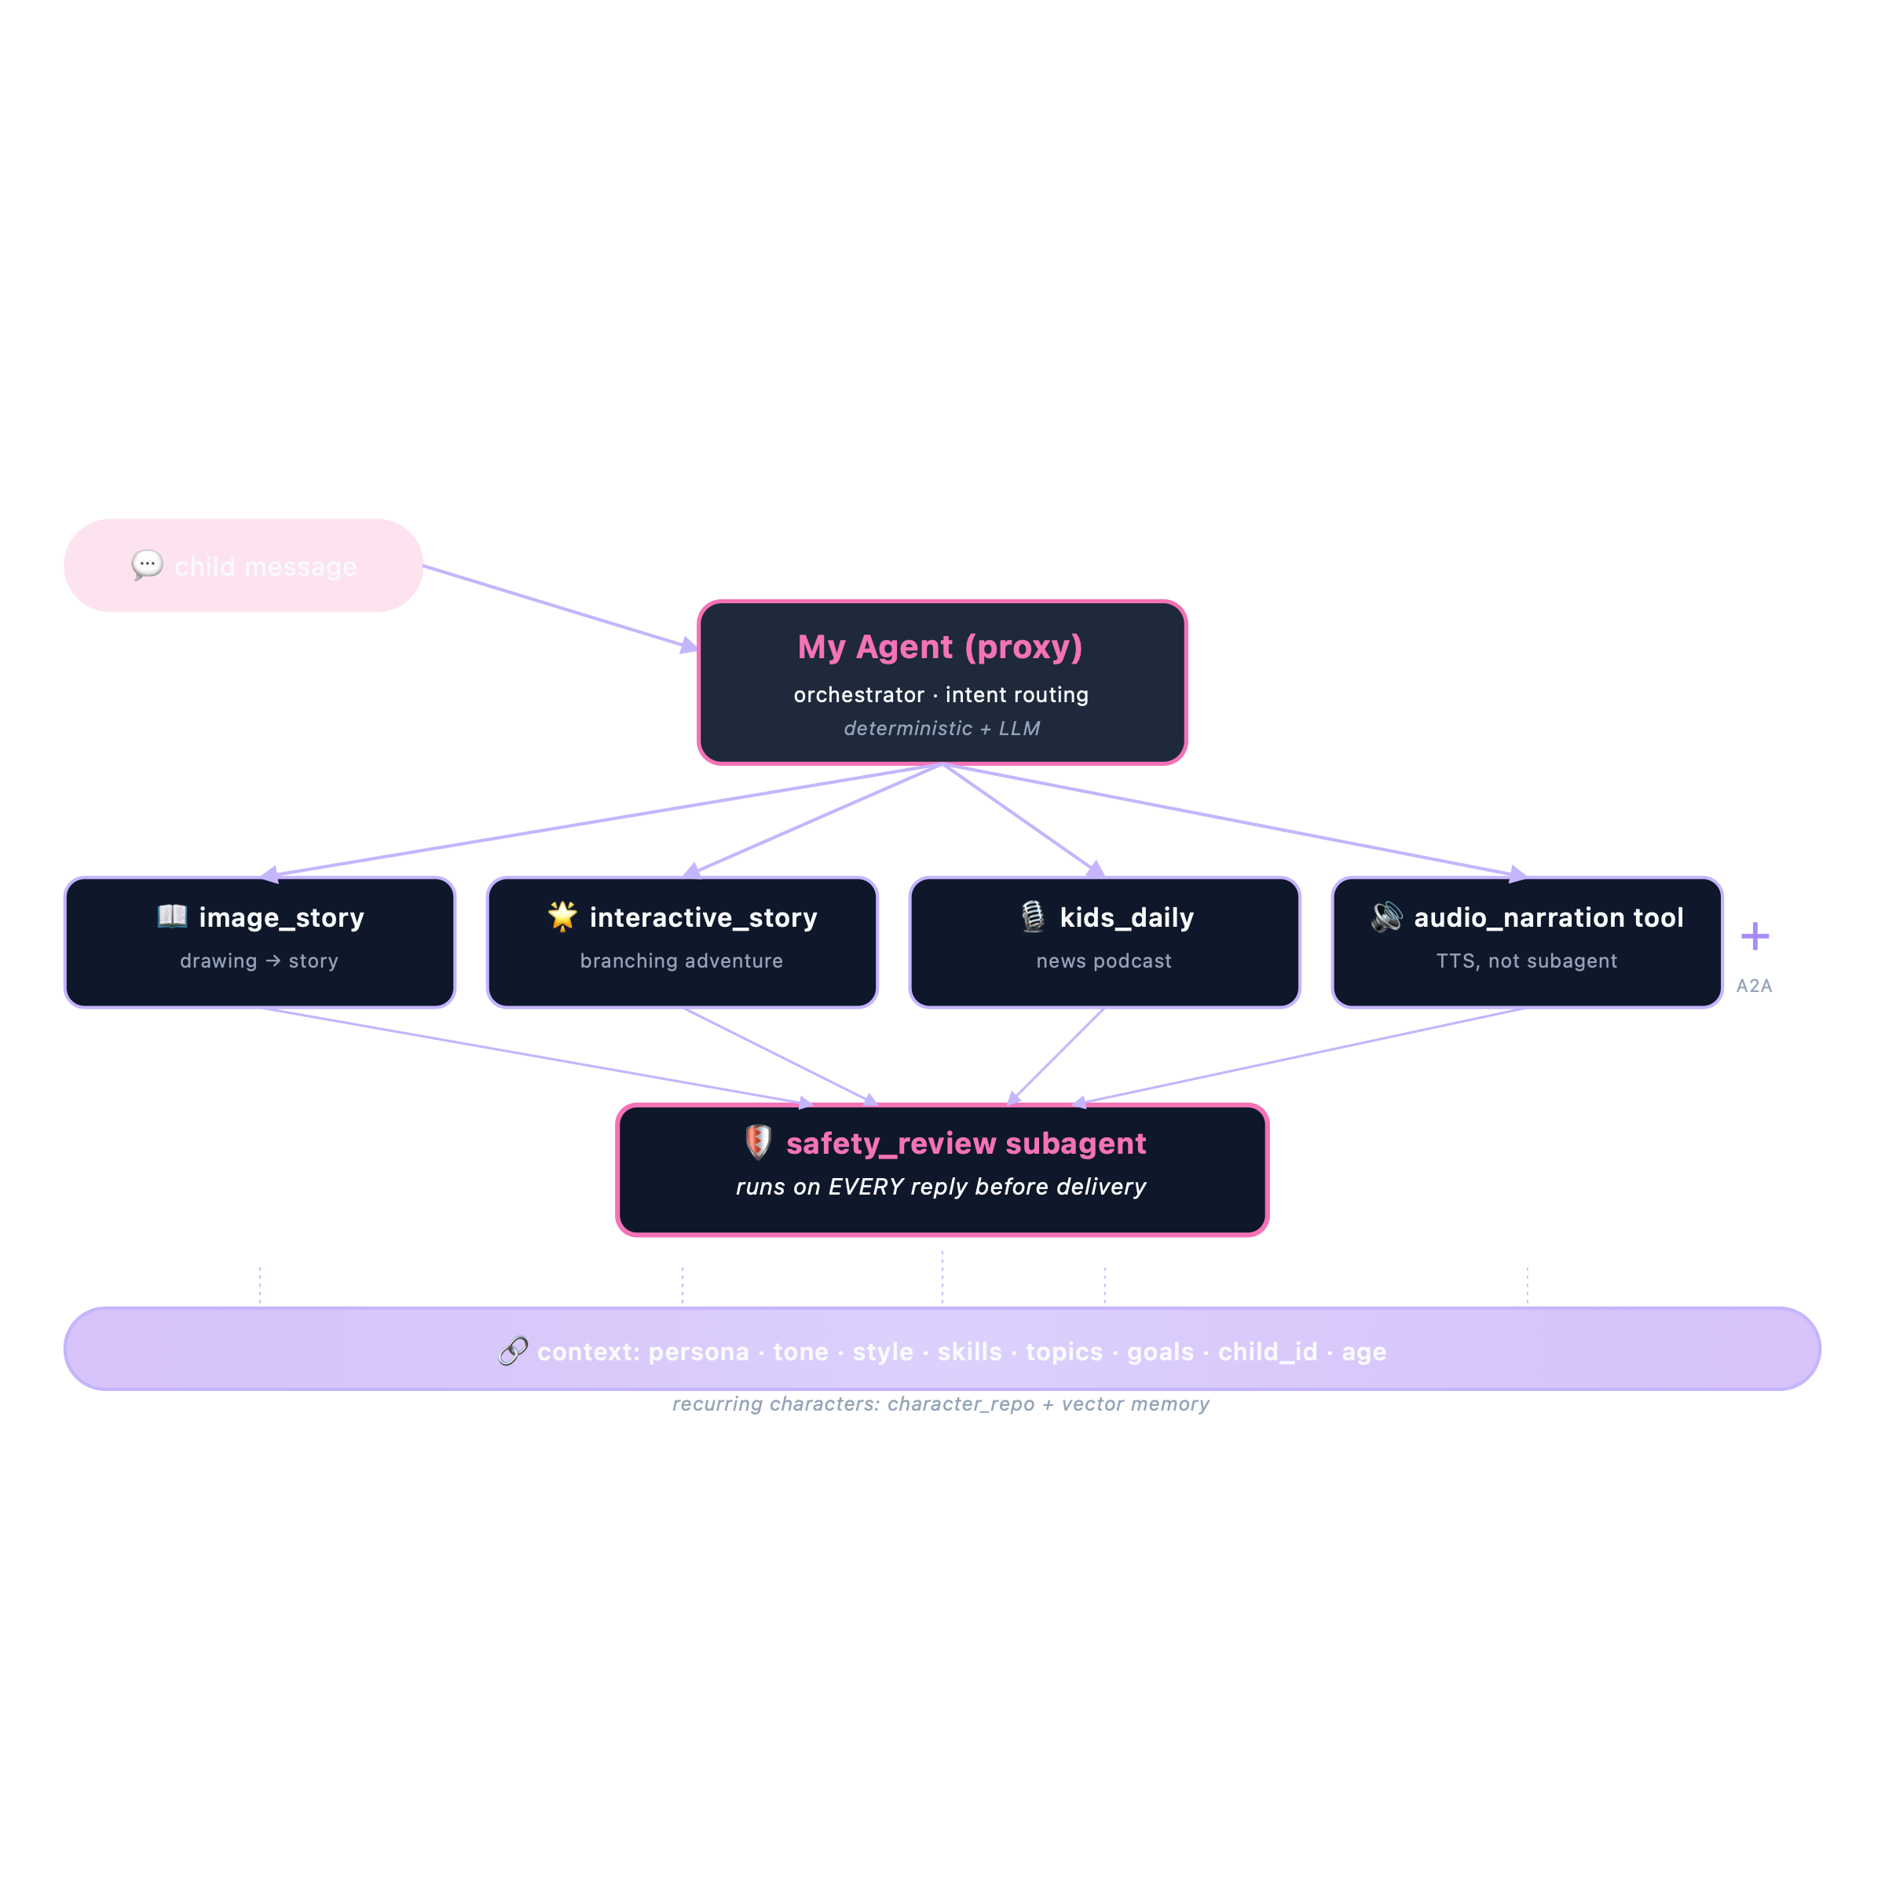
The team — one proxy, four specialists, one safety gate
Built on Claude Agent SDK + custom MCP tool servers.
Notes:
⏱ ~38 seconds · 5-min cut: KEEP
"This is the architecture. Each surface needed its own expertise — so we built an agent team, on the Claude Agent SDK.
[point at the proxy]
A child's message hits the proxy first. It orchestrates — routes intent with deterministic rules plus LLM disambiguation.
[point at the specialists]
Then the right capability runs — image story, interactive story, and Kids Daily are specialists; audio narration is a reusable TTS tool. Each has its own prompt and tools.
[point at safety_review — pause]
Every reply passes through safety review before it reaches the child. That's the non-negotiable gate.
[point at the context bus]
And underneath, shared context — persona, characters — flows to every agent. Same character in the story and the podcast.
This unlocks responsive, dynamic, and A2A-extensible."
🎬 Centerpiece slide. Walk top to bottom. Pause after "before it reaches the child."
➡ Next: "Every primitive here earned its place."

Slide 9
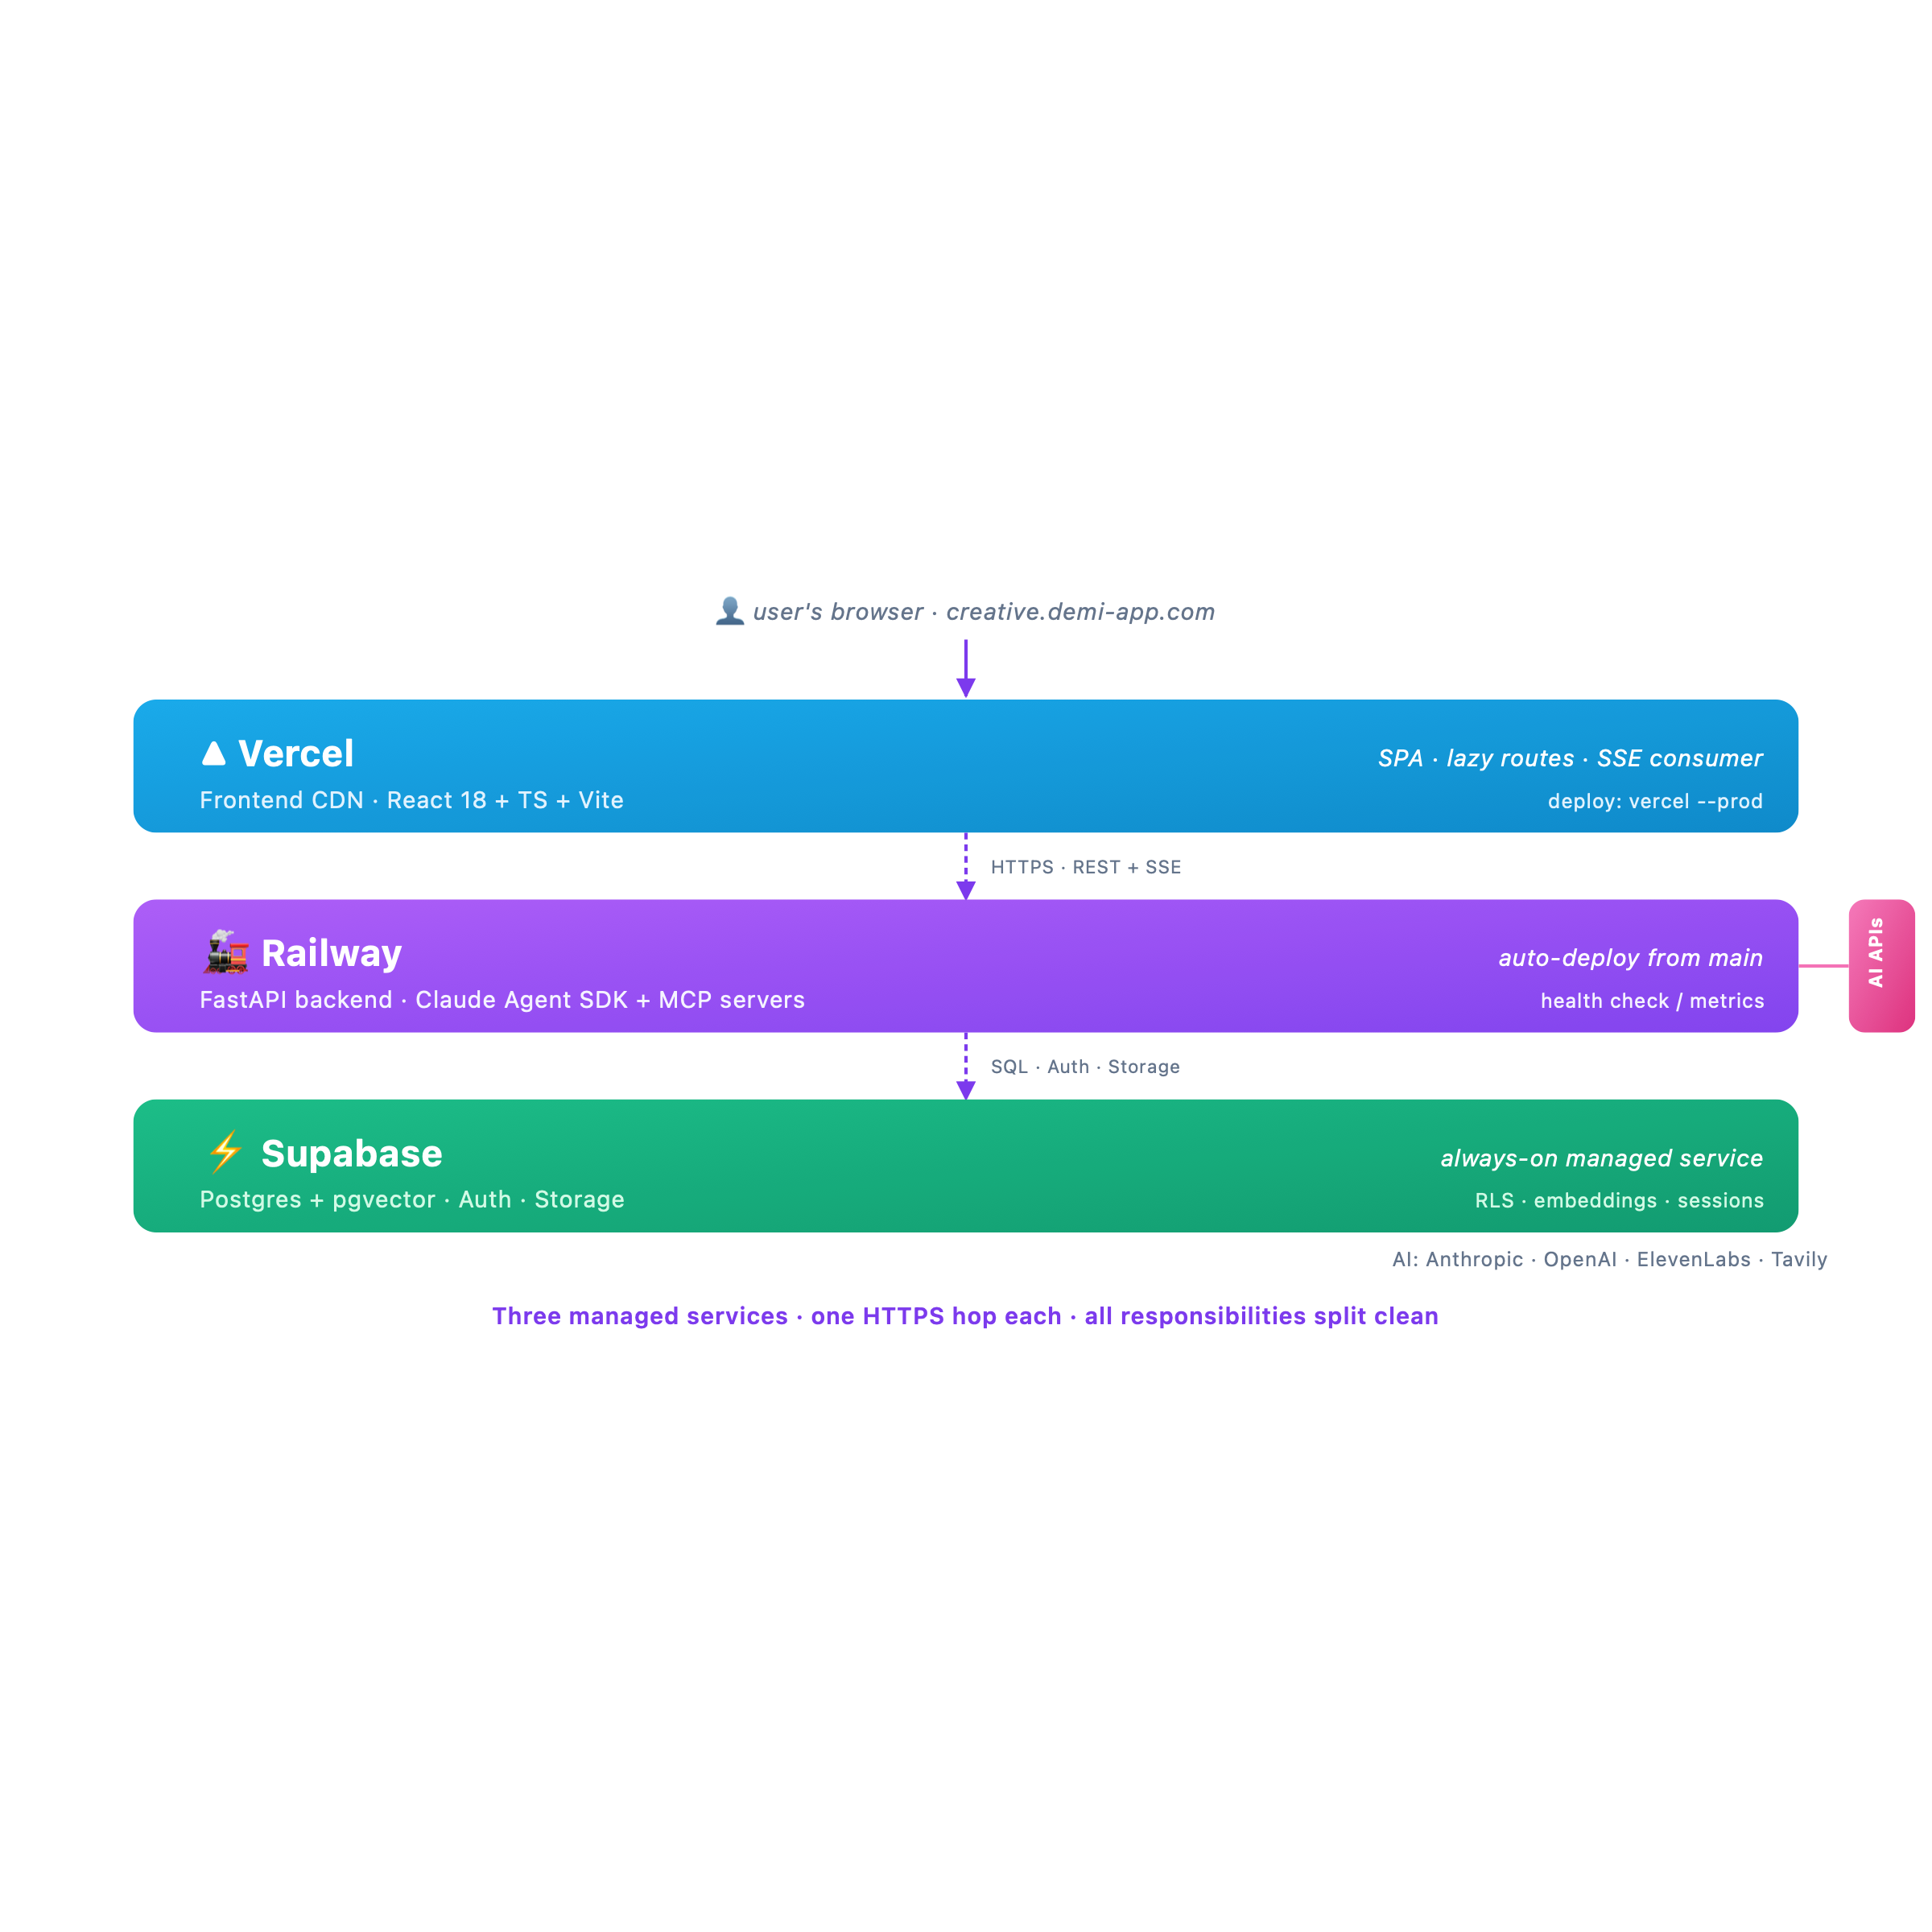
Three-layer infrastructure — each service does one thing
Notes:
⏱ ~24 seconds · 5-min cut: KEEP
"The infrastructure is three managed services.
Vercel hosts the frontend — a React app on a CDN.
Railway runs the FastAPI backend — the Agent SDK and seven MCP servers, auto-deployed from main.
Supabase is the database — Postgres with pgvector, plus auth and storage.
Plus AI APIs — Anthropic, OpenAI, ElevenLabs, Tavily.
Each service does one job. No magic, no monorepo coupling."
🎬 Trace top to bottom. Land "no magic, no monorepo coupling" slowly.
➡ Next: "Inside the backend, the same discipline holds."

Slide 10
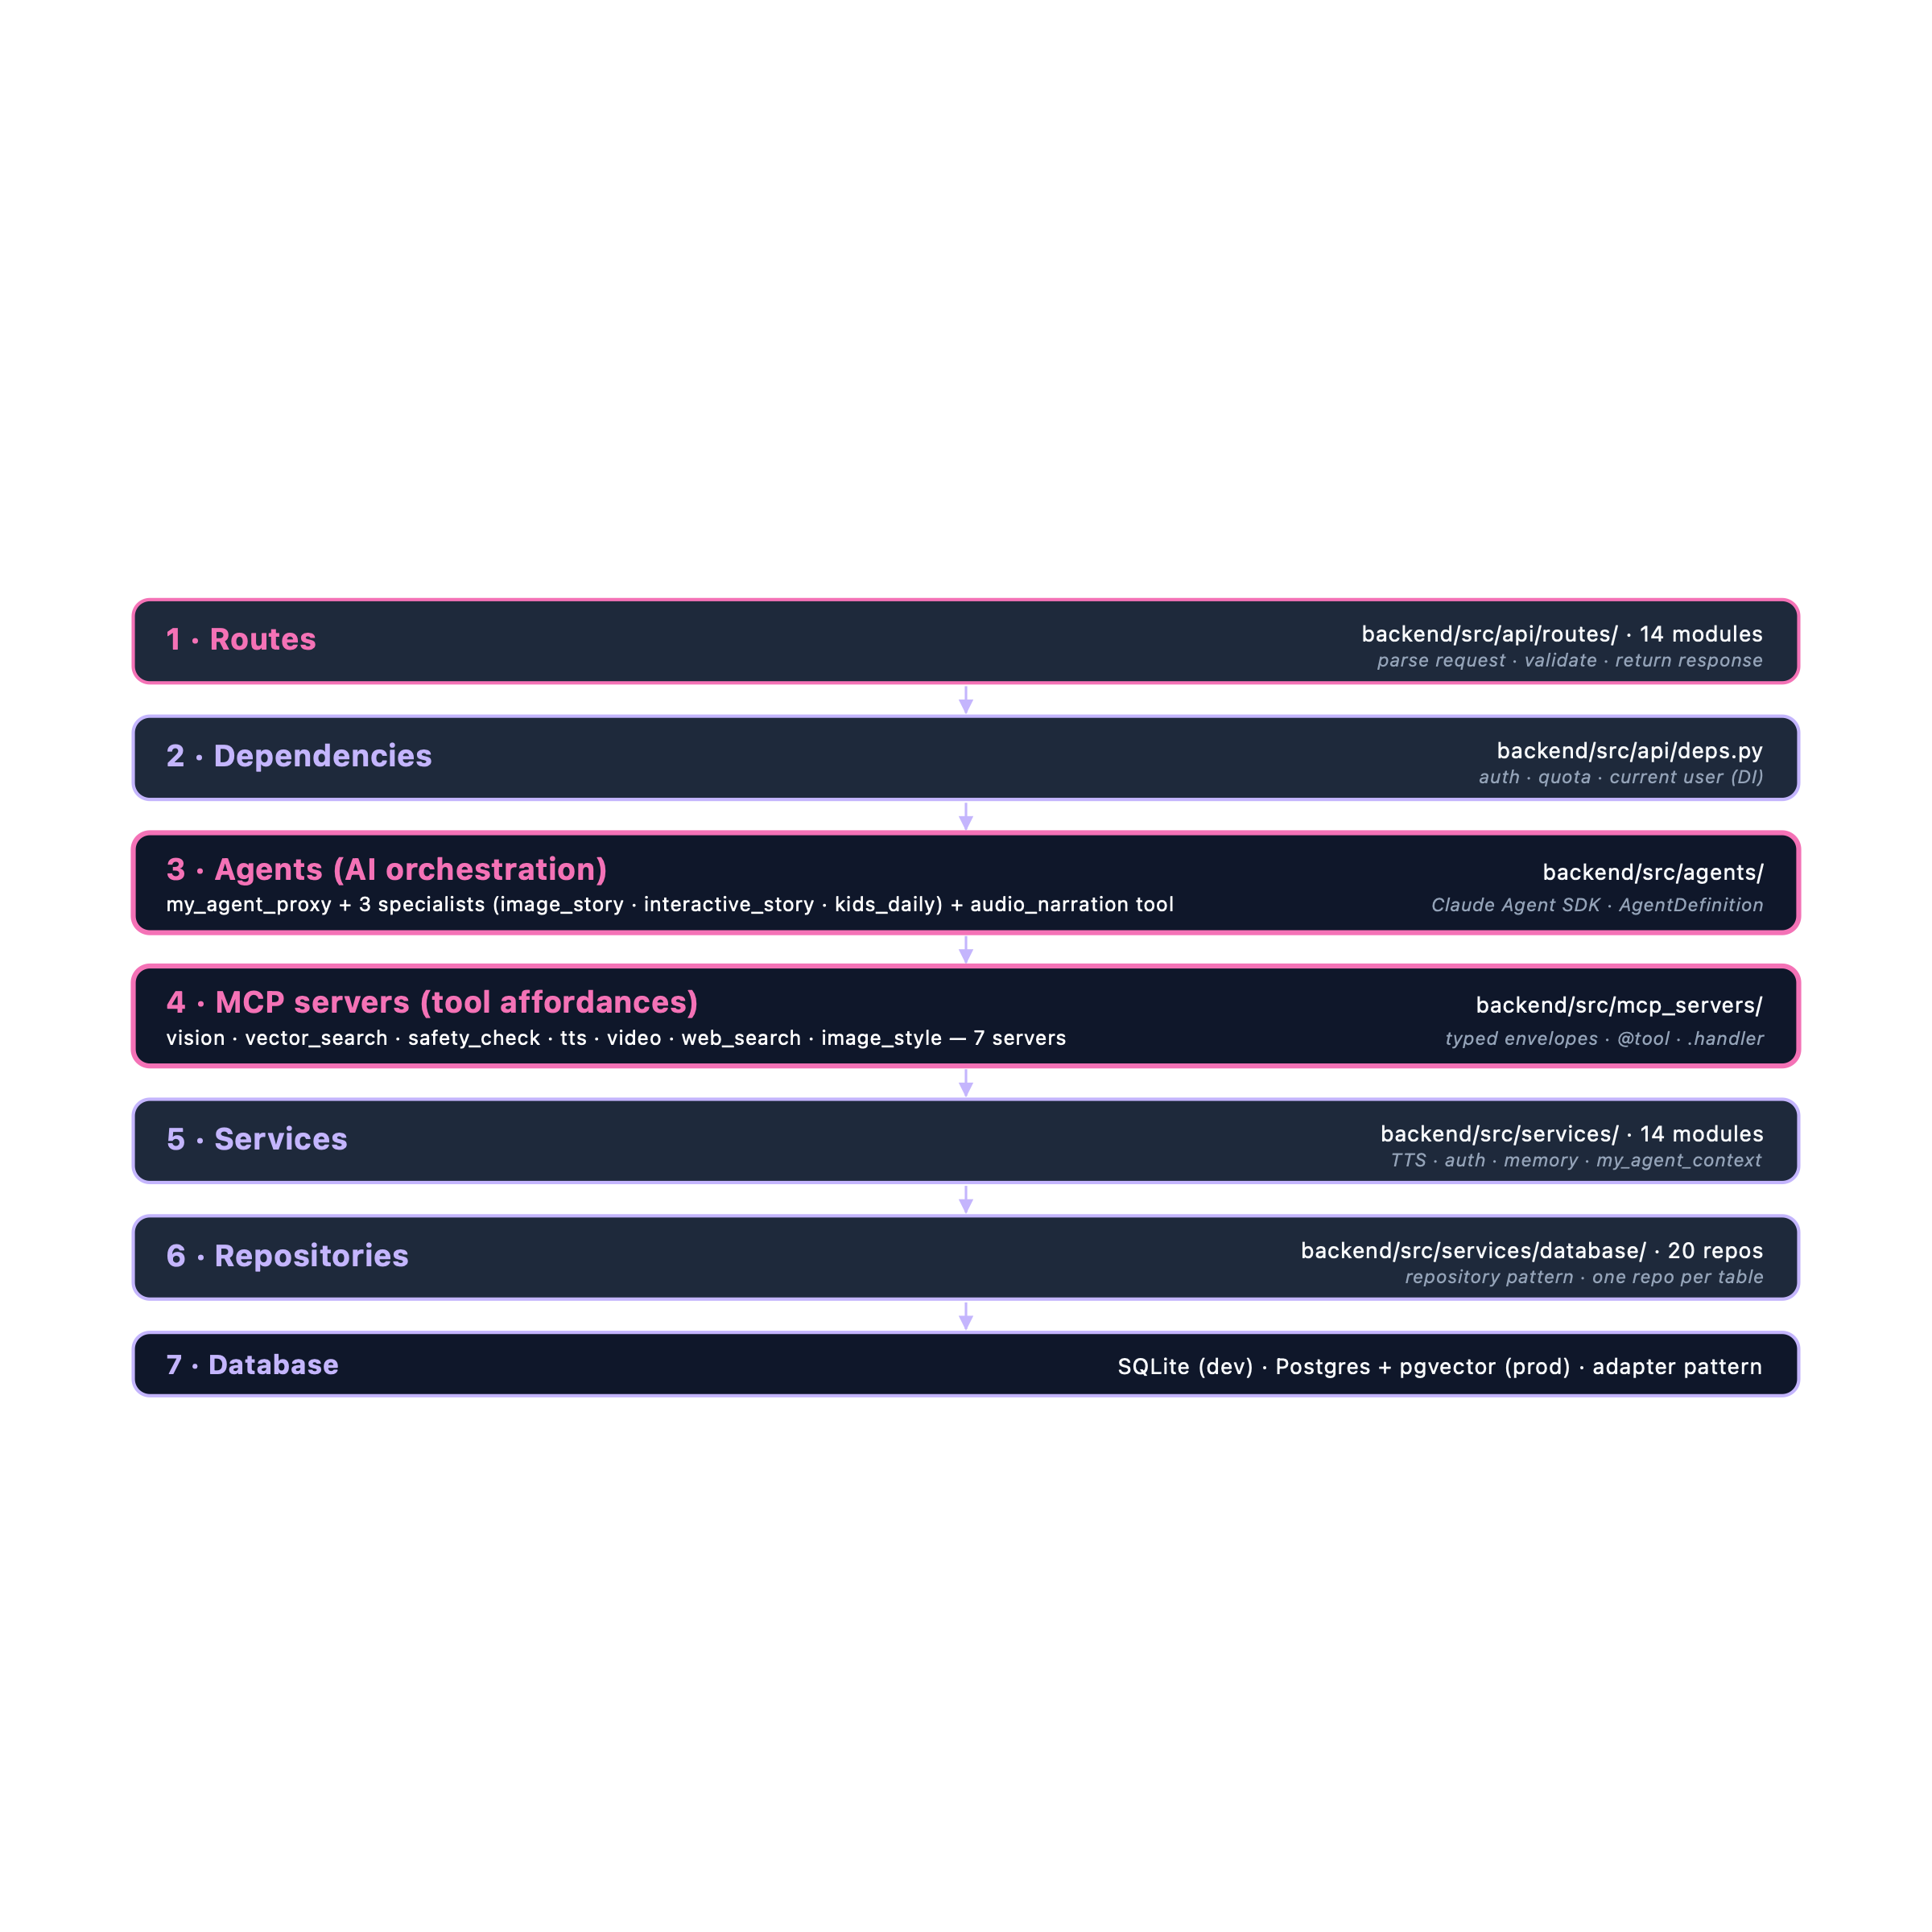
Backend — seven layers, one direction
Notes:
⏱ ~26 seconds · 5-min cut: KEEP
"Inside the backend — seven layers, all talking one direction.
Routes parse requests. Dependencies handle auth and quota.
Agents orchestrate the AI. MCP servers are the tool layer — seven of them.
Services hold business logic. Repositories wrap database access — twenty of them.
And the database adapter — SQLite in dev, Postgres in production.
Each layer talks down, never up. That's how we replace any layer in isolation."
🎬 Walk layer by layer. Land "talks down, never up" slowly.
➡ Next: "Let me show you what the kid actually sees."

Slide 11
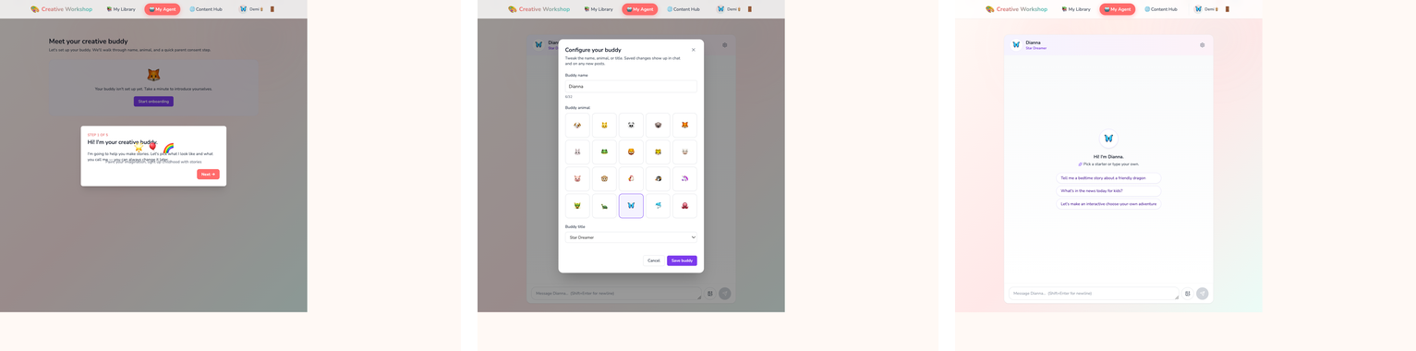
The buddy — three states, one identity
Empty state → Customize (name, avatar, theme) → Chat. Three React states, one persona, persisted across every session.
Notes:
⏱ ~22 seconds · 5-min cut: KEEP
"Here's the buddy — three states, one identity.
First, the empty state — no buddy yet.
Then customize — the child names their buddy, picks an avatar, chooses a theme. Kids love this part.
Then chat — the buddy greets them with three starter prompts, each routing to a specialist.
Three states, one persona, persisted across every session."
🎬 Point at each pane. "Kids love this part" — say it casually, like an observation.
➡ Next: "And here's what the buddy actually creates."

Slide 12
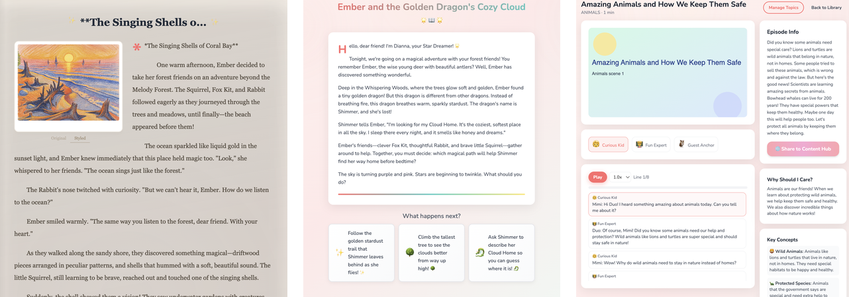
What the buddy creates — three surfaces, one character
📖 Image-to-Story | 🌟 Interactive Story | 🎙️ Kids Daily
The Singing Shells of Coral Bay — art story with illustrated cover | Ember and the Golden Dragon — branching scene with 3 choice cards | Amazing Animals and How We Keep Them Safe — episode + transcript + audio
Same character — Ember + the recurring crew — across all three. Real outputs from the live app.
Notes:
⏱ ~28 seconds · 5-min cut: KEEP
"These are real outputs from the live app.
On the left — an art story. The child's drawing became a sixty-second narrative with their character, Ember.
In the middle — an interactive story. The same Ember, now in a branching adventure with three choices.
On the right — a kids daily episode. Ember again, as guest anchor, with transcript and audio.
Three surfaces, same character. Continuity made real — not just claimed."
🎬 Point at each pane. Say "Ember" each time — that makes continuity concrete.
➡ Next: "And kids share what they make — safely."

Slide 13
Community & sharing — COPPA by schema, not by policy
Where most products fail | What we do
Posts JOIN to users.name for byline | hub_posts.agent_name is a snapshot column — written at post time, never JOINed
users.email accidentally leaks via API | Read paths can't reach users at all — schema doesn't allow it
Safety is a code-review checklist | Safety is a CHECK constraint + invariant test
Every Hub post is bylined by the buddy persona, never the child. Verified by test_hub_coppa_invariant.py.
Notes:
⏱ ~24 seconds · 5-min cut: KEEP
"Kids share what they create — safely.
Most kid-AI products fail COPPA the same way: they join posts back to the users table for a byline, and a child's name leaks.
Our schema doesn't allow it. The hub-posts table has immutable persona snapshot columns. No read path joins the users table.
The unsafe query can't even be expressed. Safety is a schema invariant — with a test that enforces it."
🎬 The COPPA moat. Say "the unsafe query can't even be expressed" slowly.
➡ Next: "And the architecture is built to extend."

Slide 14
Open by design — one AgentDefinition adds a specialist
# Adding a "music_story" specialist to the agent team:
proxy.register(AgentDefinition(
name="music_story",
model="haiku",
system_prompt=Path("prompts/music-story.md").read_text(),
tools=["music_generator", "vector_search"],
enabled_skills=["compose"],
))
# Routing picks it up automatically. Safety gate runs on every reply.
# Shared context (persona, child_id, recurring chars) flows in.
A2A bridge (future) extends to external agent teams via the same registration contract.
Notes:
⏱ ~24 seconds · 5-min cut: KEEP
"This architecture is open by design.
Adding a new specialist takes one AgentDefinition — a model, a prompt, its tools, its skills.
Register it, and routing picks it up automatically. The safety gate still runs on every reply. Shared context still flows in.
And in the future, an A2A bridge lets external agent teams join — through the same contract."
🎬 Let the audience read the code. "One AgentDefinition" is the moat — slow on that.
➡ Next: "And here's where we're headed."

Slide 15
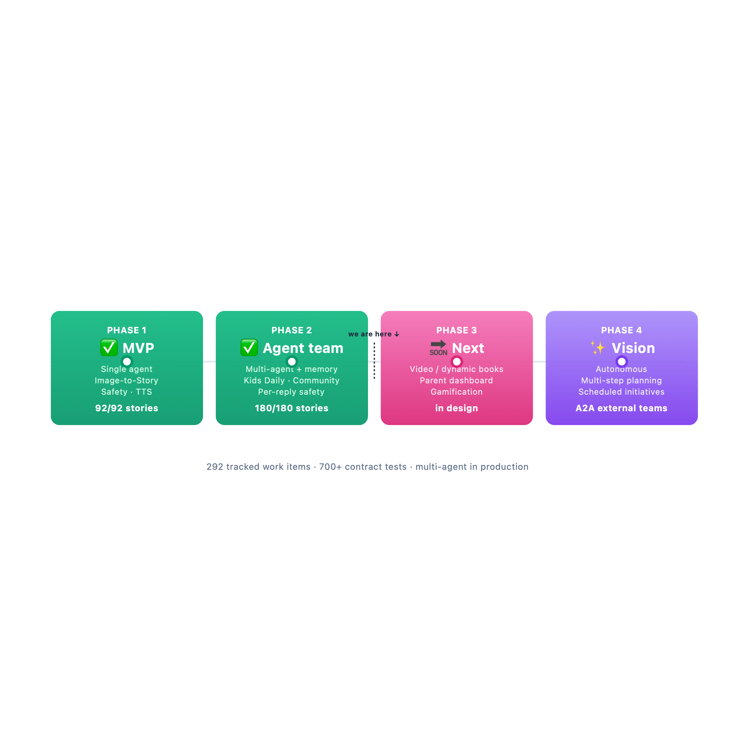
Roadmap — two phases shipped, two ahead
Notes:
⏱ ~30 seconds · 5-min cut: KEEP
"Our roadmap — two phases shipped, two ahead.
Phase one, the MVP — single agent, image-to-story, safety, TTS. Done.
Phase two, the agent team — multi-agent, memory, Kids Daily, community. Done.
Phase three, in design — video, parent dashboard, gamification.
Phase four, the vision — autonomous.
We don't pitch features. We ship them."
🎬 Tap each phase card. Land "we don't pitch features, we ship them" slowly.
➡ Next: "And the engineering rigor behind that velocity."

Slide 16
Where we are
Milestone | Status
Phase 1 — MVP: single agent + image-to-story + safety + TTS | ✅ 92/92 shipped
Phase 2 — multi-agent team + memory + news + community | ✅ 180/180 shipped
Phase 3 — video · parent dashboard · gamification | 🔜 In design
Engineering rigor: 700+ contract tests · per-reply programmatic safety (age-aware) · silent safety-bypass caught + fixed in 24h · merge-train of 7 PRs landed last week.
Add real numbers before presenting: pilot users · sessions/week · feedback quotes.
Notes:
⏱ ~22 seconds · 5-min cut: KEEP
"Where we are today. Two hundred ninety-two tracked work items — phases one and two done, phase three moving into build.
The engineering rigor: over seven hundred contract tests, per-reply safety, a silent safety bug we caught and fixed in twenty-four hours.
We don't pitch features. We ship them."
🎬 Speak numbers as words. If you have real pilot data, swap it in. Closing repeats slide 15 on purpose — lands the receipt.
➡ Next: "And we own our bugs too."

Slide 17
Failures we owned — receipts, not theater
What we tried | How it broke | What we did about it
SDK subprocess for image-to-story | Railway exit -9 · OOM kills under load | Ported all 3 generation agents to direct API · ~50% memory drop
await check_content_safety({...}) | SdkMcpTool wrapper not callable · TypeError swallowed → default 0.9 score | Caught + fixed in 24h · .handler calling convention · 3 agents, 1 PR
Single agent + safety prompt | Model occasionally produced unsafe replies | Per-reply programmatic safety subagent · age-aware · fail-closed retry
Most pitches hide bugs. We name ours — that's how you know we run safety like infrastructure.
Notes:
⏱ ~26 seconds · 5-min cut: DEFAULT-CUT (keep for 6-min slot)
"This is the slide most pitches don't have — the bugs we caught.
One — we ran the SDK as a subprocess. Railway killed it on memory. We ported to a direct API and got half the memory back.
Two — we called the safety check the wrong way. A swallowed error meant stories shipped with a fake score. We caught it ourselves, fixed it in a day.
Three — a single agent with a safety prompt wasn't enough. So we built per-reply programmatic safety.
Most pitches hide bugs. We name ours."
🎬 Speak each row in ~7 seconds. The 24-hour bug story is the receipt — slow on it.
➡ Next: "Here's why this matters."

Slide 18
Why this matters
Agentic from day one — not a wrapper, not a prompt. Real SDK, real tools, real orchestration.
272 stories shipped across 3 milestones — execution proof.
Programmatic safety on every reply — non-negotiable, code-enforced, not vibes.
Community that protects child PII at the schema level — COPPA by construction.
A buddy that grows with the child — character continuity across image, story, podcast, share.
AI that grows up with kids — safely.
Notes:
⏱ ~24 seconds · 5-min cut: KEEP
"Why this matters.
Agentic from day one — real SDK, real tools, real orchestration. Not a wrapper.
292 tracked work items across shipped and planned milestones — execution proof.
Programmatic safety on every reply — code-enforced, not vibes.
A community that protects child PII at the schema level.
A buddy that grows with the child.
[pause]
This is AI that grows up with kids — safely.
[pause — hold eye contact]
I'd love to take your questions."
🎬 Stack the lines briskly. Hard pause before "AI that grows up with kids — safely." Don't smile until you've asked for questions.
➡ End of pitch.

Slide 19
Appendix — technical deep-dive (backup for Q&A)
Topic | One-line answer
Agent | AgentDefinition(model, system_prompt, tools, enabled_skills) — one specialist w/ a curated capability set
Subagent | An agent registered under the proxy's agents= dict · invoked via the SDK's Agent tool delegation
Agent team | Proxy + 3 product subagents + audio_narration tool + safety_review · all share the context bus
Orchestrator | The proxy — routes intent · composes specialist outputs · runs safety_review on every reply
Why this shape | Bigger prompt degrades w/ specialty count · prompt chaining = no shared state · agent team = shared context + parallel specialty
Per-reply safety | enforce_chat_safety() after every reply · age-aware threshold · suggest-improvements retry · safety_blocked telemetry
COPPA pattern | hub_posts.agent_name/avatar/title — immutable snapshot columns; no read path JOINs users
Tech stack | FastAPI + Pydantic v2 · SQLite (dev) / Postgres + pgvector (prod) · React 18 + TS + Tailwind
Notes:
⏱ Variable · Only reveal during Q&A
This slide should be HIDDEN during the main presentation:
Keynote → right-click slide thumbnail → Skip Slide
Only reveal it if a judge asks a deep technical question. Then jump straight to the row that answers them.
Here are three example answers you might give out loud:
If they ask "what's the difference between an agent and a subagent?":
"An agent in our system is an AgentDefinition — it has a model, a system prompt, a set of tools, and a set of skills. A subagent is one of those registered underneath our proxy. The SDK's Agent tool is what lets the proxy delegate to a subagent based on the child's intent."
If they ask "why didn't you just use a bigger prompt?":
"Two reasons. First, quality degrades as you stuff more specialties into one prompt — the model loses focus. And second, we'd lose the per-reply safety subagent as a separate gate, which is non-negotiable for a kids product."
If they ask "how is your COPPA pattern different from other kid-AI products?":
"Most teams enforce their kid-PII rules in code review. We enforce them in the schema. The hub_posts table has agent_name, agent_avatar, and agent_title as immutable snapshot columns — written once at post time. No read path in our codebase JOINs the users table. The unsafe query literally can't be expressed in our schema."
🎬 Don't read the whole table out loud. Just jump to the row that answers the question and explain it conversationally.

