Slide 1

Oracle 10g Database Administrator: Implementation and Administration
Chapter 3
Creating an Oracle Instance

Slide 2
Objectives
Learn the steps for creating a database
Understand the prerequisites for creating a database
Configure initial settings for database creation
Create, start, and stop a database instance

Slide 3
Objectives (continued)
Learn the basics of managing configuration parameter files
Learn the purpose and location of the alert log and trace files

Slide 4
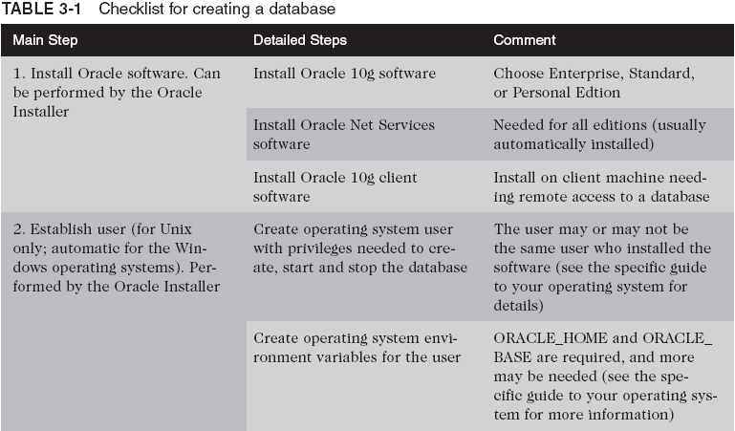
Steps for Creating a Database

Slide 5
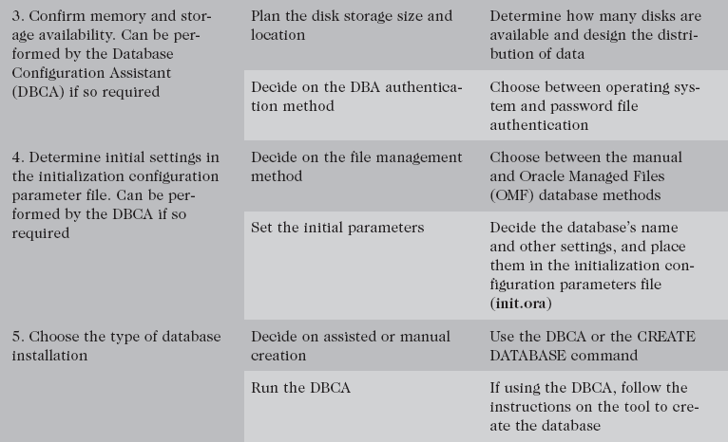
Steps for Creating a DB (continued)

Slide 6
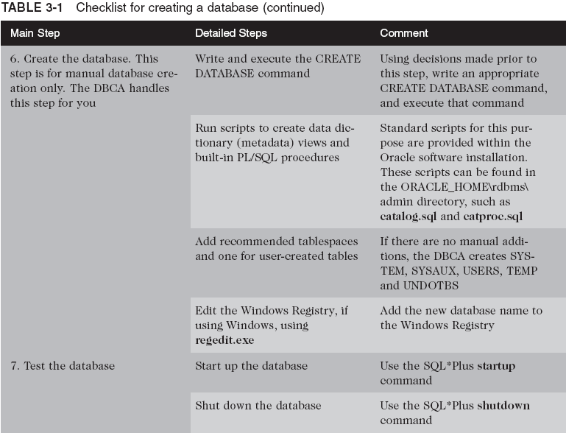
Steps for Creating a DB (continued)

Slide 7
Overview of Prerequisites for Creating a Database
Creating a database is a separate process that occurs after DB software has been installed
Prerequisites:
  Oracle software must be installed on the computer
    SW may reside on a different machine than the database
  You must be able to log on as a user with installation privileges and with the correct set of environmental variables in place
  The machine must have enough memory and disk space to install and start the database

Slide 8
Overview of Prerequisites for Creating a Database (continued)
Requirements to install Oracle 10g Enterprise Edition on Windows 2000:
  RAM: 512 MBs minimum, 1024 MBs recommended
  Virtual memory: double-up the amount of RAM
  Temp space: 100 MBs
  Storage space: ORACLE_HOME drive for Oracle binary files (system drive) of at least 100 MBs
  Start database size: At least 800 MBs
  Total space: at least 1.5 GBs recommended in total
  Video adapter: greater than 256 colors
  Processor speed: greater than 450 Mhz

Slide 9
Choosing Configuration
Important configuration tasks:
  Choose a database type
    Transactional, data warehouse, or hybrid
  How should the database be managed?
    OEM Grid Control or OEM Database Control
  Decide on the DBA authentication method
  Select a storage mechanism
    OS, ASM, or raw devices
  Decide on the file management method
    Specified or set using OMF
  Set the initial parameters (init.ora)

Slide 10
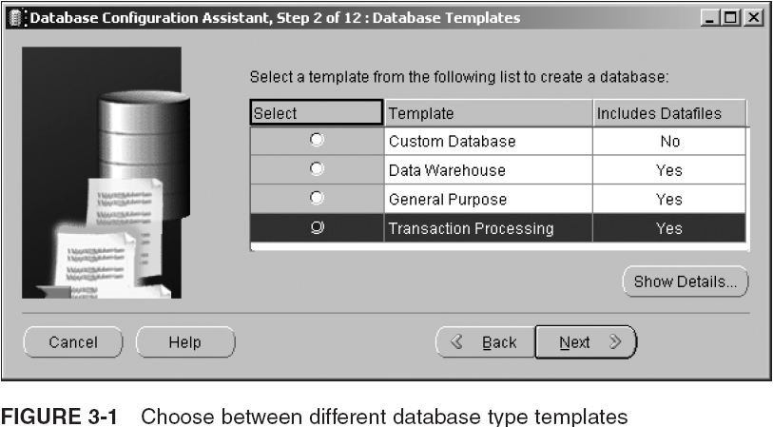
Database Type

Slide 11
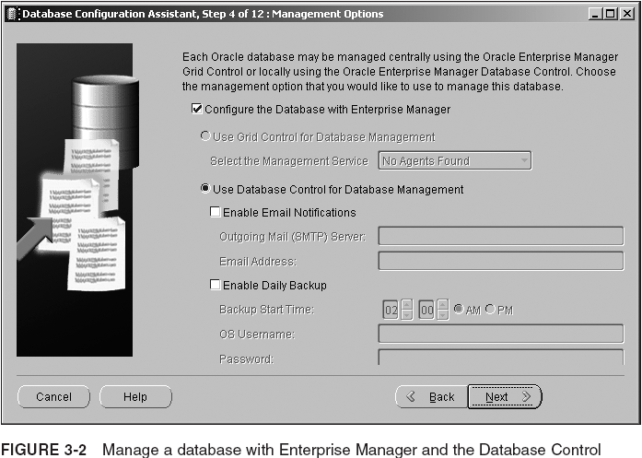
Database Management Tool

Slide 12
DBA Authentication Methods
The DBA authentication method encompasses the method used to validate logon of users with the SYSDBA or SYSOPER role
  SYSDBA: ADMIN role and can CREATE DATABASE
  SYSOPER: has system privileges to start up, shut down, and back up the database, and modify database components
Two authentication methods:
  OS authentication
  Password file authentication

Slide 13
Operating System (OS) Authentication
User logs without specifying user name/password
To set up OS authentication, follow these steps:
  Create OS user for the DBA
  Unix only: Create an OSDBA group
  Optional: Create an OSOPER group
  Set the initialization parameter REMOTE_LOGIN_PASSWORDFILE to NONE
  Assign OS user to OSDBA or OSOPER group
  Create Oracle user in DB with same name
To log on to SQL*Plus using OS authentication:
  sqlplus /nolog
  CONNECT /@ORACLASS AS SYSDBA

Slide 14
Password File Authentication
Encrypted file contains user names and passwords
To set up password file authentication:
  Create a new password file (orapwd)
    Windows: PWD<sid>.ORA, in ORACLE_HOME\database
    Unix: orapw<sid>.ora, typically in ORACLE_HOME/dbs
  REMOTE_LOGIN_PASSWORD FILE = EXCLUSIVE
  Log on to DB with SYSDBA privileges
  Create the new DBA user name if needed
  Grant SYSDBA or SYSOPER privilege to user

Slide 15
Password File Authentication (continued)
You can log on to the database with SYSDBA or SYSOPER roles in Enterprise Manager as well as in SQL*Plus

Slide 16
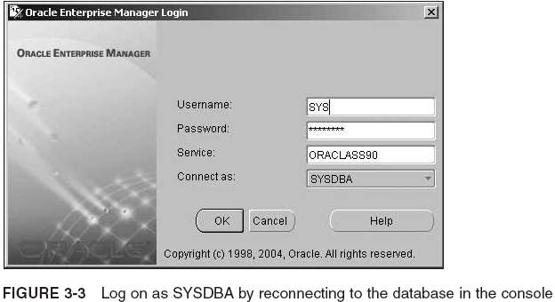
Password File Authentication (continued)

Slide 17
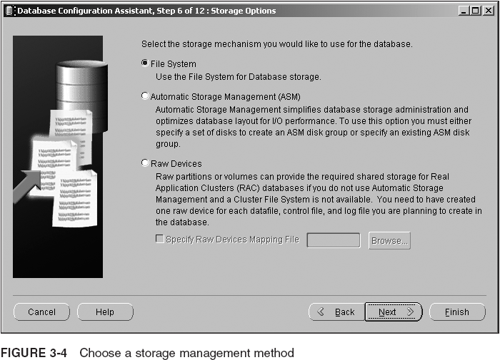
Storage Management Methods

Slide 18
File Management Methods
The two primary tasks in file management are:
  Location of files
    Oracle recommends that you multiplex control files
  Addition, expansion, and deletion of files
    Storage requirements grow and shrink according to the activity in the database
There are two basic file management methods available for a new database
  User-managed
  Oracle Managed Files

Slide 19
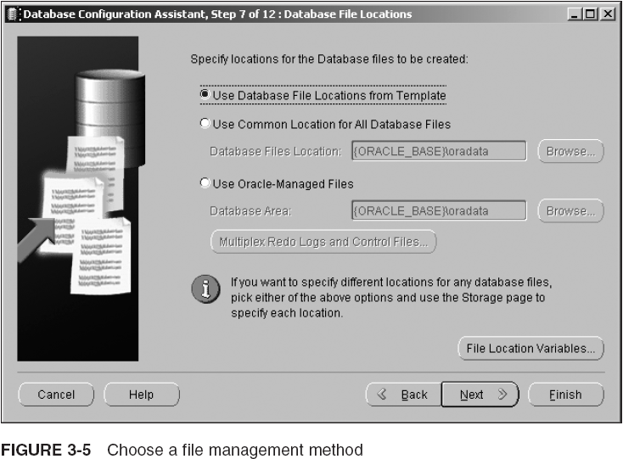
File Management Methods (continued)

Slide 20
User-Managed File Management
A good reason for using the user-managed method of file management is to continue with a customized file management standard that was in place for earlier versions of the database
  Advantage: administrator has total control
  Disadvantage: many tasks involve manual intervention
To implement user-managed redo log files, use the LOGFILES clause in CREATE DATABASE
Omitting a fully qualified DATAFILE clause in CREATE DATABASE causes Oracle 10g to create OMFs as the datafiles for the SYSTEM tablespace

Slide 21
Oracle Managed Files
OMF automates most menial file management tasks, leaving more important decisions to DBA
  File creation/expansion/deletion as DB size changes
Advantages:
  Adherence to OFA naming standards
  Automatic removal of dependent datafiles when a tablespace is dropped
  Simplified syntax for CREATE DATABASE
  Automated expansion and addition of datafiles as storage requirements change

Slide 22
Oracle Managed Files (continued)
Main disadvantage: inability to control exact size and name of datafiles, control files, and log files
You can create some files as user-managed files and leave others as OMF in the same database
Specify values in these initialization parameters:
  DB_CREATE_FILE_DEST = D:\oracle\product\10.2.0
  DB_CREATE_ONLINE_LOG_DEST_1 = D:\oracle\product\10.2.0
  DB_CREATE_ONLINE_LOG_DEST_2 = E:\oracle\product\10.2.0
  The directories must already exist
  On CREATE DATABASE, omit the parameters for control file, redo log file, and SYSTEM tablespace datafiles
Names comply with OFA

Slide 23
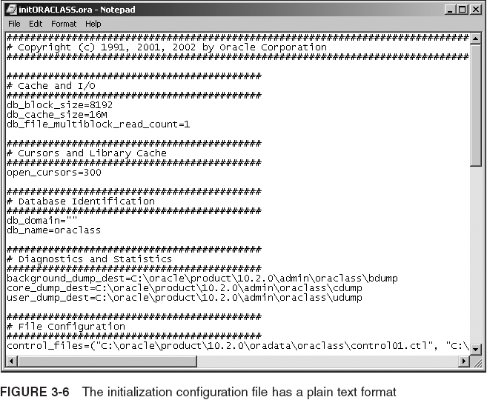
Set the Initialization Parameters

Slide 24
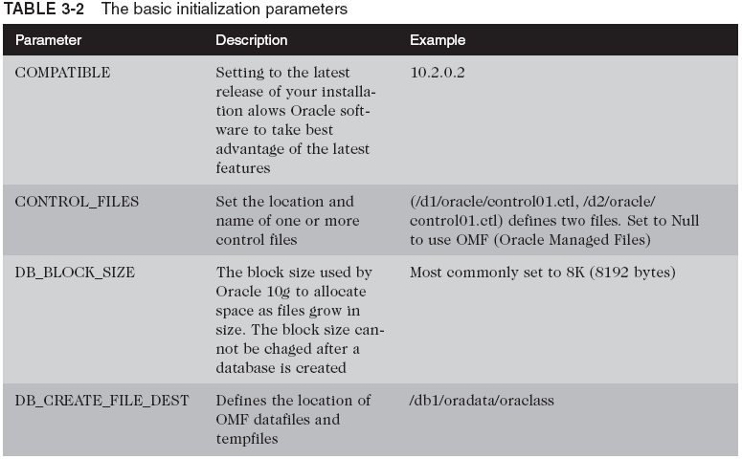
Set the Initialization Parameters (continued)

Slide 25
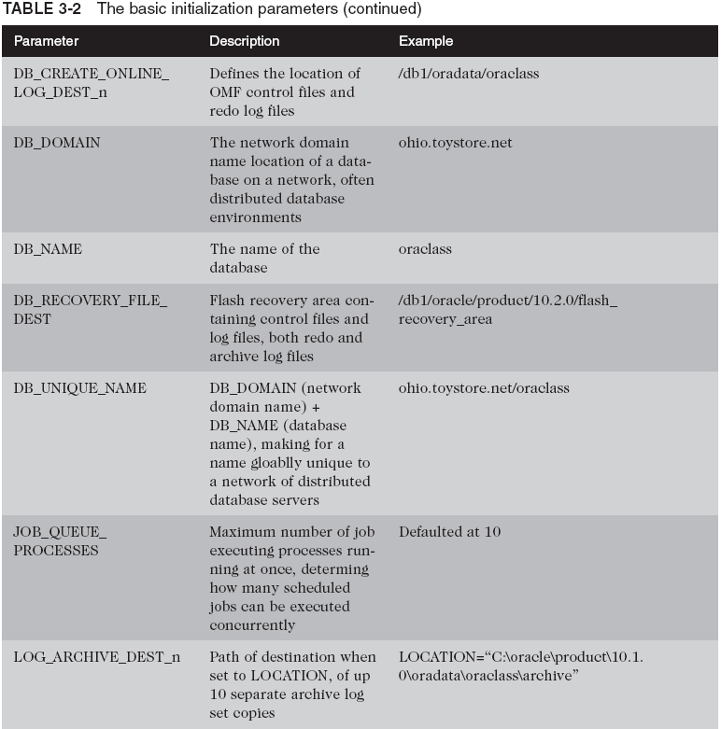
Set the Initialization Parameters (continued)

Slide 26
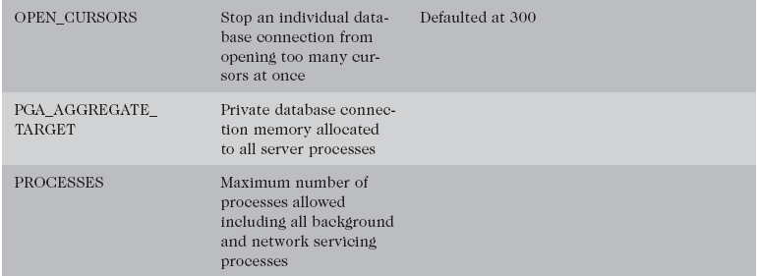
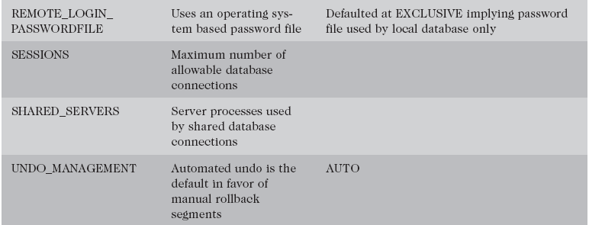
Set the Initialization Parameters (continued)

Slide 27
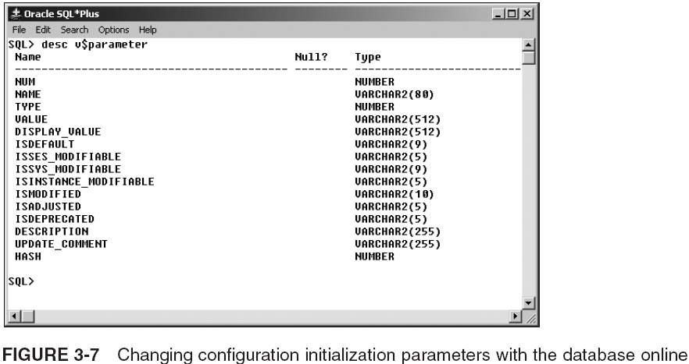
Set the Initialization Parameters (continued)

Slide 28
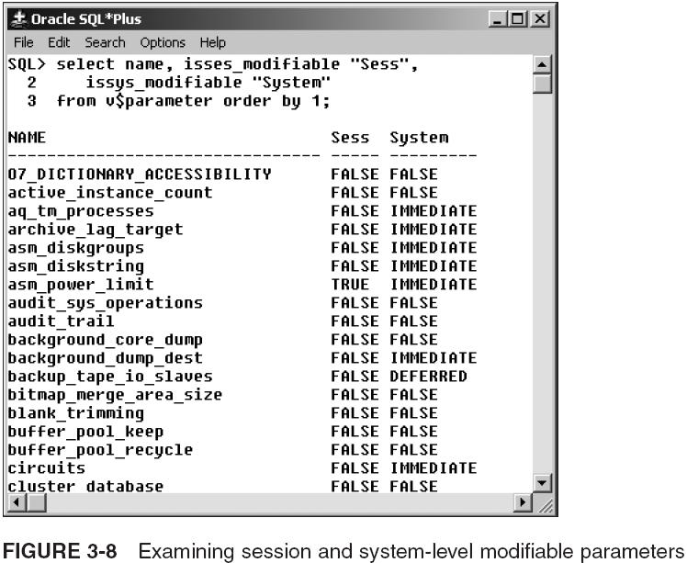
Set the Initialization Parameters (continued)

Slide 29
Creating a Database
To create a database you can use:
  Database Configuration Assistant (DBCA tool)
  CREATE DATABASE command
You can use the DBCA tool to generate scripts for creating a database manually
  You can use these scripts if you have multiple consistent databases to create at different sites
CREATE DATABASE gives you greater flexibility but unnecessary complexity with settings
  You do need to be familiar with its syntax

Slide 30
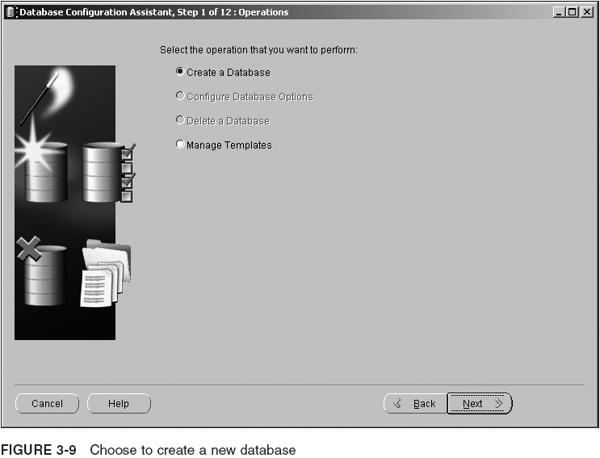
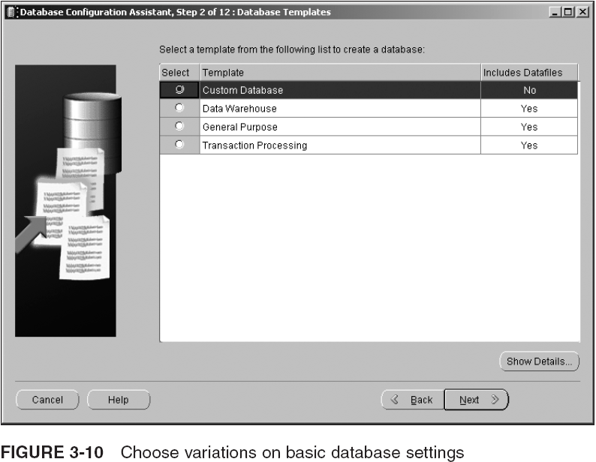
Create a New Database Using the Database Configuration Assistant

Slide 31
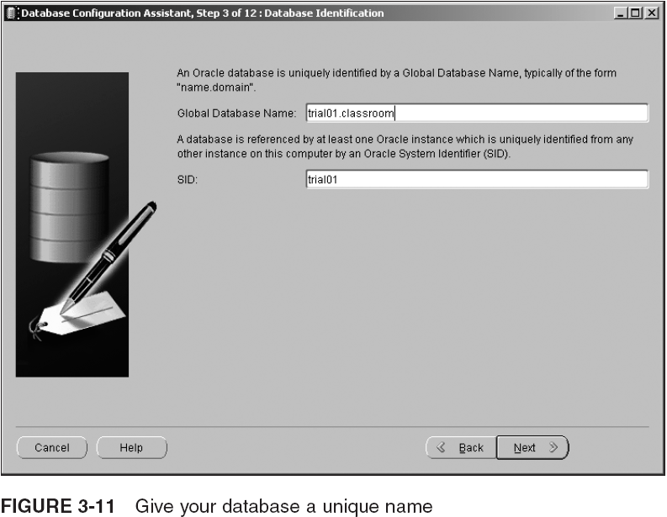
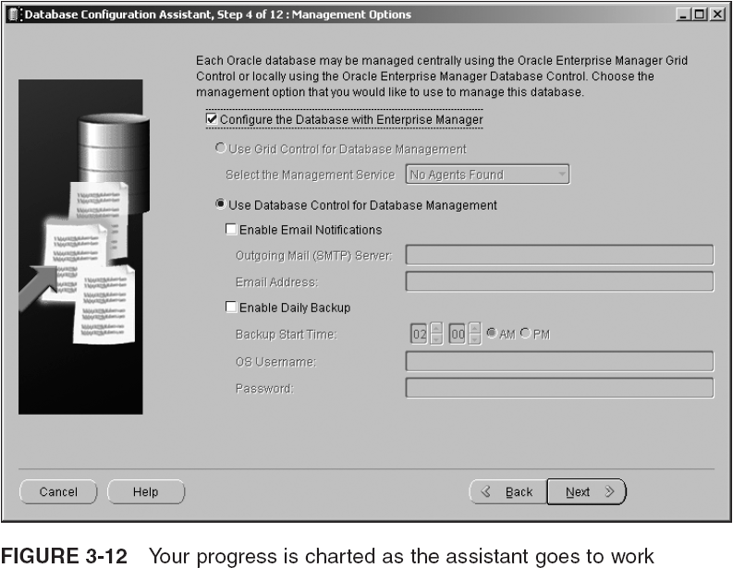
Create a New Database Using the DCBA Tool (continued)

Slide 32
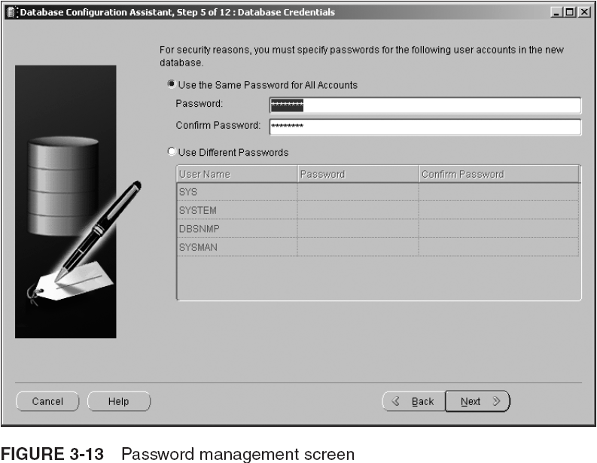
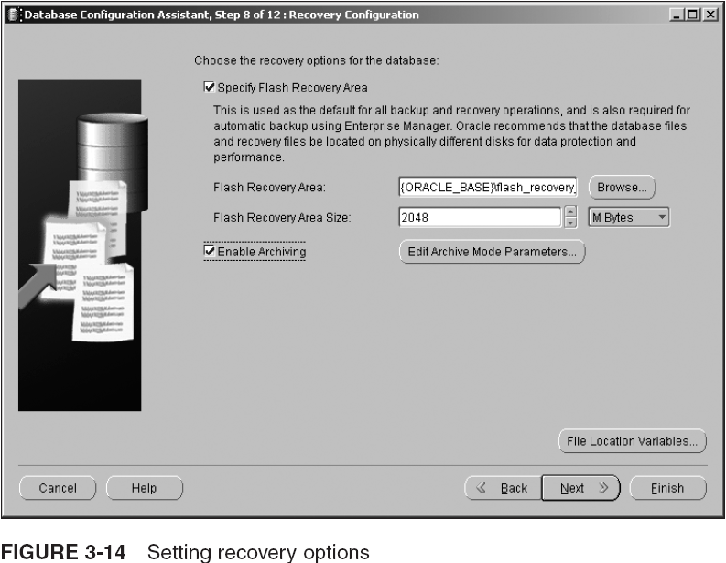
Create a New Database Using the DCBA Tool (continued)

Slide 33
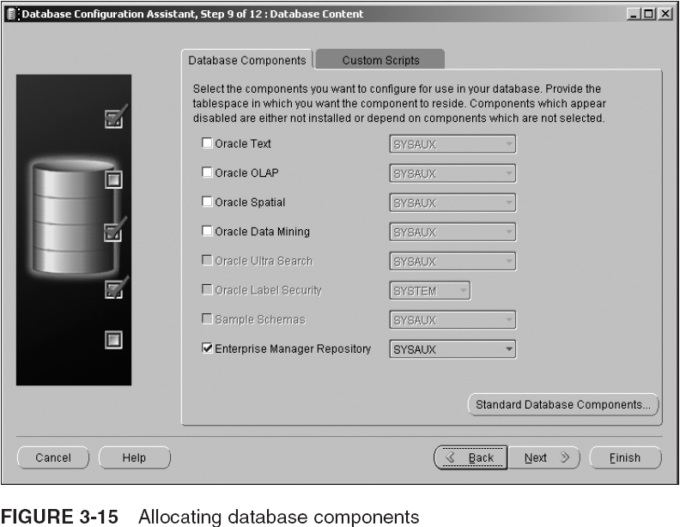
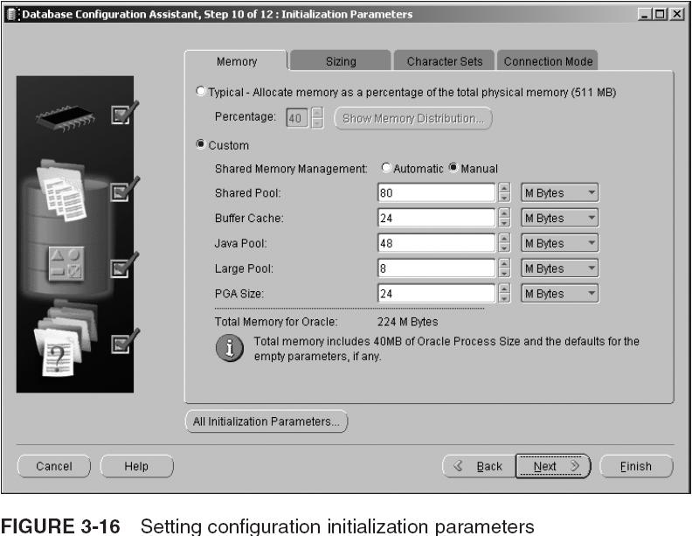
Create a New Database Using the DCBA Tool (continued)

Slide 34
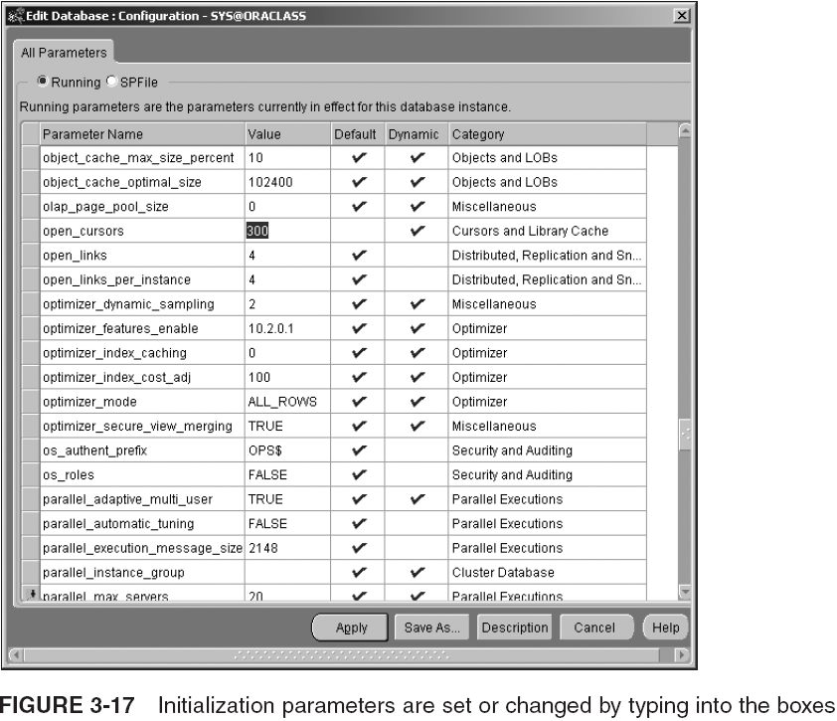
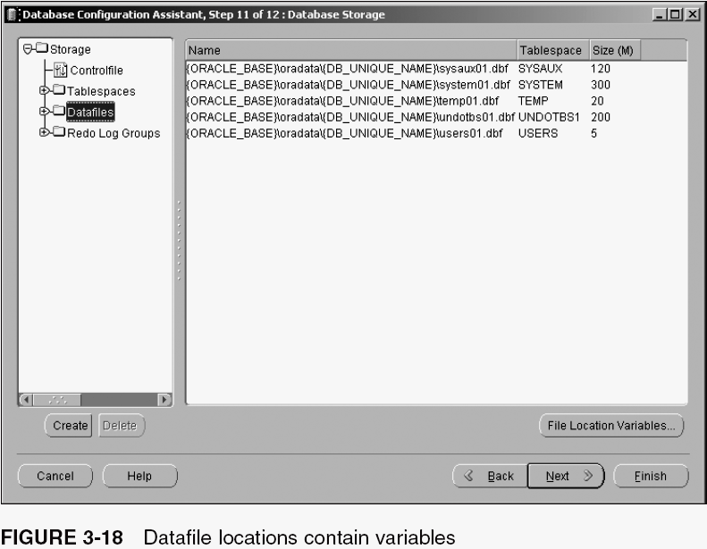
Create a New Database Using the DCBA Tool (continued)

Slide 35
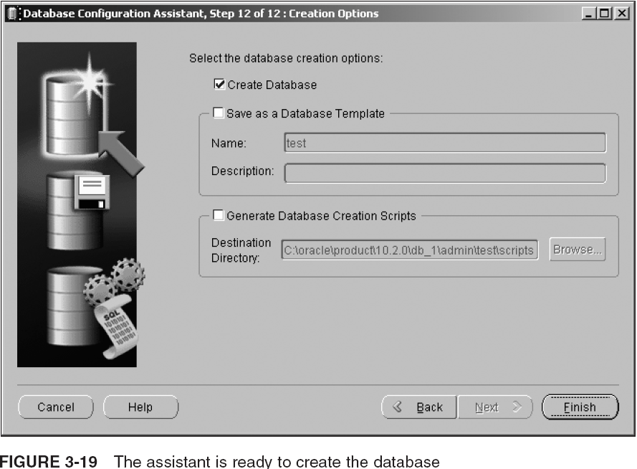
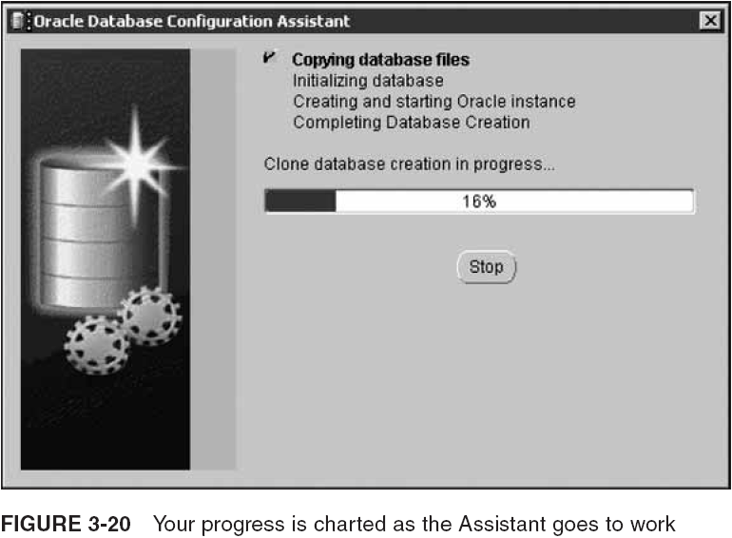
Create a New Database Using the DCBA Tool (continued)

Slide 36
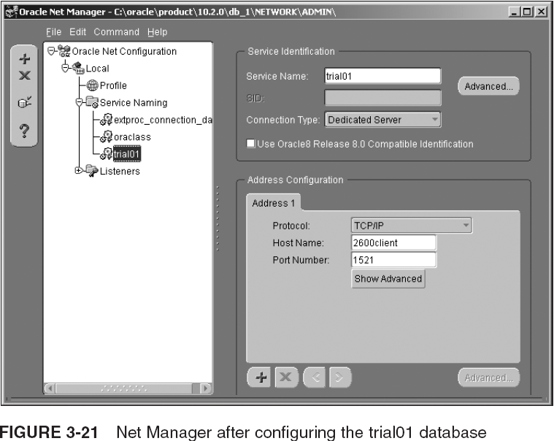
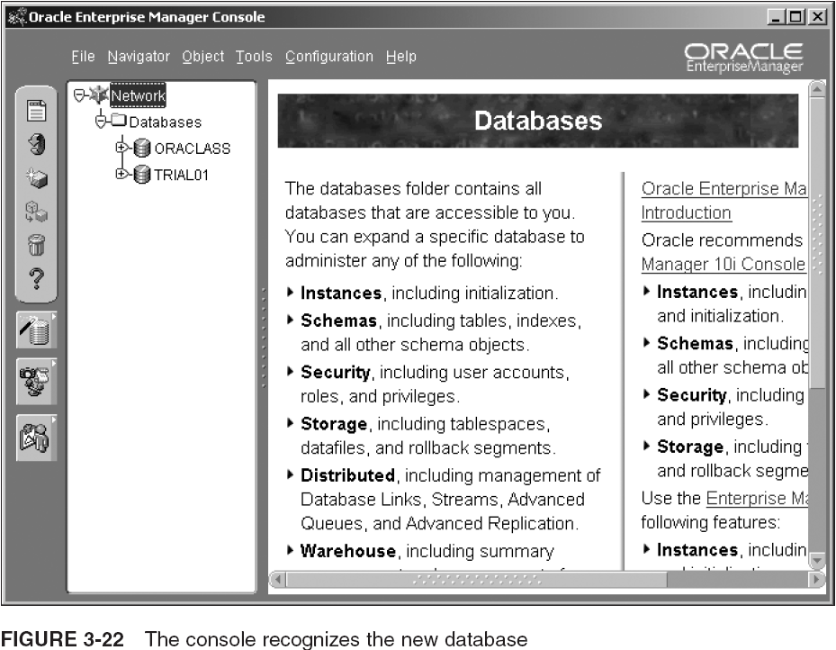
Connecting to a New Database

Slide 37
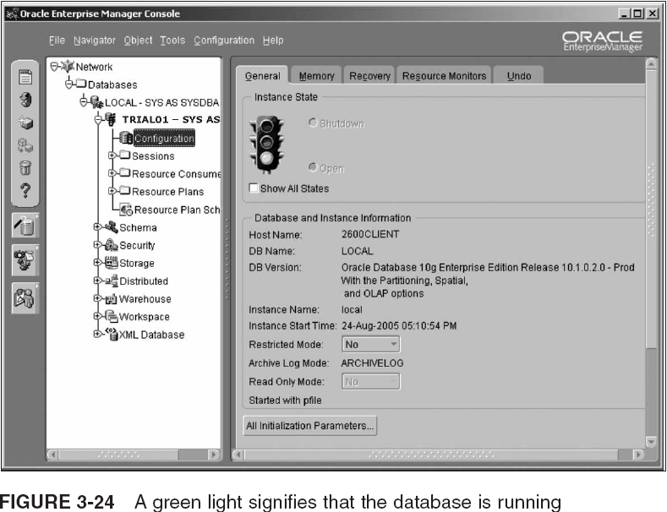
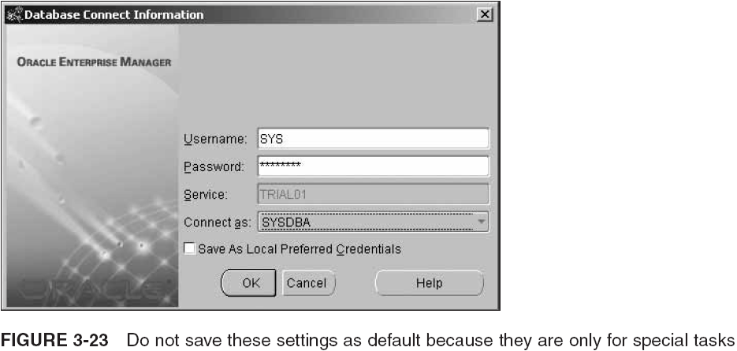
Connecting to a New Database (continued)

Slide 38
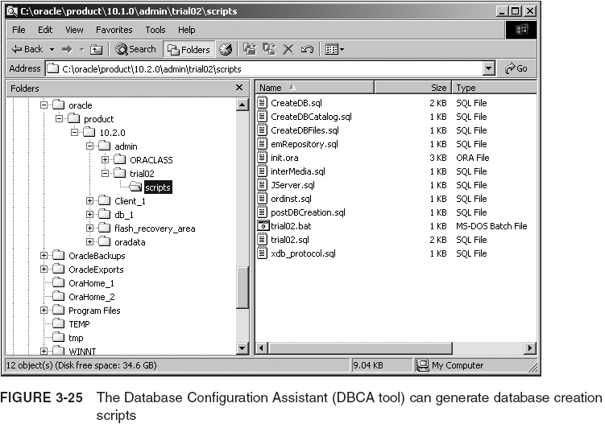
Creating a Database Manually

Slide 39
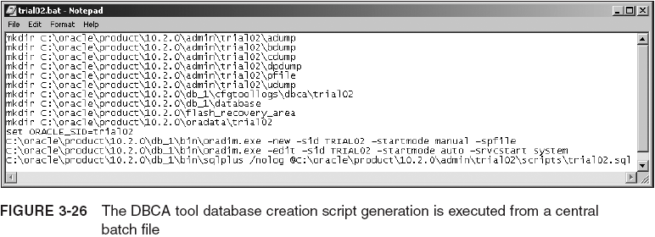
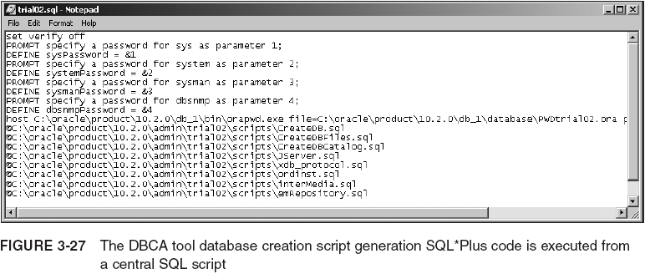
Creating a Database Manually (continued)

Slide 40
Creating a Database Manually (continued)
CREATE DATABASE "trial02"
MAXINSTANCES 8
MAXLOGHISTORY 1
MAXLOGFILES 16
MAXLOGMEMBERS 3
MAXDATAFILES 100
DATAFILE 'ORACLE_BASE\oradata\trial02\system01.dbf' SIZE 300M REUSE
AUTOEXTEND ON NEXT 10240K MAXSIZE UNLIMITED
EXTENT MANAGEMENT LOCAL
SYSAUX DATAFILE 'ORACLE_BASE\oradata\trial02\sysaux01.dbf' SIZE 120M
REUSE
AUTOEXTEND ON NEXT 10240K MAXSIZE UNLIMITED
DEFAULT TEMPORARY TABLESPACE TEMP TEMPFILE
'ORACLE_BASE\oradata\trial02\temp01.dbf' SIZE 20M REUSE
AUTOEXTEND ON NEXT 640K MAXSIZE UNLIMITED
UNDO TABLESPACE "UNDOTBS1" DATAFILE
'ORACLE_BASE\oradata\trial02\undotbs01.dbf' SIZE 200M REUSE
AUTOEXTEND ON NEXT 5120K MAXSIZE UNLIMITED
CHARACTER SET WE8MSWIN1252
NATIONAL CHARACTER SET AL16UTF16
LOGFILE GROUP 1 ('ORACLE_BASE\oradata\trial02\redo01.log') SIZE 10240K,
GROUP 2 ('ORACLE_BASE\oradata\trial02\redo02.log') SIZE 10240K,
GROUP 3 ('ORACLE_BASE\oradata\trial02\redo03.log') SIZE 10240K
USER SYS IDENTIFIED BY "&&sysPassword"
USER SYSTEM IDENTIFIED BY "&&systemPassword"
;

Slide 41
Creating a Database Manually (continued)
CREATE DATABASE is simple when using OMF
  DB_FILE_DEST tells where to locate datafiles
  DB_ONLINE_LOGFILE_DEST_n tells where to place control and redo log files
  If you omit these parameters from init<sid>.ora, you can still use OMF, placing files in a default directory
    To invoke OMF, omit all of the filenames and locations in CREATE DATABASE
      CREATE DATABASE testOFM
      MAXINSTANCES 1
      CHARACTER SET WE8MSWIN1252
      NATIONAL CHARACTER SET AL16UTF16;
To execute the scripts, execute the batch file created in ORACLE_BASE/admin/trial02/scripts

Slide 42
Starting and Stopping the Instance and Database
To shut down a running database using SQL*Plus:
  Start a Command Prompt window (or shell)
  Start up SQL*Plus without logging: sqlplus /nolog
  Connect as SYS with SYSDBA
    CONNECT SYS/<password>@trial01 AS SYSDBA
  Type SHUTDOWN IMMEDIATE and press Enter
    Database closed.
    Database dismounted.
    ORACLE instance shut down.
There are four options for SHUTDOWN:
  NORMAL, TRANSACTIONAL, IMMEDIATE, ABORT

Slide 43
Starting and Stopping the Instance and Database (continued)
To start DB, change step 4 in previous slide:
  STARTUP PFILE=ORACLE_BASE\admin\trial01\pfile\inittrial01.ora
  PFILE parameter needed if you have not created the SPFILE
STARTUP options:
  NOMOUNT, MOUNT, OPEN, PFILE

Slide 44
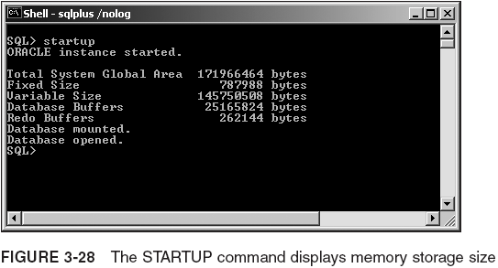
Starting and Stopping the Instance and Database (continued)

Slide 45
Managing Text and Binary (Server) Parameter Files
Starting up a DB using a PFILE requires an explicit sequence of commands, restarting DB as follows:
  SHUTDOWN;
  STARTUP MOUNT PFILE='C:\oracle\product\10.2.0
  0\admin\tria01\pfile\inittrial01.ora’;
  ALTER DATBASE OPEN;
The SPFILE can be used to create a PFILE or vice versa:
  CREATE PFILE='C:\oracle\product\10.2.0\admin\trial01\pfile\inittrial01.ora' FROM SPFILE='C:\oracle\product\10.2.0\db_1\database\spfiletrial01.ora';
  CREATE SPFILE='C:\oracle\product\10.2.0\db_1\database\spfiletrial01.ora' FROM PFILE='C:\oracle\product\10.2.0\admin\trial01\pfile\inittrial01.ora';

Slide 46
The Alert Log and Trace Files
The alert log is essential because it will contain all the essential information for the smooth running of your database
  All critical errors will be written to the alert log
Trace files contain more detailed log and tracing information about general processing
  Trace files can be used to track down problems not causing critical failures, generally using special tools
    E.g. , TKPROF

Slide 47
Expanding OFA Just a Little More
The OFA needs to be expanded from Chapter 1 to include other factors introduced in this chapter
  Chapter 1 described OFA as requiring a directory structure as follows:
      Admin/<database name>
      bdump
      cdump
      create
      pfile
      udump
      db_1
      client_1
      oradata/<database name>
      flash_recovery_area/<database name>

Slide 48
Summary
Installing the Oracle 10g database software is a separate process from that of creating a database
Databases can be created using the Database Configuration Assistant (DBCA tool) or manually using the CREATE DATABASE command
When creating a DB manually it is best to generate scripts using DBCA first, and then to edit them
The OS-specific installation guide describes minimum requirements for installing a new database
The DBA authentication method determines how Oracle 10g validates users logging on with SYSDBA or SYSOPER privileges

Slide 49
Summary (continued)
OS authentication relies on the OS’s security to validate the user/password, and authorization group
The REMOTE_LOGIN_PASSWORDFILE parameter is set to NONE for OS authentication
Password file authentication stores user names and passwords and group membership in an encrypted file in the OS
Set REMOTE_LOGIN_PASSWORDFILE to EXCLUSIVE for password file authentication
The ORAPWD utility generates the password file for SYSDBA and SYSOPER and then the database maintains it with changes to passwords

Slide 50
Summary (continued)
Control files can be multiplexed (each subsequent control file is an exact copy of the first control file)
  Multiplexed copies of control files should be located on different physical devices to guard against damage
Prevent bottlenecks in data access by placing data on several physical devices (spreads the demand)
Oracle Managed Files ease the DBA’s ongoing problem of monitoring and controlling the growth of datafiles
User-managed file management offers more detailed control over datafiles than Oracle Managed Files, but requires more manual maintenance tasks

Slide 51
Summary (continued)
The OMF method automates removal of dependent datafiles when a tablespace is dropped
OMF handles datafile creation, naming, and sizing
The parameter of DB_CREATE_FILE_DEST initialization sets the location of datafiles when using OMF
The DB_CREATE_ONLINE_LOG_DEST_ initialization parameters set the location of control files and redo log files when using OMF
OMF uses OFA as its file-naming standard

Slide 52
Summary (continued)
Initialization parameters are: basic and advanced
When using a binary parameter file, initialization parameters can be changed at the session level for the life of a database connection
The DBCA tool leads you through several steps to create a new database
  Types of database configurations, including Custom, Data Warehouse, Transaction Processing, and General Purpose
Dedicated Server mode does not work well for very large OLTP databases

Slide 53
Summary (continued)
DBCA provides an opportunity to customize memory size and initialization parameters
Adjusting of tablespace/datafile sizes and locations depends on the DB type selected using DBCA
After creating a new database, use Net Manager to set up a Net Service name for the database
To create a DB manually, first set up a directory structure for the files that are to be created
Create a password file to implement password file authentication when the new database is created

Slide 54
Summary (continued)
A DB service must be started if using Windows, but is not required if you are using Unix or Linux
CREATE DATABASE generates datafiles, control files, etc.
Manually created DBs should have tablespaces called SYSTEM for metadata, SYSAUX for Oracle add-on options, temporary storage, an undo tablespace, and a tablespace for other schemas
Manually created DBs should include minimum scripting generation options, as created by DBCA
To use SHUTDOWN in SQL*Plus, log in as SYSDBA

Slide 55
Summary (continued)
SHUTDOWN IMMEDIATE is faster than SHUTDOWN NORMAL
SHUTDOWN ABORT is used only when the database has errors and does not shut down with NORMAL, IMMEDIATE, or TRANSACTIONAL
A DB can be started up with a text or binary configuration initialization parameter file
  A binary file allows changing of most parameters with the database up and running
Alert log contains critical errors

