Slide 1

Oracle 10g Database Administrator: Implementation and Administration
Chapter 4
Oracle Physical Architecture and Data Dictionary Views

Slide 2
Objectives
Examine tablespaces and datafiles
Understand how the control file, datafiles, redo log files, and archive log files are linked
Examine advanced database architectures, including OMF, partitioning, replication, standby, and grids
Manage and multiplex control files
Use OMF to manage control files

Slide 3
Objectives (continued)
Create new control files
View control file data
Learn to describe redo log files, groups, and members
Manage redo log groups and members
List useful dynamic performance views

Slide 4
Tablespaces and Datafiles
Datafiles: physical files stored in the underlying OS
Tablespaces: logical overlays of underlying datafiles, allowing access to data stored in datafiles
  SYSTEM
  SYSAUX
  UNDO
  TEMP
  USERS
A tablespace can contain multiple datafiles
  Datafiles can be stored on separate disk drives
  Multiple tablespaces cannot share the same datafile

Slide 5
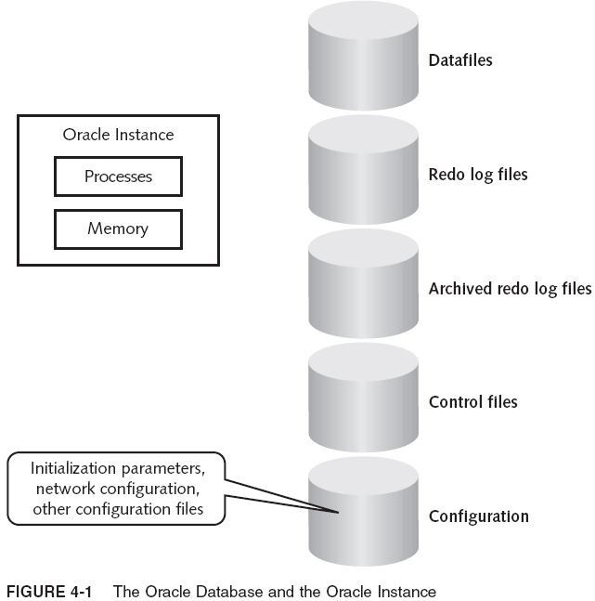
Tablespaces and Datafiles (continued)

Slide 6
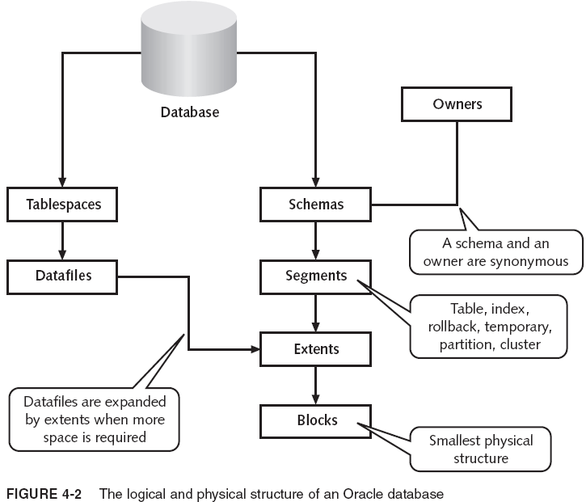
Tablespaces and Datafiles (continued)

Slide 7
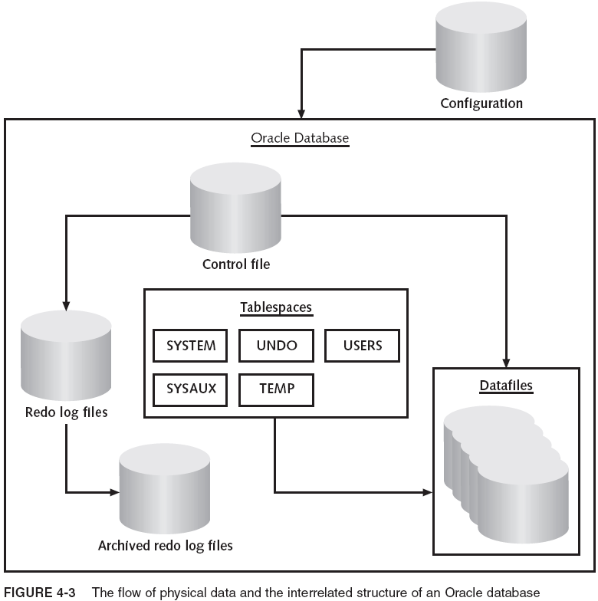
Tablespaces and Datafiles (continued)

Slide 8
Advanced Database Architectures
Oracle Managed Files (OMF)
Partitioning
Replication
Standby (Failover) Databases
Grid Computing, Oracle RAC, and ASM

Slide 9
Oracle Managed Files (OMF)
OMF allows automated creation and dropping of underlying datafiles, in addition to automated management of both redo log files and control files
OMF has been examined in detail in previous chapters

Slide 10
Partitioning
Individual tables and their associated indexes can be partitioned into separate physical chunks
  Pieces can be executed in parallel or individually
Can increase performance drastically in very large databases, for data warehouses and OLTP DBs
Partitioning can split tables in a number of ways:
  Range partitioning
  List partitioning
  Hash partitioning
  Composite partitioning

Slide 11
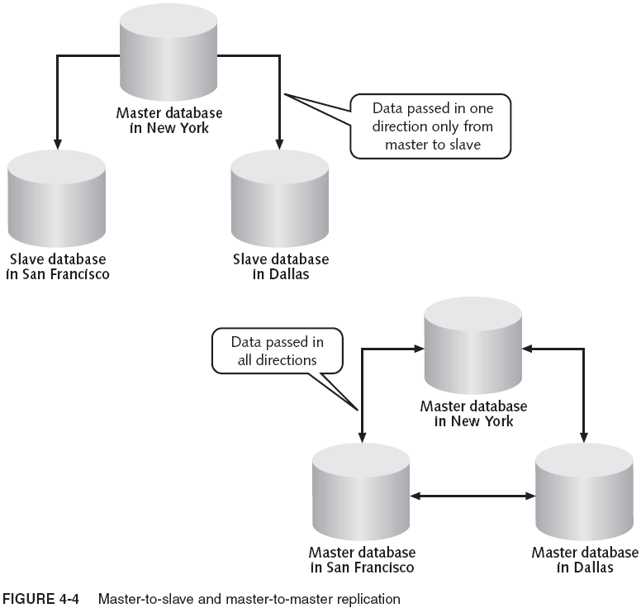
Replication
Oracle Replication has a level of complexity not suited to failover and backup management

Slide 12
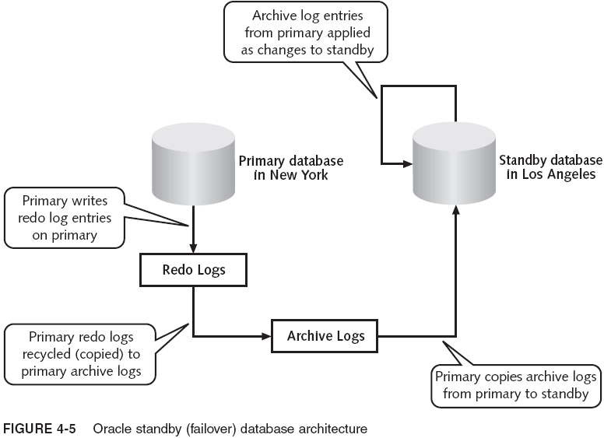
Standby (Failover) Databases

Slide 13
Grid Computing, Oracle RAC and ASM
Grid made of large number of simplistic servers
Oracle features for a grid computing architecture:
  Oracle Real Application Clusters (RAC)
  Automated Storage Management (ASM)
  Oracle Transportable Tablespaces
  Oracle Streams
  Oracle Scheduler
  Oracle Enterprise Manager Grid Control
Objective of grid computing: high performance, high scalability, automated resource allocation, information sharing, distribution, effective security

Slide 14
The Control File
An Oracle DB consists of physical/logical structures
  Physical structures: datafiles and redo logs
  Logical structures: objects overlaying the datafile structures (tablespaces, tables, and indexes)
Control file contains the pointers between datafiles and the redo log, linking them together
  Has current information on DB structure, log files, checkpoints
  Critical for opening DB
  A redo log entry is stamped with SCN
    Used to restore a datafile from an old datafile

Slide 15
The Control File (continued)
Control file contains this information about the DB:
  The database name
  Names and locations of associated datafiles and online redo log files
  The timestamp of the database creation
  The current log sequence number
  Checkpoint information
If control file is damaged, DB can’t be opened until control file is restored, recovered, or recreated
  Oracle recommends multiplexing the control file

Slide 16
Managing and Multiplexing the Control Files
You should multiplex the control file to ensure against total loss of the file
  You can create up to eight copies of the control file
After that, the control file is self-managing unless you make any of these types of changes to the DB:
  Add a new control file
  Rename or relocate one or more control files
  Replace a damaged control file
It is always a good idea to make a backup of your control files before you begin changing them

Slide 17
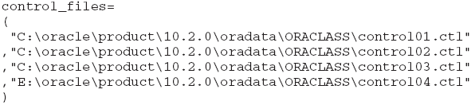
Adding a New Control File
Shut down the ORACLASS DB using SQL*Plus
Copy CONTROL1.CTL and rename copy
Open init.ora (or initORACLASS.ora) for editing
  Change CONTROL_FILES parameter in the DB’s initialization parameter file by adding the new control file’s name to the list of control files
Save the file and close Notepad
Restart DB (mounted mode), with PFILE parameter
Files are
multiplexed

Slide 18
Renaming or Relocating an Existing Control File
To relocate an existing control file:
  Shut down ORACLASS
  Locate the control file (CONTROL04.CTL); rename it using Windows Explorer
  Open the init.ora (initORACLASS.ora) file for editing
  Change CONTROL_FILES in DB’s initialization parameter file to match the current control file name
  Save and close the file; restart the DB (mounted mode) with the PFILE parameter
Technically relocating is the same as renaming

Slide 19
Replacing a Damaged Control File
Fix problem by replacing control file with a copy
  Shut down ORACLASS
  Locate the control file and delete it
  Restart the database again using SQL*Plus
  Shut down ORACLASS
  Locate the control file named control01.ctl; copy it and paste it into the original directory; rename it to old file’s name
  Restart the database again using SQL*Plus

Slide 20
Using OMF to Manage Control Files
OMF handles names/locations of DB files
  DB_CREATE_FILE_DEST must be specified
    Specifies the location of OMF managed DB files
  DB_CREATE_ONLINE_LOG_DEST_n is optional
    Specifies is 1 to 5 locations
    Control files (multiplexed) and redo log files (duplexed) will be created in each of the directories specified
  CONTROL_FILES must be null
Set parameters before creating a database

Slide 21
Creating a New Control File
Reasons for creating a new control file
  All control files damaged or lost
  Changing the value of MAXDATAFILES, MAXLOGFILES, or MAXLOGMEMBERS
  Change the name of the database
Steps:
  Gather a list of all datafiles, including their full paths
  Gather list of redo log files, including paths and group number
  Build CREATE CONTROLFILE command; save it
  Start DB (NOMOUNT); run your CREATE CONTROLFILE command; start up DB

Slide 22

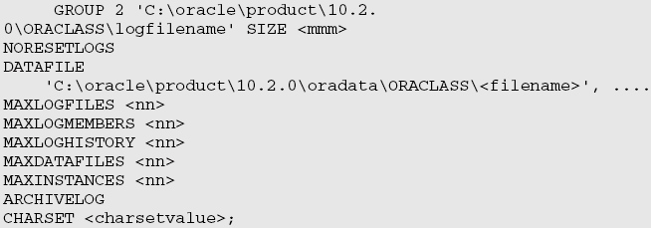
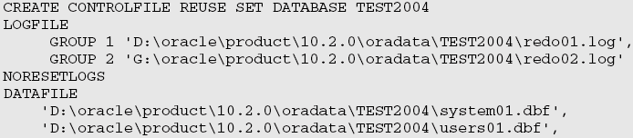
Creating a New Control File (continued)

Slide 23
Creating a New Control File (continued)
If the DB is still open, you can use the following:
  sqlplus system/<password>@<ORACLASS>
  ALTER DATABASE BACKUP CONTROLFILE TO TRACE;
Then, shut down DB, backup files, log off SQL*Plus

Slide 24
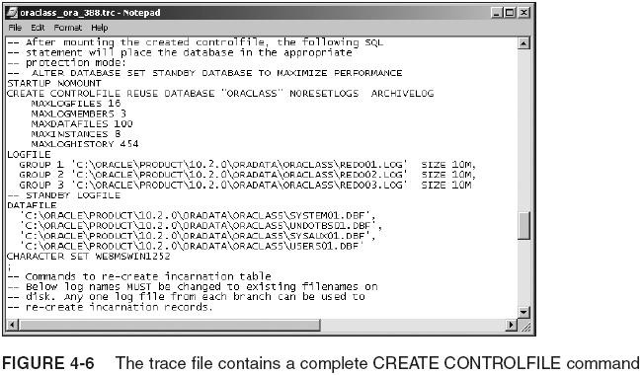
Creating a New Control File (continued)

Slide 25
Viewing Control File Data
The control file is made up of record sections
  Record sections are lists of information by categories within the control file
Use one of four dynamic performance views:
  V$CONTROLFILE
  V$CONTROLFILE_RECORD_SECTION
  V$PARAMETER
  V$DATABASE
Details contained in the record sections are spread out in many V$ dynamic performance views
  Table 4-1 shows a list of some of these views

Slide 26
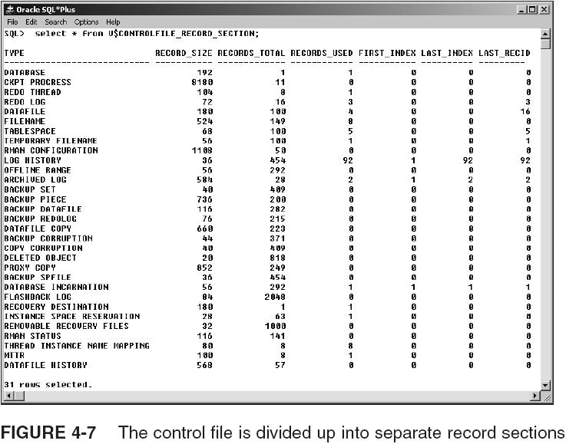
Viewing Control File Data (continued)

Slide 27
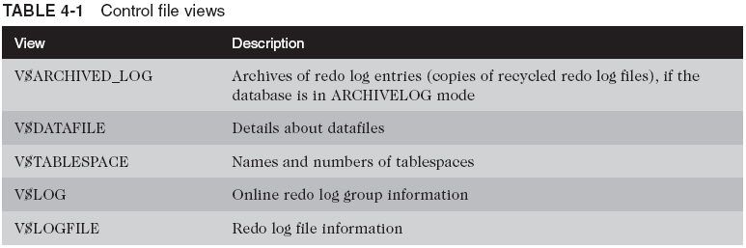
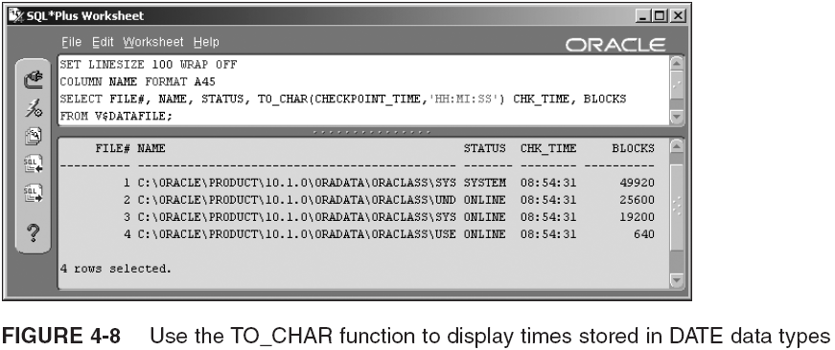
Viewing Control File Data (continued)

Slide 28
Online Redo Log Files and Archive Log Files
Redo log files record changes to database data
  Online redo log files are open and available whenever the database is up and running
  They capture details of DB transactions and information about changes to DB including:
    Checkpoints
    Changes
      Data Manipulation Language (DML)
      Data Definition Language (DDL)
    Datafile changes
A database should have at least three redo log groups containing at least one file each
Recommended; only two are required

Slide 29
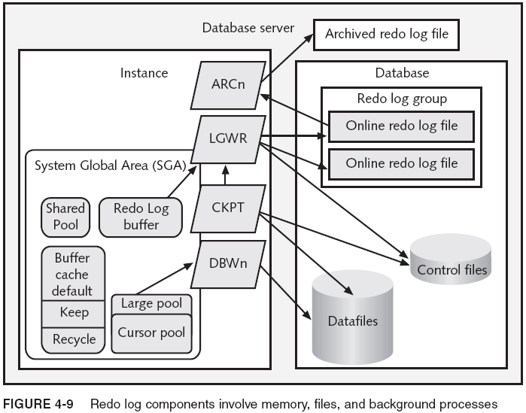
Online Redo Log Files and Archive Log Files (continued)

Slide 30
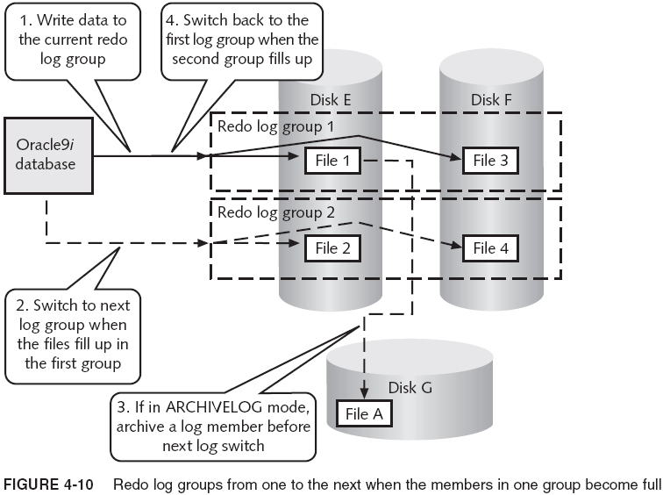
Online Redo Log Files and Archive Log Files (continued)

Slide 31
The Purpose of Redo Log Files
Purpose: aid in database recovery
  Redo log files keep list of DB changes
  If DB loses changes, recovery process restores them
  Redo log files receive the change information before the datafiles are updated
  In minor failures (e.g., short power outage), redo log files are automatically checked during DB startup, and data is restored, from redo log files into datafiles
  In major failures (e.g., loss of an entire disk), data would not be saved from the online redo logs alone
    You need a full DB backup and archived redo log files that begin after the date of the backup

Slide 32
The Structure of Redo Log Files
Redo log files store info as a result of DB activity
  Information is recorded in the redo log buffer in SGA
Contents of redo log buffer are written by LGWR process, to online redo log file, when:
  A transaction issues a COMMIT command
  Redo log buffer is one-third full
  Every 3 seconds
  A checkpoint occurs
The redo log file contains sets of redo records
  A redo record (or redo entry) is made up of a related group of change vectors that record a description of the changes to a single block in the DB
  A single transaction may generate many redo entries

Slide 33
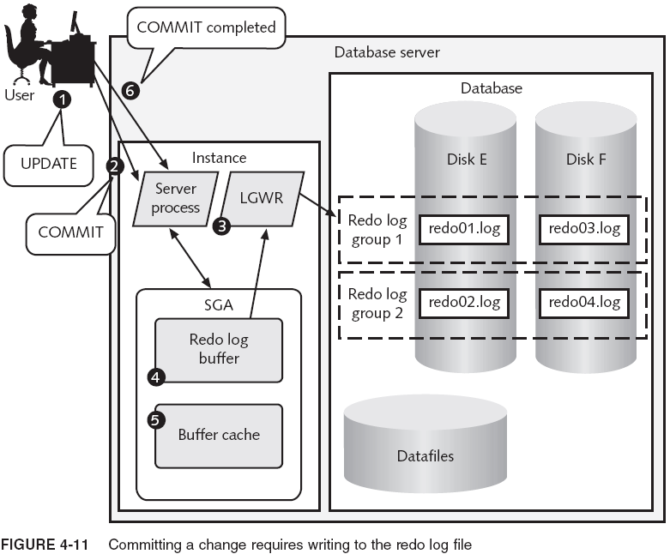
Introducing Redo Log File Management

Slide 34
Log Switches and Checkpoints
Log switch: LGWR process stops writing to a log group and begins writing to another log group
  Triggered when a log group fills up with records
  You may need to manually trigger a log switch; do this to perform maintenance on active log group
    Start up the Enterprise Manager console
    Start up the SQL*Plus Worksheet
    Connect as the SYS user
    Execute: ALTER SYSTEM SWITCH LOGFILE;
    The system displays “System altered”
A log switch triggers a checkpoint
  Checkpoints help in database recovery

Slide 35
Duplexing and Other Maintenance
Duplexing redo logs: maintaining multiple copies of a redo log file to reduce potential risk of loss
  Simply add new file members to each group
    Files in group must be the same size
  LGWR writes concurrently to redo log files in a group
    It never writes to two redo log groups at a time
    If one or more redo log files are damaged within a redo log group, it writes to the remaining file(s)
    If all files in group are damaged, it stops DB operations until a successful log switch
    If log switch is writing to a pending group, it waits until group is archived (before switch)
    If log switch fails, DB shuts down and must be recovered after restoring redo logs

Slide 36
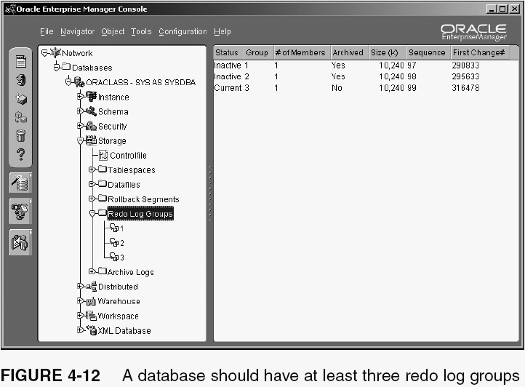
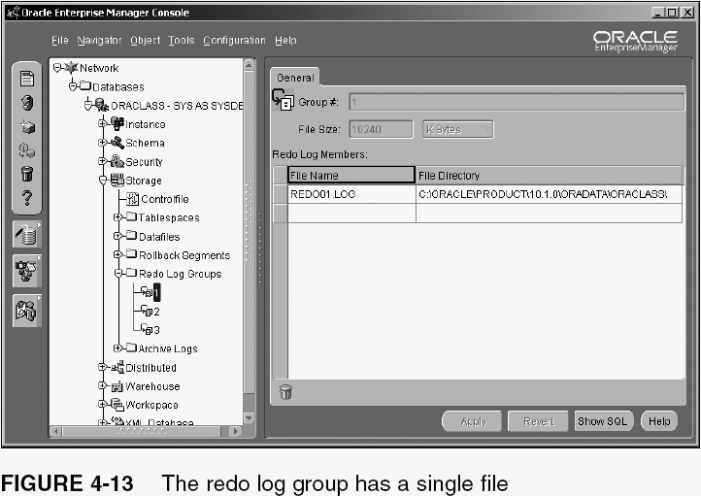
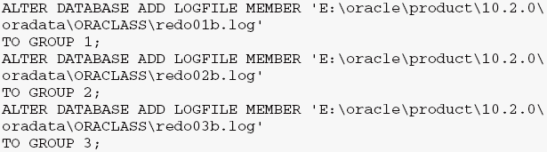
Adding a Member to a Group

Slide 37
Adding a New Group
Imagine the alert log has warning messages stating that LGWR has to wait for the ARCn process
  There can be up to 10 archiver processes
Suppose a warning is detected several times a day
  To correct problem, create a redo log group so that the archive process has some lead-time to archive the inactive group
    ALTER DATABASE
    ADD LOGFILE GROUP 4('C:\oracle\product\10.2.
    0\oradata\ORACLASS\redo04.log',
    'E:\oracle\product\10.2.0\oradata\ORACLASS\redo04b.
    log') SIZE 20M;

Slide 38
Renaming or Moving a Redo Log File
Examples:
  Move a member of a redo log group to another drive
  Rename a redo log file to match naming standards
Steps:
  Execute: SHUTDOWN IMMEDIATE
  Locate the two members of the new redo log group; rename each file to match a new naming pattern
  Execute: STARTUP MOUNT
  Alert Oracle 10g of the renamed files:
    ALTER DATABASE
    RENAME FILE 'C:\oracle\product\10.2.0\oradata\ORACLASS\REDO04.LOG',
    'C:\oracle\product\10.2.0\oradata\ORACLASS\REDO04b.LOG'
    TO 'C:\oracle\product\10.2.0\oradata\ORACLASS\REDO_GR4_M0.LOG',
    'E:\oracle\product\10.2.0\oradata\ORACLASS\REDO_GR4_Mb.LOG';
  Execute: ALTER DATABASE OPEN;

Slide 39
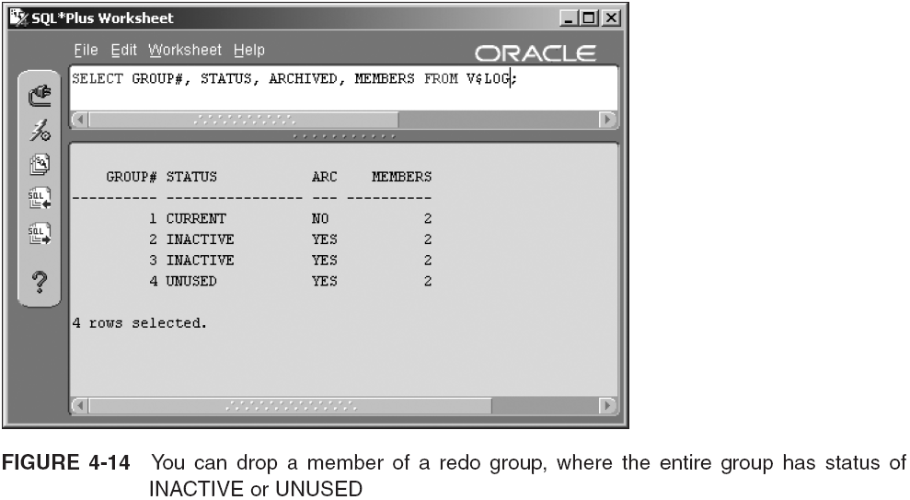
Dropping Redo Log Members or Groups
If DB is in ARCHIVELOG mode, the group must also have been archived

Slide 40
Dropping Redo Log Members or Groups (continued)
Steps:
  Determine status of redo log group (see Figure 4-14)
  Drop redo file from group:
    ALTER DATABASE DROP LOGFILE MEMBER
    'E:\oracle\product\10.2.0\oradata\ORACLASS\REDO_GR4_Mb.LOG';
  You may need to use OS to delete file (unless OMF)
  Drop group: ALTER DATABASE DROP LOGFILE GROUP 4;
  Use your OS to delete remaining file in group
  Force a log switch: ALTER SYSTEM SWITCH LOGFILE;
Transactions with dirty buffers have redo records in group, even though a log switch has occurred
  To flush outstanding records from buffer (change status to INACTIVE): ALTER SYSTEM CHECKPOINT;

Slide 41
Archiving a Redo Log Group
DB in ARCHIVELOG mode auto-archives redo logs
  To see the archive mode status: ARCHIVE LOG LIST;
To put the database into ARCHIVELOG mode:
  Shut down the DB; restart in mount mode
  Change DB to ARCHIVELOG mode:
    ALTER DATABASE ARCHIVELOG;
    ALTER DATABASE OPEN;
  Force an archive on CURRENT status redo logs:
    ALTER SYSTEM ARCHIVE LOG CURRENT;
  Generate archive logs: ALTER SYSTEM SWITCH LOGFILE;
  To archive non-current logs: ALTER SYSTEM ARCHIVE LOG ALL;

Slide 42
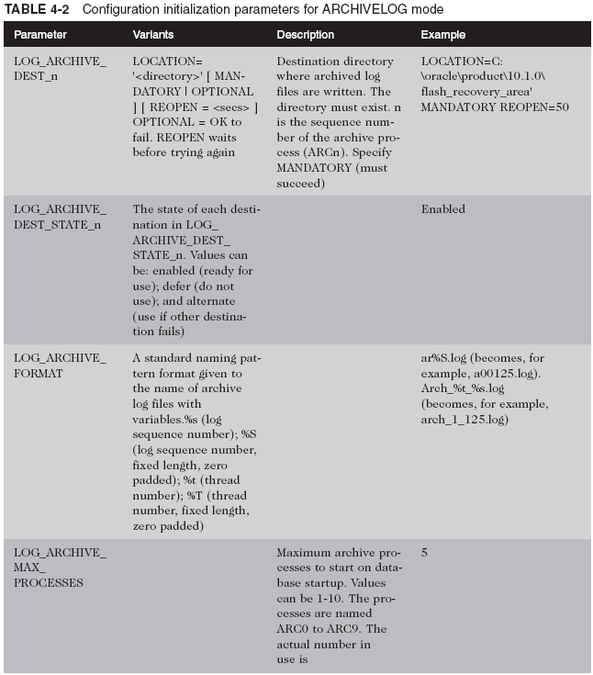
Archiving a Redo Log Group (continued)

Slide 43
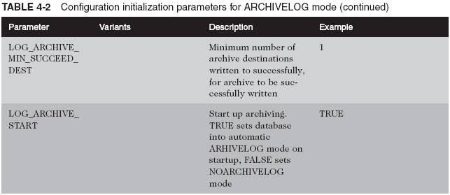
Archiving a Redo Log Group (continued)

Slide 44
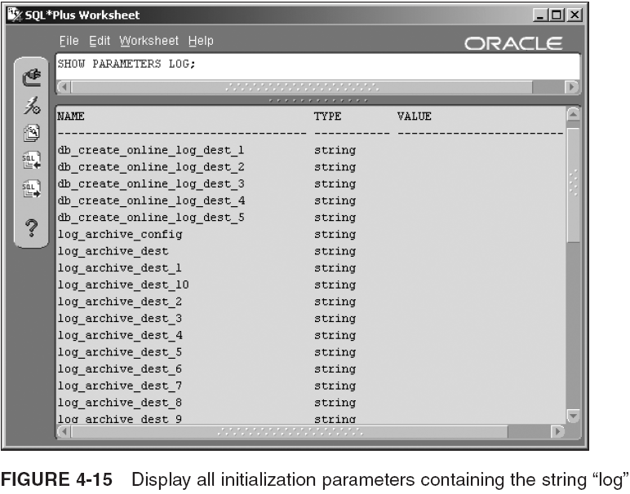
Archiving a Redo Log Group (continued)

Slide 45

Using OMF to Manage Online Redo Log Files
Appropriate initialization parameters must be set
  Same initialization parameters used for control files
    DB_CREATE_FILE_DEST to store files in single dir.
    DB_CREATE_ONLINE_LOG_DEST_n to spread control and redo log files into their own directories
Examples:
To add Oracle-managed log groups to OMF DBs:

Slide 46
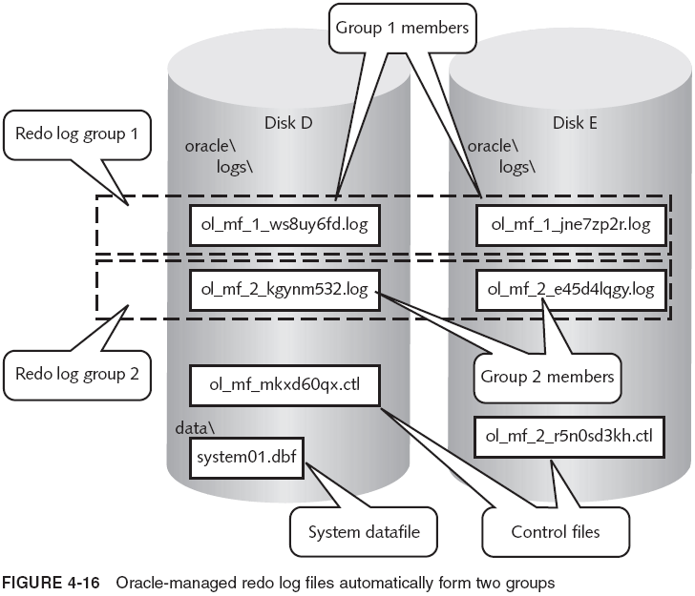
Using OMF to Manage Online Redo Log Files (continued)

Slide 47
Viewing Redo Log Information
Possible status: UNUSED, CURRENT, ACTIVE, CLEARING, CLEARING_CURRENT, INACTIVE

Slide 48
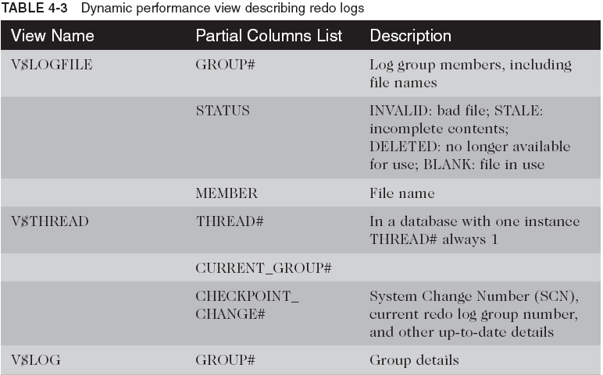
Viewing Redo Log Information (continued)

Slide 49
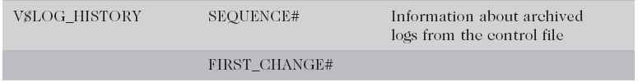
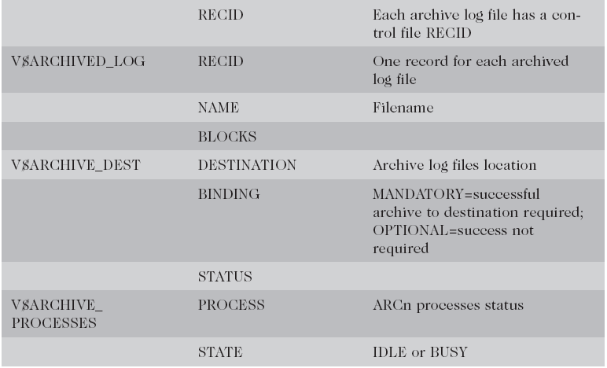
Viewing Redo Log Information (continued)

Slide 50
The Data Dictionary
Looking at Data Dictionary Components
Using Data Dictionary Views
Useful Dynamic Performance Views
Examining Table Structure Using SQL*Plus and iSQL*Plus

Slide 51
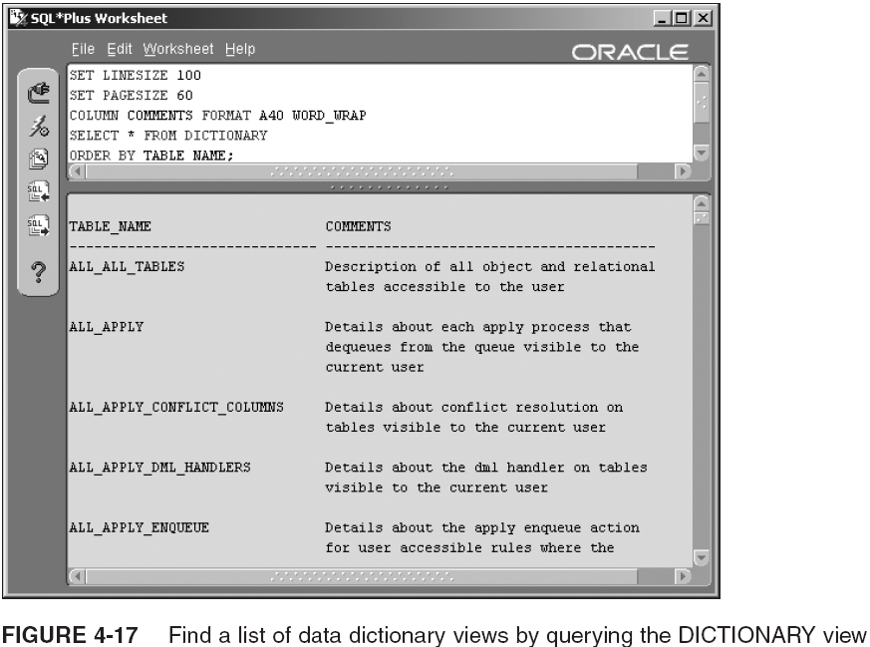
Looking at Data Dictionary Components

Slide 52
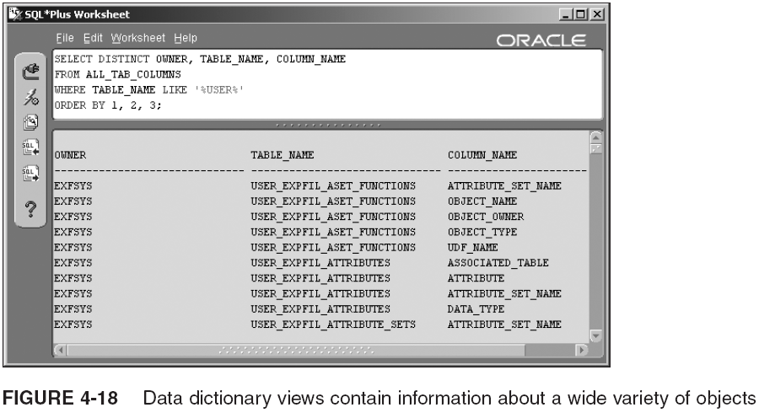
Looking at Data Dictionary Components (continued)

Slide 53
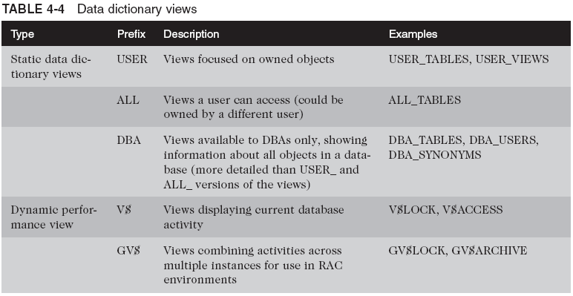
Looking at Data Dictionary Components (continued)

Slide 54

Looking at Data Dictionary Components (continued)
Generally, USER, ALL, and DBA views are in sets
  USER_TABLES, ALL_TABLES, DBA_TABLES
    Each view has nearly identical columns
      USER version omits OWNER column; it also sometimes omits columns to simplify the view
V$ and GV$ views are in sets
There are few views that don’t begin these prefixes
For simplicity, all views (except DBA ones) prefix public synonyms and public permission to query

Slide 55
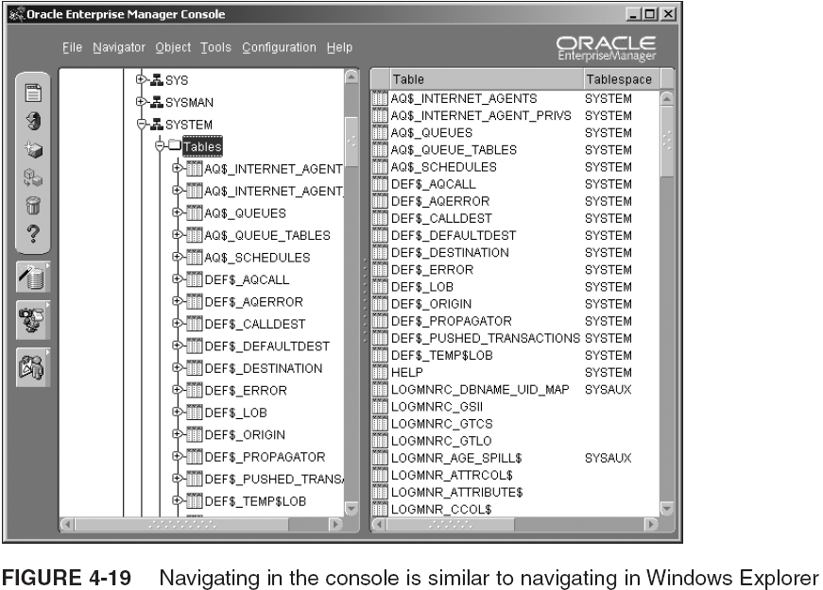
Using Data Dictionary Views

Slide 56
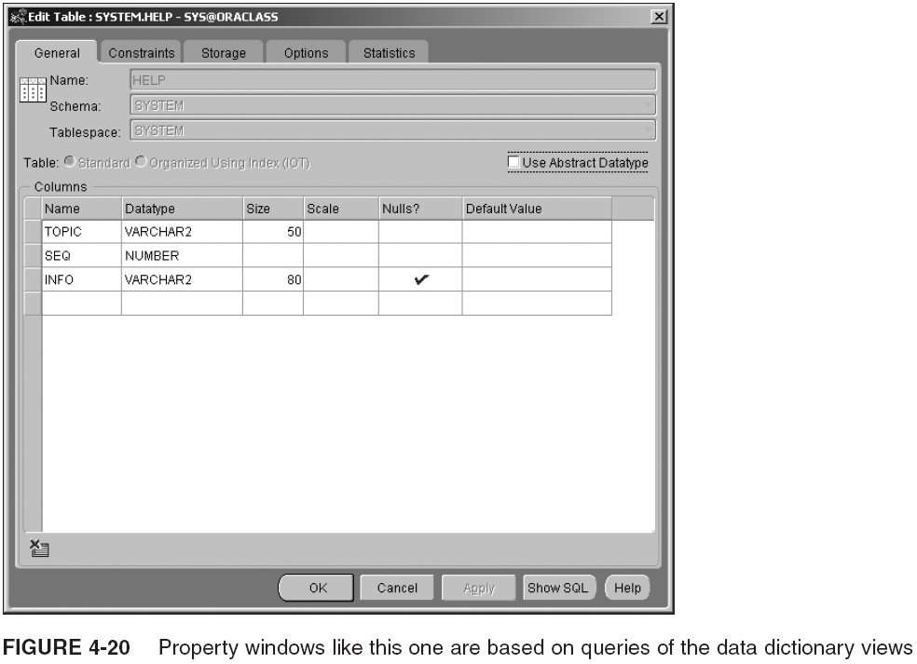
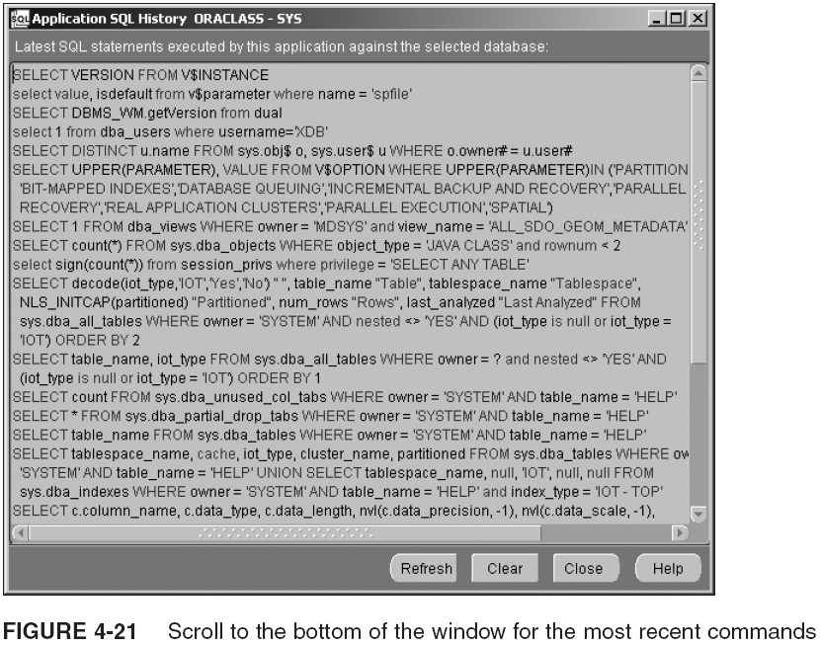
Using Data Dictionary Views (continued)

Slide 57
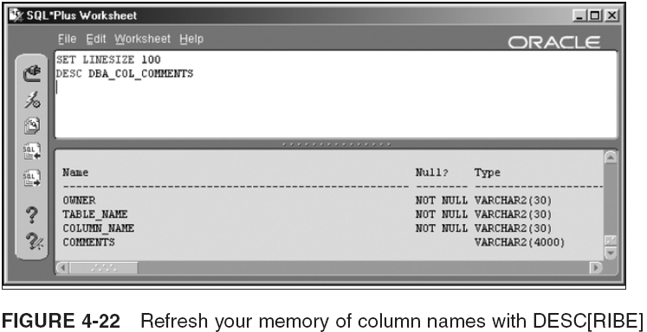
Using Data Dictionary Views (continued)

Slide 58
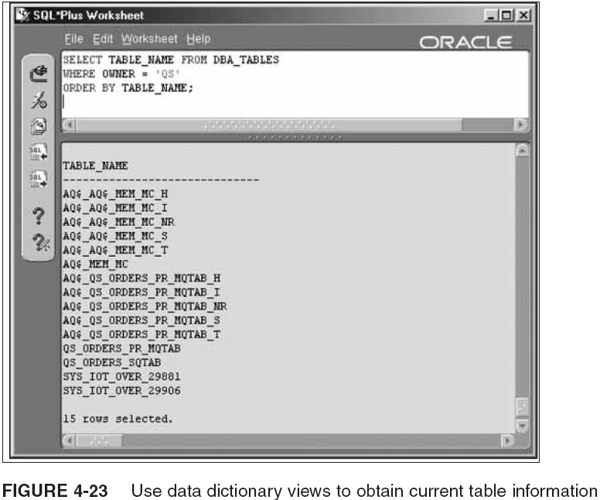
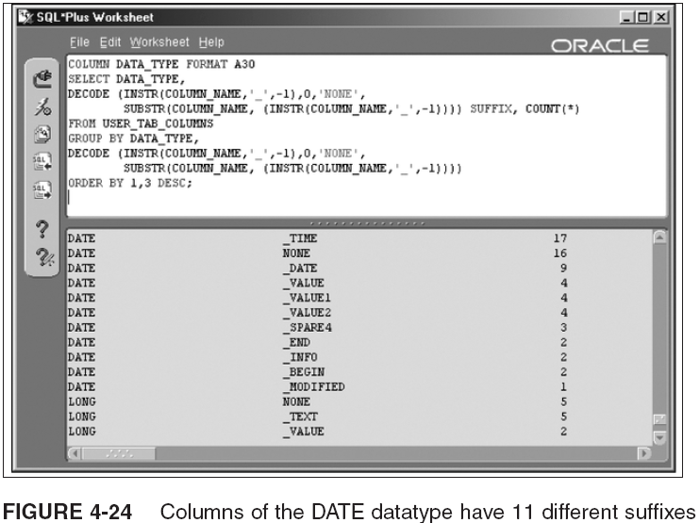
Using Data Dictionary Views (continued)

Slide 59
Using Data Dictionary Views (continued)
Frequently used (static) data dictionary views:
  USER_TABLES, USER_VIEWS
  ALL_DEPENDENCIES
  USER_ERRORS
  USER_INDEXES, USER_IND_COLUMNS
  DBA_SOURCE
  USER_TAB_PRIVS, ALL_TAB_PRIVS_MADE
  USER_TAB_PRIVS_MADE
  DBA_USERS
  PRODUCT_COMOPONET_VERSION

Slide 60
Useful Dynamic Performance Views
Begin with V$ and have a counterpart GV$ view
  V$SYSSTAT
  V$SQL
  V$SESSTAT
  V$SESSION_WAIT
  V$FILESTAT
  V$FILESTAT
Primary use: tuning the database system
Oracle provides options for gathering/viewing stats
  Statistics are used to tune a database
  This book does not cover the details of DB tuning

Slide 61
Examining Table Structure Using SQL*Plus and iSQL*Plus
It is important to know how to use SQL*Plus to access data dictionary views
  USER_TABLES
  USER_TAB_COLS and USER_TAB_COLUMNS
  USER_TAB_COMMENTS and USER_COL_COMMENTS
  USER_UNUSED_COL_TABS
  USER_OBJECT_TABLES
  USER_TAB_PARTITIONS and USER_TAB_SUBPARTITIONS
  USER_PART_TABLES

Slide 62
Summary
An Oracle DB consists of an Oracle instance and files; the instance consists of processes and buffers
The physical part of an Oracle DB consists of data, redo log, archive redo log, control, and config. files
An Oracle database is divided into logical structures (tablespaces) and physical structures (datafiles)
Control files track the current datafiles, online redo log files, checkpoints, and log group number
By creating more than one control file, you duplicate (multiplex) the control files

Slide 63
Summary (continued)
Add extra control files by copying an existing control file and updating the CONTROL_FILES parameter
Rename/relocate a control file by moving or renaming the file and updating CONTROL_FILES parameter
Replace a damaged or lost control file by replacing it with a copy of an undamaged control file
You can designate control files to be OMFs by leaving CONTROL_FILES null and using DB_CREATE_FILE_DEST instead
Add DB_CREATE_ONLINE_LOG_DEST_n values to create multiplexed Oracle managed control files

Slide 64
Summary (continued)
Create new control files, when they are damaged or lost, or when certain DB parameters change
  CREATE CONTROLFILE creates new control files
SET DATABASE clause in CREATE CONTROLFILE renames the database
Some control file record sections contain information used for DB recovery; other sections contain locations and names of files
Several V$ views query the control file
Redo log files are also called online redo log files

Slide 65
Summary (continued)
Redo log files contain information on DB changes
Redo log groups contain at least one file each
  At least two redo log groups must exist
  One group at a time is active, and changing to another log group is called a log switch
  Groups are reused sequentially, and log file data is lost unless the log group is archived
Change information is recorded in the redo log before updating the datafile
Redo logs can be used to recover from minor failures such as power outages

Slide 66
Summary (continued)
Serious DB damage requires archived redo logs, a valid control file, and a DB backup for recovery
Redo log files contain redo records or redo entries made up of change vectors
  A single transaction may generate many redo entries
Redo log groups can be duplexed
  Then, one damaged file doesn’t cause system error
The SCN is incremented every time DB changes
A checkpoint flushes dirty buffers to be written to disk

Slide 67
Summary (continued)
Some useful commands are:
  ALTER DATABASE ADD LOGFILE MEMBER
  ALTER DATABASE ADD LOGFILE GROUP
  ALTER DATABASE RENAME FILE
  ALTER DATABASE DROP LOGFILE MEMBER
  ALTER DATABASE DROP LOGFILE GROUP
  ALTER DATABASE CLEAR LOGFILE GROUP
  ALTER DATABASE ARCHIVELOG
The V$LOG dynamic performance view displays redo log group status
The V$LOGFILE shows redo log member status

Slide 68
Summary (continued)
Data dictionary views are owned by the SYS schema and are based on tables owned by SYS
  Can be queried but not updated
  Have prefixes of USER, ALL, DBA, V$, and GV$
    Prefix DBA is for users with DBA privileges
  Supply information about DB structure
Dynamic performance views begin with V$ or GV$
  Store current activity-oriented data
  Used by STATSPACK and the Enterprise Manager Diagnostic Pack to track performance trends

