Slide 1

Oracle 10g Database Administrator: Implementation and Administration
Chapter 5
Basic Storage Concepts and Settings

Slide 2
Objectives
Differentiate between logical and physical structures
Create many types of tablespaces
Configure and view storage for tablespaces and datafiles
Use and manage undo data
Learn to describe and configure diagnostic (trace) files

Slide 3
Introduction to Storage Structures
The Oracle 10g DB has an internal set of structures used to store data, users, constraints, data dictionary views, and other objects
  Also contain metadata maintained internally by DB
Metadata: data that tells Oracle 10g about all the structures that store data in the database

Slide 4
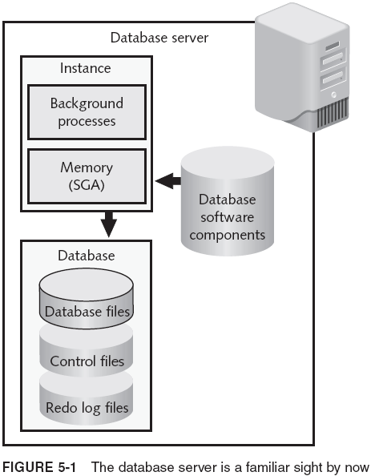
Introduction to Storage Structures (continued)

Slide 5
Logical Structure Versus Physical Structure
Physical structures: composed of OS components and have a physical name and location
  Datafiles (see Figure 5-2)
  Redo log files
  Control files
Logical structures: orderly groupings of information that allow you to manipulate/access related data
  Cannot be viewed or modified outside the database
  Generally associated with physical structure(s)
  E.g. (Figure 5-3): tablespaces, segments, schema objects, extents, database blocks

Slide 6
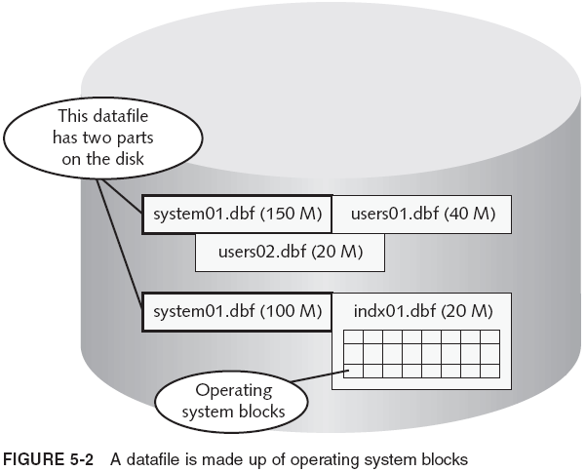
Logical Structure Versus Physical Structure (continued)

Slide 7
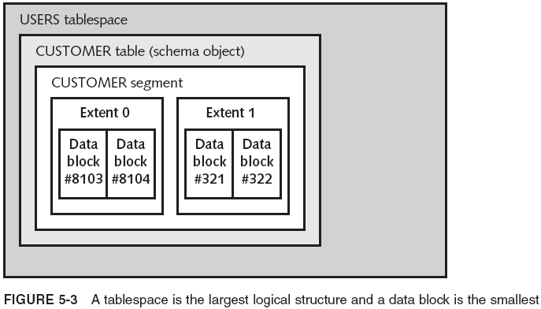
Logical Structure Versus Physical Structure (continued)

Slide 8
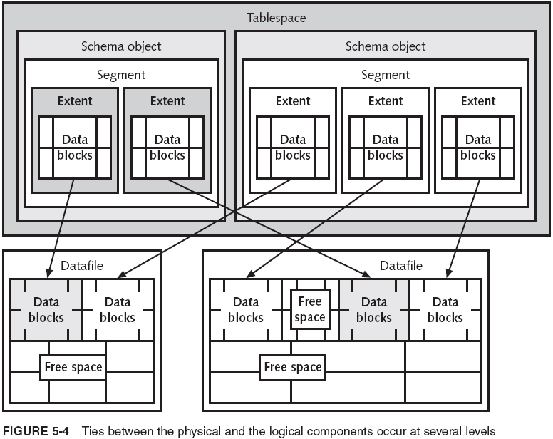
Logical Structure Versus Physical Structure (continued)

Slide 9
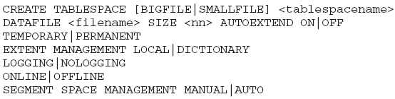
Tablespaces and Datafiles
Tablespaces are made up of at least one datafile
  You cannot create a tablespace without creating its initial datafile; you cannot create a datafile without an associated tablespace
Bigfile tablespaces must be locally managed
Undo tablespaces are specialized to store undo (rollback) data

Slide 10
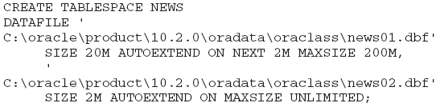
The DATAFILE Clause
When creating a tablespace with a user-managed file, specify a datafile name in the command
  Each datafile must have a specified SIZE
    Exceptions: OMFs and named files that already exist
  Omitting AUTOEXTEND and SIZE parameters results in AUTOEXTEND set to ON
Example:

Slide 11
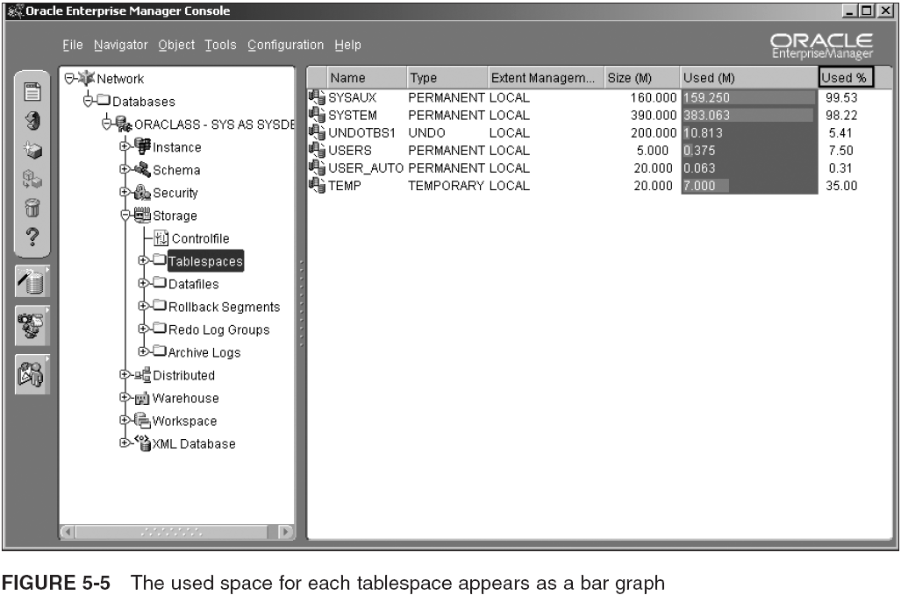
Implementing Oracle Managed Files (OMF) with Tablespaces

Slide 12
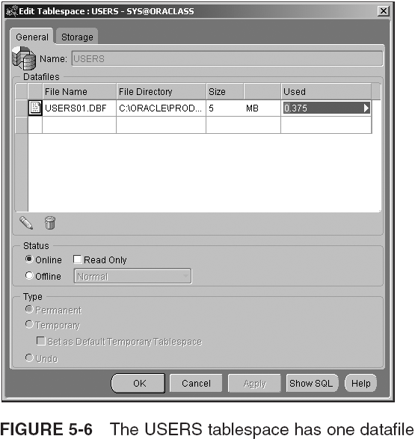
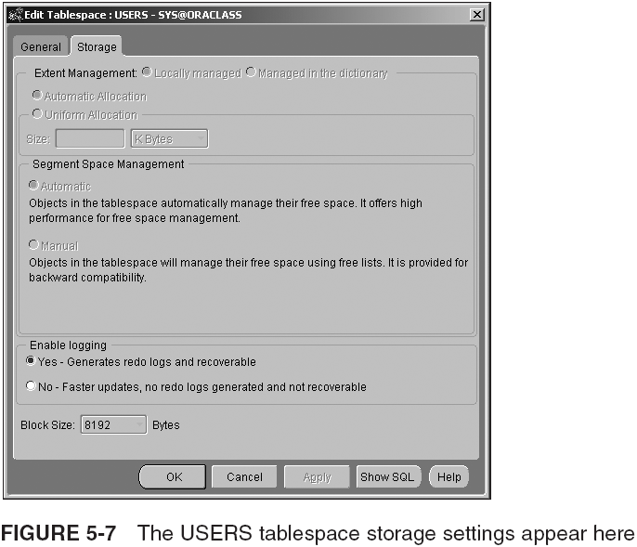
Implementing Oracle Managed Files (OMF) with Tablespaces (continued)

Slide 13
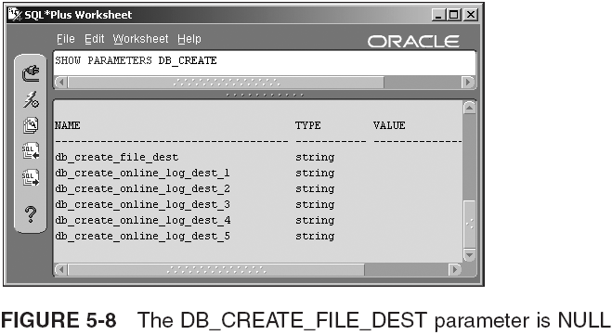
Implementing Oracle Managed Files (OMF) with Tablespaces (continued)

Slide 14
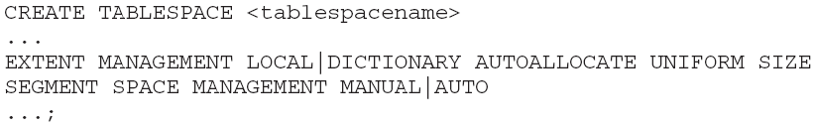
The EXTENT MANAGEMENT and SEGMENT SPACE MANAGEMENT Clauses
These clauses tell Oracle how to track the usage of blocks within each extent
Locally vs. dictionary-managed → performance:
  Locally managed tablespaces store the map of where extents are in datafiles in a rapid access bitmap, in the header of the datafile
  Dictionary-managed tablespaces store this information in metadata, in the SYSTEM tablespace
Default

Slide 15
The EXTENT MANAGEMENT and SEGMENT SPACE MANAGEMENT Clauses (continued)
Deallocated extents return to free space list in data dictionary as a contiguous chunk of data blocks
  For these to be usable, the next object that needs an extent must be that exact size (or smaller) extent
  Otherwise, deallocated data blocks are passed over, and data blocks at the end of datafile are used
    Datafile grows faster than necessary
If there are contiguous deallocated extents, they aren’t seen as a chunk of space until coalesced
  Coalescence: combining of multiple adjacent free extents into a single contiguous free extent
    Occurs periodically through the SMON background process

Slide 16
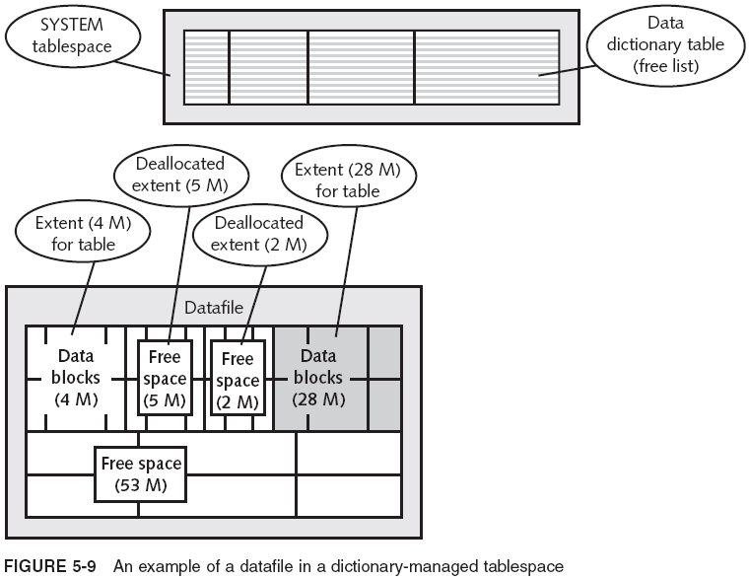

The EXTENT MANAGEMENT and SEGMENT SPACE MANAGEMENT Clauses (continued)

Slide 17
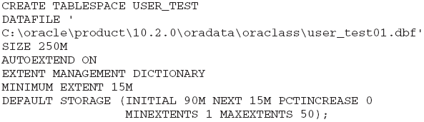
Creating a Dictionary-Managed Tablespace
Dictionary-managed tablespaces cause slower performance of DML commands
  Updates involve multiple tables behind the scenes
Locally managed tablespaces reduce/eliminate the problem of unused free space gaps (see Fig. 5-10)

Slide 18
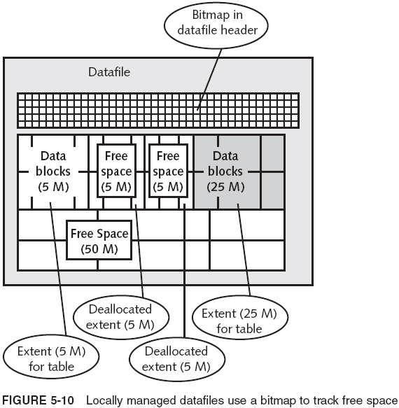
Creating a Dictionary-Managed Tablespace (continued)

Slide 19

Creating a Dictionary-Managed Tablespace (continued)
Locally managed tablespaces are more efficient (storage info is in a bitmap stored with tablespace)
  There is a bitmap for each datafile in the tablespace
  Bitmap: small record in datafile header with one bit for each data block number that marks the beginning of a used group of consecutive blocks in datafile
  Redo/undo log records created only for data changes
You can specify that segment free space be stored locally as a bitmap too

Slide 20
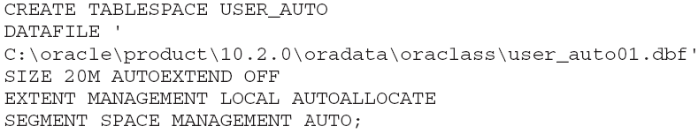
Creating a Locally Managed Tablespace
Execute:
The second largest logical structure is a segment (see next slide)

Slide 21
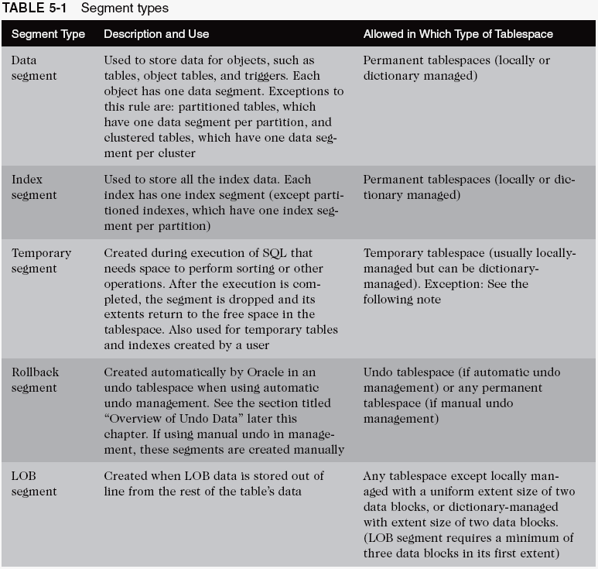
Segment Types and Their Uses

Slide 22
Segment Types and Their Uses (continued)
In Oracle 10g, segments are created automatically when they are needed
  The only exceptions are manual rollback segments, which can be created manually for cross compatibility with older versions of Oracle database
    Manual rollback is redundant, not supported, and not recommended for use in Oracle 10g

Slide 23


Temporary Tablespace
Temporary segments need a temporary tablespace
  Oracle recommends creating locally managed, temporary tablespaces
  You can also create multiple temporary tablespaces
    Require a tablespace group
    Group can be set as the default for the entire DB
Assign the user a default temporary tablespace:

Slide 24
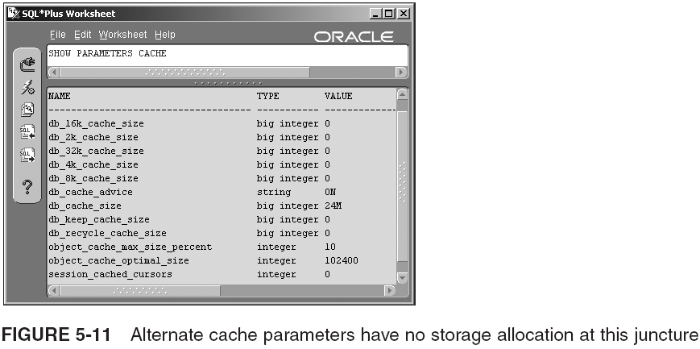

Tablespaces with Nonstandard Data Block Size

Slide 25
Configuring and Viewing Storage
Changing the Size, Storage Settings, and Status
  Read-only Tablespaces
  Dropping Tablespaces
  Renaming Tablespaces
Querying the Data Dictionary for Storage Data

Slide 26
Changing the Size, Storage Settings, and Status
Tasks you can handle with ALTER TABLESPACE:
  Change DEFAULT STORAGE settings for any future objects created in (dictionary-managed) tablespace
  Change the MINIMUM EXTENT size
  Change LOGGING to NOLOGGING and vice versa
  Change PERMANENT to TEMPORARY (vice versa)
  Change READ ONLY to READ WRITE (vice versa)
  Coalesce contiguous storage space
  Add a new datafile or temporary file
  Rename a datafile or temporary file
  Begin and end an open backup

Slide 27
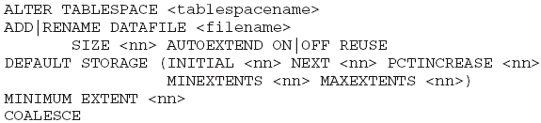


Changing the Size, Storage Settings, and Status (continued)
To change an existing datafile’s storage, you must use the ALTER DATABASE command instead:
To modify tempfile: ALTER DATABASE TEMPFILE

Slide 28


Changing the Size, Storage Settings, and Status (continued)
The status of a tablespace defines its availability to end-users and also defines how it is handled during backup and recovery
  ONLINE
  OFFLINE
    NORMAL
    TEMPORARY
    IMMEDIATE
It is possible to take individual datafiles offline

Slide 29
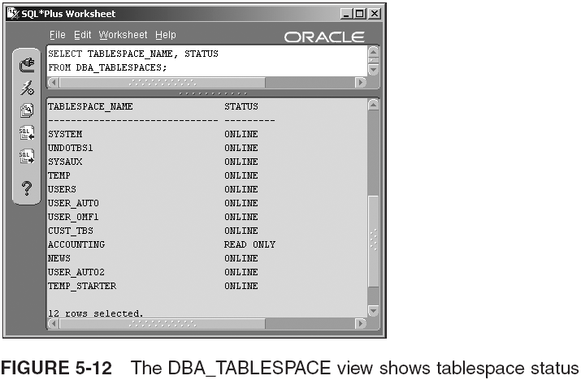
Read-only Tablespaces

Slide 30

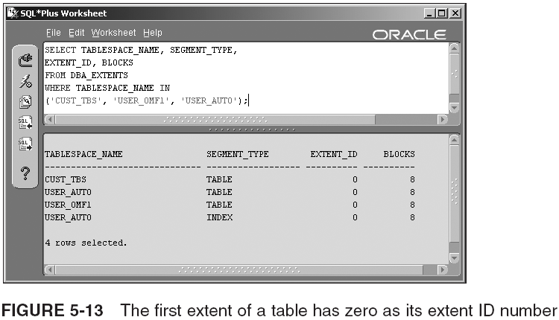
Dropping Tablespaces

Slide 31

Renaming Tablespaces
Renaming tablespaces can be useful in rare circumstances, such as when switching in and out partitioned tablespaces, or incorporating transported tablespaces into an existing database

Slide 32
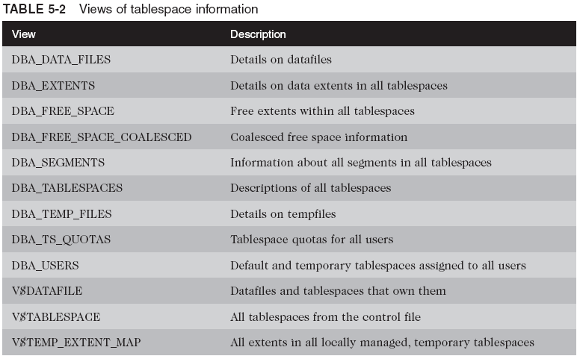
Querying the Data Dictionary for Storage Data

Slide 33
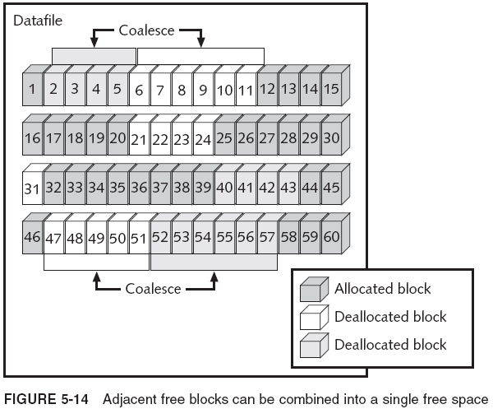
Querying the Data Dictionary for Storage Data (continued)

Slide 34
Overview of Undo Data
Undo data is made up of undo blocks
  Each undo block contains the before image of the data in the block
Also used to redo original data after a ROLLBACK
  Also provides read consistency for users accessing the table between the time the update is pending, and the time the update has been committed
Undo data is also used during database recovery
  If DB fails and prevents a commit from happening, data in the redo log is inaccurate
Ways to manage undo data: manual and automatic

Slide 35


Implementing Automatic Undo Management
To set up automatic undo management mode:
  Set UNDO_MANAGEMENT parameter to AUTO
    Default with DCBA tool
  Create an undo tablespace
You can drop an undo tablespace by using the DROP TABLESPACE command
  Wait until the status is OFFLINE before dropping the tablespace

Slide 36
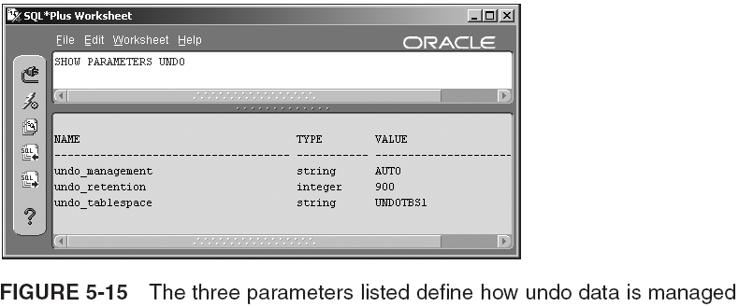

Implementing Automatic Undo Management (continued)

Slide 37
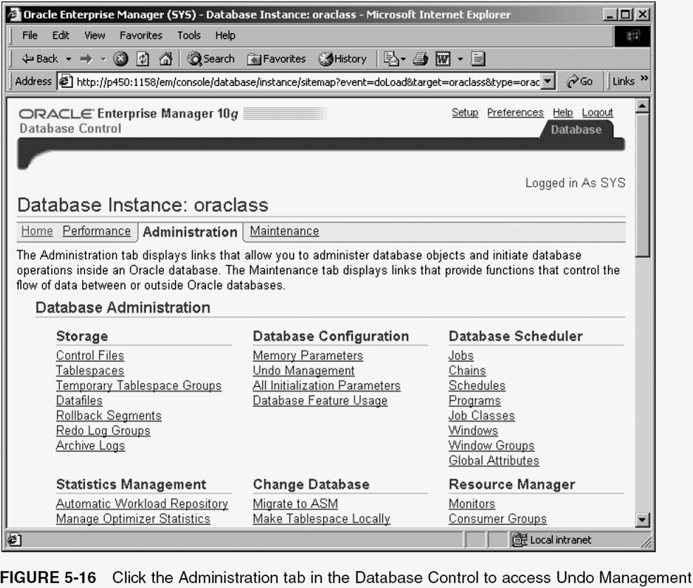
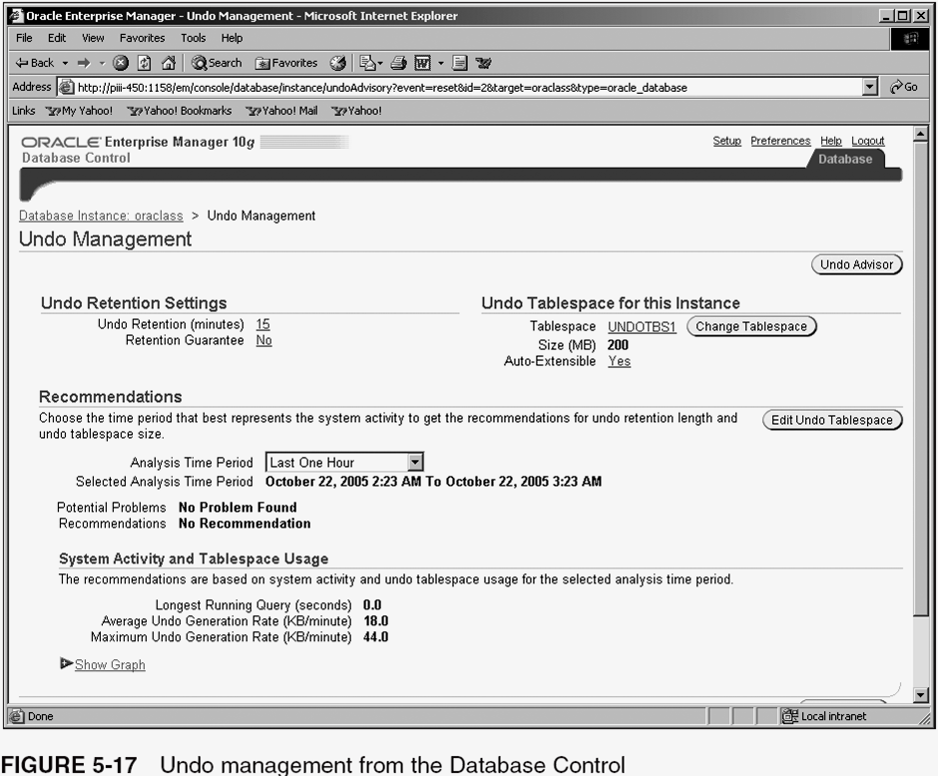
Monitoring Undo

Slide 38
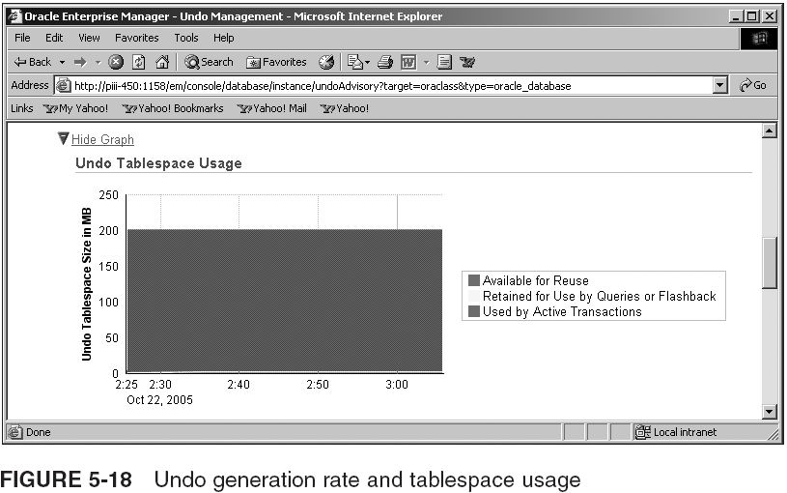
Monitoring Undo (continued)

Slide 39
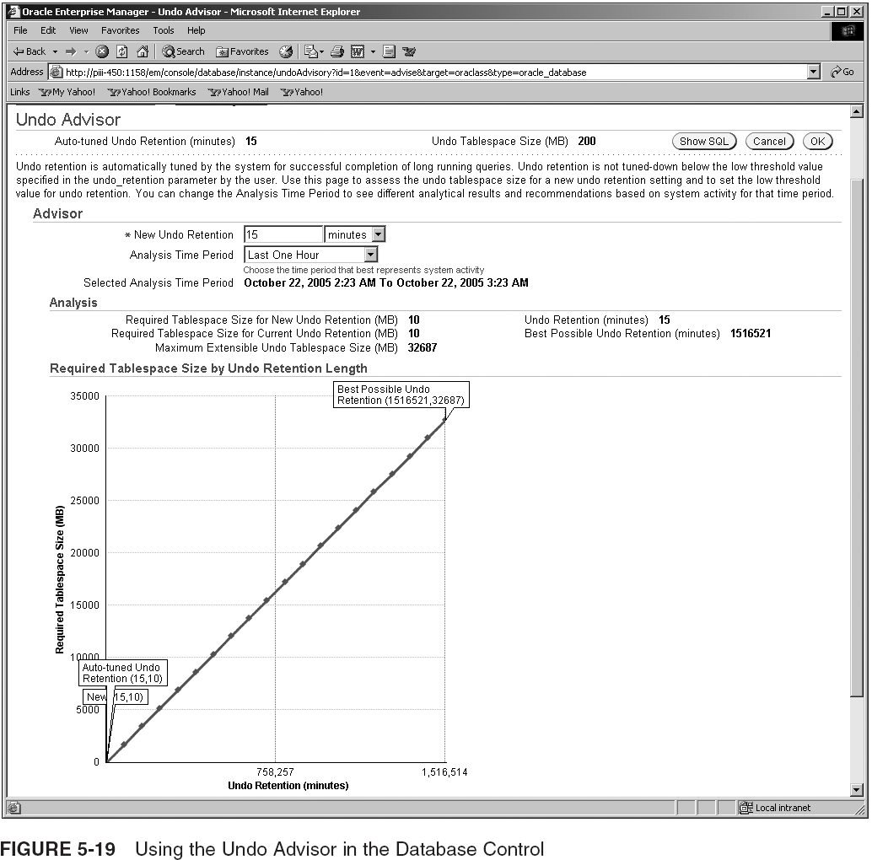
Monitoring Undo (continued)

Slide 40
Overview of Diagnostic (Trace) Files
Trace files allow highly detailed problem resolution
  Typically used to solve serious problems
Serious errors are most often written to trace files, and duplicated to the primary trace file (alert log)
Not all critical errors may be sent to the trace files
  DB crash may only be sent to a memory core dump
Relevant directories in ORACLE_BASE/admin
  bdump
  cdump
  udump

Slide 41
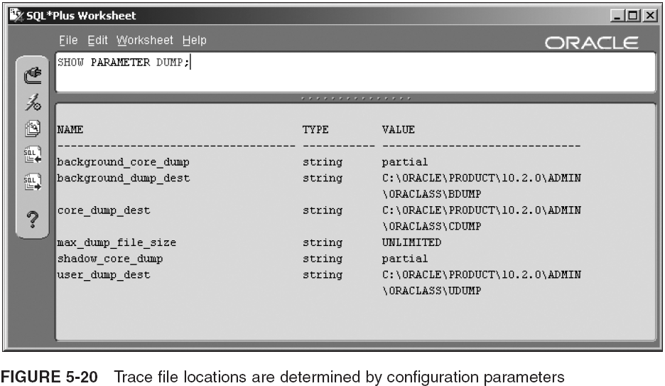
Overview of Diagnostic (Trace) Files (continued)

Slide 42
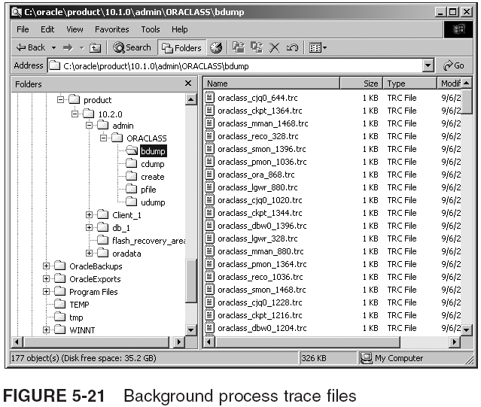
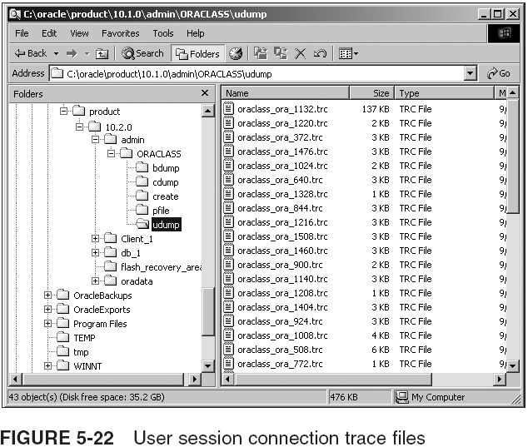
Overview of Diagnostic (Trace) Files (continued)

Slide 43
Overview of Diagnostic (Trace) Files (continued)
Trace files are automatically created/written to by DB
Alert log file (alert.log) is created when DB starts up
  The other types of files are created as events occur
Trace files are not only for logging errors
  Alert log contains details of DB start up and shut down
Other important trace configuration parameters:
  MAX_DUMP_FILE_SIZE
  SQL_TRACE
  TIMED_STATISTICS
  STATISTICS_LEVEL

Slide 44
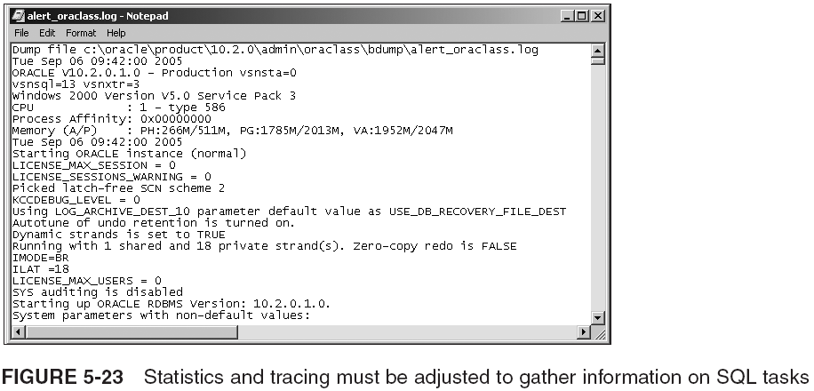
Overview of Diagnostic (Trace) Files (continued)

Slide 45
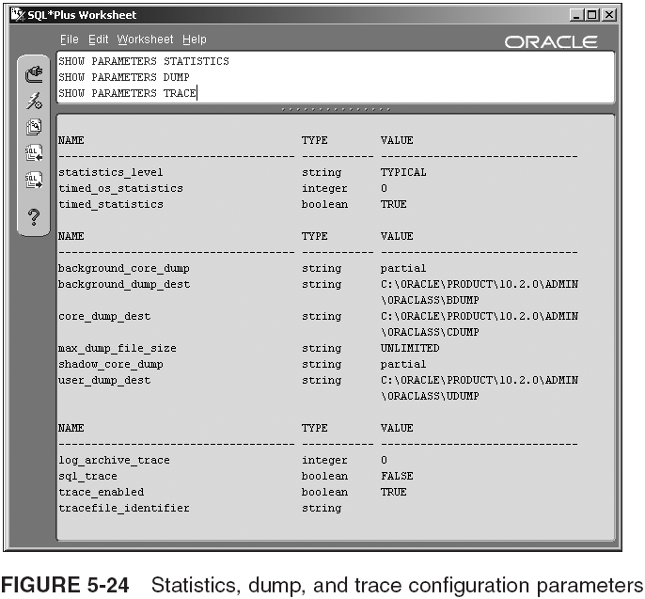
Overview of Diagnostic (Trace) Files (continued)

Slide 46
Summary
Logical structures include data blocks, extents, segments, schema objects, and tablespaces
  Permanent tablespaces store objects, such as tables and indexes
  Temporary tablespaces store temporary tables and data while the data is being sorted
  Locally managed tablespaces use a bitmap to track used and unused space
  Dictionary-managed tablespaces use the data dictionary to track used and unused space
The NOLOGGING setting does not log mass INSERT or DDL commands

Slide 47
Summary (continued)
The REUSE setting allows Oracle 10g to reuse an existing file, erasing all its data
The AUTOEXTEND ON setting gives a datafile the ability to add to its size automatically
Adjacent, free extents can be manually coalesced in a dictionary-managed tablespace
  Free extents are automatically coalesced in a locally managed tablespace
  The MINIMUM EXTENT setting overrides a smaller extent size specified by an object in the tablespace
  Set PCTINCREASE to zero to keep extent sizes more uniform

Slide 48
Summary (continued)
Dictionary-managed tablespaces use a freelist in the dictionary to track blocks
Locally managed tablespaces keep extents the same size or a variable size controlled by system
Types of segments: data, index, temporary, rollback
Before creating a tablespace with a nonstandard data block size, you must create a cache with the corresponding data block size
Many of the initial settings of a tablespace can be changed using the ALTER TABLESPACE command

Slide 49
Summary (continued)
You cannot change a tablespace from LOCAL or DICTIONARY mode
To block access, a tablespace can be changed from ONLINE to OFFLINE
  Taking a tablespace offline can be done in NORMAL, TEMPORARY, or IMMEDIATE mode
Dropping a tablespace with the INCLUDING CONTENTS clause destroys all its data
Undo data allows users to have read consistency, while other users make changes that are not yet committed

Slide 50
Summary (continued)
Manual undo management using manually specified rollback segments is no longer supported by Oracle
  Automatic mode is easier to manage than manual rollbacks, and requires a special undo tablespace
Undo blocks reside in undo extents within either an undo tablespace or a rollback segment
The alert log file should be monitored regularly to detect errors
The background trace files record errors that occur within the background processes
The user trace files log errors from user session connections and transactions executed by users

