Slide 1

Oracle 10g Database Administrator: Implementation and Administration
Chapter 6
The Basics of Querying a Database

Slide 2
Objectives
Learn about different types of queries
Cover basic SQL functions and pseudocolumns available in Oracle database
Discover facts about NULL values, the DUAL table, and the DISTINCT clause
Learn about filtered, sorted, and aggregated queries
Discuss advanced queries including joins, subqueries, and other specialized queries

Slide 3
Introduction to Queries
A query, or database query, uses a special type of SQL command called a SELECT statement
The SELECT statement allows you to specify tables and columns in the tables, from which data is selected
Numerous types of queries available in an Oracle database

Slide 4
Different Types of Queries
Basic query
  SELECT TABLESPACE_NAME FROM DBA_TABLESPACES;
Filtered query
  SELECT TABLESPACE_NAME FROM DBA_TABLESPACES
  WHERE TABLESPACE_NAME LIKE 'S%';
Sorted query
  SELECT TABLESPACE_NAME FROM DBA_TABLESPACES
  ORDER BY TABLESPACE_NAME;
Aggregated query
  SELECT COUNT(TABLE_NAME), TABLESPACE_NAME
  FROM DBA_TABLES GROUP BY TABLESPACE_NAME;
Join query
  SET WRAP OFF
  COL TABLESPACE_NAME FORMAT A10
  COL FILE_NAME FORMAT A64
  SELECT TABLESPACE_NAME, BLOCK_SIZE, FILE_NAME
  FROM DBA_TABLESPACES JOIN DBA_DATA_FILES
  USING (TABLESPACE_NAME);

Slide 5
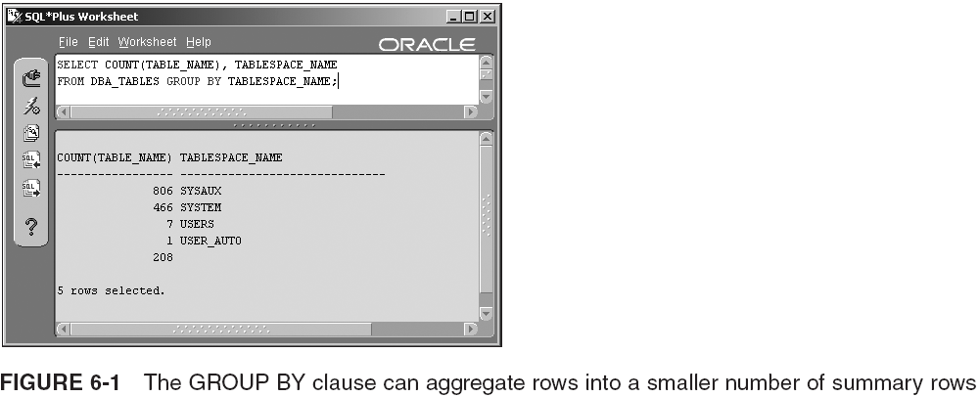
Different Types of Queries (continued)

Slide 6
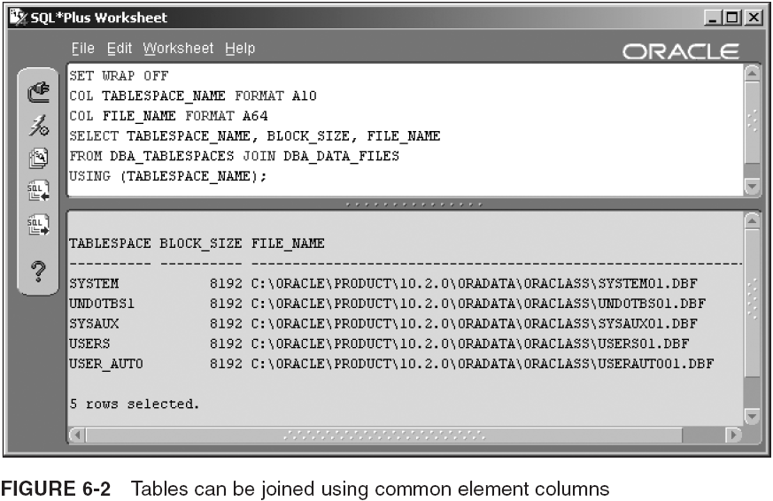
Different Types of Queries (continued)

Slide 7
Different Types of Queries (continued)
Subqueries
  SELECT TABLESPACE_NAME, BLOCK_SIZE
  FROM DBA_TABLESPACES
  WHERE TABLESPACE_NAME IN
  (SELECT TABLESPACE_NAME FROM DBA_DATA_FILES);
Create new table or view
  CREATE VIEW TABLESPACES AS
  SELECT TABLESPACE_NAME, BLOCK_SIZE, FILE_NAME
  FROM DBA_TABLESPACES JOIN DBA_DATA_FILES
  USING (TABLESPACE_NAME);
  SELECT * FROM TABLESPACES;
Other specialized queries
  Composite queries, hierarchical queries, flashback or version queries, and parallel execution queries

Slide 8
Oracle SQL Functions and Pseudocolumns
Single row functions
  SELECT SUBSTR(TABLESPACE_NAME, 1, 1) FROM DBA_TABLESPACES;
Datatype conversion functions
  SELECT GROUP#, SEQUENCE#,
  TO_CHAR(FIRST_TIME, 'DAY MONTH YEAR') FROM V$LOG;
Group (aggregate) functions
  MIN, MAX, AVG, SUM, COUNT
  SELECT SUM(BLOCKS) FROM DBA_DATA_FILES;
User-defined functions
  CREATE OR REPLACE FUNCTION GETPHONE(pPHONE IN VARCHAR2)
  RETURN VARCHAR2 IS
  BEGIN
  RETURN '('||SUBSTR(pPHONE,1,3)||')'||SUBSTR(pPHONE,4,8);
  EXCEPTION WHEN OTHERS THEN
  RETURN NULL;
  END;
  /

Slide 9
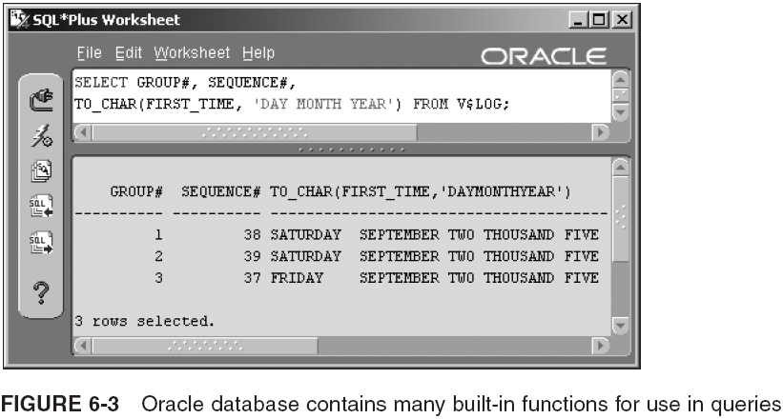
Oracle SQL Functions and Pseudocolumns (continued)

Slide 10
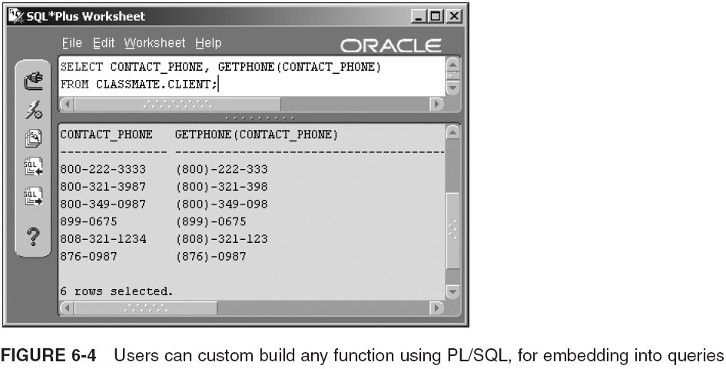
Oracle SQL Functions and Pseudocolumns (continued)

Slide 11
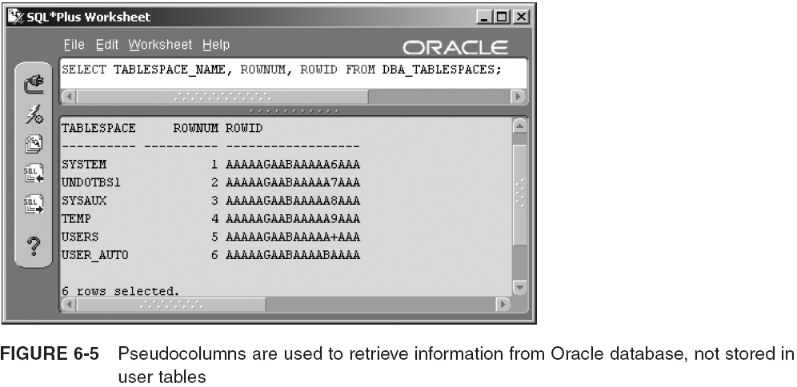
Oracle SQL Functions and Pseudocolumns (continued)
Pseudocolumn

Slide 12
What is NULL?
A NULL valued column, in a row, in a table, has not been set to anything, or has been set to NULL
  Leaving a column value set to NULL saves space
  NULL represents nothing, not a space, not a zero
  NULL values are not included in the most commonly used indexes for an Oracle database (BTree)
  Most built-in functions return NULL when passed NULL
  It can be tested for using IS [ NOT ] NULL
  An expression containing a NULL returns a NULL
  NVL({value}, {replace}) replaces NULL values
  NULL values sort as the highest value by default
  Comparing NULL to a value evaluates to false

Slide 13
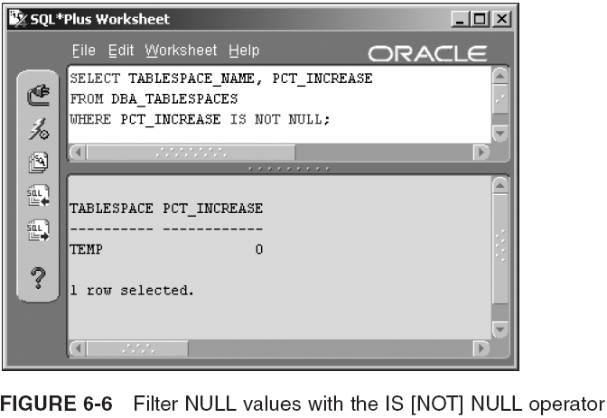
What is NULL? (continued)

Slide 14
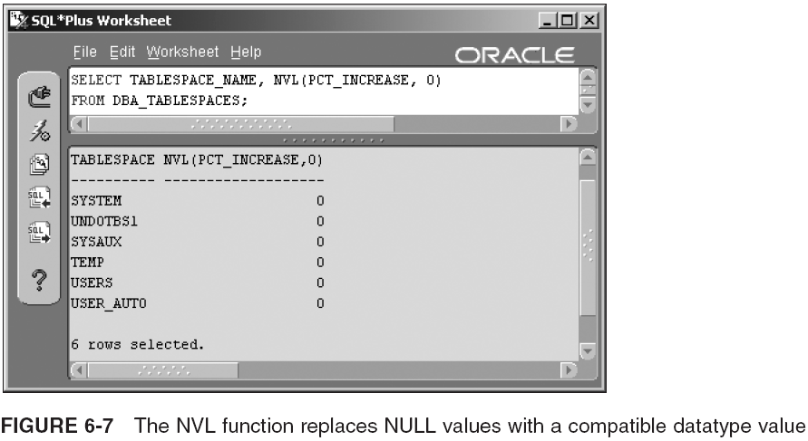
What is NULL? (continued)

Slide 15
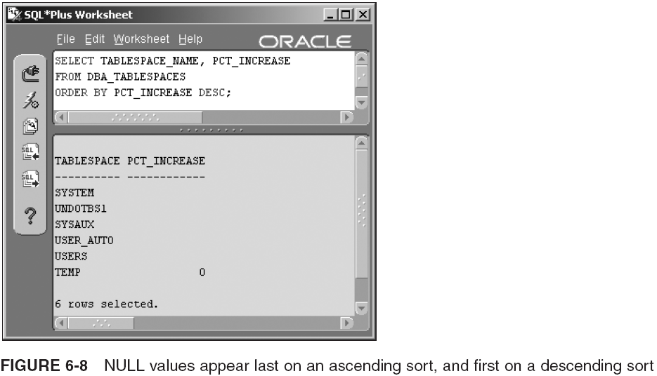
What is NULL? (continued)

Slide 16
The DUAL Table and More on Pseudocolumns
The DUAL table is used to request data from an Oracle database, where that data is not in user application tables
  It is a little like an internal Oracle database cursor
    Cursor: chunk of memory allocated to a query, to contain results of a query during query processing
  It can only be queried, never updated
  It is owned by SYS but can be queried by any user
  Examples:
    SELECT SYSDATE FROM DUAL;
    SELECT USER, UID FROM DUAL;

Slide 17
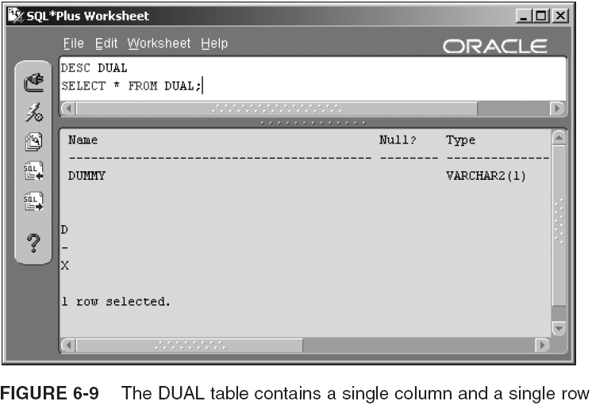
The DUAL Table and More on Pseudocolumns (continued)

Slide 18
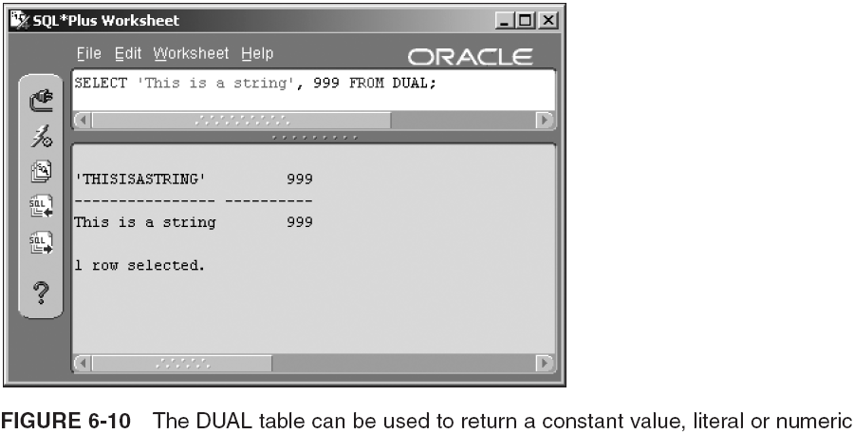
The DUAL Table and More on Pseudocolumns (continued)

Slide 19
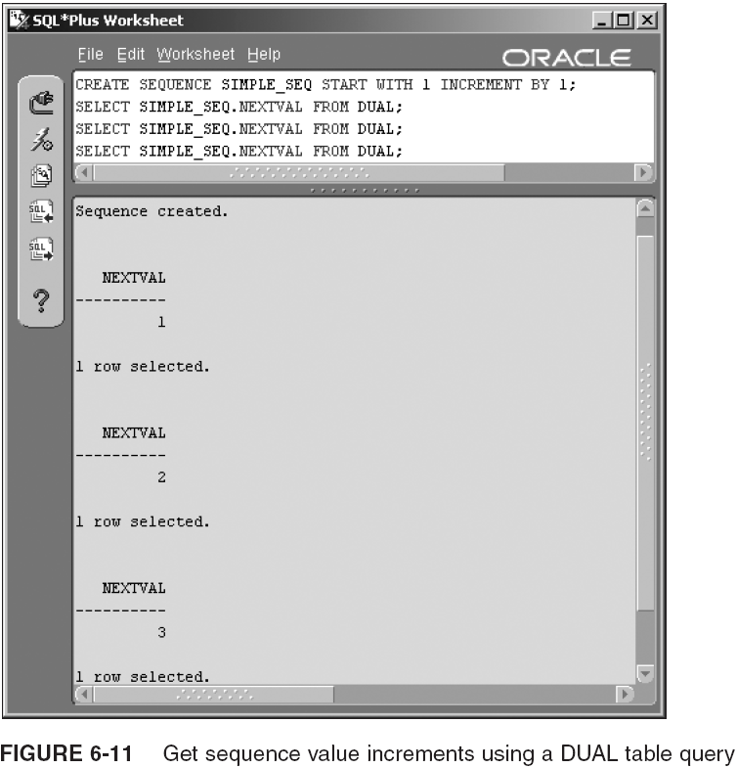
The DUAL Table and More on Pseudocolumns (continued)
A likely use of sequences is for surrogate primary key generation.

Slide 20
The DISTINCT Clause
Used to retrieve the first value of each group in a set of duplications
It can operate on single or multiple columns
  SELECT DISTINCT [(]{column} [, column ... ] ... [)] ...
Examples:
  SELECT DISTINCT OWNER FROM DBA_TABLES;
  SELECT DISTINCT TABLESPACE_NAME, OWNER FROM DBA_TABLES;
  SELECT DISTINCT (TABLESPACE_NAME||OWNER) FROM DBA_TABLES;

Slide 21
The SELECT Statement
Simple query
  SELECT TABLESPACE_NAME, BLOCK_SIZE, INITIAL_EXTENT
  FROM DBA_TABLESPACES;
Complex query
  SELECT
  (SELECT NAME FROM
  V$TABLESPACE WHERE TS# = D.TS#) AS DATAFILE,
  D.NAME AS TABLESPACE
  FROM V$DATAFILE D;
Create a view or table
  CREATE OR REPLACE VIEW CLASSMATE_TABLES_VIEW AS
  SELECT TABLE_NAME FROM DBA_TABLES
  WHERE OWNER='CLASSMATE';
  CREATE TABLE CLASSMATE_TABLES AS
  SELECT TABLE_NAME FROM DBA_TABLES
  WHERE OWNER='CLASSMATE';
INSERT, UPDATE, or DELETE data

Slide 22
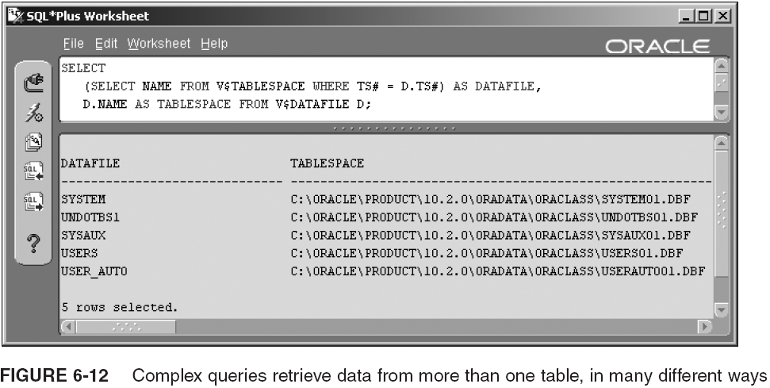
The SELECT Statement (continued)

Slide 23
The SELECT Statement (continued)
Basic syntax:
  SELECT { [alias.]column | expression | [alias.]* [ , ... ] }
  FROM [schema.]{table | view|...} [alias];
Examples:
  SELECT TABLESPACE_NAME FROM DBA_TABLESPACES;
  SELECT TABLESPACE_NAME, BLOCK_SIZE, INITIAL_EXTENT
  FROM DBA_TABLESPACES;
  SELECT * FROM DBA_TABLESPACES;
  SELECT BYTES, BYTES/1024, BYTES/1024/1024, FILE_NAME
  FROM DBA_DATA_FILES;
  SELECT BYTES "Bytes", BYTES/1024 "Kb", BYTES/1024/1024 "Mb",
  FILE_NAME "OSFile"
  FROM DBA_DATA_FILES;
  SELECT BYTES AS Bytes, BYTES/1024 AS Kb, BYTES/1024/1024 AS Mb,
  FILE_NAME AS OSFile
  FROM DBA_DATA_FILES;

Slide 24
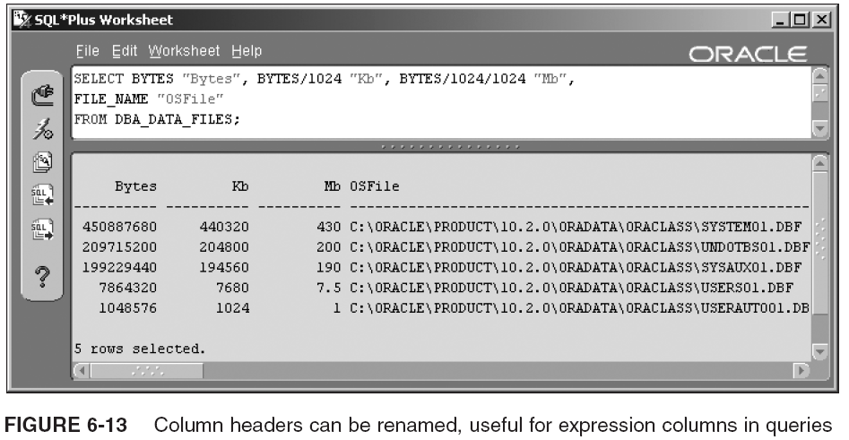
The SELECT Statement (continued)

Slide 25
The SELECT Statement (continued)
The AS clause can be used in ORDER BY clause
  SELECT BYTES/1024 AS Kb, FILE_NAME "OSFile"
  FROM DBA_DATA_FILES
  ORDER BY Kb;
An alias can be used to refer to a column
  SELECT T.NAME
  FROM V$TABLESPACE T
  WHERE EXISTS (SELECT * FROM V$DATAFILE WHERE TS# = T.TS#);
You don’t have to use aliases (it’s recommended)
  SELECT V$TABLESPACE.NAME, V$DATAFILE.NAME
  FROM V$TABLESPACE, V$DATAFILE
  WHERE V$TABLESPACE.TS# = V$DATAFILE.TS#;
Use of upper- and lowercase is a factor in queries for strings/expressions enclosed in quotation marks
  SELECT TABLESPACE_NAME, BLOCK_SIZE FROM DBA_TABLESPACES;
  select tablespace_name, block_size from dba_tablespaces;

Slide 26
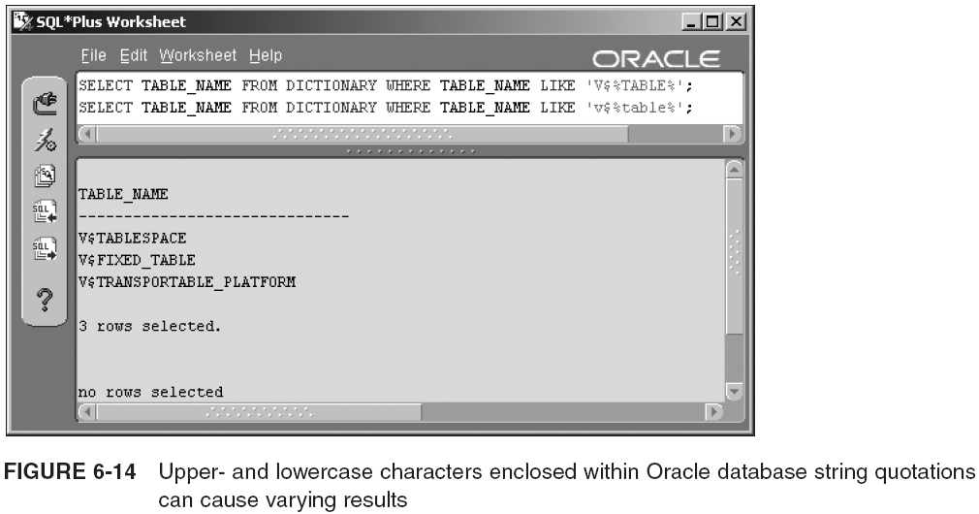
The SELECT Statement (continued)

Slide 27
Filtering, Sorting, and Summarizing (Aggregations) Queries
Filtering uses the WHERE clause to filter out unwanted rows, or retain wanted rows
Sorting allows resorting of query results using the ORDER BY clause
Queries can be summarized or aggregated into fewer rows using the GROUP BY and HAVING clauses

Slide 28
Filtering Queries with the WHERE Clause
SELECT { [alias.]column | expression | [alias.]* [ , ... ] }
FROM [schema.]{table | view|...} [alias]
[
WHERE [schema.]table [alias] { column | expression }
comparison condition
[schema.]table [alias] { column | expression }
[ {AND | OR } [NOT] ... ]
]
Comparison conditions: expression = | > | < | >= | <= | LIKE | EXISTS | ... expression
AND and OR are logical operators used to combine multiple sets of expression comparisons.
The WHERE clause has two distinct facets: (1) comparison conditions, and (2) logical operators

Slide 29
WHERE Clause Comparison Conditions
expression [ = | != | > | < | >= | <= ] expression
Examples:
  SELECT * FROM V$DATAFILE WHERE FILE# = 1;
  SELECT * FROM V$DATAFILE WHERE FILE# <> 1;
  SELECT * FROM V$DATAFILE WHERE FILE# >= 5;
  SELECT * FROM DICTIONARY WHERE TABLE_NAME LIKE 'V$%A';
  SELECT * FROM DICTIONARY WHERE TABLE_NAME LIKE 'V$__A';
  SELECT NAME FROM V$DATAFILE WHERE FILE# IN (1, 2, 3);
  SELECT NAME FROM V$DATAFILE
  WHERE TS# IN (SELECT TS# FROM V$TABLESPACE);
  SELECT NAME FROM V$DATAFILE
  WHERE EXISTS (SELECT TS# FROM V$TABLESPACE WHERE TS# < 5);
  SELECT D. NAME FROM V$DATAFILE D
  WHERE EXISTS (SELECT TS# FROM V$TABLESPACE WHERE TS# = D.TS#);
  SELECT NAME FROM V$DATAFILE WHERE FILE# BETWEEN 2 AND 4;
  SELECT NAME FROM V$DATAFILE WHERE FILE# BETWEEN 4 AND 2;
  SELECT NAME FROM V$DATAFILE
  WHERE TS# = ANY (SELECT TS# FROM V$TABLESPACE);
[NOT] IN
[NOT] EXISTS
Wrong!

Slide 30
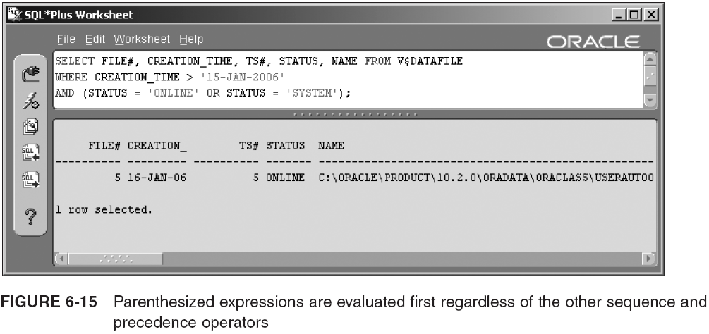
WHERE Clause Logical Operators
NOT has higher precedence than AND, followed by OR

Slide 31
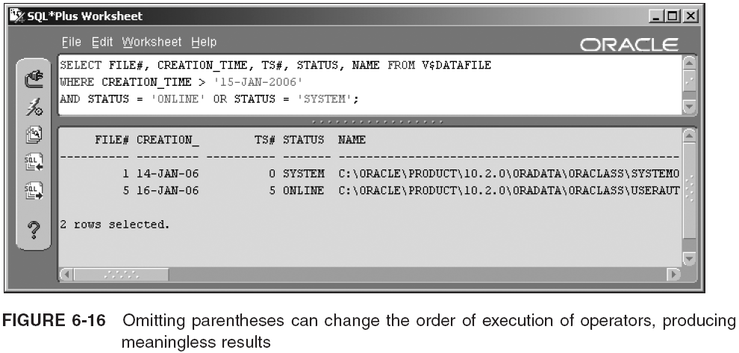
WHERE Clause Logical Operators (continued)

Slide 32
Top-N Queries
Return a small number of rows from a large query
  Save time and resources
Executed by filtering against ROWNUM
  ROWNUM: pseudocolumn generated for each row, in sequence, as each row is returned from a query
  SELECT * FROM DBA_OBJECTS
  WHERE ROWNUM <= 10;
  SELECT * FROM DBA_OBJECTS WHERE ROWNUM > 10;
The following query will return a senseless result
  SELECT * FROM DBA_OBJECTS
  WHERE ROWNUM <= 10
  ORDER BY OBJECT_NAME;
  Solution: use an inline view
    SELECT *
    FROM (SELECT * FROM DBA_OBJECTS ORDER BY OBJECT_NAME)
    WHERE ROWNUM <= 10;
Returns no rows!

Slide 33
Sorting Queries with the ORDER BY Clause
SELECT { [alias.]column | expression | [alias.]* [ , ... ] }
FROM [schema.]{table | view|...} [alias]
[ WHERE ... ]
[ ORDER BY { { column | expression | position } [, ...] } }
[ ASC | DESC ] [ NULLS { FIRST | LAST } ]
You can sort results in a number of ways:
  Sort by one or more columns
    SELECT BYTES, BLOCKS, FILE_NAME FROM DBA_DATA_FILES
    ORDER BY FILE_NAME;
  Positional sort
    SELECT BYTES, BLOCKS, FILE_NAME FROM DBA_DATA_FILES
    ORDER BY 2, 1;
  Sort by expression
    SELECT BYTES, BLOCKS, FILE_NAME FROM DBA_DATA_FILES
    ORDER BY BYTES/1024;

Slide 34
Sorting Queries with the ORDER BY Clause (continued)
Aliases
  SELECT BYTES/1024 AS KB, BLOCKS, FILE_NAME FROM DBA_DATA_FILES
  ORDER BY KB;
Ascending and descending sorts
  SELECT BYTES/1024 AS Kb, BLOCKS, FILE_NAME FROM DBA_DATA_FILES
  ORDER BY KB DESC;
Sorting NULL values
  SELECT TABLESPACE_NAME, NEXT_EXTENT FROM DBA_TABLESPACES
  ORDER BY NEXT_EXTENT DESC NULLS LAST;
Combination sorting
  SELECT TABLESPACE_NAME, NEXT_EXTENT FROM DBA_TABLESPACES
  ORDER BY TABLESPACE_NAME ASC, NEXT_EXTENT DESC NULLS LAST;

Slide 35
Aggregating Queries with the GROUP BY Clause
SELECT { [alias.]column | expression | [alias.]* [ , ... ] }
FROM [schema.]{table | view|...} [alias]
[ WHERE ... ]
[ GROUP BY expression [, expression ] [ HAVING condition ] ]
[ ORDER BY ... ]
There are a few standard rules to remember:
  Column list must include all columns in the SELECT statement not affected by any aggregate functions
  The expression for the SELECT statement should include at least one grouping function
  Clause cannot use the column positional specification like the ORDER BY clause
  Summarizes rows for output

Slide 36
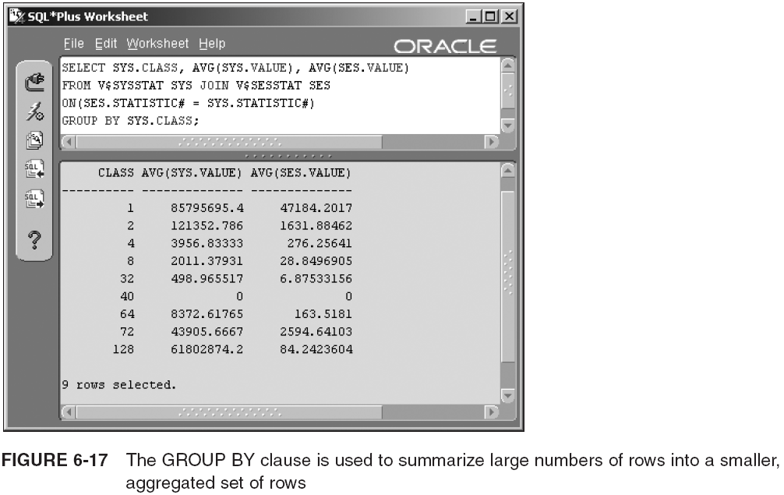
Aggregating Queries with the GROUP BY Clause (continued)

Slide 37
Filtering GROUP BY Aggregations with the HAVING Clause
The HAVING clause extends the GROUP BY clause by filtering on resulting grouped rows
  SELECT SYS.CLASS, AVG(SYS.VALUE), AVG(SES.VALUE)
  FROM V$SYSSTAT SYS JOIN V$SESSTAT SES
  ON(SES.STATISTIC# = SYS.STATISTIC#)
  GROUP BY SYS.CLASS HAVING AVG(SYS.VALUE) > 9999;
GROUP BY clause can become much more complex with the addition of OLAP functionality, and otherwise
  For the purposes of database administration, details of OLAP are not required and are out of the scope of this book

Slide 38
Advanced Queries
So far you have covered the basics of the SELECT statement and its various additional clauses
It is essential that you know the basics of the SELECT statement to be able to use SQL*Plus effectively as a database administrator
Numerous advanced query types available in an Oracle database, including joins, subqueries, and other specialized queries

Slide 39
Joins
Cross-join or Cartesian product (see Figure 6-18)
Natural or inner join (see Figure 6-19)
Outer join
Left outer join (see Figure 6-22)
Right outer join (see Figure 6-23)

Slide 40
Joins (continued)
Full outer join (see Figure 6-24)
Self join
  SELECT P.TYPE_NAME "Parent", C.TYPE_NAME "Child"
  FROM DBA_TYPES P LEFT OUTER JOIN DBA_TYPES C
  ON (C.TYPE_NAME = P.SUPERTYPE_NAME)
  ORDER BY 1, 2;
Semi-join (vague form of join using IN and EXISTS)
  SELECT NAME FROM V$DATAFILE
  WHERE EXISTS (SELECT TS# FROM V$TABLESPACE);

Slide 41
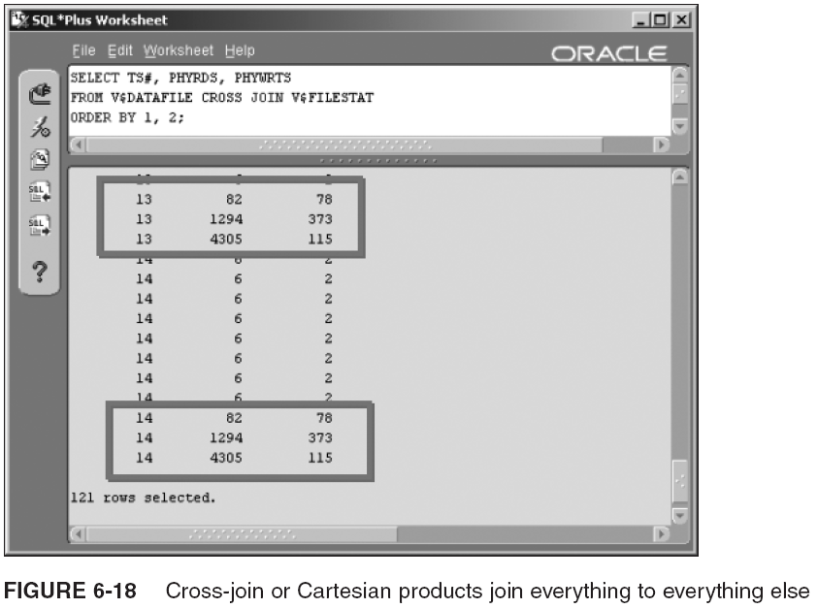
Joins (continued)

Slide 42
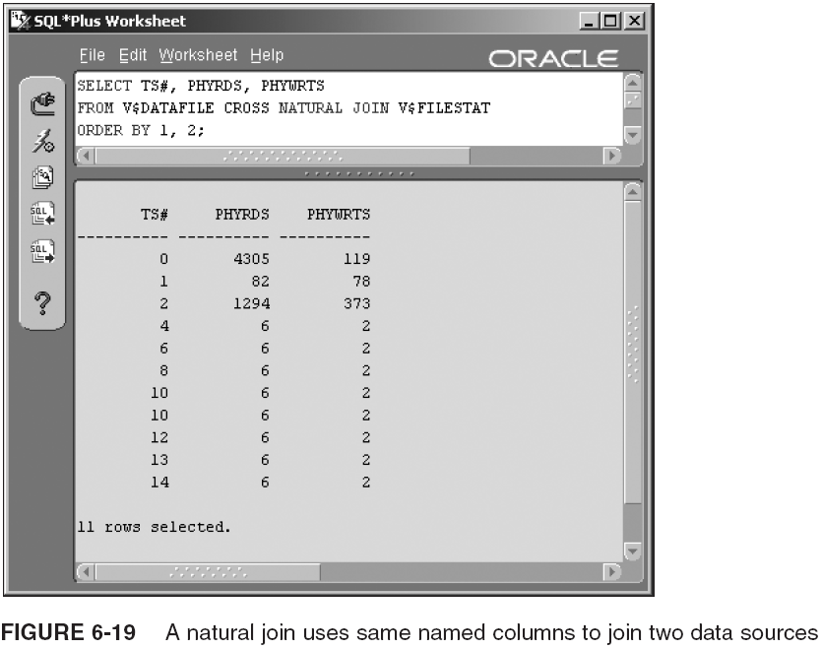
Joins (continued)

Slide 43
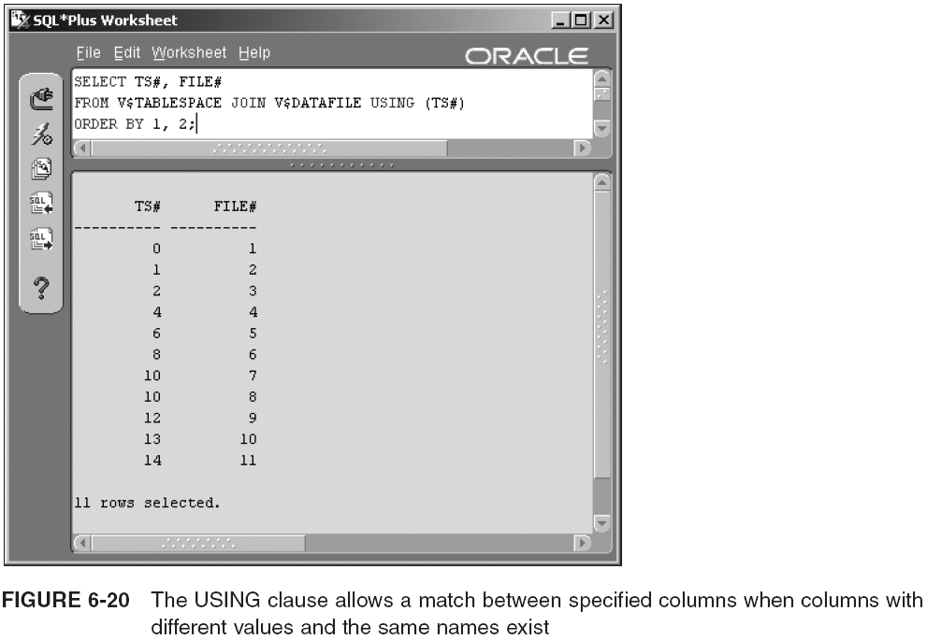
Joins (continued)

Slide 44
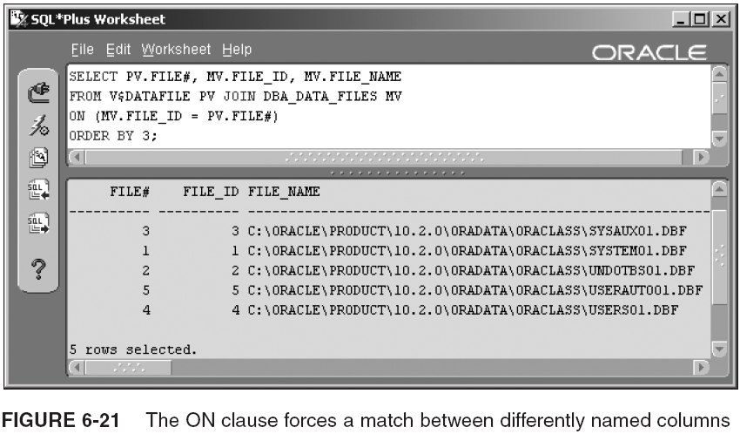
Joins (continued)

Slide 45
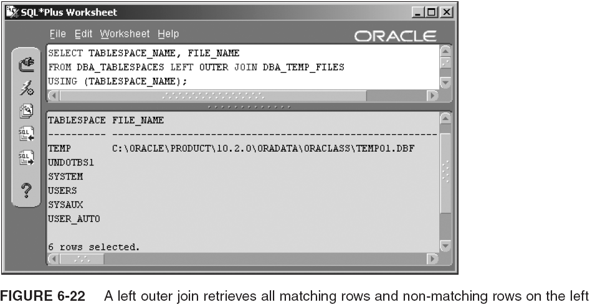
Joins (continued)

Slide 46
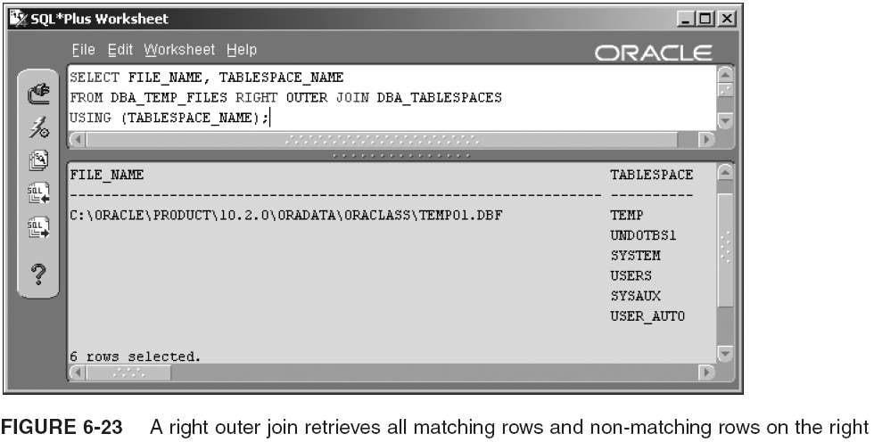
Joins (continued)

Slide 47
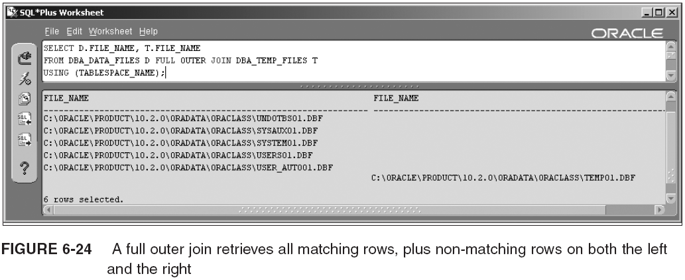
Joins (continued)

Slide 48
Subqueries
Queries executed within other queries
  (subquery) { = | != | LIKE | [ NOT ] IN } (subquery)
  [ NOT ] EXISTS (subquery)
  (subquery) BETWEEN (subquery) AND (subquery)
  (subquery) { = | != | > | < | >= | <= } {ANY | SOME | ALL} (subquery)
Types:
  Single row or single column
    SELECT * FROM V$DATAFILE
    WHERE TS# =
    (SELECT TS# FROM V$TABLESPACE WHERE NAME='SYSTEM');
  Multiple row, single column
    SELECT * FROM V$DATAFILE
    WHERE TS# IN
    (SELECT TS# FROM V$TABLESPACE);

Slide 49
Subqueries (continued)
Multiple column, single or multiple rows
  SELECT * FROM DBA_DATA_FILES
  WHERE (FILE_NAME, FILE_ID) IN
  (SELECT NAME, FILE# FROM V$DATAFILE);
Regular subquery
  SELECT * FROM V$DATAFILE
  WHERE TS# IN
  (SELECT TS# FROM V$TABLESPACE);
Correlated subquery
  SELECT * FROM V$DATAFILE D
  WHERE D.TS# IN
  (SELECT TS# FROM V$TABLESPACE
  SELECT * FROM V$DATAFILE D
  WHERE EXISTS
  (SELECT TS# FROM V$TABLESPACE
  WHERE TS# = D.TS#);

Slide 50
Subqueries (continued)
Nested subquery
  SELECT * FROM DBA_INDEXES
  WHERE TABLE_NAME IN
  (
  SELECT TABLE_NAME FROM DBA_TABLES
  WHERE TABLESPACE_NAME IN
  (
  SELECT TABLESPACE_NAME FROM DBA_TABLESPACES
  WHERE TABLESPACE_NAME IN
  (
  SELECT TABLESPACE_NAME FROM DBA_DATA_FILES
  )
  )
  );

Slide 51
Subqueries (continued)
Inline view
  SELECT T.TABLESPACE_NAME, D.FILE_NAME
  FROM DBA_TABLESPACES T,
  (
  SELECT TABLESPACE_NAME, FILE_NAME
  FROM DBA_DATA_FILES
  ) D
  WHERE D.TABLESPACE_NAME = T.TABLESPACE_NAME;
DML subqueries
  INSERT INTO DETAIL_TABLE (DETAIL_PK_ID, MASTER_FK__ID)
  VALUES (DETAIL_SEQ,
  ( SELECT MASTER_ID FROM MASTER_TABLE
  WHERE MASTER_NAME = '<a unique master literal value>')
  );
  UPDATE DETAIL_TABLE SET MASTER_PK_ID =
  ( SELECT MASTER_ID FROM MASTER_TABLE
  WHERE MASTER_NAME = '<a unique master literal value>')
  WHERE DETAIL_PK_ID = 1;

Slide 52
Other Specialized Queries
Specialized query types examined in this section are:
  Composite queries
  Hierarchical queries
  Flashback queries
  Parallel queries

Slide 53
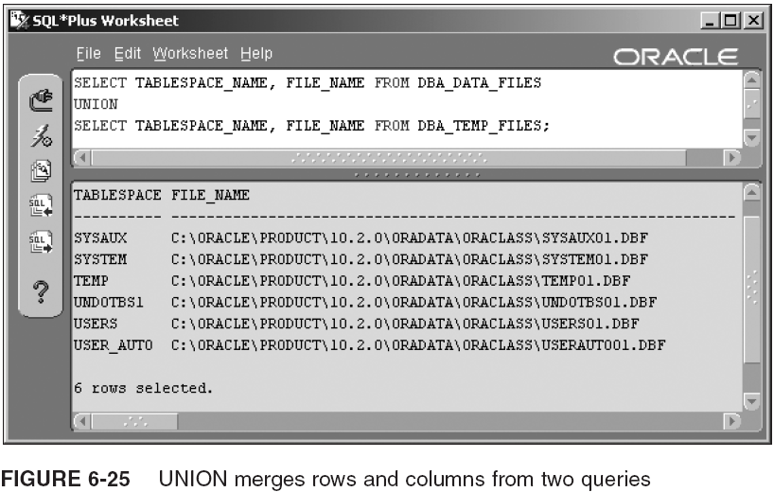
Composite Queries
Other variations use UNION ALL, INTERSECT, and MINUS

Slide 54
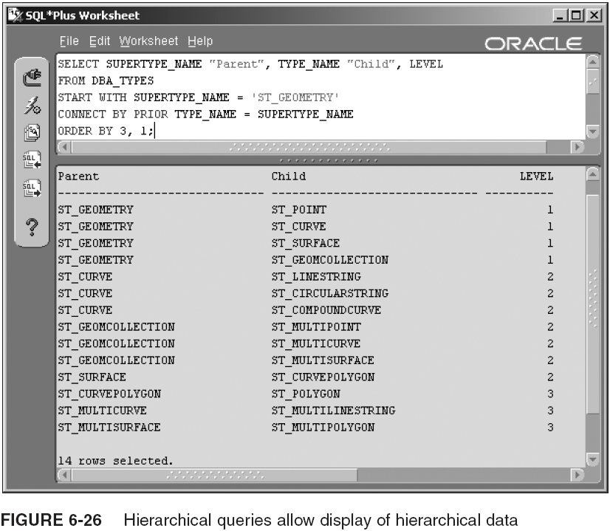
Hierarchical Queries

Slide 55
Flashback Queries
Allows a flashback to data as it was at some point
  AS OF queries go back = using a timestamp or SCN
  SELECT ... FROM ...
  [
  AS OF { SCN | TIMESTAMP } expression
  | VERSIONS BETWEEN { SCN | TIMESTAMP} { expression | MINVALUE }
  AND { expression | MAXVALUE }
  ]
  [ WHERE ... ] [ ORDER BY ... ] [ GROUP BY ... ];
Pseudocolumns available for flashback queries:
  ORA_ROWSCN
  VERSIONS_{START|END}TIME
  VERSIONS_{START|END}SCN
  VERSIONS_XID
  VERSIONS_OPERATION

Slide 56
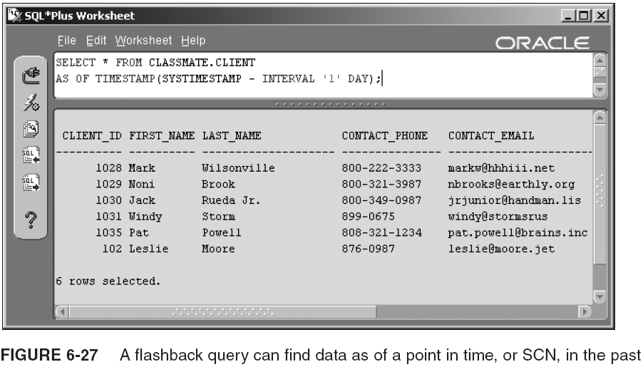
Flashback Queries (continued)

Slide 57
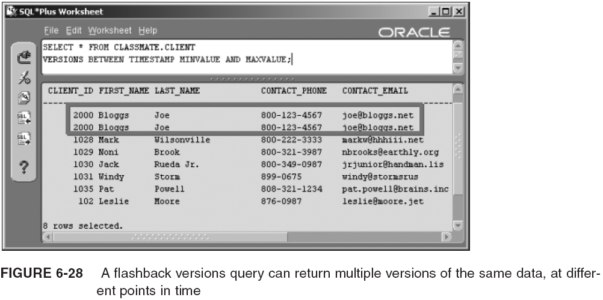
Flashback Queries (continued)

Slide 58
Flashback Database
Another feature of flashback technology is the ability to flashback an entire table or even a complete database using the following syntax:
  FLASHBACK [ STANDBY ] DATABASE [ database ]
  TO { SCN | TIMESTAMP } expression;
  FLASHBACK TABLE { [ schema.]table , ... }
  TO { SCN | TIMESTAMP } expression
  [ { ENABLE | DISABLE } TRIGGERS ];
  FLASHBACK DATABASE and FLASHBACK TABLE allow restoration of either the entire database or a single table back to, and in the case of a table, even forward to a different SCN

Slide 59
Parallel Queries
Work best on multiple CPU platforms in tandem with partitioning, and with multiple disks or RAID arrays
SQL queries and coding that can be executed in parallel are limited to the following functionality:
  Queries containing at least one table scan using SELECT/INSERT/UPDATE/DELETE statements
  CREATE INDEX and ALTER INDEX REBUILD statements
  CREATE TABLE statements for generating a table from a SELECT command
  Queries on partitions with local indexes; a local index is an index created on each separate partition

Slide 60
Parallel Queries (continued)
You can cause parallel execution in two ways:
  The PARALLEL hint:
    SELECT /*+ PARALLEL(CLASSMATE.CLIENT, 2) */ *
    FROM CLASSMATE.CLIENT;
  CREATE TABLE and ALTER TABLE statements can include the PARALLEL clause using the following syntax:
    { CREATE | ALTER } TABLE ... [ NOPARALLEL | PARALLEL [n] ];

Slide 61
Summary
A SELECT uses a list of columns and a FROM clause to retrieve rows from a table or view
  WHERE filters for removing/retaining rows from/in a query result
  ORDER BY allows sorting of rows returned by a query
Aggregate queries use GROUP BY to group rows, and HAVING to filter in or out resulting grouped rows
Join queries allow merging of columns and rows from two or more tables
Subquery: query executed within a calling query
A table/view can be created from the result of a query
Composite queries use a set operator (e.g., UNION)

Slide 62
Summary (continued)
Oracle built-in functions can be single row functions, data type conversions, or grouping functions
  You can build custom functions using PL/SQL
NULL: nothing value (sort last by default, ascending)
  NVL acts as a parse replace function for NULL values
DUAL table: dummy table, usually used to contain query results not in application tables or in metadata, such as the current system date and time
DISTINCT: used to retrieve unique values from a set
Dual comparisons can be joined (AND, OR, NOT)
Comparison conditions include conditionals such as equality, inequality, and LIKE pattern matches

Slide 63
Summary (continued)
Aliases can be used in queries (for tables/columns)
Types of joins:
  Cartesian product (cross join): merges the results of two sources, without linking the two
  Natural/inner join: finds the intersecting rows between two tables, based on a common column
  Outer join: finds intersection of two tables, plus any rows in one table, and not in the other, or both
  Left outer join: returns intersecting rows, plus all those in the left table, and not in the right table
  Right outer join: opposite of left outer join
  Full outer join: intersecting rows, left/right outer joins
  Self-join: joins rows in the same table

Slide 64
Summary (continued)
Semi-join: similar to a join but often returns only rows from one of the tables in the join
An inline view is a subquery, returning rows to the calling query, placed into the FROM clause
Hierarchical query: for construction of hierarchical row-column maps from hierarchical data
  Pseudocolumn: retrievable in a query, but not accessed from a table or view, or even metadata
Flashback queries snapshot data as it was at a previous point in time
Parallel operations can be performed on a limited set of query types

