Slide 1

Oracle 10g Database Administrator: Implementation and Administration
Chapter 7
Basic Table Management

Slide 2
Objectives
Describe the different types of tables and their storage methods
Create relational and temporary tables
Examine datatypes
Create tables containing VARRAYs and nested tables

Slide 3
Objectives (continued)
Create object and partitioned tables
View database object metadata in SQL*Plus, Enterprise Manager console, and the Database Control

Slide 4
Introduction to Table Structures
There are several different kinds of tables you can create, depending on what you need to store:
  Relational table
  Index-organized table
  Object tables
  Temporary table
  External table
  Nested table
  XML table
  Cluster
  Partitions

Slide 5
Setting Block Space Usage
A table’s storage is contained in a single segment
  Segment contains one or more extents
  Each extent contains a contiguous set of data blocks
  A block represents a group of bytes in physical file
    Default size is 8192 bytes, determined on DB creation
  DEFAULT STORAGE (INITIAL <nn> NEXT <nn> PCTINCREASE <nn>
  MINEXTENTS <nn> MAXEXTENTS <nn>)
  TABLESPACE <tablespace name>
  STORAGE (INITIAL <nn> NEXT <nn> PCTINCREASE <nn>
  MINEXTENTS <nn> MAXEXTENTS <nn>
  FREELISTS <nn> FREELIST GROUPS <nn>
  BUFFER_POOL KEEP|RECYCLE|DEFAULT
  PCTFREE <nn> PCTUSED <nn> MINTRANS <nn>)

Slide 6
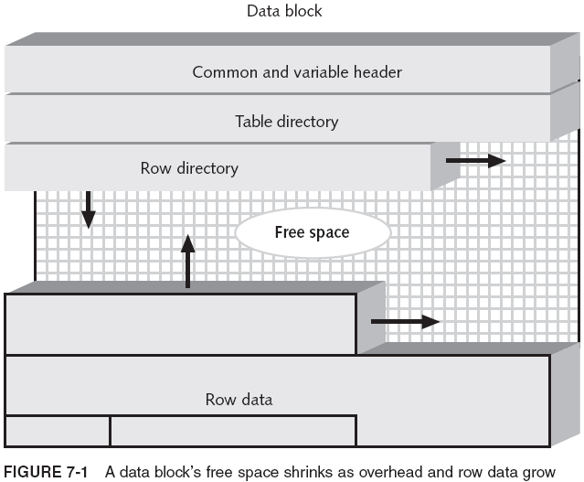
Setting Block Space Usage (continued)

Slide 7
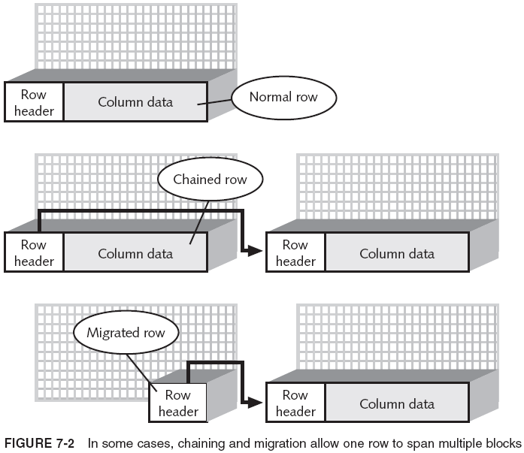
Setting Block Space Usage (continued)

Slide 8
Storage Methods
Storage methods for tables depend on the type of table you are creating and the characteristics of the tablespace in which you create the table
  If you define a table with no storage settings, Oracle uses the default settings in tablespace (if they exist)
    If no storage defaults were set up, Oracle uses:
      PCTFREE=10
      PCTUSED=40
      INITRANS=1 (1 for tables and 2 for indexes)
The most important difference in storage methods is between locally and dictionary-managed tablespaces

Slide 9
How to Set Storage for Locally Managed Tables
What storage information do you specify for a table in a locally managed tablespace?
  TABLESPACE
  STORAGE (INITIAL <nn>)
    If clause is omitted, Oracle uses the tablespace settings, applying them table creation as a default
If tablespace has no MINEXTENTS setting, Oracle creates a table with an initial extent of five data blocks for AUTOALLOCATE, or one extent of whatever extent size is specified in UNIFORM
Locally managed tables eliminate much of the work in managing storage space
  It is still important to estimate the initial size of table

Slide 10
How to Set Storage for Dictionary-Managed Tables
Examples:
  CREATE TABLE BIKE_MAINTENANCE
  (BIKE_ID NUMBER(10),
  REPAIR_DATE DATE,
  DESCRIPTION VARCHAR2(30));
  DEFAULT STORAGE (INITIAL 10M NEXT 2M
  PCTINCREASE 0 PCTFREE 10 PCTUSED 80)
  CREATE TABLE TRUCK_MAINTENANCE
  (TRUCK_ID NUMBER(10),
  REPAIR_DATE DATE,
  PROBLEM_DESCRIPTION VARCHAR2(2000),
  DIAGNOSIS VARCHAR2(2000),
  BILLING_DATE DATE,
  BILLING_AMT NUMBER (10,2))
  TABLESPACE USER_DTAB
  STORAGE (INITIAL 80M NEXT 40M PCT INCREASE 0
  MINEXTENTS 2 MAXEXTENTS 25
  PCTFREE 25 PCTUSED 50 MINTRANS 1 MAXTRANS 2)

Slide 11
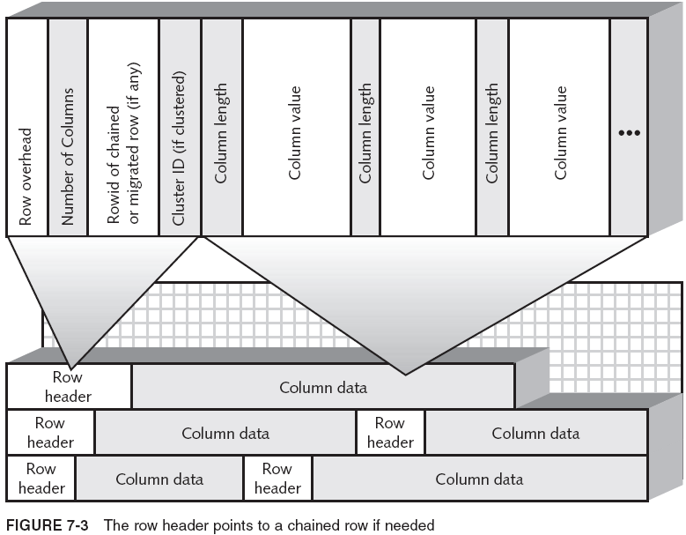
Row Structure and the ROWID

Slide 12
Row Structure and the ROWID (continued)
A chained or migrated row is located by the ROWID stored in the row header
Indexes store the index column values and the ROWID of the associated row in the table
The ROWID allows Oracle to retrieve a row quickly
  Access by ROWID is probably the fastest method of data retrieval but is unreliable
A ROWID is made up of both physical and logical disk references
  The ROWIDs can be changed by the database
    Oracle does not recommend using ROWID values for referential integrity (primary and foreign keys)

Slide 13
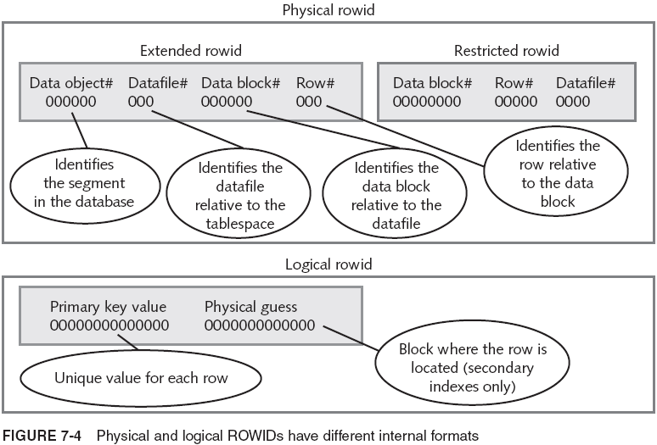
Row Structure and the ROWID (continued)

Slide 14
Row Structure and the ROWID (continued)
Frequently updated object types in read-only DBs use ROWIDs as standard reference values
Indexes have ROWID pointers back to table rows
  Indexes often can retrieve data more rapidly than a full scan of an entire table
  Optimizer decides whether to use an index for a query or not
  Automatically kept updated as data in table changes
  UROWID datatype

Slide 15
Creating Tables
For relational tables (the most common type of table), the CREATE TABLE syntax looks like this:
  CREATE TABLE <schema>.<tablename>
  (<column_name> <datatype> <size> NULL|NOT NULL
  DEFAULT <default_value> CHECK <check_constraint>,
  ... )
  <constraints>
  TABLESPACE <tablespace name>
  STORAGE (INITIAL <nn> NEXT <nn> PCTINCREASE <nn>
  MINEXTENTS <nn> MAXEXTENTS <nn>
  FREELISTS <nn> FREELIST GROUPS <nn>
  BUFFER_POOL KEEP|RECYCLE|DEFAULT
  PCTFREE <nn> PCTUSED <nn> MINTRANS <nn> MAXTRANS <nn>)

Slide 16
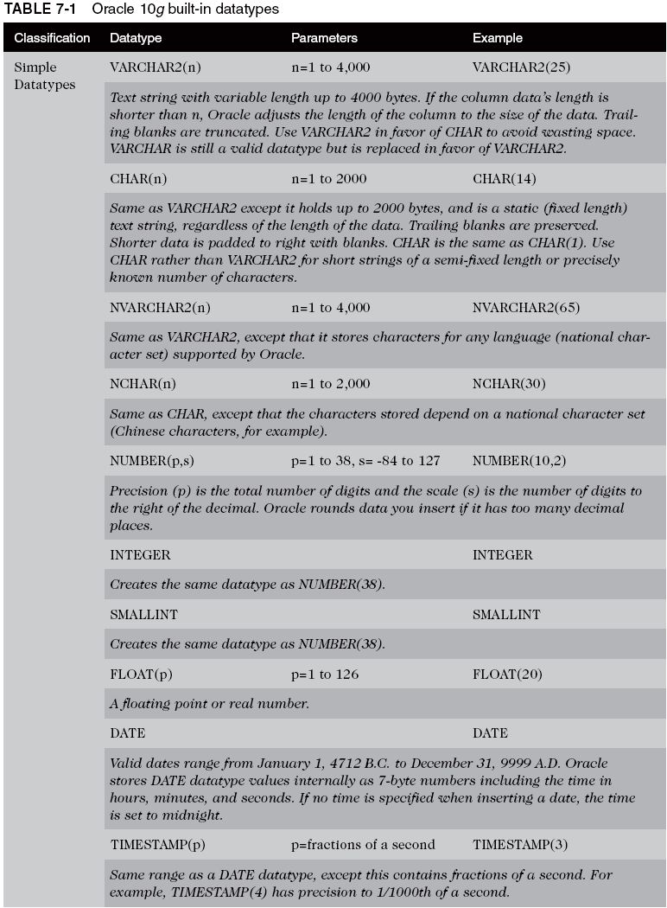
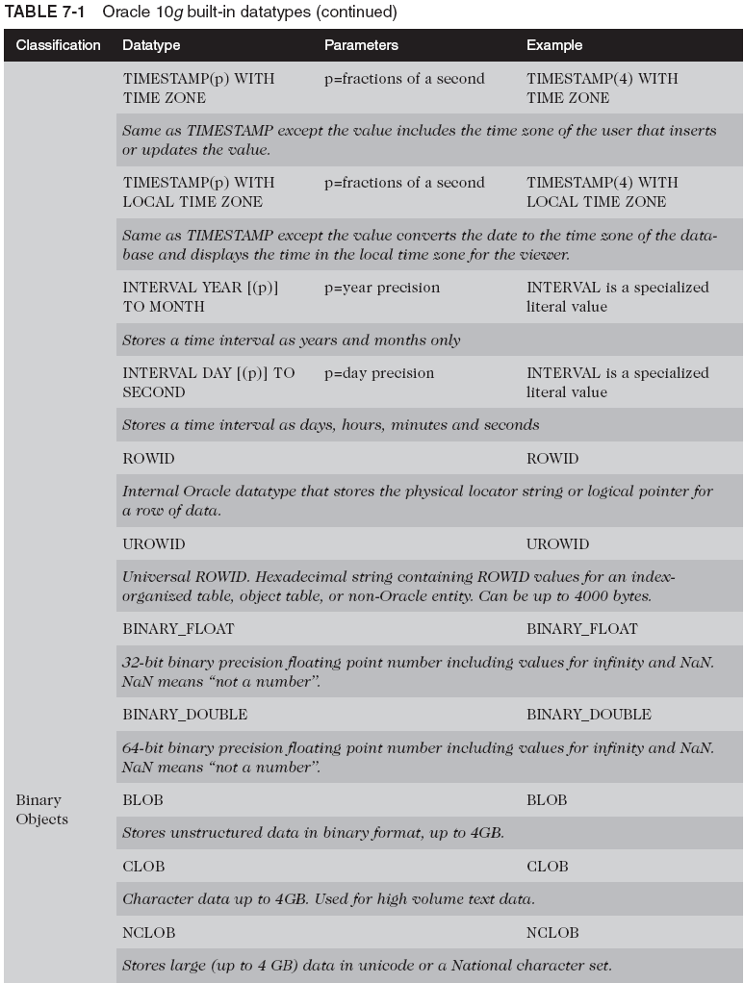
Columns and Datatypes

Slide 17
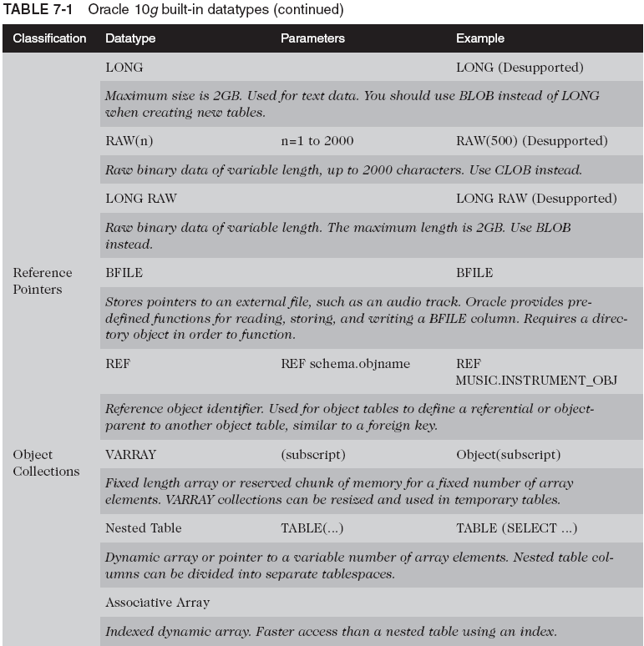
Columns and Datatypes (continued)

Slide 18
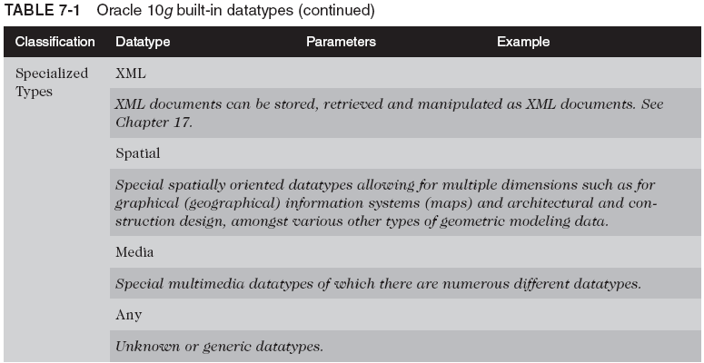
Columns and Datatypes (continued)

Slide 19
Creating Relational Tables
To design a relational table, decide these factors:
  Name of the table
  Name and datatype of all columns
    1–30 characters long
    If enclosed in “”, it is case sensitive and can begin with any letter/number/symbol (including spaces)
      Otherwise it is interpreted as uppercase, and must begin with a letter, although it can contain any letter, number, and the symbols #, $, and _
  Estimated initial size and growth pattern
    Helps you specify the storage settings for the table
  Location of the table
  Constraints, relationships to other tables, default data

Slide 20
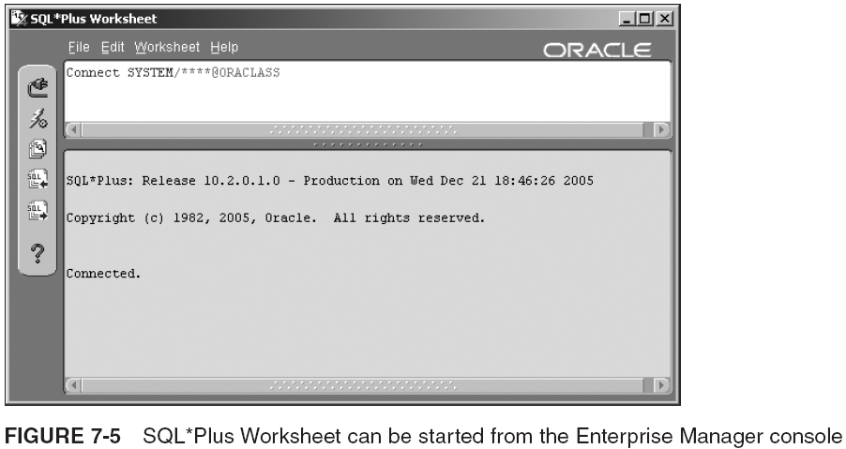
Creating Relational Tables (continued)

Slide 21
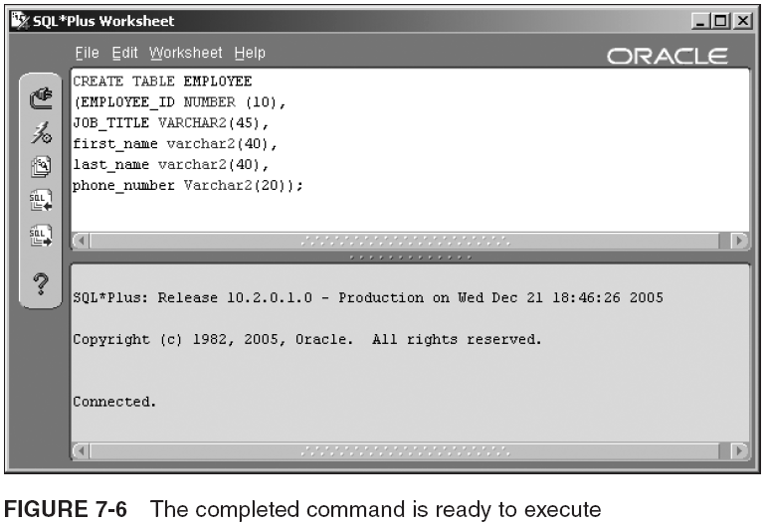
Creating Relational Tables (continued)

Slide 22
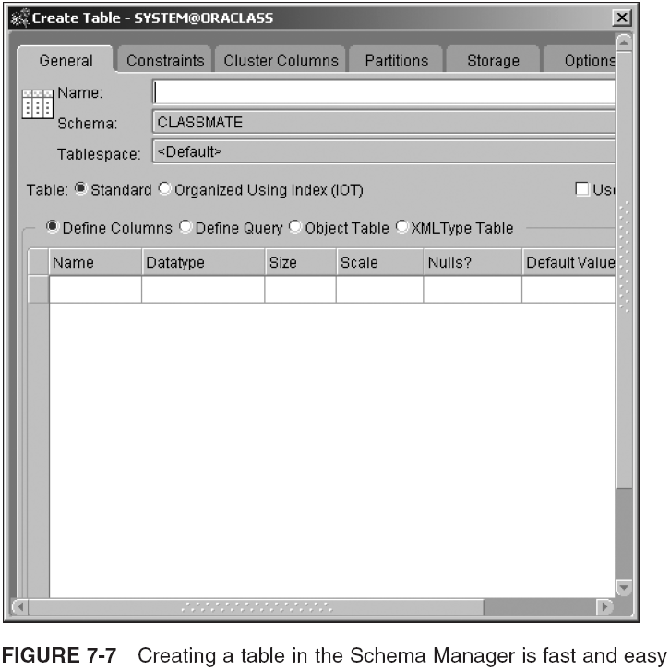
Creating Relational Tables (continued)

Slide 23
Creating Relational Tables (continued)
CREATE TABLE CLASSIFIED_AD
(AD_NO NUMBER NOT NULL,
SECTION_NO NUMBER NOT NULL,
AD_TEXT VARCHAR2(1000),
CUSTOMER_ID NUMBER,
INTAKE_EDITOR_ID NUMBER,
PRICE NUMBER (6,2),
PLACED_DATE DATE,
"Run Start Date" TIMESTAMP WITH LOCAL TIME ZONE,
"Run End Date" TIMESTAMP WITH LOCAL TIME ZONE,
RUN_DAYS INTERVAL DAY(3) TO SECOND(0))
TABLESPACE USERS
STORAGE (INITIAL 2M NEXT 2M MAXEXTENTS 10);

Slide 24
Creating Temporary Tables
Temporary table: created to store data for a session
  Data automatically deleted on log off or after COMMIT
    Timing of removal depends on ON COMMIT clause
      CREATE GLOBAL TEMPORARY TABLE <tablename>
      ON COMMIT DELETE ROWS|PRESERVE ROWS
      <table specifications>
      TABLESPACE <tablespace name>
      STORAGE (<storage settings>);
      If you name tablespace, it must be the current temporary tablespace or a tablespace you have authority to use (preferably locally managed)
  Adding/changing data does not generate redo log entries; however, it does generate undo log entries
  Uses temporary segments, which are not allocated to table until data is actually inserted into the table

Slide 25
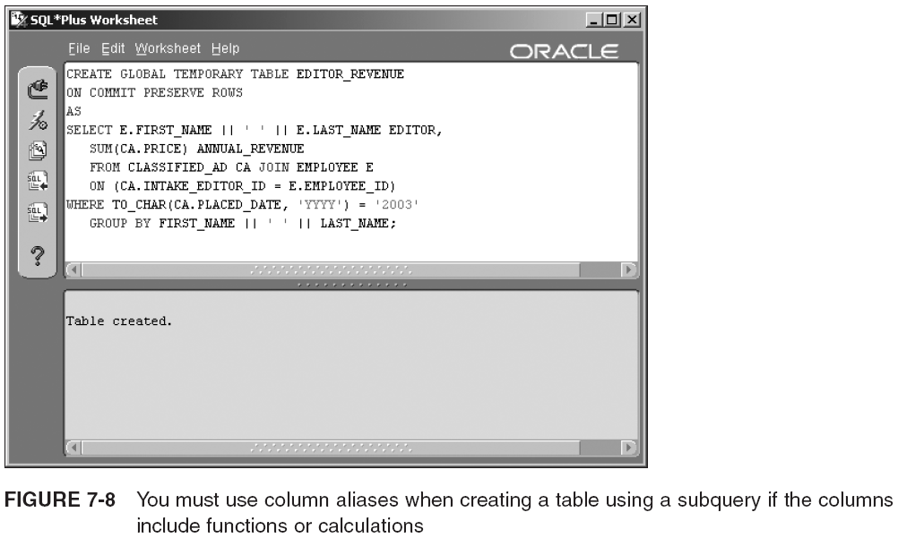
Creating Temporary Tables (continued)

Slide 26
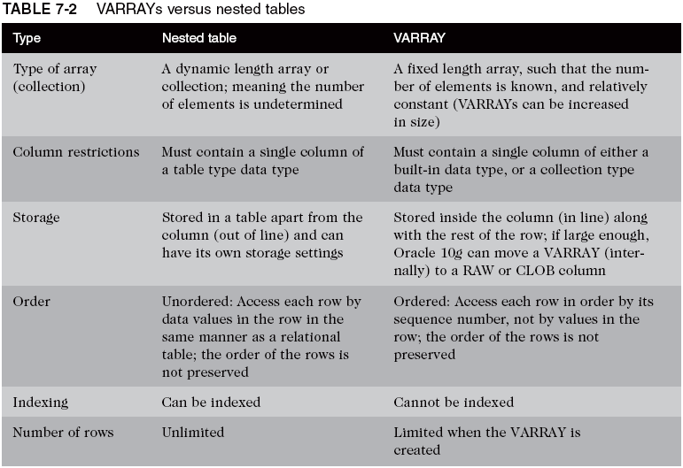
Creating VARRAYs and Nested Tables

Slide 27
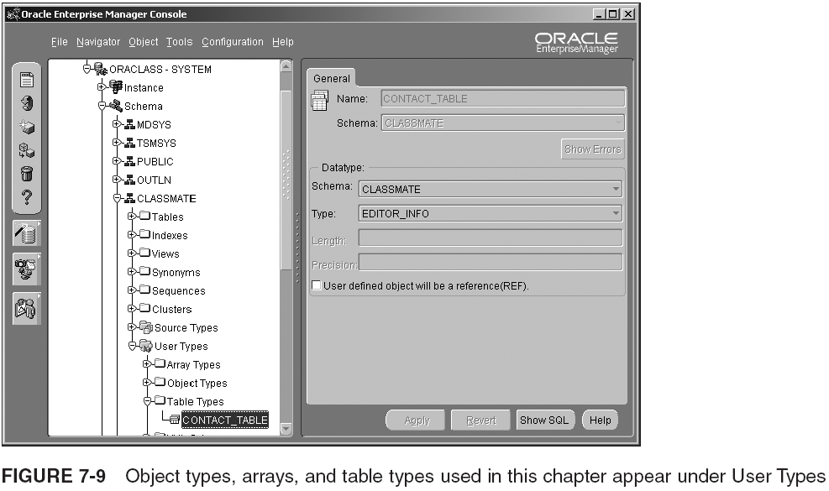
Creating VARRAYs and Nested Tables (continued)

Slide 28
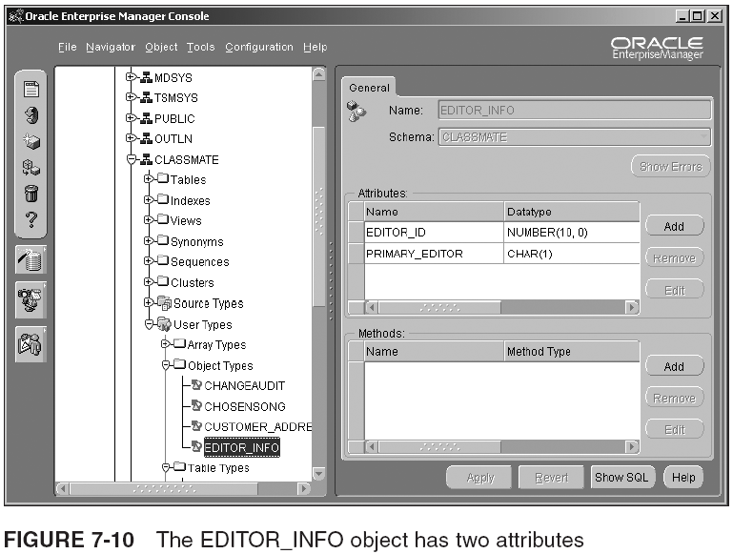
Creating VARRAYs and Nested Tables (continued)

Slide 29
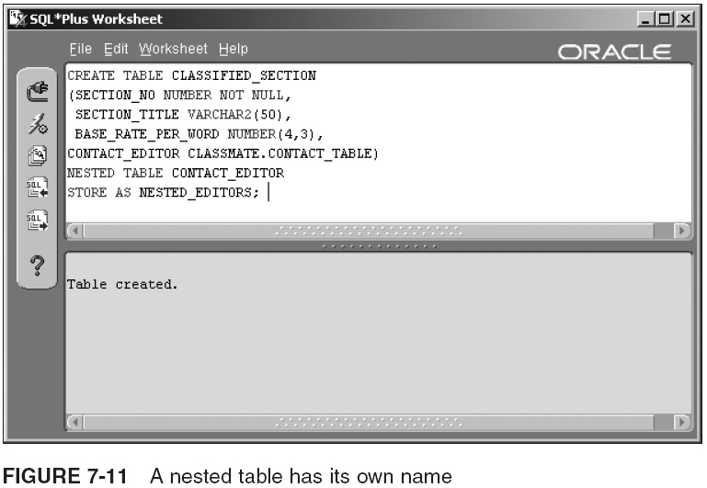
Creating VARRAYs and Nested Tables (continued)

Slide 30
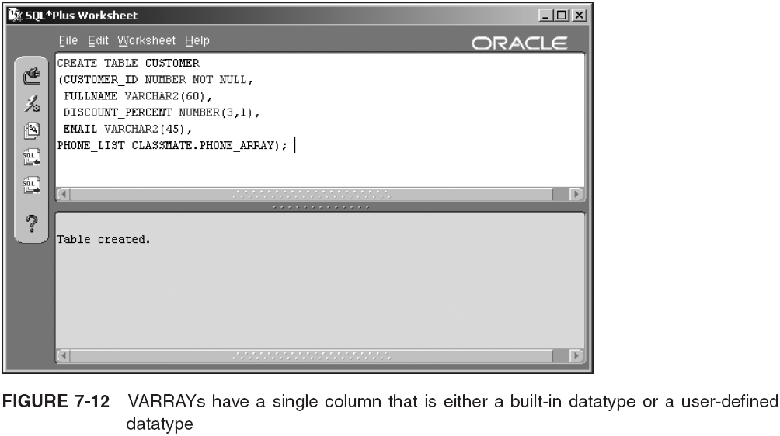
Creating VARRAYs and Nested Tables (continued)

Slide 31
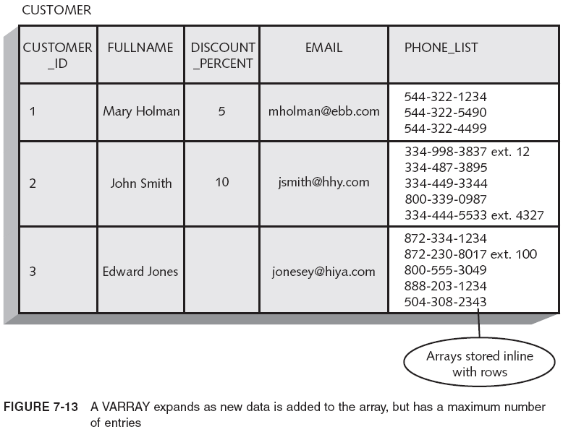
Creating VARRAYs and Nested Tables (continued)

Slide 32
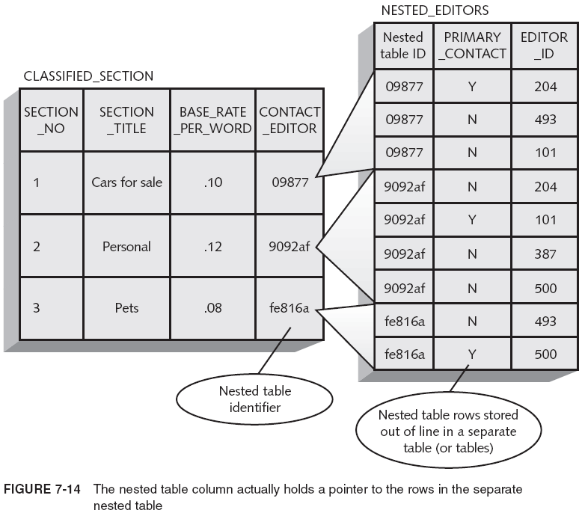
Creating VARRAYs and Nested Tables (continued)

Slide 33
Creating Object Tables
Object tables are created with one column that has a datatype that is a user-defined object type
  An object type contains one or more attributes, which can be made up of another object type
  Object tables can be built with layers of object types in their definitions
  You must create an object type that has the design you want to use for your object table before actually creating the object table
    CREATE TABLE CUSTOMER_ADDRESS
    OF CUSTOMER_ADDRESS_TYPE;
  An object table row is also called an object table instance

Slide 34
Creating Partitioned Tables
To improve performance, you can break a large table into separate sections, called partitions
  You can partition any table (except if part of a cluster)
  Partitions can be stored in separate tablespaces
Partitioning can be done in five ways:
  Range
  Hash
  List
  Composite range-hash
  Composite range-list
To create a partitioned table, use CREATE TABLE and add the PARTITION clause

Slide 35
Range Partitioning
CREATE TABLE TRANSACTION_RECORD
( ACCT_NO NUMBER NOT NULL,
ACTION VARCHAR2(5) NOT NULL,
AMOUNT NUMBER(8,2) NOT NULL,
SENDING_ACCT_NO NUMBER NOT NULL,
ACTION_DATE DATE NOT NULL )
PARTITION BY RANGE (ACCT_NO)
( PARTITION TRANS_P1 VALUES LESS THAN (2900999)
TABLESPACE TBS1,
PARTITION TRANS_P2 VALUES LESS THAN (5900999)
TABLESPACE TBS2,
PARTITION TRANS_P3 VALUES LESS THAN (9900999)
TABLESPACE TBS3);

Slide 36
Hash Partitioning
CREATE TABLE MORTGAGE_HISTORY
(LOAN_NO NUMBER,
ACCT_NO NUMBER,
DATE_CREATED DATE,
MORTGAGE_AMOUNT NUMBER)
PARTITION BY HASH (DATE_CREATED)
PARTITIONS 3
STORE IN (HISTORY_TBS1, HISTORY2, HISTORYEXTENDED);
The tablespace to use for each partition is named in the STORE IN clause

Slide 37
List Partitioning
CREATE TABLE TRANS_BY_BRANCH_HISTORY
(BRANCH_ID NUMBER(9,0),
BRANCH_REGION VARCHAR2(10),
TRANS_YEAR NUMBER(4,0),
TRANS_MONTH NUMBER(2,0),
TRANS_AMOUNT NUMBER(10,2))
PARTITION BY LIST (BRANCH_REGION)
(PARTITION WESTERN VALUES ('WESTCOAST', 'NORTHWEST')
TABLESPACE TBS1,
PARTITION MOUNTAIN VALUES ('ROCKIES', 'SOUTHWEST')
TABLESPACE TBS2,
PARTITION MIDWEST
VALUES ('MIDWEST', 'IL-METRO')
STORAGE (INITIAL 20M NEXT 40M)
TABLESPACE TBS2,
PARTITION NORTHEAST VALUES ('NY-METRO', 'NE-STATES')
TABLESPACE TBS3,
PARTITION SOUTHEAST VALUES ('SOUTHEAST'))
TABLESPACE TBS4;

Slide 38
Composite Range-Hash Partitioning
CREATE TABLE TRANSACTION_RECORD
( ACCT_NO NUMBER NOT NULL,
ACTION VARCHAR2(5) NOT NULL,
AMOUNT NUMBER(8,2) NOT NULL,
SENDING_ACCT_NO NUMBER NOT NULL,
ACTION_DATE DATE NOT NULL )
PARTITION BY RANGE (ACCT_NO)
SUBPARTITION BY HASH (ACTION_DATE)
SUBPARTITIONS 4 STORE IN
(TBS1, TBS2, TBS3, TBS4)
PARTITION TRANS_P1 VALUES LESS THAN (2900999),
PARTITION TRANS_P2 VALUES LESS THAN (5900999),
PARTITION TRANS_P3 VALUES LESS THAN (9900999));

Slide 39
Composite Range-List Partitioning
CREATE TABLE TRANSACTION_RECORD
( ACCT_NO NUMBER NOT NULL,
ACTION VARCHAR2(5) NOT NULL,
AMOUNT NUMBER(8,2) NOT NULL,
SENDING_ACCT_NO NUMBER NOT NULL,
ACTION_DATE DATE NOT NULL )
PARTITION BY RANGE (ACCT_NO)
SUBPARTITION BY LIST (ACTION)
(PARTITION TRANS_P1 VALUES LESS THAN (9900999)
TABLESPACE TBS1
(SUBPARTITION WESTERN VALUES ('WESTCOAST', 'NORTHWEST'),
SUBPARTITION MOUNTAIN VALUES ('ROCKIES', 'SOUTHWEST'),
SUBPARTITION MIDWEST VALUES ('MIDWEST', 'IL-METRO'),
SUBPARTITION NORTHEAST VALUES ('NY-METRO', 'NE-STATES'),
SUBPARTITION SOUTHEAST VALUES ('SOUTHEAST')),
PARTITION TRANS_P2 VALUES LESS THAN (5900999)
TABLESPACE TBS2
(SUBPARTITION WESTERN VALUES ('WESTCOAST', 'NORTHWEST'),
SUBPARTITION MOUNTAIN VALUES ('ROCKIES', 'SOUTHWEST'),
SUBPARTITION MIDWEST VALUES ('MIDWEST', 'IL-METRO'),
SUBPARTITION NORTHEAST VALUES ('NY-METRO', 'NE-STATES'),
SUBPARTITION SOUTHEAST VALUES ('SOUTHEAST')),
PARTITION TRANS_P3 VALUES LESS THAN (2900999)
TABLESPACE TBS3
(SUBPARTITION WESTERN VALUES ('WESTCOAST', 'NORTHWEST'),
SUBPARTITION MOUNTAIN VALUES ('ROCKIES', 'SOUTHWEST'),
SUBPARTITION MIDWEST VALUES ('MIDWEST', 'IL-METRO'),
SUBPARTITION NORTHEAST VALUES ('NY-METRO', 'NE-STATES'),
SUBPARTITION SOUTHEAST VALUES ('SOUTHEAST'));

Slide 40
Composite Range-List Partitioning (continued)
CREATE TABLE TRANSACTION_RECORD
( ACCT_NO NUMBER NOT NULL,
ACTION VARCHAR2(5) NOT NULL,
AMOUNT NUMBER(8,2) NOT NULL,
SENDING_ACCT_NO NUMBER NOT NULL,
ACTION_DATE DATE NOT NULL )
PARTITION BY RANGE (ACCT_NO)
SUBPARTITION BY LIST (ACTION)
SUBPARTITION TEMPLATE
(SUBPARTITION WESTERN VALUES ('WESTCOAST', 'NORTHWEST'),
SUBPARTITION MOUNTAIN VALUES ('ROCKIES', 'SOUTHWEST'),
SUBPARTITION MIDWEST VALUES ('MIDWEST', 'IL-METRO'),
SUBPARTITION NORTHEAST VALUES ('NY-METRO', 'NE-STATES'),
SUBPARTITION SOUTHEAST VALUES ('SOUTHEAST'))
(PARTITION TRANS_P1 VALUES LESS THAN (9900999)
TABLESPACE TBS1,
PARTITION TRANS_P2 VALUES LESS THAN (5900999)
TABLESPACE TBS2,
PARTITION TRANS_P3 VALUES LESS THAN (2900999)
TABLESPACE TBS3);

Slide 41
Composite Range-List Partitioning (continued)
Index-organized tables can also be partitioned with the following restrictions:
  The partition key must be all or a subset of the table’s primary key
  Only range and hash partitioning are allowed
  Only range-partitioned, index-organized tables can contain large object (LOB) columns

Slide 42
Viewing Database Object Attributes
Like many types of objects in an Oracle database, tables, indexes, and their attributes can be examined easily using some specific metadata dictionary views
You can also look at metadata structures using tools, such as the Enterprise Manager console and the Database Control
You begin with metadata views, then the console, and finally the Database Control

Slide 43
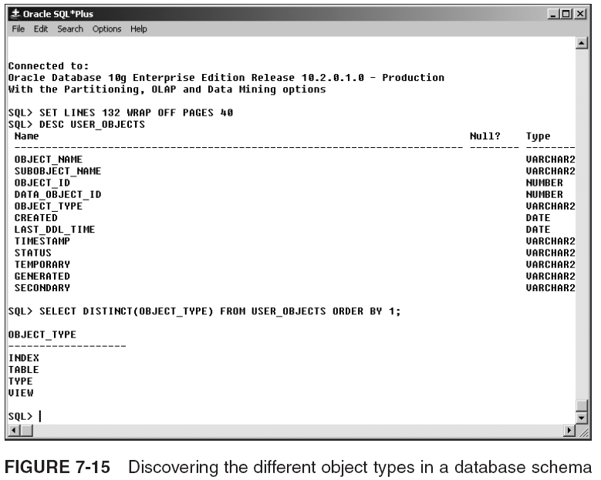
Viewing Object Metadata in SQL*Plus

Slide 44
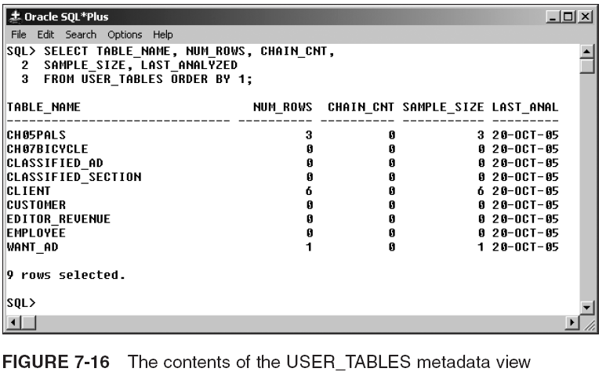
Viewing Object Metadata in SQL*Plus (continued)

Slide 45
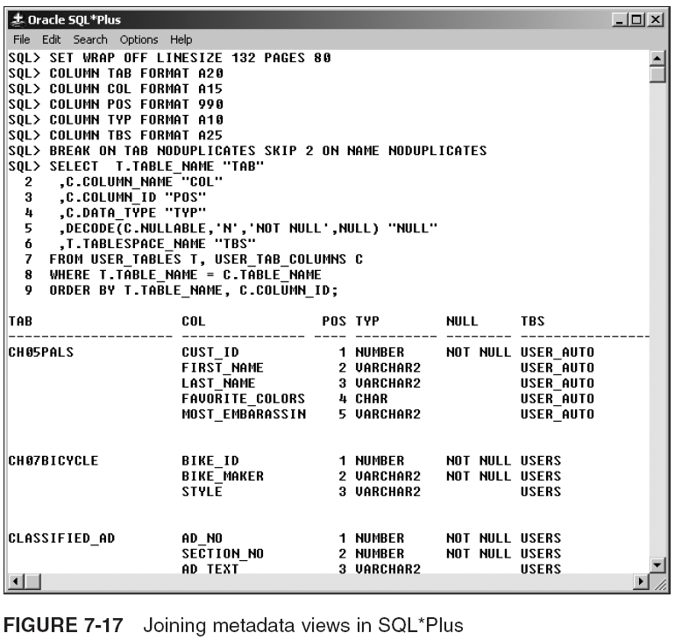
Viewing Object Metadata in SQL*Plus (continued)

Slide 46
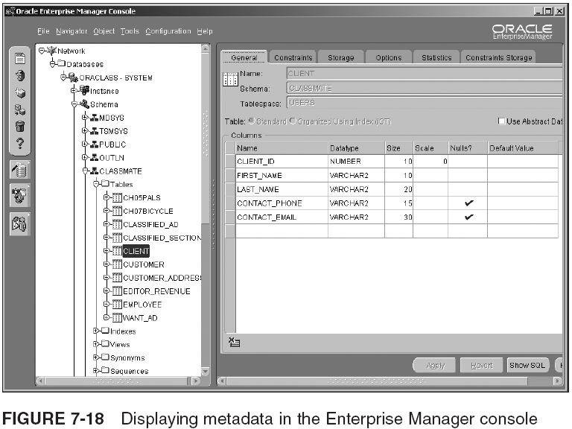
Viewing Object Metadata in the Console

Slide 47
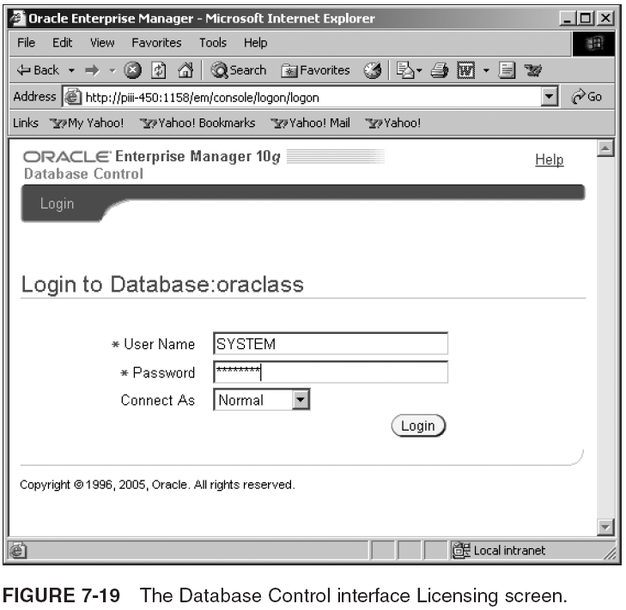
Viewing Object Metadata in the Database Control

Slide 48
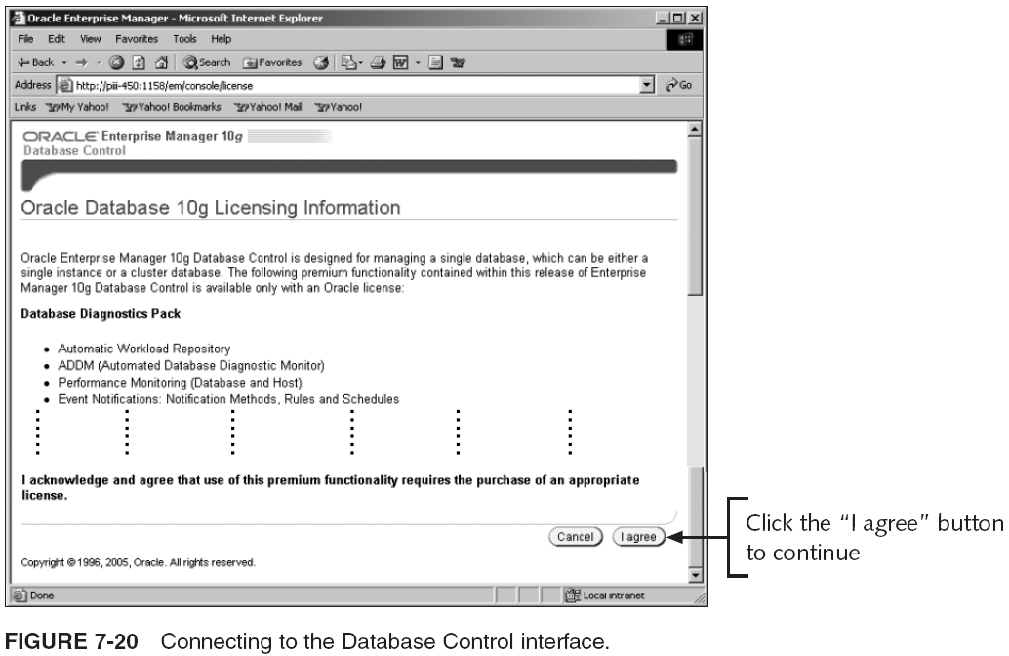
Viewing Object Metadata in the Database Control (continued)

Slide 49
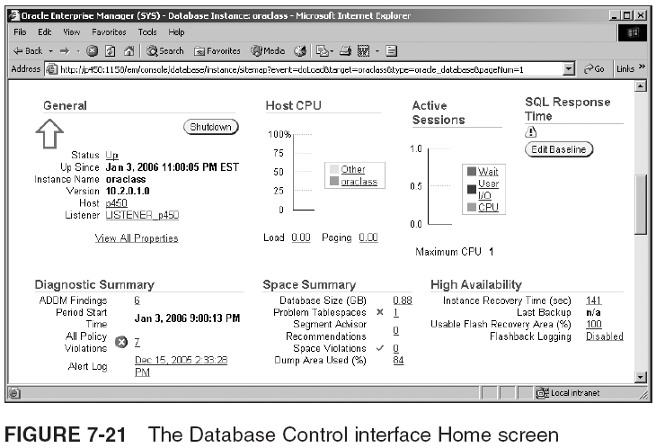
Viewing Object Metadata in the Database Control (continued)

Slide 50
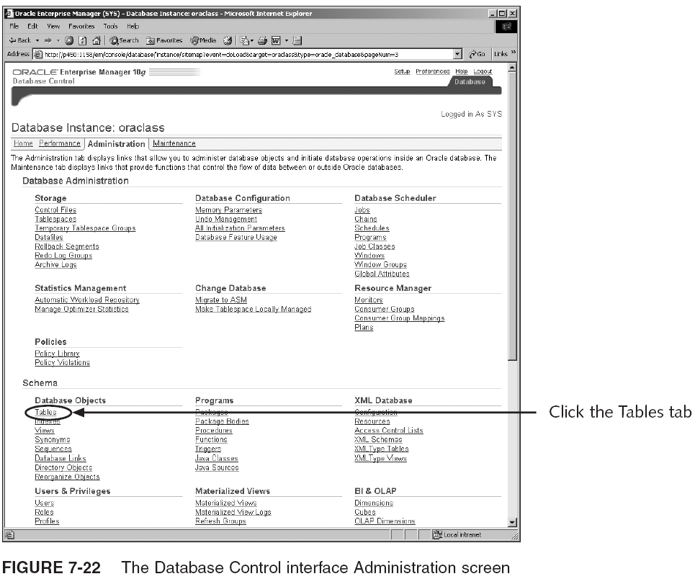
Viewing Object Metadata in the Database Control (continued)

Slide 51
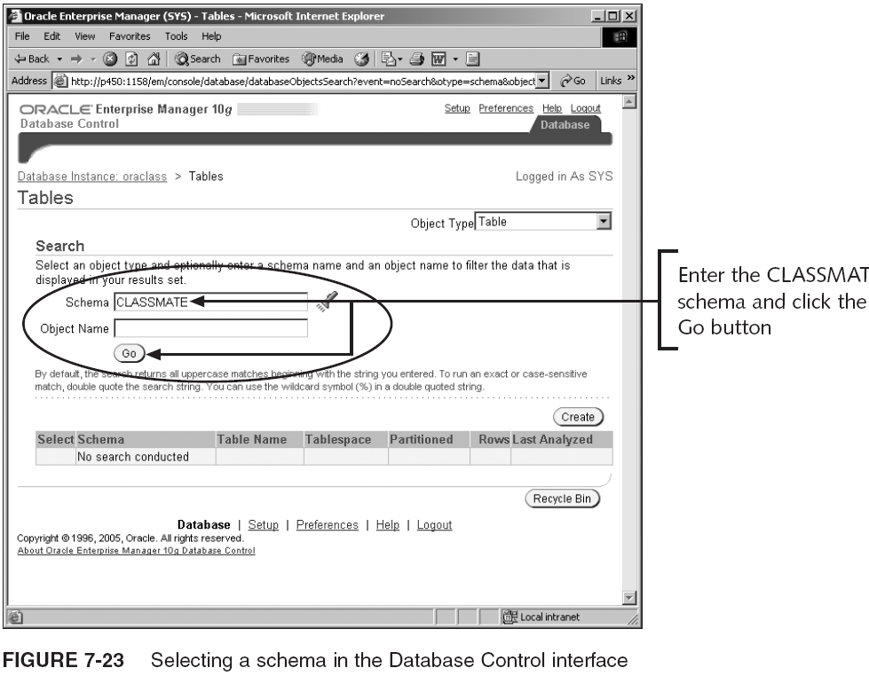
Viewing Object Metadata in the Database Control (continued)

Slide 52
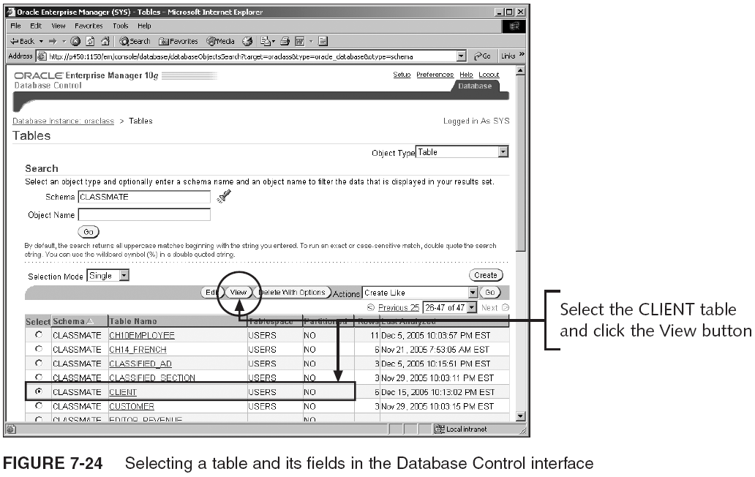
Viewing Object Metadata in the Database Control (continued)

Slide 53
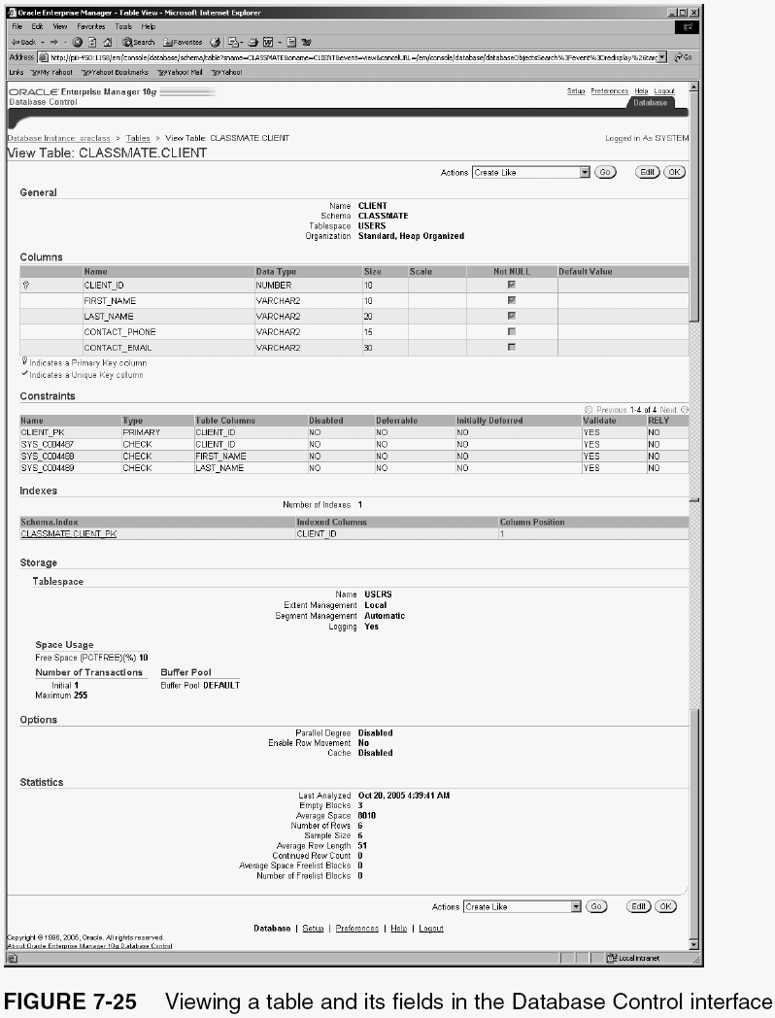
Viewing Object Metadata in the Database Control (continued)

Slide 54
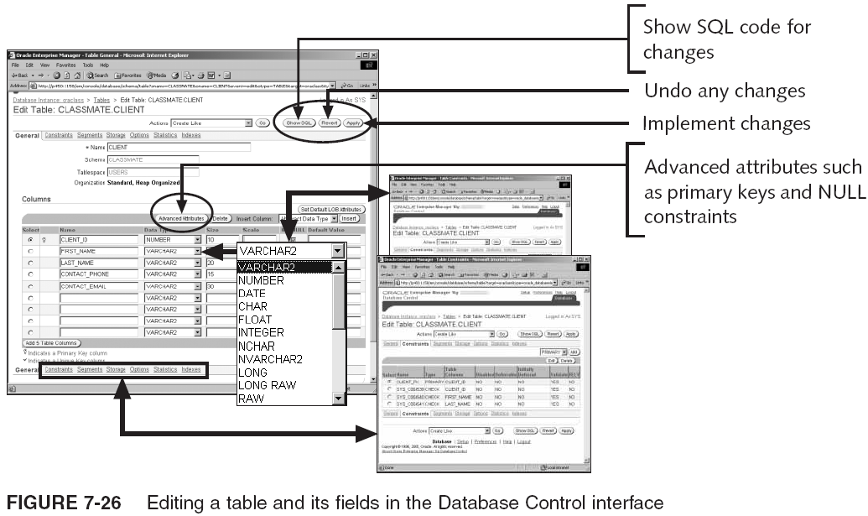
Viewing Object Metadata in the Database Control (continued)

Slide 55
Summary
Relational tables: most common table in Oracle DB
  Reside in a single segment within a tablespace
    Unless table is partitioned
  Index-organized tables have a primary key used to arrange the physical order of rows
  Object tables have rows made up of an object type
  A temporary table is seen only by one user and is created for private data
  External tables are read-only
  A nested table is a table within a single column or within an attribute of an object table
  An XML table has a single column of the XML type datatype and contains XML formatted data

Slide 56
Summary (continued)
DB objects can use the default storage settings of tablespaces, augment them, or override them entirely with storage settings specific to the object
Data block components: common and variable header, table and row directory, free space, row data
Chained row: too large, so it spans multiple blocks
Migrated row: moved from one block to another
  Adjusting the PCTFREE and PCTUSED parameters can help avoid migrated rows
  Chained rows and migrated rows can slow database
Tables can be in dictionary-managed or locally managed tablespaces
A row is made up of a row header and column data

Slide 57
Summary (continued)
A physical ROWID can be extended or restricted
A logical ROWID is used to locate rows in an index-organized table
Query ROWID value with ROWID pseudocolumn
ROWIDs provide the fastest possible DB access
Each column in a table has a datatype
Relational tables can be defined as a list of columns or as a subquery
Column names are case sensitive when enclosed within double quotes
Temporary tables contain private data that can be viewed only by the user who inserted the data

Slide 58
Summary (continued)
VARRAYs and nested tables are effectively tables built within a column of another table
  When creating a VARRAY or nested table column, you must define a collection type used as the column’s datatype
  Nested table data is stored out of line from table
A partition of a table resides in its own segment
  Partitioning can be done with range, list, hash, or composite methods
    Composite partitioning can be range-hash or range-list
Datatypes built into Oracle 10g can be divided into simple datatypes, binary objects, reference pointers, collections, and some specialized types

