Slide 1

Oracle 10g Database Administrator: Implementation and Administration
Chapter 8
Advanced Table Management

Slide 2
Objectives
Create tables with large object (LOB) columns
Create index-organized tables
Analyze tables to collect statistics of data in a table
Understand the tasks involved in table management including table storage structure
Changing table columns

Slide 3
Objectives (continued)
Redefine a table when the table is online
Specialized table changes including flashback and transparent encryption
Understand the tasks involved in table management
Use data dictionary views to find information about tables and underlying structures

Slide 4
Advanced Table Structure
Two table types use unusual methods of storing data
  Tables with LOB columns
    Can store huge amounts of data in a single column
      E.g., the digital audio file for one song on a CD
  Index-organized tables
    Help you query table rows more quickly by reducing the number of times a process must read either memory or disk to retrieve the row data, when rows are read according to the primary key
      E.g., a table used to look up the population of a city by its state, county, and municipal code

Slide 5
Tables with LOB Columns
LOB datatypes
  BLOB: binary large object
  CLOB: character large object (for storing text strings)
  NCLOB: as for CLOB but using Unicode
  BFILE: a pointer to externally stored multimedia file
Two groups
  Internal LOB (BLOB, CLOB, and NCLOB)
    Have their data stored inside the database
    Use copy semantics
  External LOB (BFILE)
    Data is stored outside the database in an OS file
    Reference semantics

Slide 6
Tables with LOB Columns (continued)
Example:
  CREATE TABLE SOUNDBYTES
  (ALBUM_ID VARCHAR2(20),
  ARTIST VARCHAR2(40),
  CD_MUSIC BFILE,
  POSTER_SHOT BLOB);
PL/SQL package called DBMS_LOB is used to simplify the manipulation of data in LOB columns
  OPEN (<location>, <mode>)
  CLOSE (<location>)
  ISOPEN (<location>)
  READ (<location>,<length>,<offset>,<output-buffer>)
  WRITE (<location>,<length>,<offset>,<output-buffer>)
  GETLENGTH (<location>)
  …

Slide 7
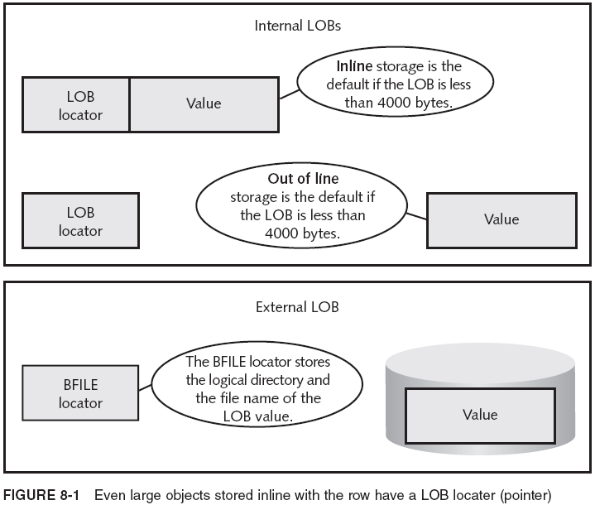
LOB Storage

Slide 8
LOB Storage (continued)
When an internal LOB is stored out of line, a separate LOB data segment is created
  You can specify that all LOB data is to be stored out of line
  CREATE TABLE <tablename>
  (<other_column_specs>,
  <LOBcolumnname> <LOBdatatype>)
  LOB (<LOBcolumnname>) STORE AS <lobsegmentname>
  (TABLESPACE <tablespacename>
  ENABLE STORAGE IN ROW|DISABLE STORAGE IN ROW
  CHUNK <nn>
  STORAGE
  (INITIAL <nn> NEXT <nn> MAXEXTENTS UNLIMITED|<nn>)
  PCTVERSION <nn>|RETENTION
  LOGGING|NOLOGGING
  CACHE|NOCACHE);
max 32 KB

Slide 9
LOB Storage (continued)
You can define attributes with LOB datatypes in object types for use in object tables or user-defined datatype columns in relational tables
LOB data segments can be used to store VARRAYs
  VARRAYs LOB cannot be in a different tablespace than the table
    CREATE TYPE RACE_ARRAY AS VARRAY (1500) OF CHAR (25);
    /
    CREATE TABLE HORSERACE
    (HORSE_NAME VARCHAR2(50),
    RACE_LIST RACE_ARRAY)
    VARRAY RACE_LIST STORE AS LOB RACEARRAYLOB
    (CHUNK 32768
    STORAGE (INITIAL 20M NEXT 40M MAXEXTENTS 100))
    STORAGE (INITIAL 80M);

Slide 10
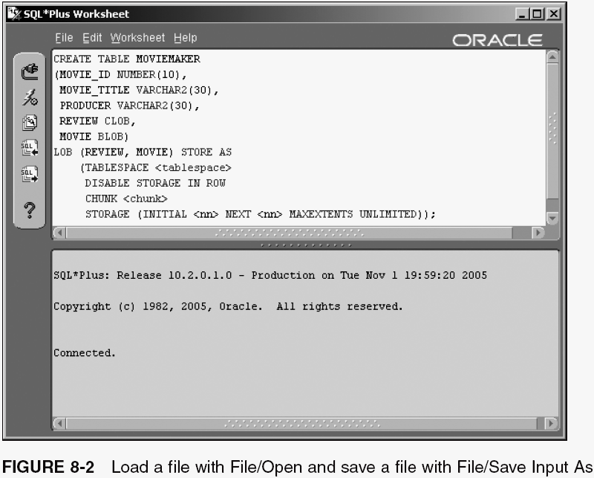
LOB Storage (continued)

Slide 11
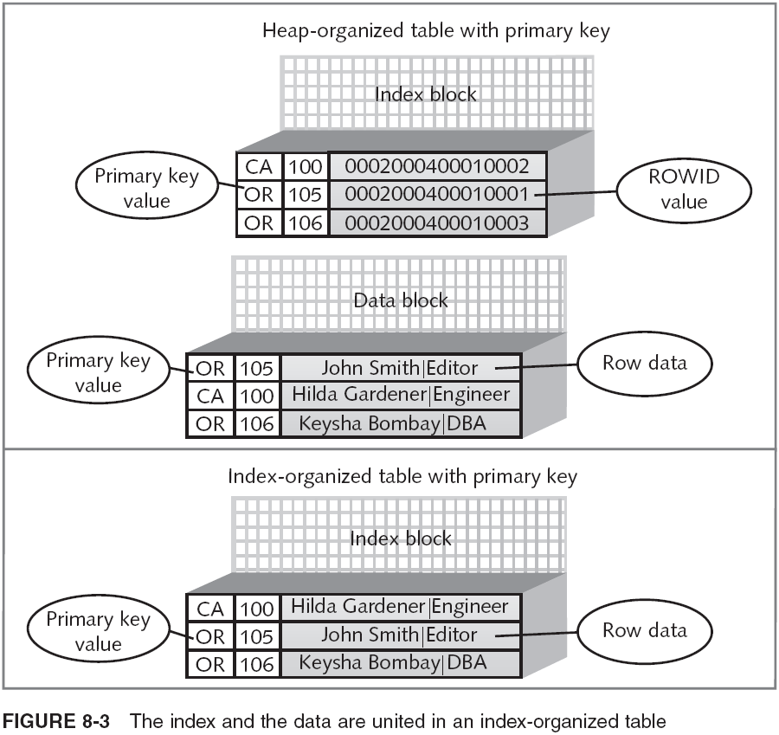
Index-Organized Tables

Slide 12
Index-Organized Tables (continued)
A relational table with a primary key constraint has a unique index associated with the primary key
  Index is stored in primary key order in a BTree
  The index stores the primary key columns and the ROWID of the associated row
  The actual data is stored in the data block
An index-organized table does not have an index
  Entire table becomes an index
  Primary advantage of index-organized tables is that queries based on primary key are faster
    But, inserts, updates, and deletes are slower
    Additionally, continual change activity will eventually deteriorate the BTree structure

Slide 13
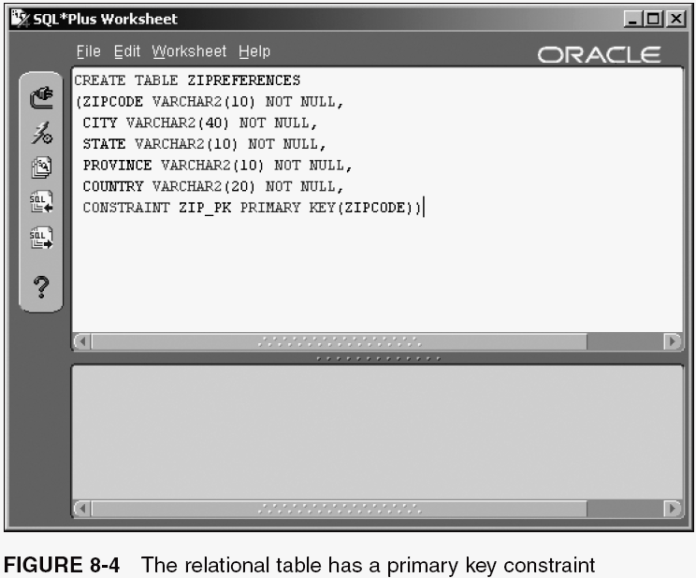
Index-Organized Tables (continued)

Slide 14
Index-Organized Tables (continued)
Here are some additional points about index-organized tables:
  You can include LOB columns
  You can partition index-organized tables, but only using hash or range partitioning
    In addition, the partition key must be all or a subset of the primary key
  You can add secondary indexes; however, they should be rebuilt if the table is updated often, so that the physical guess stored in the index is accurate
  Inaccurate physical guesses cause extra I/O

Slide 15
Overview of Table Management
Change the storage setting
  Adjust the size of the next extent, maximum extents, percent free, and most of the other storage settings
Reorganize the table online
  Rearrange/add/delete columns, change column names or datatypes while table remains online
Drop columns
  Mark a column as unavailable, or drop it immediately
Truncate or drop the table
  TRUNCATE removes all rows in table without generating redo log entries
  DROP removes the rows and the table structure

Slide 16
Analyzing a Table
Analyze tables in schema to give optimizer up-to-date info for optimizing queries and SQL commands
  To analyze a table, you issue a command that causes Oracle 10g to read the table’s structure and update the table’s metadata with current information
  Provides accurate statistics for cost-based optimizer
    Optimizer: process that decides the most efficient method of executing a query; creates a query plan
      Rule-based (no longer available)
      Cost-based
  Gives DBA in-depth information, helping decide which storage or column settings to change (if any)

Slide 17
Analyzing a Table (continued)
Use ANALYZE or the DBMS_STATS package
  ANALYZE TABLE CUSTOMER COMPUTE STATISTICS;
  ANALYZE TABLE CUSTOMER ESTIMATE STATISTICS SAMPLE 1000 ROWS;
  EXECUTE DBMS_STATS.GATHER_TABLE_STATS ('CLASSMATE','CUSTOMER');
  BEGIN
  DBMS_STATS.GATHER_TABLE_STATS
  ('CLASSMATE','CUSTOMER');
  END;
  EXECUTE DBMS_STATS.GATHER_SCHEMA_STATS('CLASSMATE');

Slide 18
Adjusting Table Storage Structure
Many portions of the storage structure of a table can be modified after the table is created
    ALTER TABLE <schema>.<tablename>
    PCTFREE <nn> PCTUSED <nn>
    INITTRANS <nn> MAXTRANS <nn>
    STORAGE (NEXT <nn> PCTINCREASE <nn>
    MAXEXTENTS <nn>|UNLIMITED)
    ALLOCATE EXTENT SIZE <nn> DATAFILE <filename>
    DEALLOCATE UNUSED KEEP <nn>
    COMPRESS|NOCOMPRESS
    SHRINK SPACE [COMPACT] [CASCADE] MOVE TABLESPACE <tablespacename>
      STORAGE (INITIAL <nn> NEXT <nn> PCTINCREASE <nn>
      MAXEXTENTS <nn>|UNLIMITED)
      COMPRESS|NOCOMPRESS
      ONLINE

Slide 19
Adjusting Table Storage Structure (continued)
DEALLOCATE UNUSED: releases unused data blocks above the high watermark of the table
  High watermark: boundary between used data blocks and unused data blocks in a table
  ALTER TABLE HORSERACE DEALLOCATE UNUSED KEEP 50K;
You can change the size of subsequent extents by changing the NEXT parameter to a smaller size
  ALTER TABLE CLASSIFIED_AD MOVE TABLESPACE USERS
  STORAGE (NEXT 56K);

Slide 20
Redefining Tables Online
Oracle’s online table redefinition allows you to make nearly any change to a table, while keeping table available for inserts/updates most of the time
Phases:
  Creation of an interim table
  Redefinition of a table
  Application of the redefinition back to original table
PL/SQL package called DBMS_REDEFINITION
  Must have several DBA-level privileges to use it

Slide 21
Redefining Tables Online (continued)
CONNECT SYSTEM/<password>@ORACLASS
GRANT EXECUTE_CATALOG_ROLE TO SYSTEM;
BEGIN
  DBMS_REDEFINITION.CAN_REDEF_TABLE
  ('CLASSMATE','CLASSIFIED_AD');
  END;
BEGIN
  DBMS_REDEFINITION.CAN_REDEF_TABLE
  ('CLASSMATE','CLIENT');
  END;
CREATE TABLE CLASSMATE.CLIENT1
  (CLIENT_ID NUMBER(10) NOT NULL,
  FIRST_NAME VARCHAR2(10) NOT NULL,
  LAST_NAME VARCHAR2(20) NOT NULL,
  FULLNAME VARCHAR2(32),
  CONTACT_PHONE VARCHAR2(15),
  CONTACT_EMAIL VARCHAR2(30),
  CONSTRAINT CLIENT_PK1 PRIMARY KEY(CLIENT_ID))
  TABLESPACE USERS PCTFREE 0
  STORAGE (INITIAL 64K NEXT 8K
  MINEXTENTS 1 MAXEXTENTS 10);

Slide 22
Redefining Tables Online (continued)
BEGIN
  DBMS_REDEFINITION.START_REDEF_TABLE ('CLASSMATE', 'CLIENT',
  'CLIENT1',
  'CLIENT_ID CLIENT_ID,
  FIRST_NAME FIRST_NAME,
  LAST_NAME LAST_NAME,
  SUBSTR(CONCAT(RPAD(FIRST_NAME,LENGTH(FIRST_NAME)+1), LAST_NAME),1,32) FULLNAME,
  CONTACT_PHONE CONTACT_PHONE,
  CONTACT_EMAIL CONTACT_EMAIL');
  END;
BEGIN
  DBMS_REDEFINITION.ABORT_REDEF_TABLE
  ('CLASSMATE', 'CLIENT', 'CLIENT1');
  END;
BEGIN
  DBMS_REDEFINITION.FINISH_REDEF_TABLE
  ('CLASSMATE','CLIENT', 'CLIENT1');
  END;
SELECT * FROM CLASSMATE.CLIENT;

Slide 23
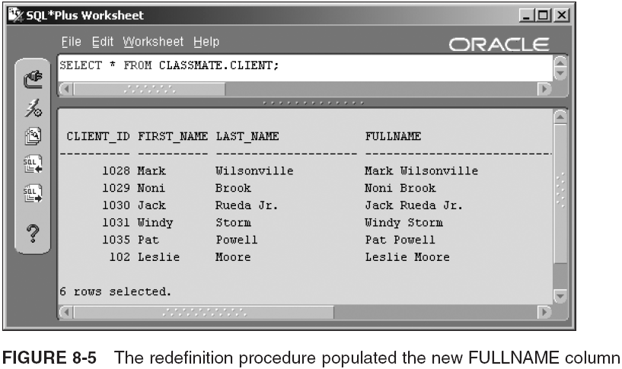
Redefining Tables Online (continued)

Slide 24
Redefining Tables Online (continued)
You can use ALTER TABLE with object tables and relational tables, with object-type columns
  Object tables and object-type columns are based on the definition of an object type
    On definition change, tables in which object type is used don’t change automatically; you must upgrade structure
      Upgrading table structure causes object types used in table to be updated with most recent version of the object type definition
  ALTER TABLE CUSTOMER UPGRADE INCLUDING DATA;

Slide 25
Dropping, Adding, or Modifying a Column in a Table
ALTER TABLE <schema>.<tablename>
RENAME COLUMN <oldcolname> TO <newcolname>
ADD (<colname> <datatype>, ... )
MODIFY (<colname> <datatype>, ... )
DROP (<colname>, <colname>,...)|COLUMN <colname> CASCADE CONSTRAINTS
SET UNUSED (<colname>,<colname>,...)|COLUMN <colname> CASCADE CONSTRAINTS
DROP UNUSED COLUMNS
  ALTER TABLE CH08SURGERY
  RENAME COLUMN PATIENT_FISRT_NAME TO PATIENT_FIRST_NAME;
  ALTER TABLE CH08SURGERY
  ADD (OUTCOME VARCHAR2(40), OPERATING_ROOM_NO CHAR(4));
  ALTER TABLE CH08SURGERY
  MODIFY (DOCTOR_NAME VARCHAR2(20));
  ALTER TABLE CH08SURGERY
  MODIFY (DOCTOR_NAME VARCHAR2(25));
  ALTER TABLE CH08SURGERY
  SET UNUSED (PROCEDURES, OUTCOME);
  ALTER TABLE CH08SURGERY
  ADD (PROCEDURES PROCEDURES_ARRAY, OUTCOME NUMBER(2,0));
  ALTER TABLE CH08SURGERY
  DROP UNUSED COLUMNS;

Slide 26
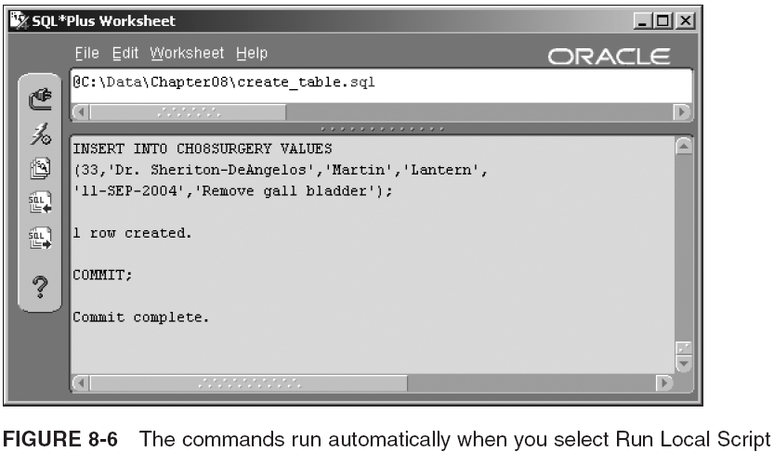
Dropping, Adding, or Modifying a Column in a Table (continued)

Slide 27
Truncating and Dropping a Table
DELETE FROM <tablename>;
  Oracle 10g background processes to write undo records and redo log entries for each row deleted
    This can be reversed by executing a ROLLBACK, but takes time
TRUNCATE TABLE <schema>.<tablename>
DROP STORAGE|REUSE STORAGE
  Does not generate undo records or redo log entries
  DROP STORAGE (default) frees up all but the space allocated to the table except space required by the MINEXTENTS setting of the table or tablespace
Use DROP TABLE to remove rows and table structure

Slide 28
The Recycle Bin
DROP TABLE <schema>.<tablename> [ CASCADE CONSTRAINTS ] [ PURGE ]
By default, the CASCADE CONSTRAINTS and PURGE options are not included in a DROP TABLE
  When dropping a table, it will automatically be saved in the Oracle 10g database recycle bin
A table in the recycle bin can be recovered to its prior state using FLASHBACK TABLE
  FLASHBACK TABLE <schema>.<tablename> TO BEFORE DROP [ RENAME TO , tablename> ]
  Example:
    FLASHBACK TABLE COPCAR TO BEFORE DROP RENAME TO COPCARS;

Slide 29
Making Other More Specialized Table Changes
You can make several other specialized table changes using the ALTER TABLE command
  ALTER TABLE <schema>.<tablename>
  RENAME TO <newname>
  LOGGING|NOLOGGING
  ENABLE|DISABLE ROW MOVEMENT
  CACHE|NOCACHE
For example:
  ALTER TABLE EMPLOYEE CACHE;

Slide 30
Table Flashback Recovery
Syntax for the FLASHBACK TABLE command:
  FLASHBACK TABLE <schema>.<tablename>
  [ {TO SCN | TIMESTAMP} <expression> ] [ {ENABLE | DISABLE} TRIGGERS ]
  [ TO RESTORE POINT <expression> ] [ { ENABLE | DISABLE } TRIGGERS ]
  [ BEFORE DROP [ RENAME TO <tablename> ] ]
TO RESTORE POINT is used to restore a table to a previously set restore point
  A restore point must have been created with the CREATE RESTORE POINT command
Using BEFORE DROP can allow the recovery of a previously dropped table from the recycle bin, where a new copy of the table already exists

Slide 31
Transparent Table Encryption
Oracle 10g has introduced encryption of data within the confines of an Oracle database, preventing potential snooping into datafiles from outside the confines of Oracle database software
  { CREATE | ALTER } TABLE <schema>.<tablename> ENCRYPT
  [ USING 'encryption algorithm' ]
  [ IDENTIFIED BY <password> ]
  [ [NO] SALT ]
    All subsequent use of encryption is automated, or transparent

Slide 32
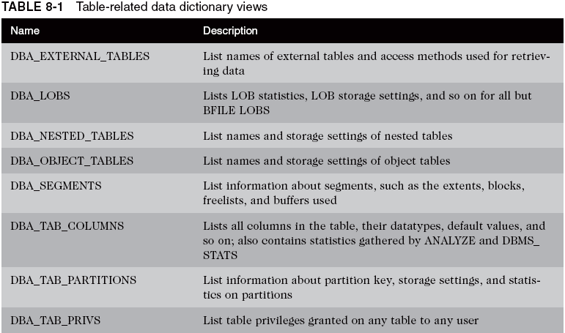
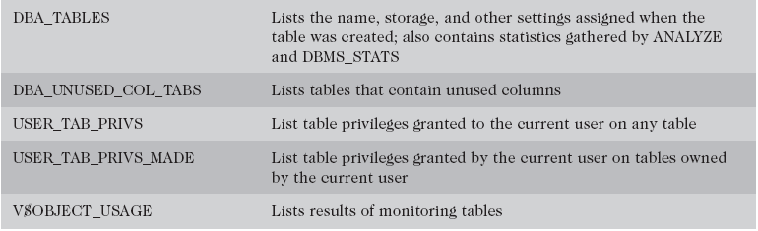
Querying Data Dictionary Views for Tables and Other Objects

Slide 33
Summary
LOB datatypes are internal (stored within the DB) or external (stored outside the DB)
  Oracle 10g contains a package called DBMS_LOB, used to manage and access LOB objects
  By default, internal LOB values are stored inline (if less than 4000 bytes long); larger internal LOB values are stored out of line in a LOB data segment
  Oracle 10g works with LOBs by reading and writing one chunk at a time
  LOB segment and table storage settings are similar
  LOB datatypes can be part of partitioned tables, index-organized tables, and object tables
  LOB data segments can be used for VARRAY data

Slide 34
Summary (continued)
Index-organized tables require a primary key, and store data in order
  Can split column data in main and overflow segments
ANALYZE gathers statistics on a table’s size, number of rows, column distribution, and free space
  DBMS_STATS package is a better option
Changing a table’s storage parameters involves using the ALTER TABLE command
DBMS_REDEFINITION package can help restructure a table while keeping it online most of the time
Upgrading object/relational table with object columns redefines their object types with latest definition

Slide 35
Summary (continued)
Rename a table with ALTER TABLE ... RENAME
  Modifying columns also uses ALTER TABLE
To a drop column involved in another table’s foreign key constraint, specify CASCADE CONSTRAINTS
  SET UNUSED marks column for dropping later
If you truncate a table, you cannot undo the transaction with a ROLLBACK command
Use DROP TABLE ... CASCADE CONSTRAINTS if table is named in foreign keys in other related tables
Data dictionary views store table, segment, extent, column, and LOB segment information

