Slide 1

Oracle 10g Database Administrator: Implementation and Administration
Chapter 9
Constraints, Indexes, and Other Specialized Objects

Slide 2
Objectives
Learn the types and the uses of constraints
Examine the syntax and options for creating constraints
Work with practical examples of creating, modifying, and dropping constraints
Query database dictionary views to monitor constraints
Learn the types of indexes Oracle offers and when to use each type

Slide 3
Objectives (continued)
Understand how to create each type of index
Determine which data dictionary views contain information on indexes
Find out how to monitor index usage and when to drop an index
Learn how to modify, rebuild, and coalesce an index
Learn the basics about views, sequences, and synonyms

Slide 4
What are Constraints?
You can enforce integrity constraints in several ways
  Defined at the database level on a column or a table
  Trigger: program that runs when an event occurs
    Triggers are at DB level and provide more flexibility in designing complex constraints than integrity constraints, while keeping the constraint within the DB
  Include constraints in an application
    Constraint is outside the database
    Are flexible and can be fine-tuned for each application
    Enforce only those changes that are made within the application

Slide 5
Types of Integrity Constraints
Oracle 10g supports five types of integrity constraints
  PRIMARY KEY: column or set of columns that define a unique identifying value for every row in the table
  UNIQUE: allows null values in the column or columns that are named in the constraint
  FOREIGN KEY: establishes a relationship between two tables (parent and child)
  NOT NULL: all rows in the table must contain a value in the column
  CHECK: enforces a predefined list of values for a column

Slide 6
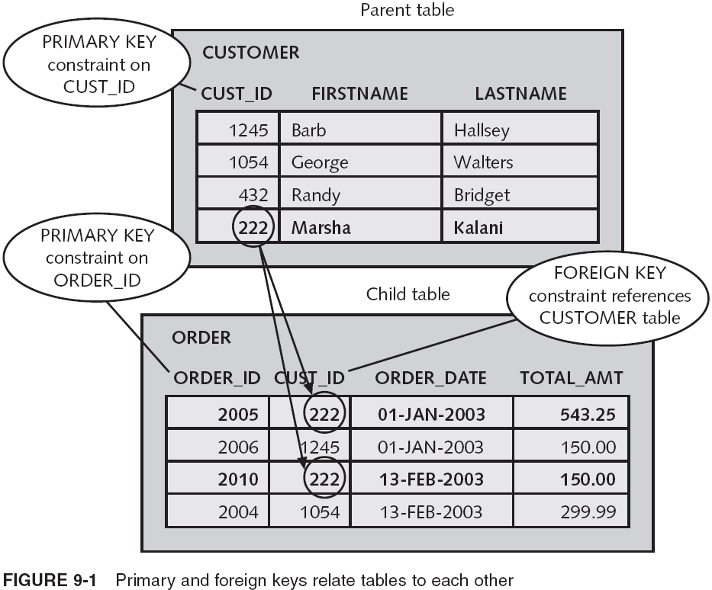
Types of Integrity Constraints (continued)

Slide 7
How To Create and Maintain Integrity Constraints
Two ways to create integrity constraints on columns and tables:
  Use CREATE TABLE to create the constraint while creating the table (most common method for PRIMARY KEY and NOT NULL constraints)
  Use ALTER TABLE later to create the constraint
    Use this to add constraints that were either missed or added to the table design after table creation
    Typically, all rows in the table must conform to the new constraint, although you can modify this default action if needed

Slide 8
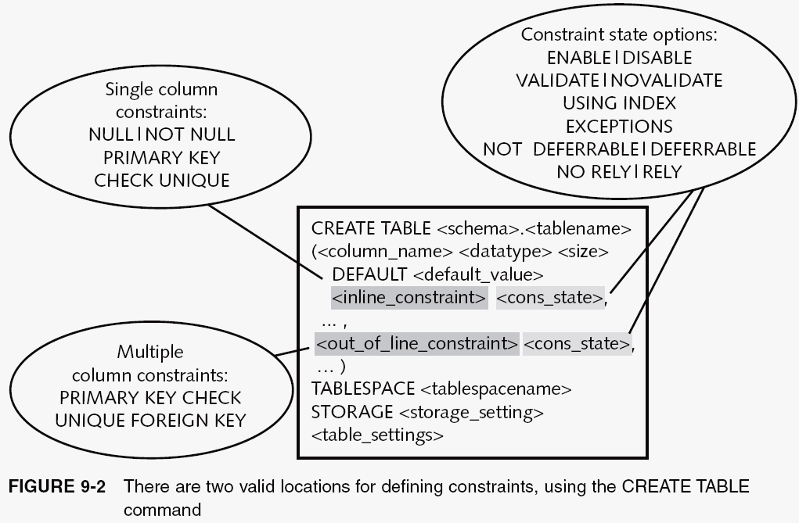
Creating Constraints Using the CREATE TABLE Command

Slide 9
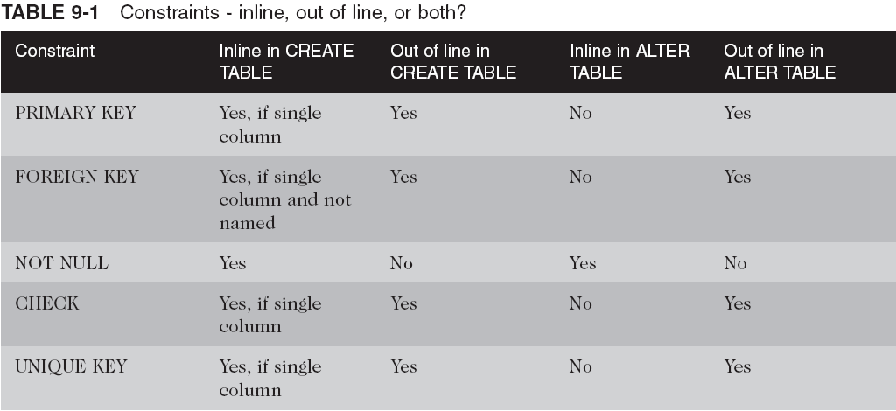
Creating Constraints Using the CREATE TABLE Command (continued)

Slide 10
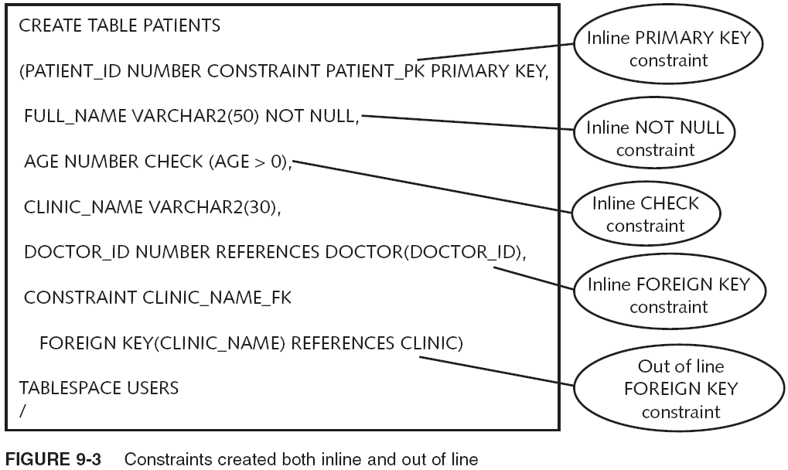
Creating Constraints Using the CREATE TABLE Command (continued)

Slide 11
Creating Constraints Using the CREATE TABLE Command (continued)
You can create/modify constraints in different states
  Constraint state: attribute that tells Oracle 10g how to use the constraint when data is added to the table
    If state changes from DISABLE to ENABLE, constraint state tells Oracle how to use it on existing data
  Constraint states:
    ENABLE|DISABLE
    VALIDATE|NOVALIDATE
    INITIALLY IMMEDIATE|INITIALLY DEFERRED
    DEFERRABLE|NOT DEFERRABLE
    RELY|NORELY
    USING INDEX <index>|<storage>
    EXCEPTIONS|EXCEPTIONS INTO <tablename>

Slide 12
Creating or Changing Constraints Using the ALTER TABLE Command
To add/remove a NOT NULL constraint on an existing column
  ALTER TABLE <tablename>
  MODIFY(<columnname> NULL|NOT NULL);
To add a new constraint to an existing table
  ALTER TABLE <tablename>
  ADD CONSTRAINT <constraintname>
  PRIMARY KEY (<colname>, ...) |
  FOREIGN KEY (<colname>, ...)
  REFERENCES <schema>.<tablename> (<colname>, ...) |
  UNIQUE (<colname>, ...) |
  CHECK (<colname>, ...) (<check_list>);
To change/remove a constraint
  ALTER TABLE <tablename>
  MODIFY CONSTRAINT <constraintname>
  <constraint_state> <constraint_state> ...;

Slide 13
Working with Constraints
The next five sections provide step-by-step examples in which you create, modify, and drop constraints of all types
New details about constraints are explained as you work through the examples
The first constraint you examine is the easiest one:
  The NOT NULL constraint

Slide 14
Adding or Removing a NOT NULL Constraint
NOT NULL is often used when creating tables
Use the NOT NULL constraint to require a value in a column when a row is inserted or updated
  CREATE TABLE CH09DOGSHOW
  (DOGSHOWID NUMBER NOT NULL,
  SHOW_NAME VARCHAR2(40) NOT NULL,
  DATE_ADDED DATE DEFAULT SYSDATE NOT NULL);
  INSERT INTO CH09DOGSHOW
  (DOGSHOWID, SHOW_NAME) VALUES
  (1, 'AKC Portland');
To remove/add NOT NULL constraint
  ALTER TABLE CH09DOGSHOW
  MODIFY (SHOW_NAME NULL);
  ALTER TABLE CH09DOGSHOW
  MODIFY (SHOW_NAME NOT NULL);

Slide 15
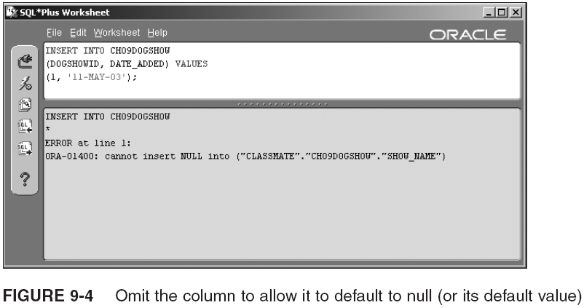
Adding or Removing a NOT NULL Constraint (continued)

Slide 16
Adding and Modifying a PRIMARY KEY Constraint
PRIMARY KEY is important for table integrity
Primary key can be one or more columns
  The columns are usually placed at the beginning of the table, although this is not a requirement
  CREATE TABLE CH09DOGOWNER
  (OWNER_ID NUMBER CONSTRAINT CH09_PK PRIMARY KEY,
  OWNER_NAME VARCHAR2(50),
  MEMBER_OF_AKC CHAR(3) DEFAULT 'NO',
  YEARS_EXPERIENCE NUMBER(2,0));
  ALTER TABLE CH09DOGOWNER
  RENAME CONSTRAINT CH09_PK TO CH09_DOG_OWNER_PK;
  ALTER TABLE CH09DOGOWNER
  DROP CONSTRAINT CH09_DOG_OWNER_PK;
  ALTER TABLE CH09DOGOWNER
  ADD CONSTRAINT CH09_DOG_OWNER_PK PRIMARY KEY (OWNER_ID) DISABLE;
  ALTER TABLE CH09DOGOWNER
  MODIFY CONSTRAINT CH09_DOG_OWNER_PK ENABLE;

Slide 17
Adding and Modifying a UNIQUE Key Constraint
The UNIQUE key constraint and the PRIMARY KEY constraint are very similar
  A UNIQUE constraint is often used in addition to a PRIMARY KEY rather than in place of it
    CREATE TABLE CH09WORLD
    (COUNTRY VARCHAR2(10),
    PERSON_ID NUMBER,
    US_TAX_ID NUMBER(10) CONSTRAINT US_TAX_UNIQUE UNIQUE,
    FIRST_NAME VARCHAR2(10),
    LAST_NAME VARCHAR2(20),
    CONSTRAINT CH09WORLD_PK PRIMARY KEY (COUNTRY, PERSON_ID));
    ALTER TABLE CH09WORLD
    MODIFY CONSTRAINT US_TAX_UNIQUE DISABLE;
    ALTER TABLE CH09WORLD
    MODIFY CONSTRAINT US_TAX_UNIQUE ENABLE VALIDATE
    EXCEPTIONS INTO EXCEPTIONS;

Slide 18
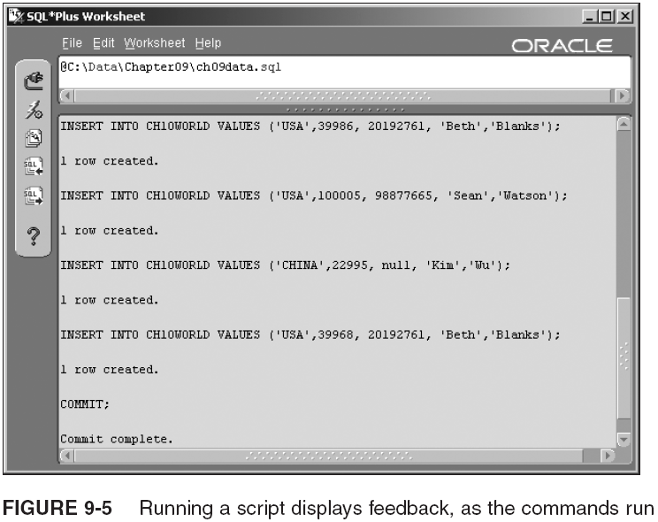
Adding and Modifying a UNIQUE Key Constraint (continued)

Slide 19
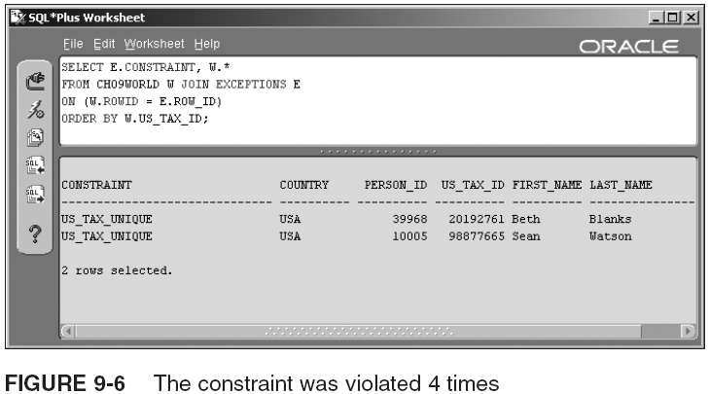
Adding and Modifying a UNIQUE Key Constraint (continued)
SELECT E.CONSTRAINT, W.*
FROM CH09WORLD W, EXCEPTIONS E
WHERE W.ROWID = E.ROW_ID
ORDER BY W.US_TAX_ID;
Query executed is formatted in the new ANSI-standard JOIN syntax introduced in Oracle 10g

Slide 20
Working with a FOREIGN KEY Constraint
CREATE TABLE CH09DOG
(DOG_ID NUMBER,
OWNER_ID NUMBER(10) ,
DOG_NAME VARCHAR2(20),
BIRTH_DATE DATE,
CONSTRAINT CH09DOGOWNER_FK
FOREIGN KEY (OWNER_ID) REFERENCES CH09DOGOWNER
DEFERRABLE INITIALLY IMMEDIATE);
INSERT INTO CH09DOG VALUES
(1,2,'Chow Moon','15-JAN-02');
SET CONSTRAINTS ALL DEFERRED;
INSERT INTO CH09DOGOWNER VALUES
(2, 'Jack Maylew','YES', 3.5);
SET CONSTRAINTS ALL IMMEDIATE;
ALTER TABLE CH09DOGOWNER
DROP CONSTRAINT CH09_DOG_OWNER_PK CASCADE;
ALTER TABLE CH09DOGOWNER
ADD CONSTRAINT CH09_DOG_OWNER_PK PRIMARY KEY(OWNER_ID);
ALTER TABLE CH09DOG
ADD CONSTRAINT CH09DOGOWNER_FK FOREIGN KEY (OWNER_ID)
REFERENCES CH09DOGOWNER
ON DELETE CASCADE;
DELETE FROM CH09DOGOWNER WHERE OWNER_ID = 2;
SELECT * FROM CH09DOG;

Slide 21
Creating and Changing a CHECK Constraint
CHECK constraint helps validate the value within a column or a set of columns within one row
  Useful for columns with a fixed number of values
  ALTER TABLE CH09DOGOWNER ADD CONSTRAINT AKC_YN
  CHECK (MEMBER_OF_AKC IN ('YES','NO'));
  ALTER TABLE CH09DOGSHOW ADD CONSTRAINT ALL_CAPS
  CHECK (SHOW_NAME = UPPER(SHOW_NAME)) DISABLE;
  UPDATE CH09DOGSHOW SET SHOW_NAME = UPPER(SHOW_NAME);
  ALTER TABLE CH09DOGSHOW MODIFY CONSTRAINT ALL_CAPS ENABLE;
  ALTER TABLE CH09WORLD ADD CONSTRAINT CHK_NAMES
  CHECK ((FIRST_NAME IS NOT NULL OR LAST_NAME IS NOT NULL)
  AND(FIRST_NAME <> LAST_NAME));
  INSERT INTO CH09WORLD VALUES
  ('USA', 1995, 99877689, 'Jeremy', 'Jeremy');
  INSERT INTO CH09WORLD VALUES
  ('USA', 1995, 99877689, NULL, NULL);
  INSERT INTO CH09WORLD VALUES
  ('USA',1995, 99877689, 'Jeremy', NULL);

Slide 22
Data Dictionary Information on Constraints
Constraint-related data dictionary views
  ALL_CONSTRAINTS: contains the definition of a constraint
    CONSTRAINT_NAME
    CONSTRAINT_TYPE
    SEARCH_CONDITION
    STATUS
  ALL_CONS_COLUMNS: lists the columns associated with each constraint
    There is one row for each column in the constraint

Slide 23
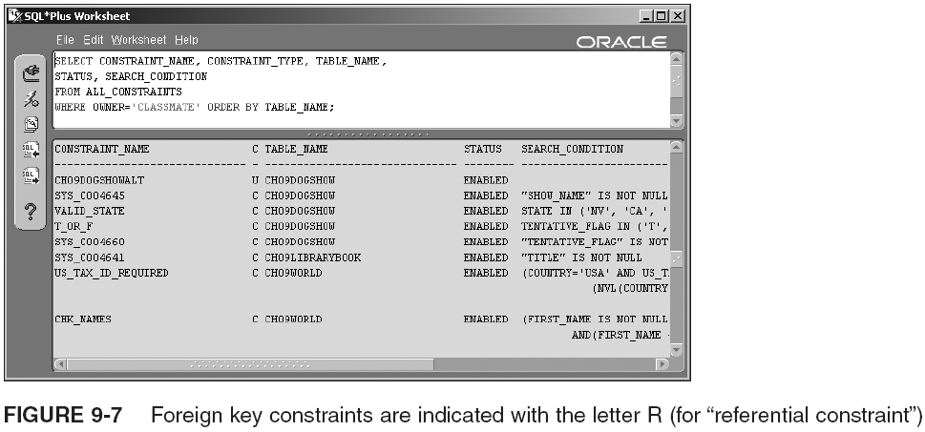
Data Dictionary Information on Constraints (continued)
Note that the NOT NULL constraints are listed as CHECK constraints, and have system-assigned names

Slide 24
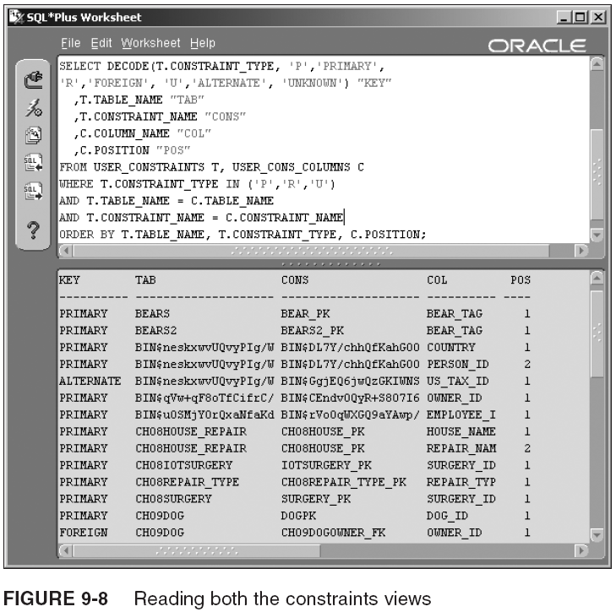
Data Dictionary Information on Constraints (continued)

Slide 25
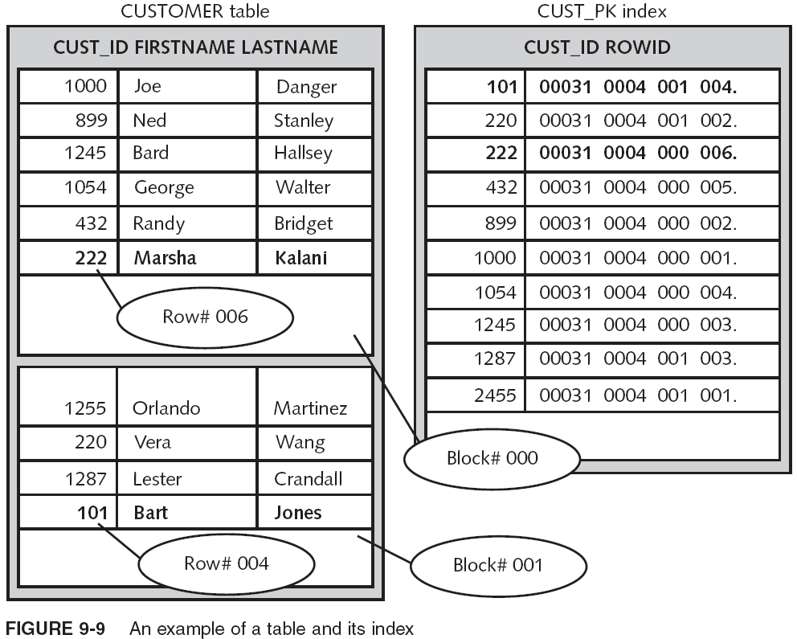
What are Indexes?

Slide 26
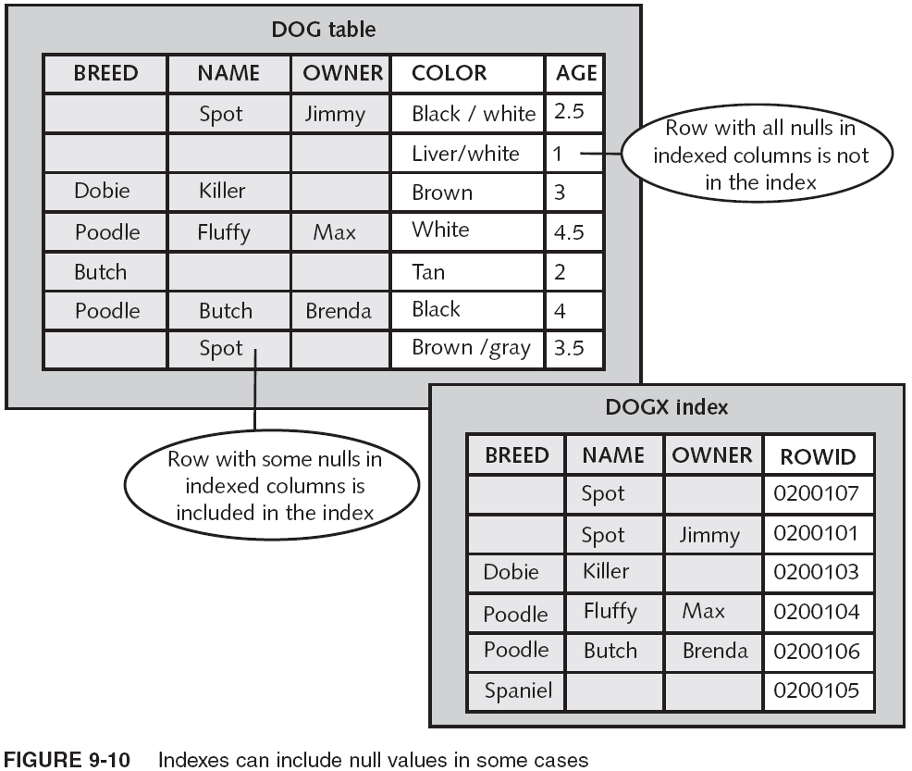
What are Indexes? (continued)

Slide 27
Types and Uses of Indexes
Can create many types of indexes in Oracle 10g:
  BTree index
    Reverse key index
    Function-based index
  Bitmap index
  Local partitioned index
  Global partitioned index
  Cluster index
  Domain index

Slide 28
Types and Uses of Indexes (continued)
CREATE UNIQUE|BITMAP INDEX <schema>.<indexname>
ON <schema>.<tablename>
(<colname>|<expression> ASC|DESC,
<colname>|<expression> ASC|DESC, ..)
TABLESPACE <tablespacename>
STORAGE (<storage_settings>)
LOGGING|NOLOGGING
ONLINE
COMPUTE STATISTICS
NOCOMPRESS|COMPRESS <nn>
NOSORT|REVERSE
NOPARALLEL|PARALLEL <nn>
PARTITION|GLOBAL PARTITION <partition_settings>

Slide 29
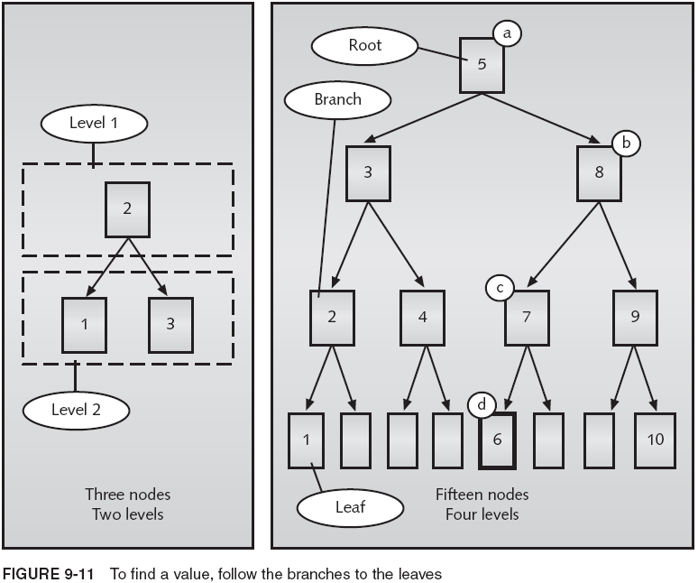
BTree Index

Slide 30
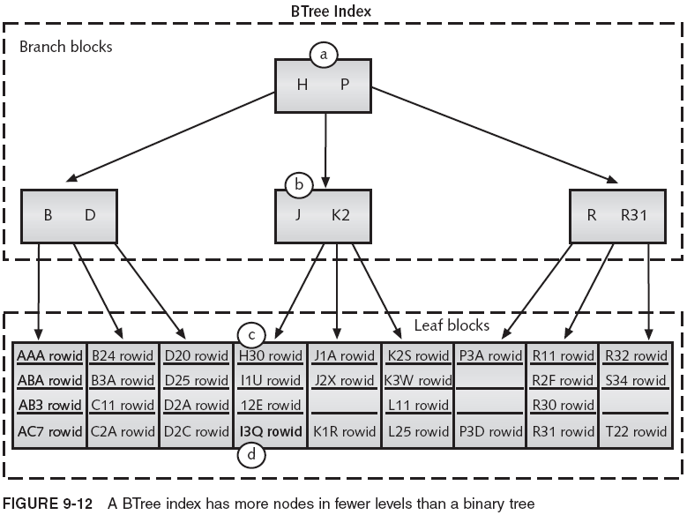
BTree Index (continued)

Slide 31
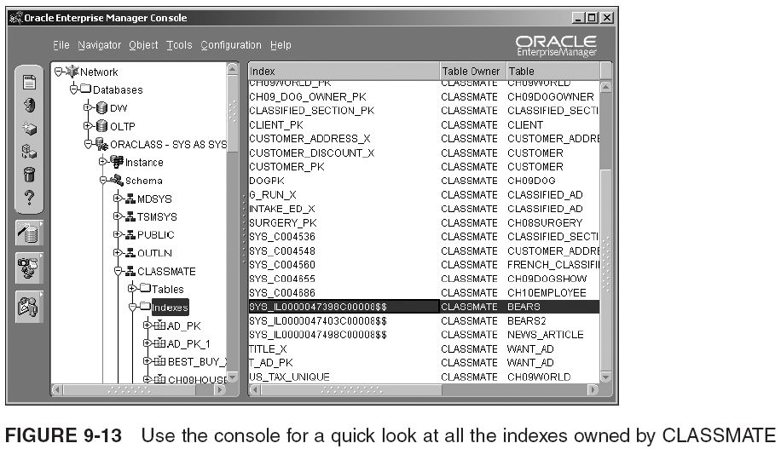
BTree Index (continued)

Slide 32
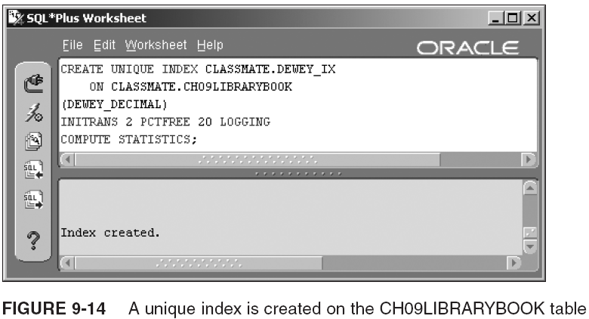
BTree Index (continued)

Slide 33
Bitmap Index
A bitmap index uses a bitmap to store index key values and row locations
  The indexed columns should have low cardinality
  Table should be used primarily for queries rather than updates (e.g., data warehouse system)
  Majority of queries should use AND, OR, NOT, and “equal to” in the WHERE clause referencing the table’s indexed columns
  Majority of queries use complex conditions in WHERE
  The table should not have concurrent updates
  Bitmapped index cannot be a unique index
  Bitmapped index cannot contain any DESC columns

Slide 34
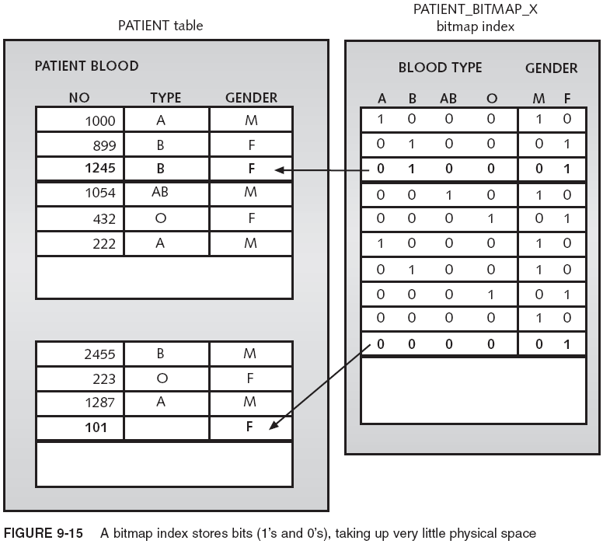
Bitmap Index (continued)
    BLOOD_TYPE column and GENDER could be indexed using:
CREATE BITMAP INDEX PATIENT_BITMAP_X
ON PATIENT (BLOOD_TYPE, GENDER);

Slide 35
Local Partitioned Index
Local partitioned index: index on a partitioned table, in which the index is partitioned in the same way and on the same columns as the table
  Queries using the index are faster than an index that contains values from entire table
  A local partitioned index is automatically updated if you update the partitioning of the table
Oracle 10g handles naming and locating the index partitions, unless you specifically name or locate the index partitions in CREATE INDEX
  CREATE INDEX LOCAL_X ON CH09MORTGAGE_HISTORY(DATE_CREATED)
  LOCAL
  STORE IN (USERS, USER_AUTO);

Slide 36
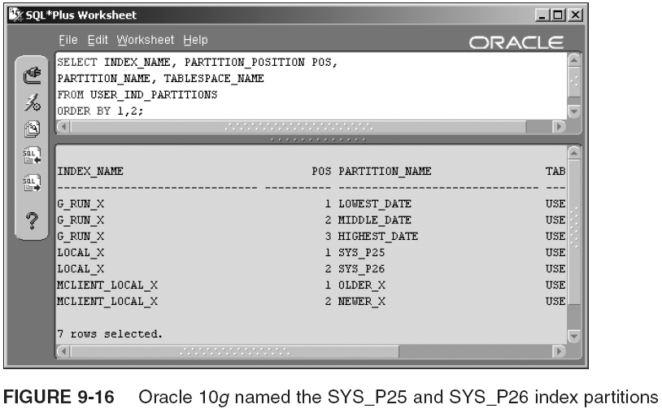
Local Partitioned Index (continued)

Slide 37
Global Partitioned Index
Global partitioned index: index that is partitioned when either the table is not partitioned or the table is partitioned in a different way than the index
  CREATE INDEX G_ACCT_X ON CH09MORTGAGE_HISTORY (ACCT_NO)
  GLOBAL PARTITION BY RANGE (ACCT_NO)
  (PARTITION LOWEST_ACCT VALUES LESS THAN (5000),
  PARTITION MIDDLE_ACCT VALUES LESS THAN (10000),
  PARTITION HIGHEST_ACCT VALUES LESS THAN (MAXVALUE));
Use this type of index when you have queries on a table that are not using the partitions efficiently
An index can also be created, global to all partitions, but not using the partition key as index
  Normal index or nonpartitioned global index
  CREATE UNIQUE INDEX G_LOAN_X
  ON CH09MORTGAGE_HISTORY (LOAN_NO) GLOBAL;

Slide 38
Reverse Key Index
A reverse key index creates an unusual form of BTree index
  Every byte in the indexed column is reversed
  The leaf blocks include the ROWID (not reversed); however, the distribution of the data is changed
The real usefulness of the reverse key index is found when you have a clustered database using Real Application Clusters, in which many users are accessing the same section of data from a large table, causing I/O contention
  CREATE INDEX EVENT_REVERSE ON CURRENT_EVENTS(CREATE_DATE)
  REVERSE;

Slide 39
Function-Based Index
A function-based index is an index with one or more columns indexed that are actually expressions or functions instead of columns
Allowing functions and expressions within an index gives optimizer ability to search an index for values that otherwise would require a full table scan
  CREATE INDEX PUB_YEAR_IX
  ON CH09LIBRARYBOOK(TO_CHAR(PUB_DATE,'YYYY'));
  CREATE INDEX TOTAL_PAIDX
  ON CH09MORTGAGE_CLIENT ((MORTGAGE_AMOUNT*NUMBER_OF_YEARS*MORTGAGE_RATE)
  + MORTGAGE_AMOUNT)
  TABLESPACE USERS
  STORAGE (INITIAL 20K NEXT 10K) LOGGING COMPUTE STATISTICS;

Slide 40
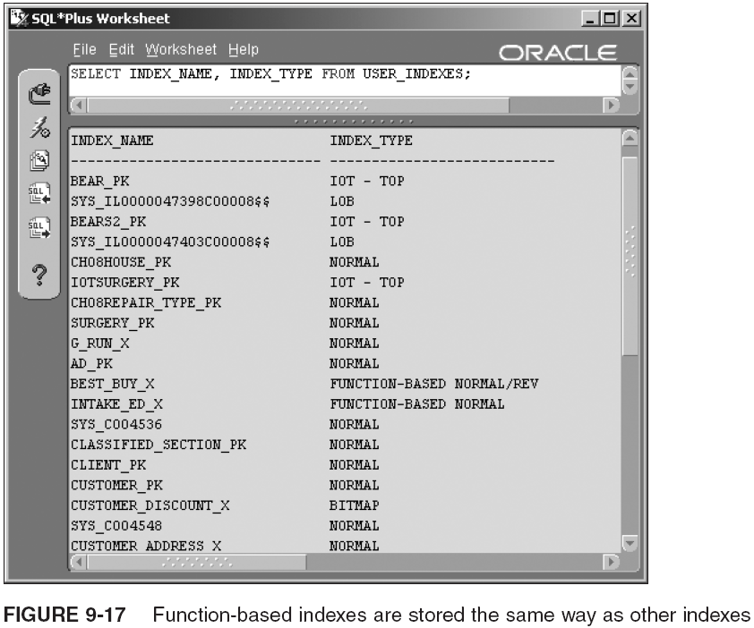
Function-Based Index (continued)

Slide 41
Managing Indexes
Like tables, indexes may require maintenance
The ALTER INDEX command has many parameters for helping maintain an index
Use the DROP INDEX command to remove an index from the database
The next few sections describe how to monitor, modify, rebuild, and remove your indexes

Slide 42
Monitoring Indexes and Dropping Indexes
You can monitor an index the same way that you monitor a table:
  ALTER INDEX <schema>.<indexname> MONITORING USAGE;
To query the monitoring information:
  SELECT * FROM V$OBJECT_USAGE;
  If the index is being used for queries, USED column contains “YES”; otherwise it contains “NO”
  Before dropping an index not being used, review the queries and index columns to see if you can modify one or the other, so the index can be used
To remove an index:
  DROP INDEX <schema>.<indexname>;

Slide 43
Reorganizing and Modifying Indexes
When reviewing an index’s statistics, you may find that the index has much unused storage allocated or that the index has an incorrect setting for PCTINCREASE, NEXT, or other storage settings
  You can modify index with ALTER INDEX...REBUILD
To change storage settings on an index:
  ALTER INDEX <schema>.<indexname>
  REBUILD PARTITION|SUBPARTITION
  REVERSE|NOREVERSE
  TABLESPACE <tablespacename>
  STORAGE (NEXT <nn> MAXEXTENTS <nn>)
  PCTFREE <nn>
  COMPUTE STATISTICS
  COMPRESS|NOCOMPRESS
  LOGGING|NOLOGGING
  ONLINE;

Slide 44
Reorganizing and Modifying Indexes (continued)
ALTER INDEX ... REBUILD has these features:
  Automatically rebuilds BTree structure of a normal index, which adjusts levels and leaves as needed
  If successful, an index rebuild automatically corrects an index that has been marked “UNUSABLE” because a change was made to the structure of the underlying table or partition
  An index rebuild can be performed on only one partition at a time for partitioned indexes
  It can change a reverse key index to a normal index or vice versa

Slide 45
Reorganizing and Modifying Indexes (continued)
You can change other index settings with the ALTER INDEX command as well:
  ALTER INDEX <schema>.<indexname>
  COALESCE
  UPDATE BLOCK REFERENCES
  UNUSABLE
  ONLINE
  RENAME <oldindexname> TO <newindexname>
  RENAME PARTITION <oldname> TO <newname>
  DEALLOCATE UNUSED KEEP <nn>
  LOGGING|NOLOGGING
  NOPARALLEL|PARALLEL <nn>
  MONITORING USAGE|NOMONITORING USAGE;
  You coalesce an index to consolidate fragmented storage space in the leaf blocks
    Faster and takes less temporary storage space than rebuilding an index; useful to quickly compact index without completely rebuilding it

Slide 46
Data Dictionary Information on Indexes
Periodically run DBMS_STATS to analyze indexes
  BEGIN
  DBMS_STATS.GATHER_SCHEMA_STATS (ownname=>'CLASSMATE',cascade=>TRUE);
  END;
INDEX_STATS is updated with statistics that currently are only gathered by ANALYZE
  ANALYZE INDEX TOTAL_PAIDX VALIDATE STRUCTURE;
  SELECT NAME, BR_ROWS, BR_BLKS, LF_ROWS, DEL_LF_ROWS
  FROM INDEX_STATS;

Slide 47
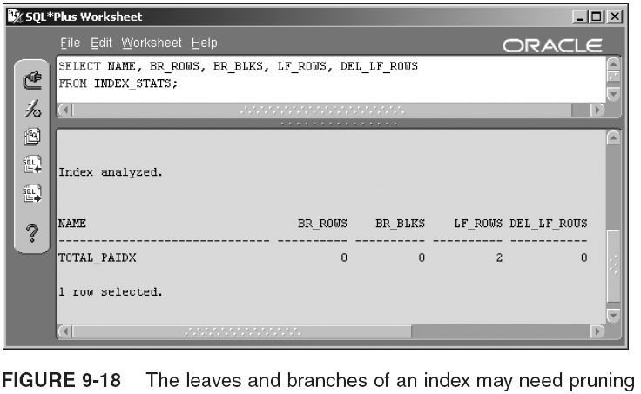
Data Dictionary Information on Indexes (continued)

Slide 48
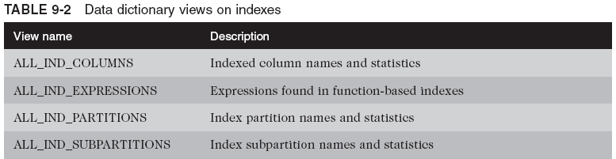
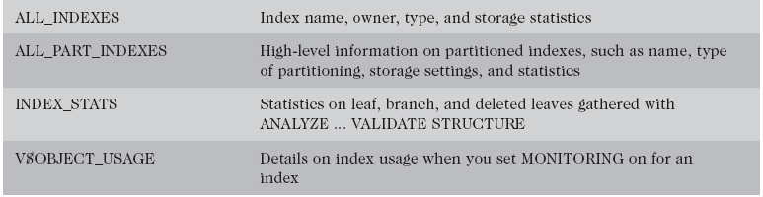
Data Dictionary Information on Indexes (continued)

Slide 49
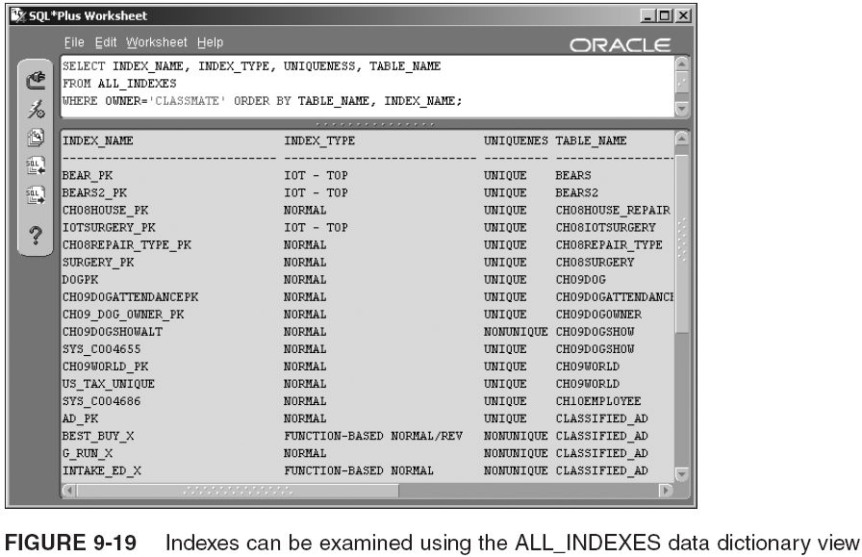
Data Dictionary Information on Indexes (continued)

Slide 50
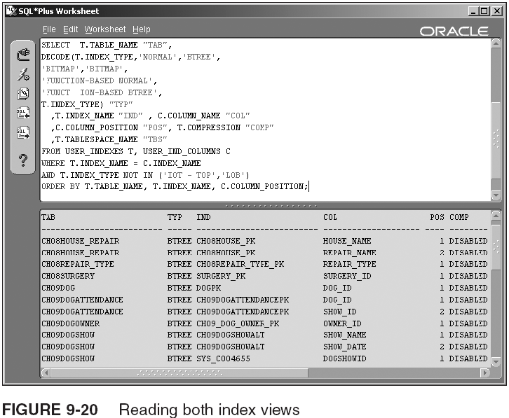
Data Dictionary Information on Indexes (continued)

Slide 51
Other Specialized Database Objects
Numerous other specialized database objects available for creation in Oracle 10g
This section examines some of them briefly

Slide 52
Views
A view is an overlay onto one or more tables
  Overlay is built by creating a DB object called a view, which contains no data but only a SQL query SELECT statement, to retrieve data from underlying tables, whenever the view is queried
  Views can be categorized into two distinct forms:
    Simple view
    Constraint view
Common reasons for using views are as follows:
  Security
  Simplicity
  Complex joins
  Materialized views

Slide 53
Views (continued)
Basic view creation syntax is as follows:
  CREATE [ OR REPLACE ] [ [ NO ] FORCE ] VIEW <schema>.<viewname>
  [ inline constraint ] [ out of line constraint ]
  <columnname> [ , ... ]
  AS <subquery>
  [ WITH { READ ONLY | CHECK OPTION [ CONSTRAINT <constraintname> ] } ];

Slide 54
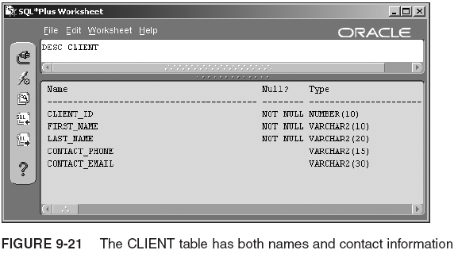
Views (continued)

Slide 55
Sequences
Sequences are used to contain automated counter values, most commonly used to retain counter values for integer-valued primary keys
  CREATE SEQUENCE <schema>.<sequencename>
  [ START WITH <n> ]
  [ INCREMENT BY <n> ]
  [ [ NO ] MINVALUE <n> ]
  [ [ NO ] MAXVALUE <n> ]
  [ [ NO ] CYCLE ]
  [ [ NO ] CACHE <n> ]
  [ [ NO ] ORDER ];
  ALTER SEQUENCE <schema>.<sequencename>
  [ INCREMENT BY <n> ]
  [ [ NO ] MINVALUE <n> ]
  [ [ NO ] MAXVALUE <n> ]
  [ [ NO ] CYCLE ]
  [ [ NO ] CACHE <n> ]
  [ [ NO ] ORDER ];
  DROP SEQUENCE <schema>.<sequencename>

Slide 56
Sequences (continued)
A sequence allows for generation of unique, sequential values
Typically used in SQL statements listed below:
  The VALUES clause of an INSERT statement
  A subquery SELECT list contained within the VALUES clause of an INSERT statement
  In the SET clause of an UPDATE statement
  A query SELECT list
Sequence values can be accessed using the CURRVAL and NEXTVAL pseudocolumns:
  <sequencename>.CURRVAL
  <sequencename>.NEXTVAL

Slide 57
Synonyms
A synonym can provide an alias to any object, in any schema in a database, assuming that the user has privileges to view the underlying objects
  It makes an object appear as if you own it, because you do not have to use a schema prefix when querying or performing other tasks with the object
  CREATE [ OR REPLACE ] [ PUBLIC ] SYNONYM <schema>.<synonymname>
  FOR [<schema>.]<objectname>[@<databaselinkname>];
  DROP [ PUBLIC ] SYNONYM <schema>.<synonymname> [ FORCE ];
Benefits:
  Transparency
  Simplified SQL code
  Easy changes

Slide 58
Data Dictionary Information on Views, Sequences, and Synonyms
Three views are of interest:
  ALL_VIEWS
    VIEW_NAME
    TEXT
  ALL_SEQUENCES
  ALL_SYNONYMS

Slide 59
Summary
Integrity constraints can be enforced with declared constraints, triggers, or application programming
  PRIMARY KEY: constraint can cover one or more columns in a table
  UNIQUE constraint: requires unique values or null values in the unique key columns
  FOREIGN KEY constraint: enforces integrity of a relationship between parent and child table
  NOT NULL constraint: must be on a single column
  CHECK constraint: compares column to a list or range of values
Constraints can be created with CREATE TABLE and ALTER TABLE

Slide 60
Summary (continued)
PRIMARY KEY is crucial to relational DB design
  When a constraint is created (and not disabled), a unique index is created to help enforce it
  Dropping/disabling constraint causes underlying index to be dropped
USING INDEX applies only to PRIMARY KEY and UNIQUE key constraints in which you want to use a preexisting index or specify storage settings for the index to be created when the constraint is created
FOREIGN KEY constraint can define the behavior of DB when a parent row is deleted using ON DELETE CASCADE or ON DELETE SET NULL

Slide 61
Summary (continued)
CHECK constraint can look for a specified list of values or other simple expressions
The ALL_CONSTRAINTS data dictionary view contains details on all five types of constraints
Index: holds data and has its own storage in DB
  Contains columns and ROWIDs
  Can be based on a table’s primary key or any combination and order of columns
  Can have up to 32 columns (30 for bitmap indexes)
  Types: BTree (default), bitmap, local partitioned, global partitioned, reverse key, function-based, BTree cluster, hash cluster, and domain indexes
  Create using CREATE INDEX

Slide 62
Summary (continued)
BTree searches take longer as levels are added
  BTrees are efficient even for large amounts of data
Bitmap indexes consume far less storage space
  Cannot be unique; best suited for data warehouses
Local partitioned indexes mirror the partitioning of the partitioned table
Global partitioned indexes can be created on partitioned or nonpartitioned tables
Reverse key indexes contain columns that have been stored in reverse byte order
  Usually only for Real Application Cluster systems
Function-based indexes substitute a function or expression for a column

Slide 63
Summary (continued)
Views can be used to restrict access to both columns and rows in one or more underlying tables
Sequences can be used to store automated sequential counters for surrogate primary key columns in tables
Synonyms allow easy access to database objects across schemas and databases

