Slide 1

Oracle 10g Database Administrator: Implementation and Administration
Chapter 10
Basic Data Management

Slide 2
Objectives
Discover changing data using Data Manipulation (DML) statements
Describe syntax for, and use the INSERT statement
Describe syntax for, and use the UPDATE statement
Describe syntax for, and use the DELETE statement
Describe and learn how to control transactions

Slide 3
Introduction to Basic Data Management
Tables
  Most basic storage unit for data
  Two-dimensional storage structures comprised of rows and columns
    Column stores individual values such as a person’s name
    Row stores all the things about a person
Statements to work with tables
  INSERT
    Adds new rows to a table

Slide 4
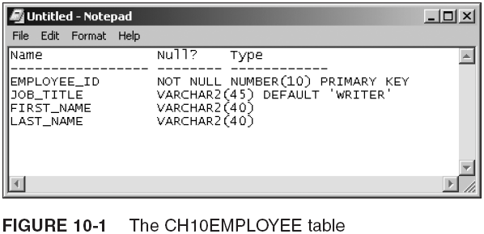
Introduction to Basic Data Management (continued)

Slide 5
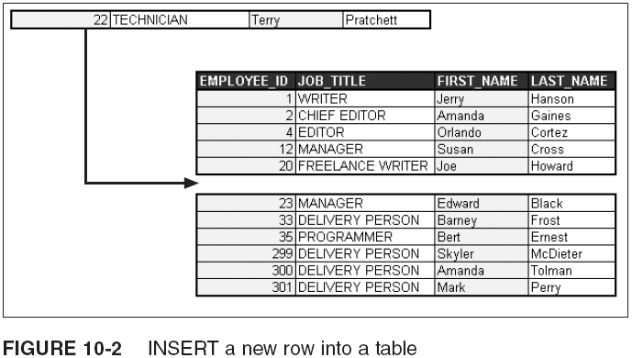
Introduction to Basic Data Management (continued)

Slide 6
Introduction to Basic Data Management (continued)
Statements to work with tables
  UPDATE
    Allows existing rows in a table to be changed
  DELETE
    Lets you remove existing rows from tables
More advanced methods of data management
  Programming Language for SQL (PL/SQL)
  Data Pump import and export
  SQL Loader utility

Slide 7
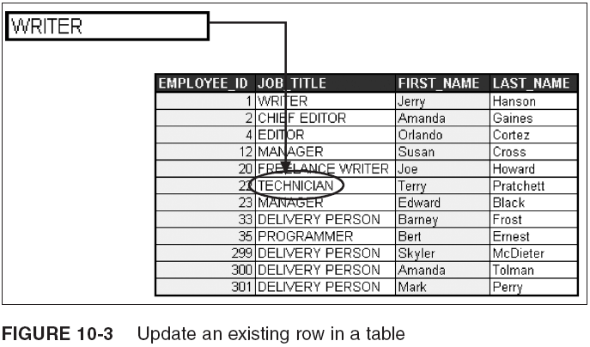
Introduction to Basic Data Management (continued)

Slide 8
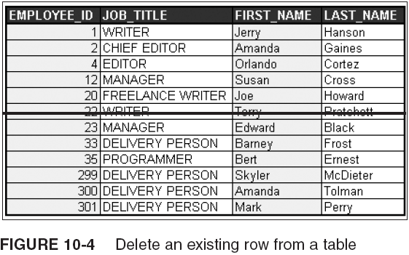
Introduction to Basic Data Management (continued)

Slide 9
What are DML and DDL?
Data Manipulation Language (DML) statements
  Allow you to change data in tables
  Statements: INSERT, UPDATE, and DELETE
Data Definition Language (DDL) statements
  Used to change data structures such as tables
  Make permanent changes to the database
    Cannot be undone (roll back)
COMMIT statement
  Permanently stores changes to a database
ROLLBACK statement
  Reverses changes done with COMMIT

Slide 10
What is a Transaction?
Transaction
  Sequence of one or more DML statement-induced database changes
  Not yet permanently committed to that database
COMMIT and ROLLBACK
  COMMIT makes changes to the database
  ROLLBACK undoes changes to the database

Slide 11
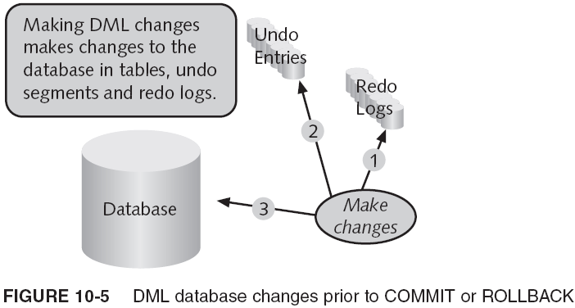
What is a Transaction? (continued)

Slide 12
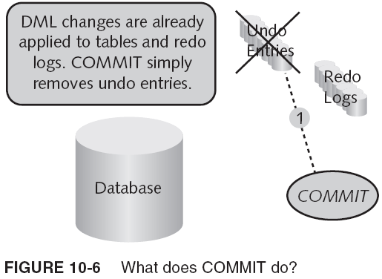
What is a Transaction? (continued)

Slide 13
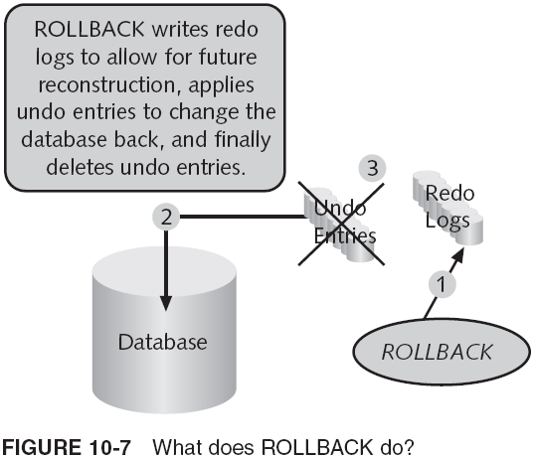
What is a Transaction? (continued)

Slide 14
What is a Transaction? (continued)
MERGE statement
  DML statement
  Used to merge data from a source table into a target table
Committing changes is a more frequent event
  Than undoing changes
Three types of INSERT statements
  A single table INSERT statement
  A non-conditional multiple-table INSERT statement
  A conditional multiple table INSERT statement

Slide 15
Using DML Statements
DML statements
  INSERT
  UPDATE
  DELETE

Slide 16
The INSERT Statement (Adding New Data)
Single table INSERT
Example:

Slide 17
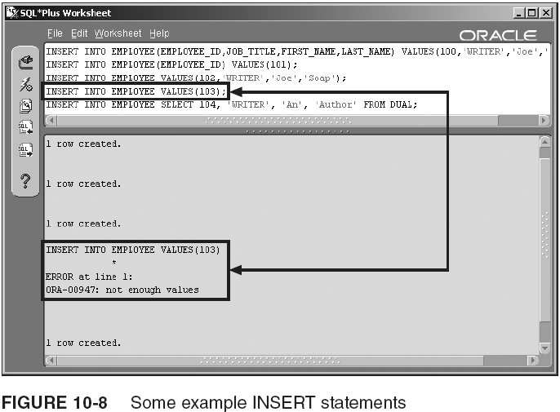
The INSERT Statement (Adding New Data) (continued)

Slide 18
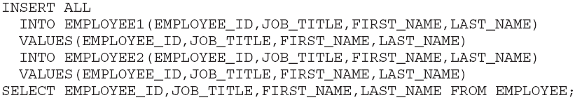
The INSERT Statement (Adding New Data) (continued)
Non-conditional multiple-table INSERT
Example:

Slide 19
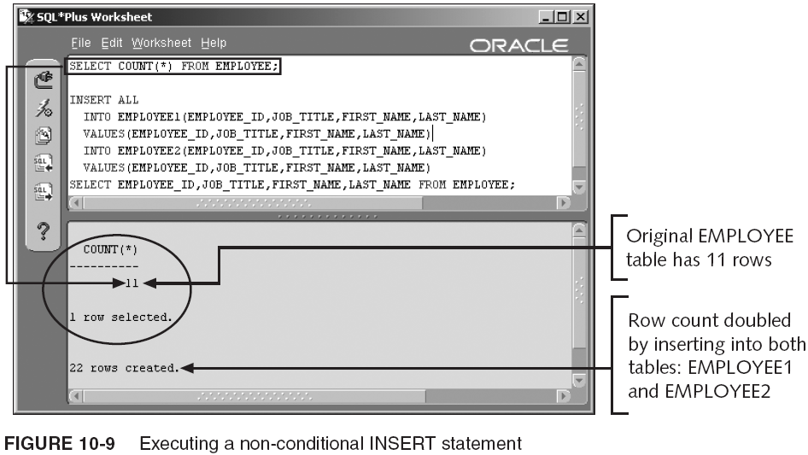
The INSERT Statement (Adding New Data) (continued)

Slide 20
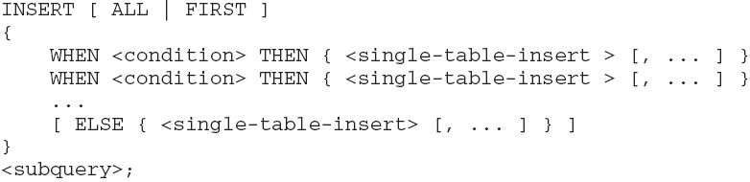
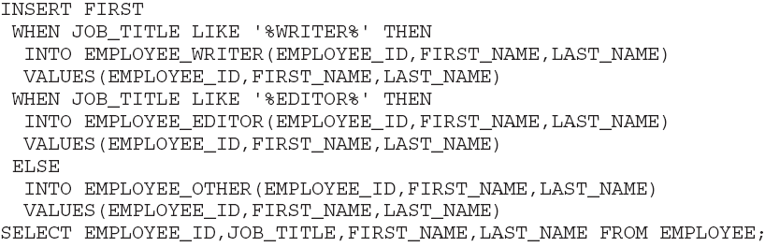
The INSERT Statement (Adding New Data) (continued)
Conditional multiple table INSERT
Example:

Slide 21
The INSERT Statement (Adding New Data) (continued)

Slide 22

The UPDATE Statement (Changing Existing Data)
Syntax:
Example:

Slide 23

The DELETE Statement (Delete Existing Data)
Syntax:
Example:

Slide 24
Controlling Transactions
Statements
  COMMIT
  ROLLBACK
  SAVEPOINT
  SET TRANSACTION
  LOCK TABLE

Slide 25
The COMMIT Statement
Makes pending changes permanent
  For an existing transaction in the current session
Syntax:
  COMMIT;

Slide 26
The ROLLBACK Statement
Removes pending changes (not yet committed)
  For an existing transaction in the current session
Syntax:
  ROLLBACK;

Slide 27

The SAVEPOINT Statement
Creates a label
  Label can be used later in a transaction as a point to roll back to
Syntax:

Slide 28
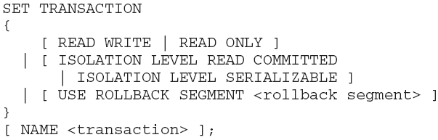
SET TRANSACTION Statement
Permits control of a transaction as a whole
  From the first DML statement through to a transaction completion statement or event
Syntax:

Slide 29
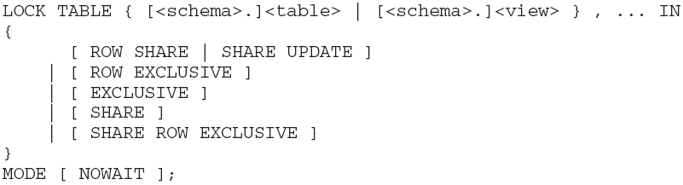
The LOCK TABLE Statement
Places a lock on an entire table
  Prohibiting other transactions in other sessions from making changes to that table
    Until the lock is released by ending the transaction (COMMIT or ROLLBACK)
Syntax:

Slide 30
Directory Objects
Directory object
  Used to create a reference to a file
    Which is stored externally to an Oracle database
  Typically, directory objects are used for external tables
External table
  Contains data in a file outside the database
  External tables are read-only
  Can be created/loaded using an AS subquery clause
  Cannot have DML statements executed against them

Slide 31
Summary
DML or Data Manipulation Language statements
  Used to change data in tables in a database
  Can be rolled back using the ROLLBACK statement
DDL or Data Definition Language statements
  Used to change the structure of database objects
  Automatically execute a COMMIT statement
Transaction constitutes one or more database changes through DML statements
The COMMIT statement stores changes to the database

Slide 32
Summary (continued)
The ROLLBACK statement will undo or reverse any DML statement-induced changes not yet committed
DML statements
  INSERT, UPDATE, and DELETE
  Can be rolled back
Types of INSERT statement
  Single table
  Non-conditional multiple-table
  Conditional multiple table

Slide 33
Summary (continued)
The SAVEPOINT statement creates a label allowing for partial transaction rollback
The SET TRANSACTION statement allows application of specific attributes for a transaction
The LOCK TABLE statement allows locking of tables during the processing of a transaction
Directory objects
  Used to create storage areas outside of an Oracle database

