Slide 1


Oracle 10g Database Administrator: Implementation and Administration
Chapter 11
Advanced Data Management

Slide 2
Objectives
Examine the basics of PL/SQL
Use the Data Pump export and import utilities
Use the SQL Loader utility for rapid bulk data loads
Briefly examine transportable tablespaces

Slide 3
Introduction to Advanced Data Management
Advanced data management methods in Oracle
  Programming Language for SQL (PL/SQL)
    Allows construction of properly scripted intra-dependant SQL command structures
  Data pump technology
    Used to perform bulk loads and dumps into and out of an Oracle database
  SQL Loader
    Generally most efficient tool for mass data loading
    Allows loading of OS flat files into table(s) at once

Slide 4
Introduction to Advanced Data Management (continued)
What are the components of PL/SQL?
  Modular block structures
  Anonymous blocks
  Exception trapping
  Stored (named) procedures: procedures, functions, procedure packaging using packages and triggers
  Variables and datatypes
  Explicit and implicit cursors
  Control structures:
    IF statement
    CASE statement
    Looping constructs (FOR, WHILE, LOOP...END, FORALL)
    Sequencing controls (GOTO, NULL)

Slide 5
Introduction to Advanced Data Management (continued)
Data Pump provides the following advantages over the original Import and Export utilities:
  Better handling of bulk loading and unloading
  Parallel processing
  Better network support
  Metadata filters allowing inclusion and exclusion of specific metadata items (DB objects such as tables)
  Interactive command mode (for job monitoring)
  Space estimations of a Data Pump export job
  Versions of objects can be specified
  Fine-grained object selection

Slide 6
Coding SQL into Programs with PL/SQL
A study of PL/SQL can be broken in specific parts
  For example, the identification of PL/SQL objects, triggers, and the events that execute triggers
    This text will cover a little more, even if briefly
Begin with the most fundamental—blocks of code

Slide 7
Blocks, Exception Trapping, and Anonymous Blocks
What is a block?
  In programming terms a block is a section of code
  A block of code is a self-contained sequence of one or more commands
  In PL/SQL a block is a chunk of code containing both PL/SQL and SQL commands
    PL/SQL is a programming form of SQL where SQL commands such as INSERT and SELECT can be contained with PL/SQL blocks
    Simplest PL/SQL block of code:
      BEGIN
      NULL;
      END;

Slide 8
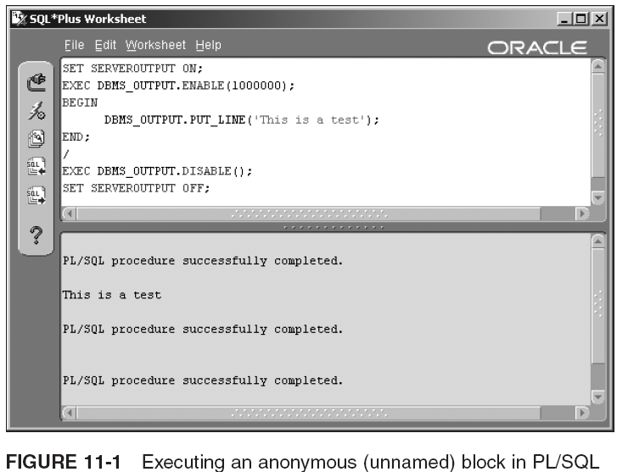
Blocks, Exception Trapping, and Anonymous Blocks (continued)

Slide 9
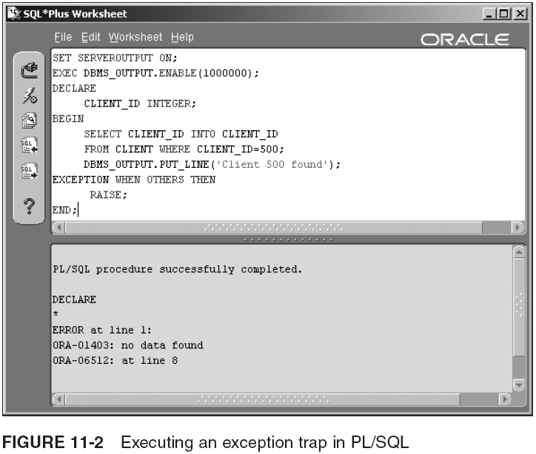
Blocks, Exception Trapping, and Anonymous Blocks (continued)
Exceptions or errors can be detected within the block using the EXCEPTION
trapping command

Slide 10
Named Blocks and Packages
A named block is a chunk of code given a label, so that block of code can be stored in the database
  Is stored and can be recalled later and re-executed, without having to retype the entire block of code
  Can be of various types with various restrictions:
    Procedure
    Function
    Trigger
    Package

Slide 11
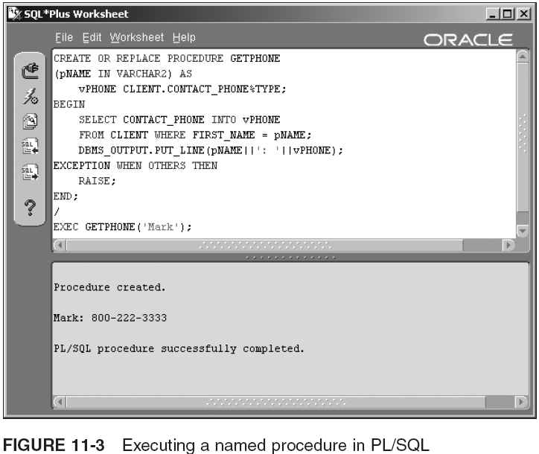
Named Blocks and Packages (continued)

Slide 12
Named Blocks and Packages (continued)
Named function:
  CREATE OR REPLACE FUNCTION STRIPCODE
  (pPHONE IN VARCHAR2) RETURN VARCHAR2 IS
  BEGIN
  RETURN SUBSTR(pPHONE,5,8);
  EXCEPTION WHEN OTHERS THEN
  RAISE;
  END;
  /
Embedding a function into a procedure:
  CREATE OR REPLACE PROCEDURE GETPHONE
  (pNAME IN VARCHAR2) AS
  vPHONE CLIENT.CONTACT_PHONE%TYPE;
  BEGIN
  SELECT CONTACT_PHONE INTO vPHONE
  FROM CLIENT WHERE FIRST_NAME = pNAME;
  DBMS_OUTPUT.PUT_LINE(STRIPCODE(vPHONE));
  EXCEPTION WHEN OTHERS THEN
  RAISE;
  END;
  /

Slide 13
Named Blocks and Packages (continued)
To package a procedure and function:
  CREATE OR REPLACE PACKAGE PHONENUMBERS AS
  FUNCTION STRIPCODE(pPHONE IN VARCHAR2) RETURN VARCHAR2;
  PROCEDURE GETPHONE(pNAME IN VARCHAR2);
  END;
  /
  CREATE OR REPLACE PACKAGE BODY PHONENUMBERS AS
  FUNCTION STRIPCODE
  (pPHONE IN VARCHAR2) RETURN VARCHAR2 IS
  BEGIN
  RETURN SUBSTR(pPHONE,5,8);
  EXCEPTION WHEN OTHERS THEN
  RAISE;
  END;
  PROCEDURE GETPHONE
  (pNAME IN VARCHAR2) AS
  vPHONE CLIENT.CONTACT_PHONE%TYPE;
  BEGIN
  SELECT CONTACT_PHONE INTO vPHONE
  FROM CLIENT WHERE FIRST_NAME = pNAME;
  DBMS_OUTPUT.PUT_LINE(STRIPCODE(vPHONE));
  EXCEPTION WHEN OTHERS THEN
  RAISE;
  END;
  END;
  /

Slide 14
Triggers and Events Firing Triggers
A trigger is executed based on a DB event
  CREATE [ OR REPLACE ] TRIGGER [ <schemaname>.]<triggername>
  { BEFORE | AFTER | INSTEAD OF }
  {
  INSERT ON <tablename>
  | UPDATE ON <tablename> [ OF <columnname> ]
  | DELETE ON <tablename>
  }
  BEGIN
  ... trigger code ...
  END;
  /
You can refer to column values in row prior to and after the DML command change; new and old values exist depending on the DML command
  INSERT has only new values, UPDATE has both old and new values, and DELETE has old values only

Slide 15
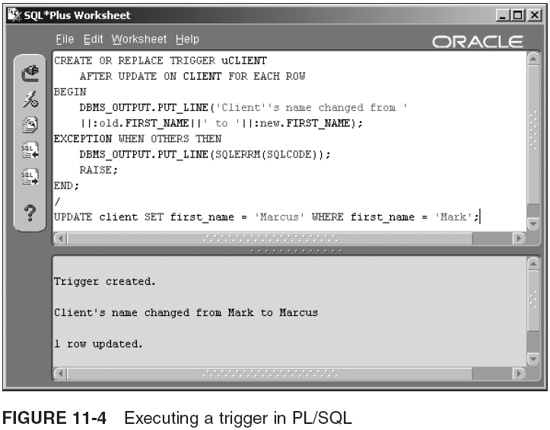
Triggers and Events Firing Triggers (continued)

Slide 16
PL/SQL Variables and Datatypes
PL/SQL uses the datatypes used in SQL (Table 7-1)
It also uses some additional datatypes:
  NUMBER: different NUMBER datatypes (FLOAT, etc.)
  BINARY_INTEGER: signed integer value
  BOOLEAN: TRUE, FALSE or null
  RECORD: similar to VARRAY or TABLE; allows creation of a table row structure in memory
    RCLIENT CLIENT%ROWTYPE;
  Reference datatypes: A REF cursor is a by reference cursor (BYREF)
  Associative arrays: dynamic array (like a nested table object), but it is indexed and has better performance

Slide 17
PL/SQL Variables and Datatypes (continued)
In the next sample a new record structure is built using an added identifier field (ID), the name of the client and his phone number
  DECLARE
  TYPE TCLIENT IS RECORD
  (
  CLIENT_ID INTEGER
  , NAME CLIENT.FIRST_NAME%TYPE
  , PHONE CLIENT.CONTACT_PHONE%TYPE
  );
  RCLIENT TCLIENT;
  BEGIN
  NULL;
  END;
  /

Slide 18
PL/SQL Variables and Datatypes (continued)
The following script snippet shows how an associative array is declared in PL/SQL as opposed to VARRAYs and nested tables:
  DECLARE
  TYPE TTABLE IS TABLE OF VARCHAR2(32);
  TYPE TVARRAY IS VARRAY(100) OF INTEGER;
  TYPE TITABLE IS TABLE OF VARCHAR2(32)
  INDEX BY BINARY_INTEGER;
  VPOINTER TTABLE;
  VARRAY TVARRAY;
  VINDEXEDPOINTER TITABLE;
  BEGIN
  NULL;
  END;
  /

Slide 19
What is a Cursor?
What is a cursor?
  Temporary area (Work Area) in memory used to store the results of a query
  Pointer to address in memory, a chunk of memory
  SQL statement results are processed in cursors during execution
  In PL/SQL cursors can be created as programming structures for holding iterations of data
  Can be used for queries returning one or many rows and can be of two types, implicit and explicit cursors

Slide 20
What is a Cursor? (continued)
Explicit cursor: declared by the programmer
  Allows greater programming control
  Cursor commands: OPEN, FETCH, and CLOSE
    DECLARE
    CURSOR CCLIENT IS SELECT * FROM CLIENT;
    RCLIENT CLIENT%ROWTYPE;
    BEGIN
    OPEN CCLIENT;
    LOOP
    FETCH CCLIENT INTO RCLIENT;
    EXIT WHEN CCLIENT%NOTFOUND;
    DBMS_OUTPUT.PUT_LINE(RCLIENT.FIRST_NAME);
    END LOOP;
    CLOSE CCLIENT;
    END;
    /
Implicit cursor: declared automatically by PL/SQL
  Automatically opened and closed by SQL or PL/SQL
  Process INSERT, UPDATE, DELETE, and SELECT
  A cursor FOR loop is a special type of implicit cursor

Slide 21
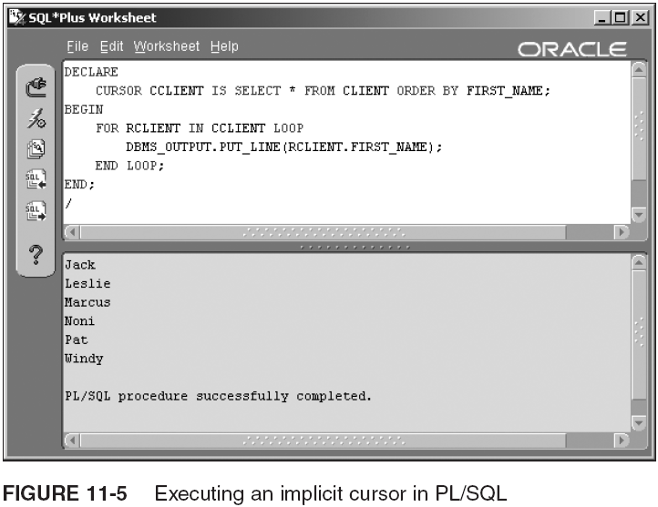
What is a Cursor? (continued)

Slide 22
PL/SQL Programming Control Structures
Control structure: special keyword(s) used to control the flow through a program
Most programming languages have largely the same control structures, with minor syntax variations
PL/SQL control structures are:
  The IF statement
  The CASE statement
  Loops
  Sequencing control

Slide 23
The IF Statement
The IF statement allows for decisions:
  IF condition THEN ...
  ELSIF condition THEN ...
  ELSE ...
  END IF;
For example:
  IF CLIENT_ID = 1 THEN RETURN 'one'
  ELSIF CLIENT_ID = 2 THEN RETURN 'two'
  ELSE RETURN 'neither'
  END IF;

Slide 24
The CASE Statement
Search condition:
  CASE
  CASE WHEN condition THEN ...
  CASE WHEN condition THEN ...
  ELSE ...
  END CASE;
For example:
  CASE
  WHEN THEDATE < SYSDATE THEN RETURN 'yesterday';
  WHEN THEDATE = SYSDATE THEN RETURN 'today';
  WHEN THEDATE > SYSDATE THEN RETURN 'tomorrow';
  ELSE ...
  END CASE;
Selector-expression variations:
  CASE selector
  WHEN expression THEN ...
  WHEN expression THEN ...
  ELSE ...
  END CASE;
For example:
  CASE THEDATE
  WHEN SYSDATE-1 THEN RETURN 'yesterday';
  WHEN SYSDATE THEN RETURN 'today';
  WHEN SYSDATE+1 THEN RETURN 'tomorrow';
  ELSE ...
  END CASE;

Slide 25
Loops in PL/SQL
Looping constructs include the FOR loop, the WHILE loop, and the LOOP...END (endless loop)
The FOR loop iterates through a known set of values:
  FOR counter IN [REVERSE] lower-value .. higher-value LOOP
  EXIT WHEN expression
  END LOOP;
For example:
  DECLARE
  STEP INTEGER;
  BEGIN
  FOR STEP IN 1..5 LOOP
  DBMS_OUTPUT.PUT_LINE(TO_CHAR(STEP));
  END LOOP;
  END;
  /

Slide 26
Loops in PL/SQL (continued)
The WHILE loop continues as long as a condition holds true:
  WHILE condition LOOP
  ...
  EXIT WHEN expression
  END LOOP;
For example:
  DECLARE
  STEP INTEGER DEFAULT 1;
  BEGIN
  WHILE STEP < 10 LOOP
  DBMS_OUTPUT.PUT_LINE(TO_CHAR(STEP));
  STEP := STEP + 1;
  END LOOP;
  END;
  /

Slide 27
Loops in PL/SQL (continued)
LOOP...END LOOP allows for an infinite loop
  Can be used as a WHILE loop
    LOOP
    EXIT WHEN expression
    ...
    END LOOP;
Can be used as an UNTIL loop:
  LOOP
  ...
  EXIT WHEN expression
  END LOOP;
For example:
  DECLARE
  STEP INTEGER DEFAULT 1;
  BEGIN
  LOOP
  DBMS_OUTPUT.PUT_LINE(TO_CHAR(STEP));
  STEP := STEP + 1;
  EXIT WHEN STEP > 5;
  END LOOP;
  END;
  /

Slide 28
Sequencing Controls
Include: GOTO command and NULL statement
A sequencing control is allowed to disrupt to logical flow of a program through its lines of code
NULL statement does nothing
GOTO statement allows branching from one part of a program to another
  BEGIN
  <<labelone>>
  ...
  IF condition THEN GOTO labelone; END IF;
  ...
  IF condition THEN GOTO labeltwo; END IF;
  ...
  <<labeltwo>>
  ...
  END;

Slide 29
Bulk Data Imports and Exports Using Data Pump
Previously, export (exp) and import (imp) utilities were used to import/export data from a DB
Data Pump export (expdp) and import (impdp) utilities are more versatile and much faster
  Can be executed in parallel, failed/stopped jobs can be restarted, metadata can be filtered out, etc.
Exporting/importing is allowed at all logical layers: tables, schemas, groups of objects, or an entire DB
  You export data and metadata
  Database exports can used to migrate and upgrade between different versions of Oracle

Slide 30
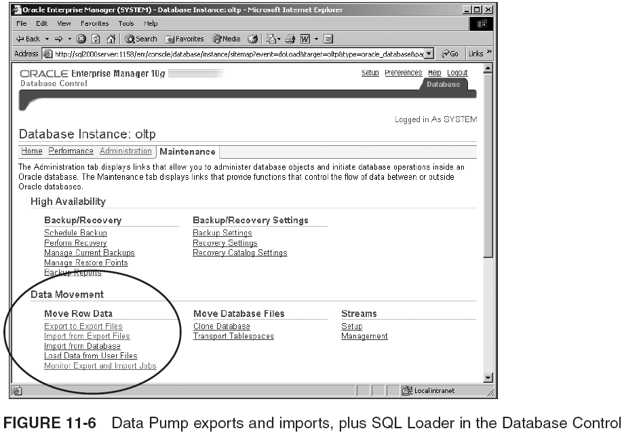
Bulk Data Imports and Exports Using Data Pump (continued)

Slide 31
Exporting Using Data Pump
Steps:
  Start a shell and
  Type expdp help=y
  Do a simple export
    expdp classmate/
    classpass@oraclass DIRECTORY=dmpdir DUMPFILE=classmate.dmp
  Create a directory object for Data Pump C/
    CREATE OR REPLACE DIRECTORY DP AS 'C:\';
  Execute the expdp utility and export
    expdp system/password@oraclass DIRECTORY=dp DUMPFILE=system.
    dmp NOLOGFILE=Y
  Export the CLASSMATE schema
    expdp system/password@oraclass DIRECTORY=dp DUMPFILE=classmate2.
    dmp SCHEMAS=('CLASSMATE') NOLOGFILE=Y

Slide 32
Importing Using Data Pump
Data Pump is only available to DB- and OS level administrative personnel
  Older utils. allow exports/imports across a network
    Are secure because users have to have the schema password names to access schemas
Steps:
  Start a shell
  Type impdp help=y
The most likely use of these utilities are as fast backups and as an easy method of copying DBs
IMP and EXP are easier to use than Data Pump, with the same options, just fewer options

Slide 33
Bulk Data Loads with SQL*Loader
SQL*Loader can perform magnificently in direct path, parallel mode, and using external tables
  Direct path loads allow appending to tables
  Some situations will cause single tables and even entire SQL*Loader executions to execute using a conventional path load
SQL*Loader is not limited to individual table loads
  It can load into more than one table at once, considering all constraints
SQL*Loader can also perform fast direct loads with external tables

Slide 34
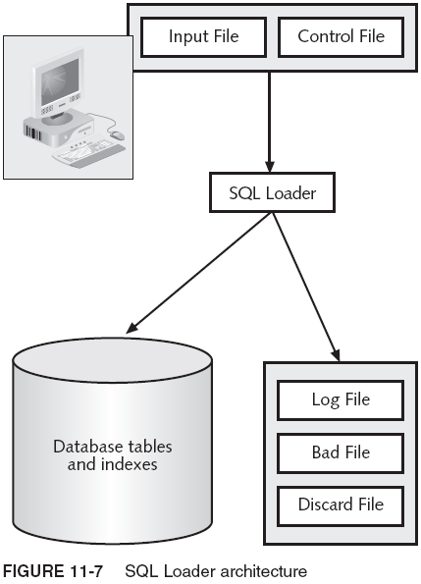
Bulk Data Loads with SQL*Loader (continued)

Slide 35
Direct Versus Conventional Path Loads
In a conventional path load rows are parsed into an array structure according to field specification, as defined by SQL Loader and table to be added to
A direct path is similar to a conventional one; but, load writes data to end of table into new block and extent structures, creating new blocks as it goes
  Potentially much faster than conventional path loads
A parallel direct path load is a variation on a direct path load and is potentially faster than a direct one
The external table load creates and loads an external table

Slide 36
SQL Loader Input Data Files
The input data files provide the data loaded in SQL Loader
  Input data file contents can be fixed-length rows, variable-length rows, or a single stream (string)
  Input data can consist of a single data file in control file, or a separate data set in the input data file
    File does not have to exist and that input data can all be included in the control file
    To avoid confusion, it is best to divide things into the different appropriate files

Slide 37
The SQL Loader Control File
Control file contains a mapping between input data and table structures into which data is to be loaded
  LOAD DATA
  INFILE 'data\Chapter11\ch11.dat'
  INTO TABLE client APPEND
  FIELDS TERMINATED BY "," TRAILING NULLCOLS
  (
  CLIENT_ID INTEGER,
  FIRST_NAME CHAR(10),
  LAST_NAME CHAR(20),
  CONTACT_PHONE CHAR(15),
  CONTACT_EMAIL CHAR(30)
  )
The bad rows and discard rows can be defined too
  BADFILE 'solutions\Chapter11\bad.dat'
  DISCARDFILE 'solutions\Chapter11\discard.dat'

Slide 38
Row Loading Options
LOAD DATA INFILE ... BADFILE ... DISCARDFILE ...
INTO TABLE table1 [ INSERT | REPLACE | TRUNCATE | APPEND ]
FIELDS TERMINATED BY "," TRAILING NULLCOLS
(
FIELD1 INTEGER EXTERNAL,
FIELD2 INTEGER EXTERNAL,
...
FIELDn ...
)
  INSERT is the default

Slide 39
Column Delimiters
Two examples:
  LOAD DATA
  INTO TABLE table1 TRUNCATE
  (
  FIELD1POSITION(001:010) CHAR(10) TERMINATED BY WHITESPACE,
  FIELD2 POSITION(011:030) CHAR(20) TERMINATED BY WHITESPACE,
  ... ,
  FIELDn ...
  )
  LOAD DATA
  INTO TABLE table1 TRUNCATE FIELDS TERMINATED BY "," TRAILING NULLCOLS
  (
  FIELD1 INTEGER EXTERNAL,
  FIELD2 INTEGER EXTERNAL,
  ...
  FIELDn ...
  )

Slide 40
Load Filters
A load filter uses a WHEN clause, which can be used to discard rows from the loading process, potentially placing discarded rows in discard file to avoid loading them into DB
In the example below only rows with specified values are loaded. Column 2 must be filled with “ABC”; others are ignored and placed into discards:
  LOAD DATA INFILE ... INTO TABLE table1 TRUNCATE
  FIELDS TERMINATED BY "," TRAILING NULLCOLS
  WHEN (2) = 'ABC'
  (
  FIELD1 INTEGER EXTERNAL,
  FIELD2 INTEGER EXTERNAL,
  ...
  FIELDn ...
  )

Slide 41
Unwanted Columns
Unwanted columns can be removed from loading process and replaced with NULL values by using FILLER clause
Other column values in the same row are still loaded:
  LOAD DATA INFILE ...
  INTO TABLE table1(
  col1 CHAR(10),
  col2 FILLER CHAR(12),
  col3 CHAR(1) TERMINATED BY WHITESPACE)
  TRUNCATE FIELDS TERMINATED BY "" TRAILING NULLCOLS
  ...

Slide 42
Control File Datatypes
SQL*Loader has limited datatype set w/ commands for handling different situations for each of them:
  Strings: CHAR[(n)]
    DEFAULTIF col1=BLANKS
    NULLIF col1=BLANKS
  Dates: DATE, TIME, TIMESTAMP and INTERVALs
  Numbers: externally or internally defined C/:.
    EXTERNAL { INTEGER | FLOAT | DECIMAL }
      DEFAULTIF col1=BLANKS
      NULLIF col1=BLANKS
    Non EXTERNAL. INTEGER(n), SMALLINT, FLOAT, DOUBLE, BYTEINT, and DECIMAL(p,s)

Slide 43
Embedded SQL Statements
Using SQL statements in control file, to be applied to every data input row, disables APPEND loads
  You will not get an error, only a message indicating a switch from direct path to conventional path load
  The following example contains a column reference for COL1, a literal SQL string for COL1 and COL2, and embedded functionality and a custom function for COL2 and the TEMPERATURE columns:
    LOAD DATA INFILE 'input.txt' INTO TABLE table1 TRUNCATE
    FIELDS TERMINATED BY "," TRAILING NULLCOLS
    (
    col1 CHAR(10)"UPPER(:col1)"
    ,col2 CHAR(12)"UPPER(INITCAP(SUBSTR(:col2,4,20)))"
    ,temperature FLOAT"FToC(temperature)"
    )

Slide 44
The Parameter File
SQL*Loader can include a parameter file containing repeated settings, across multiple executions of SQL*Loader
  USERID = CLASSMATE/CLASSPASS@ORACLASS
  DISCARDMAX = 2
  ERRORS = 1000000
To load your new client rows:
  sqlldr control=<path>\data\Chapter11\ch11.ctl log=<path>\data\Chapter11\ch11.log parfile=<path>\data\Chapter11\ch11.par
Some of the most likely uses of SQL*Loader are to bulk load large amounts of data into a data warehouse, or when importing data from outside, into an existing database

Slide 45
Summary
PL/SQL can be coded into named blocks or anonymous blocks that can be executed once
  Named blocks are stored in DB and can be executed later
    Procedures, functions, triggers, or packages
Cursor: area of memory reserved for a SQL statement to execute within or during its execution
PL/SQL allows standard control constructs such as IF statements, CASE statements, and loops

Slide 46
Summary (continued)
The Data Pump export utility is used to dump DB objects such as tables and schemas to an output file
The Data Pump import utility is used to import files created by the Date Pump export utility into a DB
SQL Loader uses a control file to map data input between data input and tables into which it is loaded
A client-side utility can be executed through an Oracle TNS network name, to a database
  Both client-side and server-side (the server contains the DB) computers can have a TNS configuration
Most Oracle 10g database utilities can execute as both client-side and server-side utilities

