Slide 1


Oracle 10g Database Administrator: Implementation and Administration
Chapter 12
Security Management

Slide 2
Objectives
Create, modify, and remove users
Discover when and how to create, use, and drop profiles
Manage passwords
View information about users, profiles, passwords, and resources

Slide 3
Objectives (continued)
Identify and manage system and object privileges
Grant and revoke privileges to users
Understand auditing capabilities and practice using auditing commands
Discover when and why to use roles

Slide 4
Objectives (continued)
Learn how to create, modify, and remove roles
Learn how to assign roles
Examine data dictionary views of roles
Assign roles and privileges using the Enterprise Management console

Slide 5
Users and Resource Control
With a new DB instance, two users are created:
  SYS
    Owns most of tables needed to run SB, and data dictionary views
    Owns a host of packages and procedures built into DB
    Can perform high-level tasks (e.g., starting up and shutting down DB instance), and backup/recovery tasks
      Do not log on as SYS for routine tasks
  SYSTEM
    Owns some tables, packages, and procedures
    Has the DBA role: it can perform routine DB administration tasks
      Log on as SYSTEM to perform these routine tasks

Slide 6
Users and Resource Control (continued)
During DB creation, Oracle creates other users to help it install some DB features
  E.g., MDSYS owns objects related to Oracle Spatial
  After DB creation, these users are disabled to prevent anyone from logging to DB with their accounts
After the DB instance is up and running, you create users that own tables and other objects
  So system and user tables are in distinct logical groups
  You can limit the ability of each user to create objects
    You can create a profile, and assign it to any user
After creating users to own the business tables, you must create users who access these tables

Slide 7
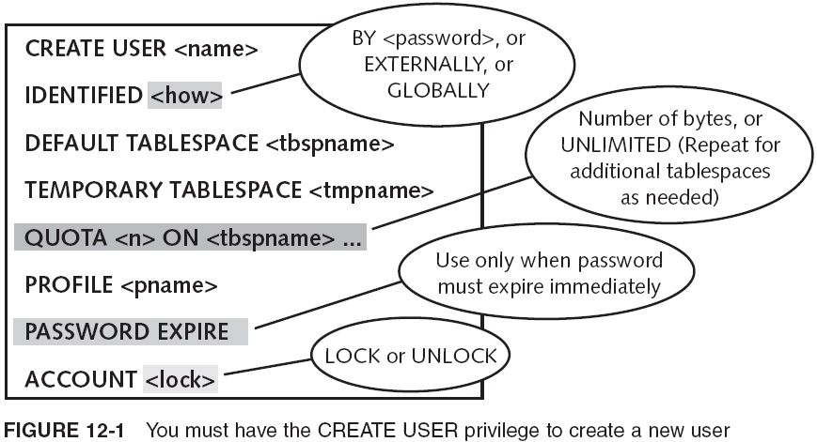
Creating New Users

Slide 8
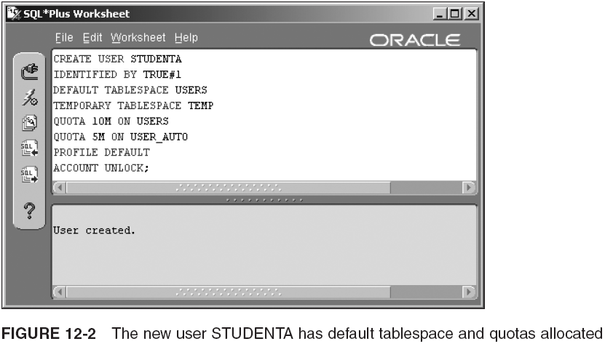
Creating New Users (continued)
GRANT CREATE SESSION TO STUDENTA, STUDENTB;

Slide 9
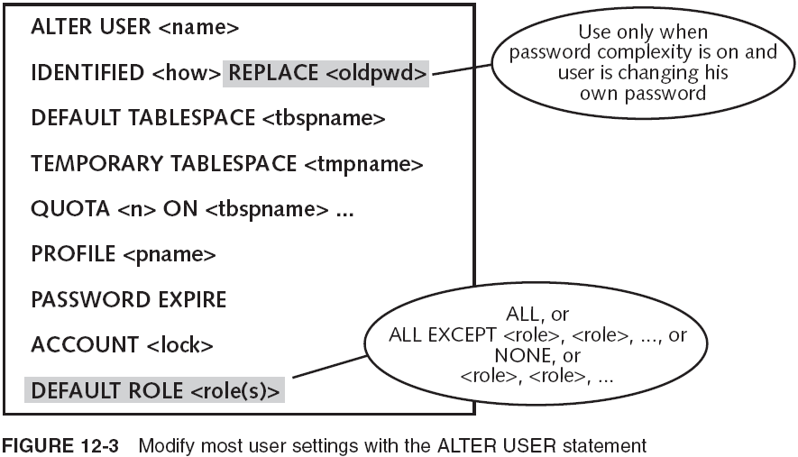
Modifying User Settings with the ALTER USER Statement

Slide 10
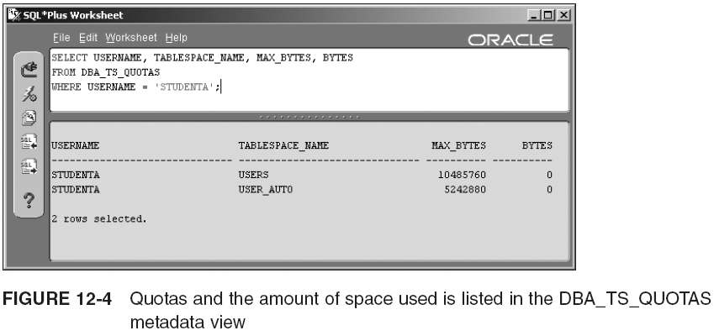
Modifying User Settings with the ALTER USER Statement (continued)

Slide 11
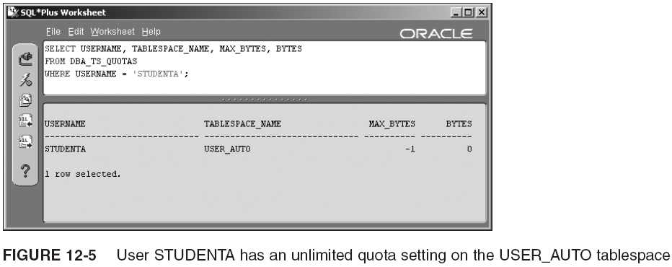
Modifying User Settings with the ALTER USER Statement (continued)
ALTER USER STUDENTA
QUOTA UNLIMITED ON USER_AUTO;
ALTER USER STUDENTA
QUOTA 0 ON USERS;

Slide 12
Removing Users
Removing users requires the DROP USER system privilege, which the SYSTEM user has.
  DROP USER <user> CASCADE;
  Use CASCADE if user owns tables or DB objects
If a user has created other users, those users are not dropped when the creating user is dropped
  The new users do not belong to the original user’s schema
If a user has created tables you want to keep, do not drop the user
  Instead, change the user account to LOCK status

Slide 13
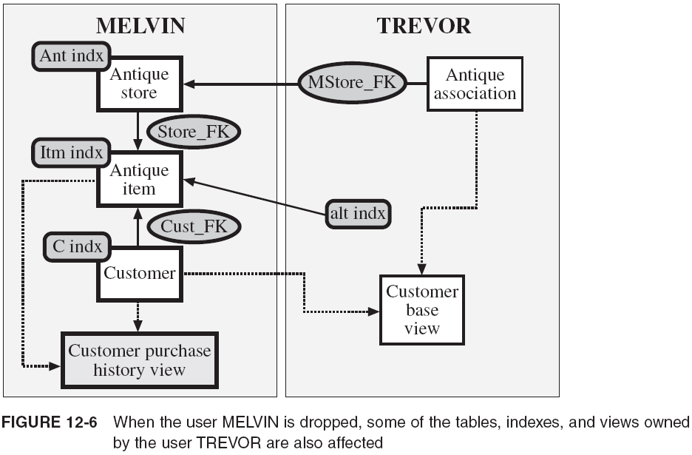
Removing Users (continued)

Slide 14
Introduction to Profiles
Specify a profile when you create/alter a DB user
Profile: collection of settings that limits the use of system resources and the database
  A profile can be assigned to any number of users
    A user can be assigned only one profile at a time
      A newly assigned profile overrides the old one
        User’s current session isn’t affected by profile change
  DEFAULT profile has no resource or DB use limits
    As a system grows, resources may become stretched
  Profiles can be used for managing passwords too

Slide 15
Creating Profiles
CREATE PROFILE <profile> LIMIT
<password_setting> ...
<resource_setting> <limit> ...;
  Password settings:
    FAILED_LOGIN_ATTEMPTS, PASSWORD_LIFE_TIME, PASSWORD_REUSE_TIME, PASSWORD_REUSE_MAX, PASSWORD_LOCK_TIME, FAILED_LOGIN_ATTEMPTS, PASSWORD_GRACE_TIME, PASSWORD_VERIFY_FUNCTION
  You can limit nine resources:
    SESSSIONS_PER_USER, CPU_PER_SESSION, CPU_PER_CALL, CONNECT_TIME, IDLE_TIME, LOGICAL_READS_PER_SESSION, LOGICAL_READS_PER_CALL, PRIVATE_SGA, COMPOSITE_LIMIT

Slide 16
Creating Profiles (continued)
Examples:
  CREATE PROFILE PROGRAMMER LIMIT
  SESSIONS_PER_USER 2;
  CREATE PROFILE POWERUSER LIMIT
  PASSWORD_LIFE_TIME 60;

Slide 17
Managing Passwords
There are three different areas to examine when working with passwords:
  Changing a password and making it expire
  Enforcing password time limits, history, and other settings
  Enforcing password complexity
    Uses a combination of a function and a profile
      Predefined SQL script to verify the complexity of a password
      Adjust the PASSWORD_VERIFY_FUNCTION setting in a profile and assign that profile to a user

Slide 18
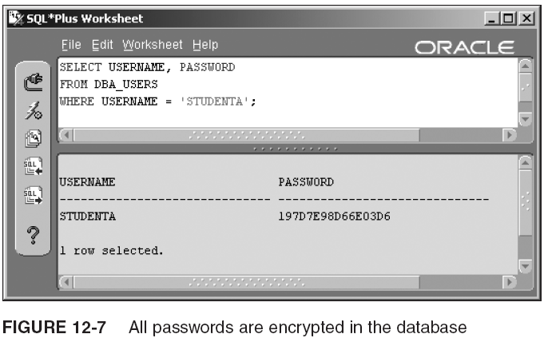
Managing Passwords (continued)

Slide 19
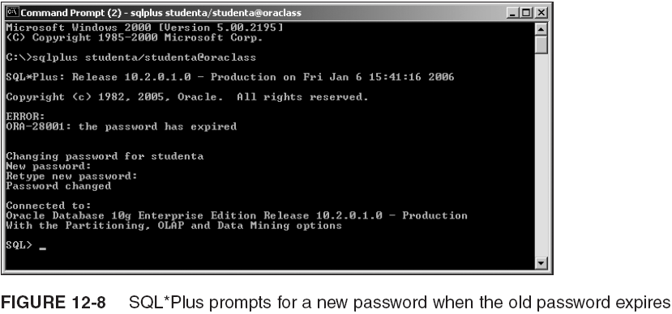
Managing Passwords (continued)

Slide 20
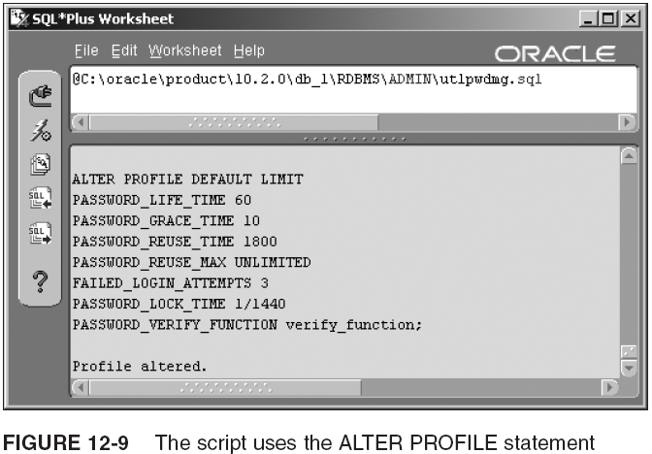
Managing Passwords (continued)

Slide 21
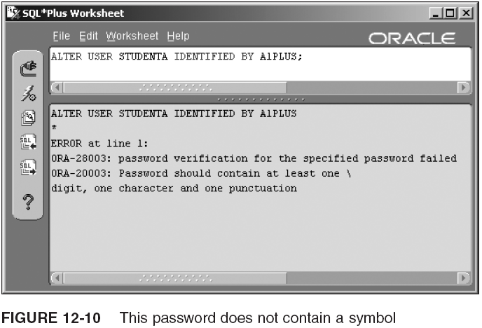
Managing Passwords (continued)

Slide 22
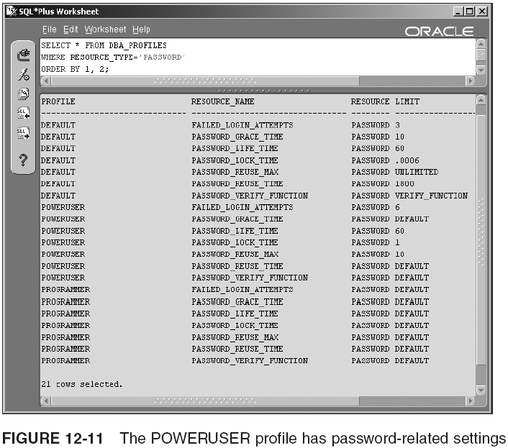
Managing Passwords (continued)

Slide 23
Controlling Resource Usage
ALTER PROFILE, with resource clauses listed:
  ALTER PROFILE <profile> LIMIT
  <password_setting> ...
  SESSIONS_PER_USER <concurrent sessions>
  CPU_PER_SESSION <hundredths of seconds>
  CPU_PER_CALL <hundredths of seconds>
  CONNECT_TIME <minutes>
  IDLE_TIME <minutes>
  LOGICAL_READS_PER_SESSION <data blocks>
  LOGICAL_READS_PER_CALL <data blocks>
  PRIVATE_SGA <bytes>
  COMPOSITE_LIMIT <service units>
Example:
  ALTER SYSTEM SET RESOURCE_LIMIT=TRUE;
  ALTER PROFILE PROGRAMMER LIMIT
  IDLE_TIME 15
  CPU_PER_CALL 100;
  ALTER RESOURCE COST
  CPU_PER_SESSION 1000
  PRIVATE_SGA 1;

Slide 24
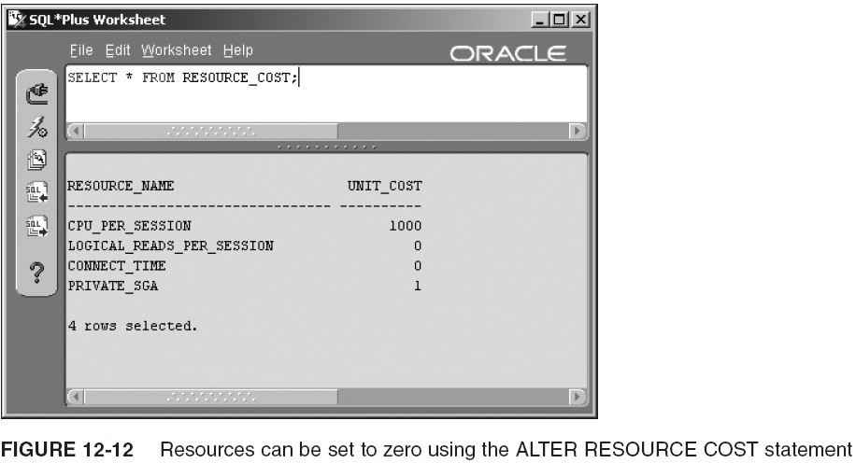
Controlling Resource Usage (continued)

Slide 25
Dropping a Profile
The syntax of DROP PROFILE is similar to the syntax for dropping a user in that it includes a CASCADE parameter:
  DROP PROFILE <profile> CASCADE;
You must add CASCADE if any users have been assigned the profile being dropped
  Oracle automatically resets these users to the DEFAULT profile
For example, if three users have been assigned to the ACCT_MGR profile, drop the profile like this:
  DROP PROFILE ACCT_MGR CASCADE;

Slide 26
Obtaining User, Profile, Password, and Resource Data
You have already seen the following data dictionary views while going through the chapter:
  DBA_USERS
    View user profile, password expiration date, and account status
  DBA_TS_QUOTAS
    View the storage quotas of each user
  RESOURCE_COST
    View the weight setting for each resource used in calculating COMPOSITE_COST
  DBA_PROFILES
    View the settings for each profile

Slide 27
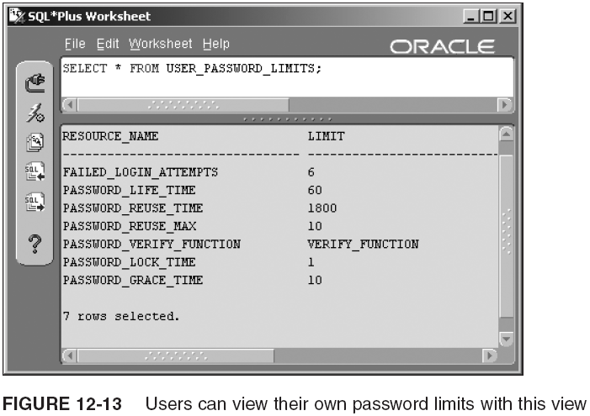
Obtaining User, Profile, Password, and Resource Data (continued)

Slide 28
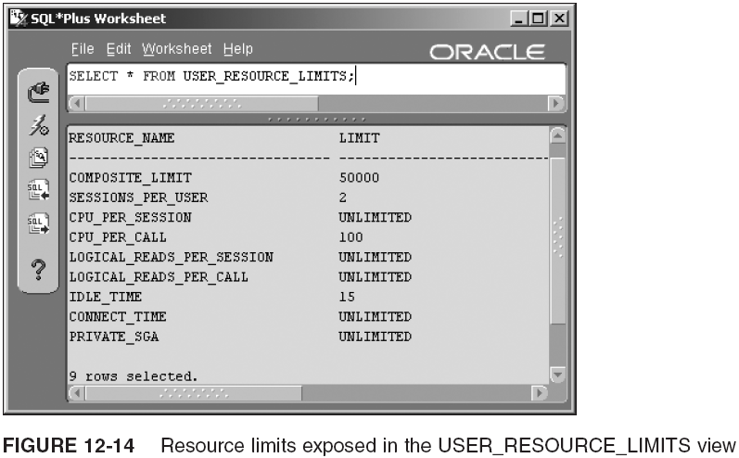
Obtaining User, Profile, Password, and Resource Data (continued)

Slide 29
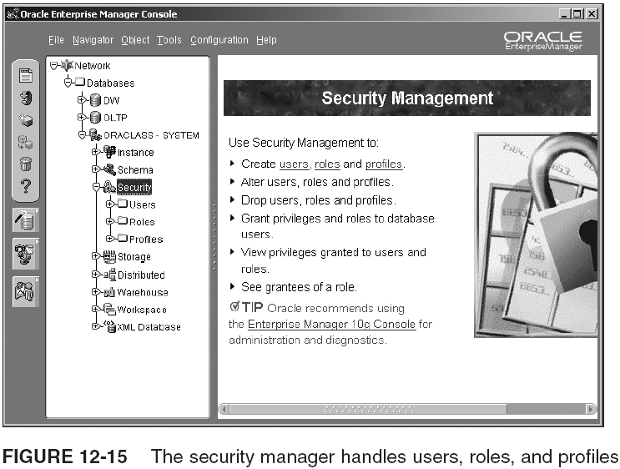
Obtaining User, Profile, Password, and Resource Data (continued)

Slide 30
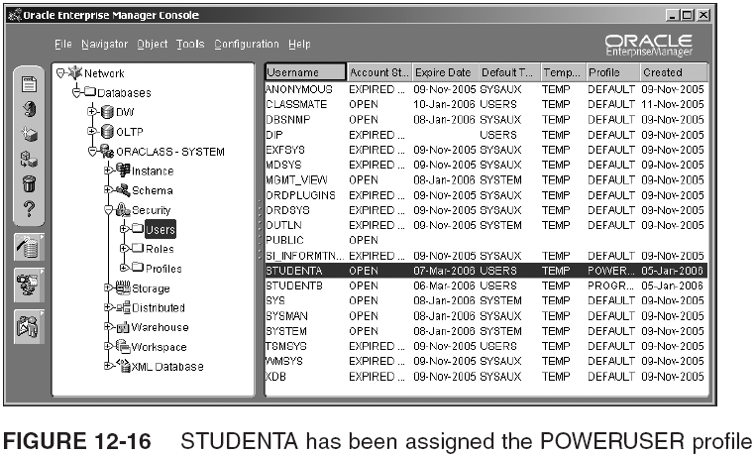
Obtaining User, Profile, Password, and Resource Data (continued)

Slide 31
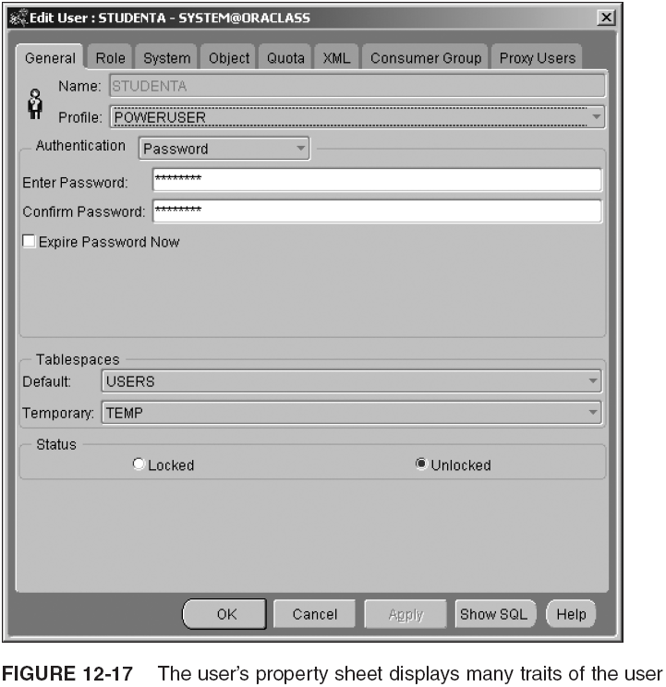
Obtaining User, Profile, Password, and Resource Data (continued)

Slide 32
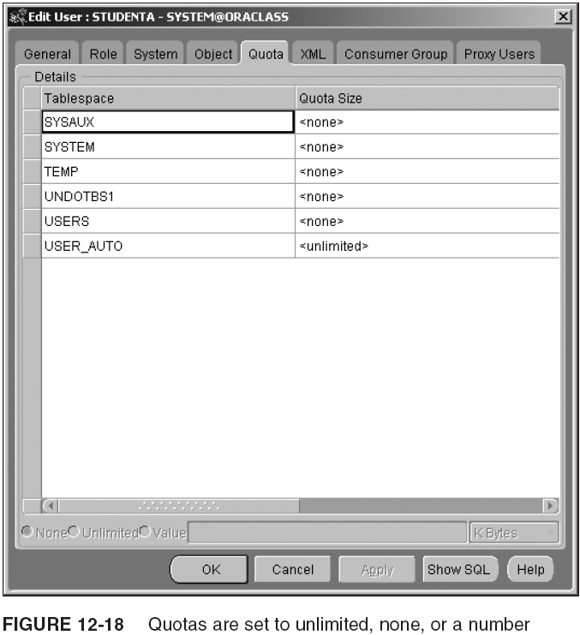
Obtaining User, Profile, Password, and Resource Data (continued)

Slide 33
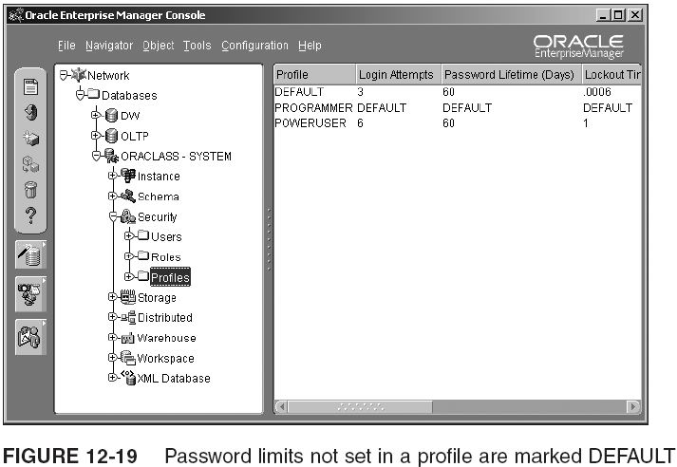
Obtaining User, Profile, Password, and Resource Data (continued)

Slide 34
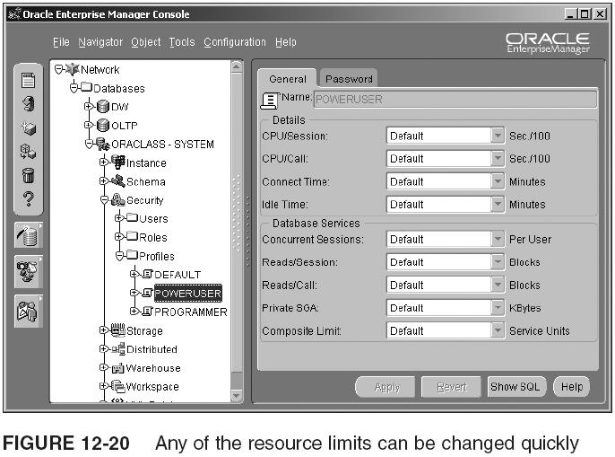
Obtaining User, Profile, Password, and Resource Data (continued)

Slide 35
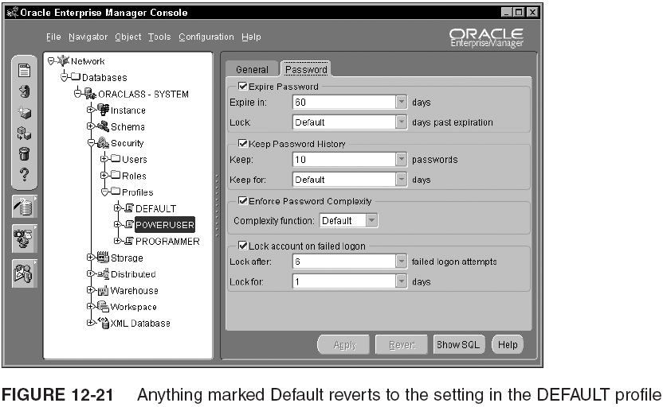
Obtaining User, Profile, Password, and Resource Data (continued)

Slide 36
System and Object Privileges
After a user has been created, the user must be assigned the ability to log on to the database
  Once logged on, the user cannot perform any other tasks unless given the privilege to do so
It is possible to give a privilege to all users
Most privileges are given to specific users or roles
  Role: named group of privileges that can be assigned to a user as a set rather than individually
Two types of privileges:
  System privileges
  Object privileges

Slide 37
Identifying System Privileges
SYSTEM has privileges needed for DBA activities
There are over 100 system privileges; for example:
  SYSDBA
  SYSOPER
  CREATE SESSION
  CREATE TABLE and CREATE VIEW
  CREATE USER
  CREATE ANY TABLE
  DROP ANY TABLE
  SELECT ANY TABLE
  GRANT ANY [OBJECT] PRIVILEGE
  BACKUP ANY TABLE

Slide 38
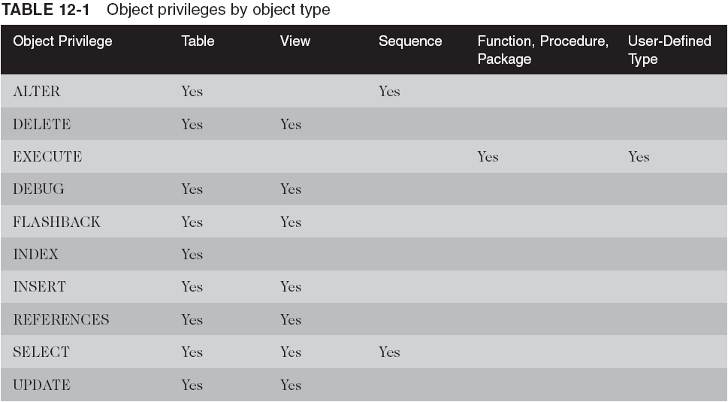
Using Object Privileges

Slide 39
Managing System and Object Privileges
When you grant a privilege, you assign a privilege to a user or a role, whether it is a system privilege or an object privilege
When you revoke a privilege, you take away the privilege
Granting privileges to roles is covered later in this chapter

Slide 40
Granting and Revoking System Privileges
The basic syntax of the GRANT command for system privileges is:
  GRANT <systempriv>, <systempriv>,...|ALL PRIVILEGES
  TO <user>,<user>...|PUBLIC
  WITH ADMIN OPTION;
Revoking a system privilege is simple:
  REVOKE <systempriv>, <systempriv>,...|ALL PRIVILEGES
  FROM <user>, <user>,...|PUBLIC;

Slide 41
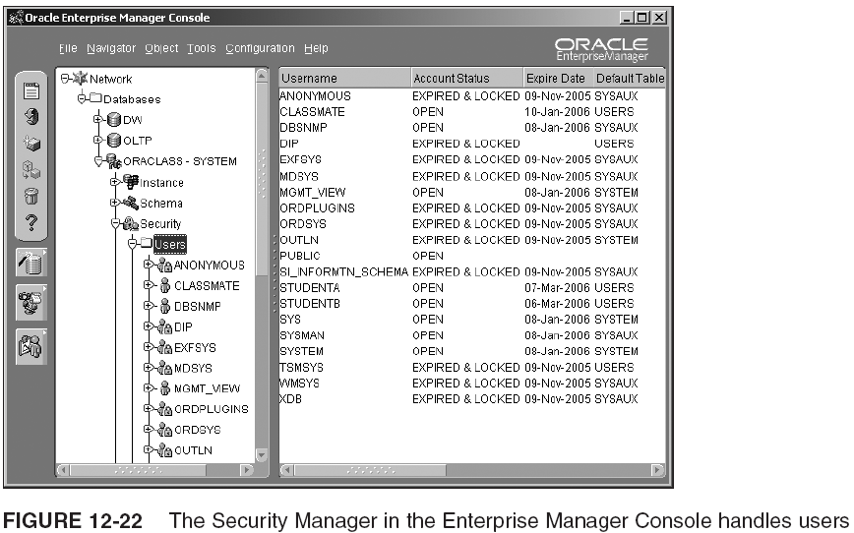
Granting and Revoking System Privileges (continued)

Slide 42
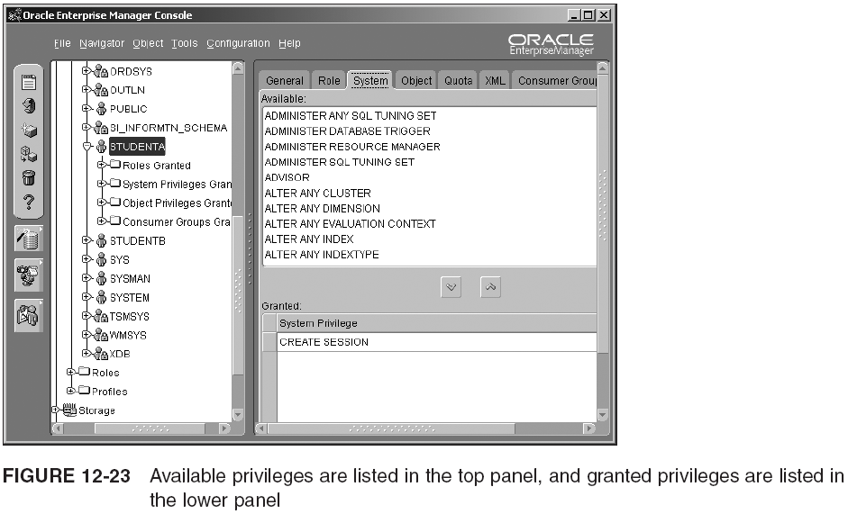
Granting and Revoking System Privileges (continued)

Slide 43
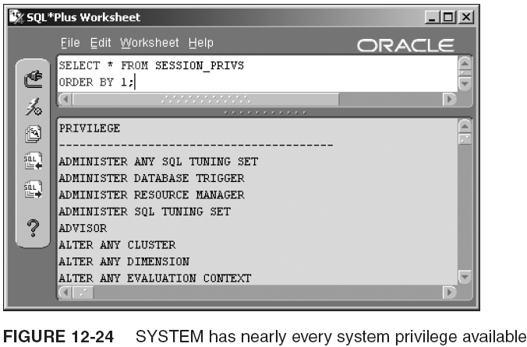
Granting and Revoking System Privileges (continued)

Slide 44
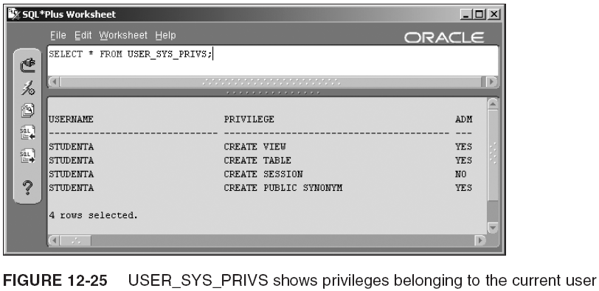
Granting and Revoking System Privileges (continued)

Slide 45
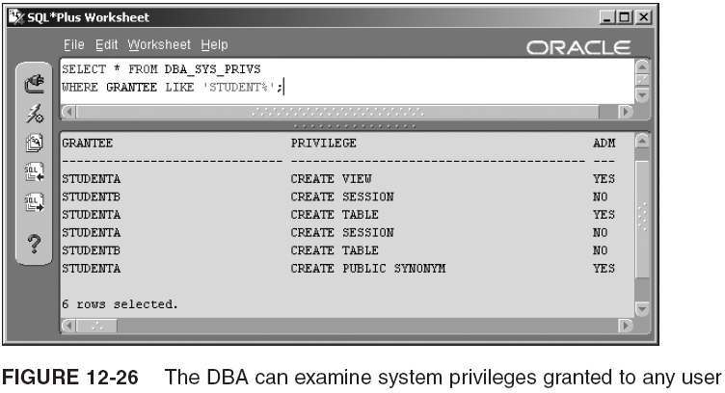
Granting and Revoking System Privileges (continued)

Slide 46
Granting and Revoking Object Privileges
The syntax for granting object privileges looks like this:
  GRANT <objectpriv>, <objectpriv>,...|ALL
  (<colname>,...) ON <schema>.<object>
  TO <user>,...|PUBLIC
  WITH GRANT OPTION
  WITH HIERARCHY OPTION;

Slide 47
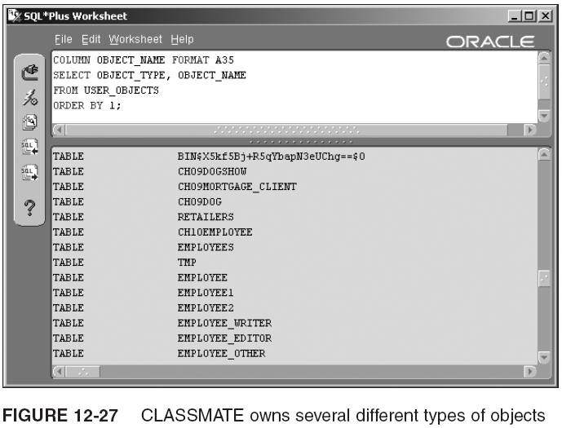
Granting and Revoking Object Privileges (continued)

Slide 48
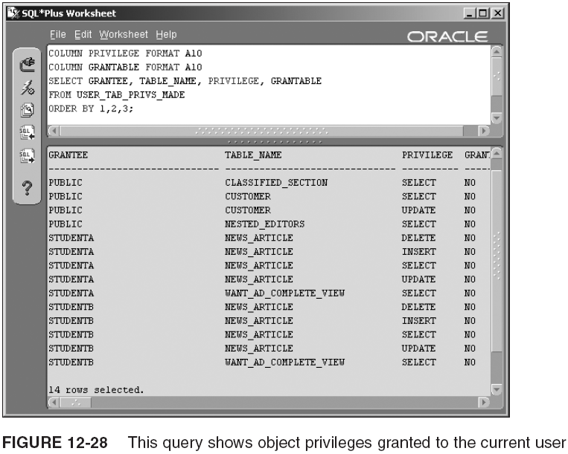
Granting and Revoking Object Privileges (continued)

Slide 49
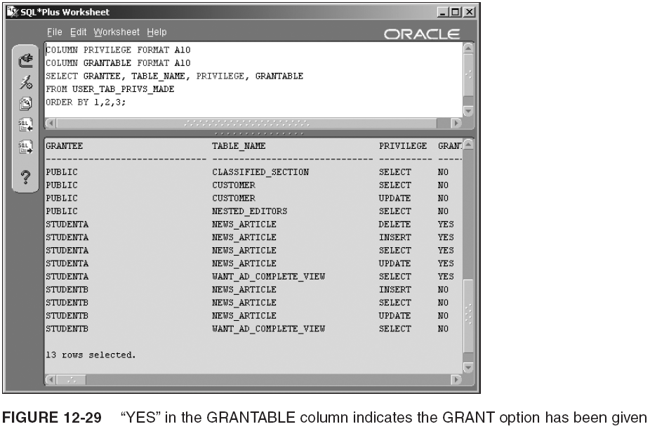
Granting and Revoking Object Privileges (continued)

Slide 50
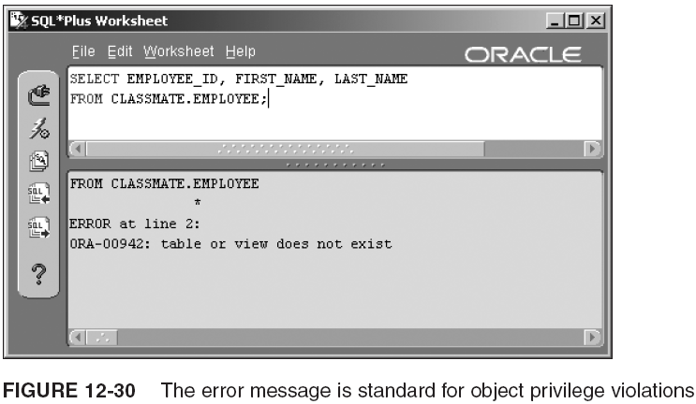
Granting and Revoking Object Privileges (continued)

Slide 51
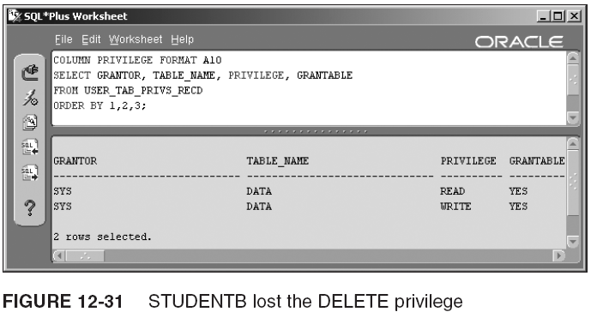
Granting and Revoking Object Privileges (continued)

Slide 52
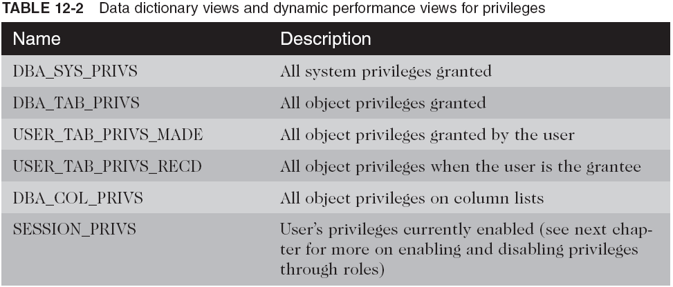
Granting and Revoking Object Privileges (continued)

Slide 53
Description of Auditing Capabilities
Monitoring activity in a database is called auditing
  Three types can be run by Oracle 10g automatically:
    Statement auditing: AUDIT UPDATE TABLE BY JACK;
    Privilege auditing: AUDIT CREATE TABLE;
    Object auditing: AUDIT SELECT ON EE_PRIVATE;
Auditing commands have no effect until you set the AUDIT_TRAIL initialization parameter
  Modify the init.ora file or the spfile
  Valid settings for AUDIT_TRAIL: TRUE or DB, FALSE or NONE, OS

Slide 54
Description of Auditing Capabilities (continued)
Syntax of AUDIT command for object auditing:
  AUDIT <objpriv>,<objpriv>,...|ALL
  ON <schema>.<object>|DEFAULT|NOT EXISTS
  BY SESSION|BY ACCESS
  WHENEVER SUCCESSFUL|WHENEVER NOT SUCCESSFUL;
AUDIT syntax for auditing privileges:
  AUDIT <priv>,<priv>,...|ALL PRIVILEGES|CONNECT|RESOURCE|DBA
  BY <username>
  BY SESSION|BY ACCESS
  WHENEVER SUCCESSFUL|WHENEVER NOT SUCCESSFUL;
The syntax for auditing SQL statements is:
  AUDIT <sql>,<sql>...|ALL
  BY <username>
  BY SESSION|BY ACCESS
  WHENEVER SUCCESSFUL|WHENEVER NOT SUCCESSFUL;

Slide 55
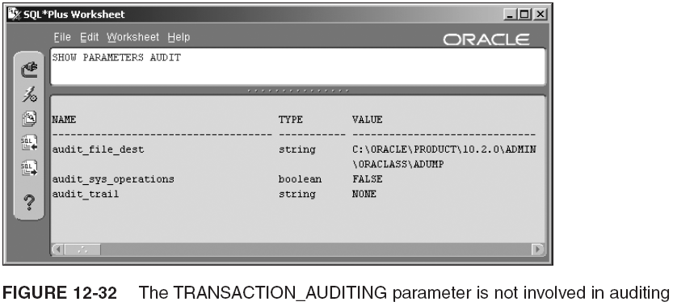
Description of Auditing Capabilities (continued)

Slide 56
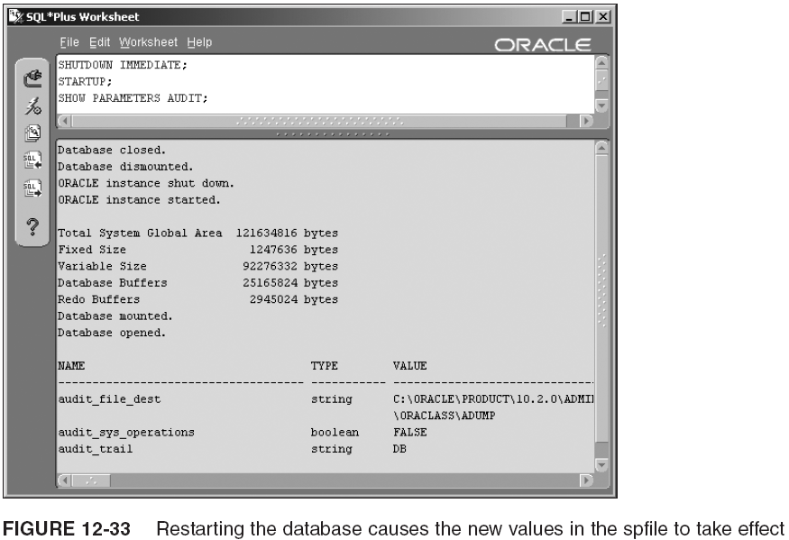
Description of Auditing Capabilities (continued)

Slide 57
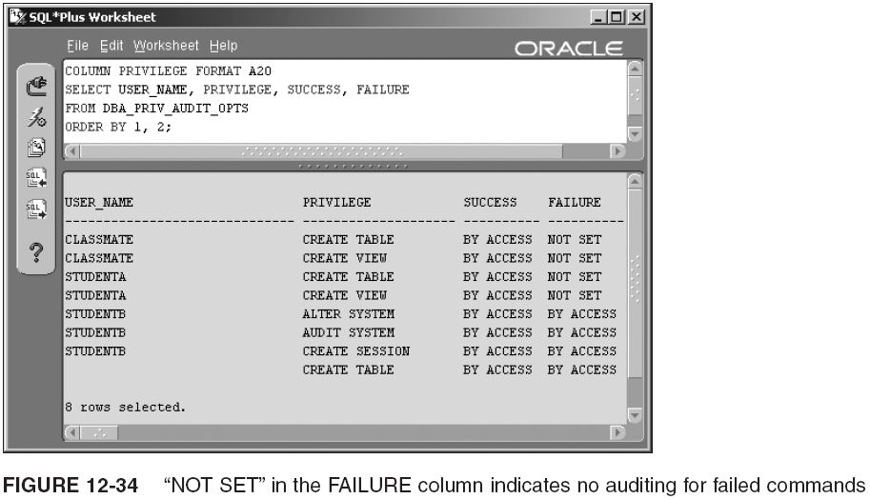
Description of Auditing Capabilities (continued)

Slide 58
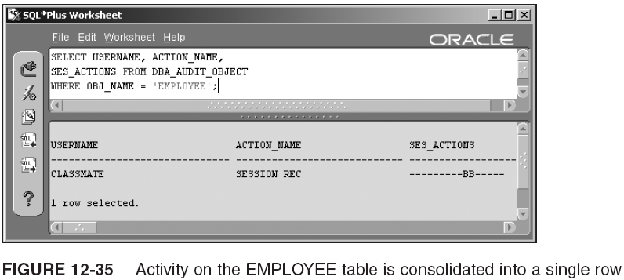
Description of Auditing Capabilities (continued)

Slide 59
Description of Auditing Capabilities (continued)
Data dictionary views you can query for audit trail results:
  DBA_AUDIT_EXISTS
  DBA_AUDIT_OBJECT
  DBA_AUDIT_SESSION
  DBA_AUDIT_STATEMENT
  DBA_AUDIT_TRAIL
The above metadata views have a corresponding USER_counterpart, except DBA_AUDIT_EXISTS

Slide 60
Description of Auditing Capabilities (continued)
You may want to turn off auditing or change what you are auditing
  This is done with the NOAUDIT command
    Its structure is exactly like the AUDIT command; it turns off the auditing it names
    Example:
      NOAUDIT SELECT TABLE BY STUDENTB;
      NOAUDIT SELECT, UPDATE ON CLASSMATE.EMPLOYEE;

Slide 61
Database Roles
A role is a collection of privileges that is named and assigned to users or even to another role
A role can help you simplify database maintenance by giving you an easy way to assign a set of privileges to new users

Slide 62
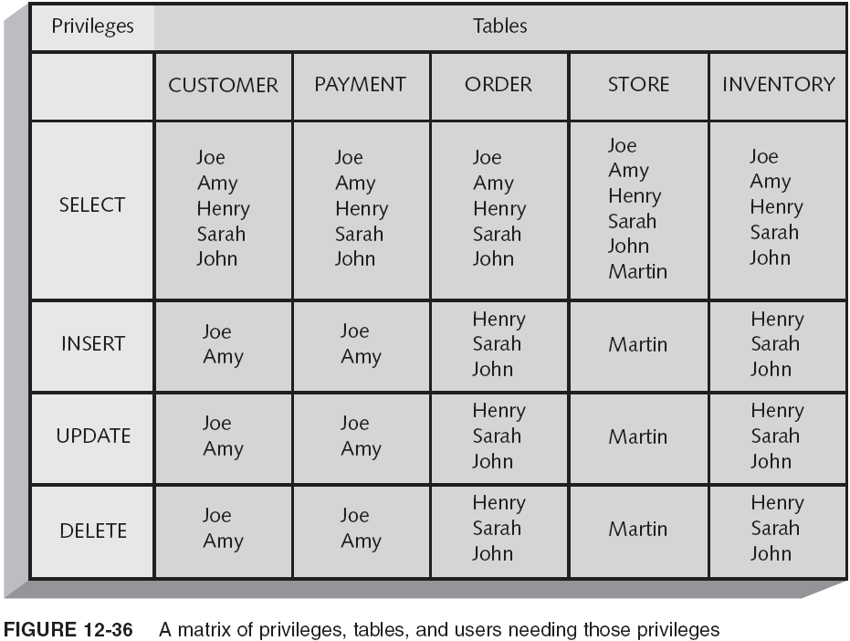
How to Use Roles

Slide 63
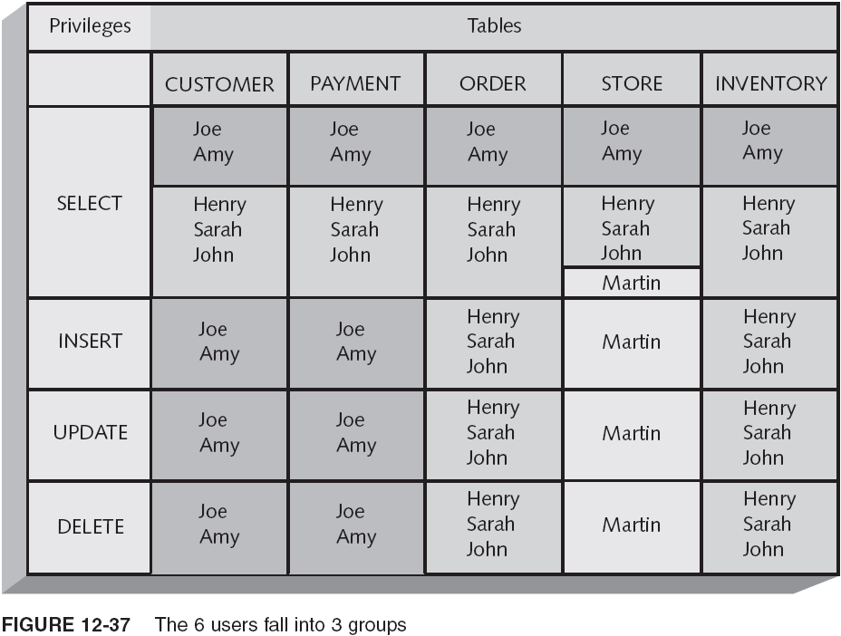
How to Use Roles (continued)

Slide 64
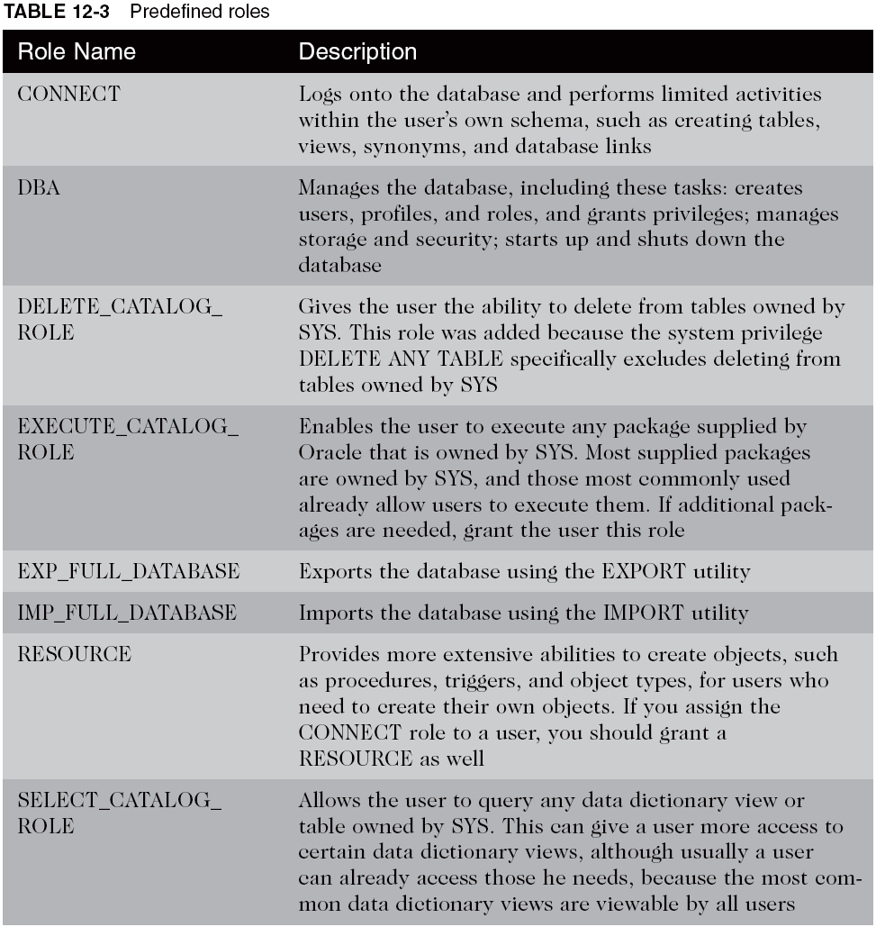
Using Predefined Roles

Slide 65
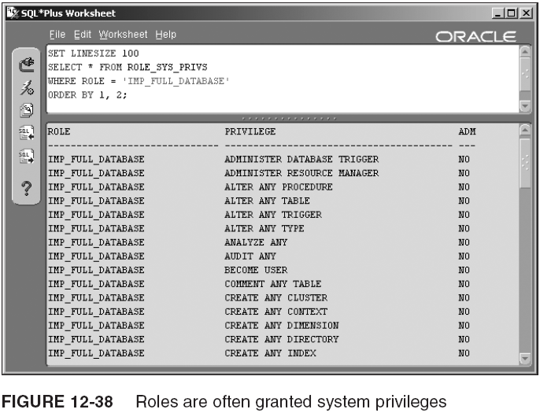
Using Predefined Roles (continued)

Slide 66
Creating and Modifying Roles
To create a role:
  CREATE ROLE <name>
  NOT IDENTIFIED|IDENTIFIED BY <password>
To assign privileges to a role:
  GRANT <privilege> TO <role>;
To assign the role to a user:
  GRANT <role> TO <user>|<role>
  WITH ADMIN OPTION;
The only part of a role you can change is whether it uses a password:
  ALTER ROLE <name>
  NOT IDENTIFIED|IDENTIFIED BY <password>
    ALTER ROLE UPDATEALL
    IDENTIFIED BY U67DATR;

Slide 67
Creating and Assigning Privileges to a Role
Example:
  CREATE ROLE SELALL;
  GRANT SELECT ON CLASSMATE.CLASSIFIED_AD TO SELALL;
  GRANT SELECT ON CLASSMATE.CLASSIFIED_SECTION TO SELALL;
  GRANT SELECT ON CLASSMATE.CUSTOMER TO SELALL;
  GRANT SELECT ON CLASSMATE.CUSTOMER_ADDRESS TO SELALL;
  GRANT SELECT ON CLASSMATE.NEWS_ARTICLE TO SELALL;
  GRANT SELECT ON CLASSMATE.EMPLOYEE TO SELALL;

Slide 68
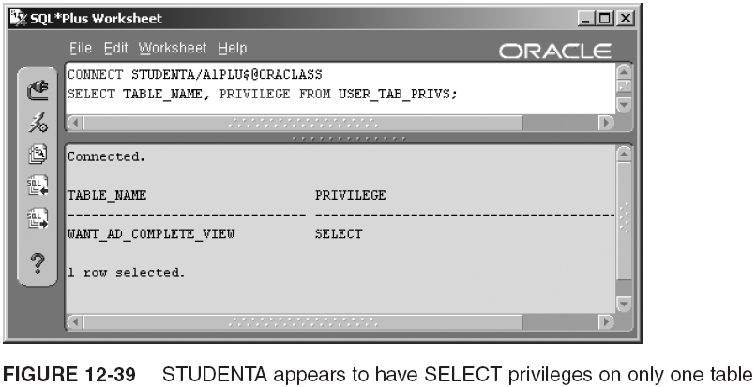
Assigning Roles to Users and to Other Roles

Slide 69
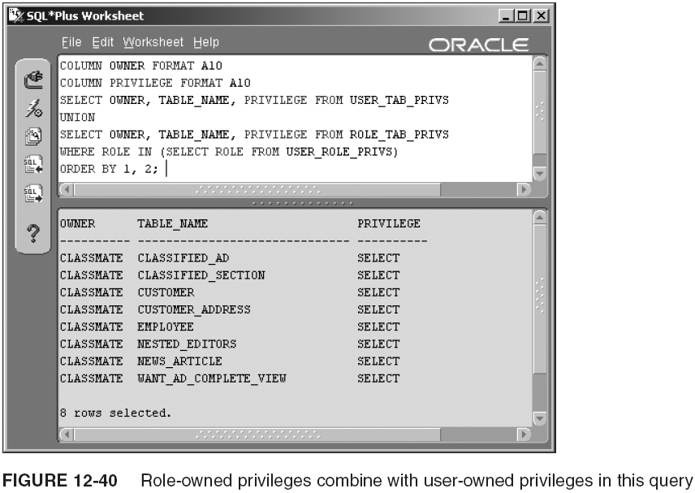
Assigning Roles to Users and to Other Roles (continued)

Slide 70
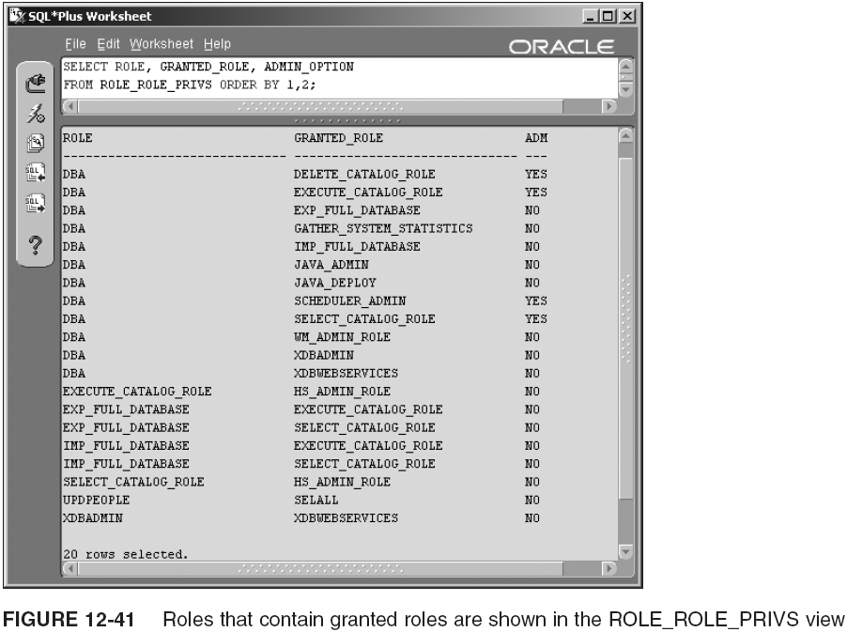
Assigning Roles to Users and to Other Roles (continued)

Slide 71
Limiting Availability and Removing Roles
You can control when a role becomes enabled for a user in these ways:
  Default roles: Creator or the DBA can adjust roles for a user using ALTER USER
    ALTER USER <username> DEFAULT ROLE
    <role>,...|ALL|ALL EXCEPT <role>,...|NONE
  Enable roles: User role can enable or disable his role with the SET ROLE command
    SET ROLE
    <role> IDENTIFIED BY <password>,...|ALL|ALL EXCEPT|NONE|
  Drop roles: DBA can drop the role from the DB and thereby cancel the role for all users who had it
    DROP ROLE <role>

Slide 72
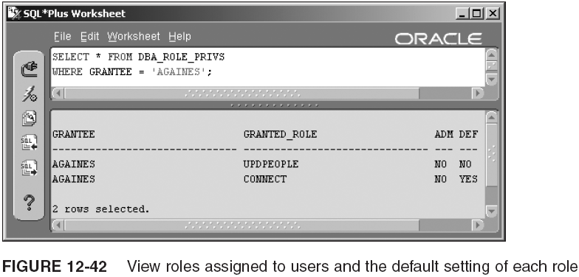
Limiting Availability and Removing Roles (continued)

Slide 73
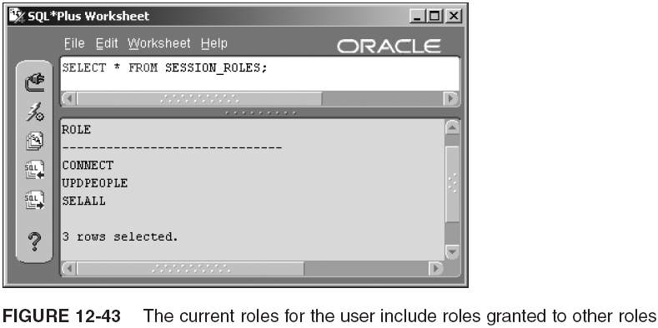
Limiting Availability and Removing Roles (continued)

Slide 74
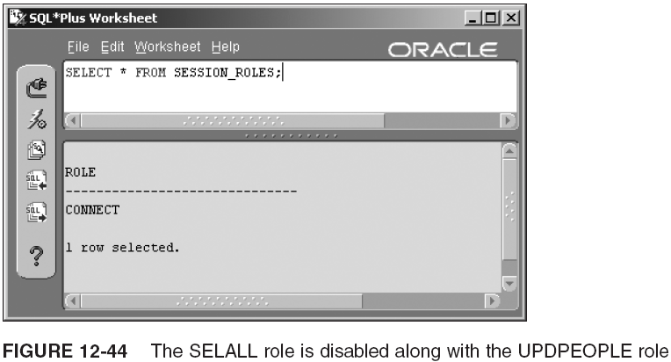
Limiting Availability and Removing Roles (continued)

Slide 75
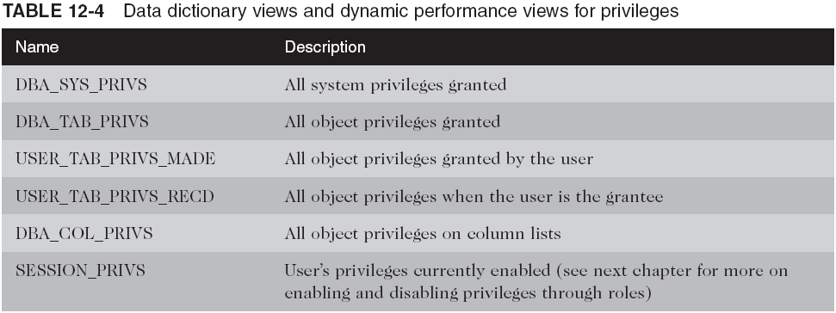
Data Dictionary Information About Roles

Slide 76
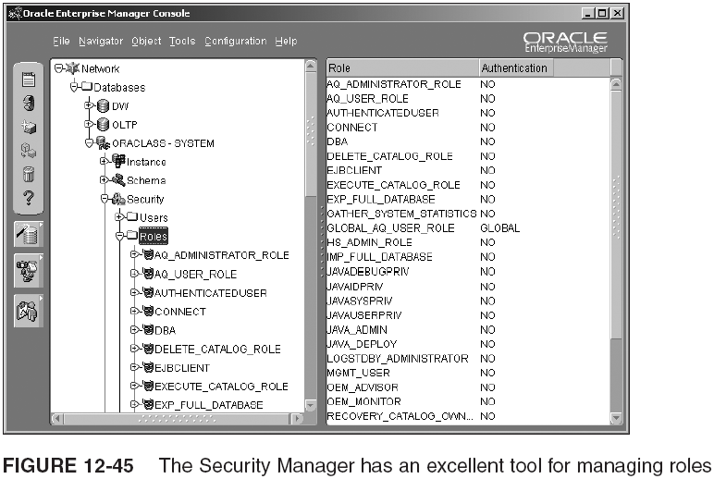
Roles in the Enterprise Manager Console

Slide 77
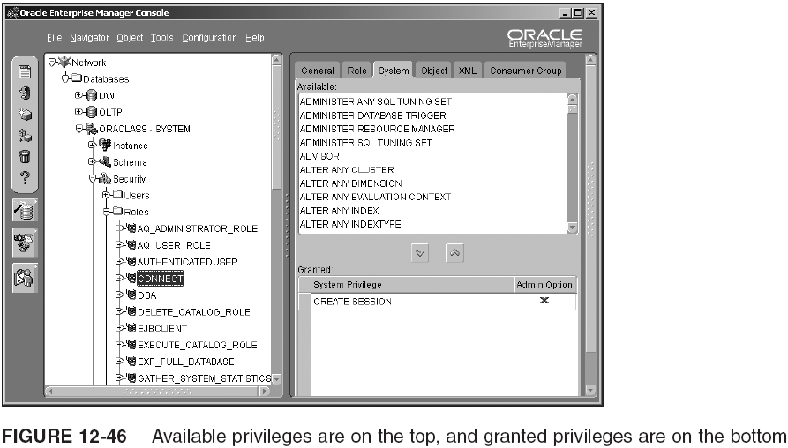
Roles in the Enterprise Manager Console (continued)

Slide 78

Roles in the Enterprise Manager Console (continued)

Slide 79

Roles in the Enterprise Manager Console (continued)

Slide 80

Roles in the Enterprise Manager Console (continued)

Slide 81

Roles in the Enterprise Manager Console (continued)

Slide 82

Roles in the Enterprise Manager Console (continued)

Slide 83

Roles in the Enterprise Manager Console (continued)

Slide 84
Summary
Users are created to either own a schema or access another user’s schema
Users identified externally or globally are validated outside the database
Tablespace quotas limit a user’s storage space
Profiles store password and resource limits
  Passwords can be changed by DBA and by user
  Limits include how long a password can stay the same and when it can be reused
    Can limit CPU usage, connect time, and more

Slide 85
Summary (continued)
System privileges allow user to manage some part of the database system
  E.g., SYSDBA and SYSOPER allow user to start up and shut down the DB, and high-level tasks
  A grant made to PUBLIC gives all users the privilege
  Revoked privileges do not cascade to other users
Object privileges allow a user to work with an object
  Revoked object privileges cascade to other users
  Object privileges can be granted on columns
  Table owner can grant object privileges on that table
    Grantor grants privilege and grantee receives privilege
  Querying an object without privileges to query causes an error stating that the object does not exist

Slide 86
Summary (continued)
Auditing types:
  Statement: activity monitoring on a type of statement
  Privilege: audits commands authorized by privilege
  Object: generates audit trail records on object use
  A group of data dictionary views shows audit trail records for each type of auditing
Roles simplify security administration
  Can be granted other roles and privileges
  Predefined roles help speed up administration
  Roles with passwords add security to the roles
  Default roles are roles enabled when you log on
  Dropped roles are revoked from users and other roles

