Slide 1


Oracle 10g Database Administrator: Implementation and Administration
Chapter 13
Performance Monitoring

Slide 2
Objectives
Discover performance and performance monitoring
Learn about different tools used for performance monitoring
Learn about gathering statistics
Discover invalidated database objects

Slide 3
Objectives (continued)
Find out about performance metrics
Examine and change performance metrics
React to performance issues
Learn about locks

Slide 4
Introduction to Performance Monitoring
Performance: measure of how fast the database reacts to access data in the database
  Measure of how quickly DB reacts to request/activity
Performance monitoring: action of monitoring database speed
  Most easily performed with custom software tools
    There are numerous tools available with Oracle Database software, at no extra cost
    These tools, along with more complex methods using command-line interfaces, allow access to underlying metadata and statistics within an Oracle database

Slide 5
Different Tools for Performance Monitoring
Tools that can be used for performance monitoring
  EXPLAIN PLAIN
  Autotrace in SQL*Plus
  SQL Trace and TKPROF
  End-to-End tracing with TRCSESS
  STATSPACK
  V$ Views
  The Wait Event Interface
  Drill-Down in the Wait Event Interface

Slide 6
Different Tools for Performance Monitoring (continued)
Tools that can be used for performance monitoring
  Drill-Down in the Wait Event Interface
  TopNNNN
  Third-Party tools: Spotlight
  Operating system tools
  Windows Performance Monitor
  Unix utilities: sar, vmstat, mpstat, and iostat

Slide 7
Statistics
Object statistics
  Generally, object statistics record the number of rows in tables and the physical size of data
    Allows optimizer to have a realistic picture of data
      You can create a histogram for a table column where the distribution of values is skewed
System statistics
  Whenever an event occurs it gets added to the sum for that event already recorded
  System statistics also store wait events
    A wait event that harms performance is a performance bottleneck

Slide 8
The Importance of Statistics
Statistics are very important to how the optimizer assesses the best way to execute a query
  Statistics: computation or estimation of the exact size and placement of data in tables and indexes
    Used by optimizer to more effectively assess data in the database
      Can produce a better query plan and potentially provide a more accurate match of the data in the database
Methods of gathering statistics in Oracle 10g:
  A manual method
  An automated process

Slide 9
Gathering Statistics Manually
Statistics can be gathered manually using
  ANALYZE command
    Simple and easy to use
  DBMS_STATS package
    Recommended method (it is parallel executable)
You can also manually gather statistics for snapshot comparison using
  STATSPACK
  Database Control

Slide 10
Using the ANALYZE Command
ANALYZE { TABLE | INDEX }
COMPUTE [ SYSTEM ] STATISTICS [ FOR ... object specifics ... ]
ESTIMATE [ SYSTEM ] STATISTICS [ FOR ... object specifics ... ]
[ SAMPLE n { ROWS | PERCENT } ]
| DELETE [ SYSTEM ] STATISTICS;
Examples:
  ANALYZE TABLE EMPLOYEE DELETE STATISTICS;
  ANALYZE TABLE EMPLOYEE COMPUTE STATISTICS;

Slide 11
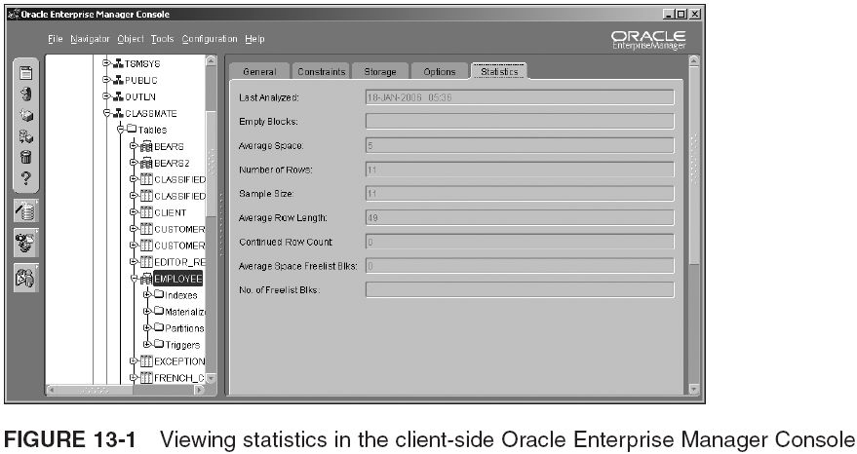
Using the ANALYZE Command (continued)

Slide 12
Using the DBMS_STATS Package
DBMS_STATS vs ANALYZE
  DBMS_STATS:
    Is more versatile and potentially faster
    Is a little more complex to use
    Has parallel execution, Oracle Partitioning benefits, and performance tuning capabilities
    Can be used to copy statistics between databases
    Can be used to gather stats at all object layers of a DB
  But, some non-optimizer statistics can only be gathered with ANALYZE
To gather statistics for a single table:
  EXEC DBMS_STATS.GATHER_TABLE_STATS('<owner>', '<table>');
To gather statistics for a single index:
  EXEC DBMS_STATS.GATHER_INDEX_STATS('<owner>', '<index>');

Slide 13
Automated Statistics Gathering
In Oracle 10g the default for statistics collection is automation
  Setting STATISTICS_LEVEL to TYPICAL or ALL
    If BASIC is used, stale statistics will not be monitored; they can give the optimizer an incorrect statistical picture of data in your database
  Automated statistics gathering in Oracle 10g is a great development
    Rule-based optimization is now obsolete
    There must be automation of statistical values
    Dynamic sampling (SAMPLE clause in queries) and CPU costing for optimizer is now more important
    Primary objective of automation is to avoid situations of stale or non-generated statistics

Slide 14
Automated Statistics Gathering (continued)
Automated statistics using GATHER_STATS_JOB
  Scheduler executes it daily (default), at default times
  Finds DB objects with missing or stale statistics, and generate those statistics for you
  Calls a DBMS_STATS procedure to generate stats
  To disable automated statistics gathering
    EXEC DBMS_SCHEDULER.DISABLE('GATHER_STATS_JOB');
Some DBs do not benefit from automation
You can force manual statistics generation on specific objects using LOCK_TABLE_STATS and LOCK_SCHEMA_STATS
  Dynamic sampling can be a good substitute

Slide 15
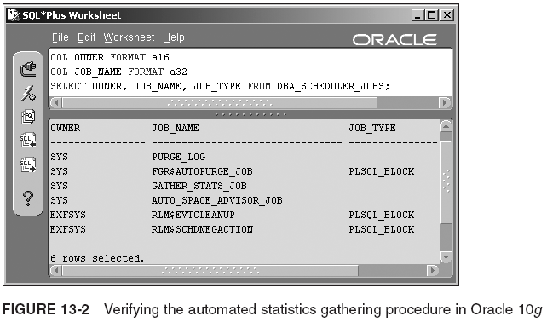
Automated Statistics Gathering (continued)

Slide 16
Dynamic Sampling
If statistics are out of date or not present, then dynamic sampling may be used
  Dynamic sampling reads a small number of blocks in a table to make a best guess at the statistical picture of data in a table
Dynamic sampling settings:
  OPTIMIZER_DYNAMIC_SAMPLING = 1
  OPTIMIZER_DYNAMIC_SAMPLING = 2
  OPTIMIZER_DYNAMIC_SAMPLING > 2
  You should leave the setting at its default level of 2, unless you have a very good reason

Slide 17
The SAMPLE Clause
SAMPLE clause is not really a part of automation
  It can be used as a substitute semi-automated statistical generator
  SAMPLE is added to the FROM clause of a query as a part of a SELECT statement
  Causes the reading of a percentage of rows or blocks, in order to gather a statistical picture of data
    Picture is passed to optimizer allowing a better cost-based guess at how data should be accessed
  Syntax:
    SELECT * FROM <table> SAMPLE(n) ...
    Will read a sample of n% of the rows in table, when generating a query plan for reading table in a query

Slide 18
Automated Statistics and the Database Control
Much of automation process is about automatic SQL tuning
  Optimizer can be switched from normal to tuning mode
    Tuning mode can consume large amounts of resources; intended for complicated and long-running queries only
    Automated SQL tuning can be performed manually using commands executed from within SQL*Plus but it is recommended to use only the Database Control
    Parts:
      The AWR, the ADDM, automatic SQL Tuning, and SQL Access Advisor

Slide 19
Automated Statistics and the Database Control (continued)
AWR executes statistical snapshots of the DB
  A snapshot takes a mathematical picture of the state of a database at a specific point in time
The AWR can be found in the Database Control
  Statistics gathered by the AWR are as follows:
    Object statistics
    Active Session History (ASH)
    High impact SQL
    System statistics
    Time model system statistics

Slide 20
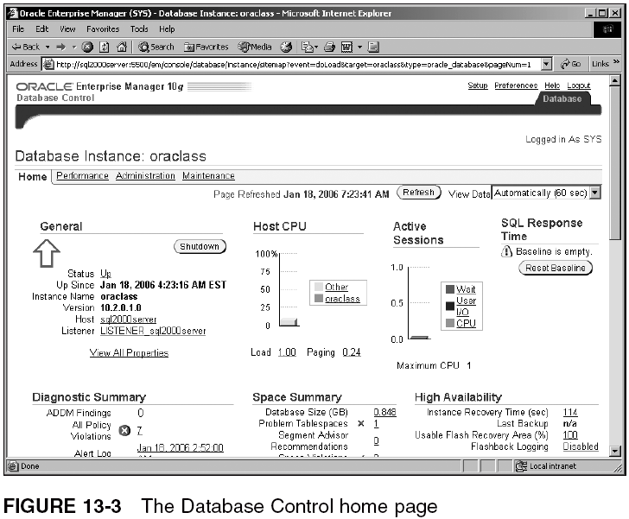
Automated Statistics and the Database Control (continued)

Slide 21
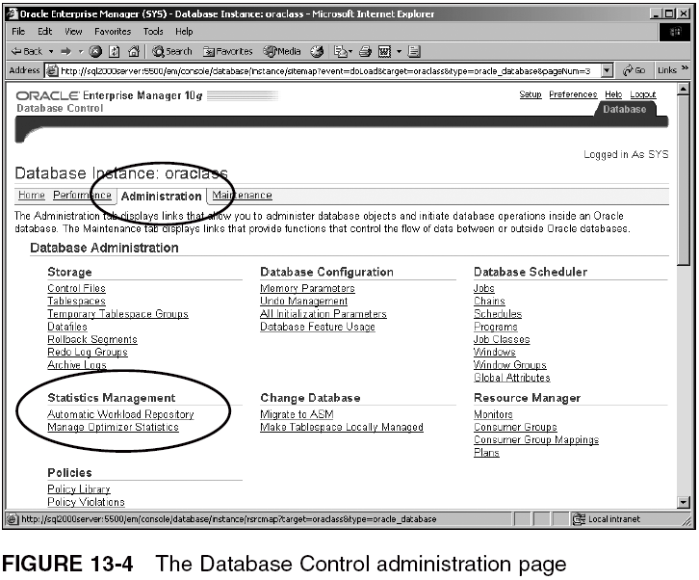
Automated Statistics and the Database Control (continued)

Slide 22
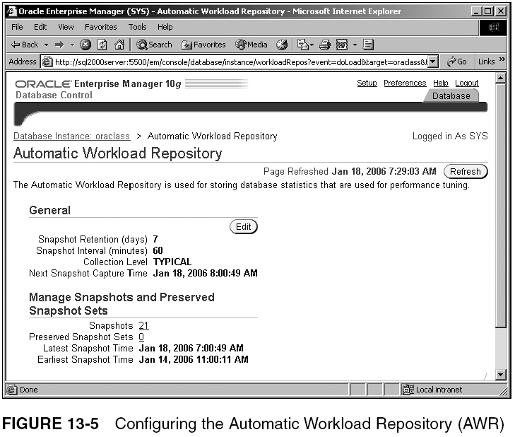
Automated Statistics and the Database Control (continued)

Slide 23
Automated Statistics and the Database Control (continued)
The ADDM uses snapshots taken by the AWR, to make statistical comparisons and reports
  Uses multiple snapshots taken by the AWR, and then performs an analysis between two snapshots
  Common issues that the ADDM is searching for:
    Over extended use of CPU time
    Sizing of memory structures
    Heavy I/O usage
    High consumption SQL statements
    Configuration issues
    Anything busy

Slide 24
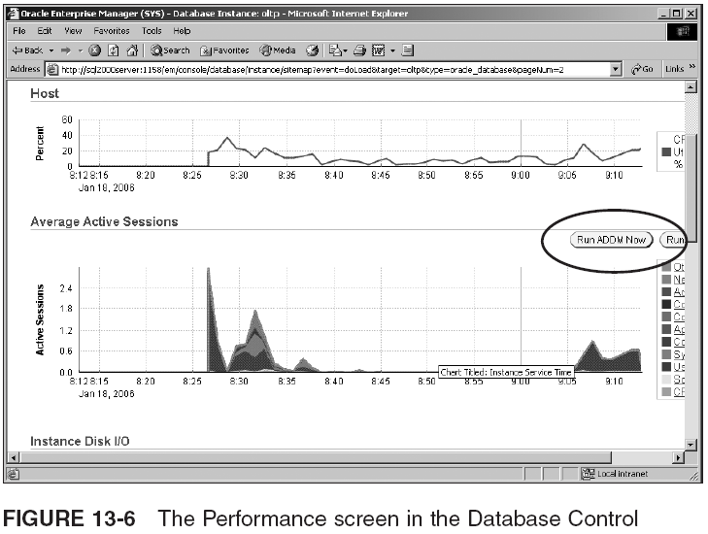
Automated Statistics and the Database Control (continued)

Slide 25
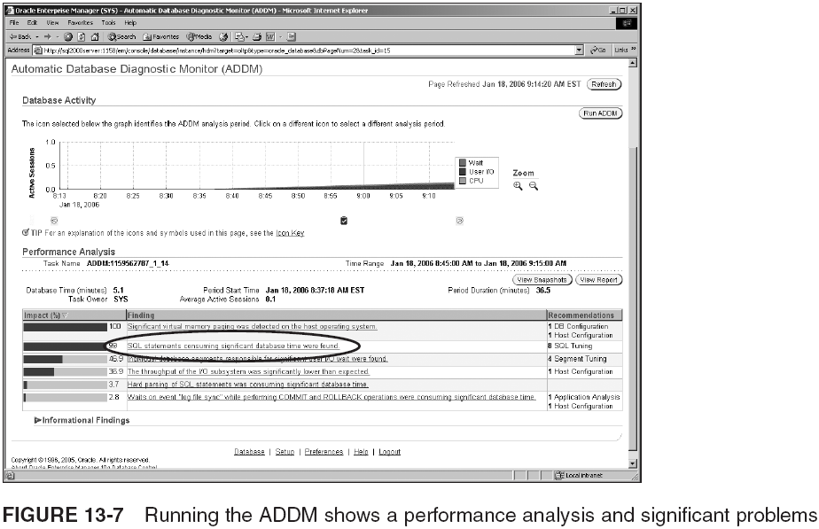
Automated Statistics and the Database Control (continued)

Slide 26
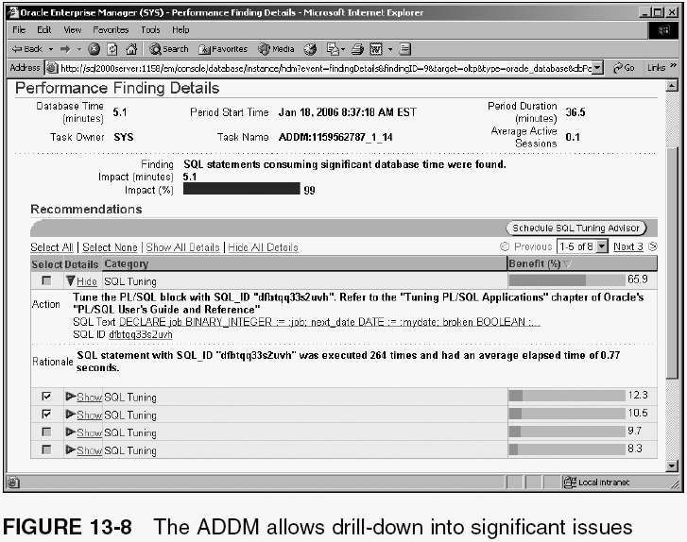
Automated Statistics and the Database Control (continued)

Slide 27
Performance Metrics
A metric in Oracle Database is a special type of statistic, defined as a measure of a rate of change on a cumulative statistic
  A metric is a measure of a rate of change
  Metrics can be found in many of the V$ performance views
    Easiest way to access performance metrics is to administer and analyze them using the Database Control

Slide 28
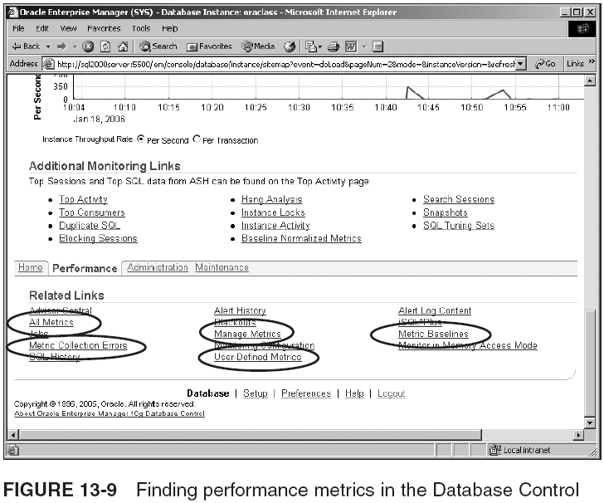
Performance Metrics (continued)

Slide 29
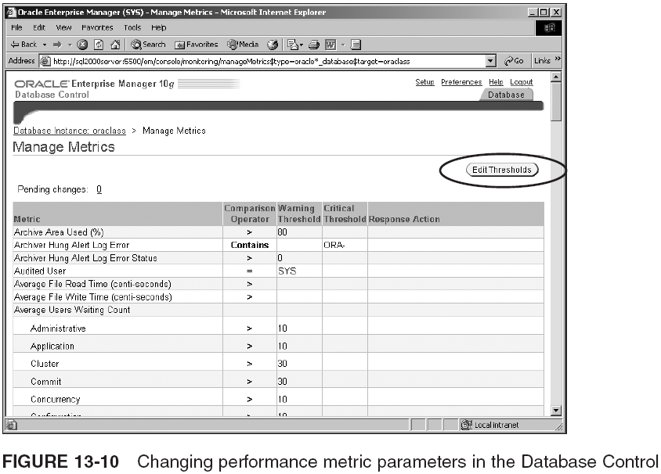
Changing Performance Metric Parameters

Slide 30
Searching for Invalidated Objects
Two ways to find invalid objects in Oracle 10g:
  Use the USER_OBJECTS metadata view and check the STATUS column (ALL_OBJECTS and DBA_OBJECTS can also be used)
  The metrics contained within the Database Control for finding invalid objects

Slide 31
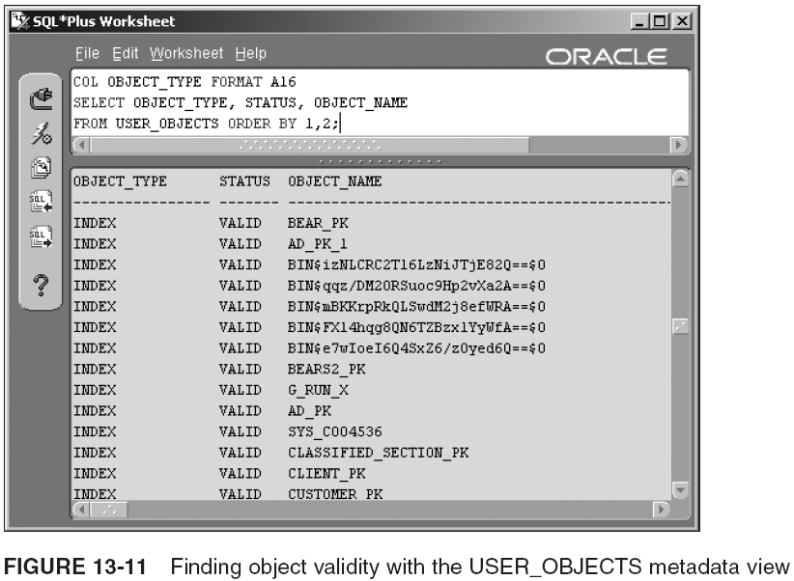
Searching for Invalidated Objects (continued)

Slide 32
Lock Conflicts
A share lock partially locks data where there is still partial access allowed to data by other sessions
An exclusive lock completely prohibits changes to data, but still allows read access
Locking of transactions and tables (using transactional control commands or LOCK TABLE) create locking situations manually
In this chapter you examine how locks can occur as a result of Oracle 10g internally creating locks
  If too many people access the same data at once, then some form of internal locking will result
Oracle 10g uses row locks (not escalating locks)

Slide 33
How to Detect Lock Conflicts
Two ways to detect locks
  The more difficult method is to use the V$ performance views and the Oracle Wait Event Interface, using V$ performance views
  The better way is to use the Database Control

Slide 34
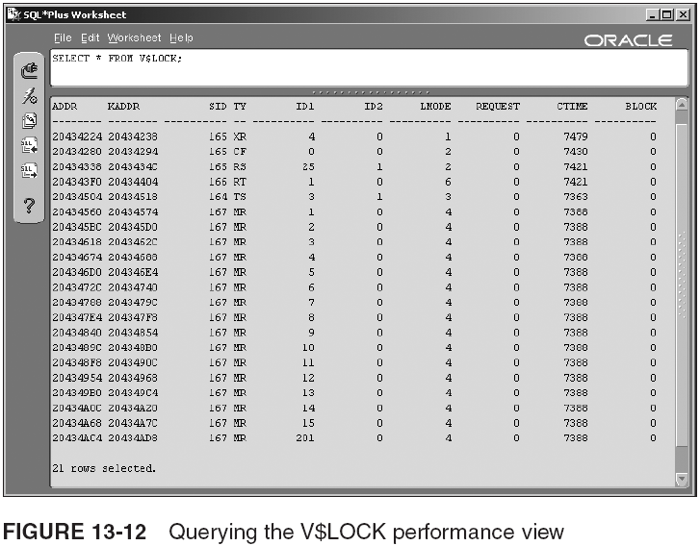
How to Detect Lock Conflicts (continued)

Slide 35
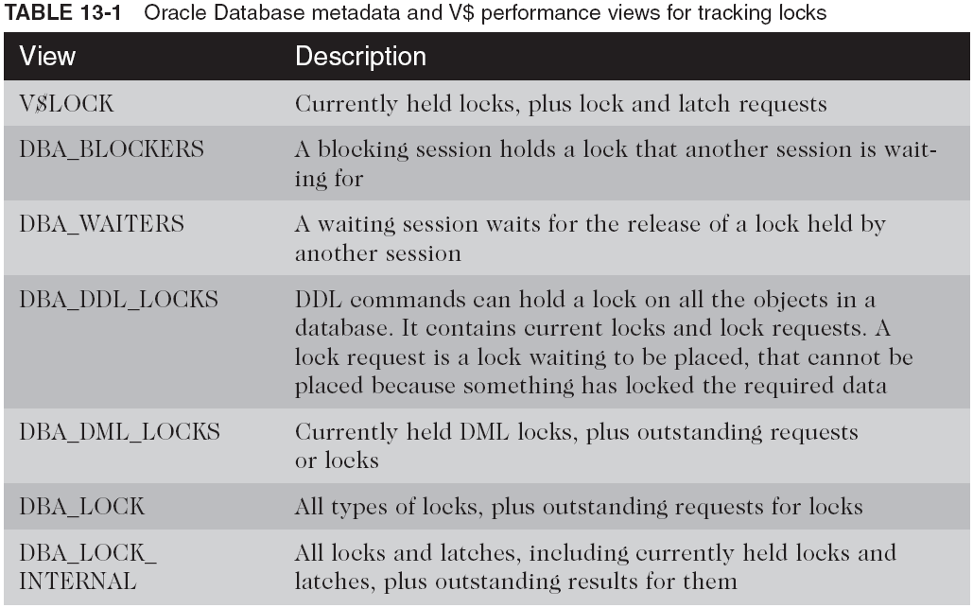
How to Detect Lock Conflicts (continued)

Slide 36
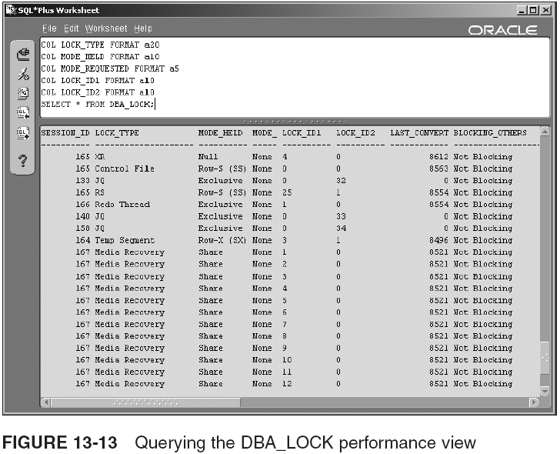
How to Detect Lock Conflicts (continued)

Slide 37
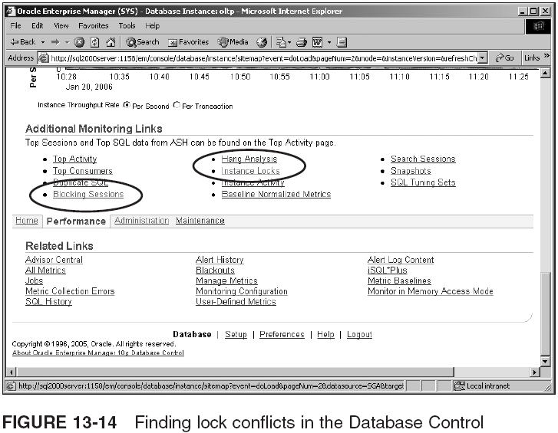
How to Detect Lock Conflicts (continued)
Notes:
Use the exercise on pages 623-626 to show how to detect lock conflicts using the Database Control.

Slide 38
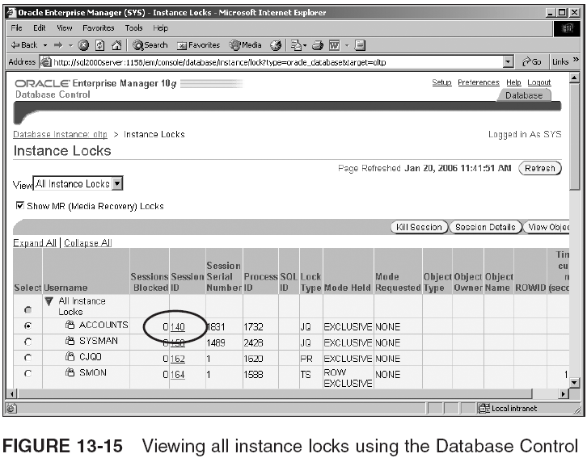
How to Detect Lock Conflicts (continued)

Slide 39
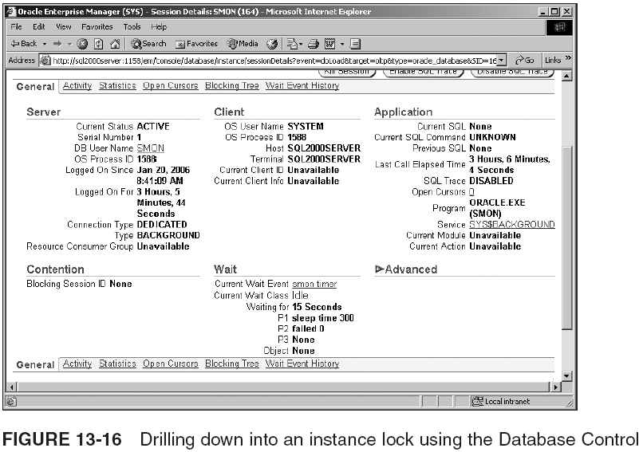
How to Detect Lock Conflicts (continued)

Slide 40
Resolving Lock Conflicts
Avoid building code/applications that cause locks
  Some locking is inevitable, especially in busy, highly concurrent OLTP databases
    In general you should not be resolving application-caused lock conflicts manually
  Lock conflicts that require manual resolution are usually caused in error
  Other problems are caused by DML commands that are not committed or rolled back, using LOCK TABLE, changing all rows in a busy table, etc.
    Altering tables in a production database is always risky and should be avoided if possible

Slide 41
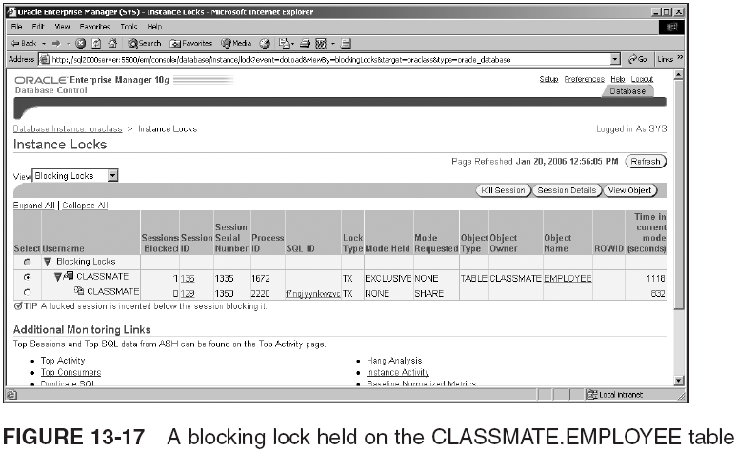
Resolving Lock Conflicts (continued)

Slide 42
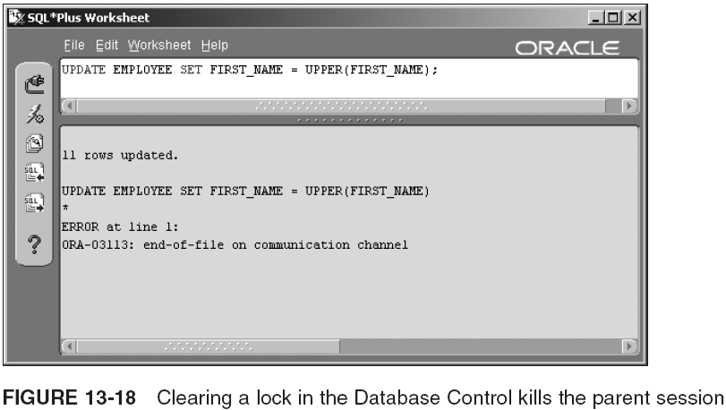
Resolving Lock Conflicts (continued)

Slide 43
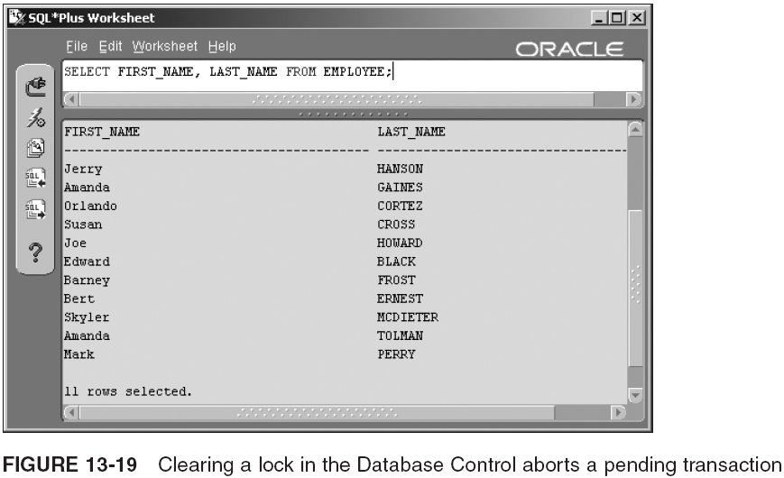
Resolving Lock Conflicts (continued)

Slide 44
What is a Deadlock?
Deadlock: one thing is waiting for another, but that other thing is also waiting for something
  A pending lock request cannot be serviced, because the lock required will never be released
  Can cause serious performance issues
Most common cause is manual locking of data using LOCK TABLE or the FOR UPDATE clause
Usually deadlocked sessions must be rolled back manually
  Ways of resolving a deadlock manually are:
    Rollback one of the deadlocked transactions
    Kill one of the sessions executing one of the deadlocked transactions

Slide 45
Summary
Performance: speed at which database services its users and applications
Performance monitoring can be manually performed by database administrators or by software
  Tools: EXPLAIN PLAN, SQL*Plus Autotrace, SQL Trace with TKPROF, STATSPACK, V$ performance views, the Wait Event Interface, and Database Control
    Database Control contains performance metrics for all sorts of performance issues
Statistics give optimizer mathematical picture of data
  Gathered using ANALYZE and DBMS_STATS package, or with Database Control (AWR and ADDM)
  Augment automated statistics with dynamic sampling and using the SAMPLE BLOCK clause

Slide 46
Summary (continued)
Performance metrics operate against thresholds
  When threshold is exceeded, a warning is sent to the Database Control main screen
    Performance metrics can be altered in Database Control
You can search for invalidated object using USER_OBJECTS, DBA_OBJECTS, ALL_OBJECTS
  Or, use the Database Control
Locks can be both explicit and implicit
  Explicit lock: when administrator issues LOCK TABLE
  Implicit locks: occur when there’s too much competition for the same data; can be shared or exclusive

