Slide 1

Oracle 10g Database Administrator: Implementation and Administration
Chapter 14
Proactive Maintenance

Slide 2
Objectives
Learn more about the Database Control
Discover how to use advice performance tools
Learn about the segment advisor
Learn about undo management and the undo management advisor

Slide 3
Objectives (continued)
Learn about the memory advisor
Learn about the SQL access advisor
Learn about the SQL tuning advisor
Learn more about changing and using baseline metrics

Slide 4
What is Proactive Maintenance?
Proactive maintenance is about setting up Database Control to predict and track performance problems
  Objective: prevent critical problems before they occur and damage a database
  Contrary to reactive maintenance, which is reacting to a problem after it has occurred
  Related to performance tuning a database
  Can be managed from within the Database Control
  A default config. is provided when you create a DB
    For most DBs you will not need to change default setup

Slide 5
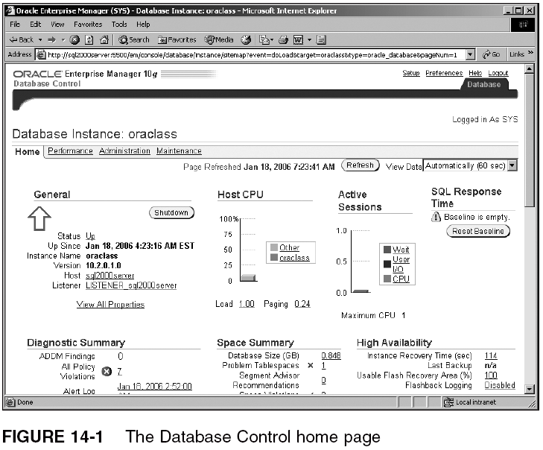
Advice Performance Tools

Slide 6
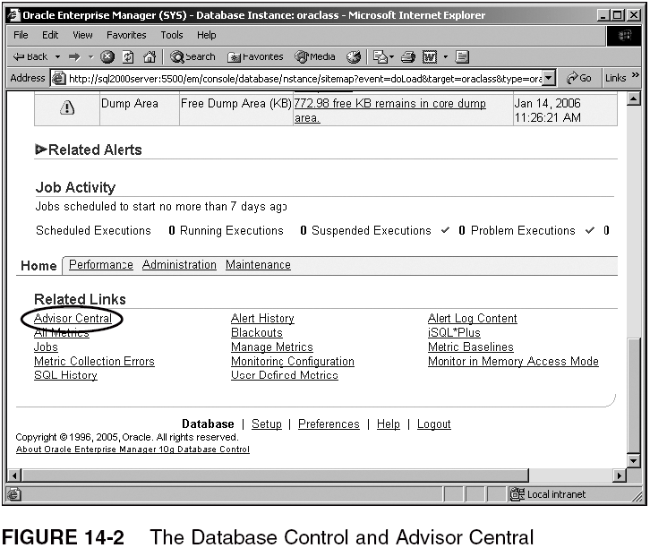
Advice Performance Tools (continued)

Slide 7
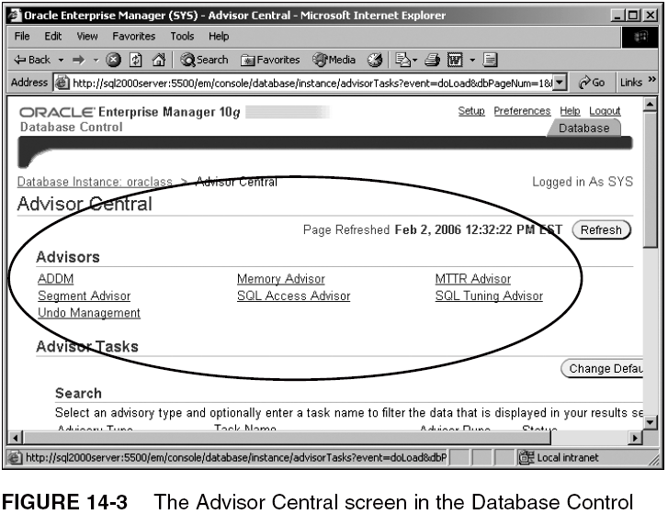
Advice Performance Tools (continued)

Slide 8
The Different Tuning and Diagnostic Advisors
Advisor Central is made up of a number of options:
  ADDM
  Segment Advisor
  Undo Management and Undo Advisor
  Memory Advisor
  MTTR
  SQL Tuning Advisor
  SQL Access Advisor

Slide 9
The Segment Advisor
The segment advisor tells you about disk space, how it is used, how it should not be used, and what to alter to help everything run smoothly
  Shrinkage, fragmentation, growth, capacity planning, row chaining, and row migration
  Primary focus is forecasting
    Proactive maintenance is all about forecasting and perhaps preventing running out of disk space
      Running out of disk space can crash a DB
  Sections:
    Scope, objects, schedule, and review

Slide 10
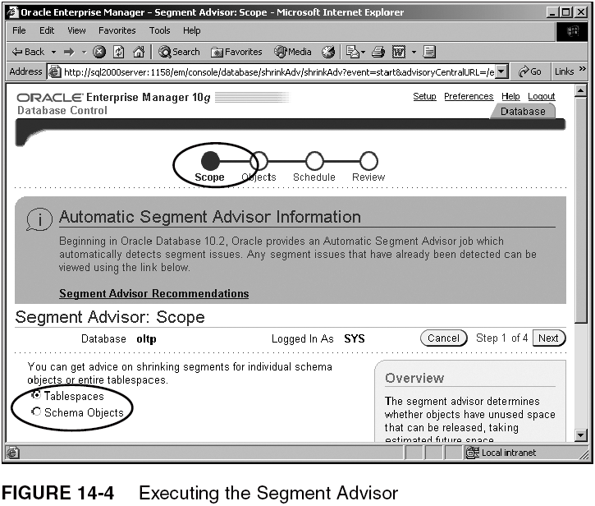
The Segment Advisor (continued)

Slide 11
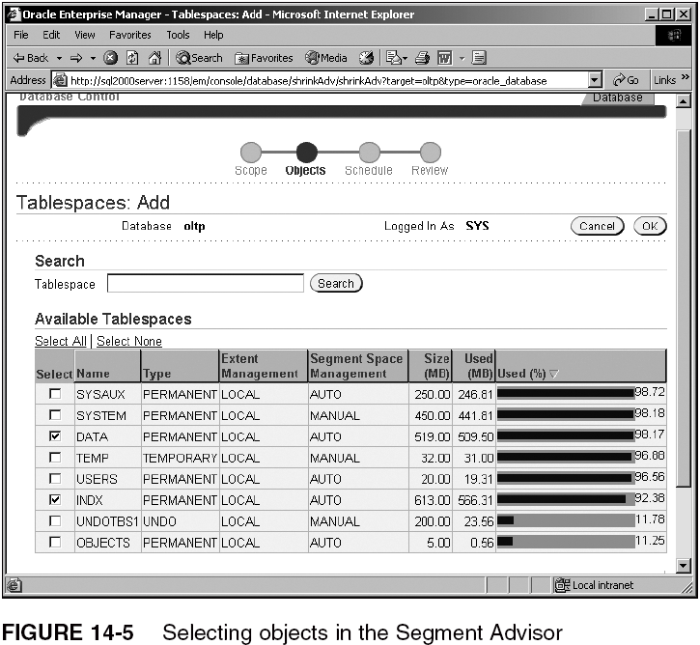
The Segment Advisor (continued)

Slide 12
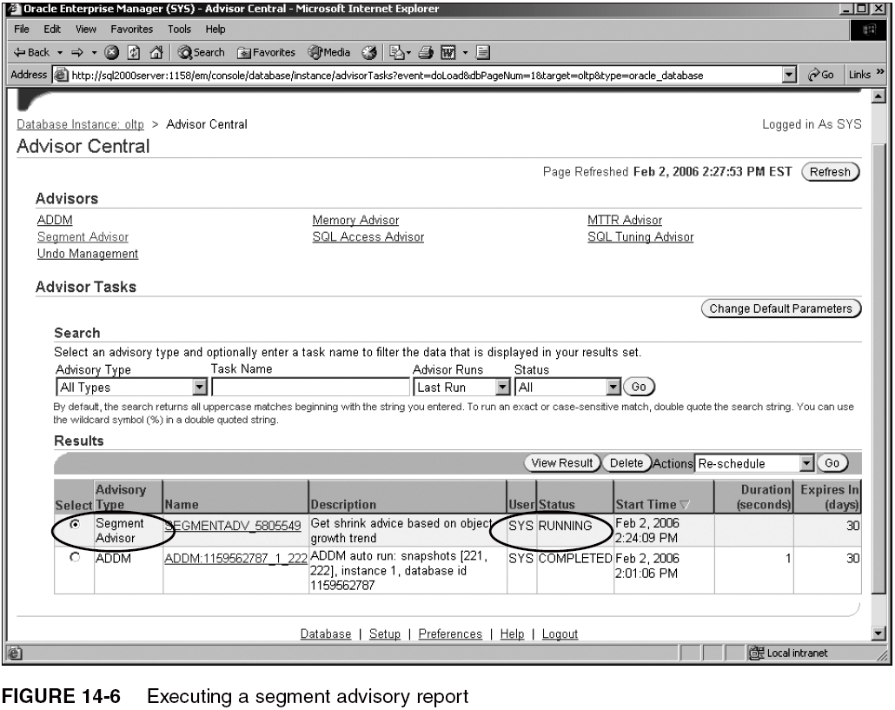
The Segment Advisor (continued)

Slide 13
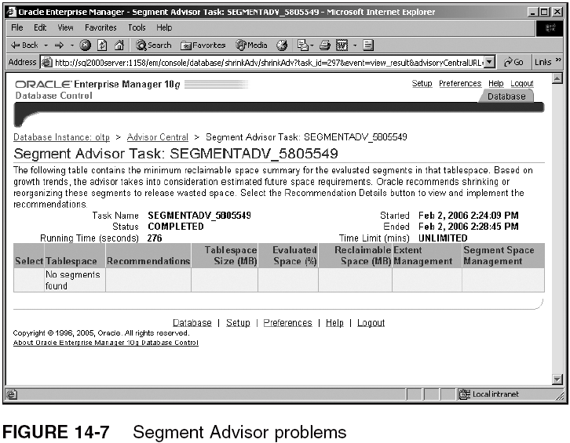
The Segment Advisor (continued)

Slide 14
Undo Management and the Undo Advisor
Undo advisor works best with automated undo
  Advisor helps with settings for automated undo config. parameters (e.g., retention, tablespace sizing)
  Automated undo has removed the need for complex maintenance of manual rollback segments
  Undo space allows for read consistency
    If a user makes a change without committing or rolling back, then only he/she can see that change
      Most DB engines function by making changes physically in the DB as soon as the change is made
        COMMIT or ROLLBACK simply removes the potential for rollback

Slide 15
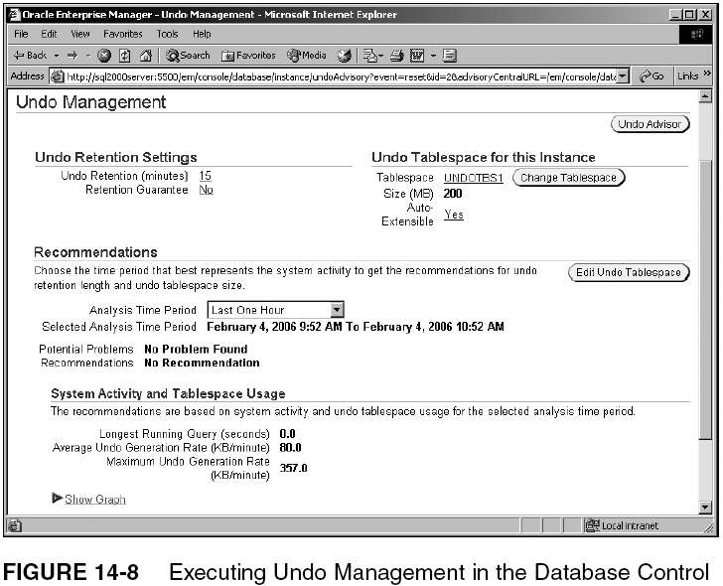
Undo Management and the Undo Advisor (continued)

Slide 16
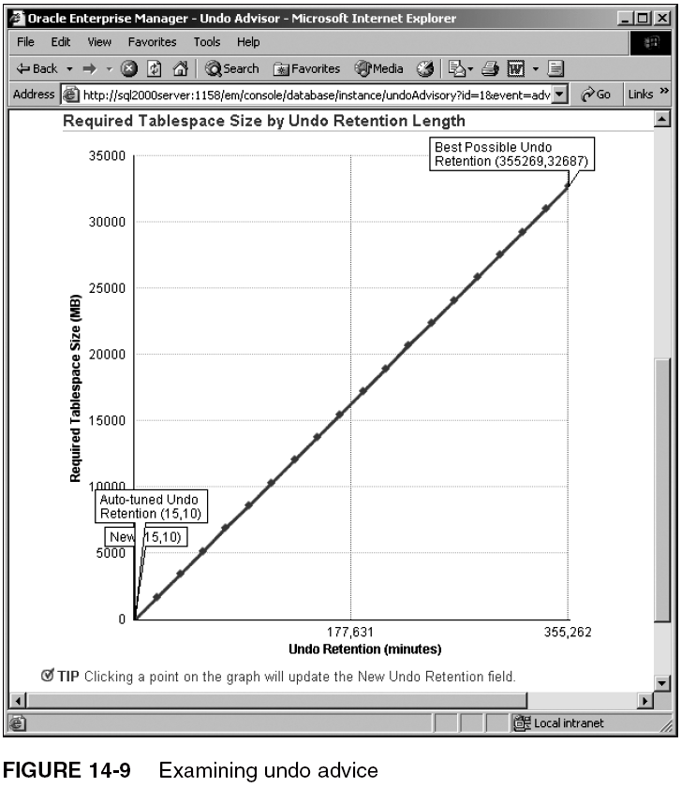
Undo Management and the Undo Advisor (continued)

Slide 17
The Memory Advisor
Split into advisors for both SGA and PGA memory
  SGA configuration parameters:
    Shared pool
    Database buffer cache
    Large pool
    Java pool
    Streams pool
    SGA max size
    SGA target size
  PGA is controlled by the PGA_AGGREGATE_TARGET parameter
    A value greater than zero enables automated PGA memory management

Slide 18
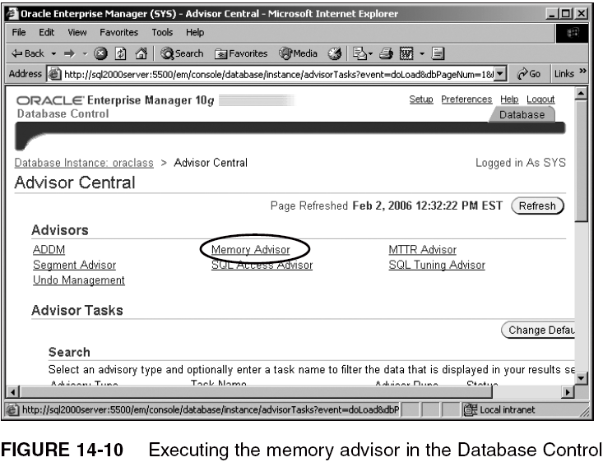
The Memory Advisor (continued)

Slide 19
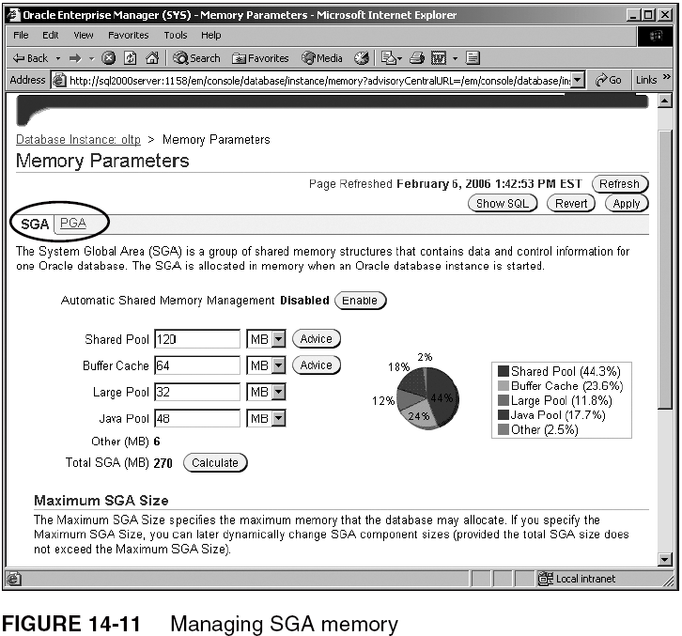
The Memory Advisor (continued)

Slide 20
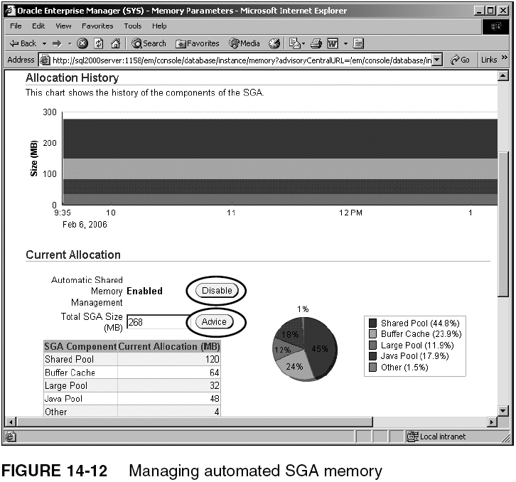
The Memory Advisor (continued)

Slide 21
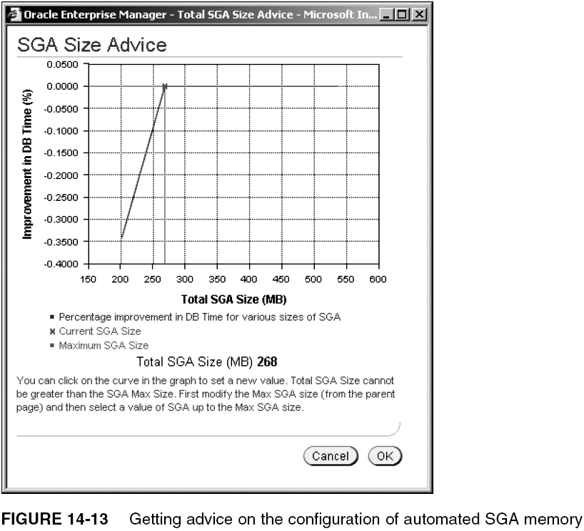
The Memory Advisor (continued)

Slide 22
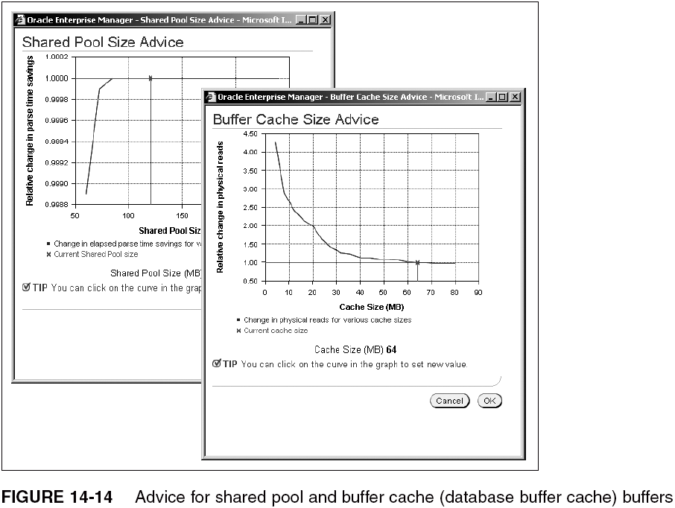
The Memory Advisor (continued)

Slide 23
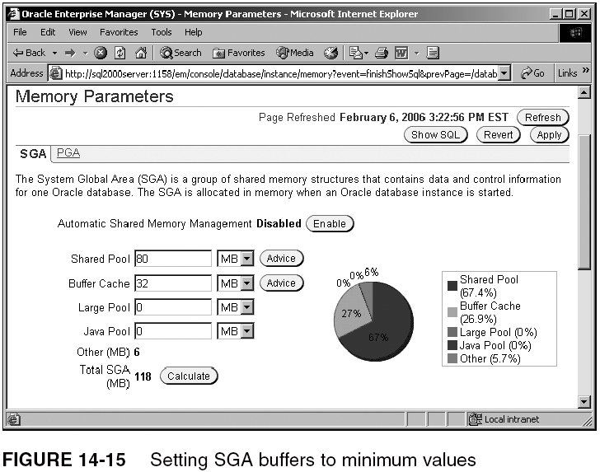
The Memory Advisor (continued)

Slide 24
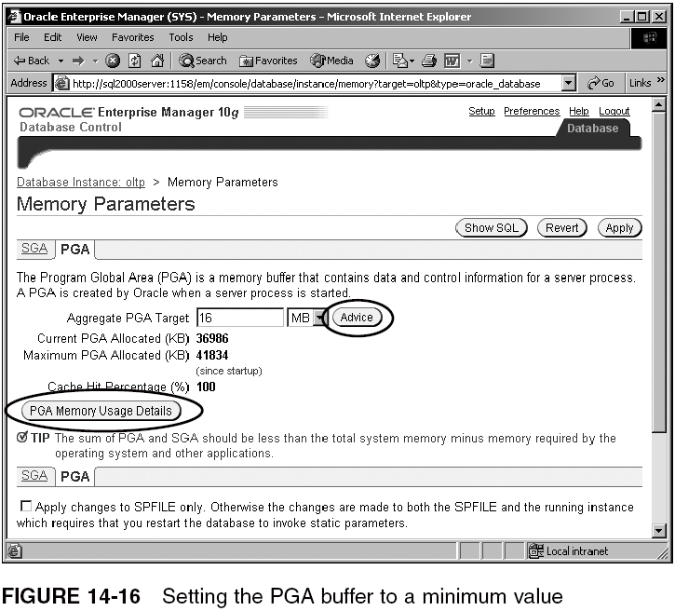
The Memory Advisor (continued)

Slide 25
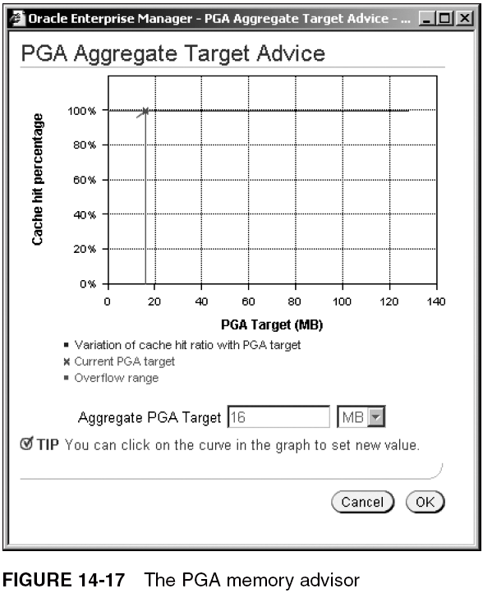
The Memory Advisor (continued)

Slide 26
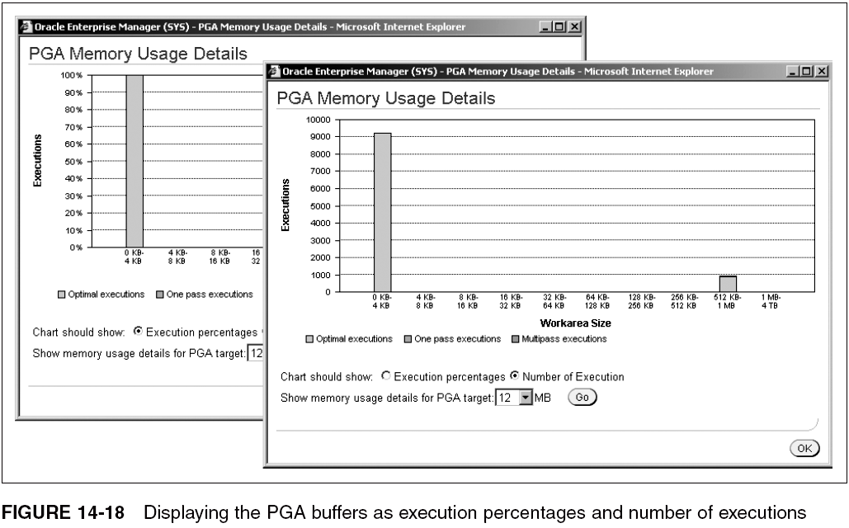
The Memory Advisor (continued)

Slide 27
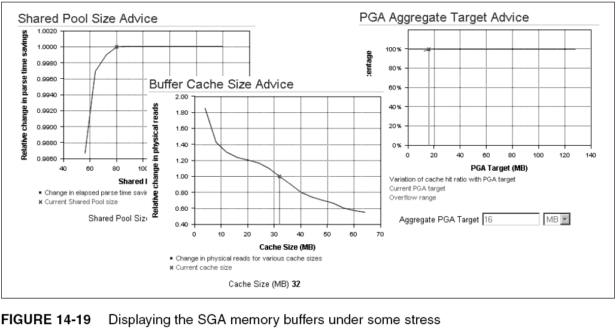
The Memory Advisor (continued)

Slide 28
The SQL Access Advisor
The SQL access advisor allows you to analyze various database objects, such as indexes and materialized views, potentially making recommendations for improving performance

Slide 29
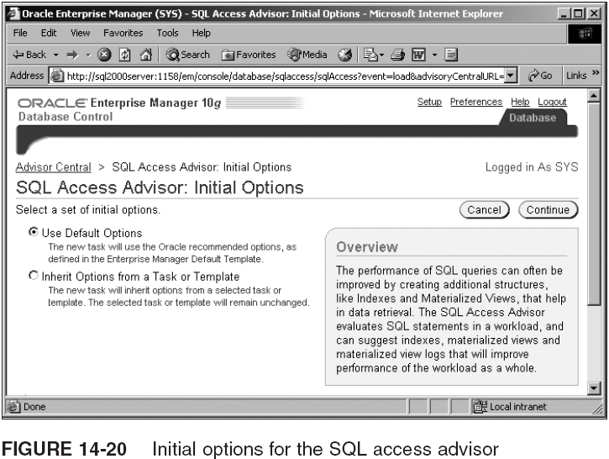
The SQL Access Advisor (continued)

Slide 30
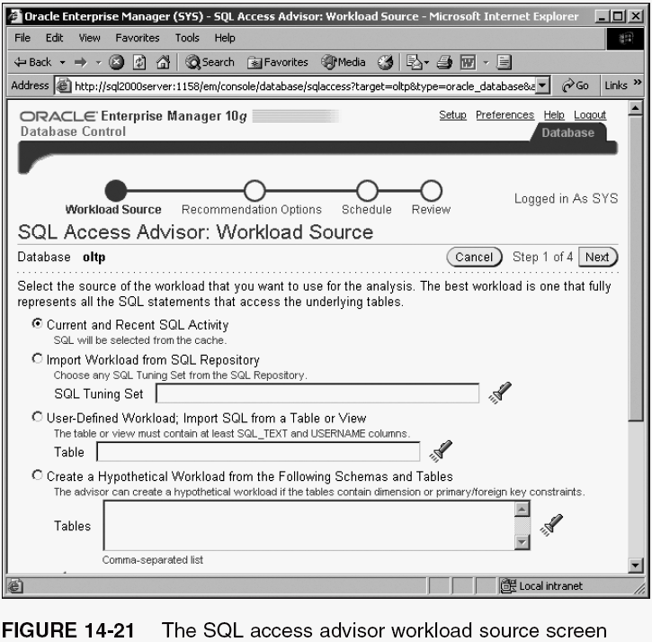
The SQL Access Advisor (continued)

Slide 31
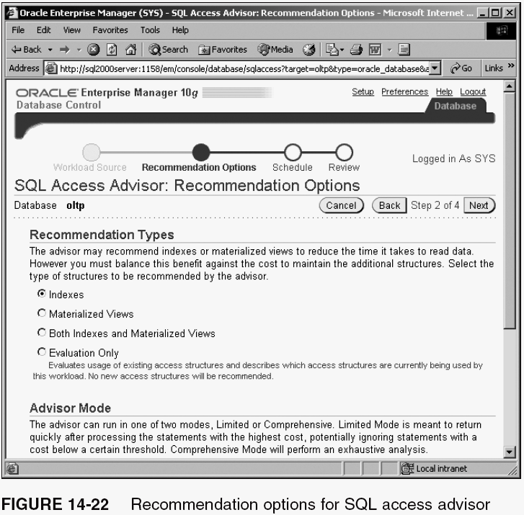
The SQL Access Advisor (continued)

Slide 32
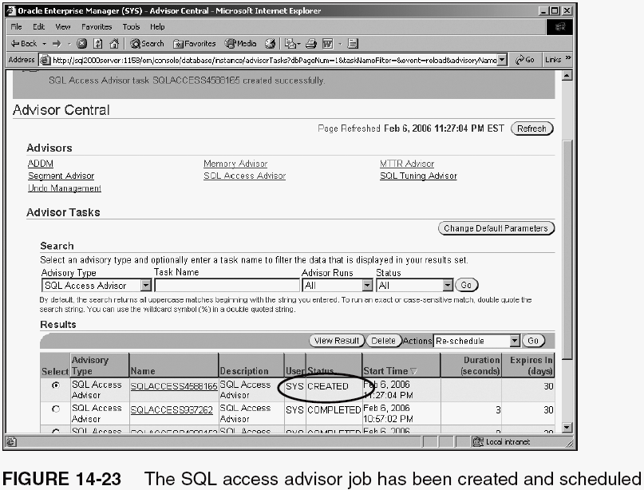
The SQL Access Advisor (continued)

Slide 33
The SQL Tuning Advisor
The SQL tuning advisor is similar to the SQL access advisor, but will analyze SQL code, perhaps making recommendations for improving performance

Slide 34
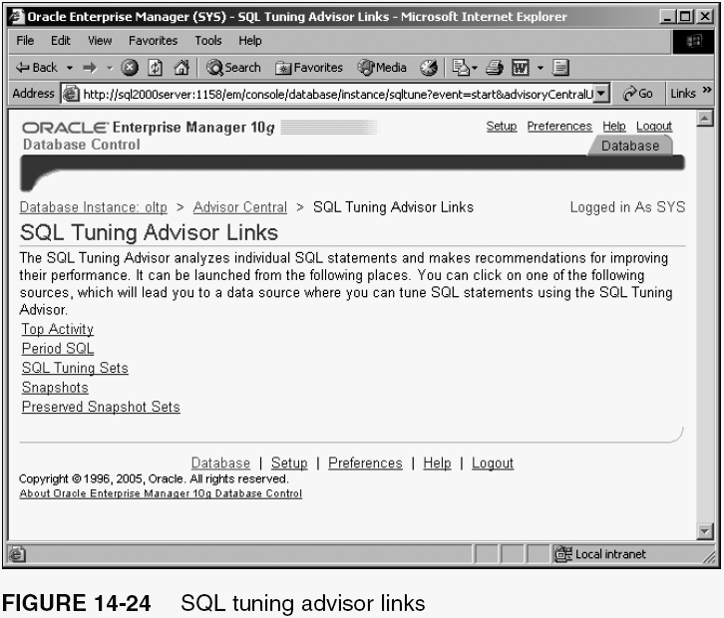
The SQL Tuning Advisor (continued)

Slide 35
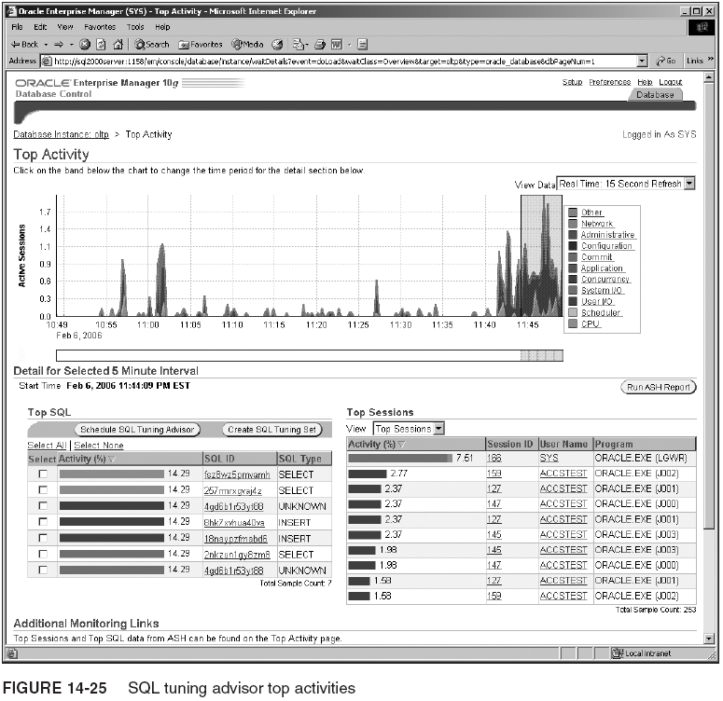
The SQL Tuning Advisor (continued)

Slide 36
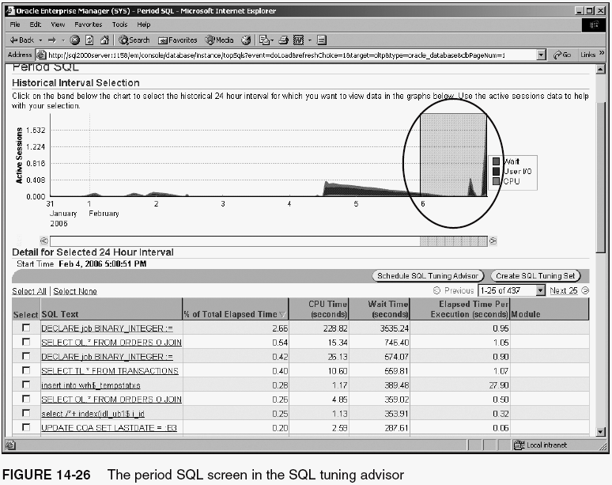
The SQL Tuning Advisor (continued)

Slide 37
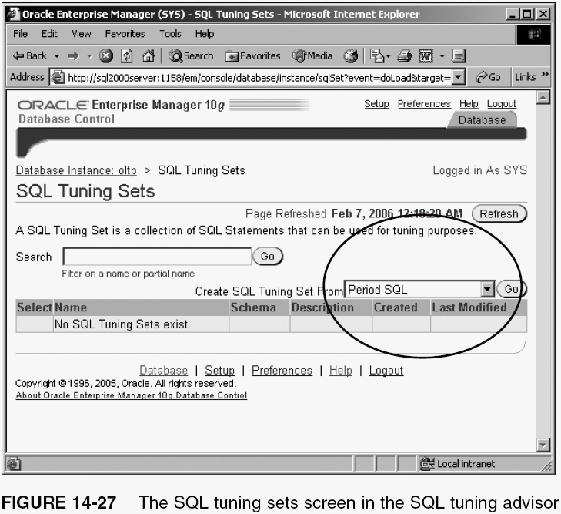
The SQL Tuning Advisor (continued)

Slide 38
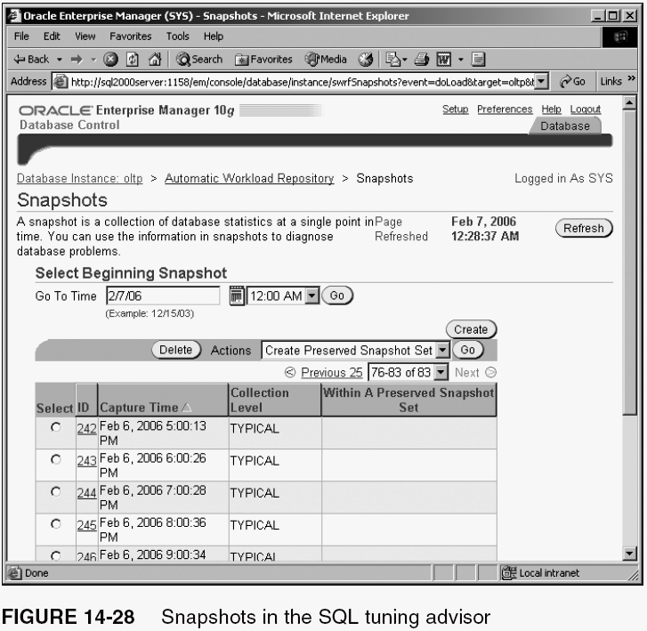
The SQL Tuning Advisor (continued)

Slide 39
Baseline Metrics
A metric is essentially a measure of a rate of change
A baseline metric is an established, expected, or even hoped for value
  Anything not conforming to a baseline value indicates a problem or potential problem
  You already know how to find this information in the Database Control

Slide 40
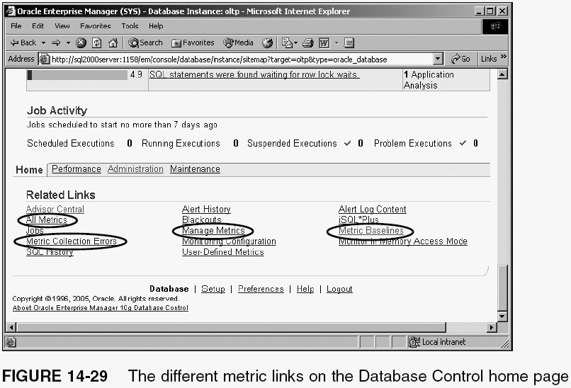
Baseline Metrics (continued)

Slide 41
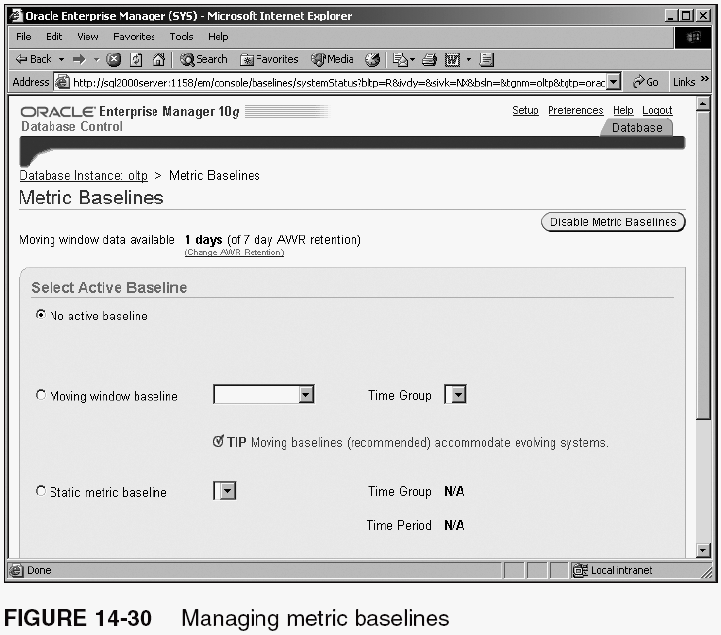
What are Baseline Metrics?

Slide 42
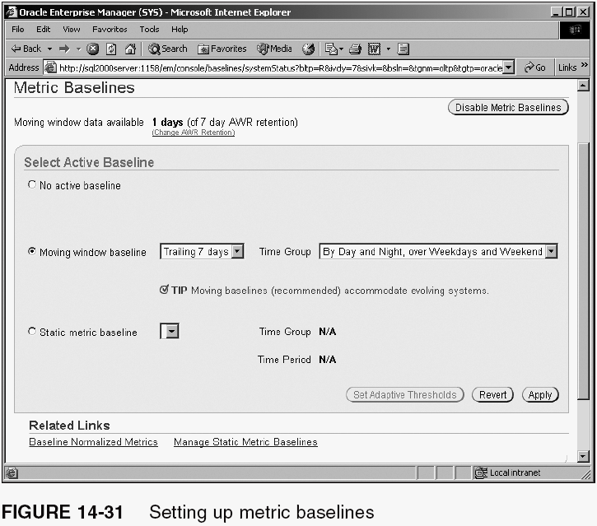
What are Baseline Metrics? (continued)

Slide 43
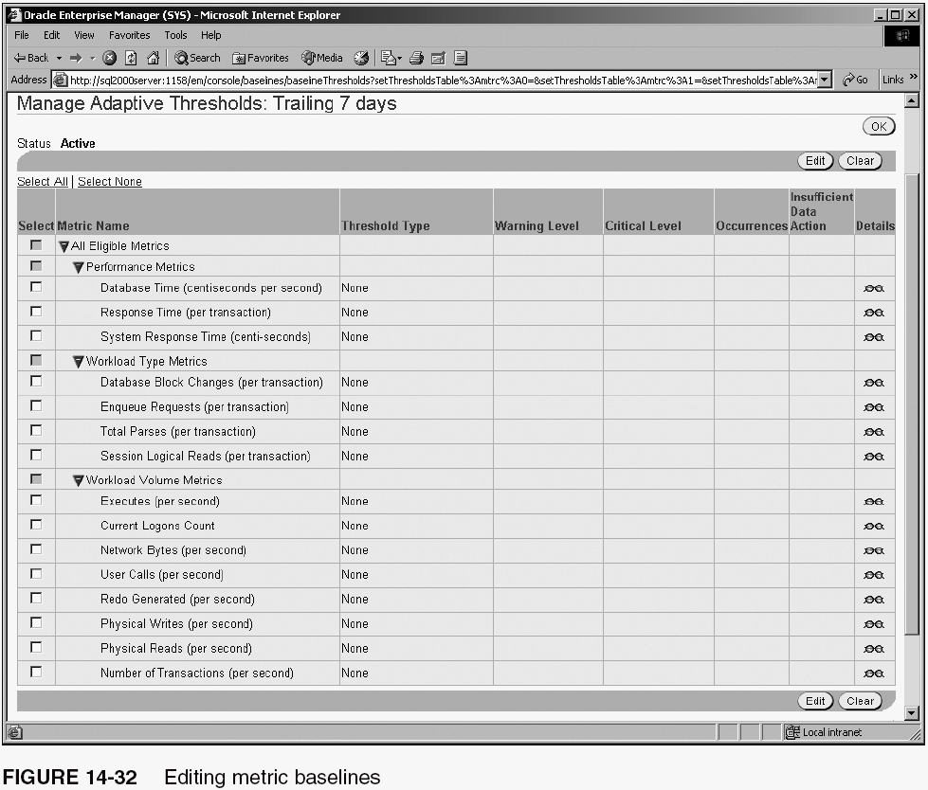
What are Baseline Metrics? (continued)

Slide 44
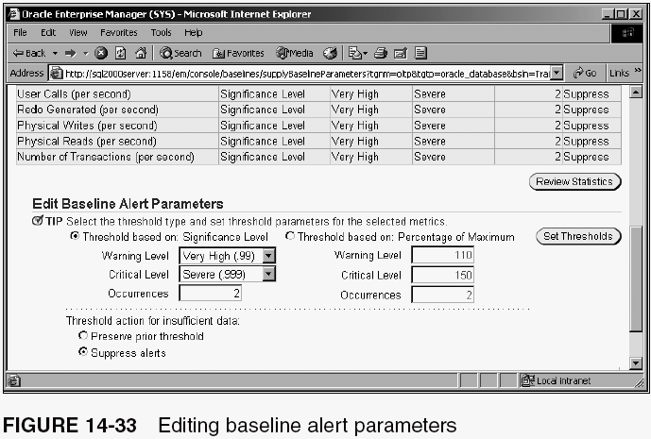
What are Baseline Metrics? (continued)

Slide 45
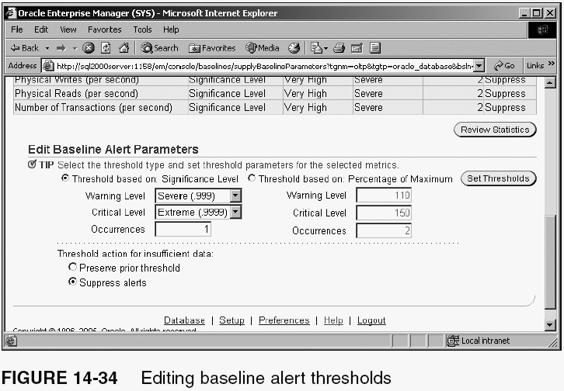
What are Baseline Metrics? (continued)

Slide 46
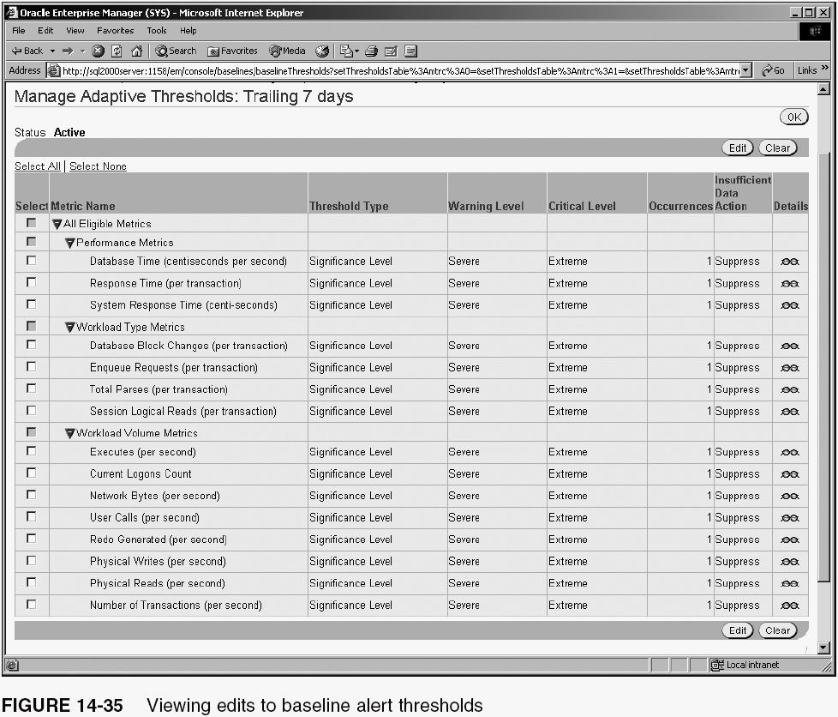
What are Baseline Metrics? (continued)

Slide 47
Changing Baseline Metrics
Changing baseline metrics involves altering the threshold values
Changing those values is simple in the Database Control

Slide 48
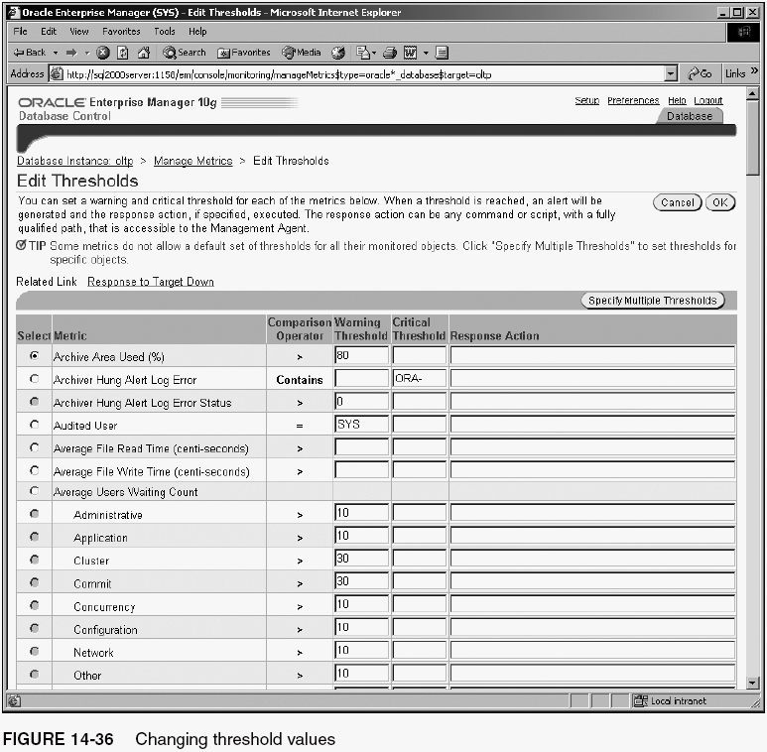
Changing Baseline Metrics (continued)

Slide 49
Summary
Proactive maintenance is all about trying to predict and track potential problems before they occur
  Use the Database Control for proactive maintenance
    Segment advisor searches for, detects, and posts warnings and alerts regarding segment issues
    Undo advisor advises as to optimal configuration of automated undo
    Memory advisor warns and alerts with respect to potential instance, media, and flashback recovery
    SQL tuning advisor performs automated SQL tuning
    SQL access advisor allows for analysis of DB objects, making recommendations for improving performance

Slide 50
Summary (continued)
A baseline metric is an established, expected, or even hoped for value
  Anything not conforming to a baseline value could possibly be an indicator of a potential problem
  Baseline metrics establish an entire automated architecture, allowing for automated monitoring of a database in all facets and at all levels of detail
  Baseline metrics can be managed using the Database Control

