Slide 1

Oracle 10g Database Administrator: Implementation and Administration
Chapter 15
Backup and Recovery

Slide 2
Objectives
Discover the difference between backup, restore, and recovery
The difference between cold and hot backups
Learn about different tools used for backup and recovery
Learn about different types of failure that create a need to recover a database

Slide 3
Objectives (continued)
Learn about different backup strategies
Learn about essential configuration as applied to making a database fully recoverable
Learn about the specific backup and recovery scenarios

Slide 4
Introduction to Backup and Recovery
Backup is the process of making some kind of copies of parts of a database, or an entire database
Recovery is the process of rebuilding a database after some part of a database has been lost
Restoration is the process of copying files from a backup
Recovery is the process of executing procedures in Oracle Database to update the recovered backup files to an up to date state

Slide 5
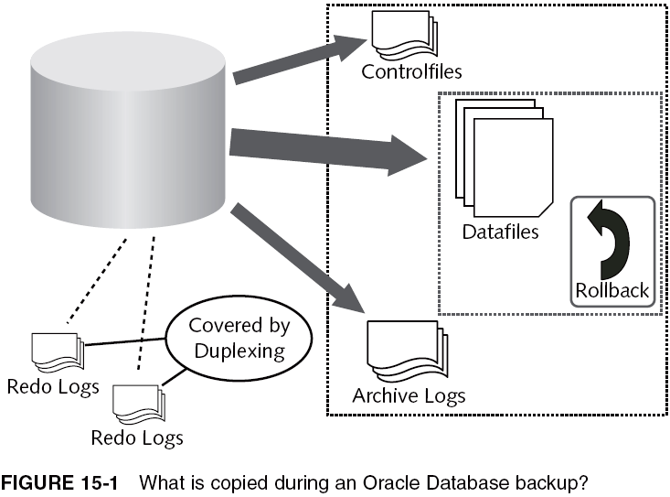
What is Backup?

Slide 6
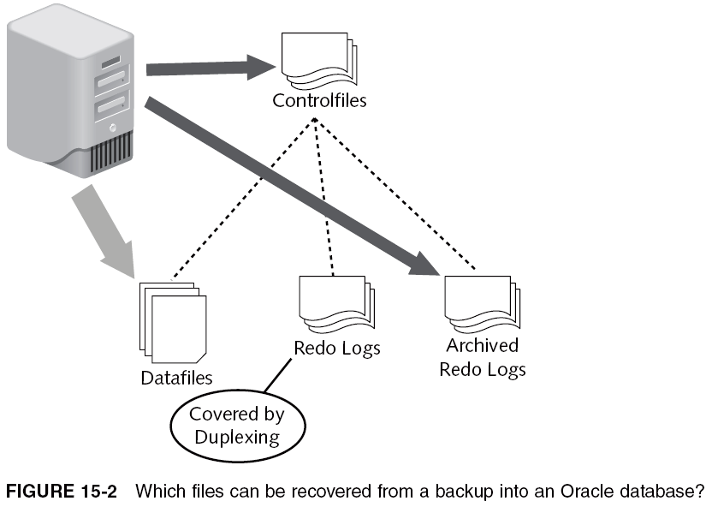
What is Restoration?

Slide 7
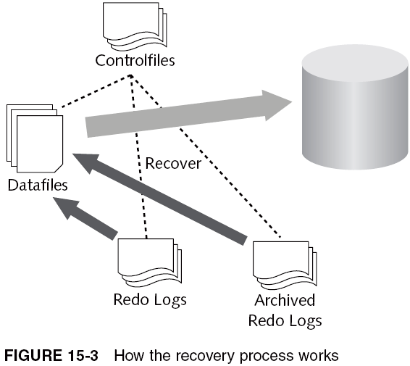
What is Recovery?

Slide 8
What is Recovery? (continued)
Redo logs and archive logs consist of records of all transactions made to a database
Controlfiles contain pointers to datafiles, dictating where datafiles should be in relation to redo log entries
  If a datafile is restored from a backup, then the controlfile will be ahead of the datafile in time
    Restoration of recovered backup is a simple process of applying redo log entries to the datafile, until the datafile “catches up” to the time indicated by controlfile
Archive logs are copies of old redo log files, copied just before redo log files are reused
  Restoration can utilize entries in both redo log files and archive log files to complete a recovery

Slide 9
Methods of Backup and Recovery
Two basic methods of backup and recovery:
  Cold backups
  Hot backups

Slide 10
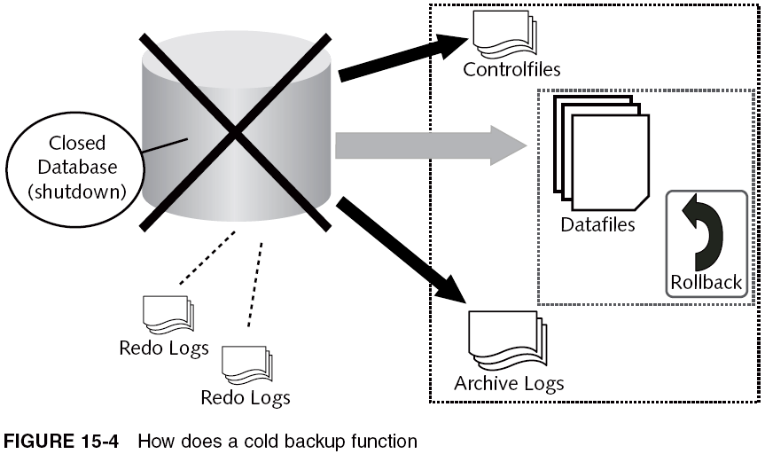
What is a Cold Backup?

Slide 11
What is a Hot Backup?
Hot backup: performed when DB is online, active, and available for use
  Many tools and methods for performing hot backups
  Takes a snapshot of a database one file or type of file at a time
    Not necessarily consistent across all files in backup
  Made of pieces of a DB, where those files making up a complete DB backup are not recoverable to a working database as a group
    Individual files can be slotted into a running DB, and can be recovered individually, or as a group

Slide 12
Tools for Backup and Recovery
Tools used for backup and recovery of an Oracle database are as follows:
  Export and Import Utilities
  Backup Mode Tablespace Copies
  RMAN (Recovery Manager)
  Oracle Enterprise Manager and the Database Control

Slide 13
Types of Failure
Different types of failure can occur, ranging from the loss of a single file to a complete loss of an entire database server
Important to understand what the various types of failure are so that you can be better prepared

Slide 14
Media Failure
Media failure is storage device failure, such as when a disk fails
  Fortunately rare because of many modern striping and mirroring utilities using specialized hardware such as RAID arrays
  What can be done to ensure that media failure can be recovered from quickly?
    Always multiplex controlfiles and duplex redo logs
    Use a RAID array for underlying disk storage, or some type of HW and/or SW architecture that allows for some type of mirroring of underlying file structures

Slide 15
User and Application Failure
User and application failure is much more likely than any other failure situation
  Applications can be improperly coded, causing errors to occur at the database level
  What can be done to ensure that user and application failure will cause minimal disruption?
    User and application errors are usually object-centric; sometimes those tables can be individually restored, particularly if a table contains static data
      Export utility dump files can be used to recover
      RMAN is capable of recovering individual objects using log entries, so the export utility is somewhat outdated

Slide 16
Oracle Database-Induced Failure
Can be result of a bug or overload applied to DB
Or, due to administrator-induced problem
  E.g., repetitive use of the SHUTDOWN ABORT command, or pulling the power plug out of the wall
    What can be done to avoid failure at this level?
      Use an uninterrupted power supply so a clean shutdown can be performed on a power failure
      Don’t pull the plug
      Never execute a SHUTDOWN ABORT, kill a process (Unix/Linux), stop and start the service (Windows), or reboot your DB server computer unless you have to
        Always use SHUTDOWN IMMEDIATE rather than SHUTDOWN ABORT (difference in speed is minimal)

Slide 17
Backup Strategy
A backup strategy is required to plan ahead:
  What types of backups should you use?
  Which tools should you use to back up, and what tools will you use in the event of failure?
  How often should you back up your database?
Establish a plan before implementing a backup plan
  Establish a strategy to allow for a better selection of options when implementing backups
    Backup strategy is dependent on factors such as the type of DB, how much data can be lost, and available equipment

Slide 18
Type of Database
An OLTP database can be large and active
  Performing regular cold backups is generally unacceptable as it requires a complete DB shutdown
  OLTP DBs must often be available all 24-hours
  OLTP DBs tend to change rapidly, in small chunks, in many different parts of the database, or all at once
  Incremental backups using RMAN are useful (they only copy what has changed since previous backup)
    Same rule applies to data warehouses because the amount of regular updating is small in relation to the physical size of the entire data warehouse
      Large parts of data warehouses are often static, and even read-only, so they need a single backup

Slide 19
Database Availability (24x7x365)
A database must be available globally without interruption
  Hot backups are essential
    Additionally, hot backups, especially in the case of using RMAN, can allow for recovery of failure due to partial errors such as a single disk failure in a collection of disks, or the loss of a single table
      Essential requirement is availability
      More likely to apply to high-concurrency OLTP data, rather than to data warehouse data

Slide 20
Data Change Speed
OLTP DBs and data warehouses can change rapidly
  However, where a data warehouse has new data appended at regular intervals, an OLTP DB has small amounts of data changed in all parts of DB, around the clock
    In terms of recoverability, a data warehouse could simply have batch processing re-executed
      An OLTP DB has to recall all transactions from log files and essentially re-execute them on recovery
Devise a backup strategy based on how long it will take to recover the database to an acceptable point, and perform the recovery as fast as possible

Slide 21
Acceptable Loss Upon Failure
Acceptable loss: how much data can a company lose while maintaining usability/availability of data
  The less acceptable loss allowed, the more complex and longer backups will take to execute (and more time needed if restoration/recovery is required)
  Examples:
    An OLTP database requires zero loss
    A data warehouse can often be rebuilt by re-executing batch processing
  Factors include: amount of storage capacity available for backups, type of media used for backups, and minor factors like network bandwidth

Slide 22
Available Equipment
Backup to disk is much faster than backup to tape
  However, if you need to retain backups for a number of years, using tape backups is much easier
  Typically, many database installations will use a combination of both disk and tape backup storage
    Recent backups will be stored on disk, allowing for rapid and specific recovery scenarios
    After a while, disk backups could be transferred to a sequential media such as tape, where recovery would be naturally slower and more cumbersome, but less expensive and easier to manage

Slide 23
Planning for Potential Disaster and Recovery
Always plan for a potential disaster!
If you begin a new job, backup and recovery should be at the top of your list of priorities
Automate the backup process if possible
  Use scripting and scheduling to perform backups periodically and automatically
  RMAN allows full automation of a backup strategy and even allows for embedded scripting, and even executing backup processing in parallel or on a specific node in a clustered environment
  Test existing backup implementation if possible and always test anything you construct as new, preferably off the production server environment

Slide 24
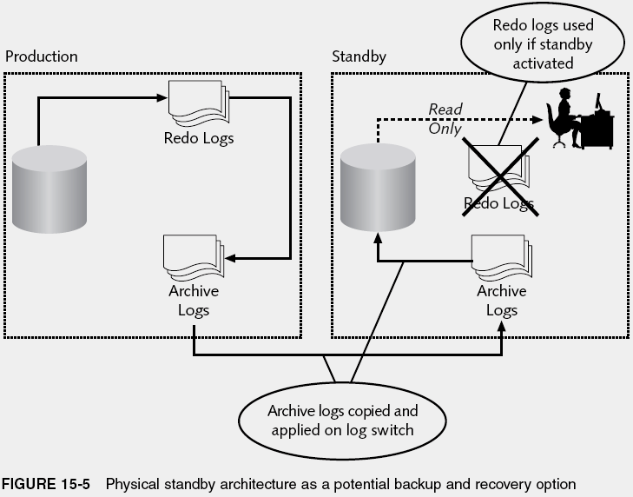
Other Approaches to Backup and Recovery

Slide 25
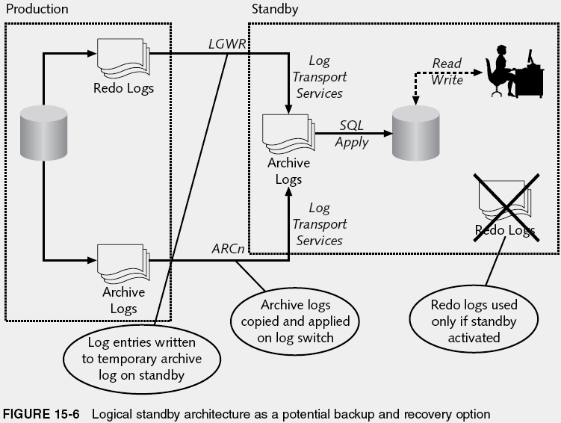
Other Approaches to Backup and Recovery (continued)

Slide 26
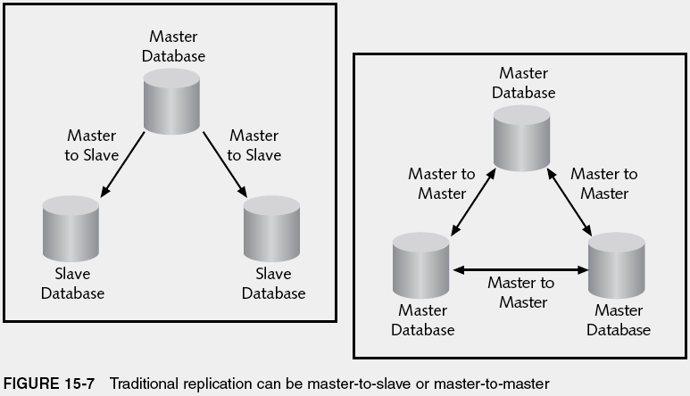
Other Approaches to Backup and Recovery (continued)

Slide 27
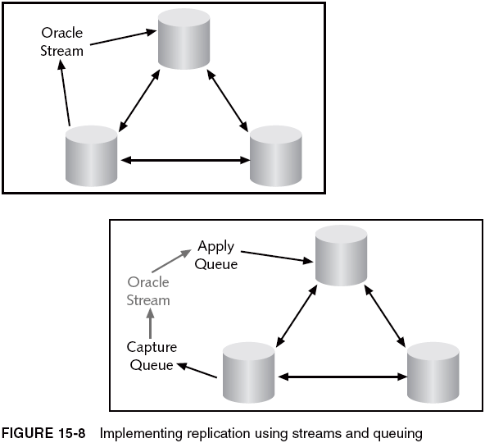
Other Approaches to Backup and Recovery (continued)

Slide 28
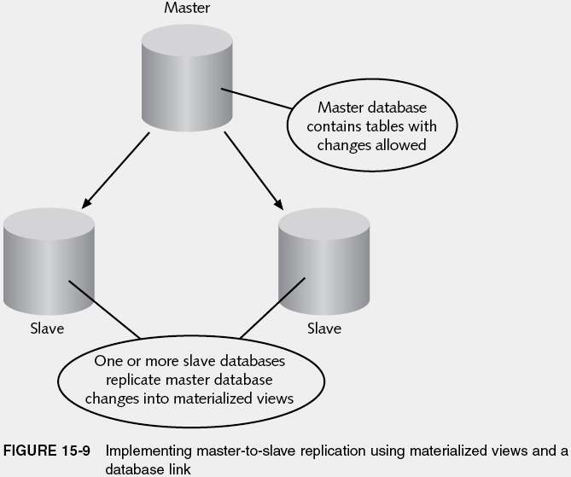
Other Approaches to Backup and Recovery (continued)

Slide 29
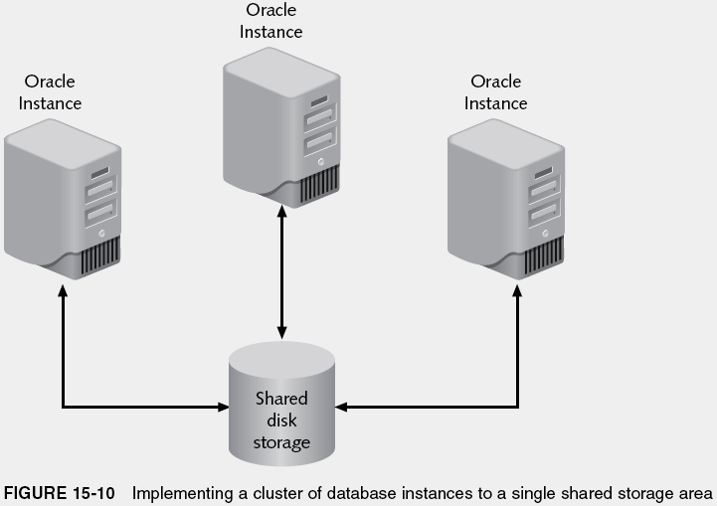
Other Approaches to Backup and Recovery (continued)

Slide 30
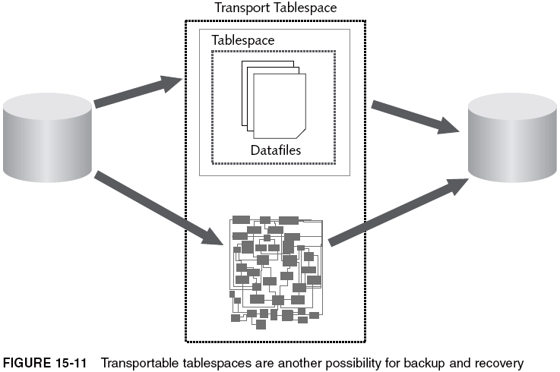
Other Approaches to Backup and Recovery (continued)

Slide 31
Configuring a Database for Possible Recovery
Various things you can do with Oracle 10g configuration to ensure proper functioning of backups
The most important thing is making sure that your database is archived

Slide 32
Setting the Database in Archive Log Mode
In archive log mode, the database will create archive logs for you
Archive logs are files that are copied from redo logs when a redo log file is switched out for recycling
Redo logs contain entries of all transactional activity in a database as transactions occur
  Redo logs are recycled
    If a redo log is recycled, unless the redo log is copied to an archive log, all entries in that redo log group are effectively lost
A database must be in archive log mode to duplicate redo logs to archive logs

Slide 33
Setting the Database in Archive Log Mode (continued)
ARCHIVE LOG LIST;
ARCHIVE LOG STOP;
SHUTDOWN IMMEDIATE;
STARTUP MOUNT;
ALTER DATABASE NOARCHIVELOG;
ALTER DATABASE OPEN;
SHUTDOWN IMMEDIATE;
STARTUP MOUNT;
ALTER DATABASE ARCHIVELOG;
ALTER DATABASE OPEN;

Slide 34
Checkpoints, Redo Logs, Archive Logs, and Fast Starts
The combination of archive logs and redo logs allows you to recover your DB from a point in time
Checkpoint: point in time where all buffers are flushed to disk
  Writes all pending redo log buffer and database buffer cache changes to disk, writing the redo log buffer first, followed by the database buffer cache
  By default, executed automatically when the log buffer is one-third full of pending changes, every three seconds, when a log switch occurs, or when COMMIT or ROLLBACK commands are executed
    To alter configuration: LOG_CHECKPOINT_INTERVAL and LOG_CHECKPOINT_TIMEOUT

Slide 35
Sacrificing Recoverability for Performance
Sacrificing recoverability for performance means that you can limit the number of checkpoints that occur, thereby potentially speeding up database performance
However, because checkpoints are not executed as frequently, your DB becomes less recoverable because you could lose what has not been written to disk from buffers at the time of failure
  This simply involves tweaking checkpoint parameter settings either directly in the parameter file or from within the Database Control

Slide 36
Flash Recovery and Backups
Flashback recovery allows retention of potential flashback data for a specified time
  Simplifies backup and recovery management
  Can speed up recovery performance
  Difference between regular physical recovery and flashback recovery is a physical versus a logical one
  Capabilities: flashback queries, flashback version queries, flashback transaction queries, flashback DB
  Technology relies generally on a combination of undo data and the recycle bin
    When retention period is exceeded, log files are used, combined with log entry records recovery

Slide 37
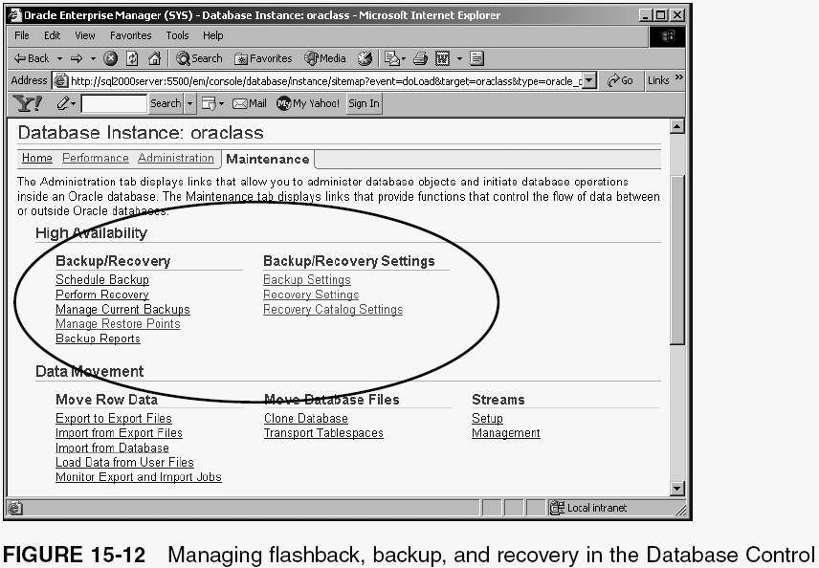
Flash Recovery and Backups (continued)

Slide 38
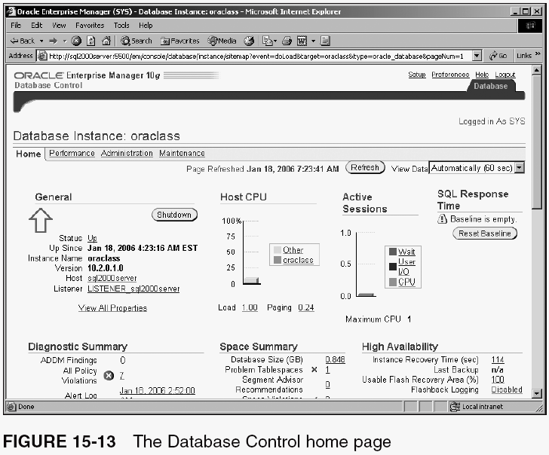
The MTTR (Mean Time To Recovery) Advisor

Slide 39
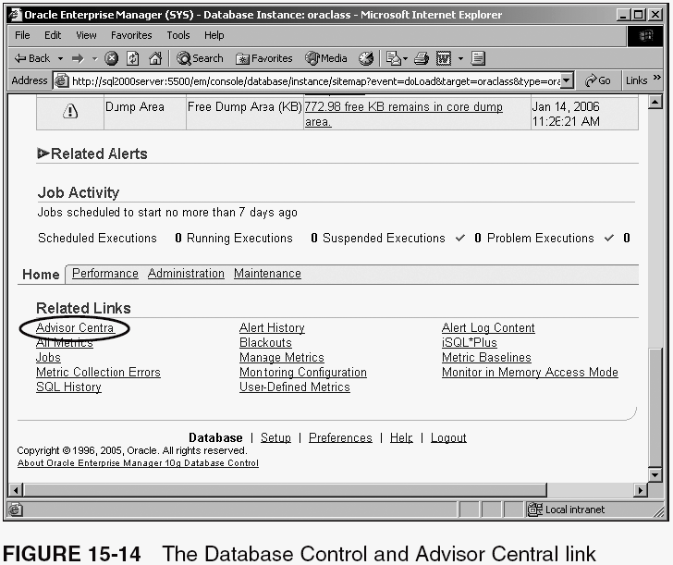
The MTTR (Mean Time To Recovery) Advisor (continued)

Slide 40
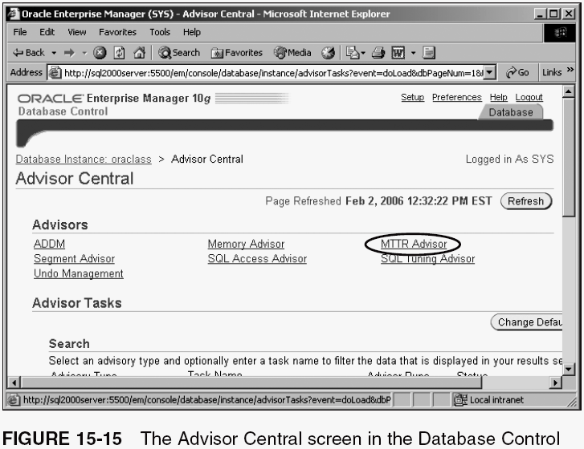
The MTTR (Mean Time To Recovery) Advisor (continued)

Slide 41
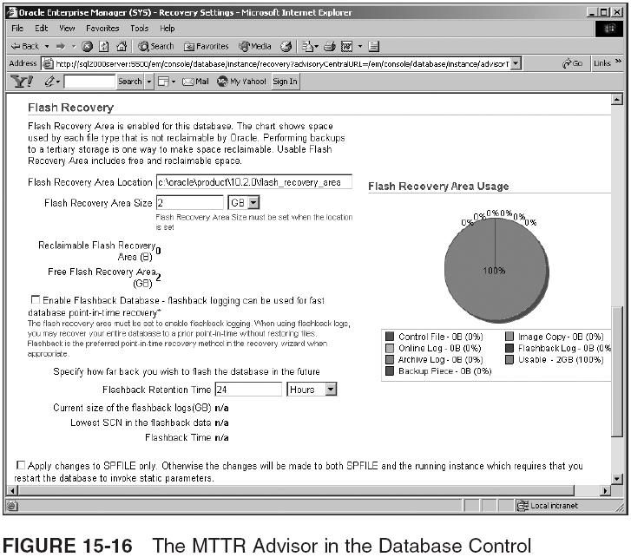
The MTTR (Mean Time To Recovery) Advisor (continued)

Slide 42
Database Backup
We will now experiment with executing some backups, using different methods
  Cold backups
  Hot Backups
    Consistent Backups Using Exports
    Tablespace Backups

Slide 43
Cold Backups
For a cold backup, shut down the database completely and then copy all the files
  All datafiles
  All redo log files
  All archive log files
  All controlfiles
  Optionally you can also back up parameter files and any networking configuration files
Restore at least all the datafiles and controlfiles
  Optionally use more current redo log files, archive log files, and controlfiles—allowing a recovery by applying redo log entries to datafiles

Slide 44
Hot Backups
The objective of a hot backup is to obtain a snapshot of all data in the database
  Can create a backup that is reconstructable by applying log entries to datafiles, based on SCN matches between datafiles, controlfiles, and redo log entries
Different methods include export plus import utilities (or Data Pump technology), RMAN, or even traditional tablespace backups

Slide 45
Consistent Backups Using Exports
Export can be used to create a consistent backup
  Export can scan through all types of data, including tables, redo and archive logs, and undo data
    Allows for a consistent backup (export) based on a snapshot of data
    In other words, regardless of any changes occurring to DB, during an export, the export utility will read datafiles and undo space to get a consistent backup
  Examples:
    exp system/<password>@oraclass file=classmate.dat owner=classmate consistent=Y
    exp classmate/classpass@oraclass file=classmatetables.dat tables=(client,customer)

Slide 46
Tablespace Backups
In a tablespace backup, you switch a tablespace into a special mode called backup mode
  This allows a physical operating system-level copy of that tablespace
  In Oracle 10g, allows a backup mode setting to be applied to all tablespaces at once
  Problem with backup mode is a performance issue
    Forces all change activity for that tablespace to be copied to the redo logs
      If there are enough redo entries produced to recycle a redo log group, then archive log files will be used too
    The longer a tablespace remains in backup mode, the more performance is affected, the longer any potential recovery is, and more redo log data is produced

Slide 47
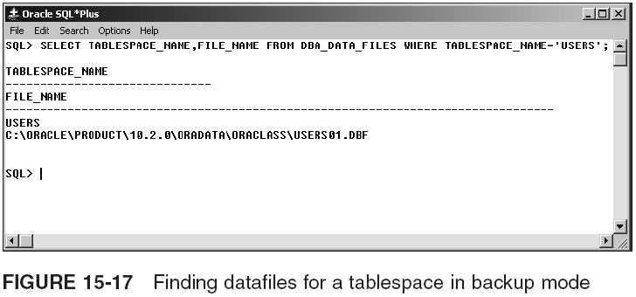
Tablespace Backups (continued)

Slide 48
Database Recovery
Various scenarios can occur with different DB failures because there are different types of failure, as discussed in this chapter
With an up-and-running Oracle 10g database, the following errors can occur:
  Losing a controlfile
  Losing a redo log file
  Losing the SYSTEM or SYSAUX tablespace datafile
  Losing an application tablespace datafile

Slide 49
Losing a Control File
Easiest way to resolve this problem is to shut down DB and copy back in a current controlfile copy
  If this can’t be done, rebuild controlfile from trace copy
Always multiplex controlfile so you have a copy that can simply be plugged into a shutdown database
There is no danger of the controlfile being mismatched in time with the other datafiles and redo logs in the database, because loss of the controlfile does not allow any change activity to continue, until that controlfile is repaired or replaced

Slide 50
Losing a Redo Log File
Redo logs should always be duplexed
  Replacing a redo log file involves shutting down the DB and restoring an exact copy into the location of the erroneous redo log file, from a duplexed copy
Other methods of recovering redo log files, when duplexed copies do not exist, involve restarting the database but with cleared redo log files
  This is a problem, and undesirable, because you will lose whatever is cleared from the redo log files

Slide 51
Losing an Individual Table
Loss of an individual table is simple to recover if you have an export
  Let’s say you lost the CUSTOMER or the CLIENT table from your CLASSMATE schema. You could easily replace them using the export dump file of those two tables, which you created earlier, using the import utility something like this:
    imp classmate/classpass file=classmatetables.dat tables=customer

Slide 52
Losing an Application Data File
Loss of an application datafile includes any non-system tablespace (except SYSTEM and SYSAUX)
Example:
  ALTER TABLESPACE USERS OFFLINE;
  ALTER TABLESPACE USERS ONLINE;
  RECOVER TABLESPACE USERS;
  ALTER TABLESPACE USERS ONLINE;

Slide 53
Losing SYSTEM or SYSAUX Tablespaces
If a SYSTEM or SYSAUX tablespace datafile is lost, you are forced to shut down DB to copy the backup file back into the DB architectural structure
  These two tablespaces run the database
  The system-level tablespaces contain everything that is the Oracle database
  They have to be permanently online when the database is open for use
    Can only be retrieved with the database shut down, and recovered when the database is not open

Slide 54
Summary
Backup of a database is the process of taking copies of part or all of a database
  The parts of a database that are backed up can help to restore the database to a specific time
DB recovery can be performed using parts of a previously created backup or an entire backup
Cold backup: snapshot of a DB when the database is completely shut down, inactive, and inaccessible
Hot backup: backup that can be taken of a database when it is running and fully available for use
  Can be: consistent snapshot of a DB or inconsistent copies of individual physical/logical parts of a DB

Slide 55
Summary (continued)
Backup and recovery tools: export and import utilities (plus Data Pump variations), RAM, OS-level copies
An Oracle DB can fail in numerous ways, including media, user error, and even Oracle software error
  Isolate the type of failure that has occurred to assist in deciding how a database should be recovered
A backup strategy is largely determined by how a DB is used, what it is used for, how much downtime is acceptable, and if any loss of data is acceptable
A DB is generally regarded as nearly 100% fully recoverable using an archive log DB configuration
  Duplexed redo logs and multiplexed controlfiles can help achieve 100% recoverability

