Slide 1
Kabbalah to Scientology
Caleb Cushing
Erin Rosario
Chad Marlat
blah

Slide 2
Kabbalah
Notes:
What is Kabbalah.

Slide 3
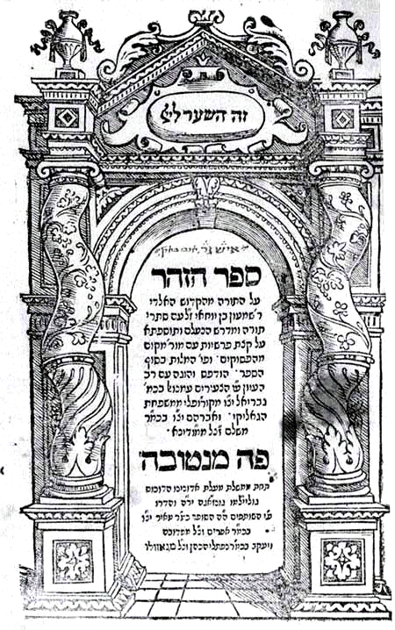
Zohar

Slide 4
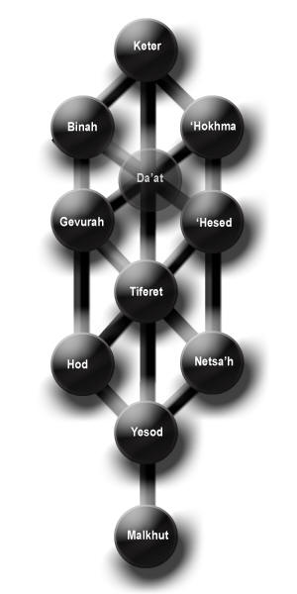
Sephirotic Tree

