Slide 1

Effective Presentation skills

Slide 2

Definition
A presentation is a means of communication which can be adapted to various speaking situations, such as talking to a group, addressing a meeting or briefing a team.

Slide 3

Presentation skills
Following are the steps include in preparing effective presentation:
Plan
Prepare
Practice
Present

Slide 4

Planning

Slide 5

Planning
Planning usually include following questions:
Who is your audience?
Why are they there?
What is your goal?
How long will it be?
Where will it take place?

Slide 6

Prepare

Slide 7

Prepare
Following points must keep in mind while preparing:
Structure
Prompt
Visual aids
Voice
Appearance
Style
Questions

Slide 8

Structure
Write your presentation in this order:
Objective
Beginning or introduction
Main content
Summary, conclusion and recommendations
Questions

Slide 9
Structure
Introduction
Grab the audience
Get Attention
attention
Main theme
content should be relevant to topic
summary/ Conclusion
Key message

Slide 10

Prompt
Short bullet points, key words only.
Put your entire prompt onto your power point slides.
These prompt are for you.

Slide 11
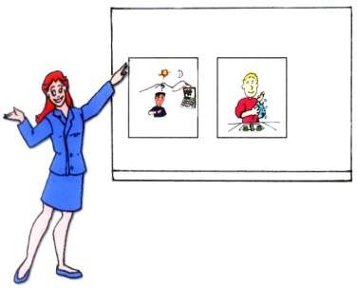
Visual aids
Use simple fonts, colors and graphs.
Use images and clipart.
3 to 7 bullets per slide.
Don’t over crowd your slides, it will not look professional.
New or different visual aids wake people up.

Slide 12

Voice
Louder and clear than your normal pitch.
Vary pitch and volume.
Over emphasis

Slide 13

Appearance
Dark colors read as businesslike.
Wear comfortable shoes to weight your feet evenly.
Allow yourself to move a bit.
Look confident.

Slide 14
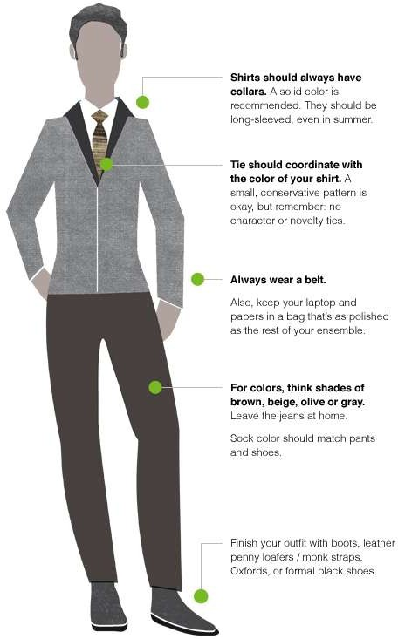
Professional dress code

Slide 15

Professionals vs. non professionals

Slide 16

Style
You already have a style don’t try to copy others.
Use words and sentences you use in normal days.
Be yourself.

Slide 17

Questions
Sketch an idea that what kind of questions audience may ask.

Slide 18
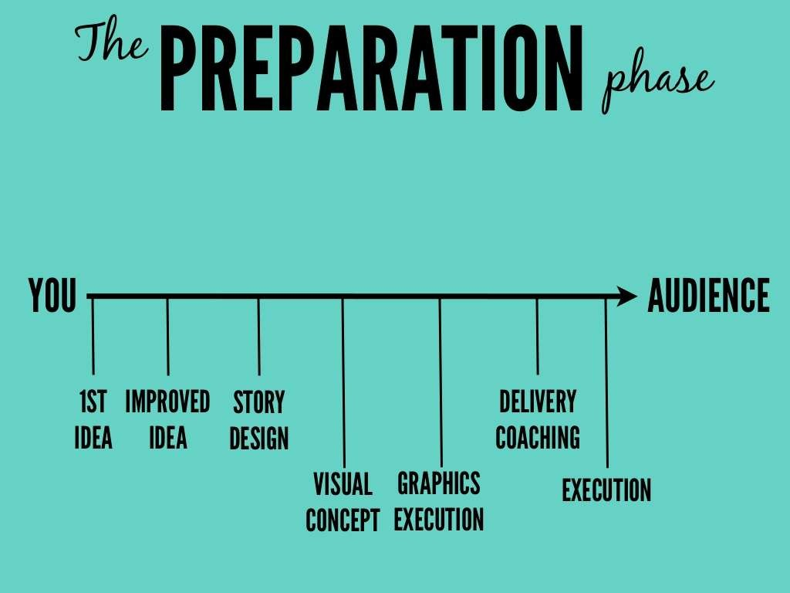

Slide 19



Preparation material
You can use following items to make the content of your presentation:
Handouts
Personal notes
Internet
Visual aids

Slide 20

Practice

Slide 21



Practice
Rehearse all points what you prepare.
Rehearse with all visual aids and handouts.
Practice again and again to manage time.
Rehearse in front of mirror or a friend.

Slide 22

Present

Slide 23

Present
Make a strong start.
Engage the audience in first 2-3 minutes.
Show your passion through your movements and gestures.
Make an eye contact.
Don’t forget to smile as well, unless your topic is very grim.

Slide 24

Speaker’s impact

Slide 25

Flaws in presentation

Slide 26
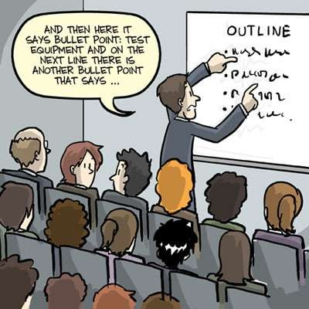
Contd.
Lack of experience.
Lack of enthusiasm.
Lack of practice.
Lack of related material.
Lack of confidence.
Hesitation.
Ambiguity in the results that you want to conclude.

Slide 27

Factors for successful presentation

Slide 28

Contd.
Be over prepared.
Rehearse and practice.
Grip on your topic.
Know your subject.
Be positive.
Avoid stress.

Slide 29

Conclusion
Always prepare
Channelize your fear
Interact with your audience

