Slide 1
B320 database project
Connor Floyd
Nicholas Vickery
Fall 2024

Slide 2
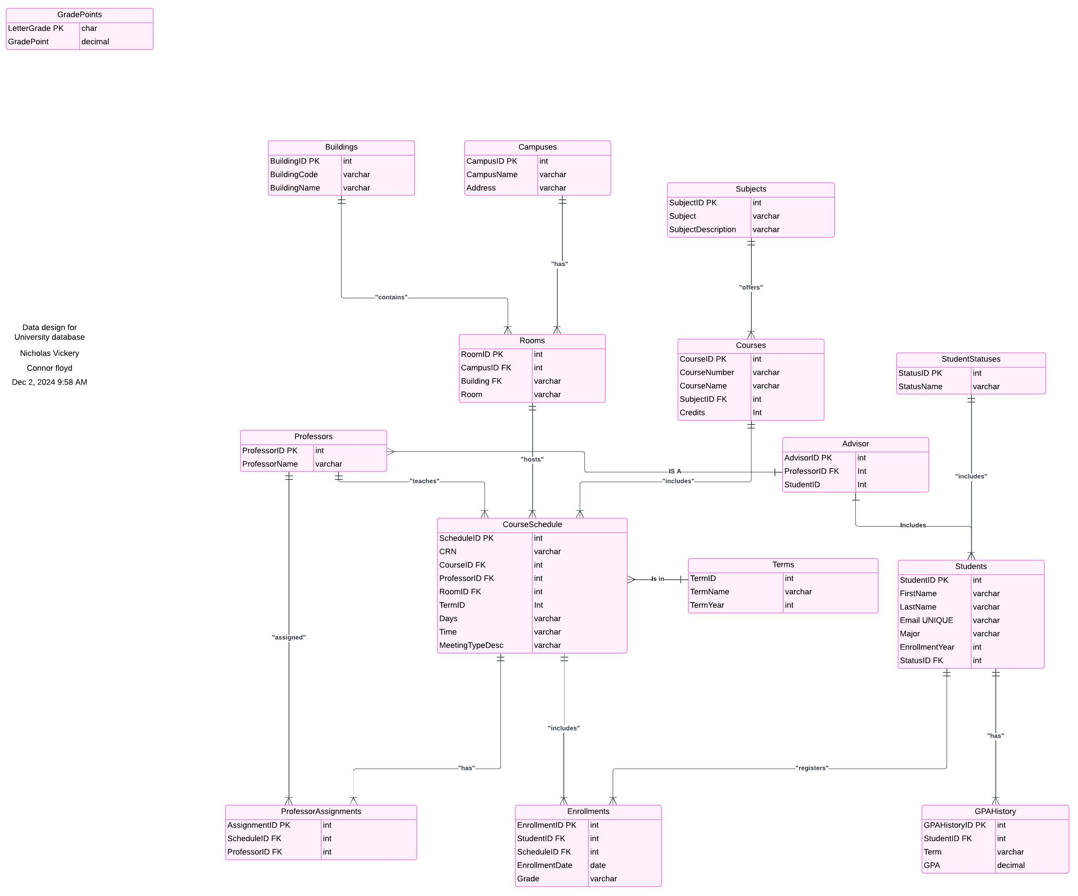
ENTITY RELATIONSHIP DIAGRAM (ERD)

Slide 3
Database script process
Excel
Python Script
SQL Inserts
SSMS Inserts
Make a column on the Excel file to concatenate columns in the format of our table inserts and fill that column.
Use a Python script to parse the inserts that are taken from the Excel column and put it into a list.
Use the Python script to replace data cells with IDs based off look-up tables that are already created and populated.
Use the structure created by this combined table to start creating or fixing tables in SSMS.
Take inserts from modified SSMS tables and replace your initial inserts.

