Slide 1
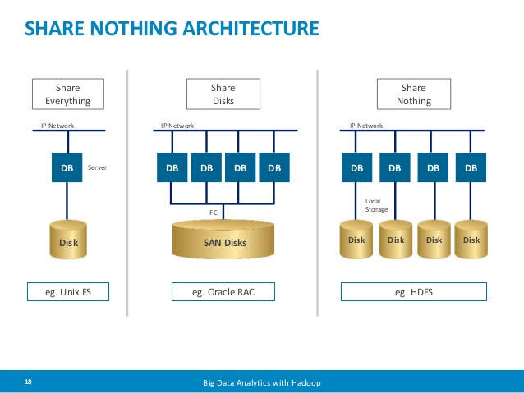
Hbase Cluster
2017.4
XenRon

Slide 2

CONTENTS
01
05
Row Key
Backup & Restore
02
Schema Design
03
API
04
Cluster & HA

Slide 3
Review
Review

Slide 4
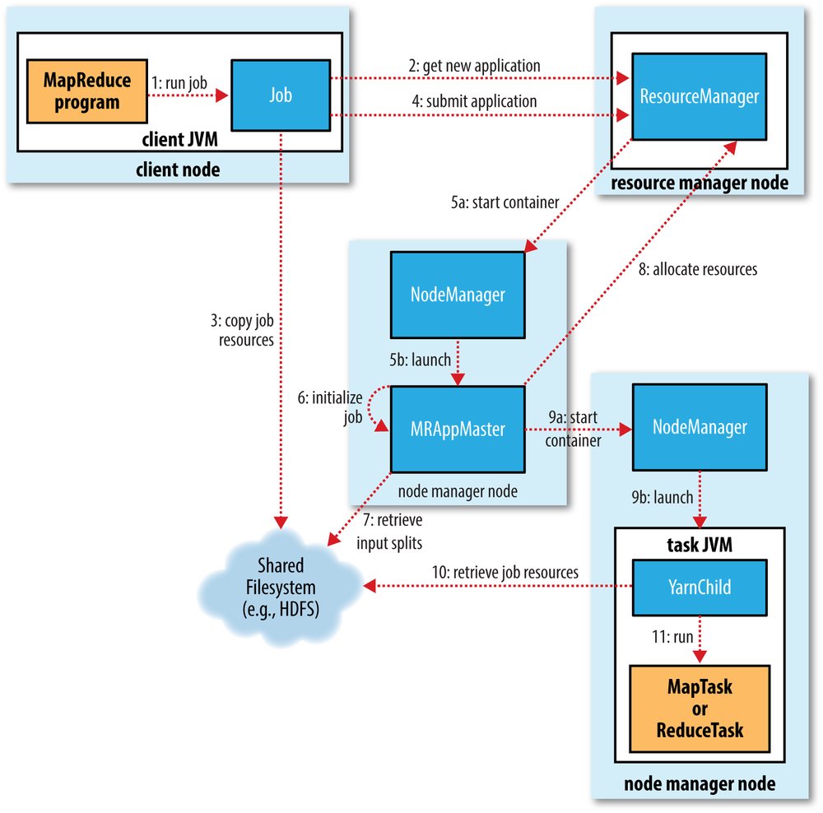
Review
Hadoop 2.x
Hadoop 1.x

Slide 5
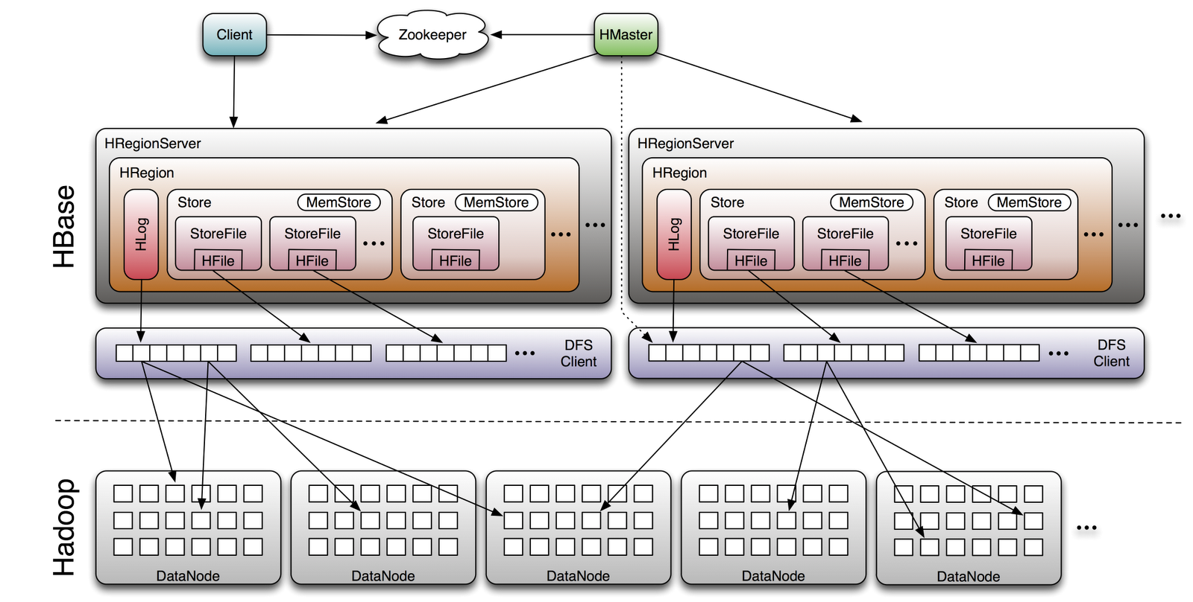
HBase

Slide 6
PART1
Row Key Type

Slide 7
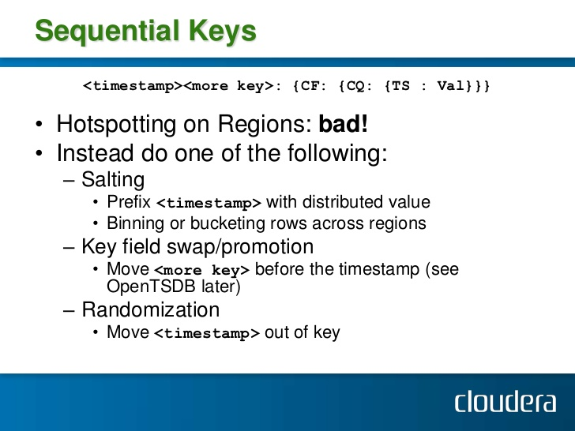
Row Key Type

Slide 8
Row Key Type

Slide 9
Row Key Type

Slide 10
Row Key Type

Slide 11
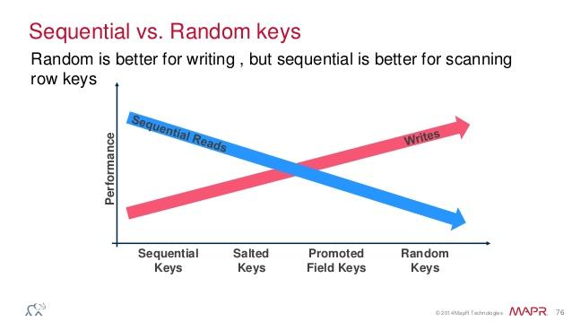
Row Key Type
https://hbase.apache.org/apidocs/org/apache/hadoop/hbase/client/Put.html
https://hbase.apache.org/apidocs/org/apache/hadoop/hbase/client/Get.html

Slide 12
PART2
Schema Design

Slide 13
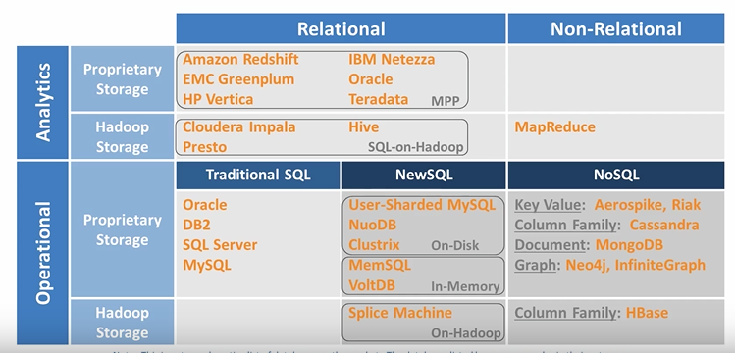
RDBMS VS NoSQL

Slide 14
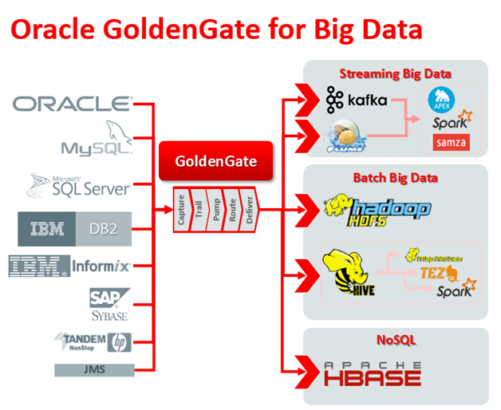
Disparate Data Sources

Slide 15
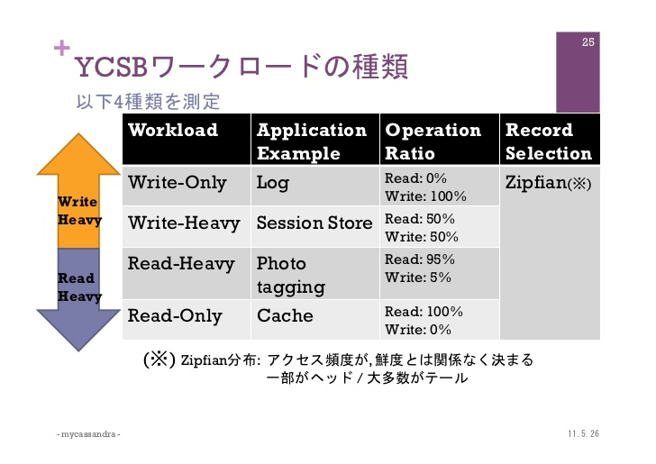
Write Heavy VS Read Heavy

Slide 16
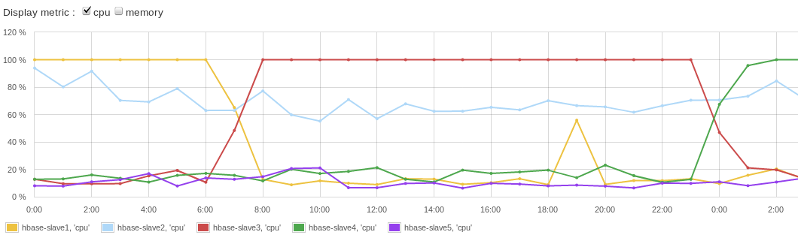
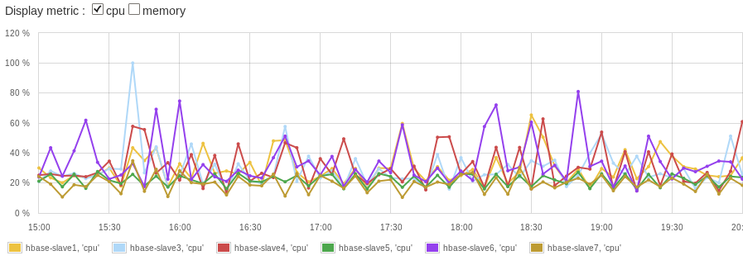
Hotspoting

Slide 17
PART3
API

Slide 18
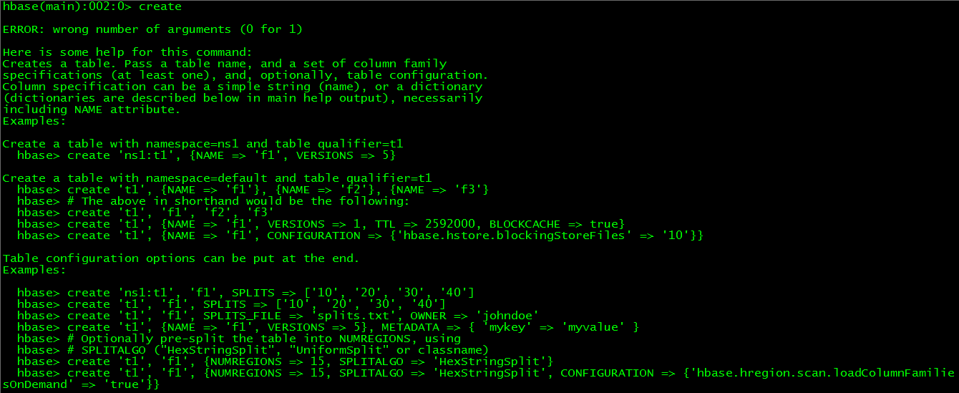
Hbase Shell

Slide 19
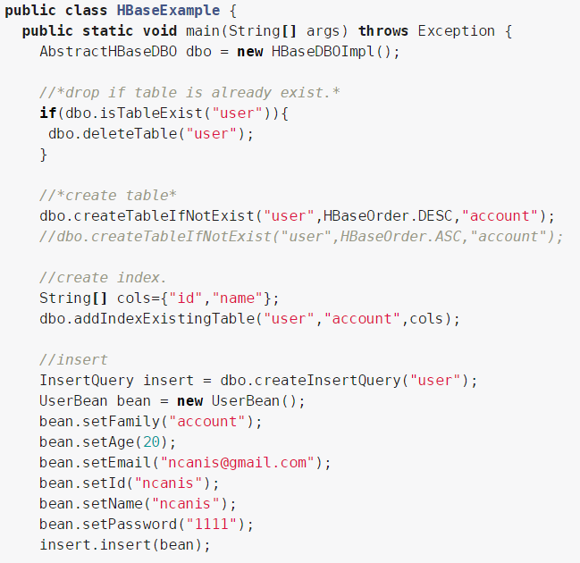
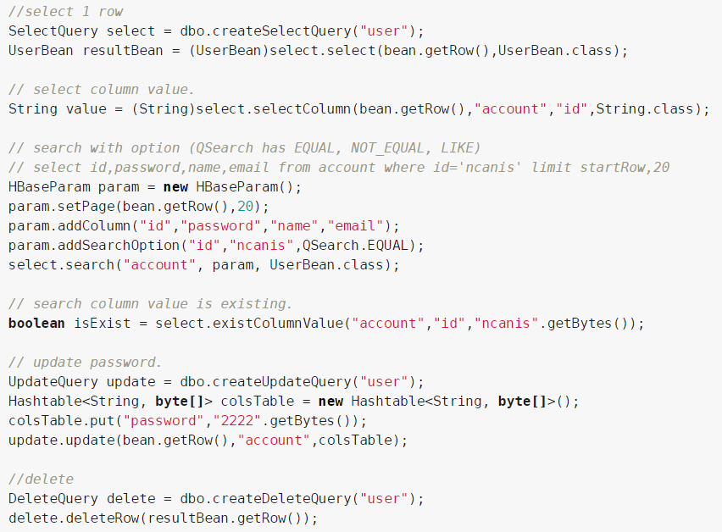
Java API
https://hbase.apache.org/book.html#jdo
https://hbase.apache.org/apidocs/index.html

Slide 20
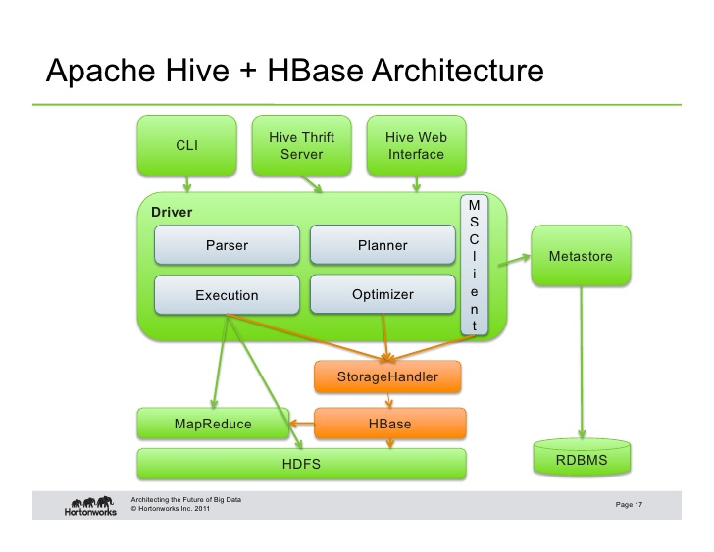
Thrift / RESTful

Slide 21
PART4
Cluster & HA

Slide 22
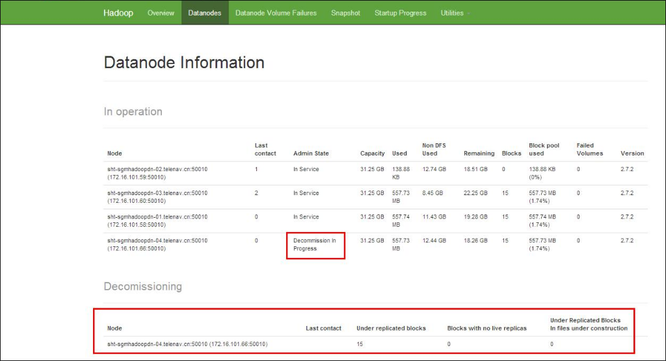
Decomission

Slide 23
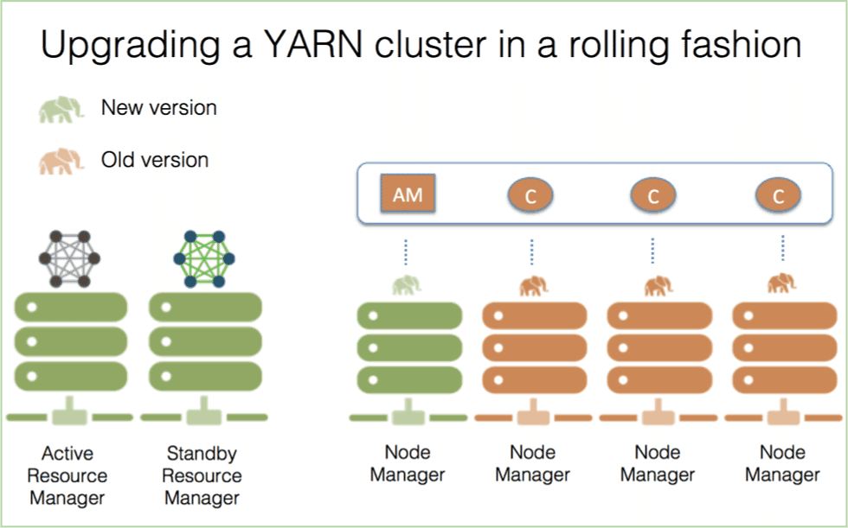
Decomission

Slide 24
PART5
Backup & Restore

Slide 25
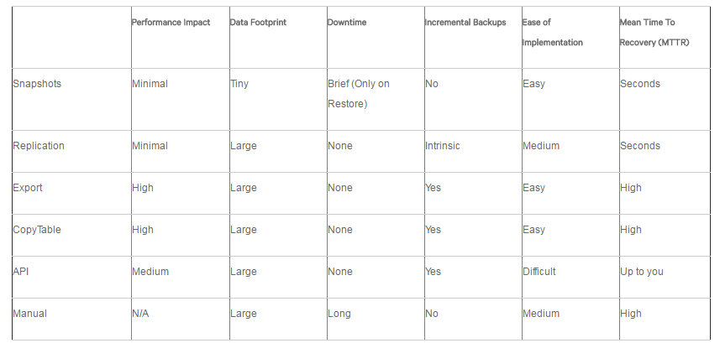
Backup & Restore

Slide 26
The End

