Slide 1
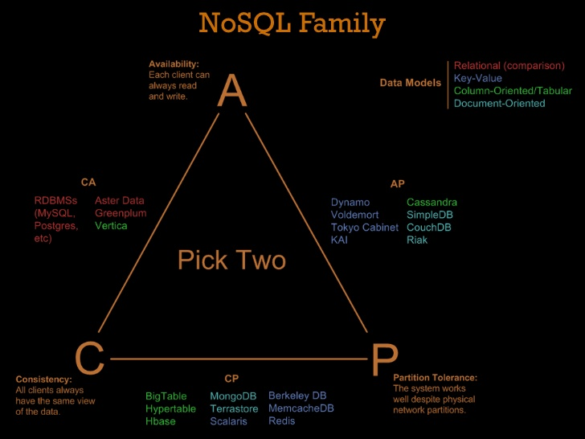
The Pilot Of HBase
2017.3
XenRon

Slide 2
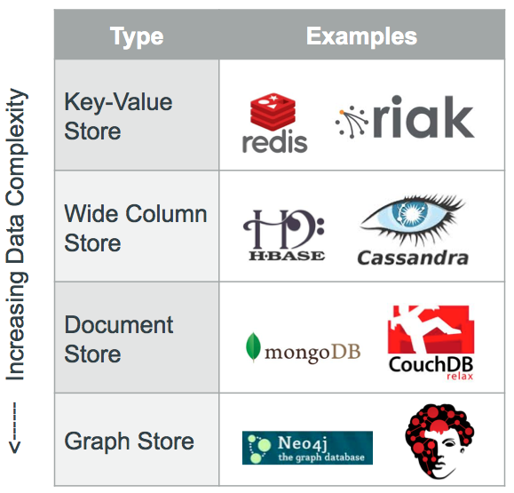
CONTENTS
01
05
NoSQL
Quick Start
02
06
HBase Origin
Reference Books
03
Architecture
04
HBase Environment

Slide 3
Review
Review

Slide 4
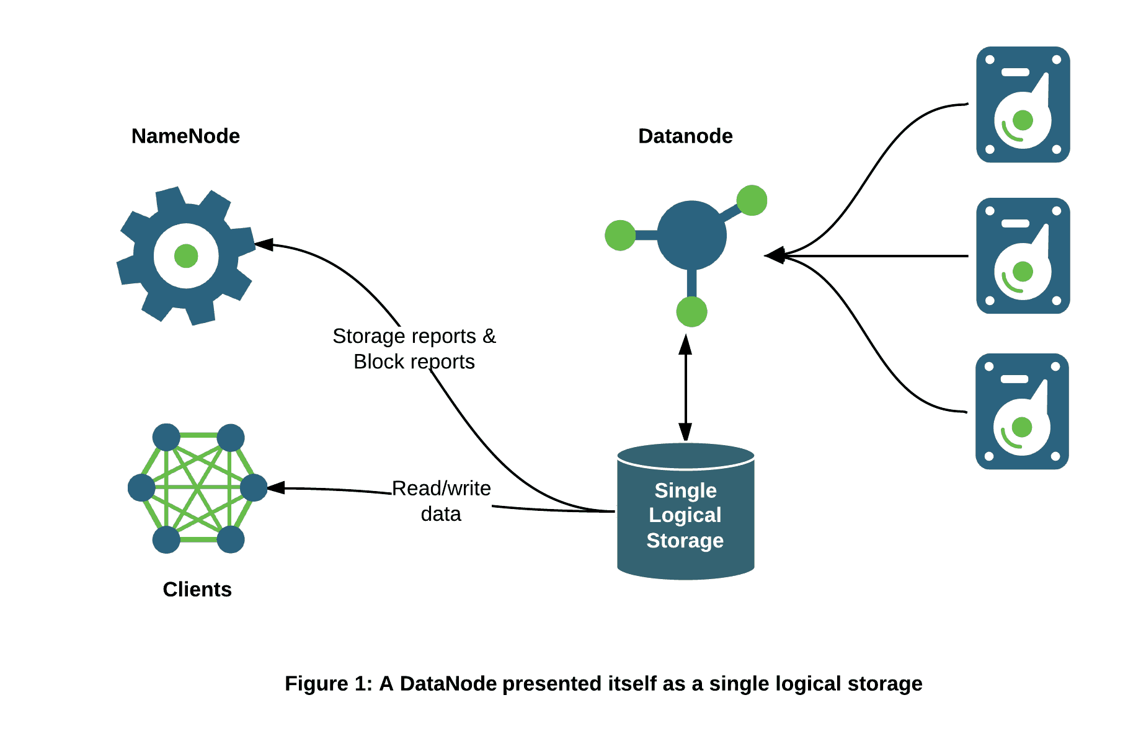
Review

Slide 5
Review

Slide 6
Review
迭代式 MapReduce
依赖关系组合式 MapReduce
链式 MapReduce
http://www.cnblogs.com/liqizhou/archive/2012/05/14/2499653.html

Slide 7
PART1
NoSQL

Slide 8
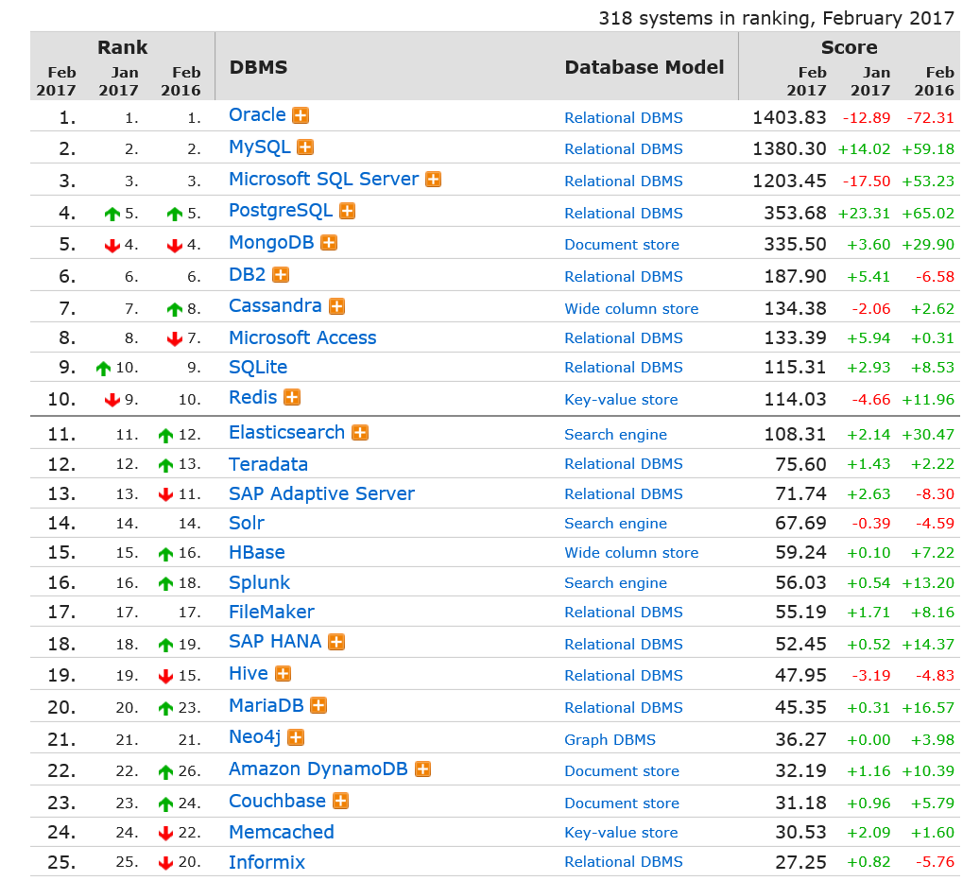
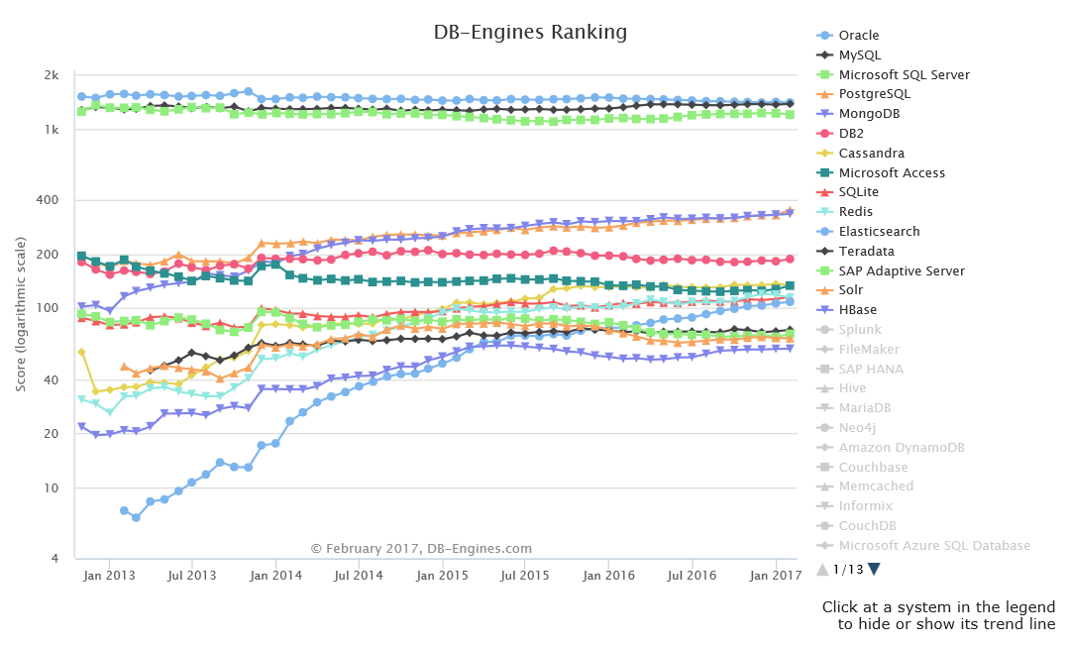
DB-Engines Ranking
http://db-engines.com/en/ranking
http://db-engines.com/en/ranking_trend

Slide 9
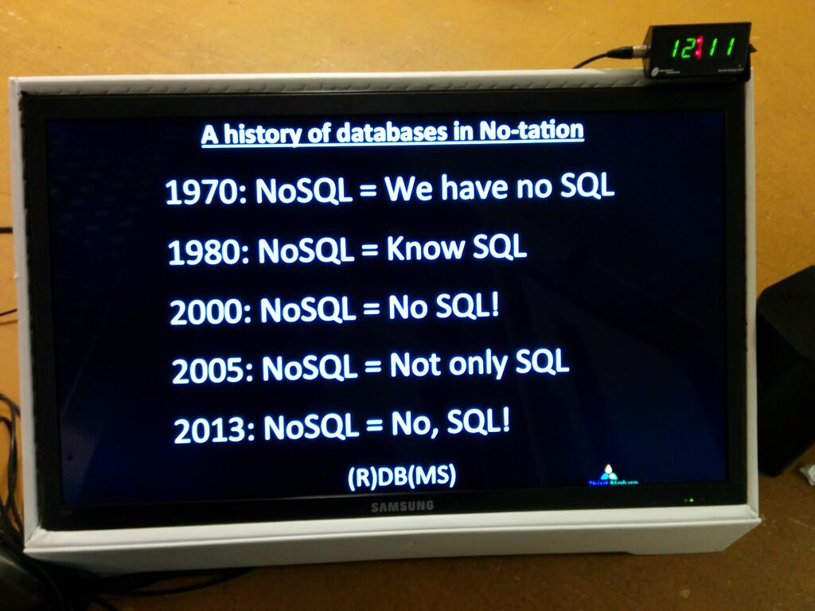
The History of SQL

Slide 10
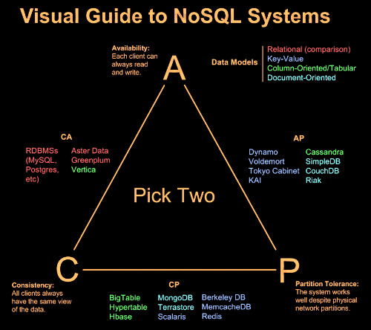
CAP Theorem
Professor Eric A. Brewer
University of California at Berkeley

Slide 11
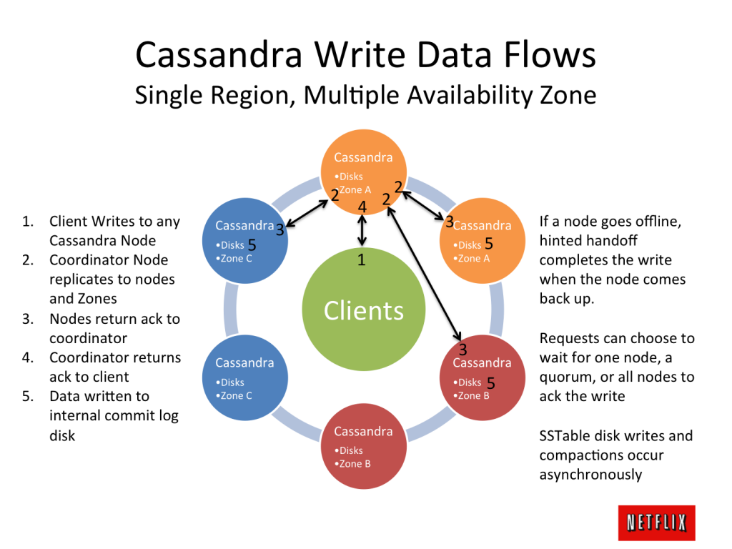
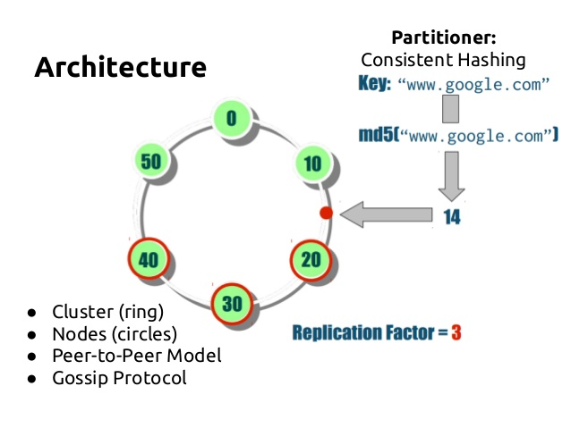
Cassandra

Slide 12

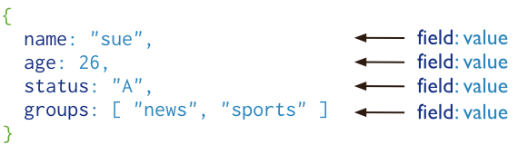
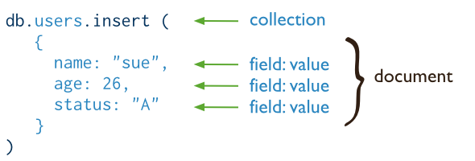
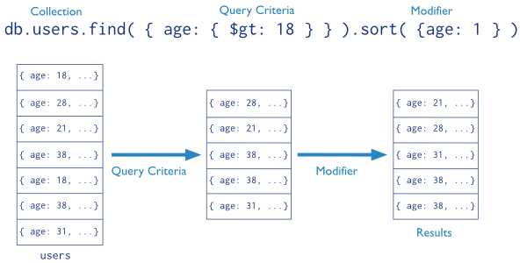
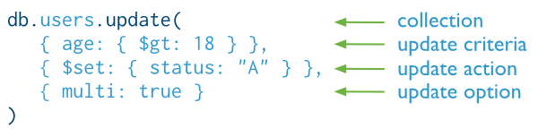
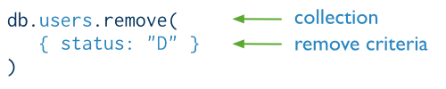
MongoDB
Official Website : https://www.mongodb.org/
The latest stable Release : v3.0.4

Slide 13
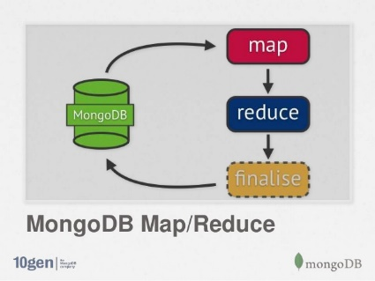
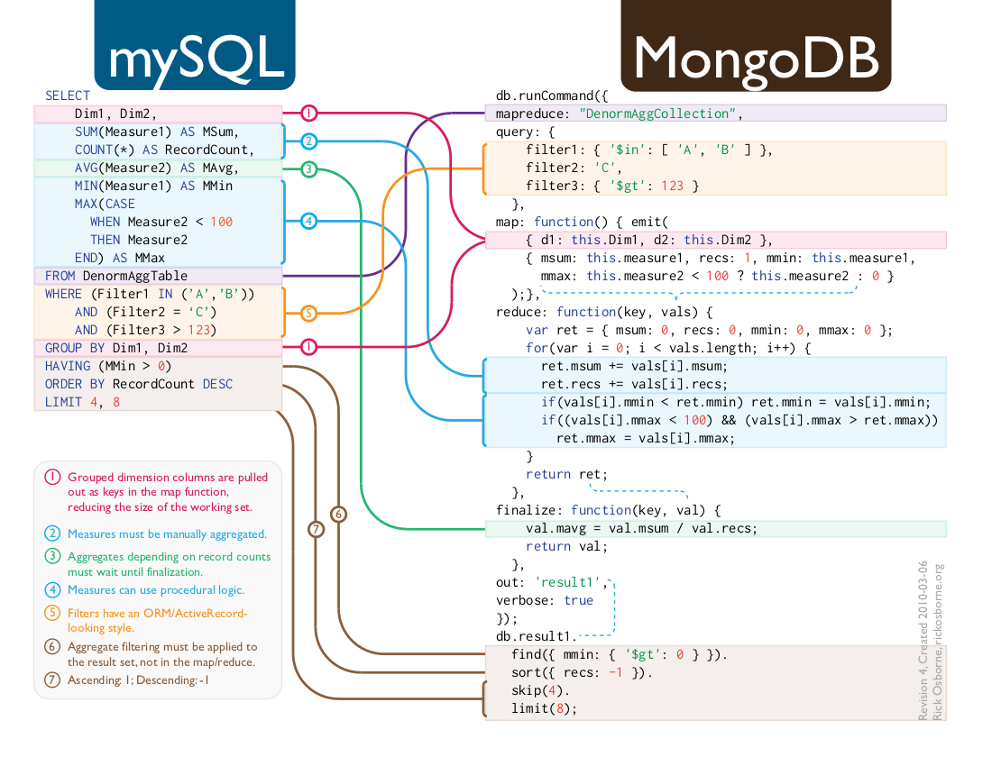
MongoDB

Slide 14
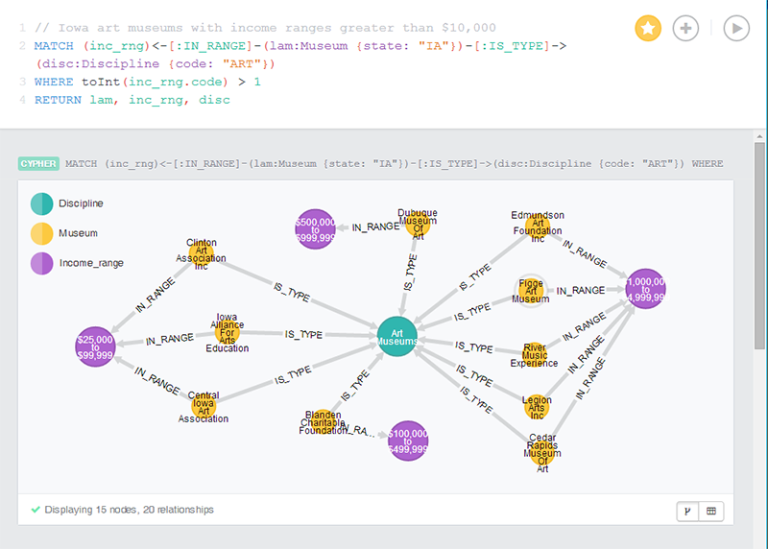
Neo4j
http://neo4j.com/docs/stable/cypher-query-lang.html
Notes:
Neo4j-Twitter-Graph-Visualization

Slide 15
PART2
Hbase Origin

Slide 16
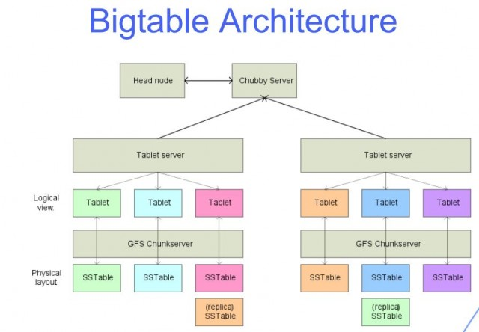
BigTable
https://research.google.com/archive/bigtable.html

Slide 17
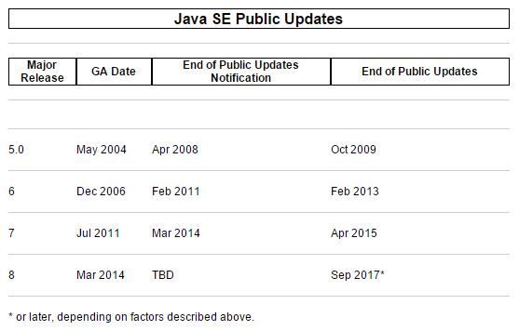

Java
http://www.oracle.com/technetwork/java/eol-135779.html

Slide 18
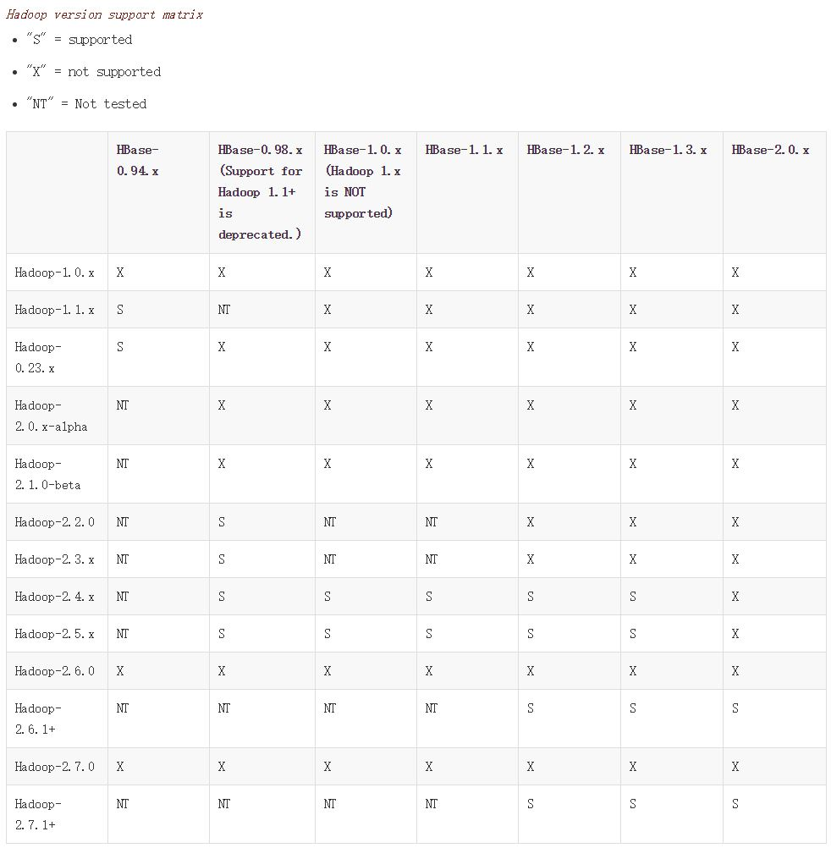
HBase Versions
https://hbase.apache.org/book.html#hadoop

Slide 19
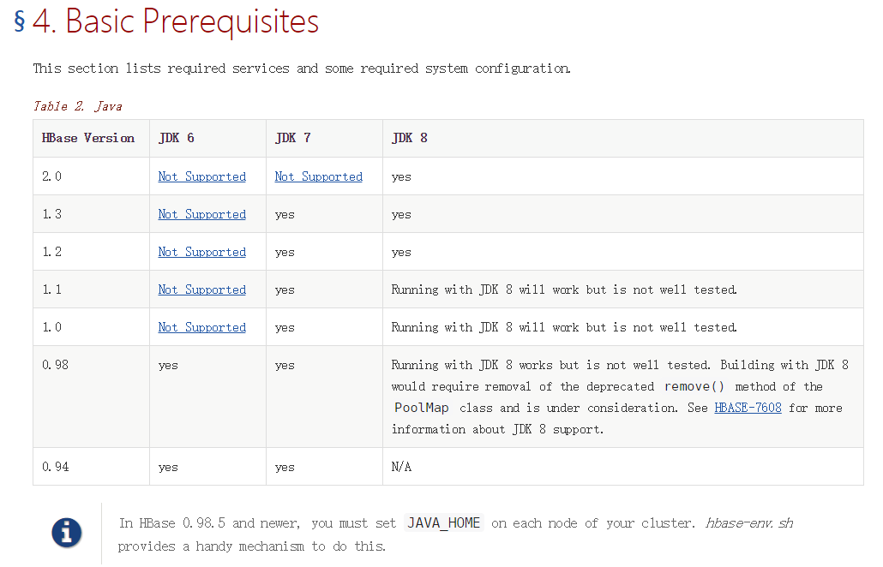
HBase Versions
https://hbase.apache.org/book.html

Slide 20
PART3
architecture

Slide 21
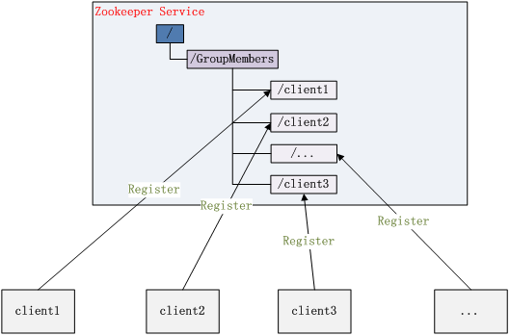
architecture

Slide 22
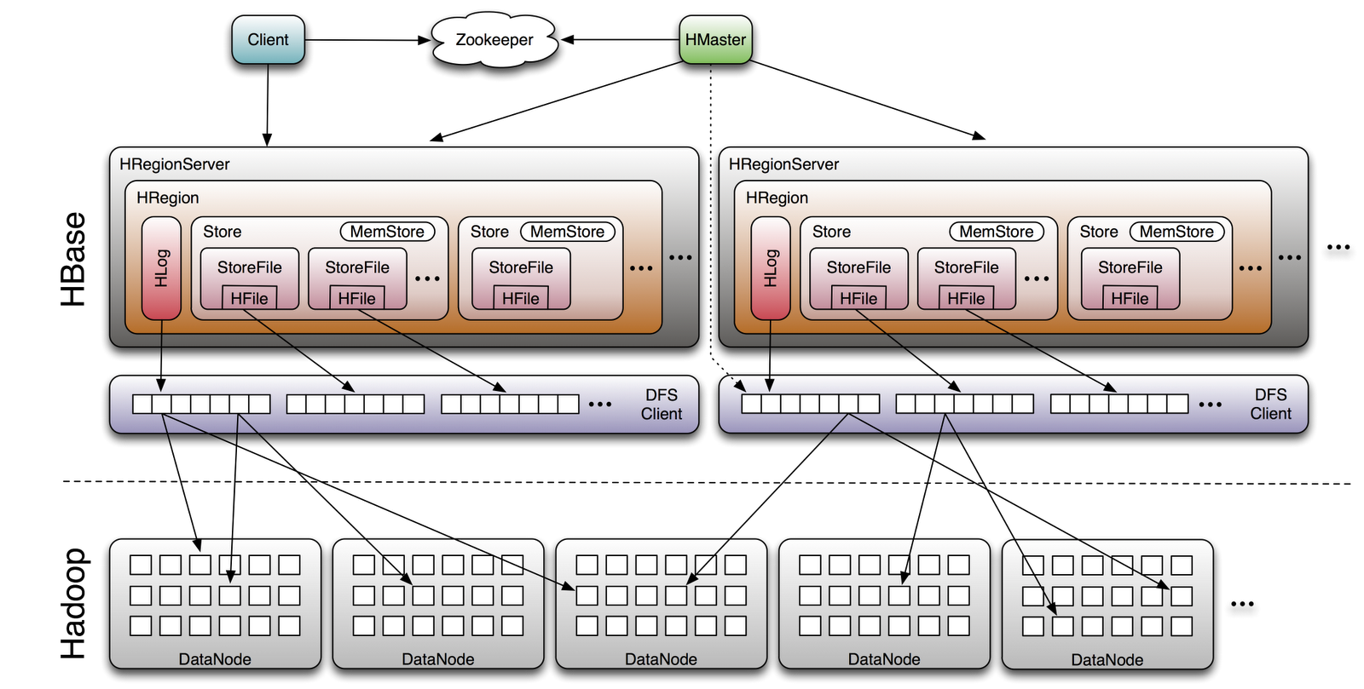
architecture

Slide 23
architecture

Slide 24
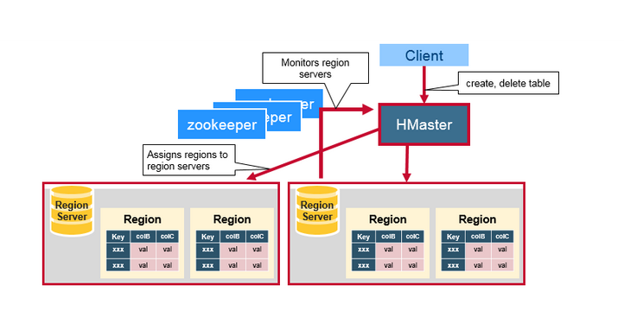
architecture

Slide 25
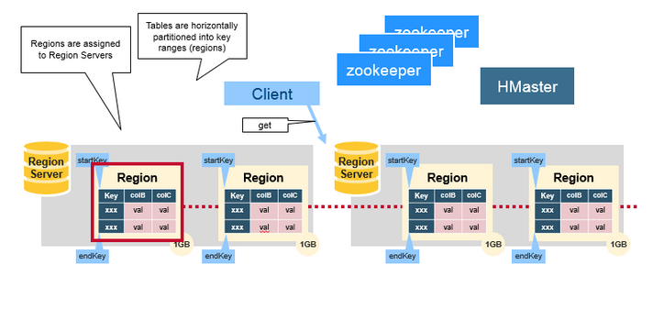
architecture

Slide 26
PART4
HBase Environment

Slide 27
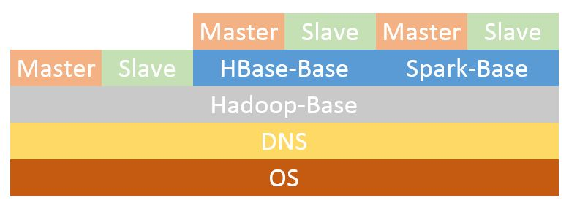
Docker

Slide 28
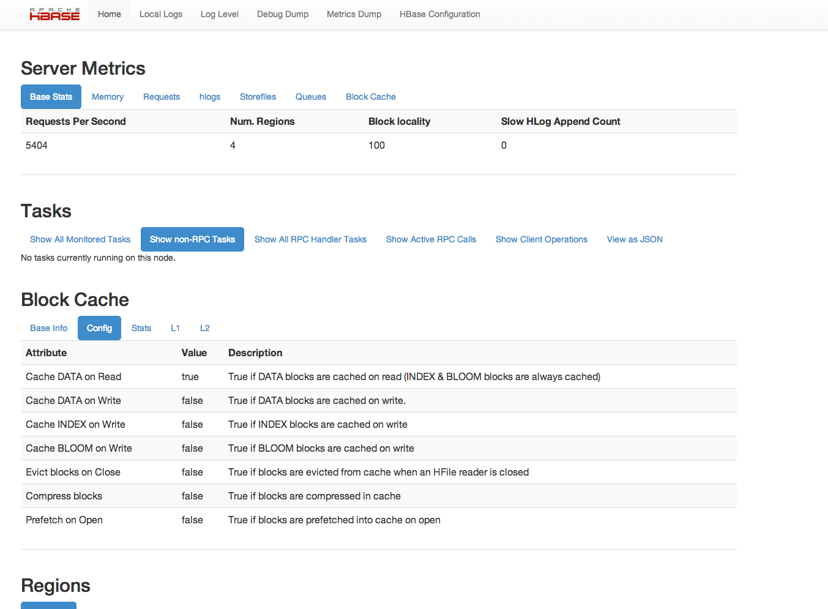
Web UI

Slide 29
PART5
Quick Start

Slide 30
Quick Start

Slide 31
Quick Start
hbase(main):0xx:0>status
hbase(main):0xx:0>version
hbase(main):0xx:0>create 'member','member_id','address','info'
hbase(main):0xx:0>list
hbase(main):0xx:0>describe 'member‘
https://hbase.apache.org/book.html

Slide 32
PART6
Reference Books

Slide 33
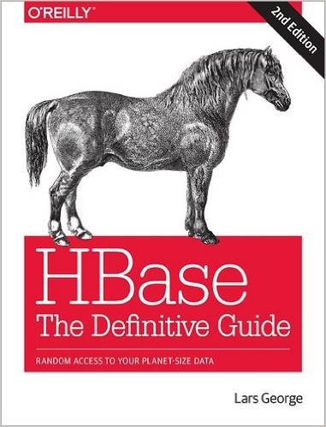
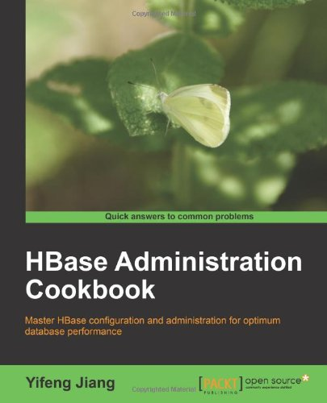
Books

Slide 34
The End

