Slide 1
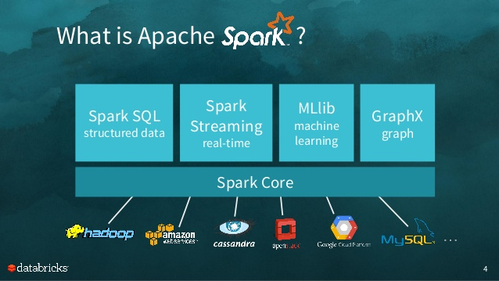
The Pilot Of Spark
2017.4
XenRon
http://spark.apache.org/docs/latest/

Slide 2

CONTENTS
01
Preliminary Topics
02
Spark Environment
03
Spark Architecture
04
Spark RDD

Slide 3
chew the fat

Slide 4
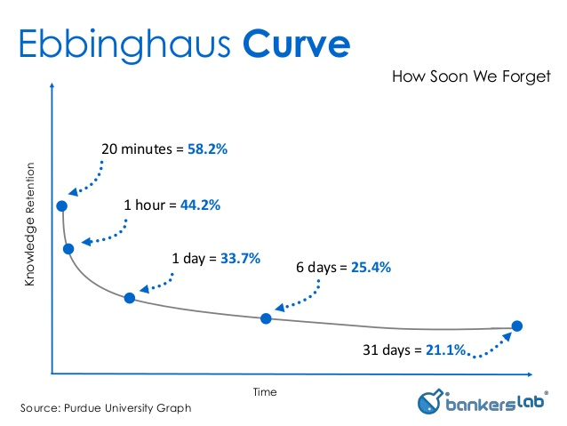
Forgetting Curve
Hermann Ebbinghaus

Slide 5
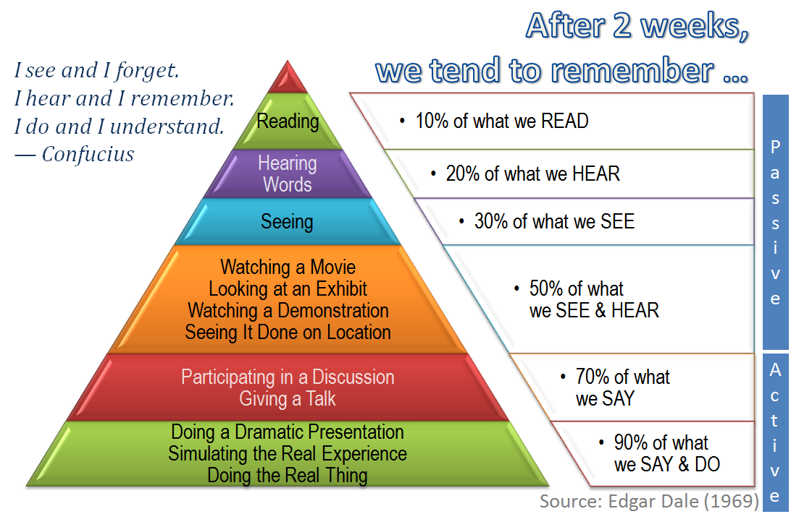
The Cone Of Learning

Slide 6
Review
Review

Slide 7
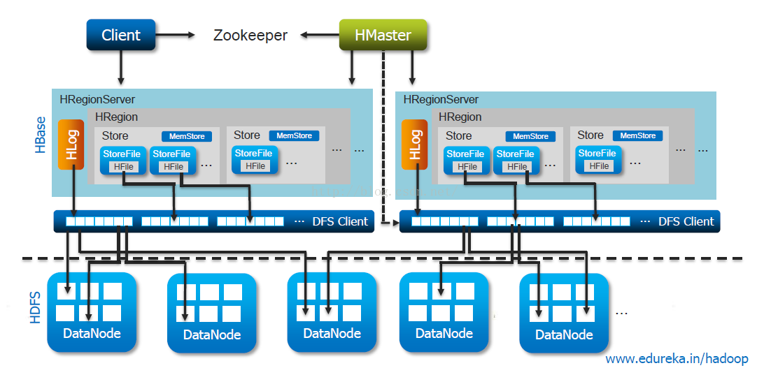
Zookeeper

Slide 8
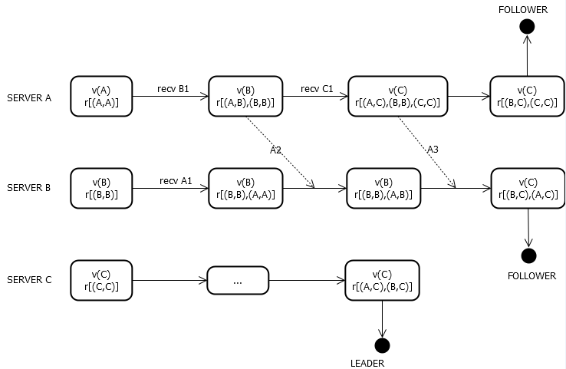
Zookeeper

Slide 9
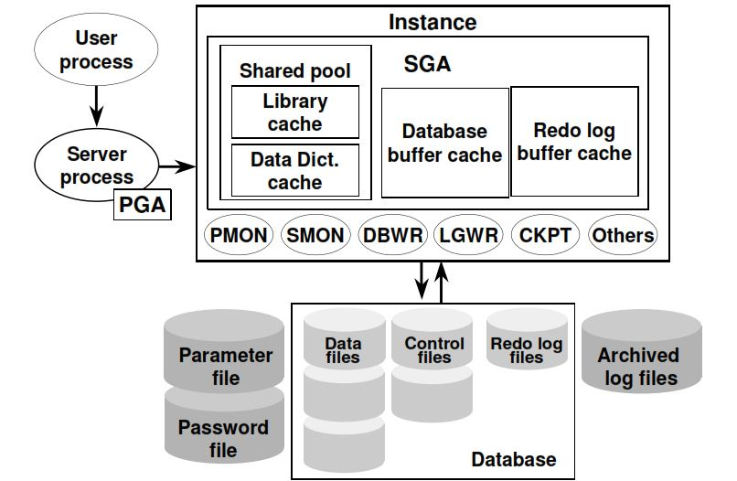
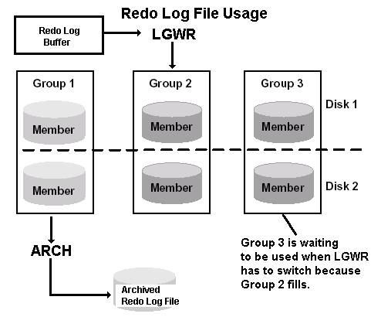
Oracle’s log

Slide 10
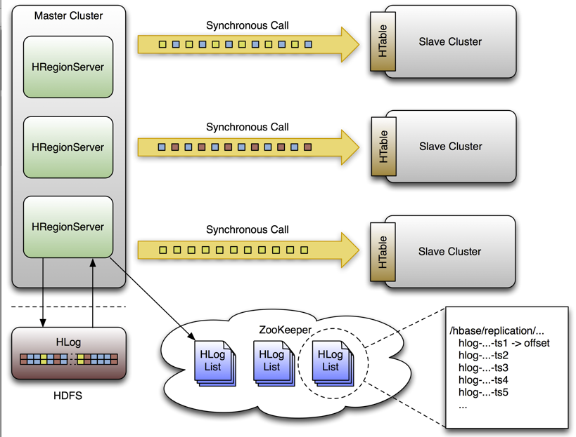
Review

Slide 11
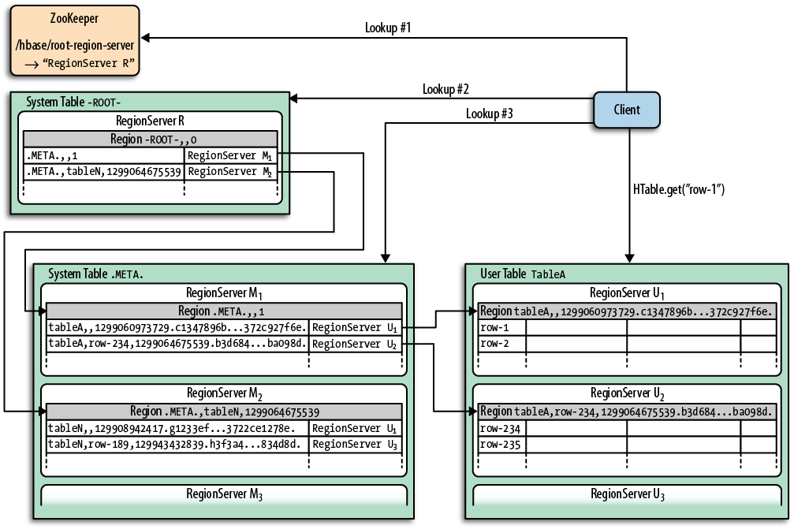
Review

Slide 12
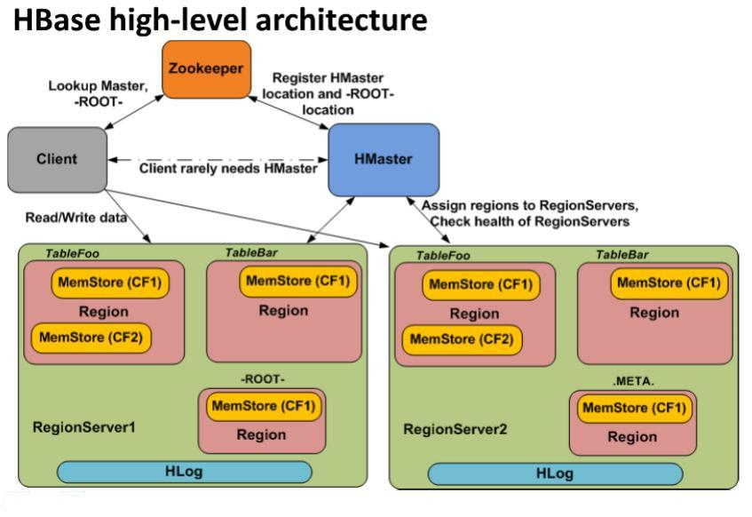
Review

Slide 13
PART1
Preliminary Topics
事前準備

Slide 14
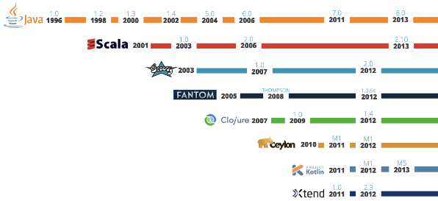
JVM

Slide 15
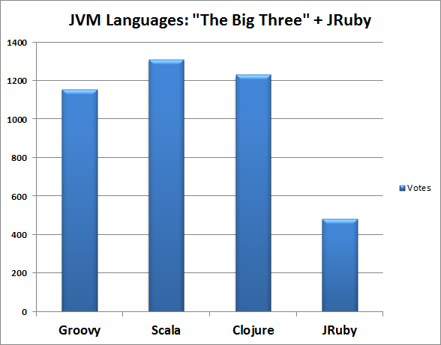
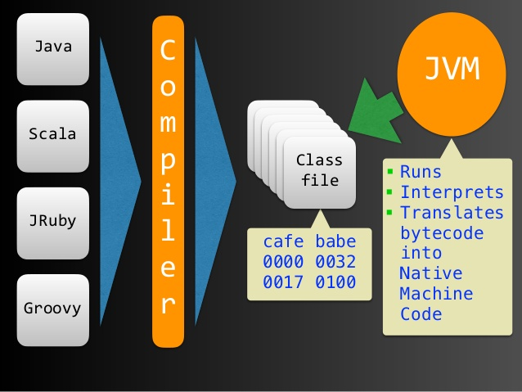
Big Three

Slide 16
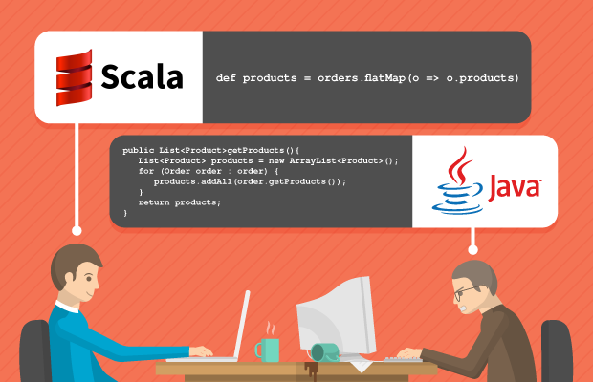
Scala

Slide 17
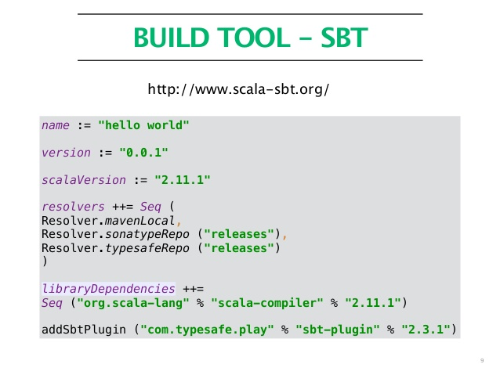
Sbt

Slide 18
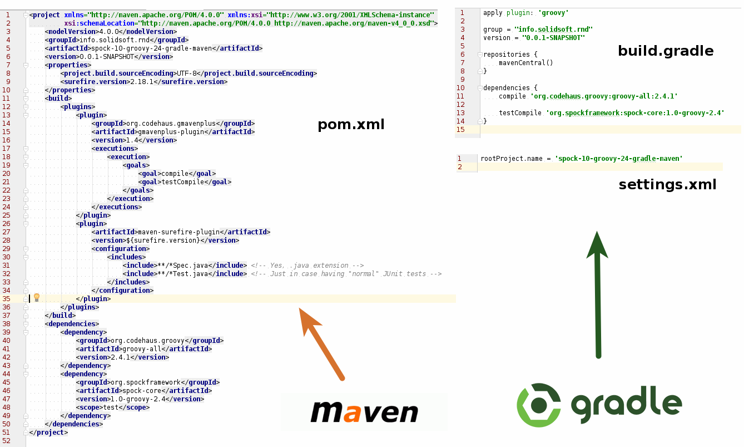
Sbt

Slide 19
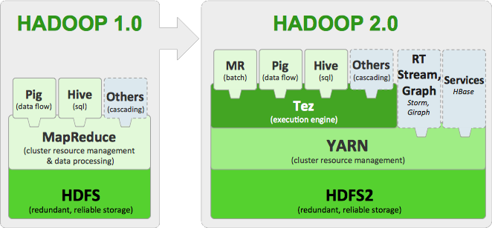
Yarn

Slide 20
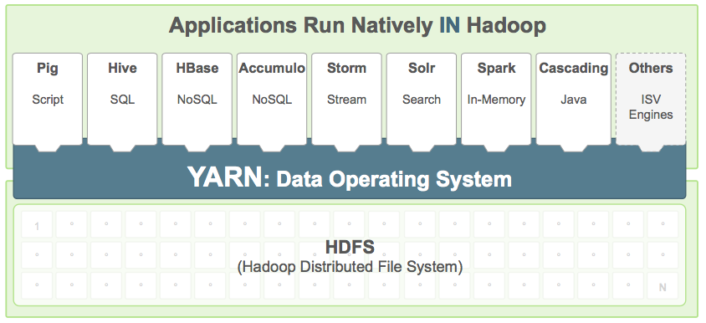
Yarn

Slide 21
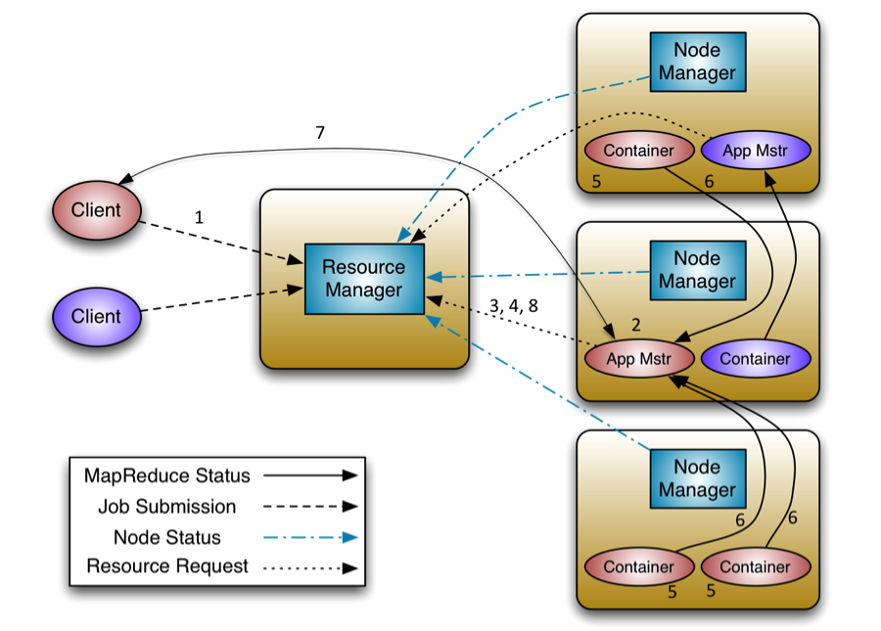
Yarn
https://hadoop.apache.org/docs/stable/hadoop-yarn/hadoop-yarn-site/WritingYarnApplications.html

Slide 22
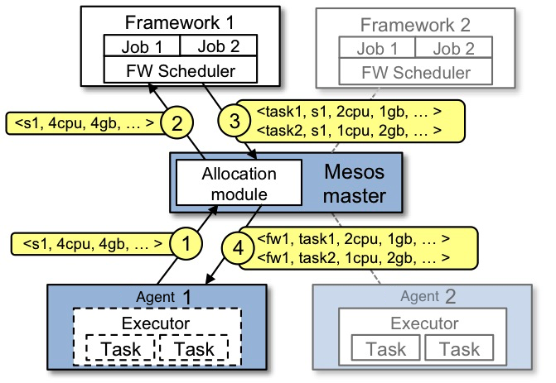
Mesos

Slide 23
PART2
Spark Environment

Slide 24
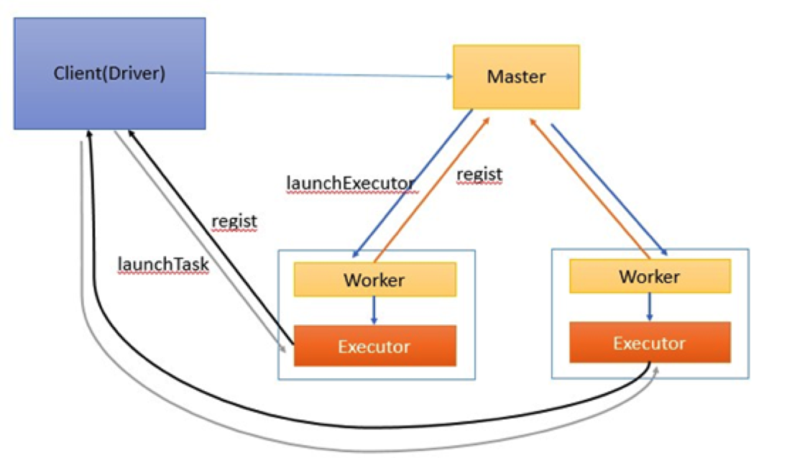
Spark Standalone

Slide 25
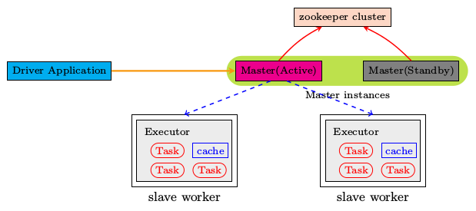
Spark Standalone HA

Slide 26
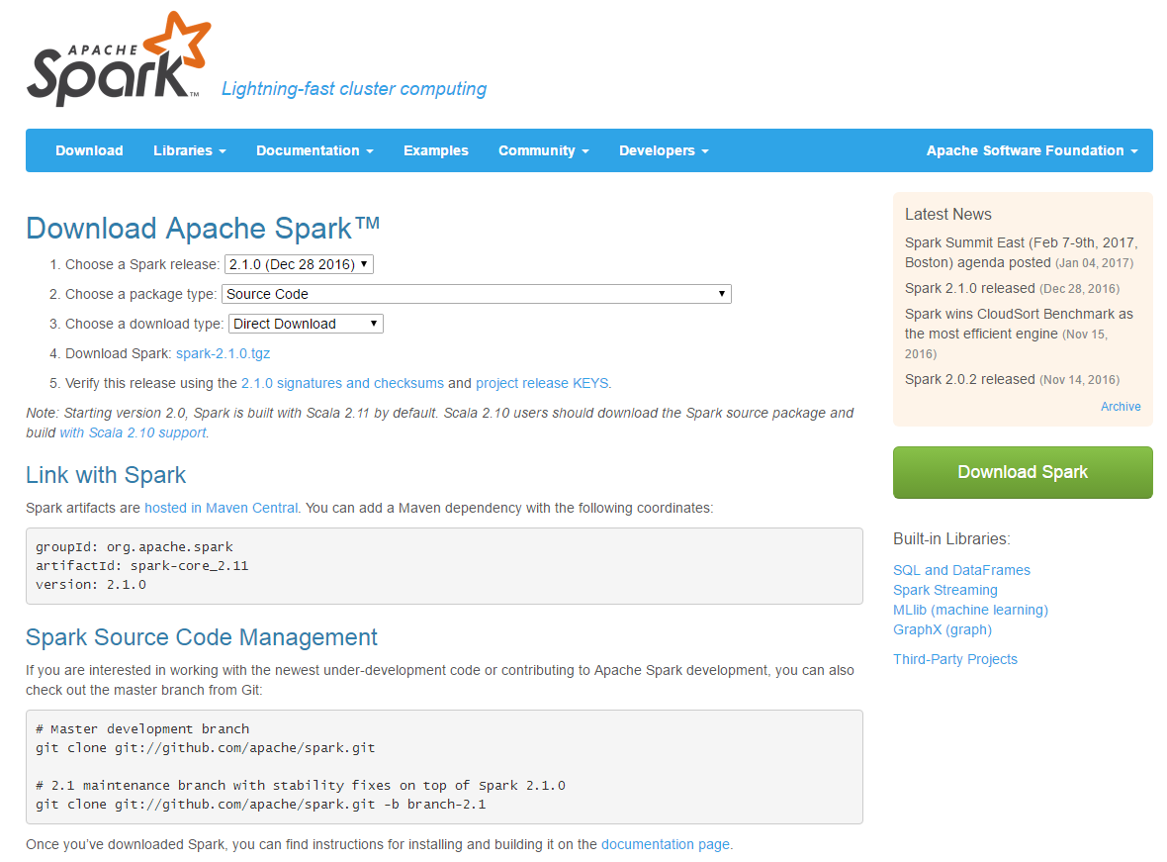
Spark Source Compile

Slide 27
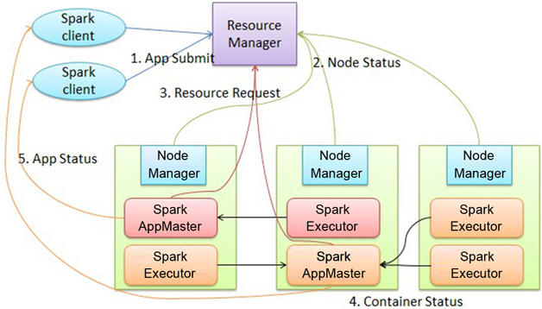
Spark On Yarn

Slide 28
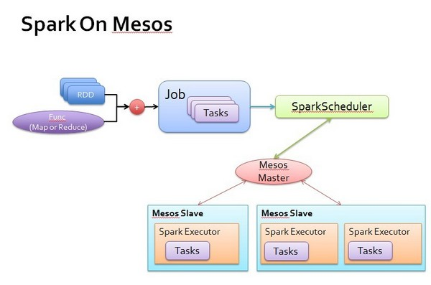
Spark On Mesos

Slide 29
PART3
Spark Architecture

Slide 30
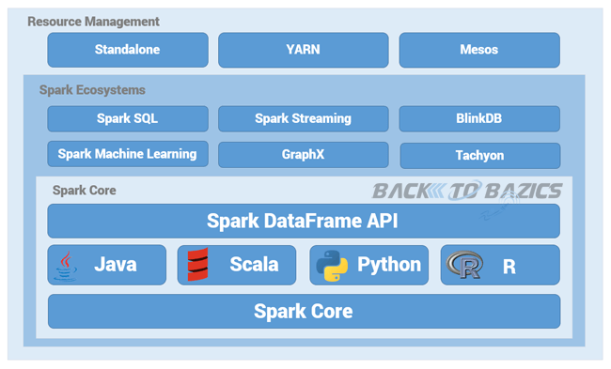
Ecosystems

Slide 31
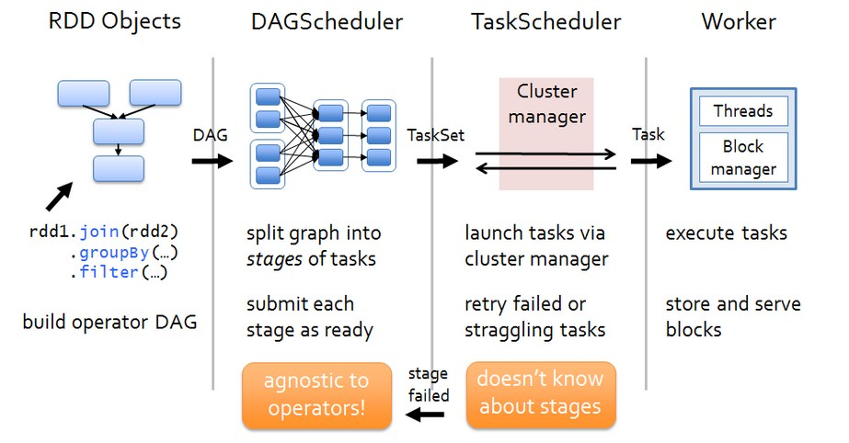
Architecture

Slide 32
PART4
Spark RDD

Slide 33
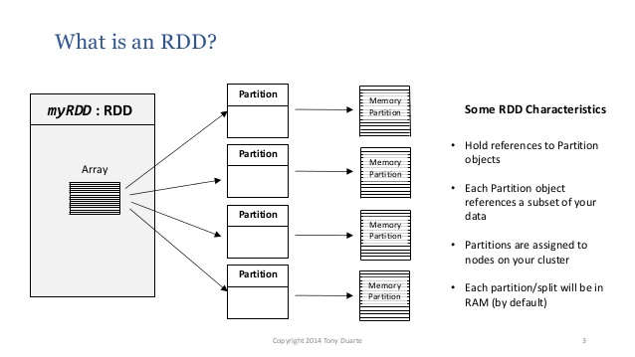
RDD

Slide 34
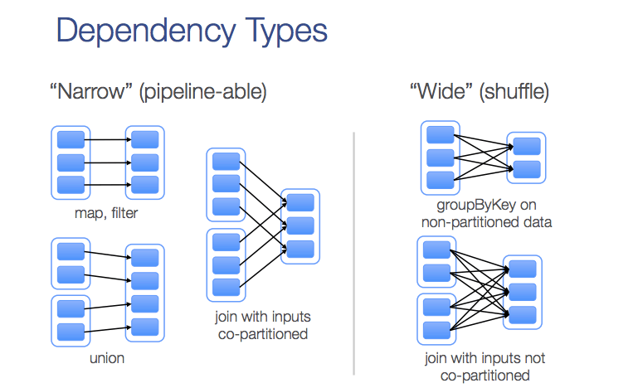
Dependency Type

Slide 35
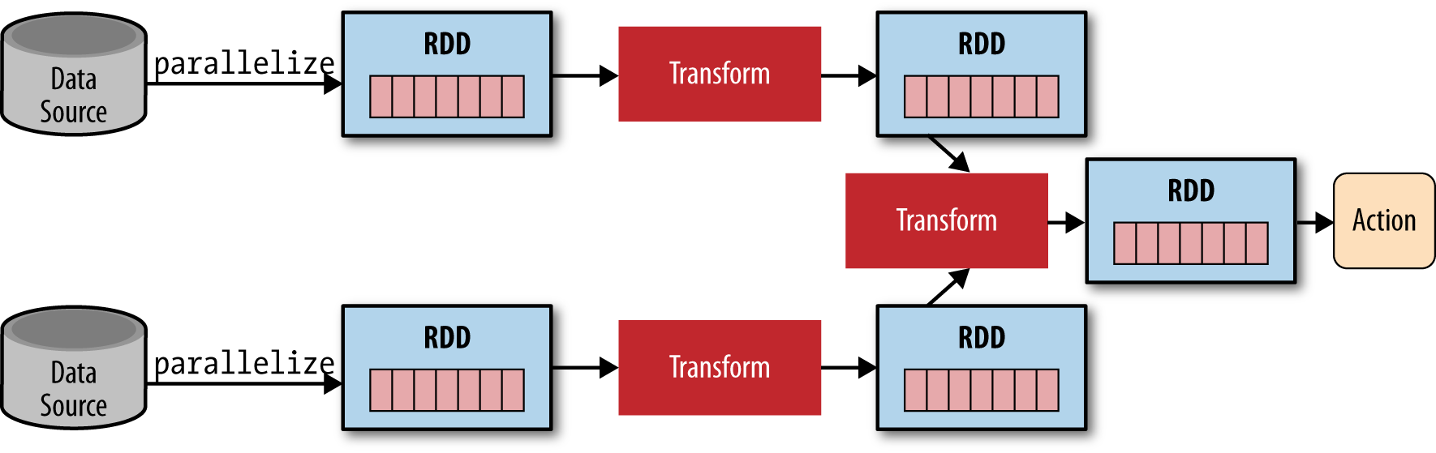
Dependency Type

Slide 36
The End

