Slide 1

Spark Computational Model
2017.4
XenRon

Slide 2
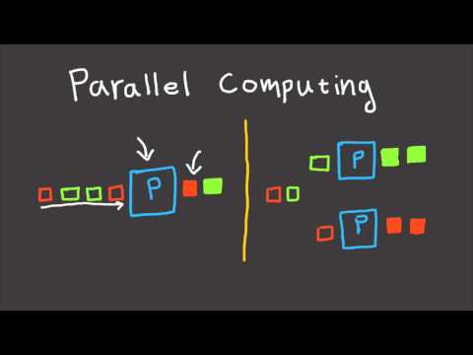
CONTENTS
01
Spark RDD
02
Parallel Computing
03
Computational Model
04
Spark SQL

Slide 3
Review
Review

Slide 4
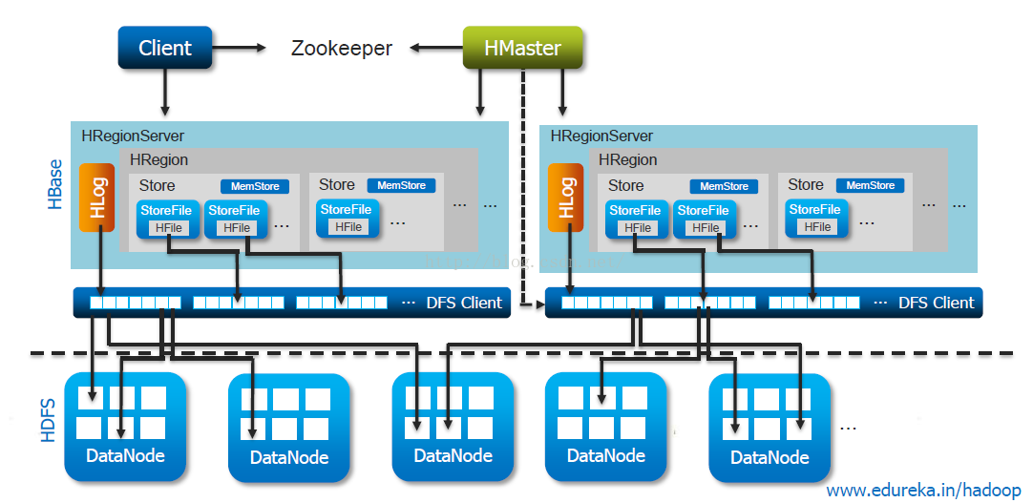
HBase

Slide 5
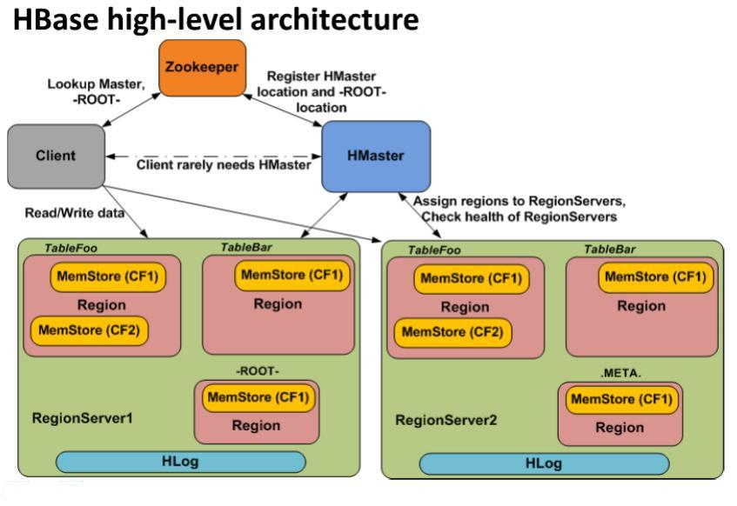
HBase

Slide 6
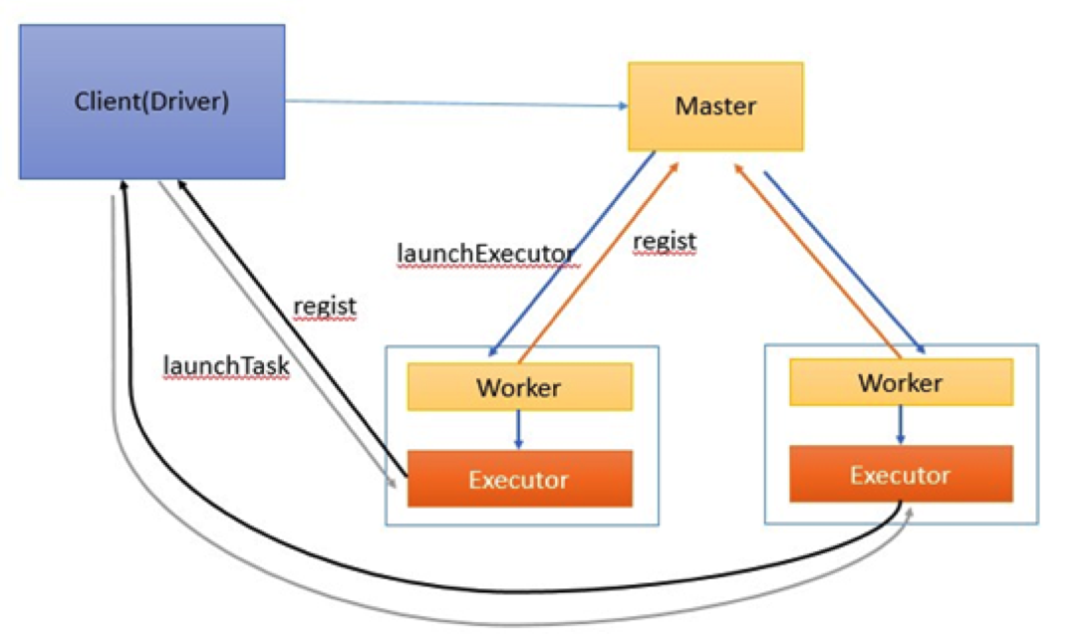
Spark Standalone

Slide 7
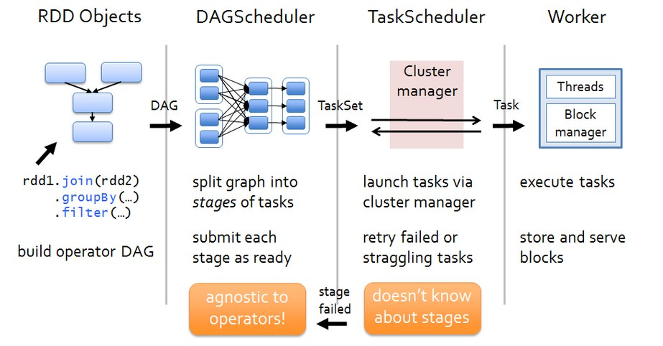
Architecture

Slide 8
PART1
Spark RDD

Slide 9
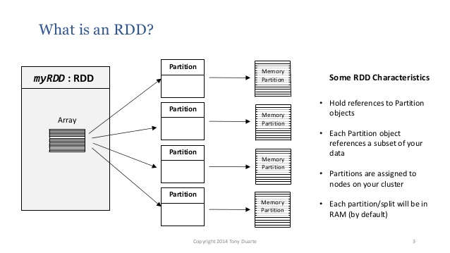
RDD

Slide 10
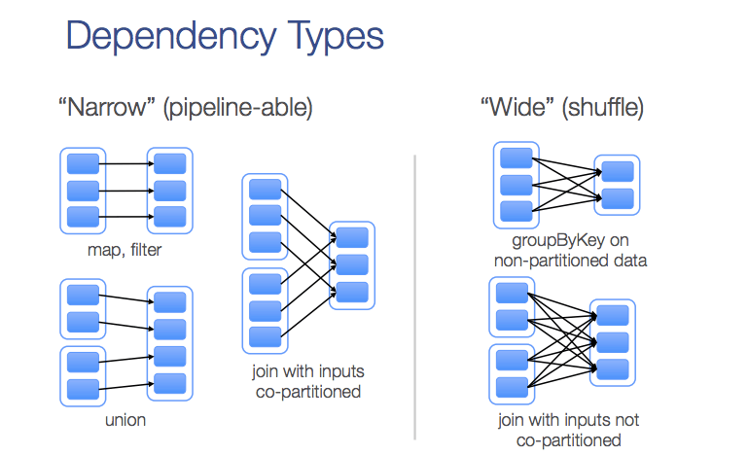
Dependency Type

Slide 11
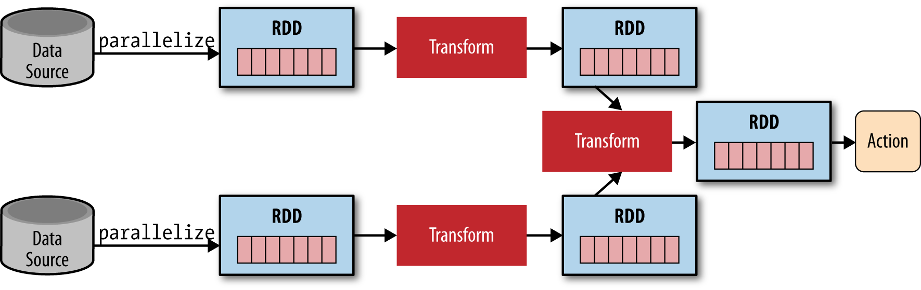
Dependency Type

Slide 12
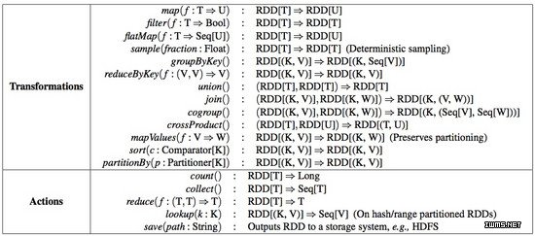
Example

Slide 13
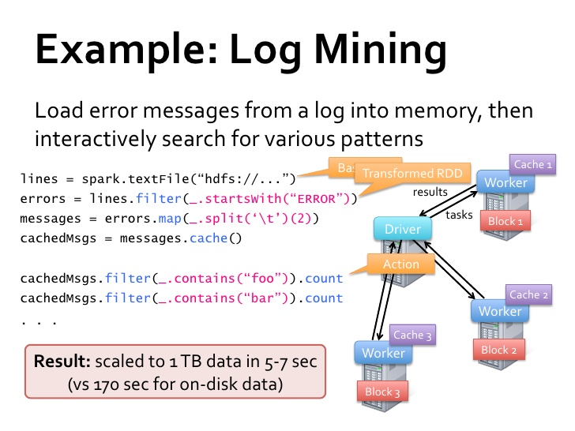
Example

Slide 14
PART2
Parallel Computing

Slide 15
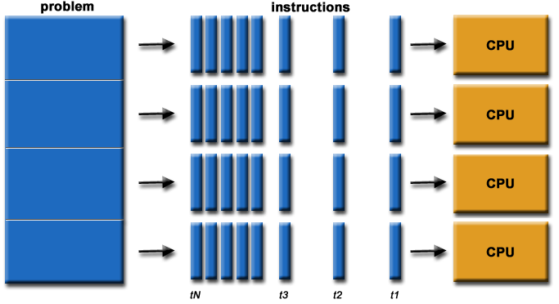
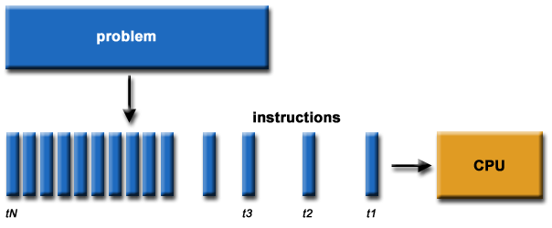
Parallel Computing

Slide 16



Parallel Computing

Slide 17
PART3
Computational Model

Slide 18
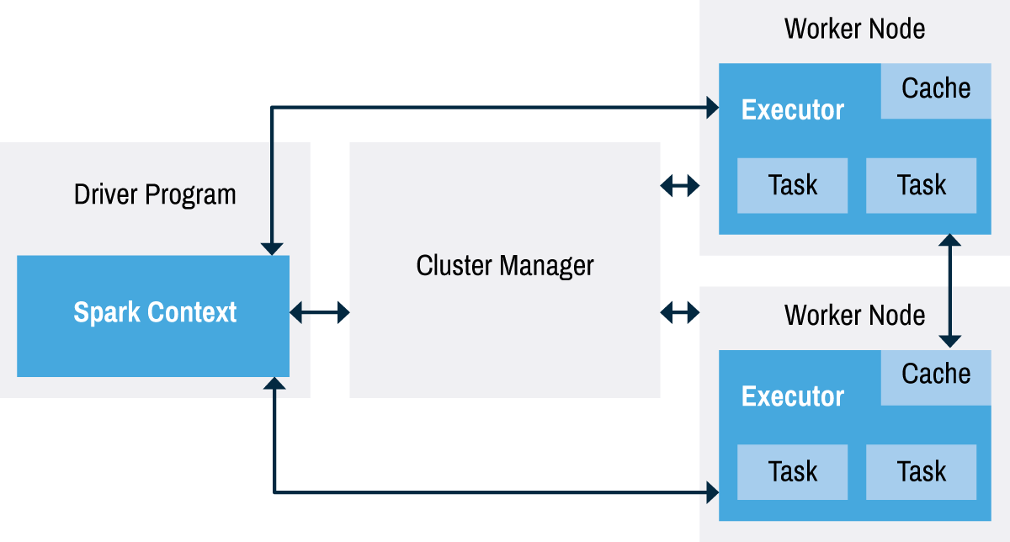
Driver
Executor
Application

Slide 19
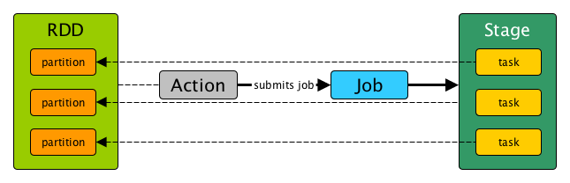
Job

Slide 20
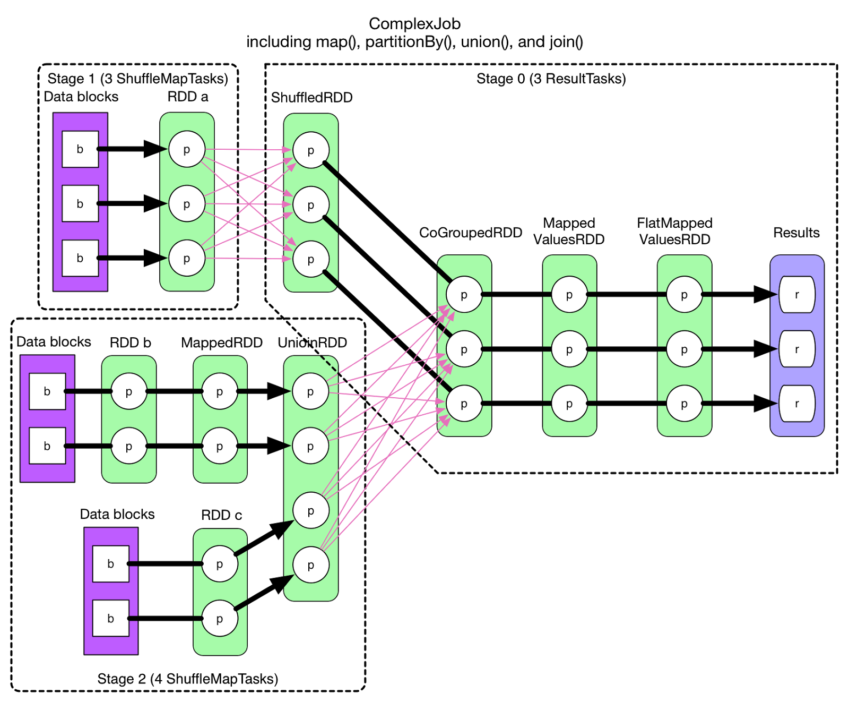
Stage

Slide 21
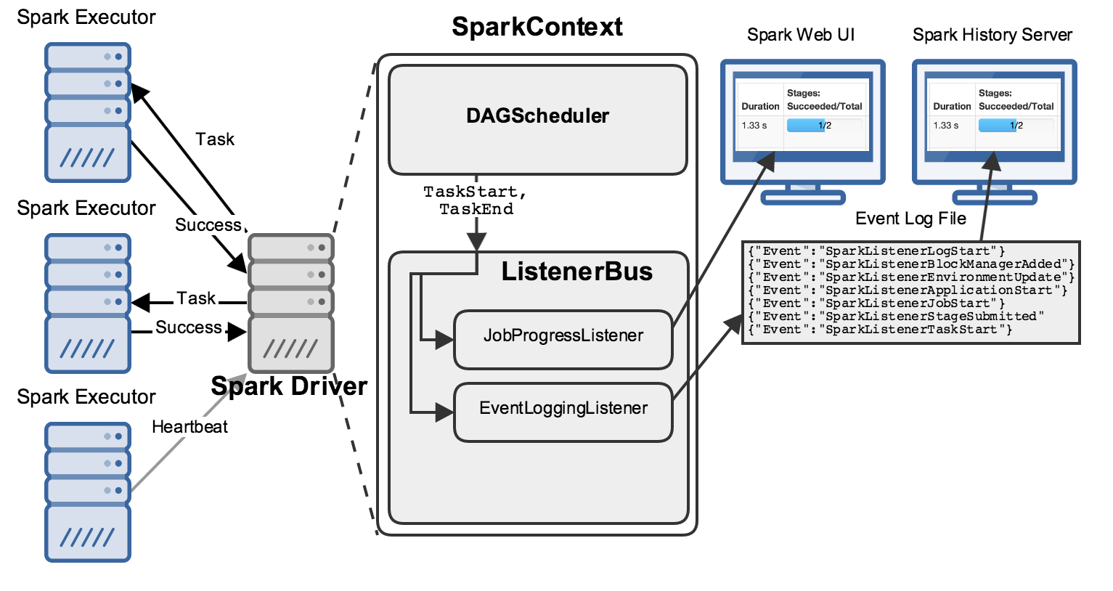
Architecture

Slide 22
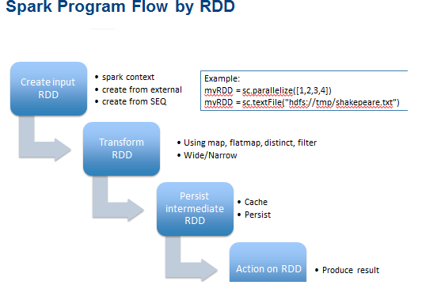
Persist & Cache

Slide 23
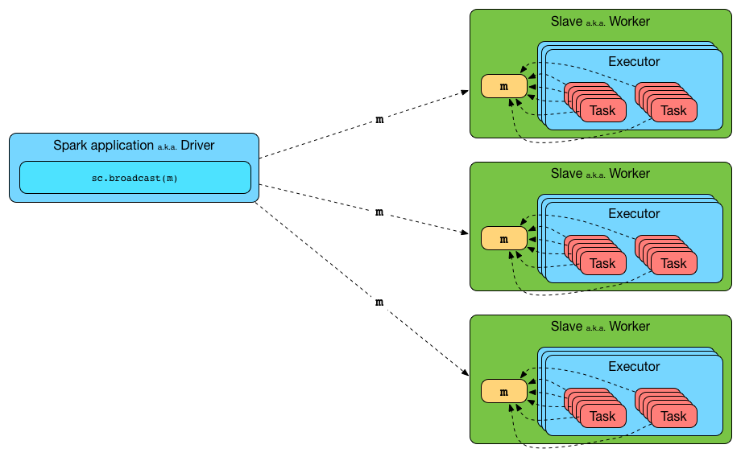
Broad Cast

Slide 24
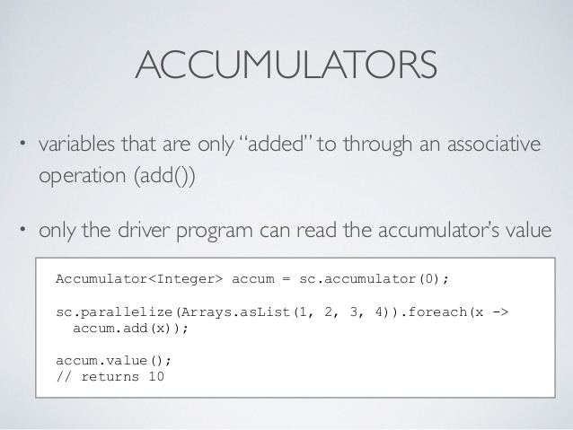
Accumulators

Slide 25
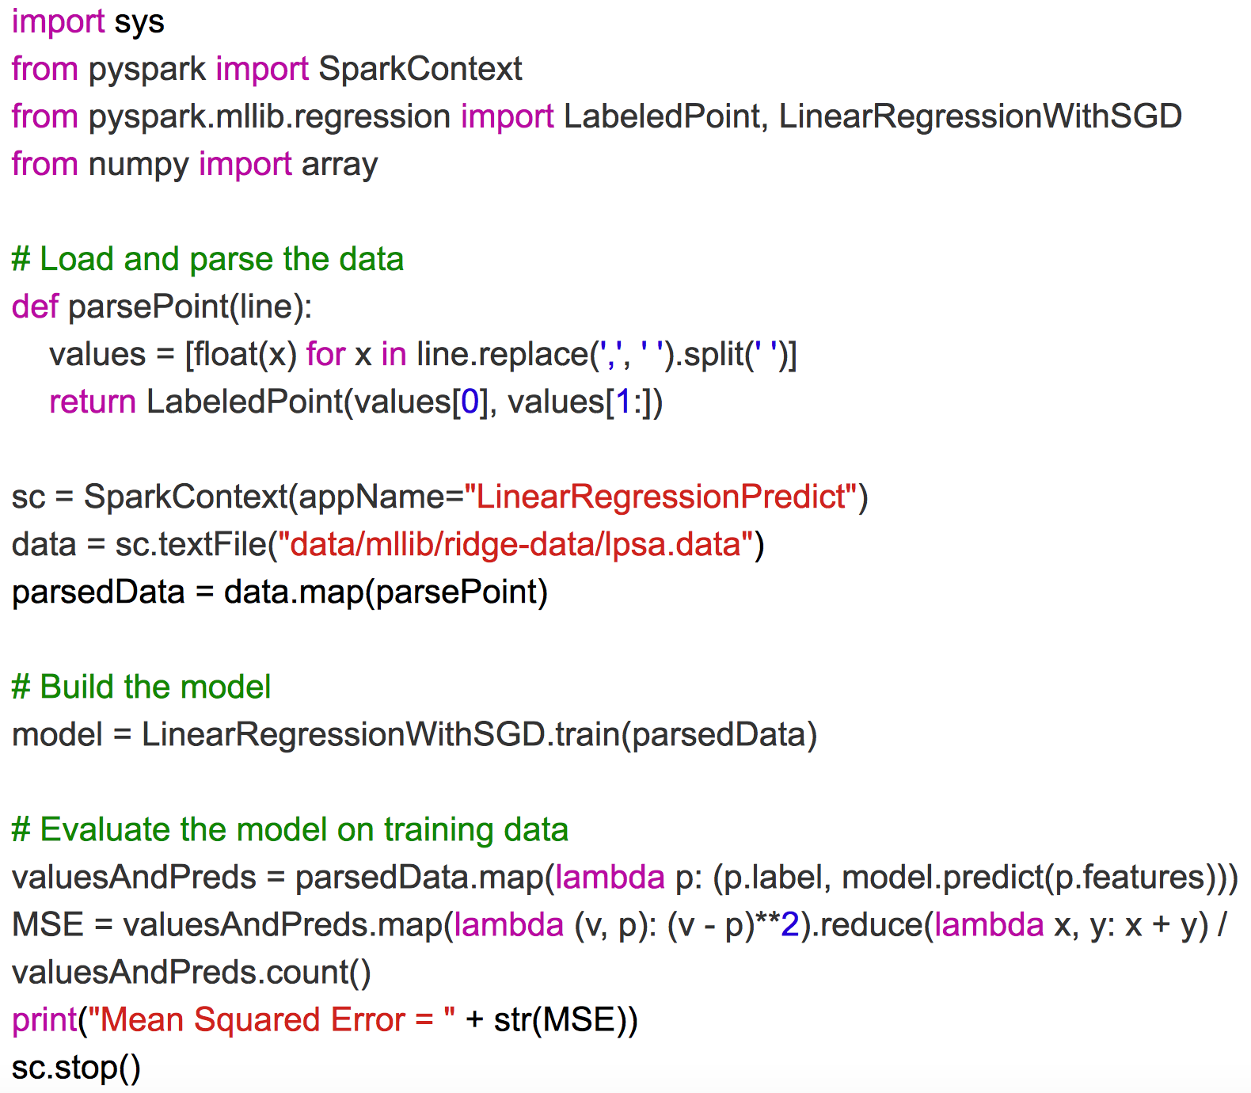
Word Count

Slide 26
DAGScheduler

Slide 27
TaskScheduler

Slide 28
TaskScheduler

Slide 29
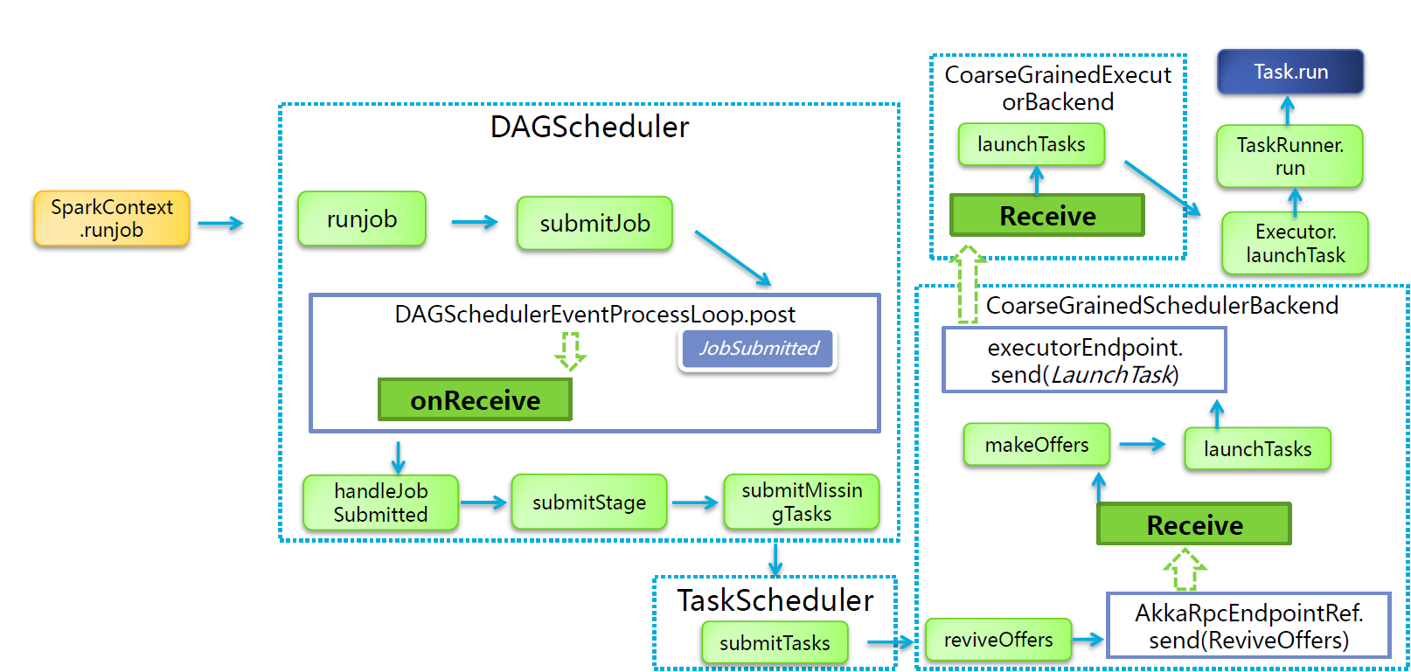
TaskScheduler

Slide 30
PART4
Spark SQL

Slide 31
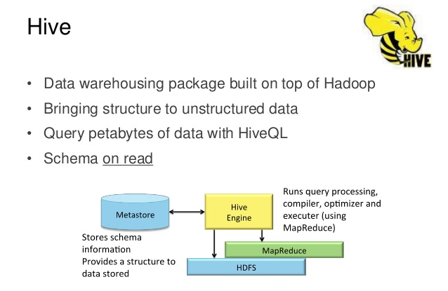
Hive

Slide 32
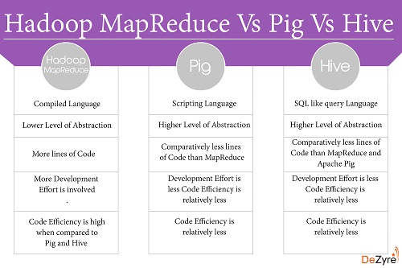
Hive

Slide 33
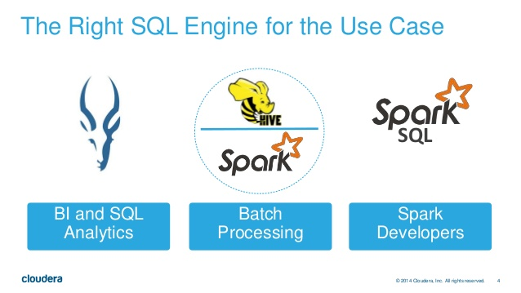
Spark SQL

Slide 34
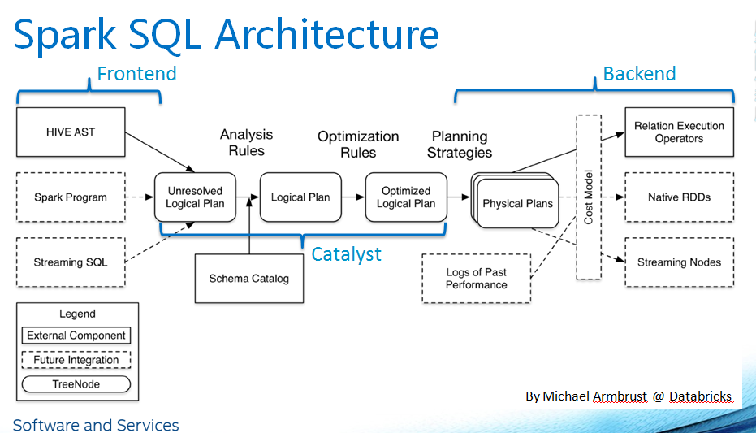
Spark SQL

Slide 35
The End

