Slide 1
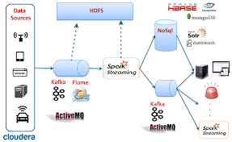
Spark Streaming
2017.4
XenRon

Slide 2
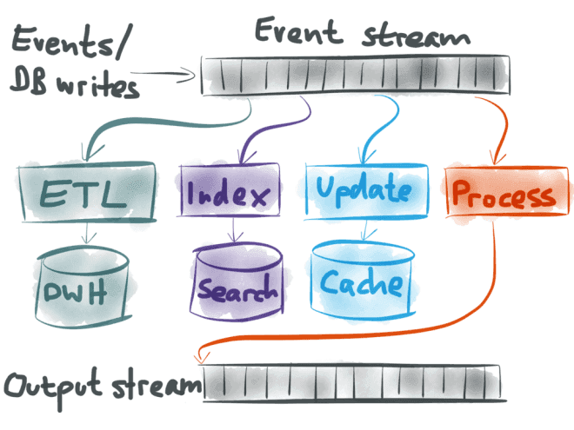
CONTENTS
01
Spark Streaming
02
Spark ML
03
Spark Graph X

Slide 3
Review
Review

Slide 4
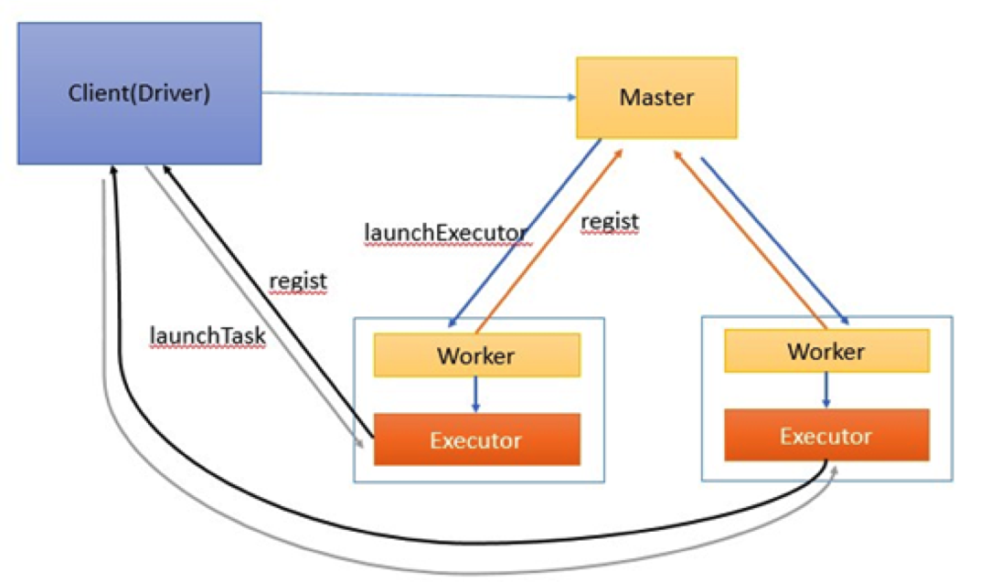
Spark Standalone

Slide 5
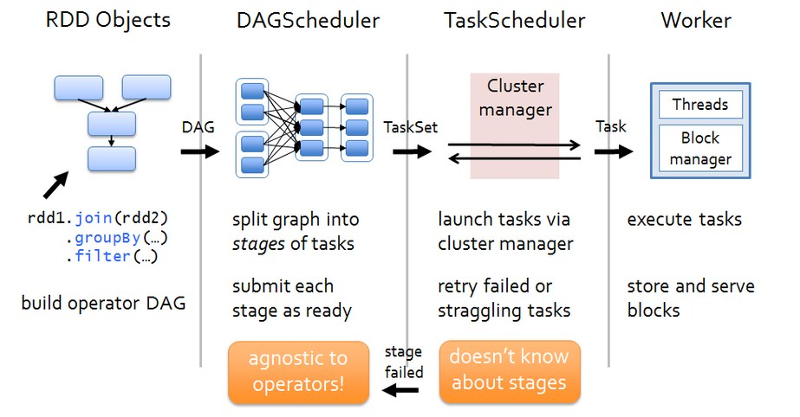
Architecture

Slide 6
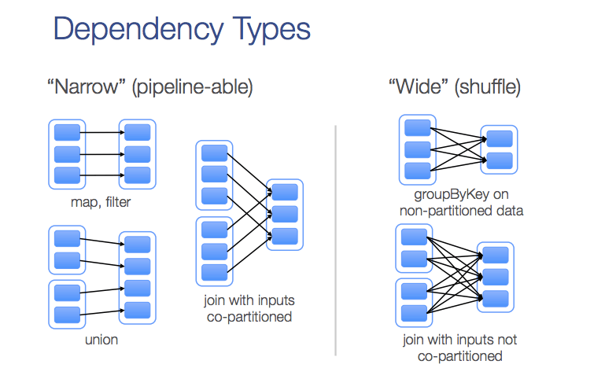
Dependency Type

Slide 7
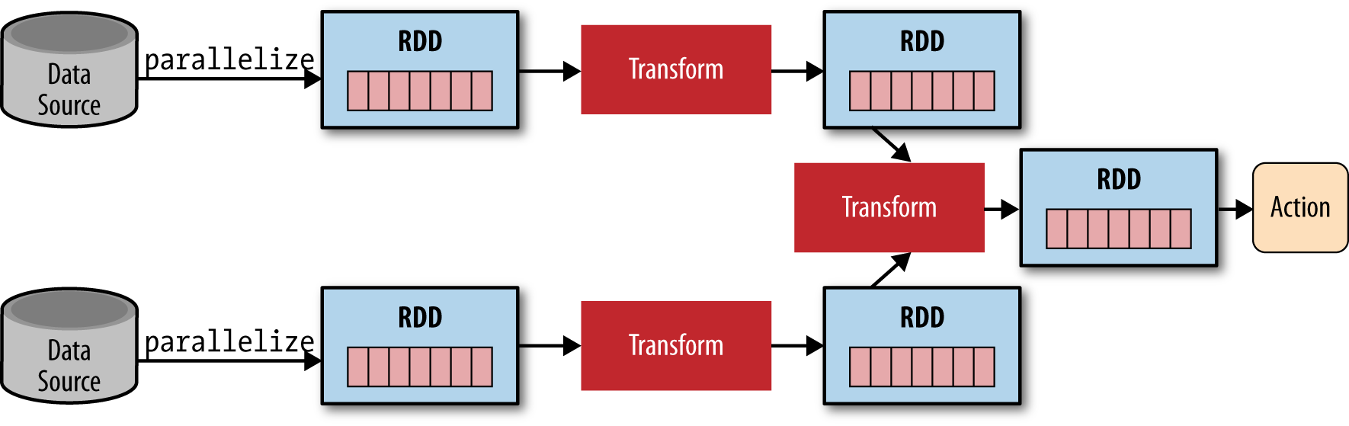
Dependency Type

Slide 8
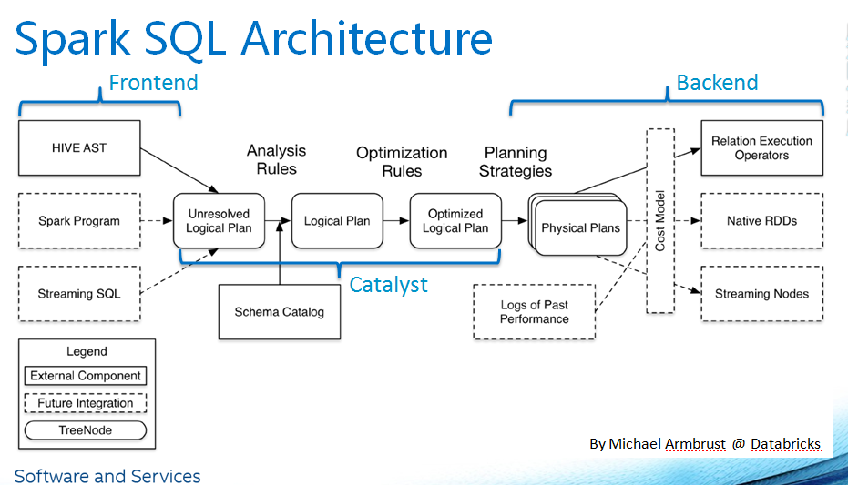
Spark SQL

Slide 9
PART1
Spark Streaming

Slide 10
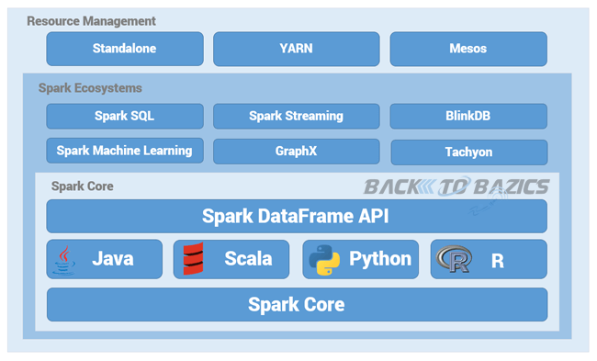
Ecosystems

Slide 11
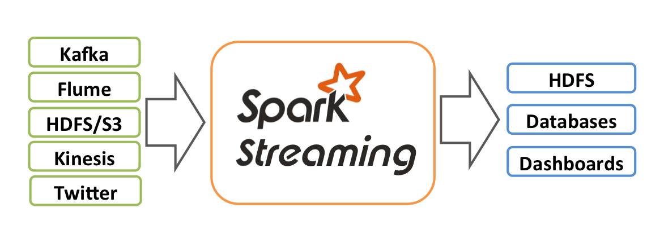
Spark Streaming

Slide 12
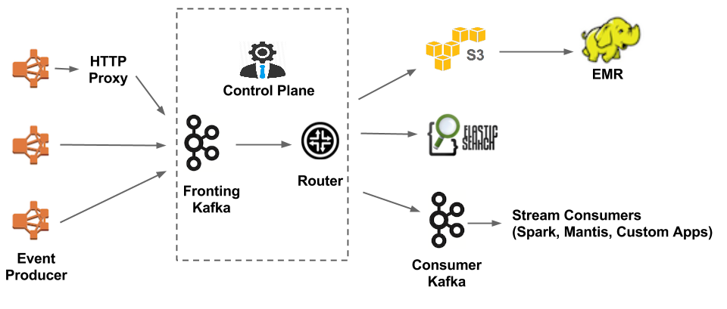
Kafka

Slide 13
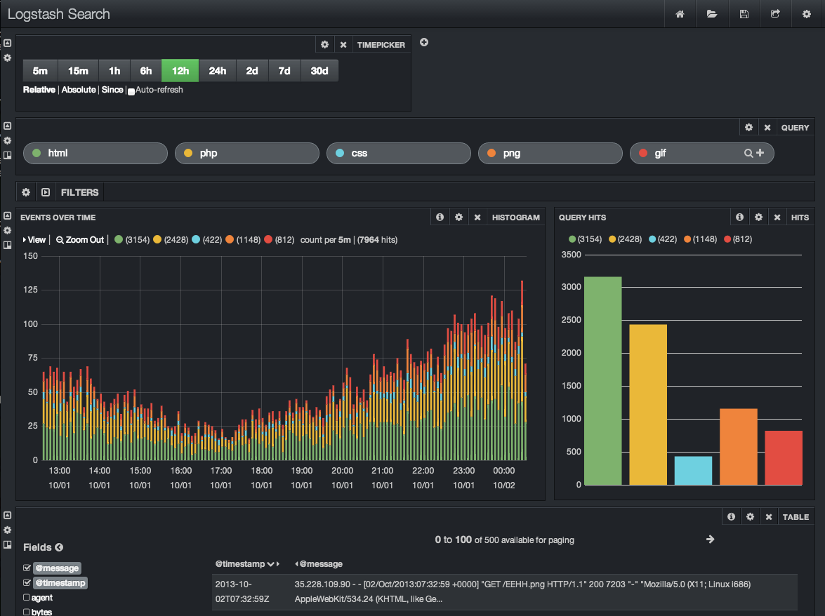
ELK (ElasticSearch LogStash Kibana)

Slide 14
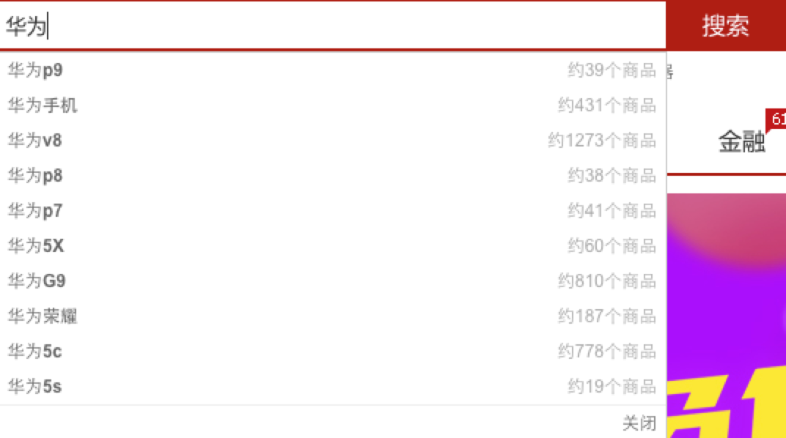
Search Engine

Slide 15
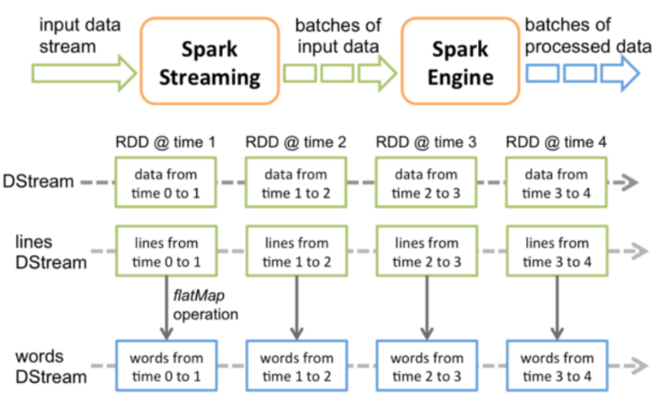
Spark Streaming

Slide 16
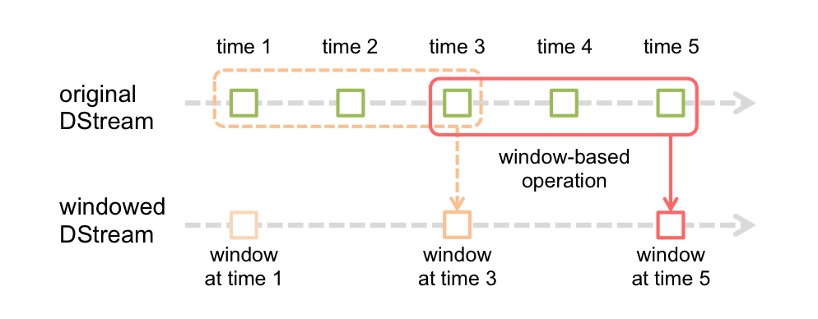
Windows based operations

Slide 17
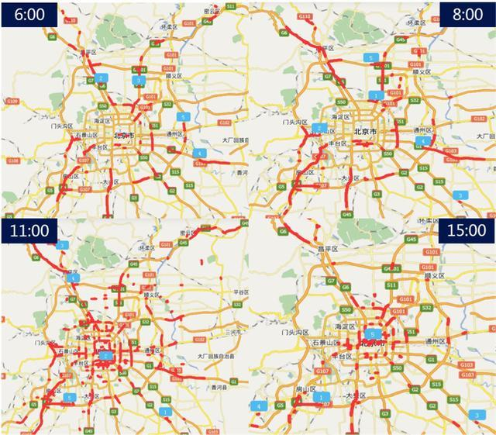
Real-Time Traffic

Slide 18
PART2
Spark Machine Learning

Slide 19
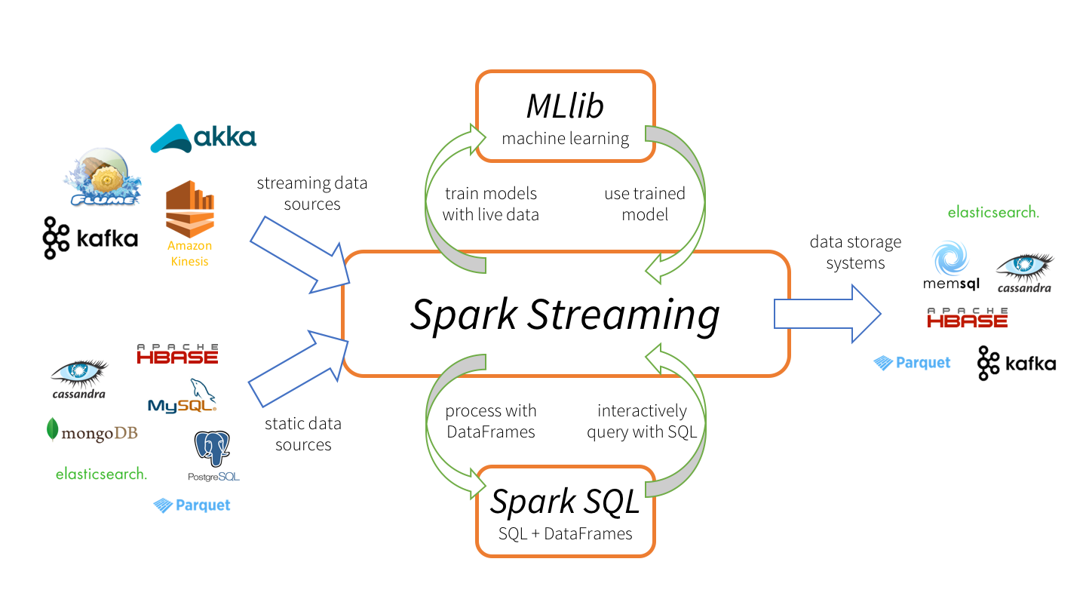
Ecosystems

Slide 20
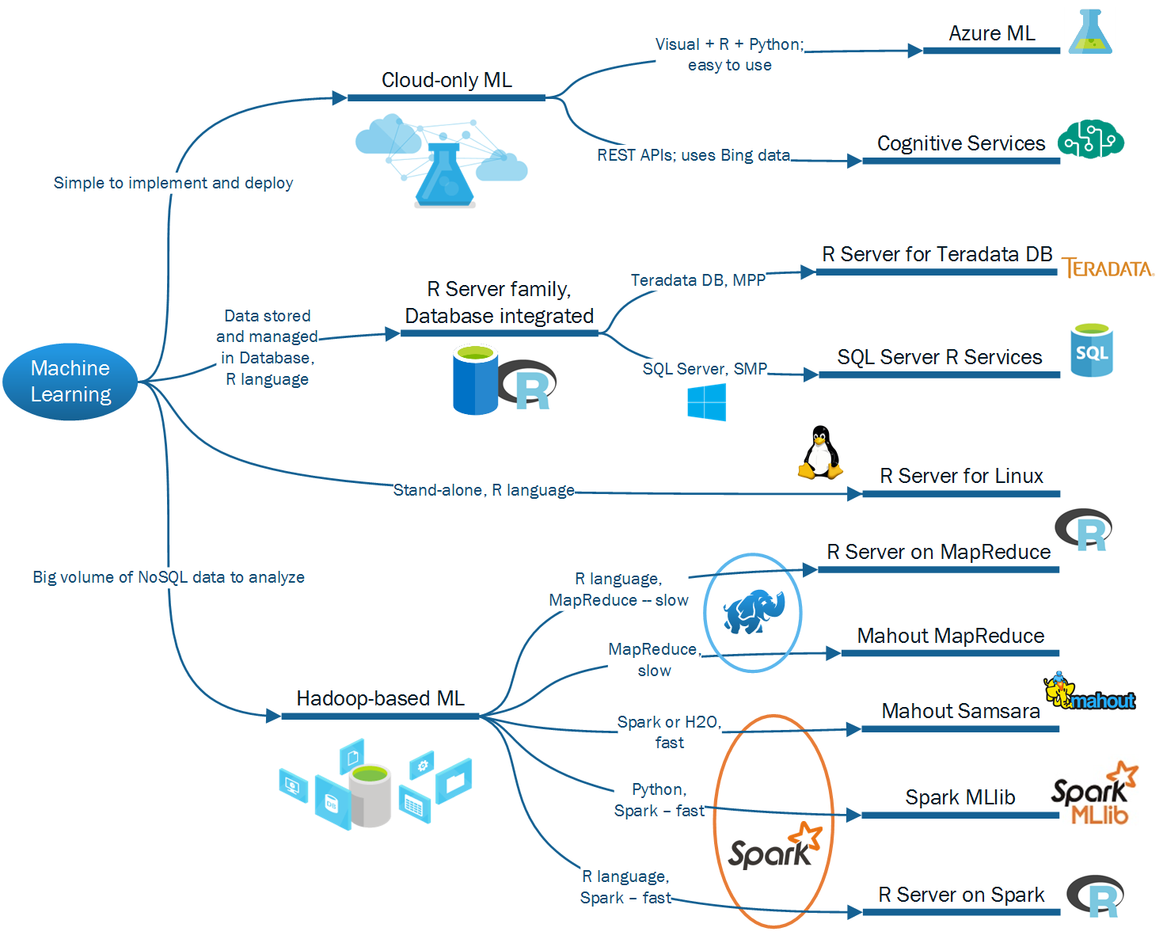
Ecosystems

Slide 21
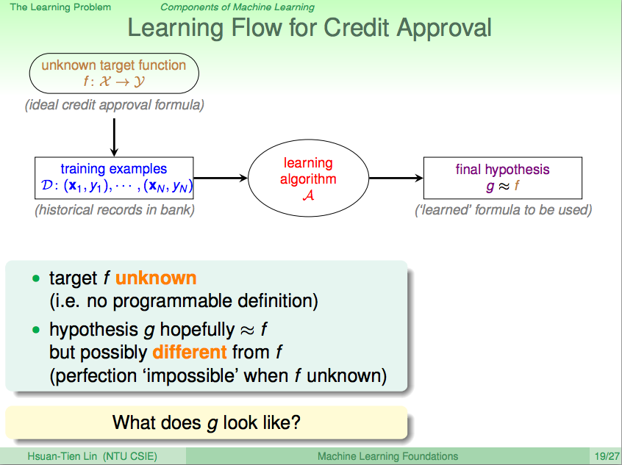
Use Case : Credit Approval

Slide 22

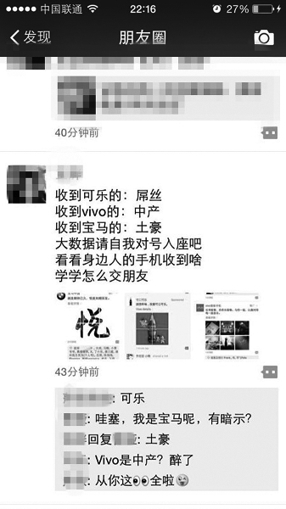
Use Case : WeChat

Slide 23


Use Case : Hatsune Miku Upscale

Slide 24
PART3
Spark GraphX

Slide 25
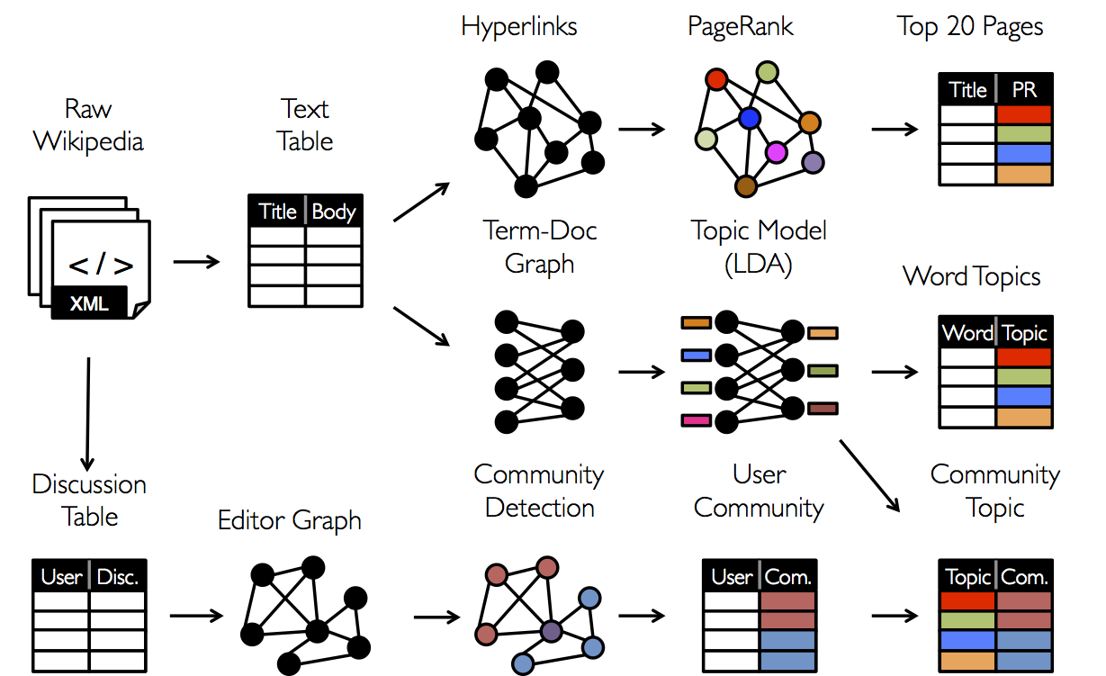
GraphX

Slide 26
Weibo

Slide 27
Social Network Site community

Slide 28
The End

