Slide 1

Improving Predictability using Kanban
Sudipta Lahiri

Slide 2
Work falls in 2 buckets
Keep the lights on...
Projects
Production Support or Maintenance project
Pipeline changes frequently
Prioritization changes frequently
Release planning is done in the following few ways:
Either a defined frequency
Around some important functionality
Estimation limited to primarily “key” work items
Discretionary or Value Enhancing
Traditionally, waterfall based
“MS Project” like scheduling
WBS is made
Estimate is made
Dependencies are defined
As project progresses, MSP keep computing a scheduled date
Increasingly Agile based

Slide 3
Forecasting...
Keep the lights on...
Projects
Quite non-committal
Whatever can be “fitted” in the given timeline, goes in the release
Trust deficit between business and IT or customer and vendor
Business/customer always feels that work items are over estimated
Extremely difficult to justify every incremental
Delivery always feels that customer/business does not appreciate the details
Estimation basis is past time sheet data
This too is error prone and massaged
Scheduling done with critical path tracking
Two key issues:
Scheduling is very deterministic
Though, it is completely based on “estimates”
Trust deficit and issues with estimation continue
With this background, there is an inherent contradiction between the estimate and the forecast
Further, as work progresses and projects start slipping, focus is around controlling critical path
Limited ability to do scenario based planning

Slide 4
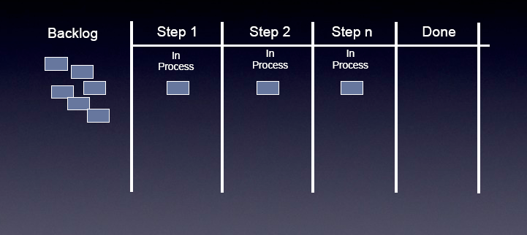
A quick Kanban primer
Visualize the Work
Map your value stream
Limit Work in Process (WIP)
Manage Flow; Establish a Cadence
Remove bottlenecks and improve the flow
Increase throughput
Make Process Policies Explicit
-------------------------------------
Implement Feedback Loops
Improve Collaboratively, Evolve Experimentally

Slide 5
So, how does Kanban help?
Flowing of cards is at the heart of a Kanban system
As cards flow, system tracks:
How much each card of different type, of each size, spends on each stage of the value stream
Sizing is based on a approx T shirt sizing
Wait time and blocked time can be excluded by the system
Focus on low WIP limits discourages people from multitasking
“Stop starting; start finishing”
Result: calendar time = approx. actual effort

Slide 6
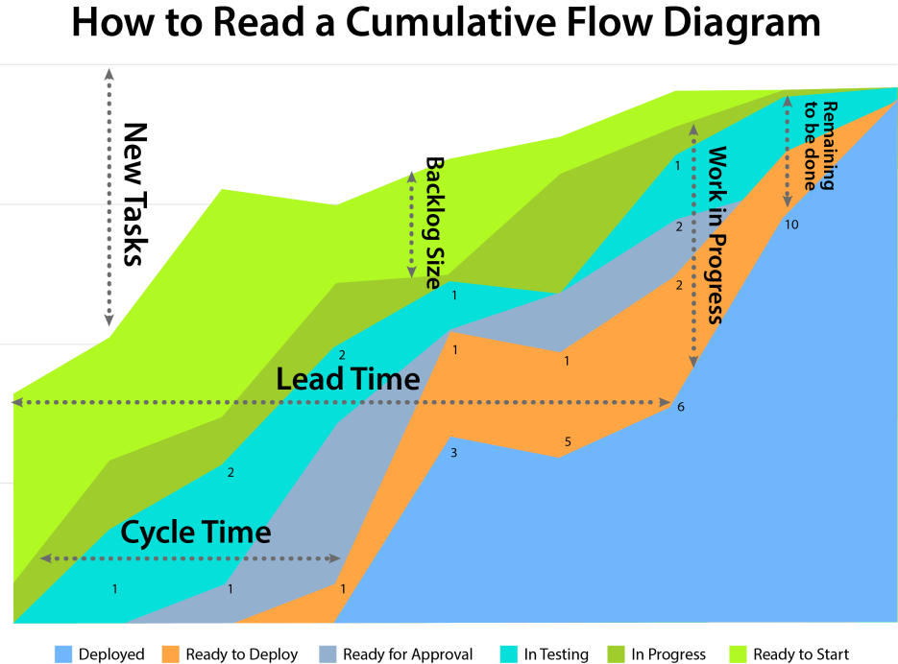
Metrics from a Kanban system
Cycle Time = WIP/Throughput
For a given inventory of work, Cycle Time and Throughput are inversely proportional
Will be used interchangeably

Slide 7
Predicting with CFD
Product demo

Slide 8
Question remains....
We know what we need to do...
But how we go about doing it?
Introducing “Simulation with Swift-Kanban”

Slide 9
Simulation with Swift-Kanban
Basis:
Estimates are not accurate
Even an accurate estimate fail for multiple reasons!
But...
We know that variation in effort takes a distribution pattern
Next:
We derive base data for the simulation from “actual” data
Not by estimates
Actual data based on progress of work on the board
Accuracy driven by the rigor of Stand-up call
Team/work profile
We do make some assumptions...
Result:
Simulation helps you to evaluate different options that impact your throughput/cycle time
You can change your team profile and see the impact
You can change your working model and see the impact
Gives you more concrete information “behind” your decision

Slide 10
Lets do some “what-if” analysis...
Product demo

Slide 11
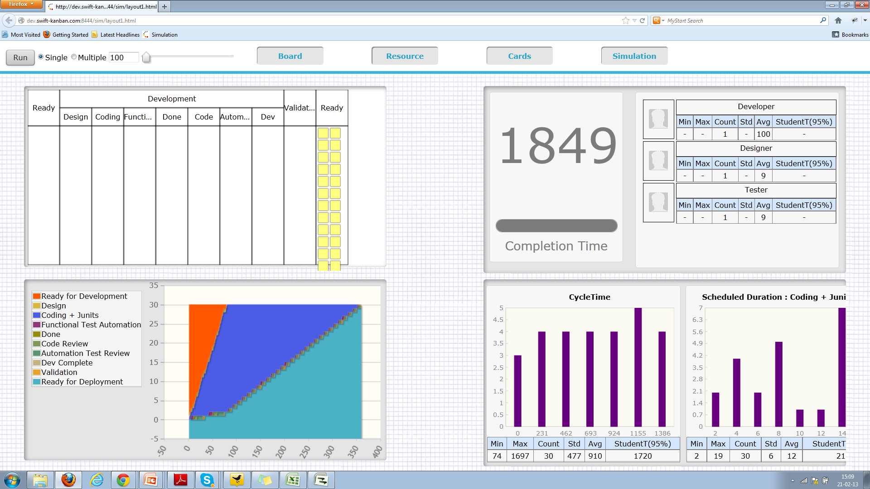
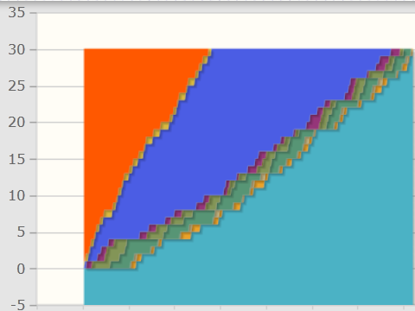
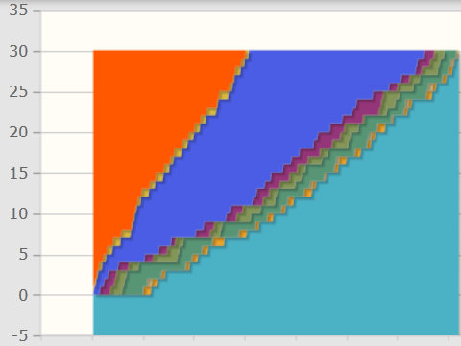
In summary...
30 cards
With a team of 3:
1 Designer
1 Developer
1 Tester
Cycle time: 1756
30 cards
With a team of 5:
1 Designer
4 Developers
1 Tester
Cycle time: 495
30 cards
With a team of 5:
1 Designer
4 Developers
1 Tester
Plus, Designers can do Development...
Cycle time: 459
Notes:
Note: Right now, it is obvious that “Coding”Junit” is the most constrained. However, it can be because of genuine overloading of the “Coding+Junit” lane OR because of overloading in the next lane (Functional Test Automation lane). If Functional Test Automation guys are overloaded, card will be waiting in the “Coding+Junit” lane EVEN IF “Coding+Junit” is completed.
To solve this issue, it is helpful to split the “Coding + Junit” lane into 2 lanes: a) Coding + Junit In Progress b) Coding + Junit Done. This will help you to understand which of the two is actually getting bottlenecked in your real execution.

Slide 12
Make prediction with confidence!
Extend the algorithm to do multiple runs
Eliminates anomalies from a single run
Gives you a 95% confidence number over a large number of runs
Product demo

Slide 13
Thank you...
Q&A

