Slide 1
Intelligent Personal Assistant and Knowledge Navigator
-under guidance of Prof. Rushali Patil
Group ID : 06
1. Amit Kumar(3407)
2. Rahul Dutta(3461)
3. Harbhajan Rai (3419)

Slide 2
Problem Statement
We aim to develop an intelligent agent namely an Intelligent Chatting Bot that can have text and voice based artificial conversations that adhere to pragmatic and content semantics.

Slide 3
Goals and Objectives
We aim to develop an artificially intelligent ChatBot that can have seamless conversations with humans using :-
  Knowledge Engine (What to say)
  Conversation Engine (What to answer)
Goals and objectives of the project extend
  Domain specific knowledge base
  Lookup Time Optimization
  Ease of Navigation
  Optimal Query Response Generation

Slide 4
Previous Works
ELIZA
  Developed in the 1960s
  Looks for pronouns and verbs
  ‘You’ becomes ‘I’ and vice versa
  User: You are a dork.
  ELIZA: What makes you think I am a dork?
RACTER
  1984
  Generate English language prose at random
  Generated a book
    The Policeman's Beard Is Half-Constructed
ALICE
  1994
  Three time loebner prize winner
  Richard Wallace

Slide 5
Existing Approaches
Existing approaches to artificial conversation generation emphasize on:
  Grammatical Modeling
  Linguistic Modeling techniques.
Existing literature in conversation engineering consists of stochastic, syntactic, and semantic approaches.
  These approaches perform poorly in conversational situations requiring contextual continuity over a series of utterances.

Slide 6
Grice’s Maxims
Grice analyzes this cooperation between the speaker and listener using four maxims:
  Quality: speaker’s utterance is the truth as provable by adequate contextual evidence or domain facts
  Quantity: speaker utterance provides as much information as appropriate, not more, not less.
  Relation: speaker’s utterance is relevant to the context and the topic of the conversation
  Manner: speaker’s utterance is direct and straightforward, without ambiguity or obfuscation

Slide 7
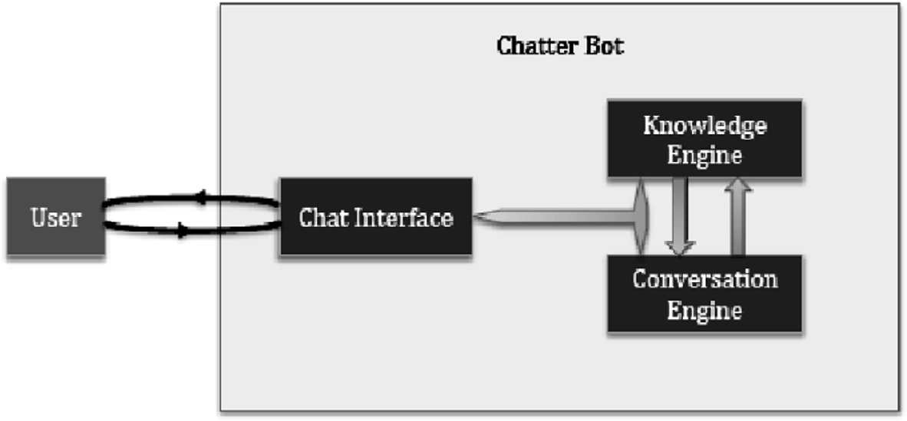
System Architecture

Slide 8
Natural Language Toolkit
A collection of Python programs, modules, data set and tutorial to support research and development in Natural Language Processing (NLP)
Written by Steven Bird, Edvard Loper and Ewan Klien
NLTK is
  Free and Open source
  Easy to use
  Modular
  Well documented
  Simple and extensible
http://www.nltk.org/

Slide 9
VISUALIZATION

Slide 10
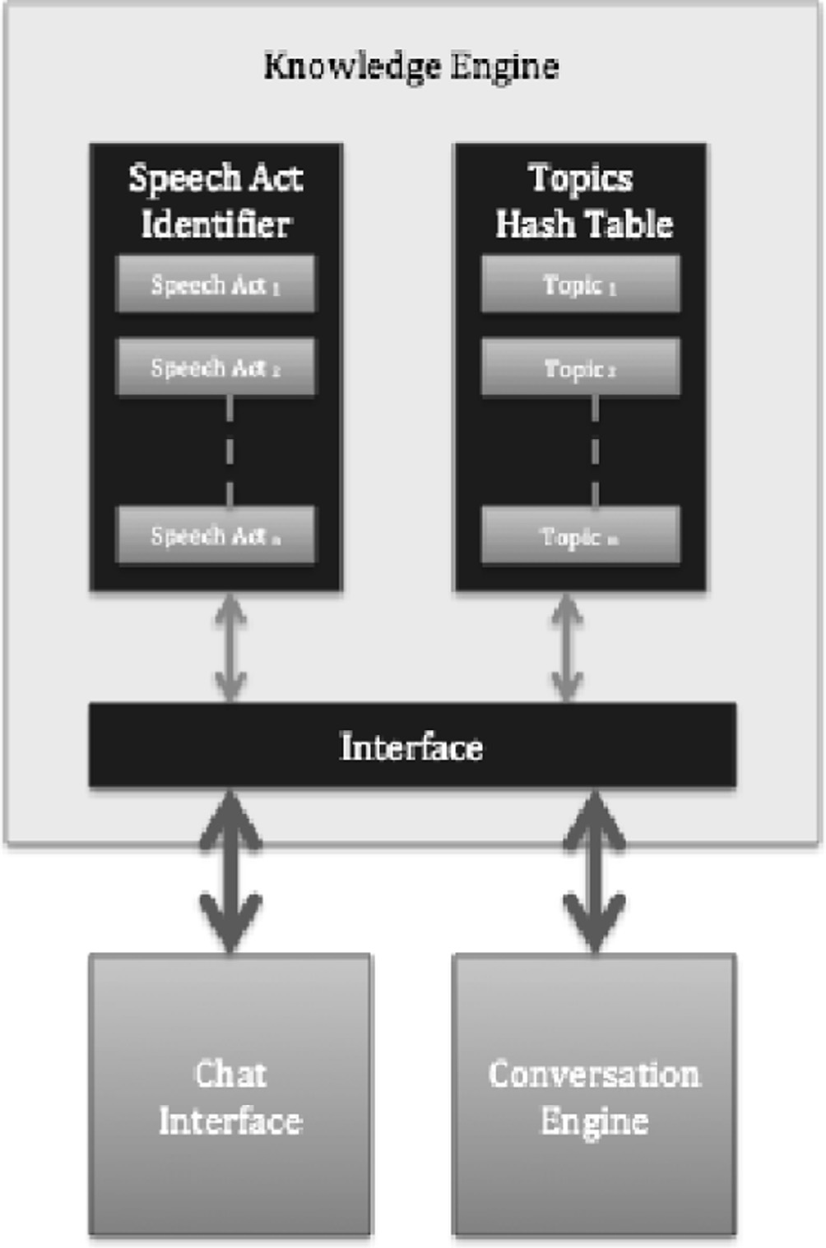
Knowledge Engine

Slide 11
Knowledge Engine Mechanism
The two main content defining characteristics of the conversation are :
  The domain-specific
  The particular speech act
The former provides the factual details for the conversation, i.e., the specific information that the customer or the agent is seeking or providing in the conversation.
The latter provides the situational context of the conversation, i.e.,the qualifiers of the information exchange in the conversation.

Slide 12
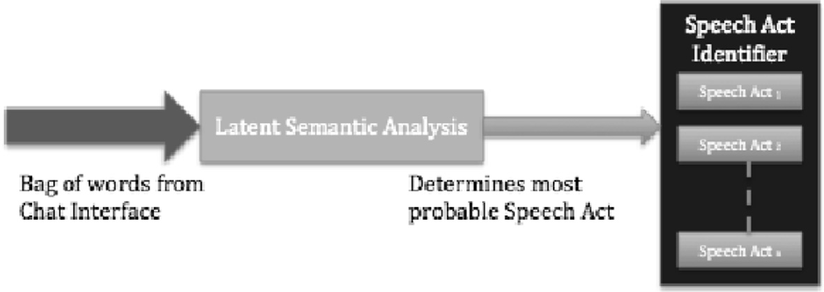
Speech Act Identifier
We identified six speech and dialog acts appropriate for our domain
  The Assertive Speech Act
  The Directive Speech Act
  The Commissive Speech Act
  The Expressive Speech Act
  The Declarative Speech Act
  The Goal-Fulfillment Speech Act

Slide 13
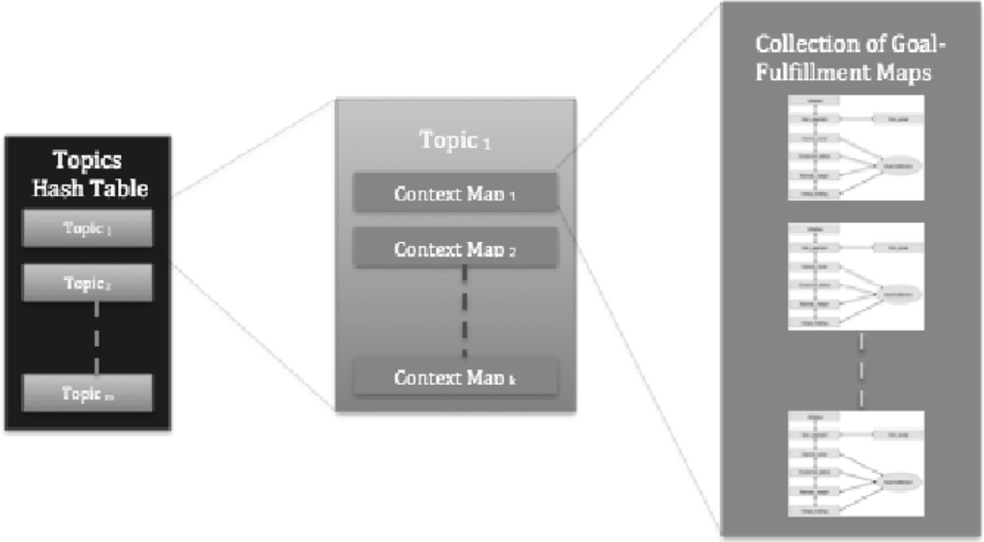
Topic Hashing
A Topics Hash Table organizes the set of topics within the scope of the conversation using a two-valued hash key.
  One hash key is the topic, where we have modeled conversations pertaining to broad topics. The relevant topic is selected using latent semantic analysis.
  The second hash key identifies the specific context within the topic.

Slide 14
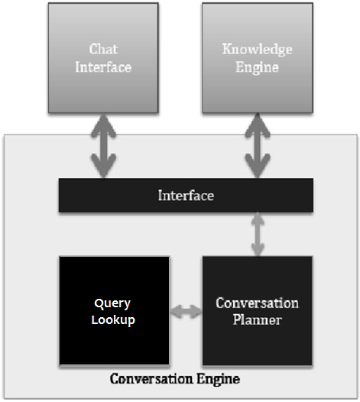
Conversation Engine

Slide 15
Conversation Engine Mechanism
Along with content, pragmatics is the other component of a good conversation. a unique contribution of our work is that the modular nature of the architecture allows content to be distinctly modeled from pragmatics.
The conversation engine contains two modules,
  Query Lookup
  The Conversation Planner
  Query lookup runs user’s conversational input through the system to generate most likely replies along with their confidence values.
The Conversation Planner, which decides the query response to select as reply based on the confidence value.

Slide 16
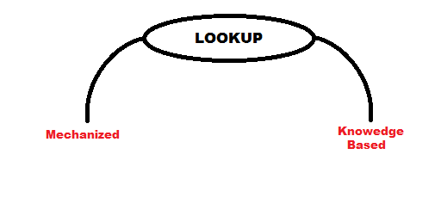
Query Lookup
Lookup is the action of systematic electronic information retrieval from trusted source like expert system, database , internet etc.
Example MS Excel provide VLOOKUP function to query particular row or multiple from table.
In Our Implementation we are doing lookup in two ways.

Slide 17

Mechanized
A very useful python module for navigating through web forms is Mechanize.
We basically Open a webpage and inspect its contents so that we can get data or information that is needed according to the query given by the user.
Example: IF we search something on Google using mechanize browser in python the it request for the page in such a way that it get raw page that is :

Slide 18
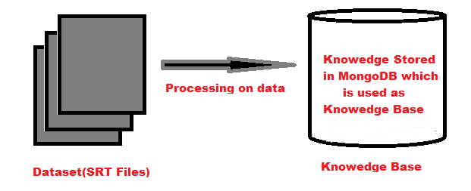
Knowledge Based Lookup
In knowledge based lookup we are using database which is generated using SRT files and stored using MongoDB as it will be unstructured.

Slide 19
Conversation Planner
The query lookup returns a list of the most likely query responses, from these responses the planner chooses one.
The responses are linked with a confidence score which details the most likeliness of the response as a reply.
Several algorithms are employed to find the confidence score.
  Jacardian Index
  Levenstien Distance
  Morphology
Higher the score the better it will be as a reply.

Slide 20
IMPLEMENTATION

Slide 21
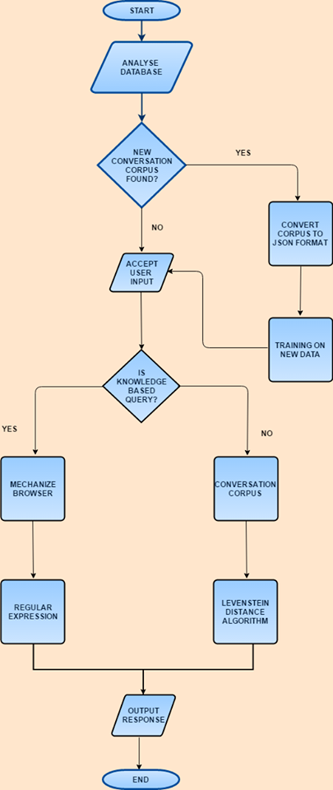
Flowchart

Slide 22
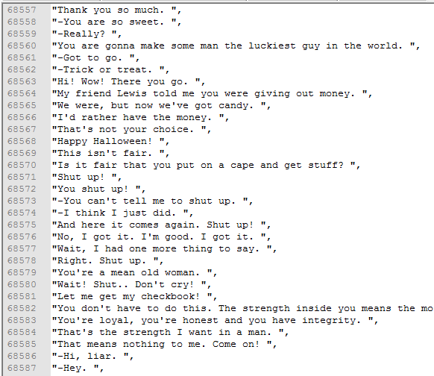
Input

Slide 23
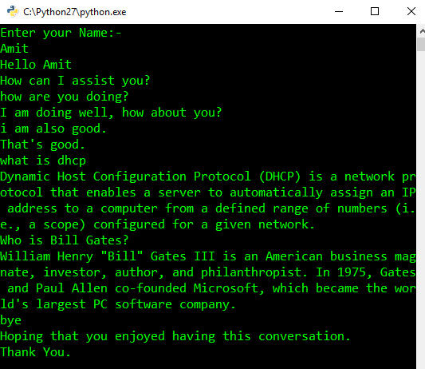
Working

Slide 24
ALGORITHMS USED

Slide 25
Bag Of Words
The bag-of-words model is a simplifying representation used in natural language processing and information retrieval (IR).
A text (such as a sentence or a document) is represented as the bag (multiset) of its words, disregarding grammar and even word order but keeping multiplicity.
After transforming the text into a "bag of words", we can calculate various measures to characterize the text. The most common type of characteristics, or features calculated from the Bag-of-words model is term frequency, namely, the number of times a term appears in the text.

Slide 26
Similarity
Numerical measure of how alike two data objects are.
  A function that maps pairs of objects to real values
  Higher when objects are more alike.
Often falls in the range [0,1], sometimes in [-1,1]
Desirable properties for similarity
  s(p, q) = 1 (or maximum similarity) only if p = q. (Identity)
  s(p, q) = s(q, p) for all p and q. (Symmetry)

Slide 27
Similarity: Intersection
Number of words in common
Sim(D,D) = 3, Sim(D,D) = Sim(D,D) =2
What about this document?
Sim(D,D) = Sim(D,D) = 3
apple releases new ipod
apple releases new ipad
new apple pie recipe
Vefa releases new book with apple pie recipes

Slide 28
Jaccard Similarity
The Jaccard similarity (Jaccard coefficient) of two sets S₁, S₂ is the size of their intersection divided by the size of their union.
  JSim (C₁, C₂) = |C₁∩C₂| / |C₁∪C₂|.
  Extreme behavior:
    Jsim(X,Y) = 1, iff X = Y
    Jsim(X,Y) = 0 iff X,Y have no elements in common
  JSim is symmetric
3 in intersection.
8 in union.
Jaccard similarity
= 3/8

Slide 29
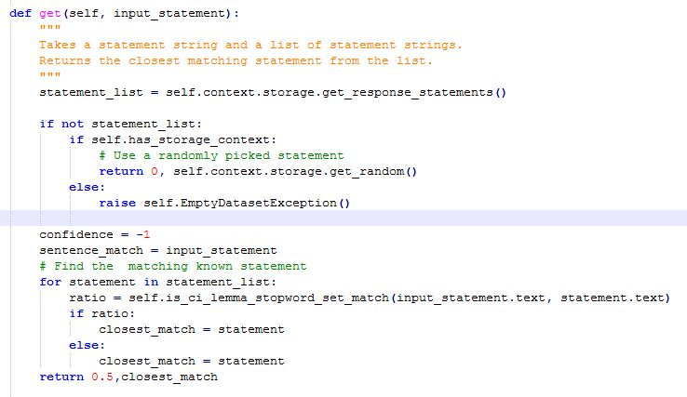
Algorithm

Slide 30
Morphology
The study of how words are composed of morphemes (the smallest meaning-bearing units of a language)
Two broad classes of morphemes:
  Stems: “main” morpheme of the word, supplying meaning
  Affixes: Bits and pieces that combine with stems to modify their meanings and grammatical functions (prefixes, suffixes, circumfixes, infixes)
    Unlike
    Trying
Multiple affixes
  Unreadable

Slide 31
Stemming vs. Lemmatization
The purpose of both stemming and lemmatization is to reduce morphological variation.
Stemming reduces word-forms to (pseudo)stems, whereas lemmatization reduces the word-forms to linguistically valid lemmas (morphological stems).
  Stemming: car, cars, car's, cars' => car
  Lemmatizing: am, are, is => be ;
  drive, drives, drove, driven => drive
In a way, lemmatization deals only with inflectional variance, whereas stemming may also deal with derivational variance;

Slide 32
Levenstein Distance
Levenshtein distance (LD) is a measure of the similarity between two strings, which we will refer to as the source string (s) and the target string (t). The distance is the number of deletions, insertions, or substitutions required to transform s into t. For example,
  If s is "test" and t is "test", then LD(s,t) = 0, because no transformations are needed. The strings are already identical.
  If s is "test" and t is "tent", then LD(s,t) = 1, because one substitution (change "s" to "n") is sufficient to transform s into t.
The greater the Levenshtein distance, the more different the strings are.

Slide 33
B
E
A
T
L
E
S
0
1
2
3
4
5
6
7
I
I
I
I
I
I
I
0
0
1
2
3
4
5
6
7
D
K
B
I
I
I
I
I
I
1
1
0
1
2
3
4
5
6
D
D
K
0
I
I
I
I
I
E
2
2
1
1
2
3
4
5
D
D
K
S
S
S
K
E
3
3
2
1
1
I
2
I
3
3
I
4
?
D
D
D
S
D
K
S
T
I
I
I
4
4
3
2
2
1
2
3
4
D
D
D
S
D
D
S
S
S
H
5
5
4
3
3
2
2
I
3
I
4
K
I
D
S
Keep
Insert
Delete
Substitute

Slide 34
B
E
A
T
L
E
S
0
1
2
3
4
5
6
7
Keep B,1
B
1
0
1
2
3
4
5
6
Keep E,2
E
2
1
0
1
2
3
4
5
Subst E→A,3
E
3
2
1
1
2
3
3
4
Keep T,4
T
4
3
2
2
1
2
3
4
Ins L,5
Ins E,6
Subst
H→S,7
H
5
4
3
3
2
2
3
4
Keep
Insert
Delete
Substitute

Slide 35
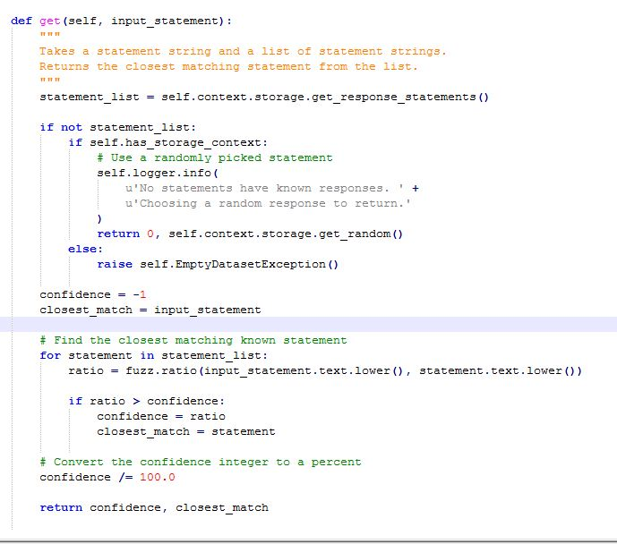
Algorithm

Slide 36
Testing
Query | Response | Bot/Human
Hello | Hello | Human
Can I ask you some questions? | Go ahead and ask. | Human
Who is Bill Gates? | William Henry "Bill" Gates III is an American business magnate, investor, author, and philanthropist. | Human
What is your name? | Your name is the wrong name for you. Here, you can learn what name should really be on that birth certificate. | Bot
Who are you? | I am Scofield. | Human
What is the meaning of Life? | The meaning of life, or the answer to the question pertains to the significance of living or existence in general. | Human
Are you a bot? | Nope. Are You? | Human
What is DNS protocol? | Domain Name Servers (DNS) are the Internet's equivalent of a phone book. | Human
Can you explain a bit more? | Sure. Where is it? | Bot
What annoys you? | It has many inconsistencies. | Human
How do you work? | Its complicated. | Human
Well you are really smart | It bodes well for me that speed impresses you. | Human
. | . | .
. | . | .
. | . | .
Total | 30
Human Like | 20
Bot Caught | 10
CHATBOT EFFICIENCY | 66.66%

Slide 37
Future Scope
Integrating this ChatBot to automate customer service.
Increase data set to cater for wider variety of queries.
Develop an AI to pass the Turing Test.

