Slide 1
学习汇报(2) 碰撞检测
汤志强 12213065

Slide 2
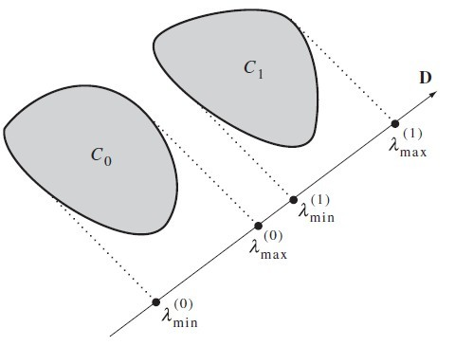
REVIEW
The METHOD OF SEPARATING AXES
规则:如果存在一条线上的投影不相交，则两物体不相交。
逆反：如果两物体相交，则它们在任何线上的投影都相交。

Slide 3
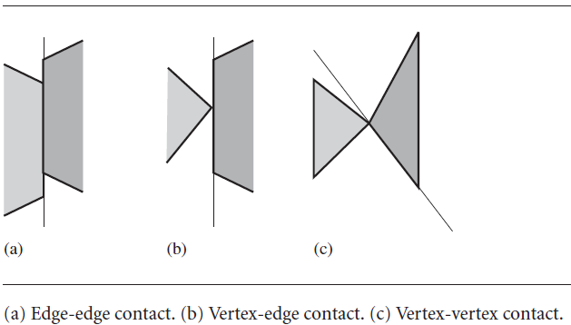
REVIEW
Only the normal vectors to the edges of the polygons needs to be considered for separation tests.
The intuition for why only edge normals must be tested in based on having tow convex polygons just touching with no interpenetration.
The contact is one of edge-edge, vertex-edge contact, and vertex-vertex.

Slide 4
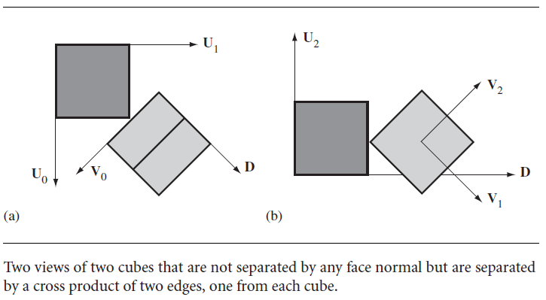
REVIEW
For a pair of convex polyhedra, the set of potential separating directions includes:
the normal vectors to the faces of the polyhedra
Vectors generated by a cross product of two edges, one from each polyhedron
The contact is one of face-face,face-edge,face-vertex,edge-edge,edge-vertex,edge-vertex,or vertex-vertex.

Slide 5
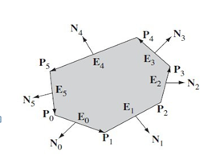
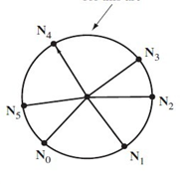


REVIEW
Extremal Query for a Convex Polygon
之前是这样查找更优极值点的
Veterx $P_{i}$ is optimal when $N_{i−1}∙D^{⊥}≥0$ and $N_{i}∙D^{⊥}<0$
可以简单修改一下判断，添加对极值边的响应
Veterx $P_{i}$ is optimal when $N_{i−1}∙D^{⊥}>0$
and $N_{i}∙D^{⊥}<0$
Edge $E_{i}$ is optimal when $N_{i−1}∙D^{⊥}=0$
and $N_{i}∙D^{⊥}<0$
相应地对于Polyhedron，除了可以返回
极值点，还可以返回极值边及极值面。
$$D^{⊥}$$
D

Slide 6
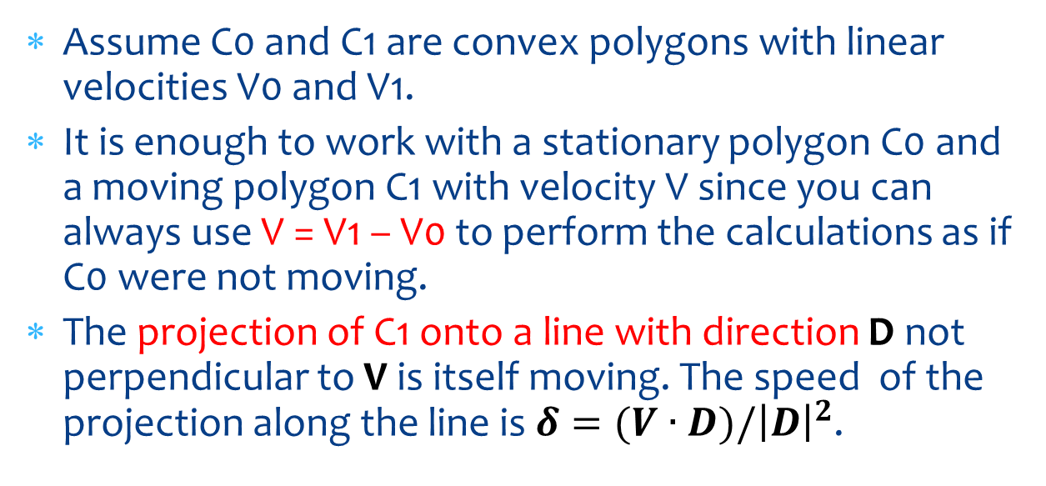
OBJECTS MOVING WITH CONSTANT LINER VELOCITY
Assume C0 and C1 are convex polygons with linear velocities V0 and V1.
It is enough to work with a stationary polygon C0 and a moving polygon C1 with velocity V since you can always use V = V1 – V0 to perform the calculations as if C0 were not moving.
The projection of C1 onto a line with direction D not perpendicular to V is itself moving. The speed of the projection along the line is $δ=(V∙D)/{\left|D\right|}^{2}$.

Slide 7
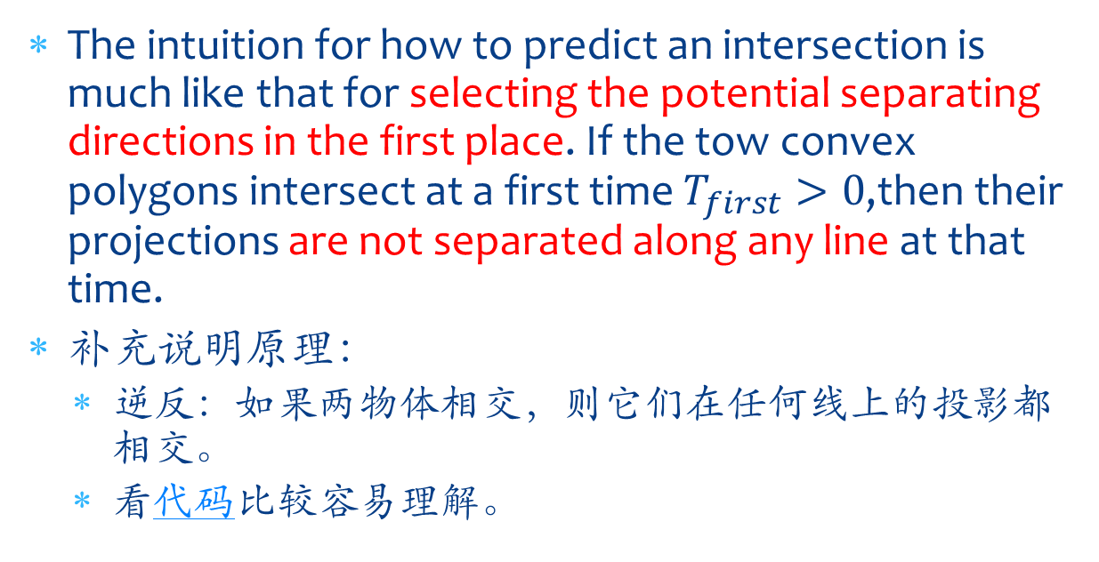
Separation of Convex Polygons
The intuition for how to predict an intersection is much like that for selecting the potential separating directions in the first place. If the tow convex polygons intersect at a first time $T_{first}>0$,then their projections are not separated along any line at that time.
补充说明原理：
逆反：如果两物体相交，则它们在任何线上的投影都相交。
看代码比较容易理解。

Slide 8
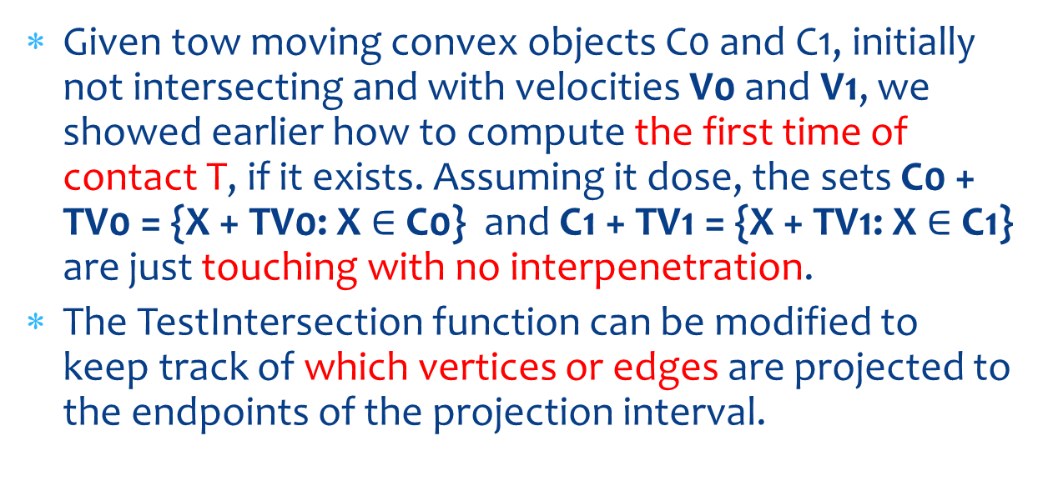
Contact Set for Convex Polygons
Given tow moving convex objects C0 and C1, initially not intersecting and with velocities V0 and V1, we showed earlier how to compute the first time of contact T, if it exists. Assuming it dose, the sets C0 + TV0 = {X + TV0: X $∈$ C0} and C1 + TV1 = {X + TV1: X $∈$ C1} are just touching with no interpenetration.
The TestIntersection function can be modified to keep track of which vertices or edges are projected to the endpoints of the projection interval.

Slide 9
Contact Set for Convex Polygons
A class to store all the relevant projection information is:
class ProjInfo{
public:
doulbe min, max;
int index[2];
bool isUnique[2];
};
If the minimum is obtained from the unique extreme vetex Vi, then index[0] stroes i and isUnique[0] is true. If the minmum is obtained from an edge Ej, then index[0] stores j and isUnique[0] stores flase;

Slide 10
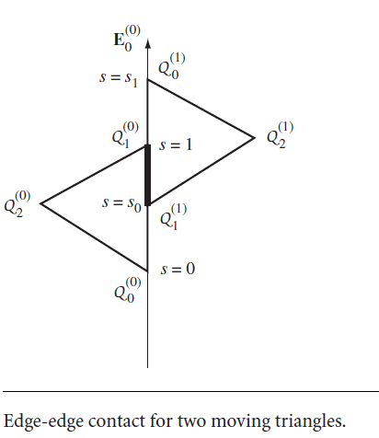

Contact Set for Convex Polygon
In the case of edge-edge contact, suppose that the contact edges are ${E_{0}}^{(0)}$ and ${E_{0}}^{(1)}$. Figure below shows the configurations for two triangles.

Slide 11
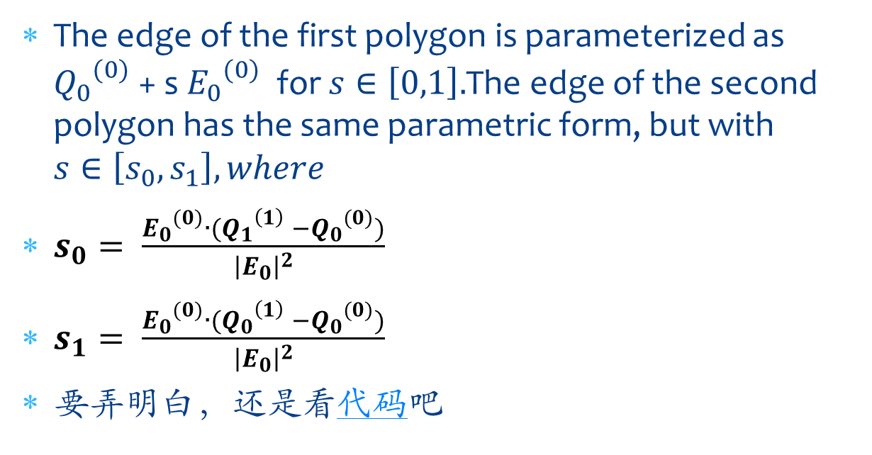
Contact Set for Convex Polygon
The edge of the first polygon is parameterized as ${Q_{0}}^{(0)}$ + s ${E_{0}}^{(0)}$ for $s∈\left[0,1\right].$The edge of the second polygon has the same parametric form, but with $s∈\left[s_{0},s_{1}\right],where$
$s_{0}= \frac{{E_{0}}^{(0)}∙({Q_{1}}^{\left(1\right)} −{Q_{0}}^{(0)})}{{\left|E_{0}\right|}^{2}}$
$s_{1}= \frac{{E_{0}}^{(0)}∙({Q_{0}}^{\left(1\right)} −{Q_{0}}^{(0)})}{{\left|E_{0}\right|}^{2}}$
要弄明白，还是看代码吧

Slide 12
FSEUDODISTANCE
The algorithm presented here is general in that it requires only a pseudodistance function to be implemented for each pair of desired object types and only for the case of stationary objects.
A pseudodistance function between two objects has the property that it is positive when the objects are separated, negative when the objects are overlapping, and zero when the objects are just touching.
A pseudodistance function may be defined based on
The separation axis tests.

Slide 13
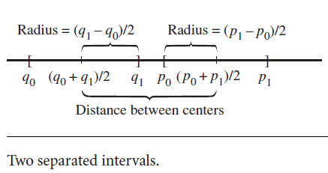

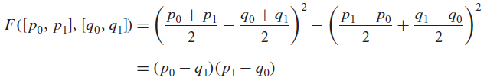
FSEUDODISTANCE
To illusstrate in one dimension:
The separation test is

Slide 14
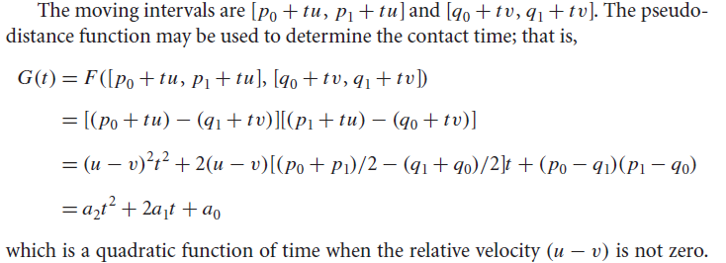
CONTACT BETWEEN MOVING INTERVALS

Slide 15
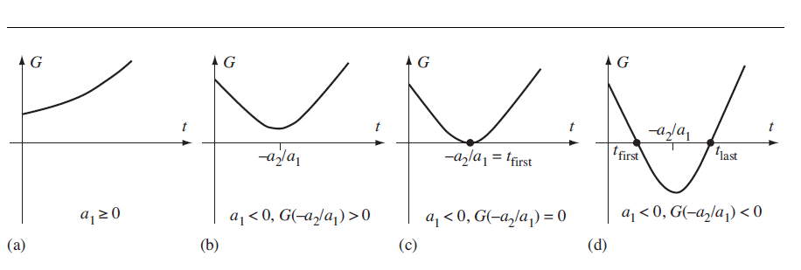
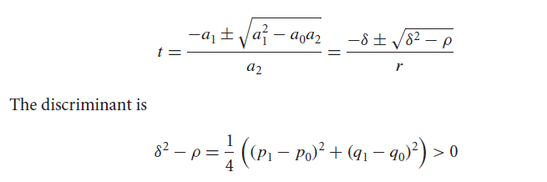
CONTACT BETWEEN MOVING INTERVALS

Slide 16
CONTACT BETWEEN MOVING INTERVALS
Using the quadratic formula in this case is apparently overkill.
The reason for introducing the quadratic approach is that generally the 3D cases are not liner, and the pseudodistance functions are not trival.

Slide 17
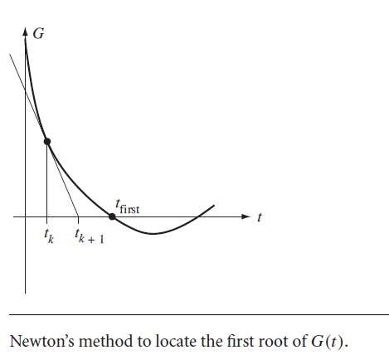

COMPUTING THE FIRST TIME OF CONTACT
牛顿迭代法的计算方法。

Slide 18
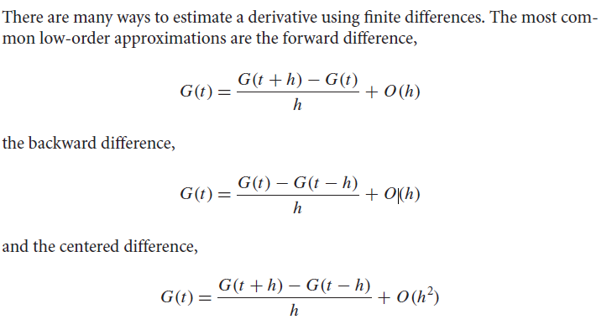
ESTIMATING THE FIRST DERIVATIVE

Slide 19
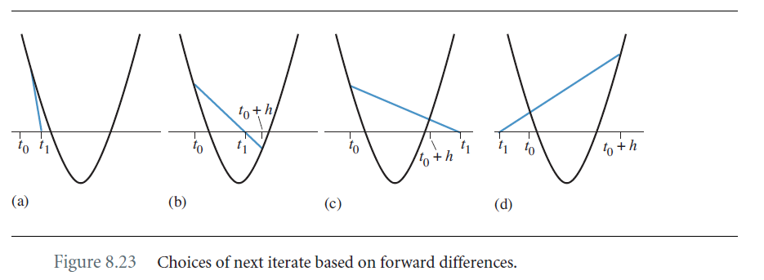
ESTIMATING THE FIRST DERIVATIVE

Slide 20
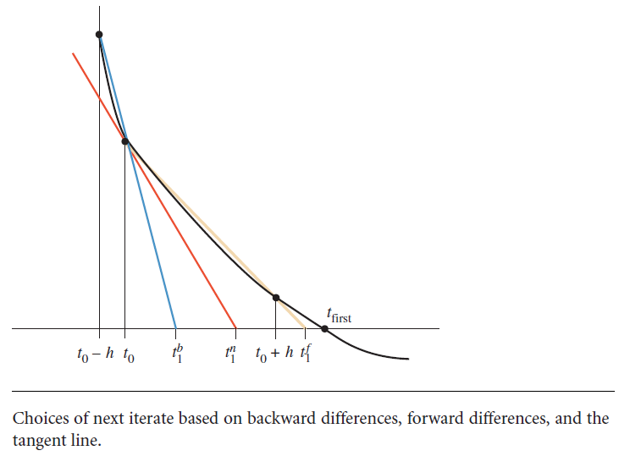
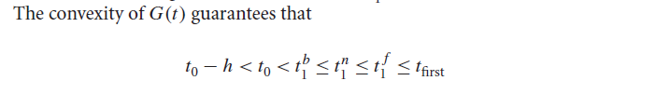
ESTIMATING THE FIRST DERIVATIVE

Slide 21
PSEUDODISTANCES FOR SPECIFIC PAIRS OF OBJECT TYPES
float Pseudodistance (Sphere sphere0, Sphere sphere1)
{
Vector3 diff = sphere1.C - sphere0.C;
float sd = diff.SquaredLength();
float rsum = sphere0.r + sphere1.r;
return sd/(rsum*rsum) - 1;
}

Slide 22
PSEUDODISTANCES FOR SPECIFIC PAIRS OF OBJECT TYPES
float Pseudodistance (Sphere sphere, Capsule capsule)
{
float sd = SquaredDistance(sphere.C,capsule.segment);
float rsum = sphere.r + capsule.r;
return sd/(rsum*rsum) - 1;
}

Slide 23
PSEUDODISTANCES FOR SPECIFIC PAIRS OF OBJECT TYPES
float Pseudodistance (Sphere sphere, Lozenge lozenge)
{
float sd = SquaredDistance(sphere.C,lozenge.rectangle);
float rsum = sphere.r + lozenge.r;
return sd/(rsum*rsum) - 1;
}

Slide 24
PSEUDODISTANCES FOR SPECIFIC PAIRS OF OBJECT TYPES
float Pseudodistance (Capsule capsule0, Capsule capsule1)
{
float sd = SquaredDistance(capsule0.segment,
capsule1.segment);
float rsum = capsule0.r + capsule1.r;
return sd/(rsum*rsum) - 1;
}

Slide 25
PSEUDODISTANCES FOR SPECIFIC PAIRS OF OBJECT TYPES
float Pseudodistance (Lozenge lozenge0, Lozenge lozenge1)
{
float sd = SquaredDistance(lozenge0.rectangle,
lozenge1.rectangle);
float rsum = lozenge0.r + lozenge1.r;
return sd/(rsum*rsum) - 1;
}

