Slide 1
学习汇报(1) 碰撞检测
汤志强 12213065

Slide 2
Collision Detection
Collision detection is a very broad topic, relevant to computer games and to other applications such as navigation and robotics.
Example:
The classic example for collision detection in a third-person perspective, indoor game is having the main character move around in a set of rooms that contain obstacles.

Slide 3
Categories
1、stationary objects. Both objects are not moving.
(a)Test-intersection queries. Determine if the two objects are intersecting.
(b) Find-intersection queries. Determine the intersection set of the objects.

Slide 4
Categories
2、Moving objects. Both objects are moving.
(a)Test-intersection queries. Determine if the two objects will intersect during the time interval.
(b) Find-intersection queries. Determine the contact time and contact set of the objects.
As you can see, even a general categorization leads to a lot of possibilities that a collision detection system must handle.

Slide 5
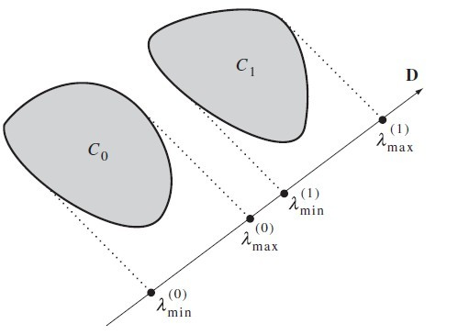
The METHOD OF SEPARATING AXES
A test for nonintersection of two convex objects is simply stated:
If there exists a line for which the intervals of projection of the two objects onto that line do not intersect, then the objects do not intersect.

Slide 6
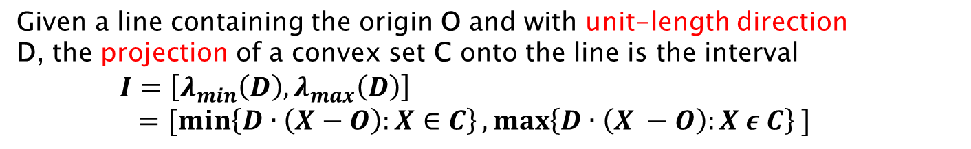
The METHOD OF SEPARATING AXES
Given a line containing the origin O and with unit-length direction
D, the projection of a convex set C onto the line is the interval
$I=\left[λ_{min}\left(D\right), λ_{max}\left(D\right)\right]$
$=[\min\left\{D∙\left(X−O\right):X∈C\right\},\max\left\{D∙\left(X −O\right):X ε C\right\} ]$

Slide 7

EXTREMA OF CONVEX POLYGONS OR CONVEX POLYHEDRA
这个问题意思是：给定一个单位向量D，求凸多边形投影到D上最大值的顶点。
数学描述：
A simple with vertices $P_{i}$ for $0≤i<n$ in the direction D is to locate the vertex $P_{j}$for which $D∙{ P}_{j}= \max_{0≤i<n}\{D∙{ P}_{i }$}.
O(N)复杂度，
下面介绍更快的O(logn)查询

Slide 8
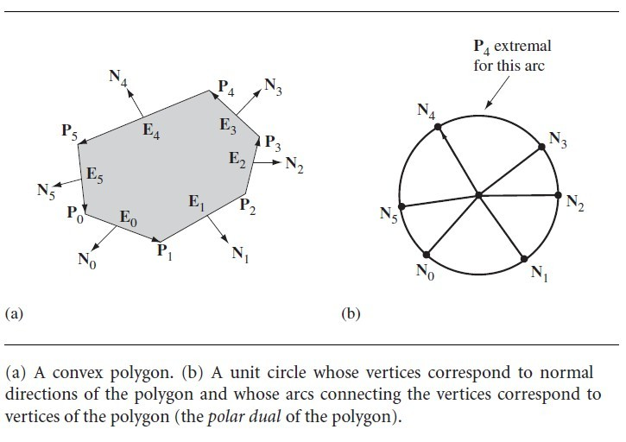
Extremal Query for a Convex Polygon

Slide 9
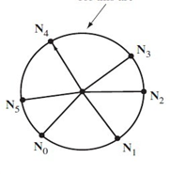
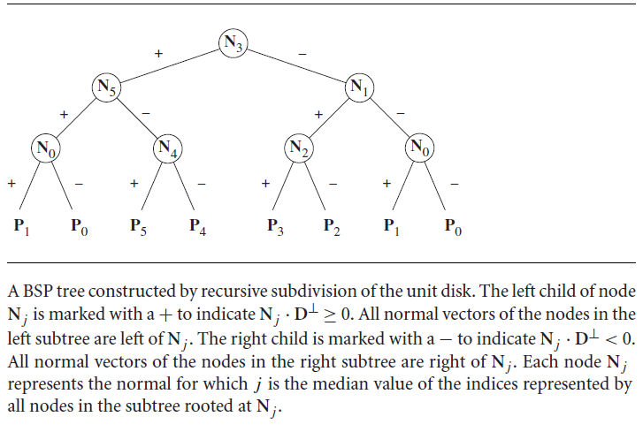

Extremal Query for a Convex Polygon
$$D^{⊥}$$
D

Slide 10
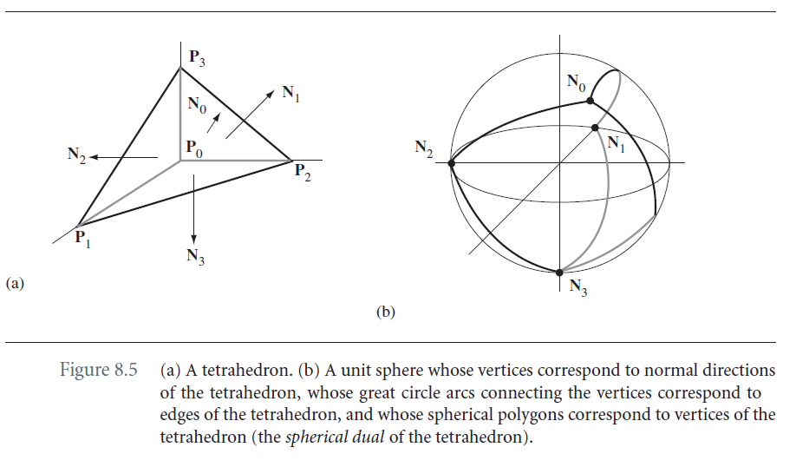
Extremal Query for a convex Polyhedron

Slide 11
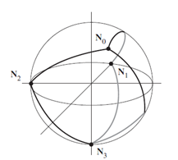
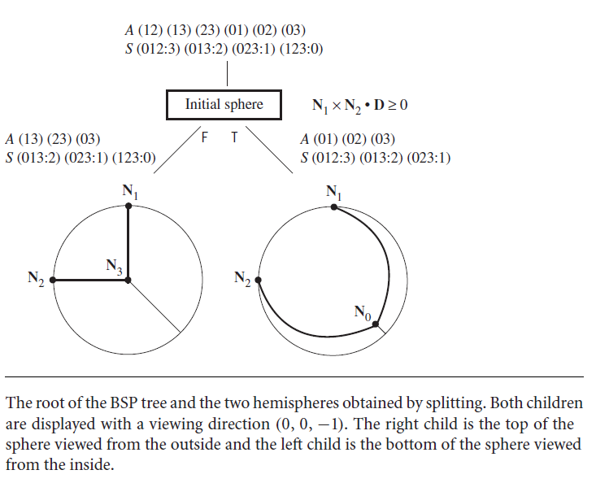

Extremal Query for a convex Polyhedron
$$H= N_{1} × N_{2}$$

Slide 12
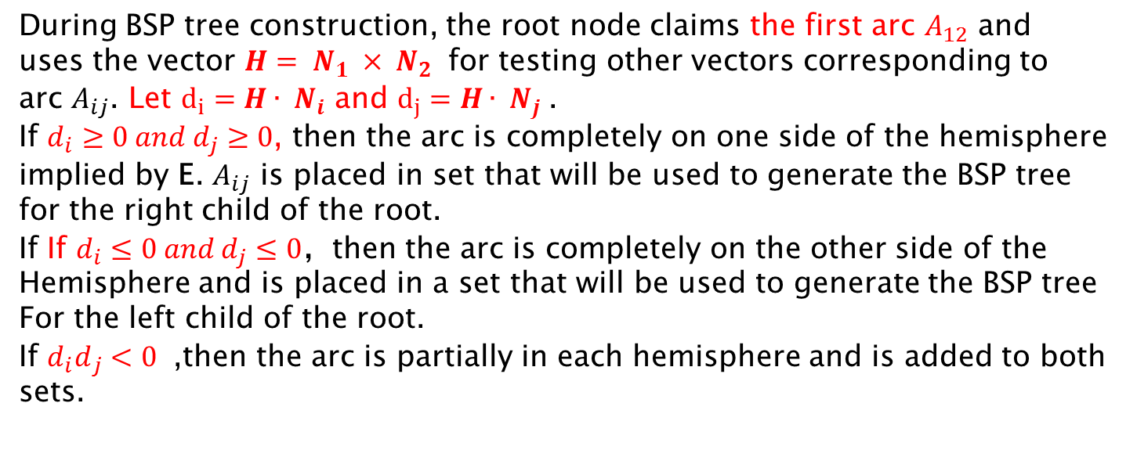
Extremal Query for a convex Polyhedron
During BSP tree construction, the root node claims the first arc $A_{12}$ and
uses the vector $H= N_{1} × N_{2}$ for testing other vectors corresponding to
arc $A_{ij}$. Let $d_{i}=H∙ N_{i}$ and $d_{j}=H∙ N_{j}$.
If $d_{i}≥0 and{ d}_{j}≥0$, then the arc is completely on one side of the hemisphere
implied by E. $A_{ij}$ is placed in set that will be used to generate the BSP tree
for the right child of the root.
If If $d_{i}≤0 and{ d}_{j}≤0$，then the arc is completely on the other side of the
Hemisphere and is placed in a set that will be used to generate the BSP tree
For the left child of the root.
If ${d_{i}d}_{j}<0$ ,then the arc is partially in each hemisphere and is added to both
sets.

Slide 13
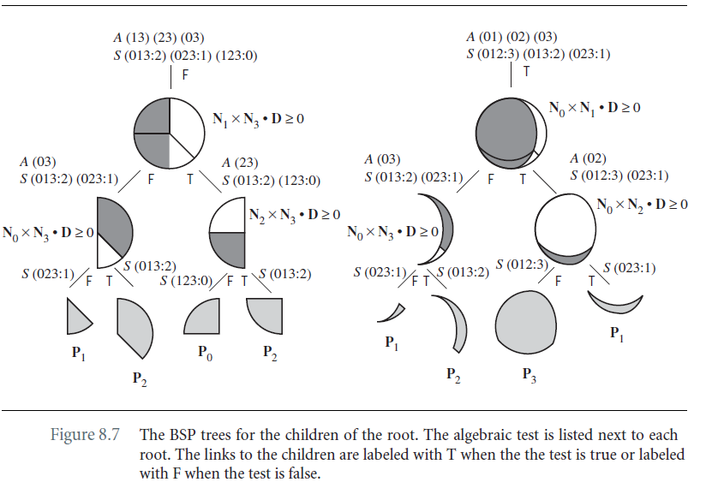
Extremal Query for a convex Polyhedron

Slide 14
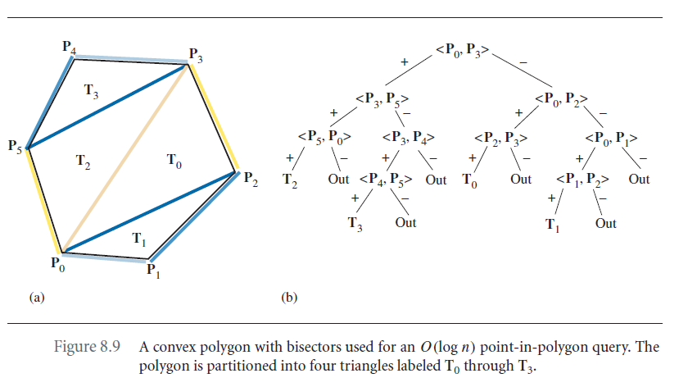
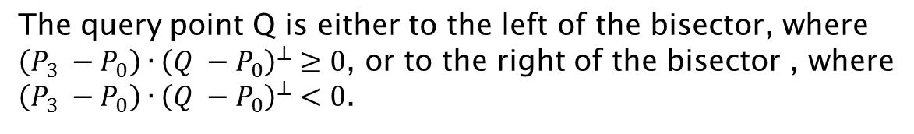
Point-in-polygon query
The query point Q is either to the left of the bisector, where
$\left(P_{3} −P_{0}\right)∙{\left(Q −P_{0}\right)}^{⊥}≥0$, or to the right of the bisector , where
$\left(P_{3} −P_{0}\right)∙{\left(Q −P_{0}\right)}^{⊥}<0$.

Slide 15
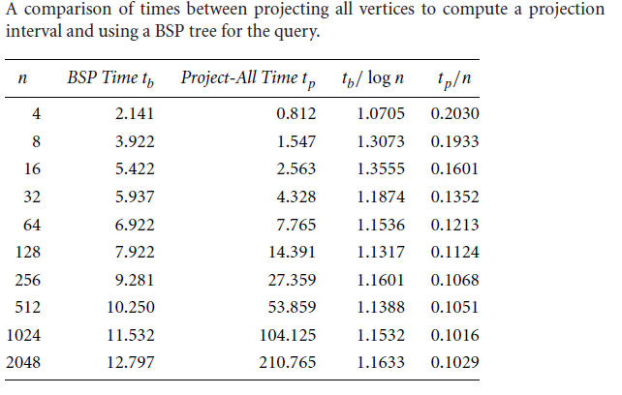
An Implementation and Timing

Slide 16
Thank You
欢迎老师同学指教批评

