Slide 1
学习汇报(3) k-dop层次包围体技术
12213065 汤志强

Slide 2
暴力解决碰撞检测问题
for example, an 3D environment consisting of 100,000 triangles together with a single flying object consisting of 20,000 triangles.
Using our current implementation of the triangle-triangle check , testing each location of the flying object would take almost two hours to perform;

Slide 3
现有的主要解决方法
层次包围树 Hierarchies of Bounding Volumes
Spheres AABB OBB K-dop
空间划分 Spatial Decompositions
Octrees k-d trees BSP-tress brep-indices tetrahedral meshes
The idea behind these approaches is to approximate the objects (with bounding volumes) or to decompose the space they occupy (using decompositions), to reduce the number of pairs of objects or primitives that need to be checked for contact.（1、使用规则多边形细分物体 2、使用空间划分。目的是减少相交测试的几何元素数目。）

Slide 4
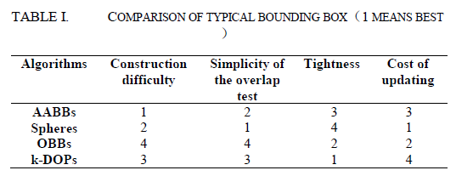
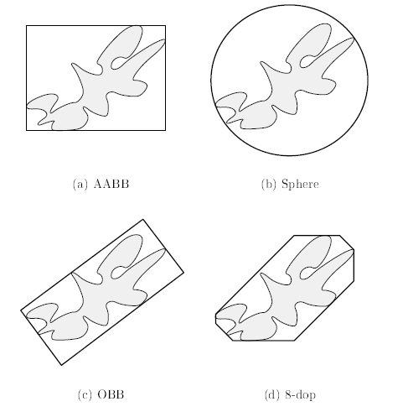
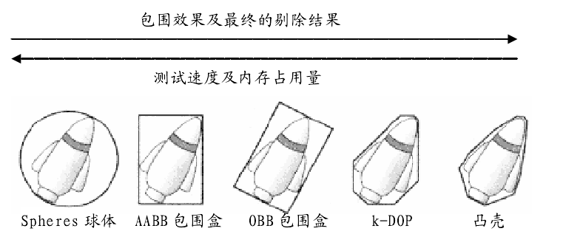
包围盒
常见的包围盒
Spheres球体包
AABBs包围盒 (Axial ly Aligned Bounding Boxes)
OBB 包围盒(Oriented Bounding Boxes)
K-DOP （Discrete Orientation Polytopes)

Slide 5
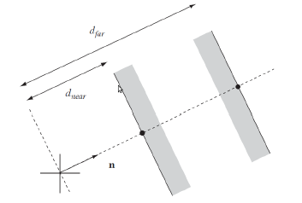
Slap
A slab is the infinite region of space between two planes, defined by a normal n and two signed distances from the origin
To form a closed 3D volume at least 3 slabs are required

Slide 6
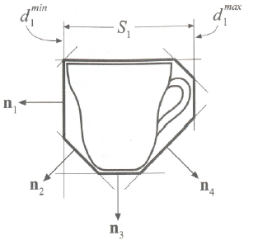
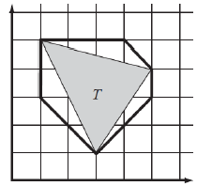
Discrete orientation polytopes K-DOPs
要构造k-dop，首先需要选择k/2个的固定方向
Dot product of the 3 vertices, with each of the normal vectors
Find the minimum and maximum along the dot products
The intersection of the set of slabs determines the k-dop
triangle (3, 1)(5, 4)(1,5) with normals (1, 0)(0, 1)(1, 1)(1,-1)

Slide 7
Compute K-DOP
Sharing normals is computational advantage
Storage is cheap, only min max from each normal must be
stored
Overlap testing, not more difficult than AABBs, simple check
if any of the pair k/2 intervals do not overlap, the K-DOPs do not intersect
Invariant on Translation
Rotation leaves the volume unaligned with the predened

Slide 8
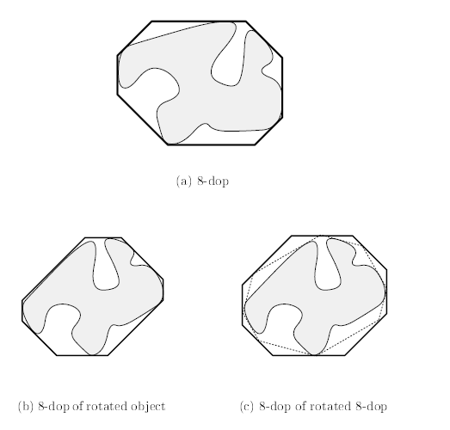
K-DOP Rotation
Must be realigned whenever the volume rotates
recompute the K-dop
Hill-climbing algorithm
爬山法是在K-DOP树的每个节点存储物体的凸包，然后通过搜索邻近点，计算k/2方向的最值，时间复杂度O(k^2)，保持包围盒是紧迫。(this upper bound is tight)
Approximation method 近似方法是只通过原来的k-dop包围盒旋转变换后，计算它在新的k/2方向上的最值。时间复杂度为O(K)，但包围盒不能保持紧迫。

Slide 9
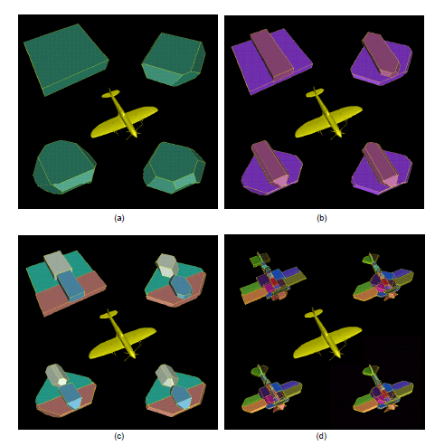
K-DOP Trees
K = 6, 14, 18, and 26

Slide 10
K-DOP future works

