Slide 1
Algorithms week 3-1: Causation
Jonathan Stray
Columbia Lede Program
July 30, 2018

Slide 2
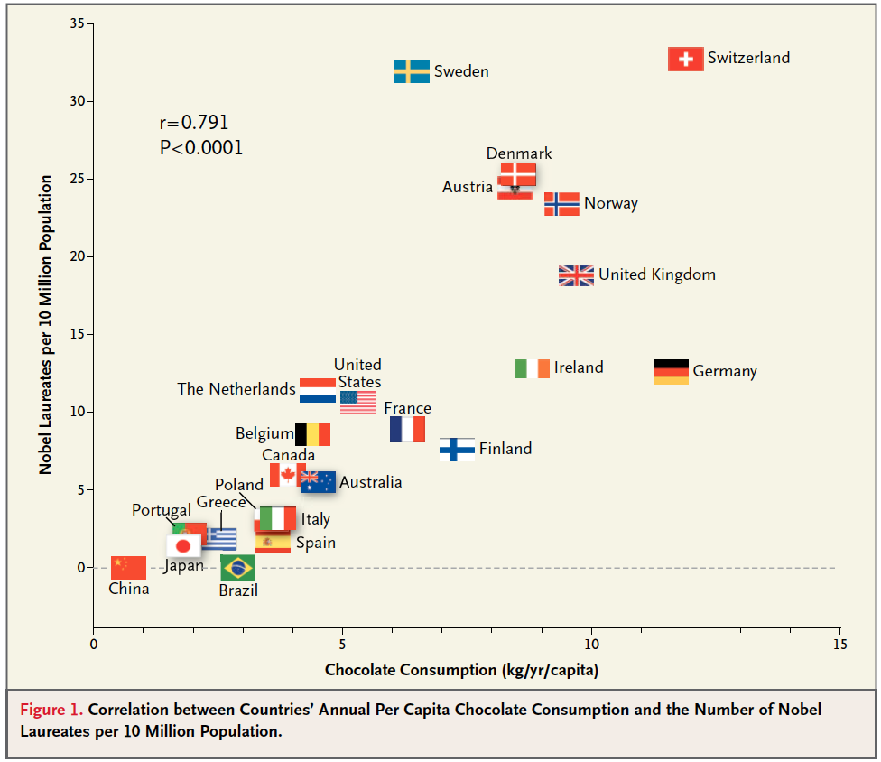
Does chocolate make you smarter?
Notes:
http://blogs.scientificamerican.com/the-curious-wavefunction/chocolate-consumption-and-nobel-prizes-a-bizarre-juxtaposition-if-there-ever-was-one/

Slide 3
Occupational Group | Smoking | Mortality
Farmers, foresters, and fisherman | 77 | 84
Miners and quarrymen | 137 | 116
Gas, coke and chemical makers | 117 | 123
Glass and ceramics makers | 94 | 128
Furnace, forge, foundry, and rolling mill | 116 | 155
Electrical and electronics workers | 102 | 101
Engineering and allied trades | 111 | 118
Woodworkers | 93 | 113
Leather workers | 88 | 104
Textile workers | 102 | 88
Clothing workers | 91 | 104
Food, drink, and tobacco workers | 104 | 129
Paper and printing workers | 107 | 86
Makers of other products | 112 | 96
Notes:
data from http://lib.stat.cmu.edu/DASL/Datafiles/SmokingandCancer.html
analysis http://www.spcforexcel.com/correlation-analysis

Slide 4
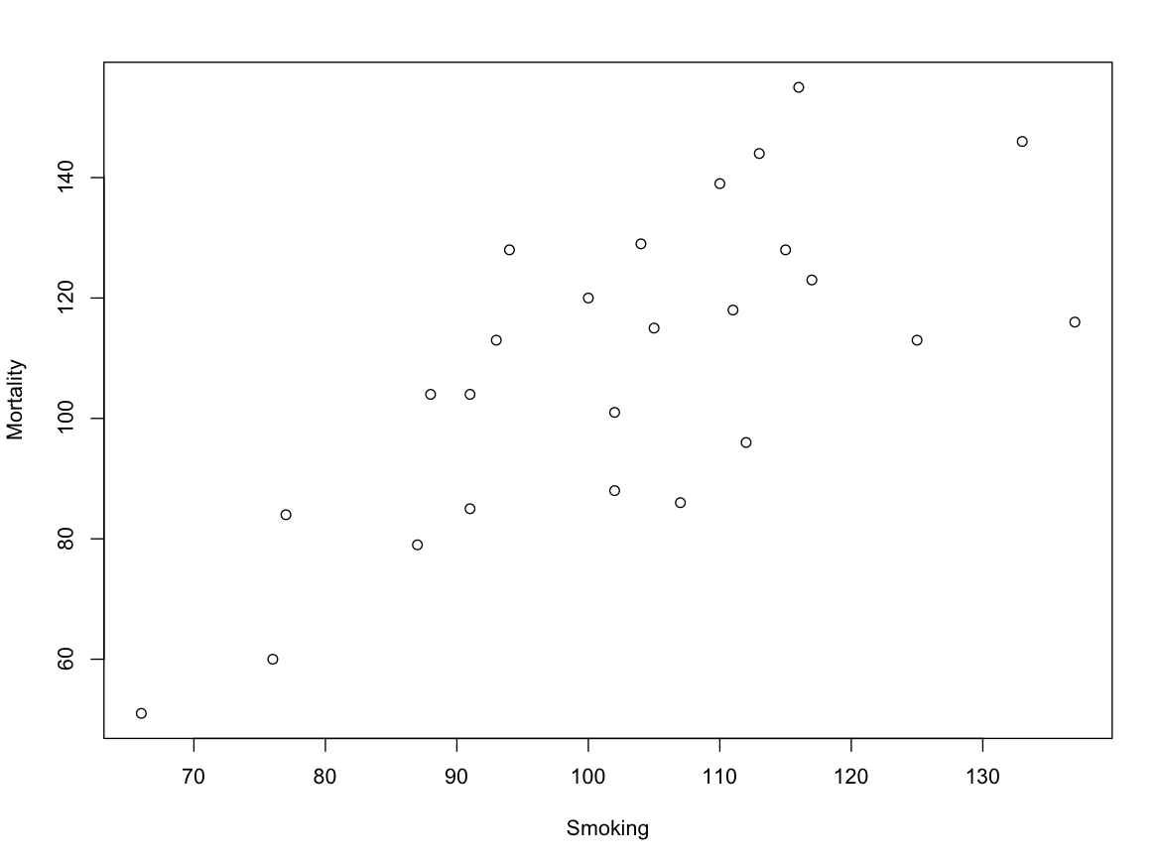

Slide 5
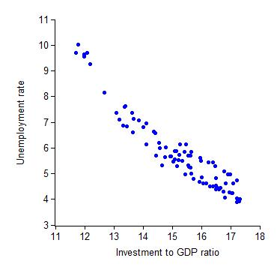
Notes:
http://gregmankiw.blogspot.com/2011/03/striking-scatterplot.html

Slide 6
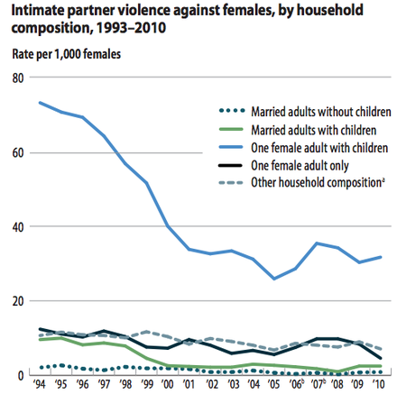
Does marriage make women safer?
Notes:
http://www.theatlantic.com/health/archive/2014/06/should-women-get-married-to-avoid-violence/372954/

Slide 7
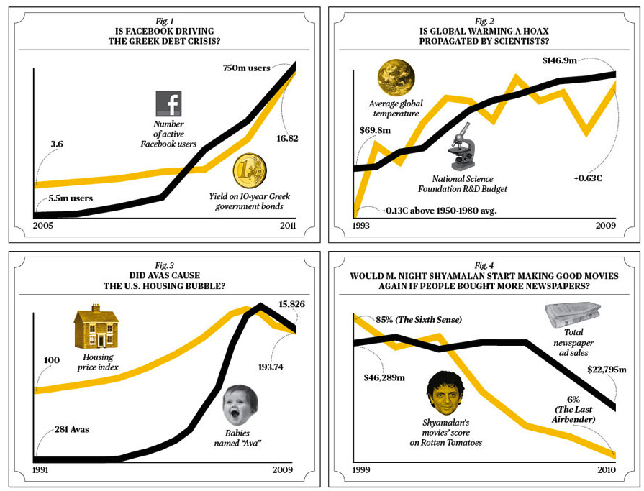

Slide 8
How correlation happens
X
Y
X
Y
X causes Y
Y causes X
Z
X
Y
X
Y
Z causes X and Y
hidden variable causes X and Y
X
Y
random chance!

Slide 9
Guns and firearm homicides?
X
Y
if you have a gun, you're going to use it
X
Y
if it's a dangerous neighborhood, you'll buy a gun
X
Y
the correlation is due to chance

Slide 10
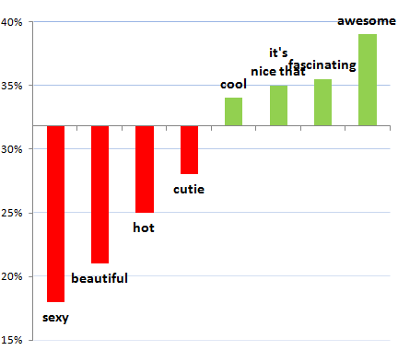
Exactly what to say in a first message, OK Cupid blog, 2009
Notes:
https://theblog.okcupid.com/exactly-what-to-say-in-a-first-message-2bf680806c72

Slide 11
Messages and responses
X
Y
Comments on her appearance
make her respond less
Z
X
Y
if a woman is attractive,
1) she'll respond less
2) people will tell her that
Attractiveness is a "confounding variable." The correlation between words and response rates is not necessarily causal.

Slide 12
Examples

Slide 13
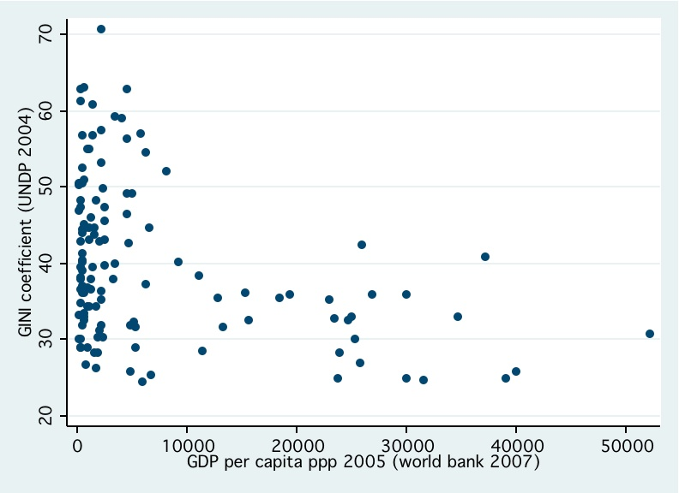

Slide 14
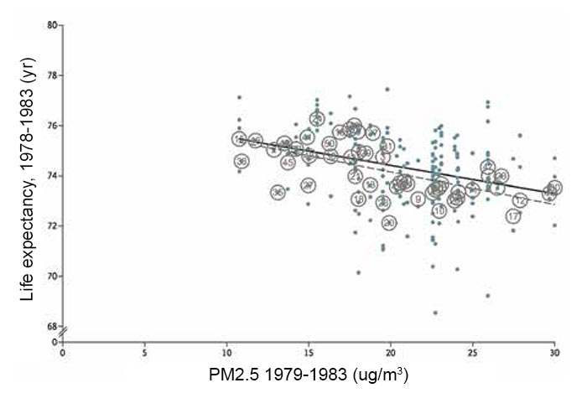
Notes:
http://www.origins-china.com/pm2-5-what-you-need-to-know/

Slide 15
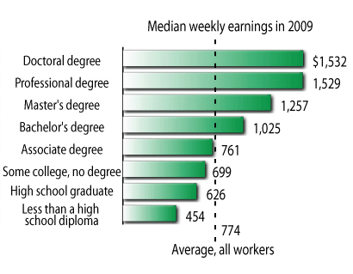

Slide 16
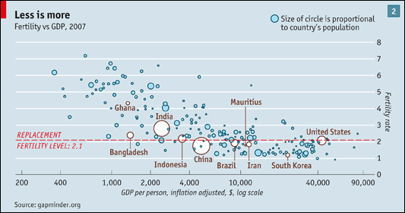
Notes:
http://www.economist.com/node/14743589

Slide 17
Odds ratio

Slide 18
Deadly Force in Black and White, ProPublica 10/10/2014
Notes:
https://assets.propublica.org/legacy/images/ngen/gypsy_image_630/police-killings-2-graphic-630.jpg
https://www.propublica.org/article/deadly-force-in-black-and-white

Slide 19
“Controlling” for a variable

Slide 20
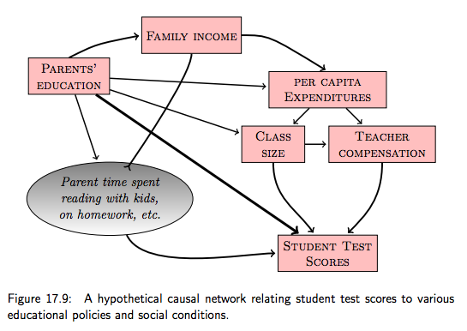
A causal network. From Statistical Modeling: A Fresh Approach
Notes:
https://towcenter.gitbooks.io/curious-journalist-s-guide-to-data/content/analysis/causal_models.html

Slide 21
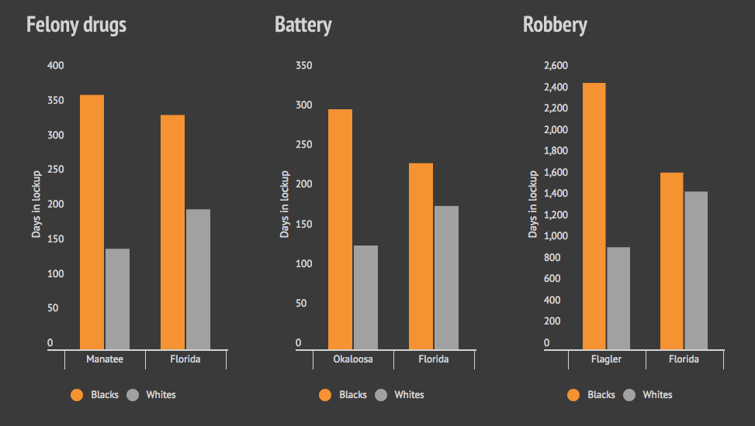
Florida sentencing analysis adjusted for “points”
Bias on the Bench, Michael Braga, Herald Tribune
Notes:
http://projects.heraldtribune.com/bias/sentencing/

Slide 22
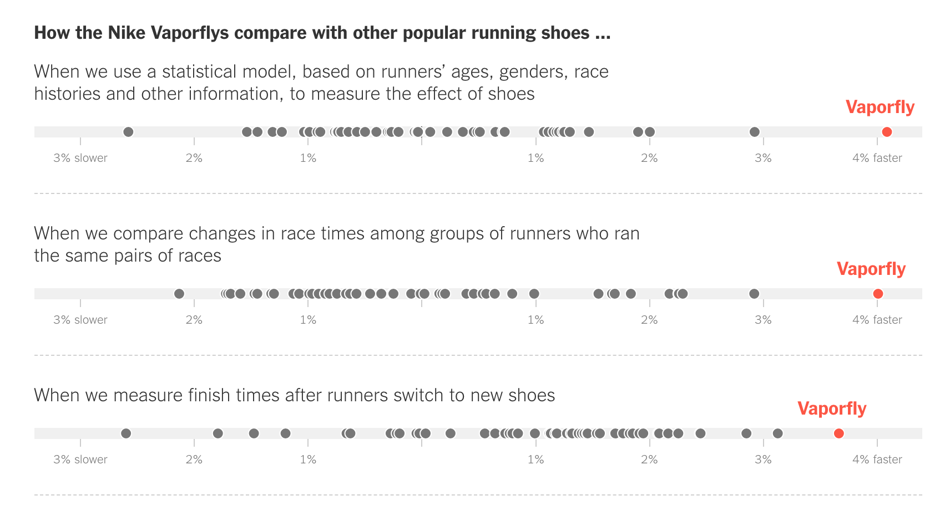
Nike Says Its $250 Running Shoes Will Make You Run Much Faster,
New York Times
Notes:
https://www.nytimes.com/interactive/2018/07/18/upshot/nike-vaporfly-shoe-strava.html

Slide 23
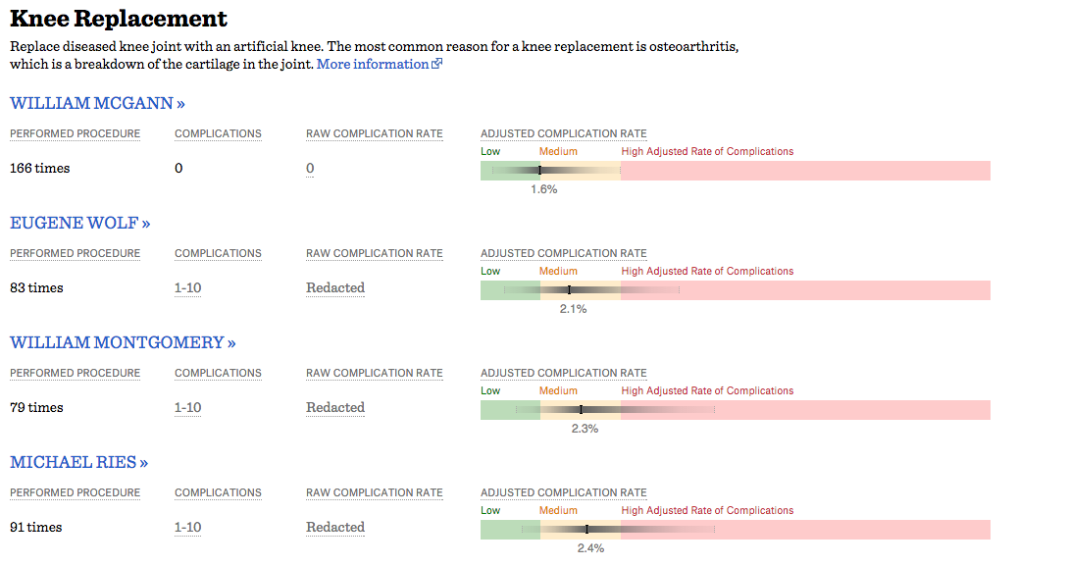
Surgeon Scorecard, ProPublica 2015
Notes:
https://www.kqed.org/futureofyou/13651/what-you-need-to-know-about-the-new-surgeon-scorecard-app

Slide 24
Observation vs. Experiments

Slide 25
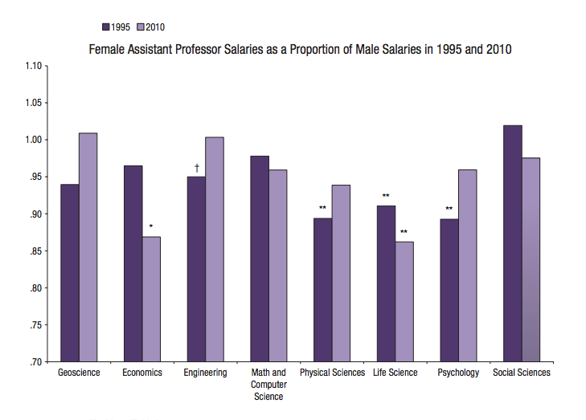

Slide 26
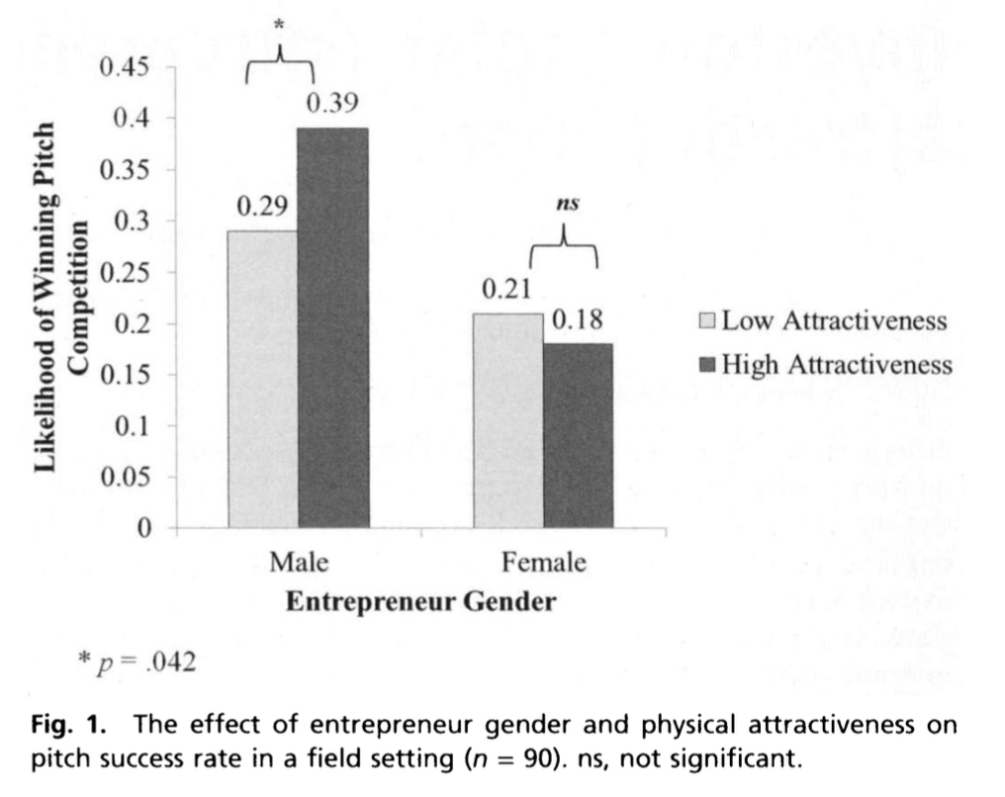
Investors prefer entrepreneurial ventures pitched by attractive men,
Brooks et. al. 2014
Notes:
http://www.pnas.org/content/111/12/4427

Slide 27
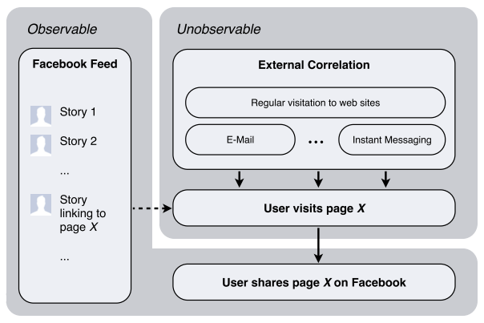
Does Facebook news feed cause people to share links?

