Slide 1
Algorithms week 5-2: Algorithmic Accountability
Jonathan Stray
Columbia Lede Program
August 15, 2018
Notes:
To open:

Slide 2
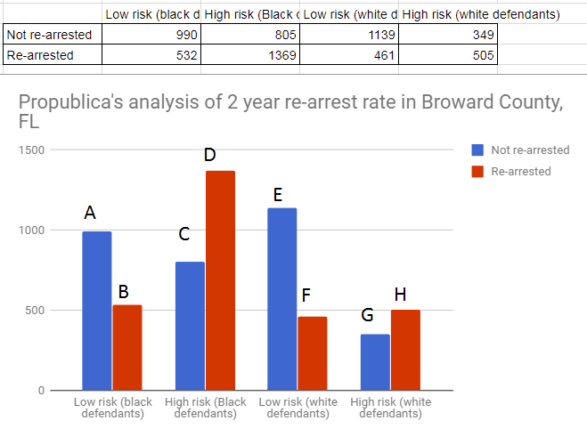
Stephanie Wykstra, personal communication

Slide 3
ProPublica argument
False positive rate
P(high risk |black, no arrest) = C/(C+A) = 0.45
P(high risk |white, no arrest) = G/(G+E) = 0.23
False negative rate
P(low risk | black, arrested ) = B/(B+D) = 0.28
P(low risk | white, arrested ) = F/(F+H) = 0.48
Northpointe response
Positive predictive value
P(arrest| black, high risk) = D/(C+D) = 0.63
P(arrest| white, high risk) = H/(G+H) = 0.59

Slide 4
Quantitative Definitions of Fairness

Slide 5
Three criteria commonly proposed as statistical definition of “fairness.” They are mutually exclusive!
“Independence” or “demographic parity”. The classifier predicts the same number of people in each group.
“Separation” or “equal error rates”. The classifier has the same false positive rate / true positive rate for each group.
“Sufficiency” or “calibration.” When classifier predicts true, both groups have the same probability of having a true outcome.
The Impossibility result: With different base rates, only one of these criteria at a time is achievable (ref: Barocas and Hardt, NIPS 2017 tutorial)
Notes:
http://fairml.how/tutorial/index.html#/40

Slide 6
“Independence” or “demographic parity”
The idea: the prediction should not depend on the group.
Same percentage of black and white defendants scored as high risk.
Same percentage of men and women hired.
Same percentage of rich and poor students admitted.
Mathematically: Equal rate of “true” prediction for all groups.
A classifier with this property: choose the 10 best scoring applicants in each group.
Drawbacks: Doesn’t measure who we accept, as long as we accept equal numbers in each group. The “perfect” predictor, which always guesses correctly, is considered unfair if the base rates are different.
Legal principle: disparate impact
Moral principle: equality of outcome
Notes:
http://fairml.how/tutorial/index.html#/40

Slide 7
“Sufficiency” or “Calibration”
The idea: a prediction means the same thing for each group.
Same percentage of re-arrest among black and white defendants who were scored as high risk.
Same percentage of equally qualified men and women hired.
Whether you will get a loan depends only on your probability of repayment.
Mathematically: Equal PPV (Precision) for each group.
A classifier with this property: any standard machine learning algorithm.
Drawbacks: Disparate impacts may exacerbate existing disparities. Error rates may differ between groups in unfair ways.
Legal principle: disparate treatment
Moral principle: equality of opportunity
Notes:
http://fairml.how/tutorial/index.html#/40

Slide 8
“Separation” or “Equal error rates”
The idea: Don’t let a classifier make most of its mistakes on one group.
Same percentage of black and white defendants who are not re-arrested are scored as high risk.
Same percentage of qualified men and women mistakenly turned down.
If you would have repaid a loan, you will be turned down at the same rate regardless of your income.
Mathematically: Equal false positive and true positive rates.
A classifier with this property: use different thresholds for each group.
Drawbacks: Classifier must use group membership explicitly. Predictive accuracy will differ between groups.
Legal principle: disparate treatment
Moral principle: equality of opportunity
Notes:
http://fairml.how/tutorial/index.html#/40

Slide 9
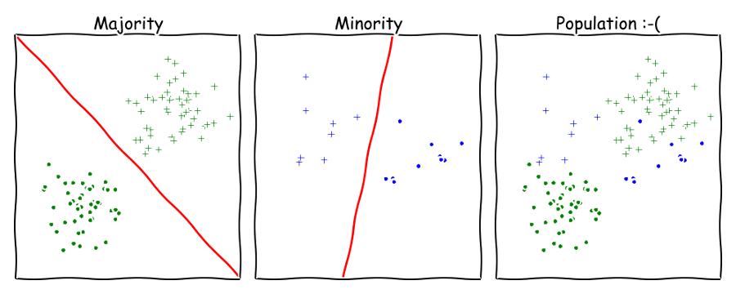
Even if two groups of the population admit simple classifiers, the whole population may not
How Big Data is Unfair, Moritz Hardt

Slide 10
Algorithms as part of a system

Slide 11
Data Quality

Slide 12
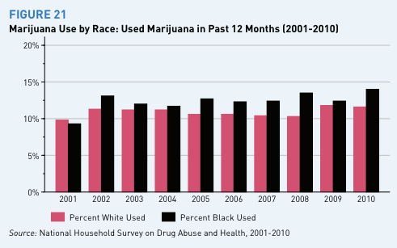
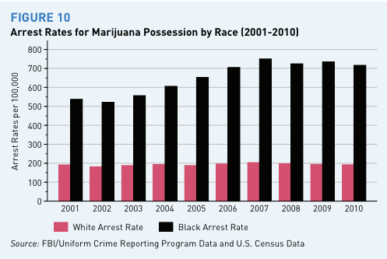
The black/white marijuana arrest gap, in nine charts,
Dylan Matthews, Washington Post, 6/4/2013
Notes:
https://www.washingtonpost.com/news/wonk/wp/2013/06/04/the-blackwhite-marijuana-arrest-gap-in-nine-charts/?noredirect=on&utm_term=.f1f409b08df0

Slide 13
A senior police official recently testified to the City Council that there was a simple justification — he said more people call 911 and 311 to complain about marijuana smoke in black and Hispanic neighborhoods
...
Robert Gebeloff, a data journalist at The Times, transposed Census Bureau information about race, poverty levels and homeownership onto a precinct map. Then he dropped the police data into four buckets based on the percentage of a precinct’s residents who were black or Hispanic.
What we found roughly aligned with the police explanation. In precincts that were more heavily black and Hispanic, the rate at which people called to complain about marijuana was generally higher.
…
What we discovered was that when two precincts had the same rate of marijuana calls, the one with a higher arrest rate was almost always home to more black people. The police said that had to do with violent crime rates being higher in those precincts, which commanders often react to by deploying more officers.
Using Data to Make Sense of a Racial Disparity in NYC Marijuana Arrests,
New York Times, 5/13/2018
Notes:
https://www.nytimes.com/2018/05/13/insider/data-marijuana-arrests-racial-disparity.html

Slide 14
The proportion of racial disparities in crime explained by differential participation versus differential selection is hotly debated
…
In our view, official records of arrest—particularly for violent offenses—are a valid criterion. First, surveys of victimization yield “essentially the same racial differentials as do official statistics. For example, about 60 percent of robbery victims describe their assailants as black, and about 60 percent of victimization data also consistently show that they fit the official arrest data” (Walsh, 2004: 29). Second, self-reported offending data reveal similar race differentials, particularly for serious and violent crimes (see Piquero, 2015).
Risk, Race, and Recidivism: Predictive Bias and Disparate Impact
Jennifer L. Skeem, Christopher T Lowenkamp, Criminology 54 (4) 2016
Notes:
https://papers.ssrn.com/sol3/papers.cfm?abstract_id=2687339

Slide 15
Transparency & Oversight

Slide 16
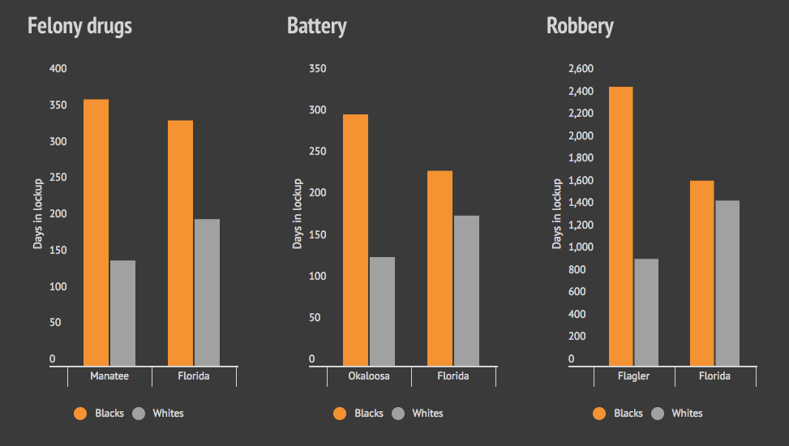
How are “points” used by judges?
Bias on the Bench, Michael Braga, Herald Tribune
Notes:
http://projects.heraldtribune.com/bias/sentencing/

Slide 17
There are a number of interventions that can be directed at individual-focused predictions of gun crime because intervening with high-risk individuals is not a new concept. There is research evidence that targeting individuals who are the most criminally active can result in significant reductions in crime
…
Conversely, some research shows that interventions targeting individuals can sometimes backfire. As an example, some previous proactive interventions, including increased arrest of individuals perceived to be at high risk (selective apprehension) and longer incarceration periods (selective incapacitation), have led to negative social and economic unintended consequences. Auerhahn (1999) found that a selective incapacitation model generated a large number of persons falsely predicted to be high-risk offenders, although it did reasonably well at identifying those who were low risk.
Predictions put into practice: a quasi-experimental evaluation of Chicago’s predictive policing pilot,
Saunders, Hunt, Hollywood, RAND, 2016
Notes:
https://link.springer.com/article/10.1007/s11292-016-9272-0

Slide 18
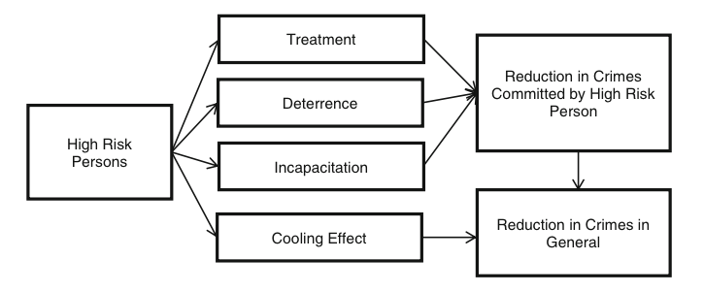
Predictions put into practice: a quasi-experimental evaluation of Chicago’s predictive policing pilot,
Saunders, Hunt, Hollywood, RAND, 2016
Notes:
https://link.springer.com/article/10.1007/s11292-016-9272-0

Slide 19
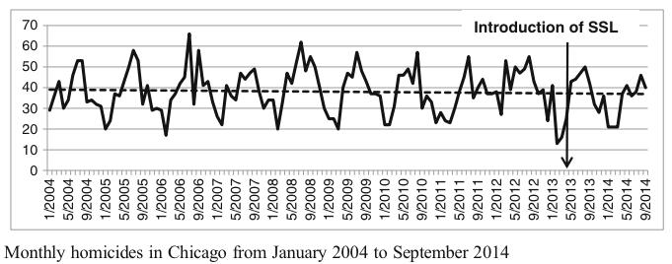
Once other demographics, criminal history variables, and social network risk have been controlled for using propensity score weighting and doubly-robust regression modeling, being on the SSL did not significantly reduce the likelihood of being a murder or shooting victim, or being arrested for murder. Results indicate those placed on the SSL were 2.88 times more likely to be arrested for a shooting
Predictions put into practice: a quasi-experimental evaluation of Chicago’s predictive policing pilot,
Saunders, Hunt, Hollywood, RAND, 2016
Notes:
https://link.springer.com/article/10.1007/s11292-016-9272-0

Slide 20
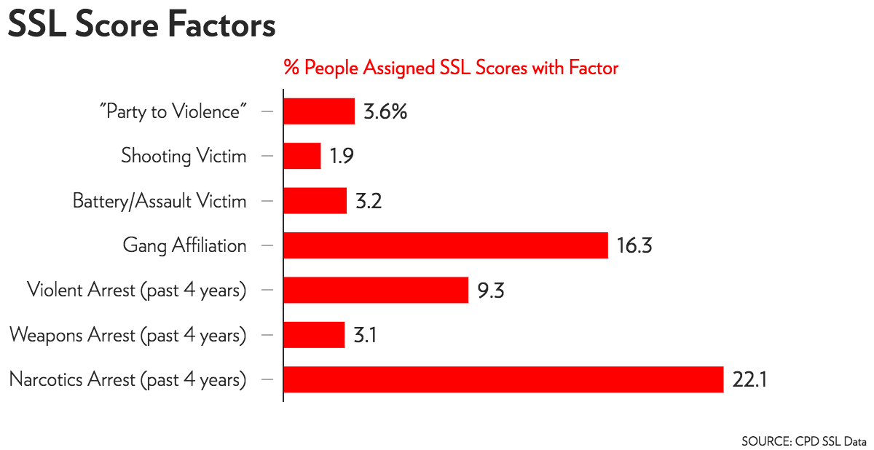
Reverse-engineering the SSL score
The contradictions of Chicago Police’s secret list,
Kunichoff and Sier, Chicago Magazine 2017
Notes:
http://www.chicagomag.com/city-life/August-2017/Chicago-Police-Strategic-Subject-List/

Slide 21
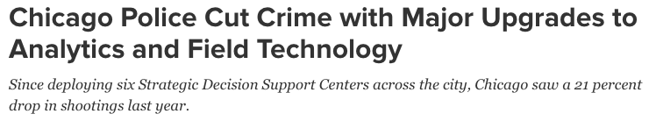
The Chicago Police Department (CPD) is deploying predictive and analytic tools after seeing initial results and delivering on a commitment from Mayor Rahm Emanuel, a bureau chief said recently.
Last year, CPD created six Strategic Decision Support Centers (SDSCs) at police stations, essentially local nerve centers for its high-tech approach to fighting crime in areas where incidents are most prevalent.
…
Connecting features like predictive mapping and policing, gunshot detection, surveillance cameras and citizen tips lets police identify “areas of risk, and ties all these things together into a very consumable, very easy to use, very understandable platform,” said Lewin.
“The predictive policing component … the intelligence analyst and that daily intelligence cycle, is really important along with the room itself, which I didn’t talk about,” Lewin said in an interview.
Theo Douglas, Government Technology, 2018
Notes:
http://www.govtech.com/public-safety/Chicago-Police-Cut-Crime-with-Major-Upgrades-to-Analytics-and-Field-Technology.html

Slide 22
Why algorithmic decisions?

Slide 23
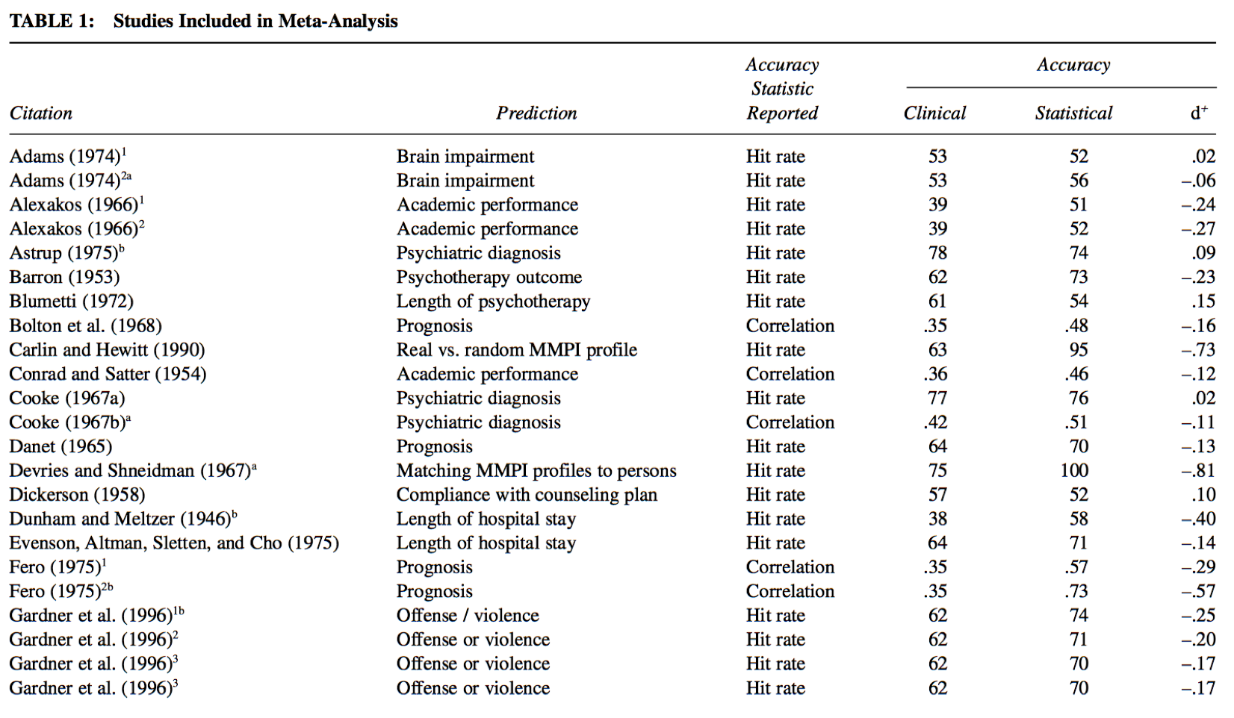
From The Meta-Analysis of Clinical Judgment Project: Fifty-Six Years of Accumulated Research on Clinical Versus Statistical Prediction, Ægisdóttir et al.
Notes:
http://citeseerx.ist.psu.edu/viewdoc/download?doi=10.1.1.862.72&rep=rep1&type=pdf

Slide 24
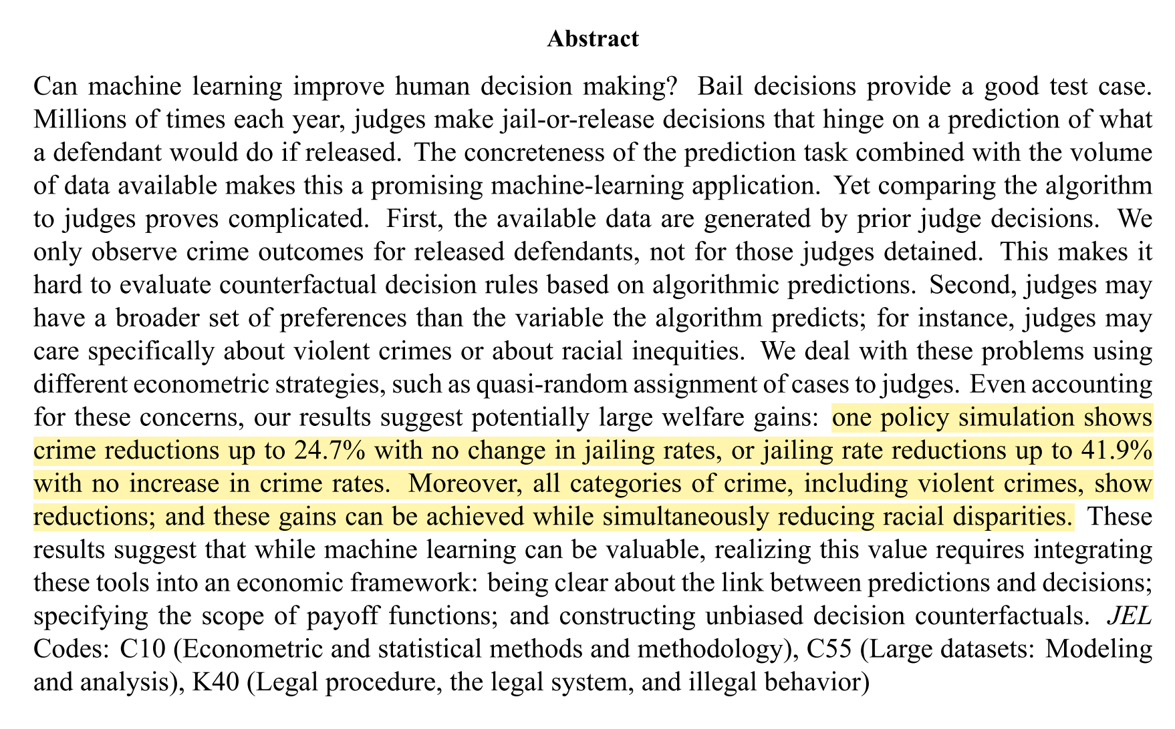
Human Decisions and Machine Predictions, Kleinberg et. al. 2017
Notes:
http://www.nber.org/papers/w23180

Slide 25
Machine learning in lending

Slide 26
None of the new start-ups are consumer banks in the full-service sense of taking deposits. Instead, they are focused on transforming the economics of underwriting and the experience of consumer borrowing — and hope to make more loans available at lower cost for millions of Americans.
…
They all envision consumer finance fueled by abundant information and clever software — the tools of data science, or big data — as opposed to the traditional math of creditworthiness, which relies mainly on a person’s credit history.
…
The data-driven lending start-ups see opportunity. As many as 70 million Americans either have no credit score or a slender paper trail of credit history that depresses their score, according to estimates from the National Consumer Reporting Association, a trade organization. Two groups that typically have thin credit files are immigrants and recent college graduates.
Banking startups adopt new tools for lending,
Steve Lohr, New York Times
Notes:
https://www.nytimes.com/2015/01/19/technology/banking-start-ups-adopt-new-tools-for-lending.html

Slide 27
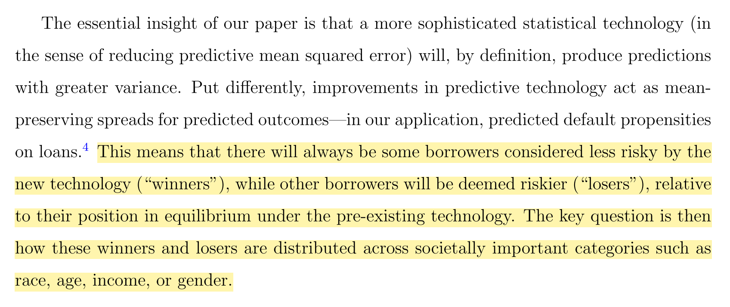
Predictably Unequal? The Effects of Machine Learning on Credit Markets,
Fuster et al
Notes:
http://www.nber.org/papers/w23180

Slide 28
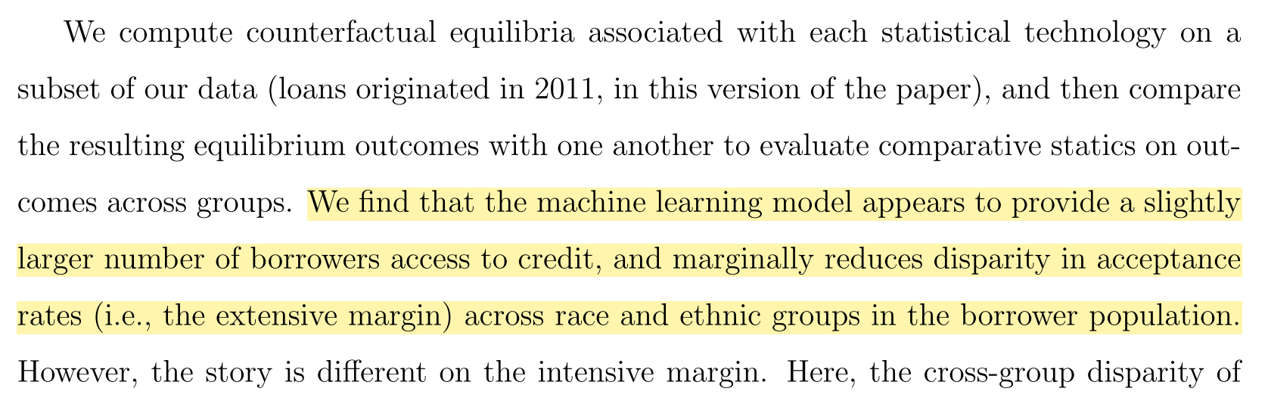
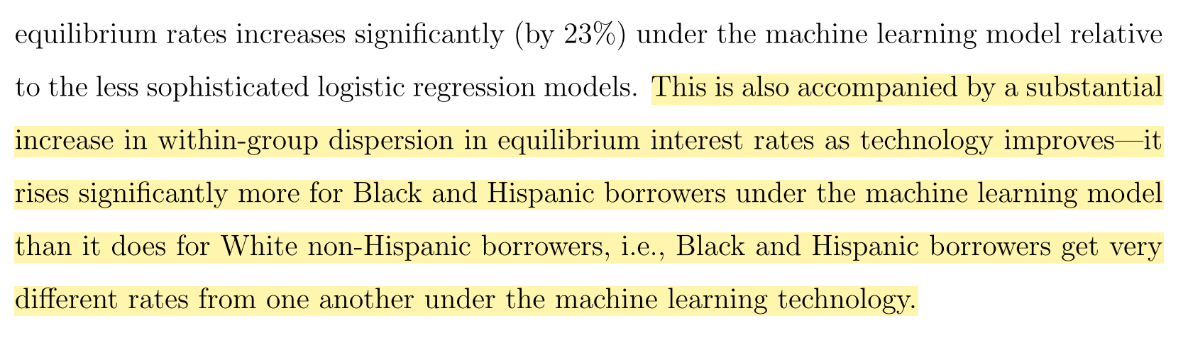
Predictably Unequal? The Effects of Machine Learning on Credit Markets,
Fuster et al
Notes:
http://www.nber.org/papers/w23180

Slide 29
Transparency of News Algorithms

Slide 30
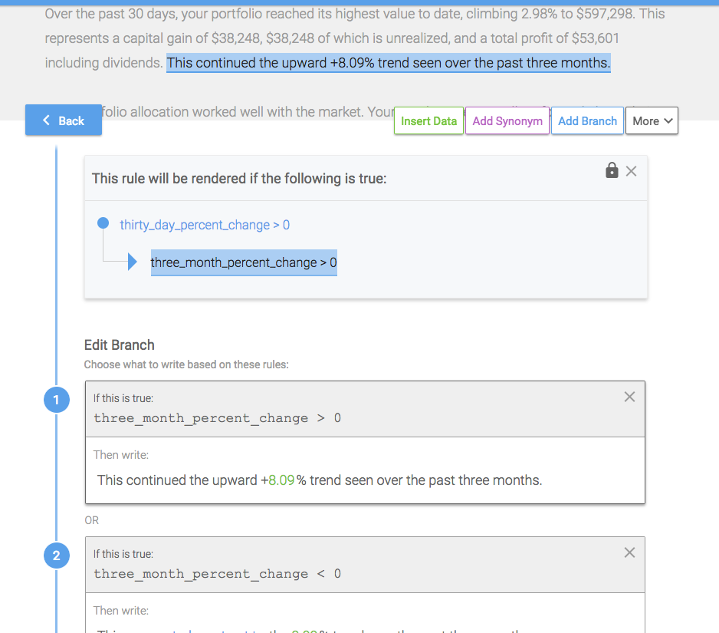
AP’s use of Automated Insights to generate earnings stories.
Notes:
https://www.techemergence.com/case-studies/Automated-Insights/news-organization-leverages-ai-generate-automated-narratives-big-data/

Slide 31
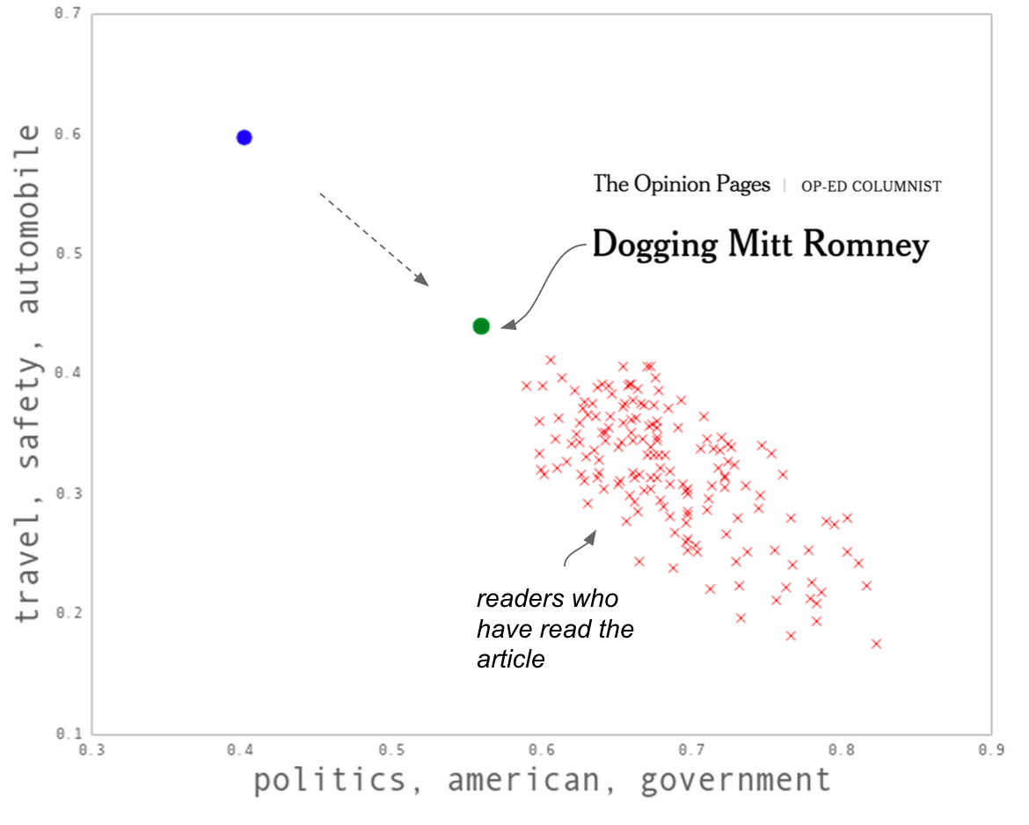
Functioning of New York Times’ article recommendation system
content only
content + social
Notes:
http://open.blogs.nytimes.com/2015/08/11/building-the-next-new-york-times-recommendation-engine/?_r=0

Slide 32
News Algorithms
Algorithms used at all stages of journalism.
Data mining or analysis during reporting
Automated story writing
Recommendation systems both publisher and platform
Ad targeting,
Subscriber retention...
Three major stakeholders: technologists, readers, and journalists.

Slide 33
Stages of news algorithm transparency
Disclosure. An algorithm was involved.
“AP created this story using an automated system”
Justification. Some reason for the algorithmic result in this case.
“You’re seeing this article because you said you liked vegetables”
Explanation. More detailed algorithmic analysis of this case.
“This is how our election prediction model works…”
Reproduction. Enough information to allow independent replication.
“This is our newsroom’s github repo” or “Here’s a link to Workbench”
How can we make algorithmic news more transparent?
Stuart Myles, AP, 2018
Notes:
https://www.slideshare.net/smyles/how-can-we-make-algorithmic-news-more-transparent-98053867

