Slide 1
CS597: Concurrency and Algorithms
FFT Compute Shader
Francis Joseph Serina

Slide 2
Objectives
Port Parallel FFT to GPU

Slide 3
Approach 1
Port C++ to DirectCompute with a similar approach
CPU Approach
Slice image horizontally for worker threads
Each worker performs FFT by row on their assigned rows
Main thread aggregates transformed rows and repeats by column
GPU Approach
Pass whole image to the GPU
Each thread is assigned 1 row to transform
When all rows are done, repeat process by column

Slide 4
Assessment of Approach 1
Advantages
Easy to implement
Disadvantages
There are pixels that are ‘waiting’

Slide 5
Approach 2
1 Thread Per Pixel
Inspiration: Bitonic Sorting (loglogN)
Advantage
No idle pixels
No loops in GPU, all kernels have a fixed running time
Disadvantage
Completely different implementation
Butterfly network stages are dispatched/blocked by the CPU

Slide 6
Results
Dimensions | Total Pixels | By CPU Threads | By Compute Shader
2048x1024 | 2,097,152
4096x2048 | 8,388,608 | ~180s (debug) 2.6s (release) | 2ms
Results may be skewed because these are 2 different languages (systems)
CPU: Intel Core i7-7700, 8 Cores
GPU: Nvidia GTX 1070 Ti
The following are ignored
Loading image to memory
Saving image

Slide 7
Techniques
Treat Compute Shaders as State Machines
Have a class represent the Compute Shader
Internally handle Double Buffer
1 Method per Kernel
Extra Care when declaring data types
All Data Types should match EXACTLY in the CPU and the GPU
Uint division is different from int division
Conversion does not occur when transferring data

Slide 8
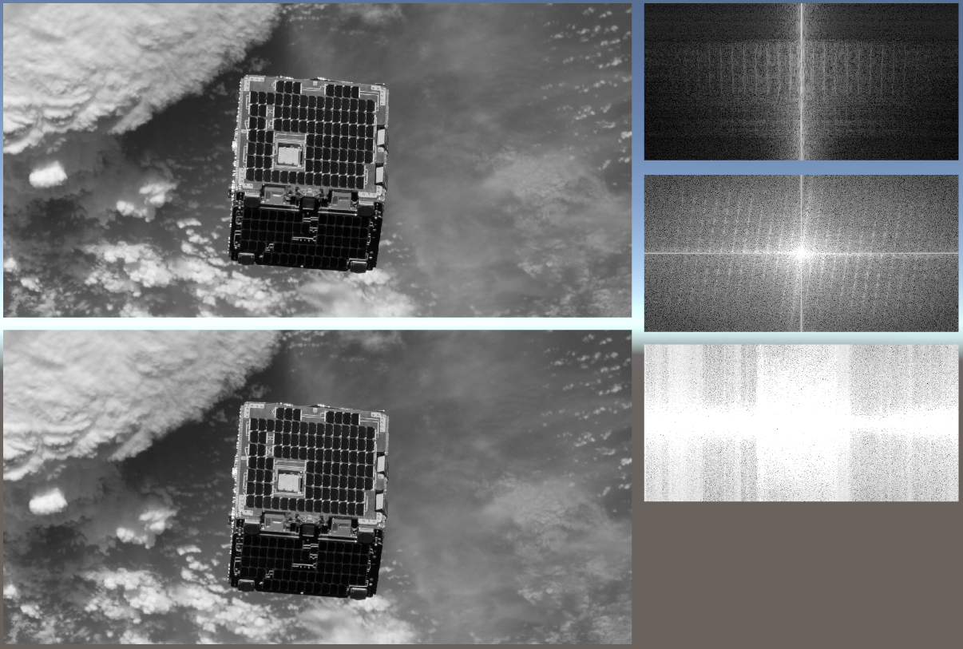
Sample Output

