Slide 1
Copper Strand Thermal Shielding
for Third-Scale Magnet
Aritra Biswas
July 13, 2015 – nEDM Collaboration Meeting

Slide 2
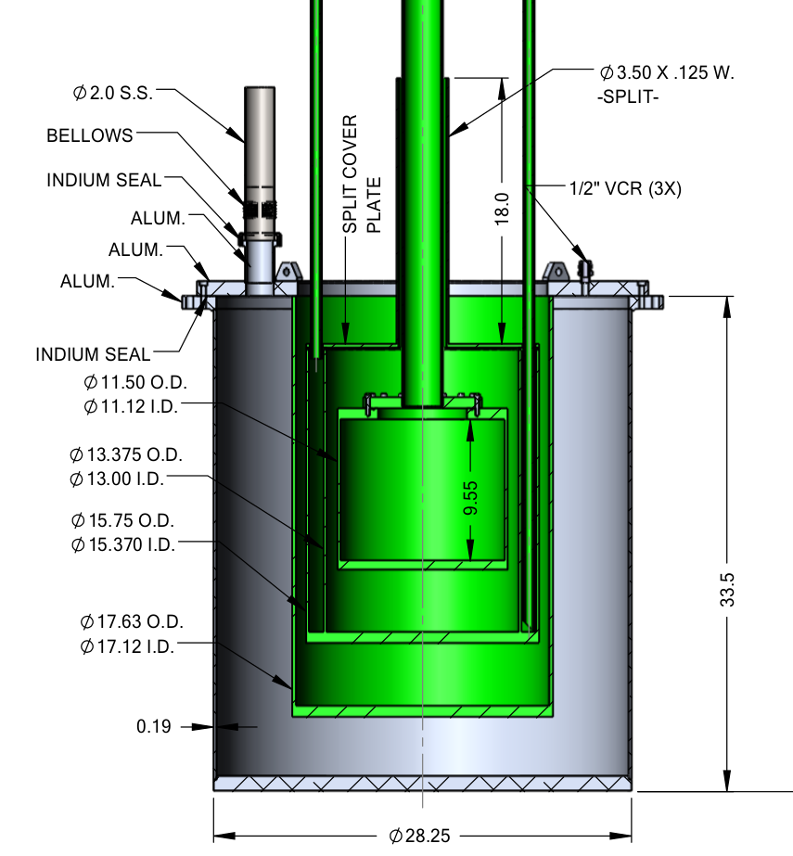
Third-Scale Magnet
superconducting lead
(T_{c} = 7.2 K) for B field uniformity
thermally-shielded warm bore to map B field
copper plating on G-10 for insulation
can't interfere with B field
thermal shield cover
warm bore

Slide 3
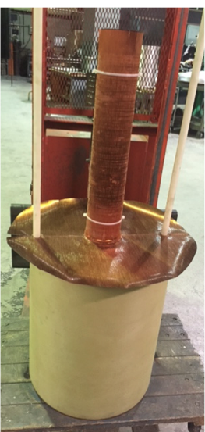
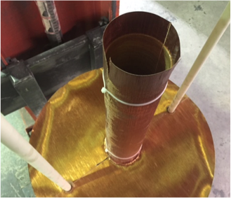
Our Thermal Shield

Slide 4
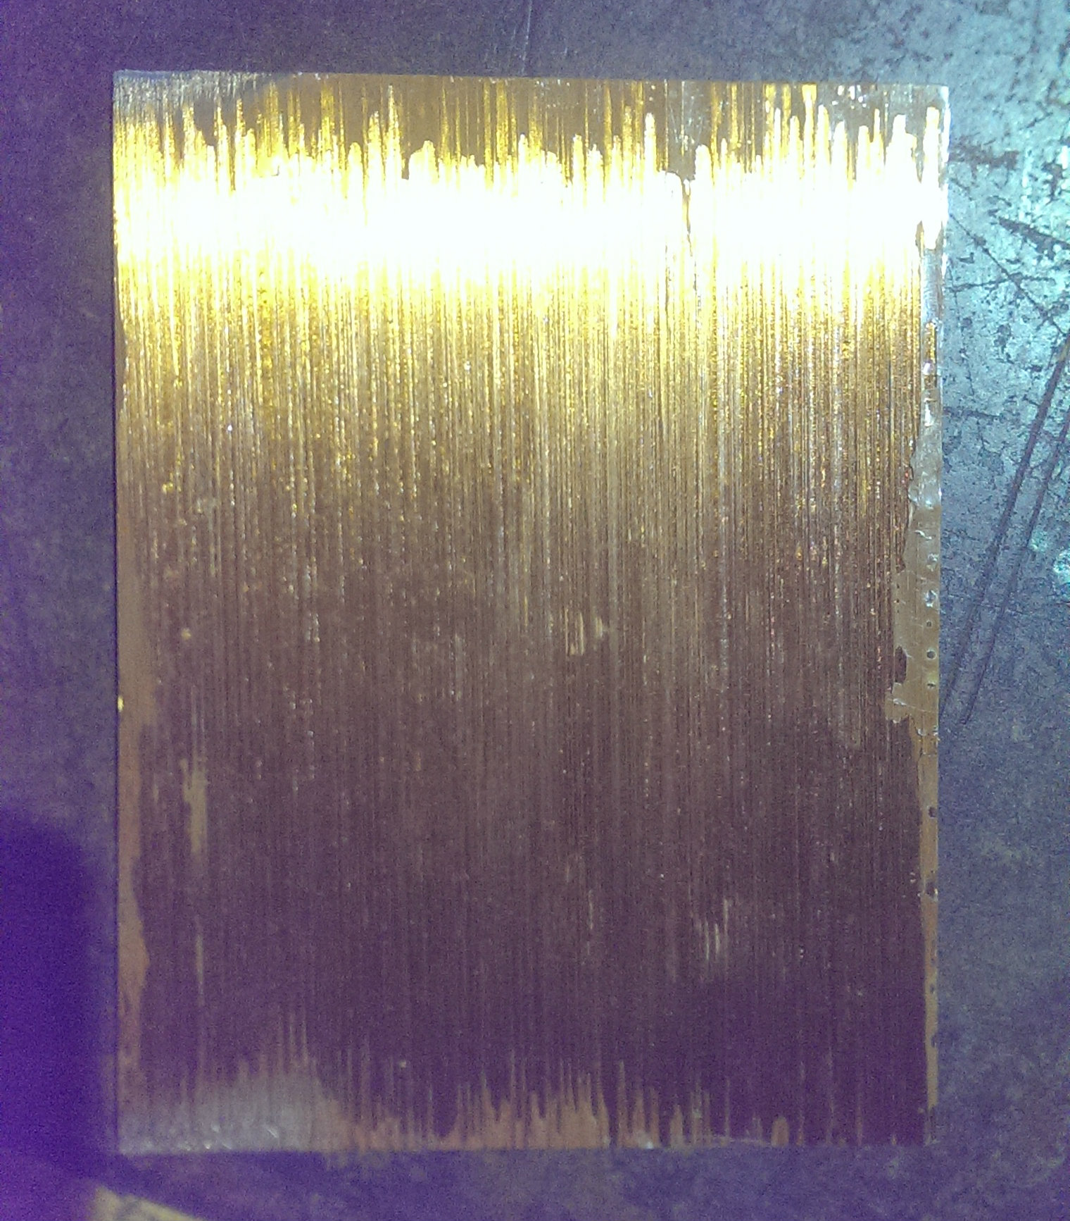
Our Thermal Shield
strands of copper held together by epoxy
currents can't jump between insulated strands
no large-scale eddy currents
measure B field effect and compare with copper plate

Slide 5
setup inside B₀ coil driven by AC
alternating field in x direction
z
x
central axis
probe
probe
gain:
phase shift:

Slide 6
Predicting γ(ω) and Δψ(ω)
induction on plate
x

Slide 9
Predicting γ(ω) and Δψ(ω)
skin depth attenuation
induction on plate
x
x

Slide 10
Remarks
gain from thermal shield, eddy current suppresion:
attenuation parameters:

